Slide 1
Visualizing Neural Networks
Model Development · Artifact 02
How components work together to turn inputs into predictions.
Arvinnd Chowdary Kuchipudi AIML-501 · Indiana Wesleyan University November 2, 2026
A feedforward classifier with two hidden layers
1 / 16

Slide 2
A map of the six components
I grouped components by their role in prediction and learning.
Layers and neurons
Organize the network and perform its computations.
Weights and biases
Control the strength and offset of each calculation.
Activation functions
Turn weighted sums into values for the next layer.
Loss and optimization
Measure errors and update the parameters.
This grouping separates structure, adjustable values, transformations, and training rules. The categories describe functions, so related components still interact.
Sources: Google, 2025a, 2025b; TensorFlow, n.d.-a, n.d.-b, n.d.-c. See References for links.
2 / 16

Slide 3
Layers organize the flow of data
Input layer
Receives the selected features, such as x₁ and x₂.
Hidden layers
Transform earlier outputs into useful intermediate features.
Output layer
Produces a prediction score from the final hidden outputs.
Illustrative 2–4–2–1 architecture matching Run A. Data flows from left to right. Two hidden layers plus one output layer contain learned parameters.
Sources: Google, 2025a, 2025b; TensorFlow, n.d.-a, n.d.-b, n.d.-c. See References for links.
3 / 16

Slide 4
A neuron combines weights and an activation
Weights scale each input
z = w₁x₁ + w₂x₂ + b z = 0.8(0.5) + (−0.4)(−1) + 0.2 = 1.0
Activation transforms the sum
a = tanh(z) = tanh(1.0) ≈ 0.762 A bias shifts the activation threshold independently of the inputs.
Illustrative values, not values extracted from the experiment. A positive weight increases z for a positive input. Its effect also depends on the input’s sign.
Weights and biases are learned during training. Learning rate and layer sizes are settings we choose.
Sources: Google, 2025a, 2025b; TensorFlow, n.d.-a, n.d.-b, n.d.-c. See References for links.
4 / 16

Slide 5
Activation functions enable nonlinear patterns
ReLU returns zero for negative inputs and grows linearly for positive inputs. Common in hidden layers.
Tanh maps values into (−1, 1). The experiments use tanh or linear hidden activations.
Sigmoid maps values into (0, 1). Often used for a binary probability output with an appropriate loss.
Stacked linear hidden layers remain affine in the selected features. Nonlinear features can also make a curved boundary possible in the original coordinates.
Playground’s classification output uses tanh even when the hidden activation is Linear. Its signed score is not a calibrated probability.
Sources: Google, 2025a; TensorFlow, n.d.-b, n.d.-c. See References for links.
5 / 16

Slide 6
Loss turns prediction error into a training objective
A loss function assigns a numerical penalty to a prediction.
This is Playground’s average half-squared error. Smaller values mean better agreement with the target scores on that dataset.
The target labels are −1 and +1. A loss of 0.016 does not mean 98.4% accuracy.
One illustrative prediction
Target y = 1 Prediction ŷ = 0.6 Error = −0.4
Averaging these penalties over the examples gives the reported loss.
Training loss measures the examples used to update parameters.
Test loss checks held-out examples. Repeated tuning against it reduces its independence.
Other tasks use other objectives, such as cross-entropy for classification or mean squared error for regression. The loss must match the output representation and task.
Sources: TensorFlow, n.d.-b, n.d.-c. See References for links.
6 / 16

Slide 7
Optimization updates weights and biases
An optimization algorithm uses gradients to reduce the loss.
η is the learning rate. Backpropagation calculates gradients using the chain rule. The optimizer applies the update.
Illustration: w = 1, η = 0.03, gradient = 0.4 w new = 0.988
Mini-batch gradient descent averages gradients over a small batch. Playground uses this approach with batch size 10 here.
Adam uses moving estimates of gradients and squared gradients to adapt updates. It is an alternative, not an optimizer tested in these runs.
Sources: TensorFlow, n.d.-b, n.d.-c, n.d.-d. See References for links.
7 / 16

Slide 8
Prediction and learning form a feedback loop
Forward
Layers pass activated values toward the output to calculate a prediction.
Backward
The loss provides the starting derivative. Backpropagation attributes gradients to earlier parameters.
Update
The optimizer changes weights and biases. Repeated batches gradually change the boundary.
Inference uses the forward pass. Training adds target labels, loss, gradients, and parameter updates.
Sources: TensorFlow, n.d.-b, n.d.-c. See References for links.
8 / 16

Slide 9
Six recorded runs with a common training budget
Settings held constant
Classification and 50% train / 50% test split
100 epochs per run and batch size 10
Learning rate 0.03 and no regularization
Displayed seed parameter 0.49259
Tanh output and average half-squared loss
Settings varied
Circle and XOR data
Noise 0 and 50
Raw coordinates and squared features
Tanh and linear hidden activation
Two hidden layers [4, 2] and one [1]
I recorded the interface at 100 epochs rather than timing browser automation. Epochs measure training progress, while parameter counts describe part of the computational cost.
Single illustrative runs, not repeated benchmarks. Configuration changes reset training and can change initialization. A shared seed setting does not guarantee identical starting weights across different structures. The recorded screenshots preserve the outcomes of these particular runs.
9 / 16
Sources: Experiments recorded in TensorFlow Playground, November 2, 2026. See References for links.

Slide 10
The results separate capacity, features, and noise
B versus C shows the value of input representation. A versus D shows the effect of noisy data in these runs. A versus F compares overall model capacity, changing both depth and width.
Run | Data / noise | Hidden activation | Inputs | Hidden neurons | Parameters | Train loss | Test loss
A | Circle / 0 | Tanh | x₁, x₂ | [4, 2] | 25 | 0.011 | 0.016
B | Circle / 0 | Linear | x₁, x₂ | [4, 2] | 25 | 0.498 | 0.500
C | Circle / 0 | Linear | x₁, x₂, x₁², x₂² | [4, 2] | 33 | 0.001 | 0.001
D | Circle / 50 | Tanh | x₁, x₂ | [4, 2] | 25 | 0.300 | 0.327
E | XOR / 0 | Tanh | x₁, x₂ | [4, 2] | 25 | 0.114 | 0.115
F | Circle / 0 | Tanh | x₁, x₂ | [1] | 5 | 0.416 | 0.434
All values are actual displayed losses at 100 epochs, rounded to three decimals. Parameter count includes weights and biases. For A: (2 + 1)×4 + (4 + 1)×2 + (2 + 1)×1 = 25. A lower loss is not an accuracy percentage.
Sources: Original Playground observations. See References for links.
10 / 16

Slide 11
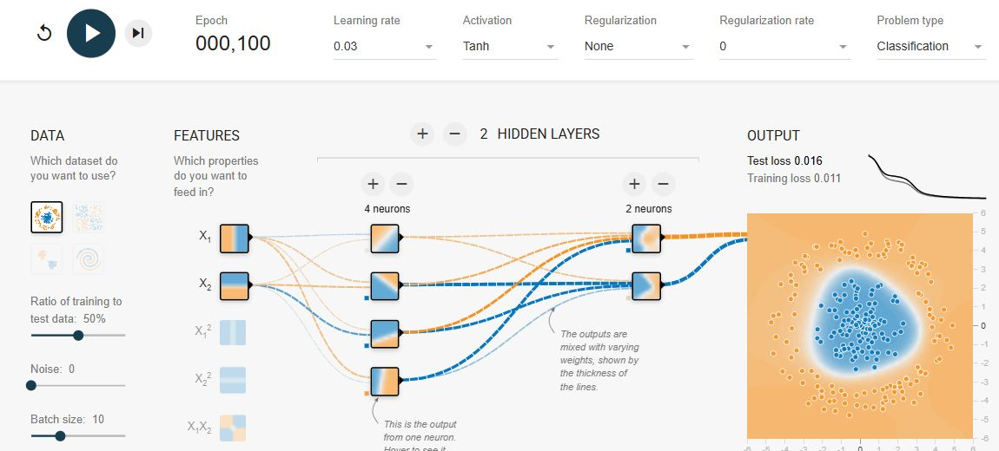
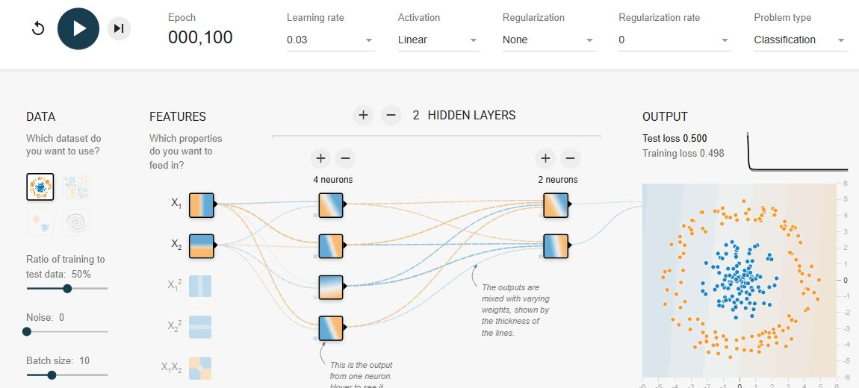
Nonlinear hidden neurons learned the circle
Run A · Tanh hidden layers Training loss 0.011 Test loss 0.016
Run B · Linear hidden layers Training loss 0.498 Test loss 0.500
With raw x₁ and x₂, Run A learned a closed boundary. Run B stayed near 0.500 test loss despite the same layer sizes.
The final tanh output can squash a linear score, but its zero-level decision boundary remains a line when all hidden transformations and inputs are linear.
Sources: TensorFlow Playground screenshots, November 2, 2026. See References for links.
11 / 16

Slide 12
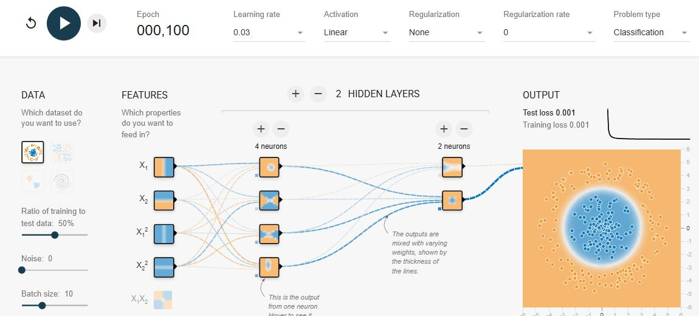
Squared features exposed the circular structure
Run C · Linear hidden layers with squared inputs Training loss 0.001 Test loss 0.001
x₁² + x₂² describes squared distance from the origin.
Adding x₁² and x₂² gave the model the ingredients for a radial boundary. Test loss fell from 0.500 in B to 0.001 in C.
Four inputs also increased the parameter count from 25 to 33, so representation and parameter count both changed.
Feature engineering can simplify the relationship the network must learn.
Sources: Original Playground observations. See References for links.
12 / 16

Slide 13
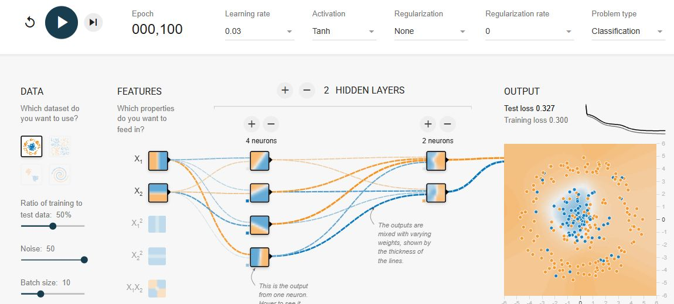
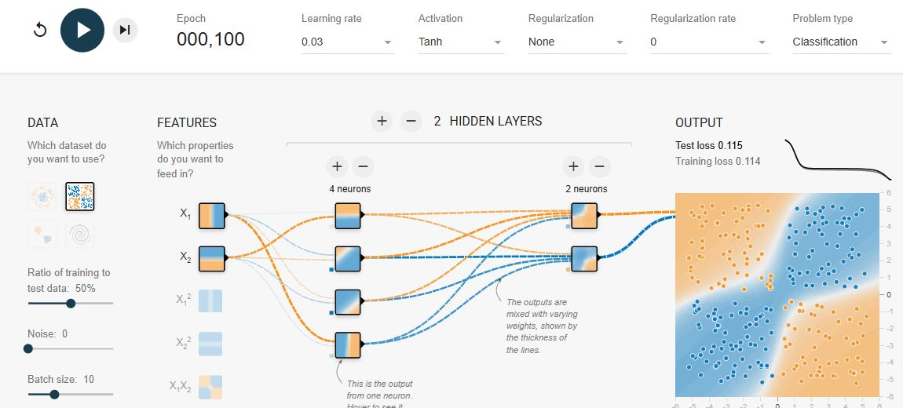
Noise and dataset geometry changed the outcome
Run D · Circle with noise 50 Training loss 0.300 Test loss 0.327
Run E · XOR with noise 0 Training loss 0.114 Test loss 0.115
Noise: D’s training loss 0.300 and test loss 0.327 both exceed A’s. Overlapping classes make separation harder. This alone does not establish overfitting.
Geometry: E reached 0.115 test loss at 100 epochs. The same architecture and budget did not produce the same loss on another data arrangement.
Sources: Original Playground observations. See References for links.
13 / 16

Slide 14
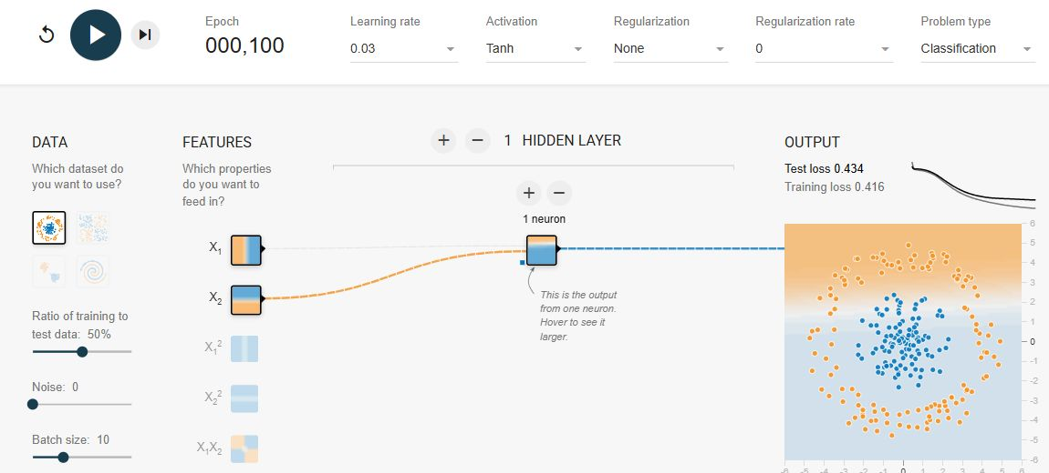
A smaller model reduced cost and capacity
Run F · One hidden neuron Training loss 0.416 Test loss 0.434
5 parameters versus 25 in the baseline
Run F reached test loss 0.434, compared with 0.016 in A. One hidden neuron could not surround the inner class.
More parameters require more arithmetic per update and can represent more complex functions. They also introduce more opportunities to fit noise.
Match capacity to the task. More layers do not automatically improve generalization.
This comparison changes depth and width together. It cannot identify their separate effects. No wall-clock speed benchmark, repeated seeds, or independent validation study was performed.
Sources: Original Playground observations. See References for links.
14 / 16

Slide 15
References
Google. (2025a, August 25). Neural networks: Activation functions. Google for Developers. developers.google.com/machine-learning/crash-course/neural-networks/activation-functions
Google. (2025b, December 3). Neural networks: Nodes and hidden layers. Google for Developers. developers.google.com/machine-learning/crash-course/neural-networks/nodes-hidden-layers
TensorFlow. (n.d.-a). A neural network playground [Interactive simulation]. Retrieved November 2, 2026, from https://playground.tensorflow.org/
TensorFlow. (n.d.-b). nn.ts [Source code]. GitHub. github.com/tensorflow/playground/blob/master/src/nn.ts
TensorFlow. (n.d.-c). playground.ts [Source code]. GitHub. github.com/tensorflow/playground/blob/master/src/playground.ts
TensorFlow. (n.d.-d). tf.keras.optimizers.Adam. tensorflow.org/api_docs/python/tf/keras/optimizers/Adam
15 / 16

Slide 16
Seeing the network made its tradeoffs clearer
Layers organize neurons. Weights and biases control their calculations. Activations determine the transformations they can express.
Loss measures errors, backpropagation calculates gradients, and optimization changes the parameters.
Features, activation, capacity, and data quality all changed the recorded outcomes. A useful boundary depends on their combination.
Visualization makes these relationships visible and helps explain why a model succeeds, stalls, or fits the wrong pattern.
Artifact 1 compared algorithm families. This second artifact explains one model family from the inside and connects its components to six recorded experiments.
16 / 16

