Slide 1


Slide 2
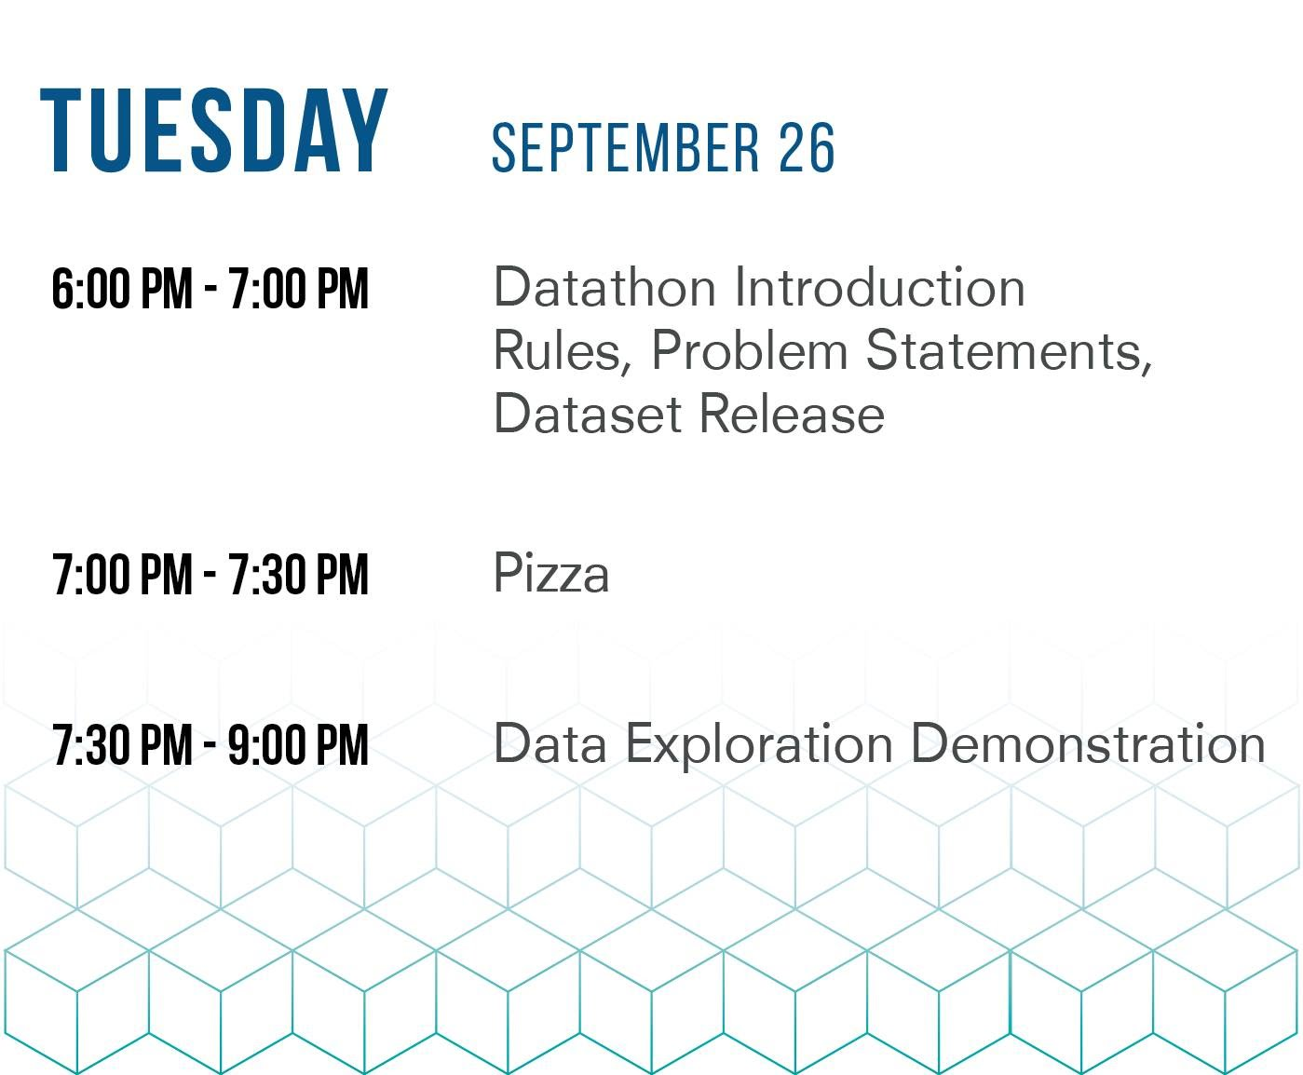
Information Night & Data Release

Slide 3

Datathon Event Schedule

Slide 4






Our Sponsors

Slide 5
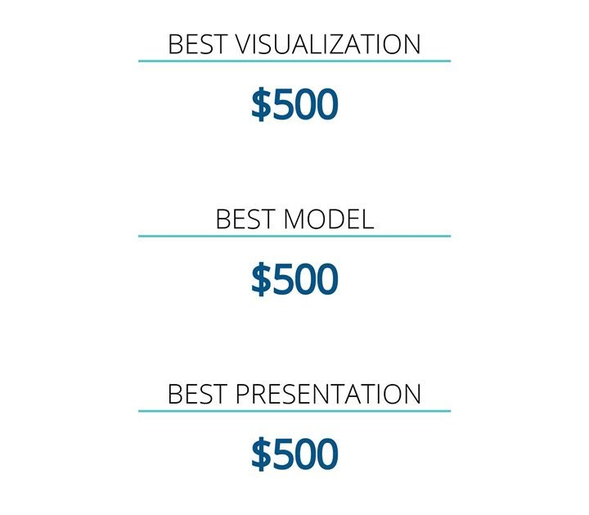
Our Prizes
Our Prizes
+ Spot Prizes!

Slide 6






Who can help you?

Slide 7

Still need a team?
Head to the Monash Data Science Society banner during Pizza break

Slide 8
How to win a prize
Create a problem statement
Consult a mentor on Saturday to confirm problem statement
Build working solution
Consult a mentor on Sunday to confirm solution / practice presentation
Submit slides via email
Present and demonstrate to a judge on Sunday

Slide 9
Introducing the dataset: Inside Airbnb
Inside Airbnb is independent source (not affiliated with AirBnB)
Publicly available information about Airbnb’s listings
Data available at:
http://insideairbnb.com/get-the-data.html

Slide 10

Dataset specific rules
01
02
03
You must use at least some data from the insideairbnb site.
You can combine this data with any open source data set.
You cannot use any other airbnb data from any other source other than the insideairbnb site.

Slide 11
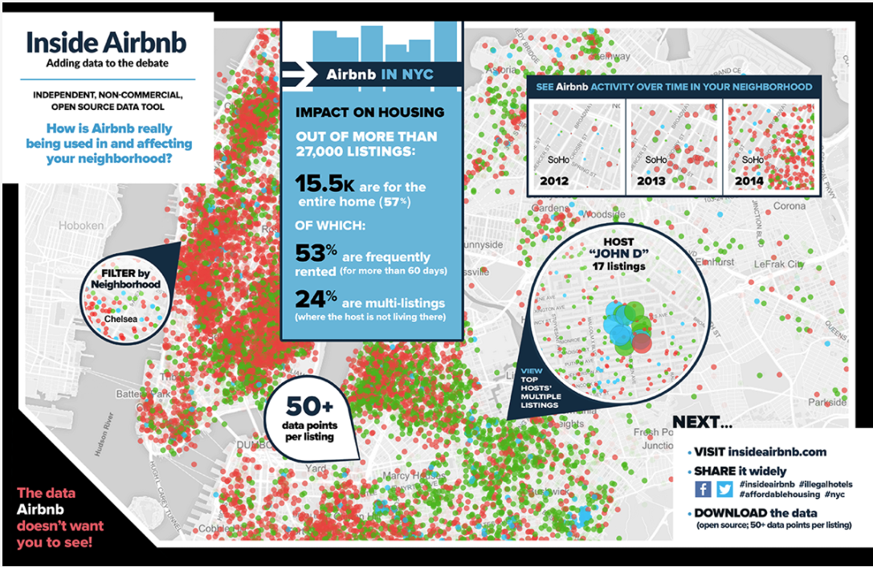

Slide 12

Example Problem Statement - Investment
Your team has been employed to help investors purchase properties in major cities around the world. The investors plan to make their money back as quick as possible by putting their properties on AirBNB when they are not using them.
Build a sales pitch to advise your investors on the best opportunities.

Slide 13

Example Problem Statement – Host Improvement
Your team has been hired by AirBNB to identify ways of improving occupancy rates for hosts.
Some of the questions hosts ask are:
I’ve received a bad review; how will it affect my occupancy rate?
How can I improve my reviews?
What type of facilities should I offer?
What type of photos should I put up to affect my occupancy rate?
Build a guide for hosts to maximise their occupancy rate.

Slide 14

Example Problem Statement – Data Journalism
You have been hired by the ABC to investigate the use of AirBnB in Australia. Communities are reporting that there has been an increase in parties, crime rates, illegal hotels in heavy AirBnB neighborhoods.
Your job is to find the real story.

Slide 15
Example Data Analysis
Image pattern recognition across AirBnB photos to determine similarities amongst the AirBnB with the highest occupancy rate.
Text analysis to determine common words used in reviews to find similarities amongst the AirBnB with the highest occupancy rate.
A model that looks for similarities between descriptive words on people’s profiles to determine if different accounts are managed by the same person – suggesting illegal hotels operating as AirBnB.
A visualisation that plots New York average rental prices over time or the amount of AirBnB properties in New York.
A chloropleth map of good places to invest in AirBnB properties.

Slide 16

Where to get more information
Ask your mentor
Check the quantify website for the Competitor Guide and check your emails.
Send an email to club.mdss@monsu.org
Quantify.monashdatascience.com

Slide 17
Questions
?

