Slide 1
UNIT-V
1.Functional programming Language
2. Logic Programming Language
3.Python

Slide 2
UNIT-V
Functional Programming Languages: Introduction, mathematical functions, fundamentals of functional programming language, LISP, support for functional programming in primarily imperative languages, comparison of functional and imperative languages.
Logic Programming Language: Introduction, an overview of logic programming, basic elements of prolog, deficiencies of prolog, applications of logic programming.
Scripting Language: Pragmatics, Key Concepts, Case Study: Python – Values and Types, Variables, Storage and Control, Bindings and Scope, Procedural Abstraction, Data Abstraction, Separate Compilation, Module Library.

Slide 3
Introduction
The design of the imperative languages is based directly on the von Neumann architecture
  Efficiency is the primary concern, rather than the suitability of the language for software development.
The design of the functional languages is based on mathematical functions
  A solid theoretical basis that is also closer to the user, but relatively unconcerned with the architecture of the machines on which programs will run.

Slide 4
Mathematical Functions
A mathematical function is a mapping of members of one set, called the domain set, to another set, called the range set.
A lambda expression specifies the parameter(s) and the mapping of a function in the following form
λ(x) x * x * x
for the function cube (x) = x * x * x
Lambda Expressions
Lambda expressions describe nameless functions.
Lambda expressions are applied to parameter(s) by placing the parameter(s) after the expression
e.g., (λ(x) x * x * x)(2)
which evaluates to 8

Slide 5
Introduction to FPL
Functional programming language are based on the mathematical functions.
First FPL is lisp and it is completely based on the lambda notations.
John backus published a lecture which published in the ACM communications which made a case functional programming is better than imperative languages.
One of the important character of pure FPL is neither expressions or nor functions have side effects.

Slide 6
Fundamentals of FPL
The main objective of the design of a functional programming language is to mimic mathematical functions.
The basic process of computation is fundamentally different in a FPL than in an imperative language
  In an imperative language, operations are done and the results are stored in variables for later use
  Management of variables is a constant concern and source of complexity for imperative programming
In an FPL, variables are not necessary, as is the case in mathematics
A purely functional languages doesn't not use variables or assignments, thus making programmers free from concerning about memory cells.

Slide 7
Since they are no variables repetition is possible through recursion only.
The execution of a function always produces the same results when given same parameters called referential transparency.
A functional programming language a set of primitive functions, a set of functional forms to construct complex functions.
FPL are often implemented with interpreters.
One of the major draw back of imperative languages are - type restrictions to functions.

Slide 8
LISP - first FPL
Lisp is the first function language which is widely used for developing Artificial Intelligent applications.
Lisp is not a pure functional language which contains some imperative features like variables, assignment statements and iterations.
Lisp represent well the fundamental concepts of functional programming.

Slide 9
Data Types and Structures
There were only two types of data objects in the original LISP.
1. atoms
2.lists
Atoms are either symbols, in the form of identifiers, or numeric literals.
Lists are specified in LISP by delimiting their elements within parenthesis.
example :
(A B C D) - Simple list
(1 (1 2) 4 (6 7 ) ) – Nested List
Lists in LISP represented internally using single linked list.
A
B
C
D

Slide 10
LIST (1 (2 3) 4 (5 6) is represented using single list as shown below
 | NUL
4
1
 | NUL
 | NUL
2
3
5
6

Slide 11
Support for Functional Programming in Primarily Imperative Languages
Imperative programming languages have always provided only limited support for functional programming.
That limited support has resulted in little use of those languages for functional programming.
One indication of the increasing interest and use of functional programming is the partial support for it that has begun to appear over the last decade in programming languages that are primarily imperative.
For example, anonymous functions, which are like lambda expressions, are now part of JavaScript, Python, Ruby, and C#.
In JavaScript, named functions are defined with the following syntax:
function name (formal-parameters) { body
}
An anonymous function is defined in JavaScript with the same syntax, except that the name of the function is omitted.

Slide 12
C# supports lambda expressions that have a different syntax than that of C# functions.
For example: i => (i % 2) == 0
This lambda expression returns a Boolean value depending on whether the given parameter (i) is even (true) or odd (false).
Python’s lambda expressions define simple one-statement anonymous functions that can have more than one parameter.
The syntax of a lambda expression in Python is exemplified by the following:lambda a, b : 2 * a – b
Note that the formal parameters are separated from function body by a colon.
Python includes the higher-order functions filter and map. Both often use lambda expressions as their first parameter.
The second parameter of these is a sequence type, and both return the same sequence type as their second parameter.
In Python, strings, lists, and tuples are considered sequences.
Example: map(lambda x: x ** 3, [2, 4, 6, 8])
This call returns [8, 64, 216, 512].

Slide 13
Ruby’s blocks are effectively subprograms that are sent to methods, which makes the method a higher-order subprogram.
A Ruby block can be converted to a subprogram object with lambda.
For example: times = lambda {|a, b| a * b}
Following is an example times:x = times.(3, 4)
This sets x to 12.

Slide 14
A Comparison of Functional and Imperative Languages
Functional languages can have a very simple syntactic structure.
The list structure of LISP, which is used for both code and data, clearly illustrates this.
The syntax of the imperative languages is much more complex.
This makes them more difficult to learn and to use.
Execution efficiency is another basis for comparison.
When functional programs are interpreted, they are of course much slower than their compiled imperative counterparts.
However, there are now compilers for most functional languages, so that execution speed disparities between functional languages and compiled imperative languages are no longer so great.
One might be tempted to say that because functional programs are significantly smaller than equivalent imperative programs, they should execute much faster than the imperative programs.

Slide 15
Another source of the difference in execution efficiency between functional and imperative programs is the fact that imperative languages were designed to run efficiently on von Neumann architecture computers, while the design of functional languages is based on mathematical functions.
Concurrent execution in the imperative languages is difficult to design and difficult to use.
In an imperative language, the programmer must make a static division of the program into its concurrent parts, which are then written as tasks, whose execution often must be synchronized.
This can be a complicated process.
Programs in functional languages are naturally divided into functions.
In a pure functional language, these functions are independent in the sense that they do not create side effects and their operations
do not depend on any nonlocal or global variables.
Therefore, it is much easier to determine which of them can be concurrently executed.

Slide 16
Imperative Languages:
  -Efficient execution
  -Complex semantics
  -Complex syntax
  -Concurrency is programmer designed
Functional Languages:
  -Simple semantics
  -Simple syntax
  -Inefficient execution
  -Programs can automatically be made concurrent

Slide 17
Logic Programming Introduction
The logic programming approach is to express programs in a form of symbolic logic and use a logical inferencing process to produce results.
Logic programs are declarative rather than procedural, which means that only the specifications of the desired results are stated rather than detailed procedures for producing them.
Programs in logic programming languages are collections of facts and rules.
Such a program is used by asking it questions, which it attempts to answer by consulting the facts and rules.
Programming that uses a form of symbolic logic as a programming language is often called logic programming.
Languages based on symbolic logic are called logic programming languages, or declarative languages.
Here we have chosen to describe the logic programming language Prolog, because it is the only widely used logic language.

Slide 18
The syntax of logic programming languages is remarkably different from that of the imperative and functional languages.
The semantics of logic programs also bears little resemblance to that of imperative-language programs.
Overview of Logic Programming
Languages used for logic programming are called declarative languages, because programs written in them consist of declarations rather than assignments and control flow statements.
These declarations are actually statements, or propositions, in symbolic logic.
One of the essential characteristics of logic programming languages is their semantics, which is called declarative semantics.
Declarative semantics is considerably simpler than the semantics of the imperative languages.
For example, the meaning of a given proposition in a logic programming language can be concisely determined from the statement itself.

Slide 19
In an imperative language, the semantics of a simple assignment statement requires examination of local declarations, knowledge of the scoping rules of the language, and possibly even examination of programs in other files just to determine the types of the variables in the assignment statement.
The resulting action of the statement, then, depends on its run-time context.
Comparing this semantics with that of a proposition in a logic language, with no need to consider textual context or execution sequences, it is clear that declarative semantics is far simpler than the semantics of imperative languages.
Programming in both imperative and functional languages is primarily procedural, which means that the programmer knows what is to be accomplished by a program and instructs the computer on exactly how the computation is to be done.
Programming in a logic programming language is nonprocedural.
Programs in such languages do not state exactly how a result is to be computed but rather describe the form of the result.

Slide 20
Example: Sorting a List
Describe the characteristics of a sorted list, not the process of rearranging a list
sort(old_list, new_list) ⊂ permute (old_list, new_list) ∩ sorted (new_list)
sorted (list) ⊂ ∀_{j} such that 1≤ j < n, list(j) ≤ list (j+1)
Logic programming languages
Programs written in logic programming languages consists declaration rather than assignments and control flow statements.
Prolog, Datalog are some of the examples of logic programming languages.
Example : prolog
likes(raju,briyani).
likes(rani,juice).

Slide 21
|?- likes(raju,juice).
no.
|?- likes(raju,briyani).
yes.
|?- likes(rani,juice).
yes.
Elements of prolog
Prolog consists several elements such as
1. Terms
2. Fact statements
3. Rule statements
4. Goal statements
Result
Result
Result

Slide 22
Terms
Term: a constant, variable, or structure
Constant: an atom or an integer
Atom: symbolic value of Prolog
Atom consists of either:
  -a string of letters, digits, and underscores beginning with a lowercase letter or a string of printable ASCII characters delimited by apostrophes.
a variable is string of letters, digits and underscore that begins with an uppercase letter.
Terms: Variables and Structures
instantiation: binding of a variable to a value
  -Lasts only as long as it takes to satisfy one complete goal
Structure represented with functor which is an atomic proposition
  functor(parameter list)

Slide 23
Fact Statements
Prolog has two basic statement forms; these correspond to the headless and headed Horn clauses of predicate calculus.
Headless horn clause in prolog is a single structure or fact that is assumed to true.
fruit(apple);
vehicle(car);
father(bill,jake);
female(shelley).
male(bill).
Rule Statements
Headed Horn clauses are Rule statements in prolog.
A rule statement is in the form of antecedent and consequent, if antecedent is true then consequent of the statement must also be true.

Slide 24
Headed Horn clause
Right side: antecedent (if part)
  May be single term or conjunction
Left side: consequent (then part)
  Must be single term
Conjunction: multiple terms separated by logical AND operations (implied)
Example :
ancestor(mary, shelley) :- mother(mary, shelley)
consequent antecedent
States that if mary is the mother of the shelley, then mary is an ancestor of shelley.

Slide 25
Example Rules
ancestor(mary,shelley):- mother(mary,shelley).
Can use variables (universal objects) to generalize meaning:
parent(X,Y):- mother(X,Y).
parent(X,Y):- father(X,Y).
grandparent(X,Z):- parent(X,Y), parent(Y,Z).
sibling(X,Y):- mother(M,X), mother(M,Y),
father(F,X), father(F,Y).
Goal Statements
These statements are used to prove or disprove the system.
They are also called queries
Example : likes(raju,briyani).
likes(rani,juice).
|?- likes(raju,juice).
no.
Same format as headless Horn
man(fred)
Goal or query

Slide 26
Conjunctive propositions and propositions with variables also legal goals
father(X,mike)
Inferencing Process of Prolog
Queries are called goals
If a goal is a compound proposition, each of the facts is a subgoal
To prove a goal is true, must find a chain of inference rules and/or facts. For goal Q:
  B :- A
  C :- B
  - - -
  Q :- P
Process of proving a subgoal called matching, satisfying, or resolution.
Simple Arithmetic
Prolog supports integer variables and integer arithmetic.
is operator: takes an arithmetic expression as right operand and variable as left operand : A is B / 17 + C
Not the same as an assignment statement!.

Slide 27
Example
speed(ford,100).
speed(chevy,105).
speed(dodge,95).
speed(volvo,80).
time(ford,20).
time(chevy,21).
time(dodge,24).
time(volvo,24).
distance(X,Y) :- speed(X,Speed),
time(X,Time),
Y is Speed * Time.
List Structures
Other basic data structure (besides atomic propositions we have already seen): list
List is a sequence of any number of elements
Elements can be atoms, atomic propositions, or other terms (including other lists)
[apple, prune, grape, kumquat]
[] (empty list)
[X | Y] (head X and tail Y)

Slide 28
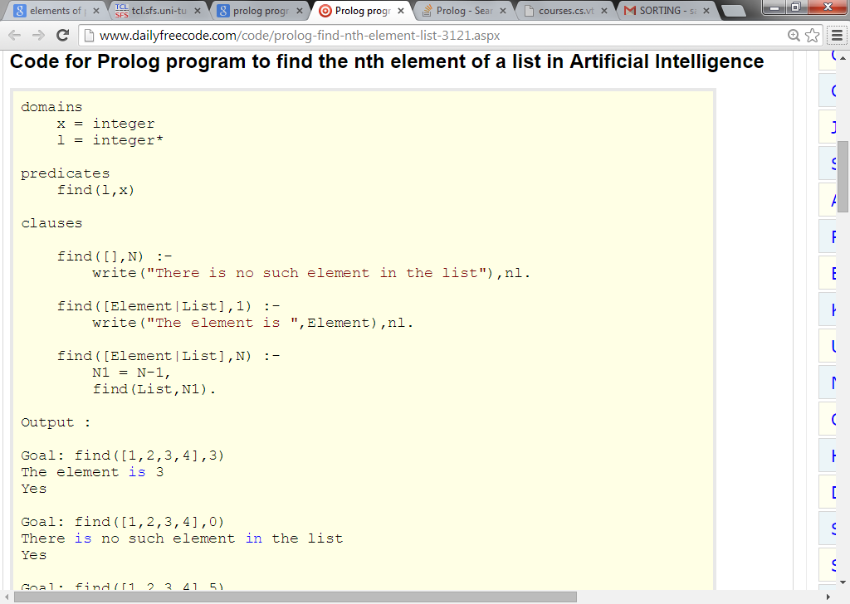
Program to search an Element in the list using prolog

Slide 29
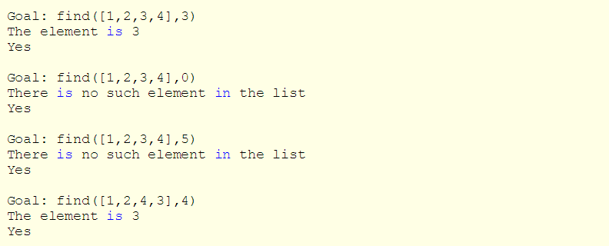
Output

Slide 30
Application of Logic Programming
They are majorly 3 application of Logic programming languages
1. Relational Database Management Systems
2. Expert Systems 3. Natural Language processing.
Relational Database Management systems
RDBMS stores the data in the form of tables. SQL queries are used to perform the operations on the data.
RDBMS uses logic programming (prolog structures) to describe the simple table information and relationship between tables using prolog rules.
Goal statements are used to retrieve the data from the RDBMS.
The advantages of using logic programming to implement and RDBMS is that only a single language is required.
Another advantage of using logic programming to implement an RDBMS is that deductive capability is built in.

Slide 31
Expert Systems
Expert system consist of database of facts, an differencing process, some heuristics about the domain, and some friendly human interface that makes the system appear much like an expert system.
Natural language processing
Certain kind of natural processing can be done with logic programming.
Natural language interfaces to computer software systems, such as intelligent knowledge based systems can be easily done with logic programming.
Set of sentences in natural languages can be expressed using logic based networks
Summary
Symbolic logic provides basis for logic programming.
Logic programs should be nonprocedural.
Prolog statements are facts, rules, or goals.
Resolution is the primary activity of a Prolog interpreter.

Slide 32
Scripting languages Pragmatics
Scripting is a paradigm characterized by
-use of scripts to glue subsystems together;
-Rapid development and evolution of scripts;
-Modest efficiency requirements;
-Very high-level functionality in application-specific areas.
A software system often consists of a number of subsystems controlled or connected by a script.
In such a system, the script is said to glue the sub systems together.
COMMON CHARACTERISTICS OF SCRIPTING LANGUAGES
Both batch and interactive use
Economy of expressions
Lack of declaration; simple scoping rules
Flexible dynamic typing
Easy access to other programs
High level data types
Glue other programs together

Slide 33
Extensive text processing capabilities
Portable across Windows, Unix and Mac
PYTHON
PYTHON was designed in the early 1990s by Guido van Rossum.
PYTHON borrows ideas from languages as diverse as PERL, HASKELL, and the object-oriented languages, skillfully integrating these ideas into a coherent whole.
PYTHON scripts are concise but readable, and highly expressive.
Python is extensible: if we invoke how to program in C, it is easy to add new built in function or module to the interpreter, either to perform critical operations at maximum speed of to link python programs to libraries that may only be available in binary form

Slide 34
Values and types
PYTHON has a limited repertoire of primitive types: integer, real, and complex Numbers. It has no specific character type; single-character strings are used instead.
Its boolean values (named False and True) are just small integers.
PYTHON has a rich repertoire of composite types: tuples, strings, lists, dictionaries, and objects.
Variables, Storage, and Control
PYTHON supports global and local variables.
Variables are not explicitly declared, simply initialized by assignment.
PYTHON adopts reference semantics. This is especially significant for mutable values, which can be selectively updated.
Primitive values and strings are immutable; lists, dictionaries, and objects are mutable; tuples are mutable if any of their components are mutable

Slide 35
PYTHON’s repertoire of commands include assignments, procedure calls, conditional (if but not case-) commands, iterative (while- and for-) commands, and exception-handling commands.
Bindings and scope
• A PYTHON program consists of a number of modules, which may be grouped into packages.
• Within a module we may initialize variables, define procedures, and declare classes
• Within a procedure we may initialize local variables and define local procedures.
• Within a class we may initialize variable components and define procedures (methods).
• PYTHON was originally a dynamically-scoped language, but it is now statically scoped
In python, variables defined inside the function are local to that function. In order to change them as global variables, they must be declared as global inside the function as given below.

Slide 36
S = 1
Def myfunc(x,y);
Z = 0
Global s;
S = 2
Return y-1 , z+1;

Slide 37
Procedural abstraction
• PYTHON supports function procedures and proper procedures.
• The only difference is that a function procedure returns a value, while a proper procedure returns nothing.
Since PYTHON is dynamically typed, a procedure definition states the name but not the type of each formal parameter
Python procedure
Eg :Def gcd (m, n):
p,q=m,n
while p%q!=0:
p,q=q,p%q
return q
Python procedure with Dynamic Typing
Eg: def minimax (vals):
min = max = vals[0]
for val in vals:
if val < min:
min = val
elif val > max:
max = val
return min, max

Slide 38
Data Abstraction
• PYTHON has three different constructs relevant to data abstraction: packages ,modules , and classes.
Modules and classes support encapsulation, using a naming convention to distinguish between public and private components. • A Package is simply a group of modules.
• A Module is a group of components that may be variables, procedures, and classes
• A Class is a group of components that may be class variables, class methods, and instance methods.
• A procedure defined in a class declaration acts as an instance method if its first formal parameter is named self and refers to an object of the class being declared. Otherwise the procedure acts as a class method.

Slide 39
Separate Compilation
• PYTHON modules are compiled separately.
• Each module must explicitly import every other module on which it depends
• Each module’s source code is stored in a text file.
Eg: program.py
• When that module is first imported, it is compiled and its object code is stored in a file named program.pyc
• Compilation is completely automatic.
• The PYTHON compiler does not reject code that refers to undeclared identifiers. Such code simply fails if and when it is executed
• The compiler will not reject code that might fail with a type error, nor even code that will certainly fail, such as:
Def fail (x):
Print x+1, x[0]

Slide 40
Module Library
• PYTHON is equipped with a very rich module library, which supports string handling, markup, mathematics, and cryptography, multimedia, GUIs, operating system services, internet services, compilation, and so on.
• Unlike older scripting languages, PYTHON does not have built-in high-level string processing or GUI support, so module library provides it.

Slide 41
1.Write about the operations that can be performed on atoms and lists in LISP.
2. Write a brief note on Scripting languages
3. Explain the important functions of LISP.
4. Compare the functional programming languages with imperative languages.
b) Write a LISP function Fib(n) that computes nth Fibonacci number.
5. Describe the two common mathematical functional forms that are provided by scheme.
6. Explain various storage and control statements available in Python
7. Explain about the fundamentals of functional programming languages
8. Explain the different types of data types used in Python.
9. Discuss about the basic elements of Prolog with examples.
10. Discuss the key concepts of scripting languages.

