Slide 1

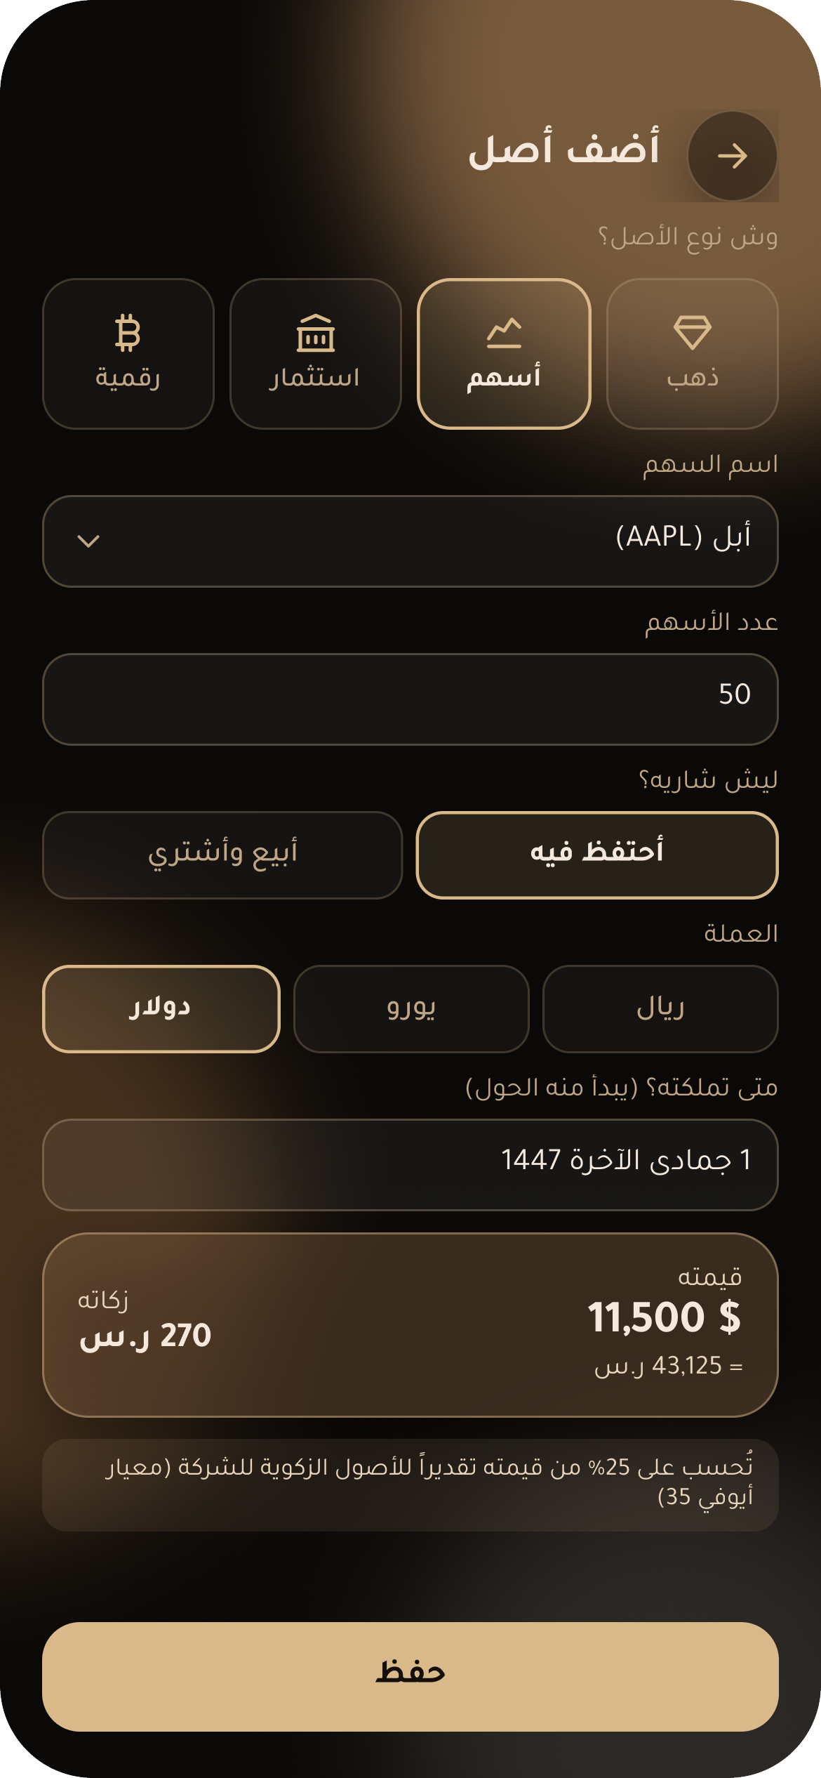
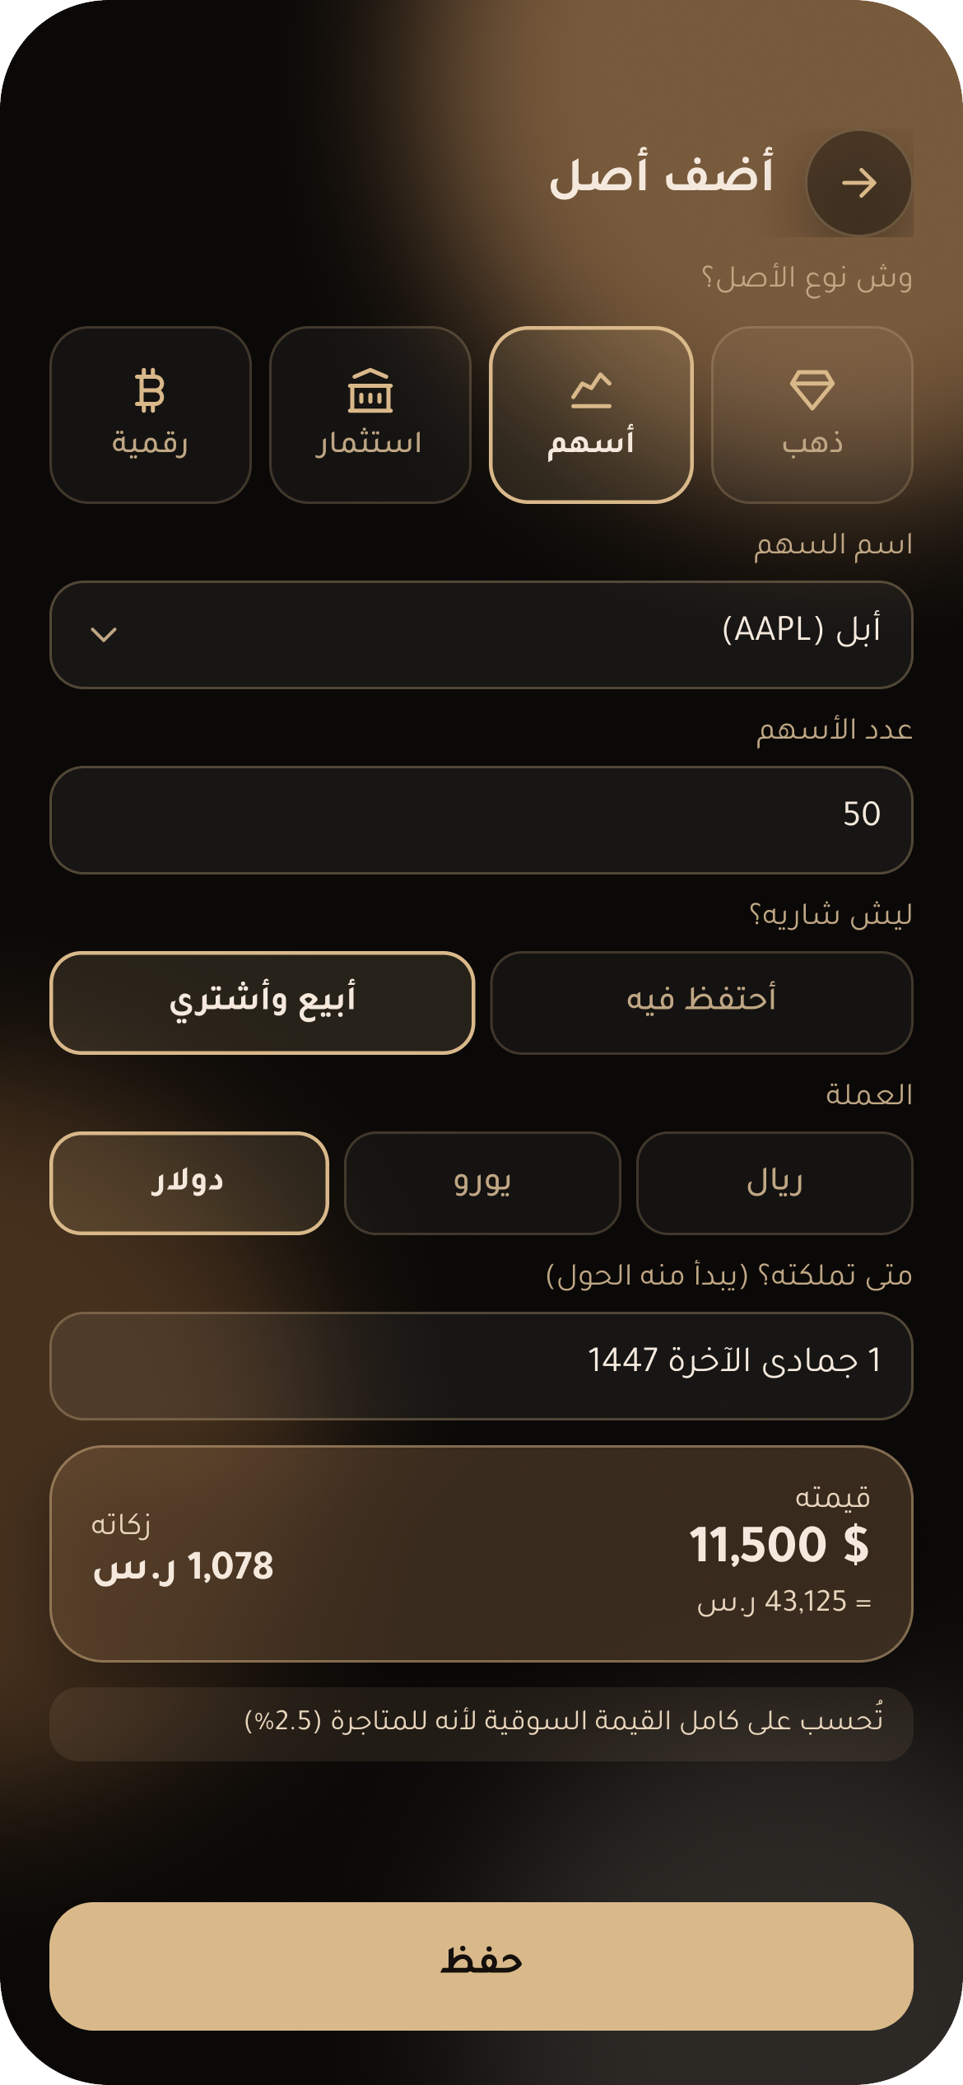
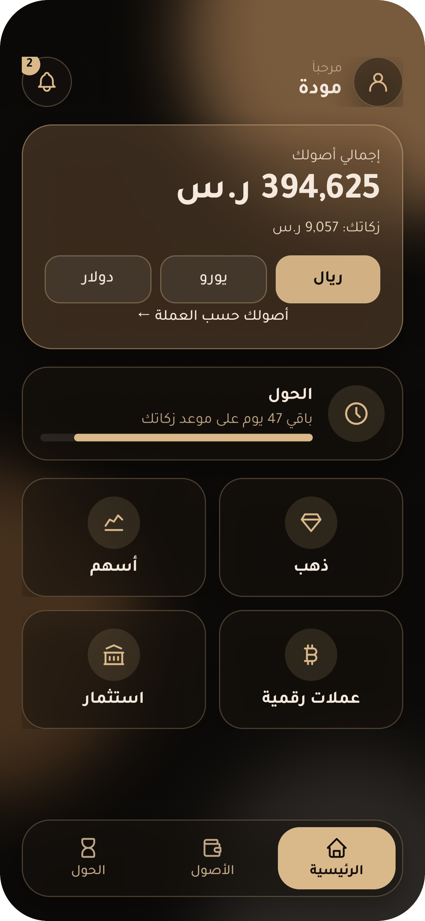
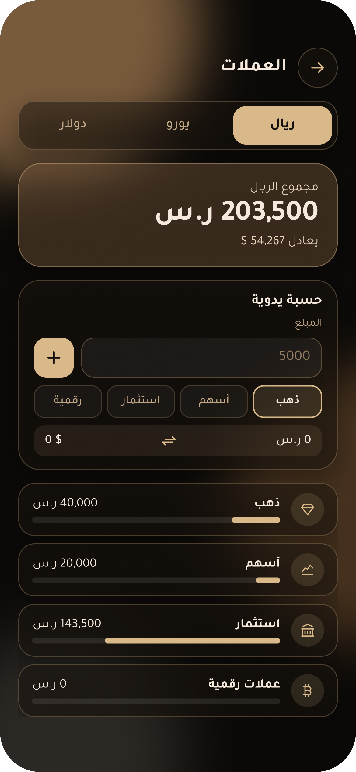
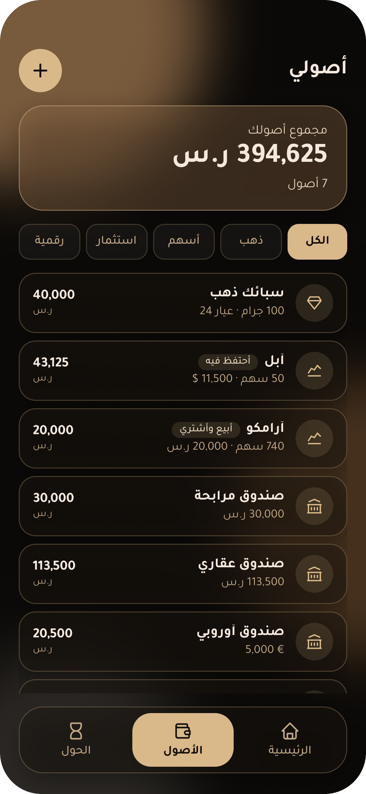
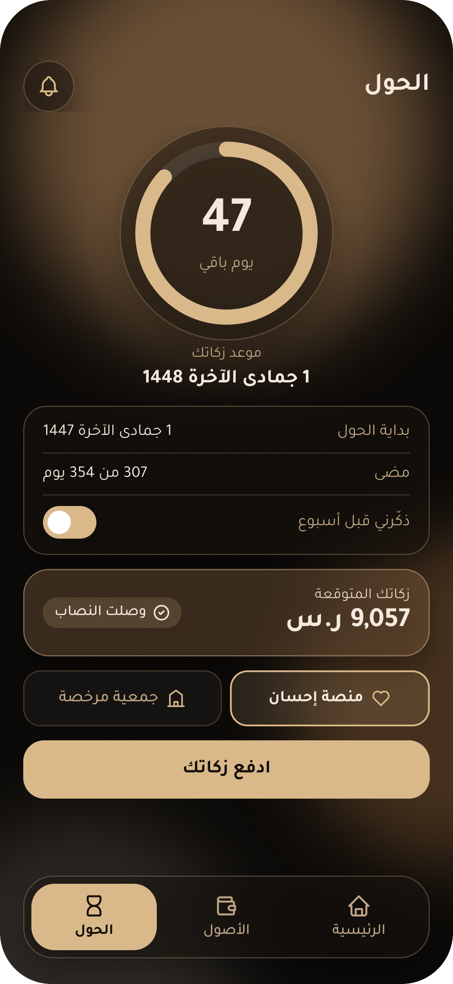
FTEC341 · FINTECH & FINANCIAL TRANSFORMATION · FINANCIAL SOLUTIONS
Mikal
ميكال
Zakat, measured right — for global, multi-currency and crypto investments
College of Business Administration
Princess Nourah bint Abdulrahman University
1st Semester 2026/2027
1
Introduction
Problem & Gap
Proposed Solution
2
3
Zakat is 2.5% of qualifying wealth held for one lunar year (hawl). In Saudi Arabia, individuals calculate it themselves [1] — while more of their wealth now sits abroad [2].
SAR 850B
18%
Mikal: one app for all assets, in any currency, that calculates zakat by why each asset is held.
Saudi trading in foreign markets, 2025 [2]
of Saudi residents trade crypto [3]
ZATCA’s Zakaty app [4] does not:
01
Intent-based zakat [5]
separate traders from long-term holders [5]
02
Every asset & currency, incl. crypto
Mikal — from mikyāl (مكيال), “a measure”.
cover crypto
03
Hawl reminder & pay via Ehsan [6]
let users choose who receives their zakat
4
Figma Implementation
6 LINKED SCREENS · CLICKABLE PROTOTYPE · ARABIC RTL
KEY FEATURE · SAME 50 SHARES, DIFFERENT ZAKAT
HOLD
TRADE
vs
Home
Currencies
Assets
Hawl
Total & zakat due
Totals per currency
Every holding in SAR
SAR 270
SAR 1,078
Countdown & pay
long-term investor · 2.5% × 25%
trader · 2.5% × 100%
USER FLOW
Home
→
Add asset
→
Why do you hold it?
→
Hold · 2.5% × 25%
→
Convert to SAR
→
Hawl reminder
→
Pay via Ehsan
Trade · 2.5% × 100%
5
Features & Usability
5
Limitations
All assets, one view
Intent-based zakat
Design: prototype with sample data; login not designed
Crypto included
Auto SAR conversion
Fiqh differences → results are estimates; needs Shariah review
Hijri hawl reminders
Pay via Ehsan
No data link to foreign brokers or wallets → manual entry
Plain Arabic, RTL
Shows how zakat is calculated
Privacy law compliance & Ehsan partnership required
Conclusion
References
6
7
Saudi investors went global; zakat tools didn’t. Mikal helps them pay exactly what is due — no more, no less.
1.
Zakat, Tax and Customs Authority. (2024, March 11). زكاتي لزكاة الأفراد [Zakaty for individuals’ zakat]. https://zatca.gov.sa/ar/MediaCenter/News/Pages/news-1215.aspx
2.
Argaam. (2026, February 24). Saudi trading in foreign markets surges in 2025: Drivers & outlook. https://www.argaam.com/en/article/articledetail/id/1882771
3.
Unlock Blockchain. (2022, February 28). 18 percent of Saudi residents trade in crypto. https://www.unlock-bc.com/en/18-percent-of-saudi-residents-trade-in-crypto
4.
Zakat, Tax and Customs Authority. (2025). دليل المستخدم لمنصة زكاتي [Zakaty platform user guide] (3rd ed.). https://www.zatca.gov.sa/ar/HelpCenter/guidelines/Documents/ZakatyManual.pdf
5.
Adam, F., Khan, A., & Omarjee, B. (2018). Zakat on share investments: Determining a proxy for calculation. National Zakat Foundation. https://nzf.org.uk/knowledge/zakat-on-share-investments-determining-a-proxy-for-calculation/
6.
Ehsan National Platform for Charitable Work. (n.d.). الزكاة [Zakat]. https://ehsan.sa/zakat

