Slide 1
CIS 174: Advanced C# Programming
Week 2: 2022-01-19 to 01-25

Slide 2
Assignments (Module 2)
Verify Azure Setup (Topic 1)
EF Core Web App Lab (Topic 2)
Murach Chapter 4 Quiz (Topic 3)
Multipage WebApp w/ DB (Topic 3)
Final Project Brainstorming (Topic 4)

Slide 3
Topics
Azure
Learn Entity Framework (EF) Core
Data-driven Multi-page Web App
Map out final project idea

Slide 4
Azure (Mod 2 Topic 1)
Readings
Microsoft: https://azure.microsoft.com/en-us/
Acronis: https://www.acronis.com/en-us/articles/what-is-microsoft-azure/
How-To Geek: https://www.howtogeek.com/337961/what-is-microsoft-azure/
Sign up using your DMACC email address
Free
Will get $100 credit
Portal: https://portal.azure.com/

Slide 5
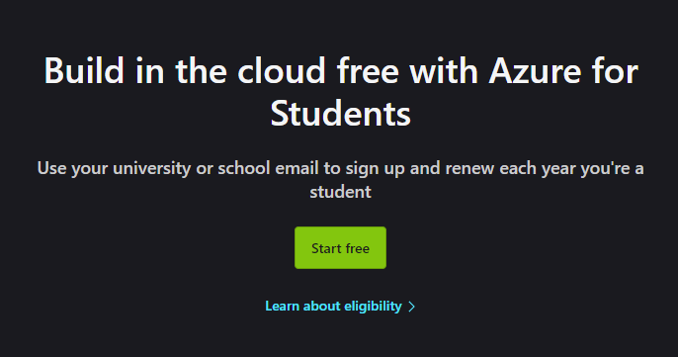
Azure Account Creation
Free Student Account: https://azure.microsoft.com/en-us/free/students/

Slide 6
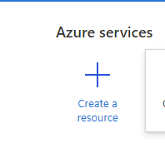
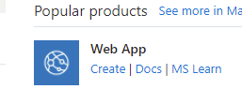
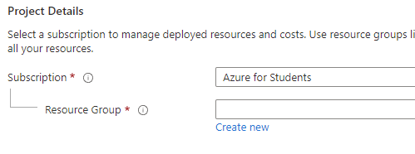
Azure: Creating a new App Service
Create a resource
Web App -> Create
Create new Resource Group named ‘cis174dmacc

Slide 7
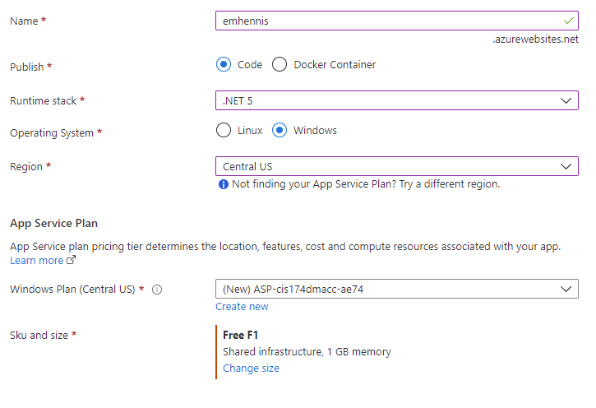
Azure: Create Web App
Name: Something unique (emhennis)
Runtime Stack: .NET 5 (or 6)
Operating System: Windows
Region: Central US
Windows Plan: [Default]
Sku and size: Free F1 (Can do bigger but $$)
Review + create

Slide 8
Deploy from Visual Studio
Create a new project (or use an existing one)
Right click on the project and select publish
Target: Azure
Specific Target: Azure App Service (Windows)
Select your created Azure Web App
Deployment Type: Publish (generates pubxml file)
Hit ‘Publish’

Slide 9
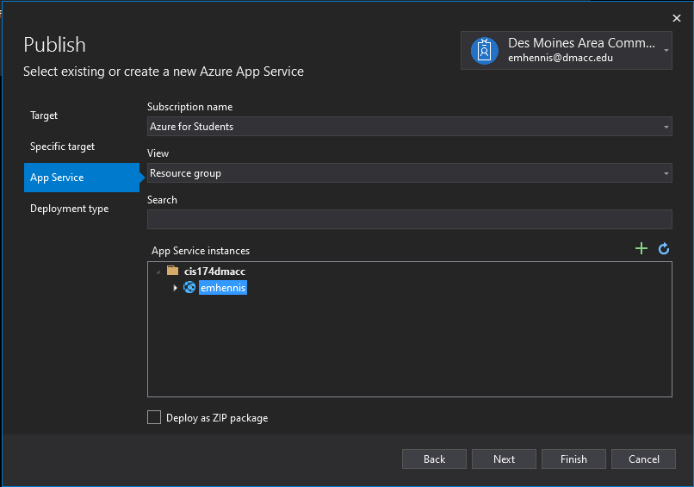
Visual Studio Publish

