Slide 1
Weather Forecast
Nearly two billion people worldwide rely on AccuWeather forecasts to help them plan their day, protect their assets, and stay safe. It has been analyzing and predicting the weather for more than 55 years. Today it uses Machine Learning services to create custom weather-impact predictions for business customers and transform its own business faster. The company’s Data-Driven Decisions service provides automated weather analytics to businesses eager to outwit
Mother Nature.

Slide 2
Data Content
This dataset contains about 10 years of daily weather observations from many locations across Australia.
Rain Tomorrow is the target variable to predict. It means -- did it rain the next day, Yes or No? This column is Yes if the rain for that day was 1mm or more.
There are 23 features in the dataset. Those 23 independent variables maintaining relationship with the Target Variable “Rain tomorrow”.
Data Context
Predict next-day rain by training Random Forest Classifier Model on the target variable ”Rain Tomorrow”.

Slide 3


What we have to predict ?
Will it rainy day tomorrow?
Will it sunny day tomorrow?

Slide 4
Problem Statement
Defend business against the weather
It’s Rainy season in the Australia. The supply chain manager for a big-box retailer needs to make daily decisions about delivery routes to the stores in the region. The operations team needs to make decisions about store safety, staffing, and inventory. The marketing team can boost customer loyalty and profits by offering discounted prices on roofing materials at the right stores and the right time.
To make the best decisions, they all need data—about their company’s previous-year sales and about the weather. That’s where Weather Forecast Model comes in.
Business cannot defend weather but we can defend business from weather

Slide 5
Libraires We Used in Python
NumPy
Pandas
Matplotlib
Seaborn
Stats
Sklearn
Random forest classifier
Standard scaler

Slide 6
Steps we performed to build the model
Data load
Data Preprocessing
Data cleaning
EDA (Exploratory data analysis)
Data Splitting (train and test data)
Model fitting
Model Evaluation

Slide 7
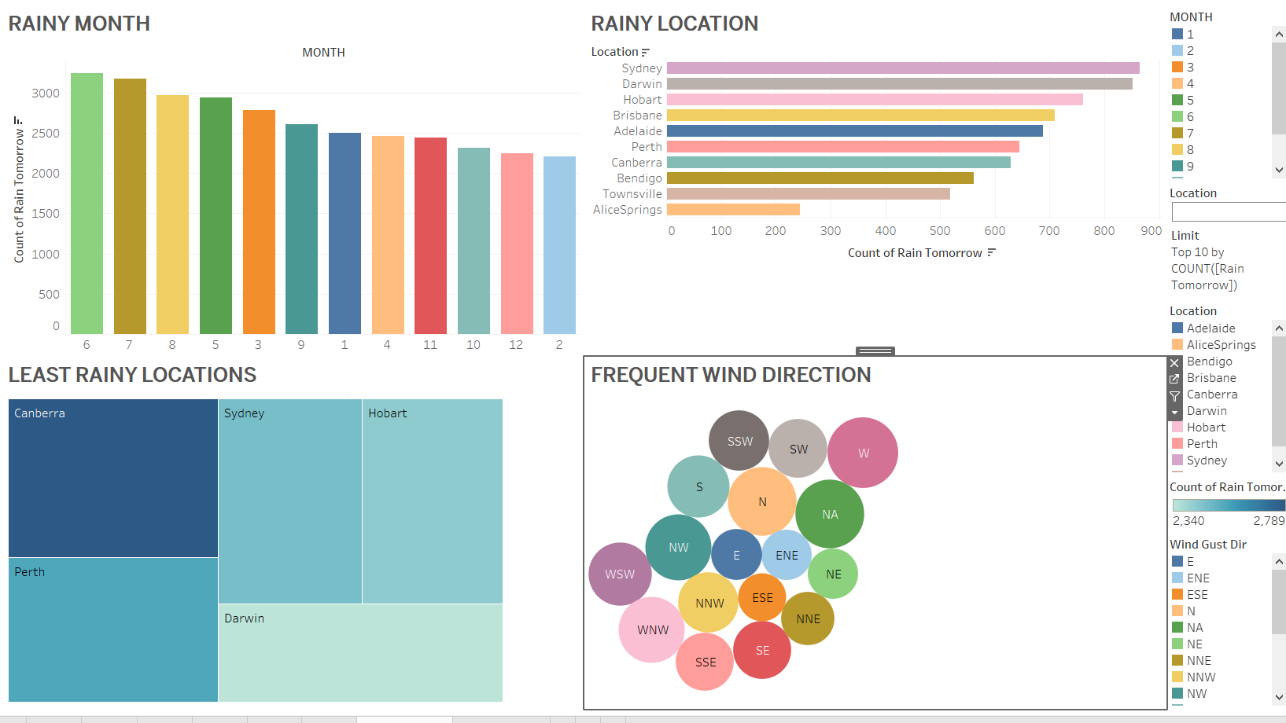
Some of the data insights by using Tableau

Slide 8
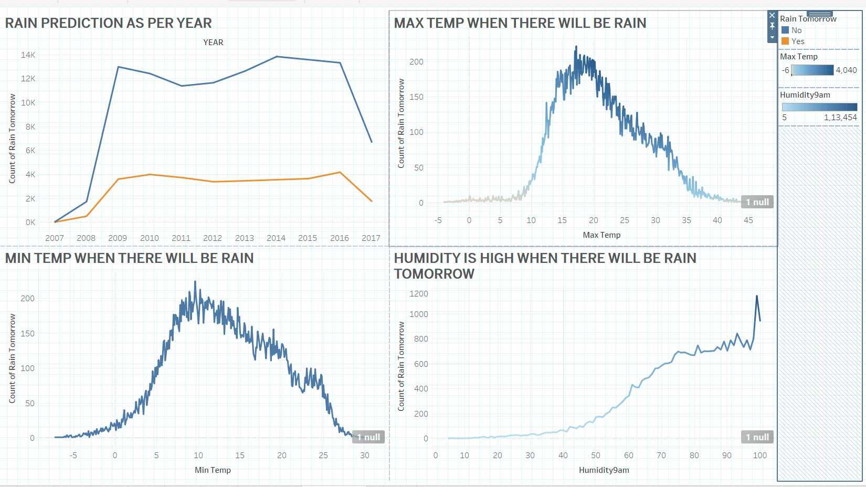
We have prepared some Tableau dashboards using different type of charts

