Slide 1
JAGSAT
Initial menu mocks

Slide 2
1.- Initial Menu
  1.1 Configuration:
    Set up players names, colors and position.
    Select map.
    Load, save, delete and modify profile.
    Load or start game.
  1.2 Save profile
    Define name.
    Set as default.
    Continue/Cancel.
  1.3 Load Game
    Select saved game.
    Delete saved game.
  1.4 Confirmation
    Continue/cancel action

Slide 3
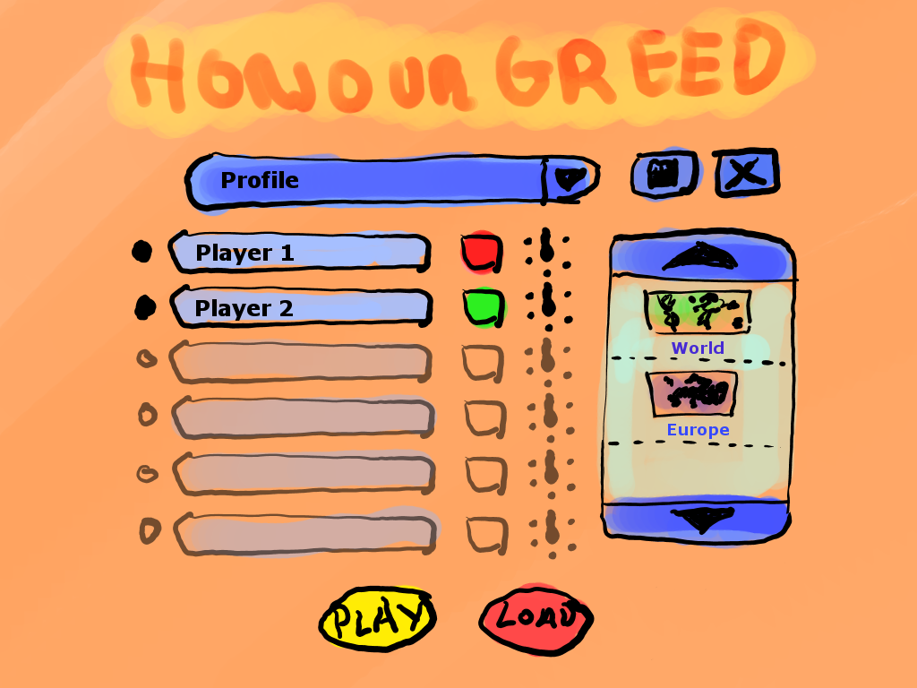
1.1.- Configuration
E
C
D
F
B
G
A
I
H

Slide 4
A: Players config.
By clicking the black left button the player will be activated. By clicking the player name button the keyboard will appear to change player name.
B: Profile menu.
Displays profile menu with profiles list.
C: Player color config.
By clicking the button player color changes.
D: Player position config.
Points the player position around the device
E: Save profile
Shows 1.2 menu
F: Delete profile
G: Posible maps:
Map selected will be remarked.
H: Load game
Shows 1.3 menu
I: Play game:
Starts game if the actual config is valid.

Slide 5
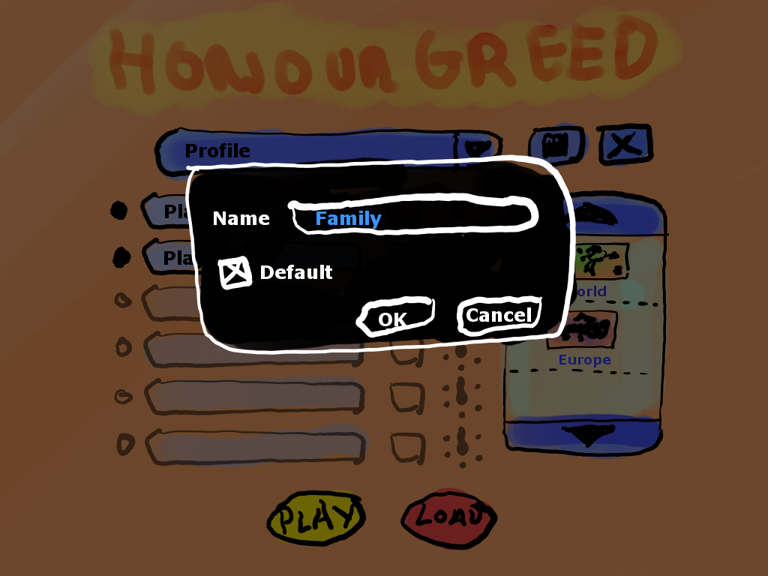
1.2.- Save profile
B
A
D
C

Slide 6
Comes from 1.1.E
A: Set profile as defaul.
This profile will be shown as marked in 1.1.B
B: Profile name.
C: Cancel button:
Back to 1.1 without changes
D: Ok button:
Back to 1.1 with profile changes

Slide 7
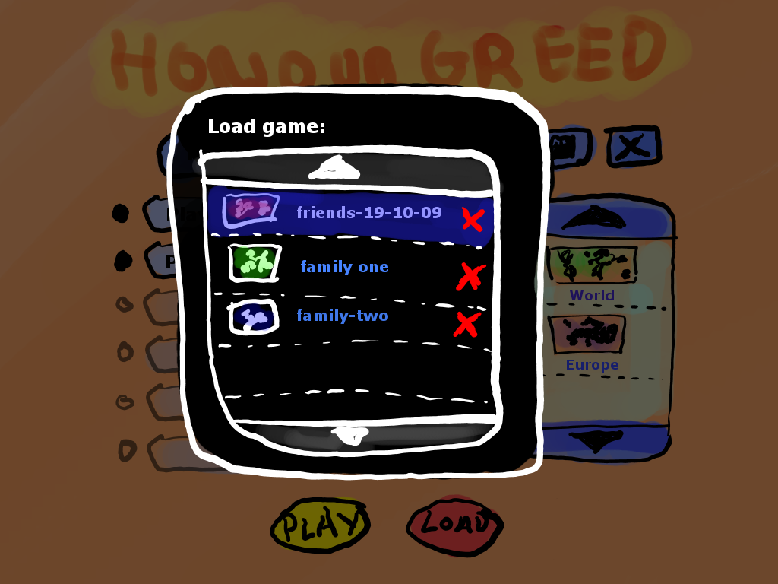
1.3.- Load Game
A
B
C

Slide 8
Comes from 1.1.H
A: Map preview.
Little picture of the kind of map played in this game.
B: Up/Down buttons
C: Delete saved game.

Slide 9
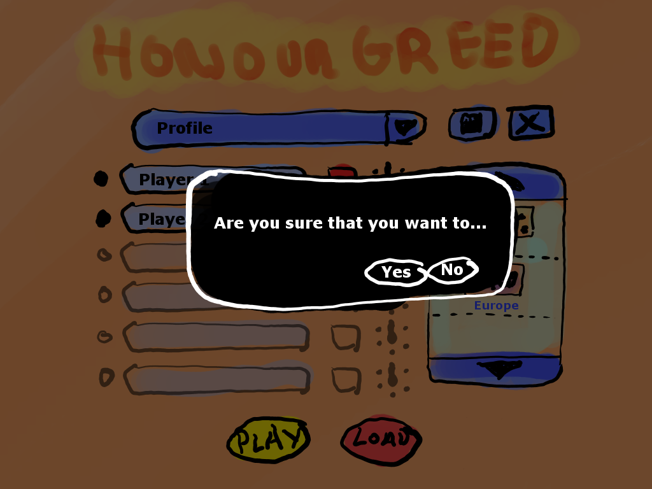
1.4.- Confirmation
A
B

Slide 10
Comes from 1.2.D, 1.3 and 1.1.I
A: Confirm
B: Cancel

