Slide 1
Ohm's law in ~5 minutes
Two videos, one topic. MARKER-PPT-TITLE. Theory + board practical wiring.

Slide 2
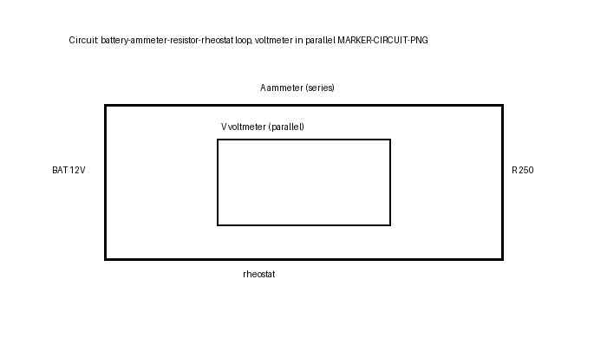
The basic circuit
Battery, wire, resistor in a loop. MARKER-PPT-CIRCUIT. Current leaves + terminal, returns to battery.

Slide 3
Hose analogy
Pressure = voltage, valve = resistor, flow = current. MARKER-PPT-HOSE.

Slide 4
V = I x R triangle
Cover-and-read: V=I*R, I=V/R, R=V/I. MARKER-PPT-TRIANGLE.

Slide 5
Symbols and units
V volts, R / ohm-sign ohms, I amps. MARKER-PPT-UNITS.

Slide 6
voltage_V | current_mA
3.0 | 12.0
6.0 | 24.0
9.0 | 36.0
12.0 | 48.0
Worked example
12V across 250 ohm gives 0.048A = 48mA. MARKER-PPT-EXAMPLE.

Slide 7
Series vs parallel
Ammeter in series; voltmeter in parallel across the resistor. MARKER-PPT-SERIES.

Slide 8
Practical checklist
Red positive, black negative, tight connections, rheostat in series. MARKER-PPT-WIRING.

Slide 9
V-I is a straight line through the origin
Slope is 1/R. MARKER-PPT-CHART.

