Slide 1
Practical: goal
Wire the Ohm's law board circuit in minutes. MARKER-PRAC-P1.

Slide 2
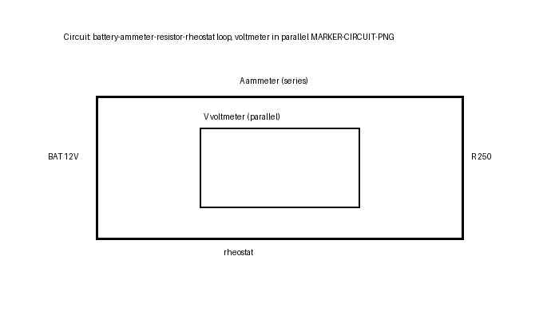
Battery to ammeter
Battery+ to ammeter+ (red). Tight connections. MARKER-PRAC-P2.

Slide 3
Resistor and rheostat
Ammeter- to resistor, resistor via rheostat to battery-. MARKER-PRAC-P3.

Slide 4
from | to
battery + | ammeter + (red)
ammeter - | resistor A
resistor B | rheostat
rheostat | battery -
voltmeter red | resistor A
voltmeter black | resistor B
Voltmeter across R
Red where current enters, black where it leaves. Parallel only. MARKER-PRAC-P4.

Slide 5
Read the loop
Battery+ ammeter+ resistor rheostat battery-. Vary, record, check V/I. MARKER-PRAC-P5.

