Slide 1
Pune Technical Analyst 2016 Project

Slide 2
Contents
Purpose Of Project & Areas of Focus
Assessment
Areas of Focus – Development Principles
Timeline
Business Projects
Technologies
Teamwork

Slide 3
Purpose Of Project
Designed to reinforce the
technical
financial
professional skills
taught during the past five weeks.
In particular to
use computer technology in the development of a complex business systems.

Slide 4
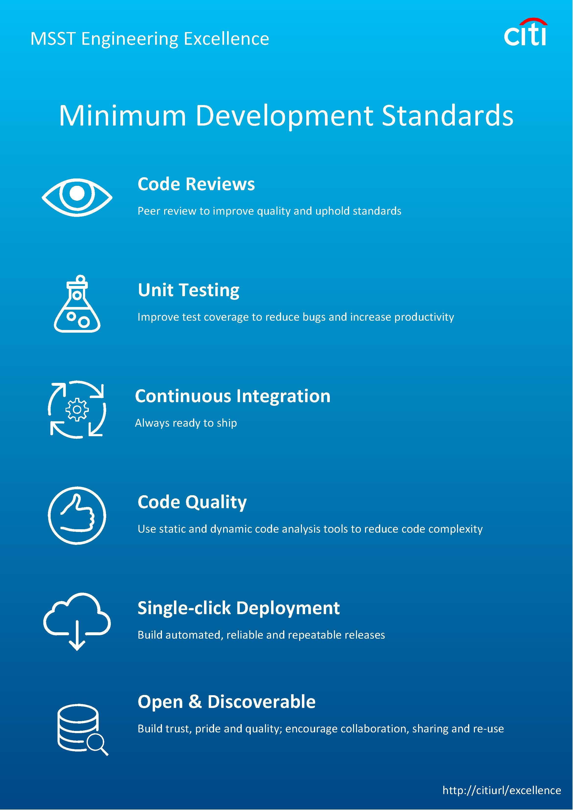
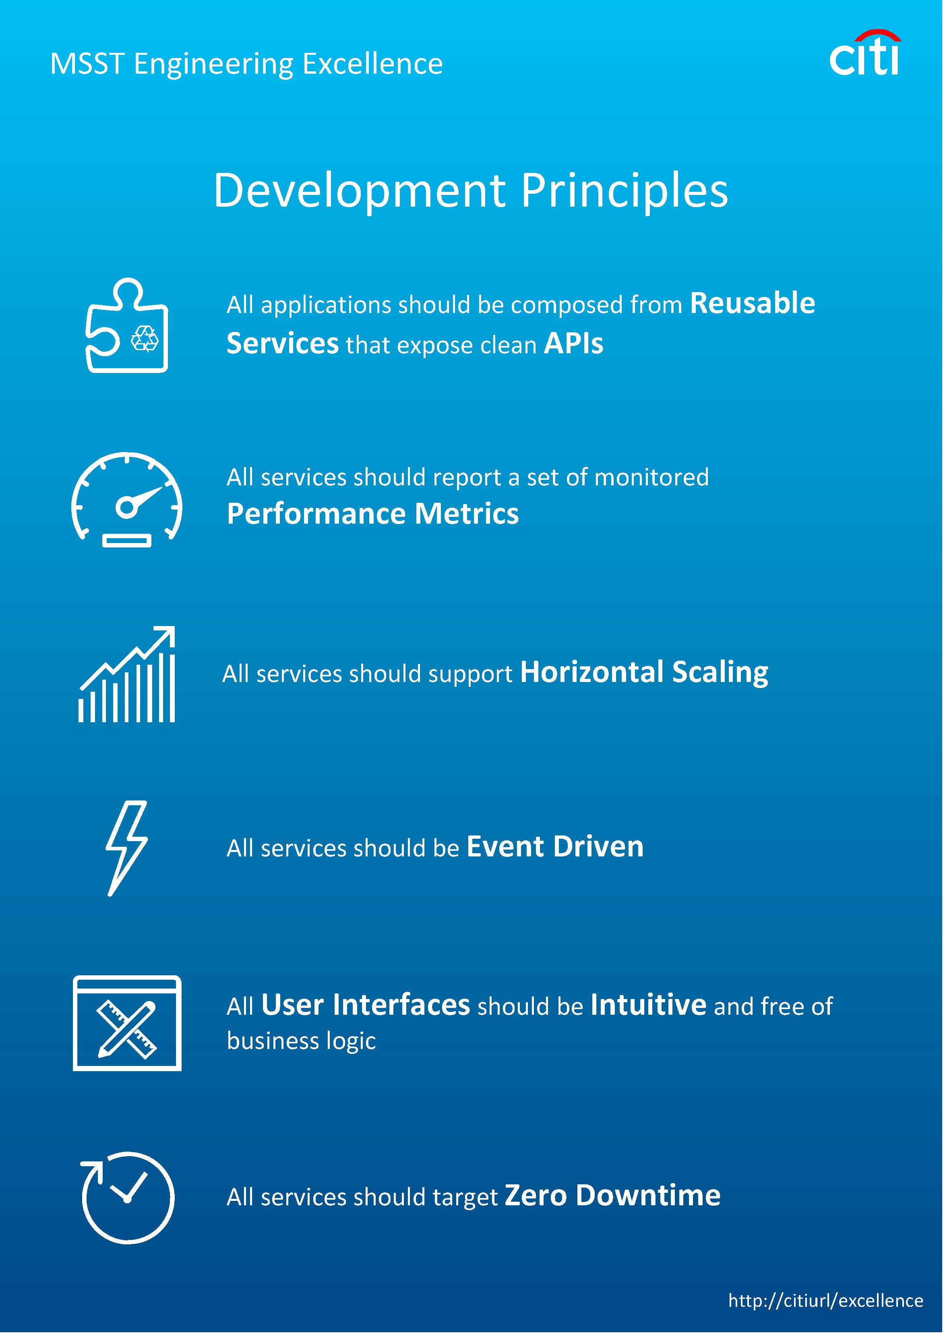
Areas of Focus

Slide 5
Assessment
The assessment will focus on
Teamwork, clear communication and logical problem solving skills
Requirements analysis and technical design
Clean coding, efficient scripting and system testing
High quality deliverables – user stories, design documentation, test cases
Working to ambitious deadlines using agile best practices
The use of appropriate tools and technologies
The preparation of a business presentation to peers, instructors and managers

Slide 6
Timeline
Task | Start | End
Specification, Analysis, Design and Planning | Thursday 25th August – 9am | Friday 26th August - 9am
Delivery of Key Project Components including minimal system: ASAP | Friday 26th August - 9am | Thurs 1st September – 9am
Final Testing | Thurs 1st September – 9am | Thurs 1st September – COB
Presentation & Demo Preparation | Fri 2nd September – 9am | Fri 2nd September – Noon
Presentation & Demo to managers | Fri 2nd September – 2:00pm | Fri 2nd September – 5:00pm
Good news – you can work over the weekend !!

Slide 7
Project specification
Short and sweet, 2-3 pages so all understand the aims
State the problem eg ‘A trading simulator to allow both trading and non-trading personnel to better understand the trading process’
Prioritised list of deliverables eg:
Display a list of stocks to the user
When the user selects a stock:
Display current bid and ask
Option to display history
Option to buy or take option
Show trading history and profit

Slide 8
Business Projects
Working in teams of 5 or 6 analysts you will be building one of the following applications
Portfolio Manager
Market Data Analysis Engine
E-Bond Financial Trader
Trade Blotter

Slide 9
Technologies
Teams can choose whichever technology they have access to, including choice of language, configuration management system and development tools.
A good starting point would be
WPF user interface
Mid Tier – Java and application servers exposing REST services
Data Tier – MySQL or SQL Server, some derived from ETL data

Slide 10
Teamwork and Planning
6 CRITICALLY IMPORTANT STEPS
Create a project plan: what are you going to do? (Be creative within limits)
Agree who is doing what – work to your strengths
Spend time on analysis and design, before you begin coding
Focus on quickly getting a simple end-to-end application working with all the key components – database, business logic, User Interface.
Version control – get your code into Git
Keep talking to each other – morning stand-ups, team meetings

Slide 11
Work as a team
Choose a project leader
If a decision is taking too long, then vote or impose a choice
If you don’t like the choice, then ‘Disagree and commit!’
Work according to the team’s priorities, not yours!
Communicate regularly
Assign specific roles: documentation, testing, posters
Choose a project manager: owns progress chasing, clear view of status and problems

Slide 12
Project Fair Friday 2nd September
Choose a good name for your project: no initials!
Prepare 2 PowerPoint portrait slides as posters
Your project name, logo, team names
Architecture with meaning eg not a box that says ‘Json’ but says ‘Trade price’ with perhaps a Json logo at the bottom
Be prepared for questions: what is best about your project, what problems did you have to overcome, why is your project useful?

Slide 13
Questions

