Slide 1
E-Commerce Application
SUBMITTED BY,
ARYA MURALI
MCA,S4

Slide 2
CONTENTS
Abstract
Modules
Introduction
Magento
Php
GIT
Table Design
UML
Coding
Forms
Future Enhancement
Conclusion

Slide 3
Abstract
E-commerce is a transaction of buying or selling online. Electronic commerce draws on technologies such as electronic fund transfer, supply chain management, Internet marketing, online transaction processing, electronic data inter change(EDI),inventory management system, and automated data collection systems. E-commerce brings convenience for customers as they do not have to leave home and only need to browse website online, especially for buying the products which are not sold in near by shops. It could help customers buy wider range of products and save customer’s time. consumers are able to research products and compare prices among retailers.

Slide 4
continues…….
Mining Hard wares are the one-stop shop for all your crypto currency mining needs. whether you are new to mining or already a ”pro miner” we have the right hardware at best prices for you. Logon to the website, select your products, pay in crypto ,get your order delivered right to your door step.

Slide 5
Existing System
In existing system, customer get into the store, slowly walking from rack to rack checking out the display, putting a dress over your body and trying to checkout.
Having the ability to physically choose and checkout what an item or product is like, would look like,and what its features are
The stores carry a range of stock that is limitted by their physical size or proximity to a distribution center.

Slide 6
Proposed System
This site act as intermediate between buyer and seller and help customer to pay crypto currency. It help to sell product easily.
E-commerce brings convenience for customers as they do not have to leave home and only need to browse website online, especially for buying the products which are not sold in near by shops. It could help customers buy wider range of products and save customer’s time.

Slide 7
Software Requirements
Front End Tool : HTML, JS,CSS,PHP
Back End Tool : Magento
Development Tool : magento
Operating System :Windows xp 7
Browse :Google Chrome

Slide 8
Hardware requirements
Processor: Intel premium processor running
at 133 MHZ
Hard disk : 1.2 GB
RAM :Client Level- Minimum 128 MB

Slide 9
Modules
PRODUCT: This module include details of products in the site.
SALE: This module include details of registered customers and their shopping details.
PAYMENT: Payment module include payment details. Pay money as electronic fund.
DROP SHIPPING: Find product from other site.
CONFIGURATION: details of all product stored in database

Slide 10
Familiarization with build tools
Here we are using building tools:
MAGENTO
PHP
GIT
Magento is the most popular Open Source Platform to build e-Commerce websites.

Slide 11
Magento
Magento is an open source e-commerce platform written in php.
Magento aim to provide new ways to heighten user engagement , smooth navigation, improve conversion rates and overall revenue generation for store owners.
It has well organized business user tools that enhance the user experience of the software.
Table locking issues have been considerably reduced.

Slide 12
Magento Features
Magento is open source.
Flexible
Highly scalable
Easy integration
SEO friendly
Community support
Built for e-commerce
High performance
Marketing and promotion tools
Checkout and shipping.

Slide 13
PHP
Php is a server side scripting language designed for web development but also used as a general purpose programming language. Php originally stood for personal home page, but it now stands for the recursive acronym
Php code may be embedded into HTML code or it can be used in combination with various web template system
Php code is usually processed by a php interpreter

Slide 14
GIT
GIT is a version control system, a tool which is extremely smart choice to use even if it sounds over whelming, VCS is a group of files with monitored access.
GIT is a VCS developed by LINUX.
Its originally designed to help manage the LINUX Kernel and make collaboration easy from the beginning.
GITHUB is the most easy way to share project with collaborators.

Slide 15
XAMPP
XAMPP is a free and open source cross-platform web server solution stack package developed by Apache consisting mainly of the Apache HTTP Server, MariaDB database, and interpreters for scripts written in the PHP and Perl programming languages. XAMPP stands for Cross-Platform (X), Apache (A), MariaDB (M), PHP (P) and Perl (P). It is a simple, lightweight Apache distribution that makes it extremely easy for developers to create a local web server for testing and deployment purposes. Everything needed to set up a web server – server application (Apache), database (MariaDB), and scripting language (PHP) – is included in an extractable file. XAMPP is also cross-platform, which means it works equally well on Linux, Mac and Windows. Since most actual web server deployments use the same components as XAMPP, it makes transitioning from a local test server to a live server extremely easy as well

Slide 16
Bugzilla
Bugzilla is an open-source issue/bug tracking system that allows developers effectively to keep track of outstanding problems with their product. It is written in perl and uses Mysql database.
Bugzilla is a Defect tracking tool,how ever it can be used as a test management tool as such it can be easily linked with other Test case management tools like quality center,Testlink etc.

Slide 17
continues…
This open bug-tracker enables users to stay connected with their clients or employees,to communicate about problems effectively throughout the data management chain.
Key features of bugzilla includes:
Advanced search capabilities ,E-mail Notifications, Modify bugs by email,Time tracking ,Strong security,Customization & Localization

Slide 18
Tables
Main tables are
Tbl_Admin
Tbl_registration
customer_entity
Tbl_Sale
Tbl_Payment
eav_attribute
core_config_data
catalog_category_entity
catalog_eav_attribute
catalog_product_entity
cms_page
cms_block

Slide 19
Admin
Field name | Data type | constraints
User_id | Int | identity
First name | Varchar | notnull
Last name | Varchar | notnull
Email | Varchar | notnull
User name | Varchar | notnull
Password | Varchar | notnull

Slide 20
Customer
Field name | Data type | Constraints
Entity_id | Int | Not null
Entity_type_id | Small int | Not null
Attribute_set_id | Small int | Not null
Website_id | Small int | Null
Email | Varchar | Not null
Group_id | Small int | Not null
Increment_id | Varchar | Not null
Store_id | Small int | Null
Created_at | Datetime | Not null
Updated_at | Datetime | Not null
Is_active | Tinyint | Not null

Slide 21
Sale-order
Field name | Data type | Constraints
Entity_id | int | identity
Entity_type_id | int | notnull
Attribute_set_id | int | Notnull
Increment_id | varchar | Notnull
Parent_id | int | notnull
Store_id | int | null
Created_at | date | Notnull
Updated_at | date | Notnull

Slide 22
Gift
Field name | Data type | constraint
Gift_msg_id | Int | Identity
Customer_id | Int | Notnull
sender | Varchar | Notnull
recipient | Varchar | Notnull
message | Varchar | Notnull

Slide 23
Compare item
Field name | Data type | constraint
Catalog_compare_item_id | Int | identity
Visitor_id | Int | Notnull
Customer_id | Int | Null
Product_id | Int | Notnull

Slide 24
Wish list
Field name | Data type | constraint
Wishlist_id | Int | identity
Customer_id | Int | Notnull
shared | Int | Null
Sharing_code | Int | Notnull
Wishlist_item | Int | identity
Wishlist_item_id | Int | Notnull
Product_id | Int | Notnull
Added_at | Date | Null
description | Text | Null

Slide 25
News letter
Field name | Data type | Constraints
Template_id | Int | Identity
Template_code | Varchar | Null
Template_text | Text | Null
Template_text_preprocessed | Text | Null
Template_type | Int | Null
Template_subject | Varchar | Null
Template_sender_name | Varchar | Null
Template_sender_email | Varchar | Null
Template_actual | Tinyint | Null

Slide 26
Search
Field name | Data type | constraint
Query_id | Int | Identity
Query_text | Varchar | Notnull
Num_results | Int | Notnull
popularity | Int | Notnull
redirect | Varchar | Notnull
Synonym_for | Varchar | Notnull
Display_in_terms | Int | Notnull
Updated_at | Date | Notnull
Store_id | Int | Notnull

Slide 27
Shipping
Field name | Data type | Constraint
Website_id | Int | Notnull
Dest_country_id | Varchar | Notnull
Dest_region_id | Int | Notnull
Dest_zip | Varchar | Notnull
Condition_name | Varchar | Notnull
Condition_value | Decimal | Notnull
price | Decimal | Notnull
cost | Decimal | Notnull

Slide 28
Payment
Field name | Data type | constraint
Debug_id | Int | identity
dir | Enum | null
Request_body | Text | null
Response_body | Text | Null

Slide 29
UML DIAGRAM

Slide 30
login
Registration
Search
user
Admin
reg
seller
purchase
cancel
feedback
view
Approve reg

Slide 31
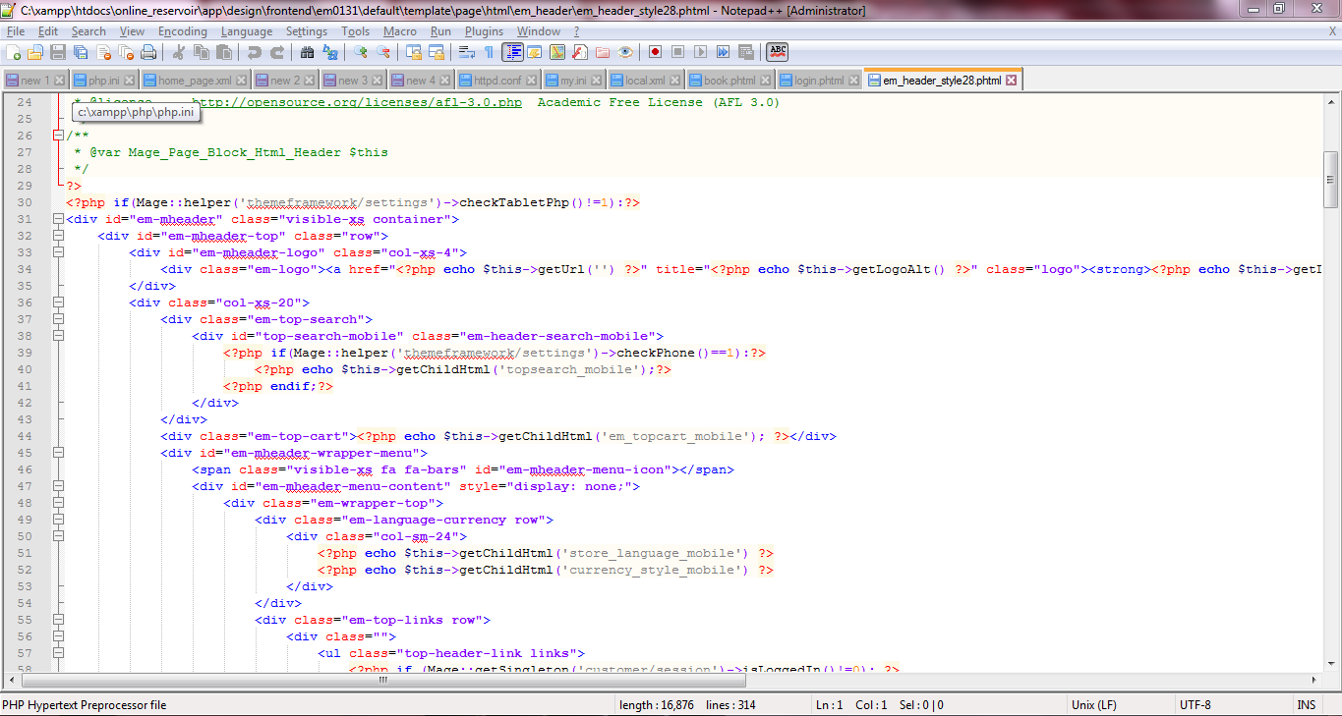
CODING

Slide 32
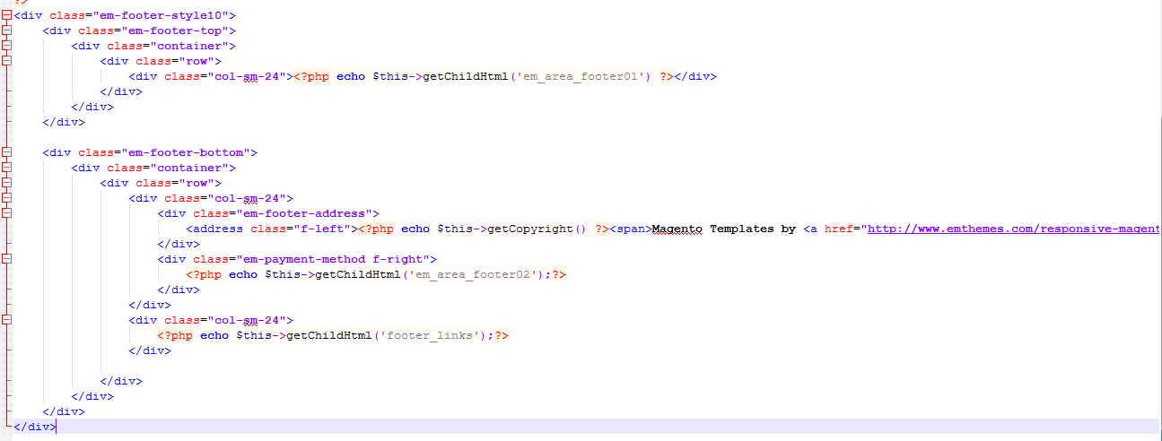

Slide 33
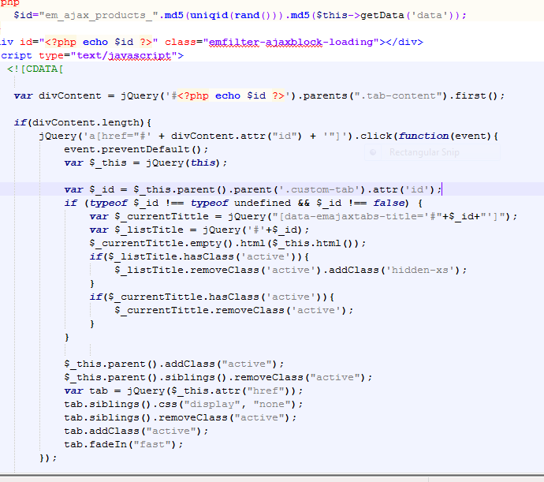

Slide 34
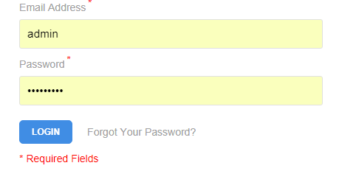
Login form

Slide 35
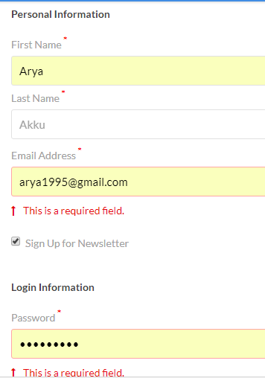
Registration

Slide 36
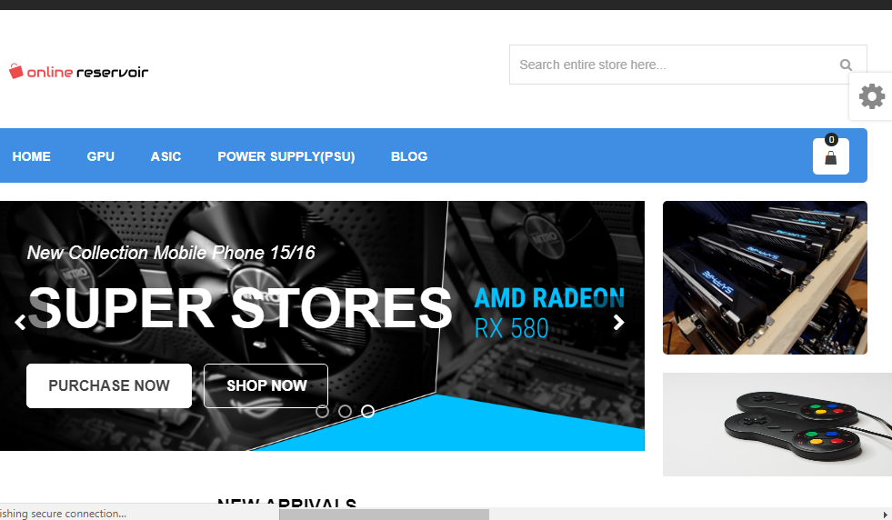
Home page

Slide 37
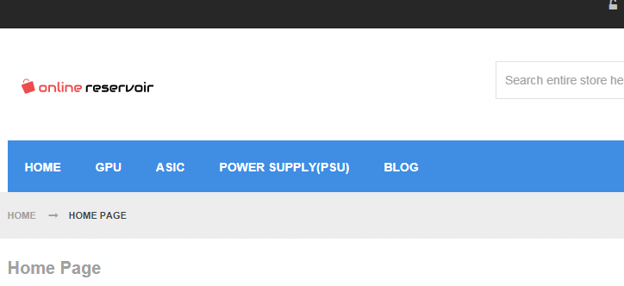
SITE

Slide 38
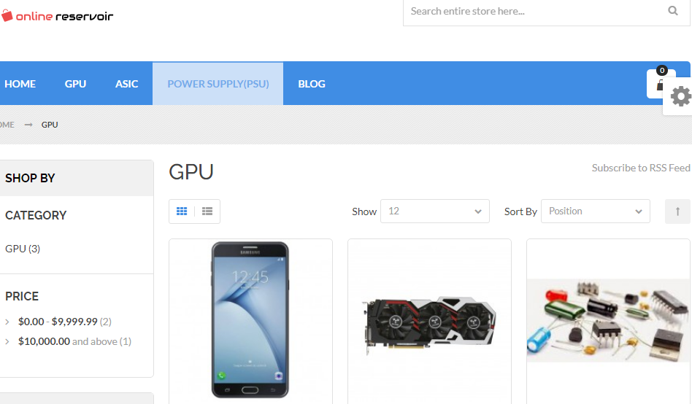
Gpu

Slide 39
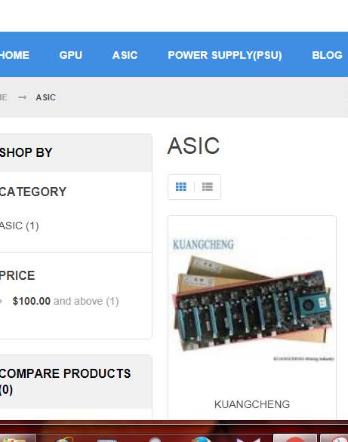
ASIC

Slide 40
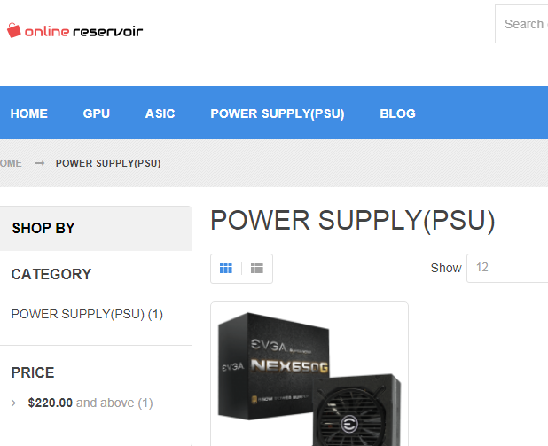
PSU

Slide 41
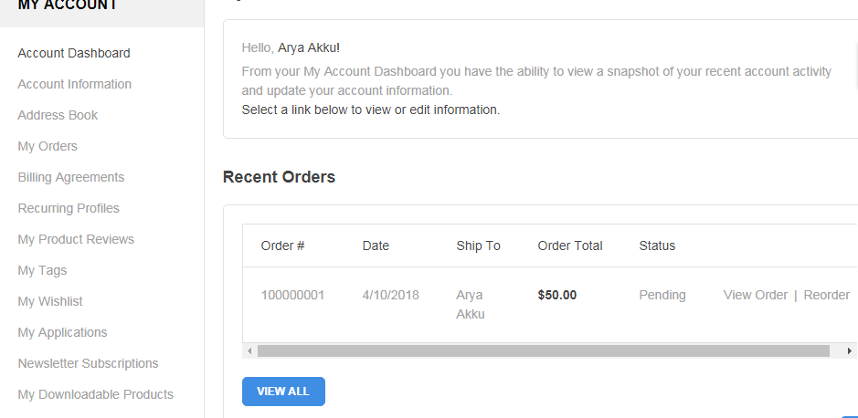
account page

Slide 42
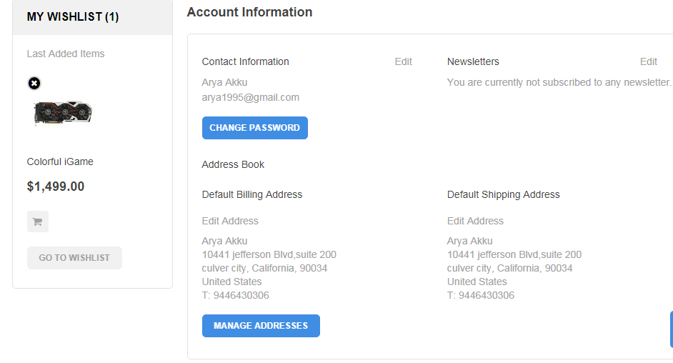
wish list

Slide 43
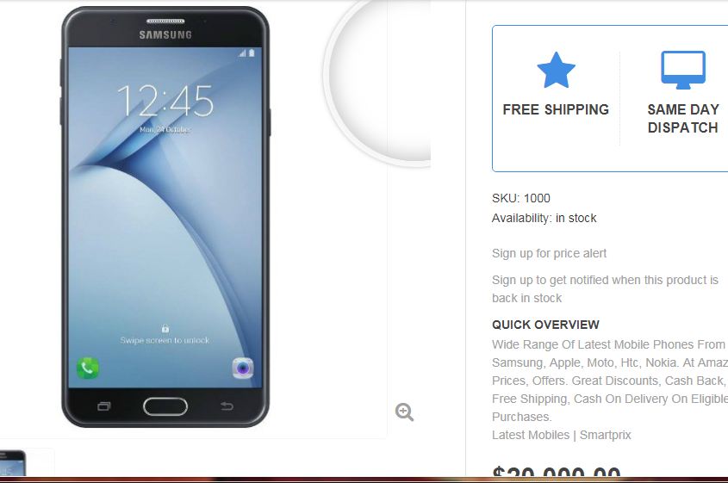
product display

Slide 44
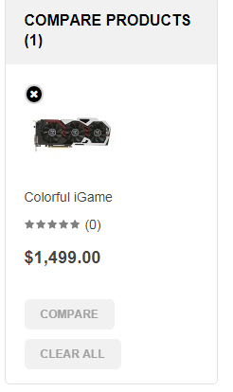
compare

Slide 45
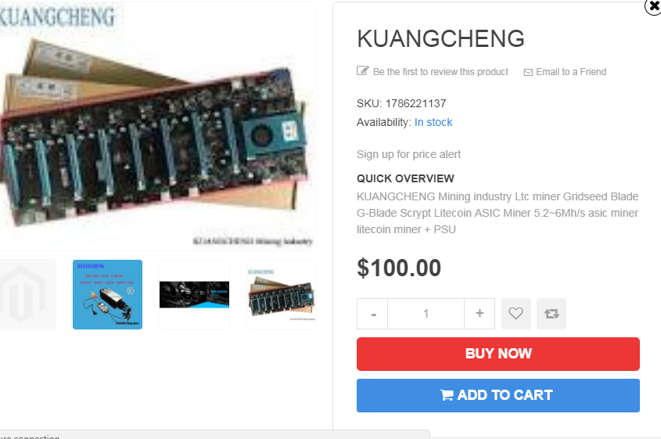
payment

Slide 46
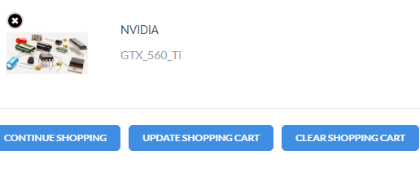
payment

Slide 47
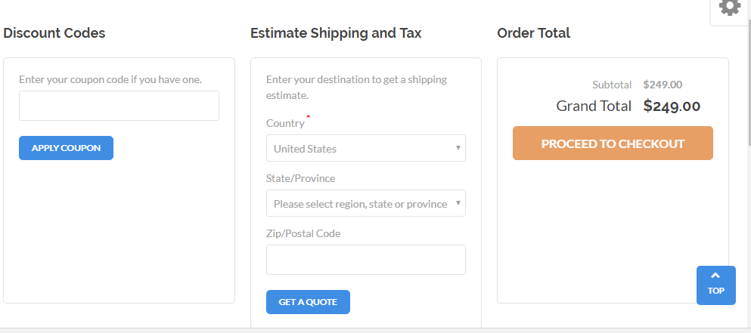
payment

Slide 48
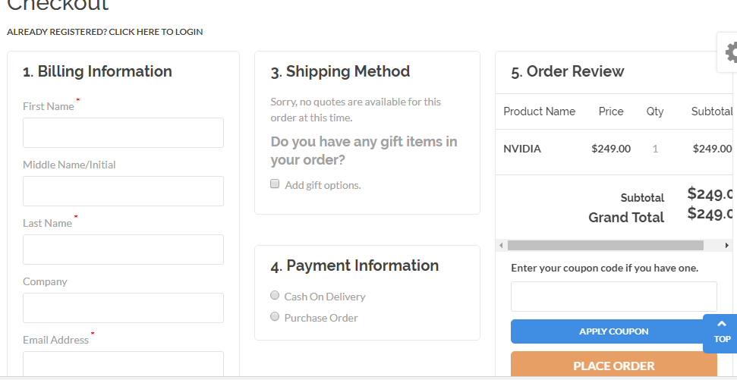
payment

Slide 49
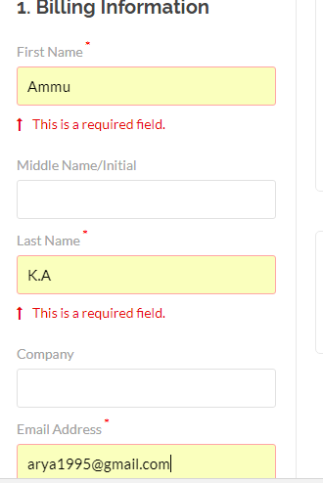
billing

Slide 50
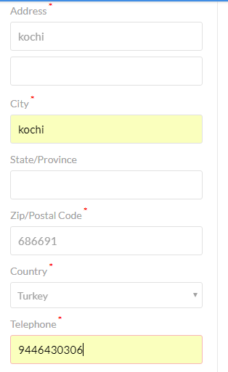
payment

Slide 51
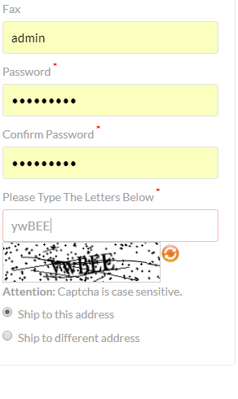
payment

Slide 52
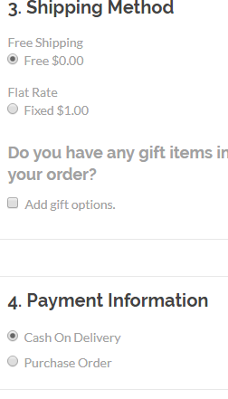
shipping

Slide 53
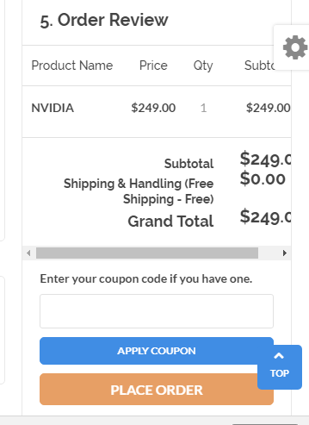
order review

Slide 54
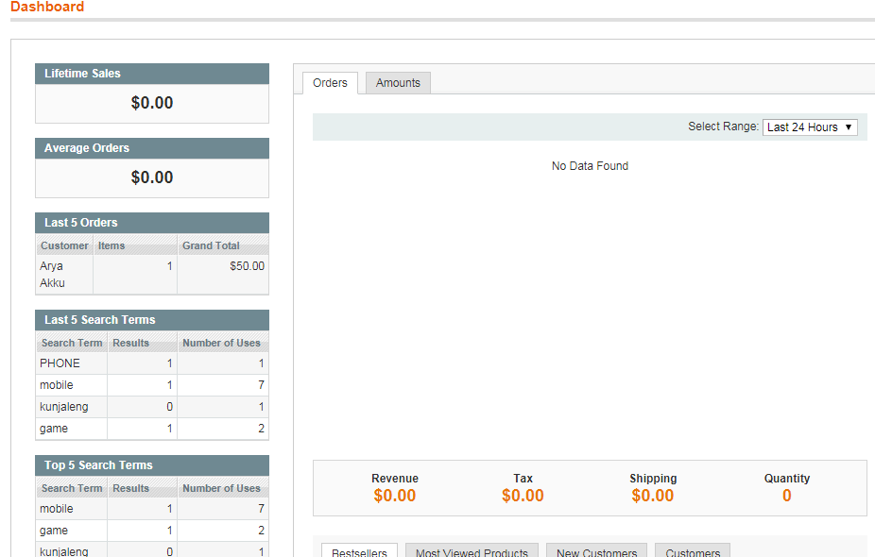
dash board

Slide 55
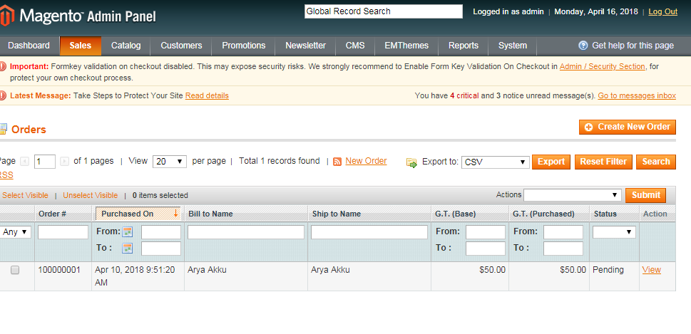
order details

Slide 56
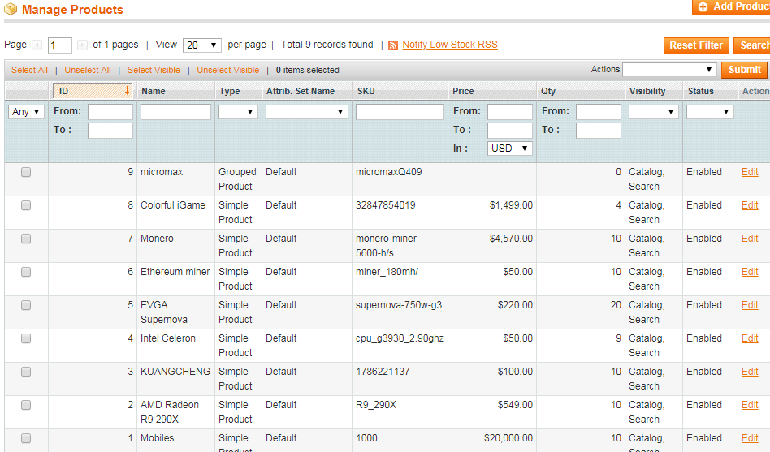
products

Slide 57
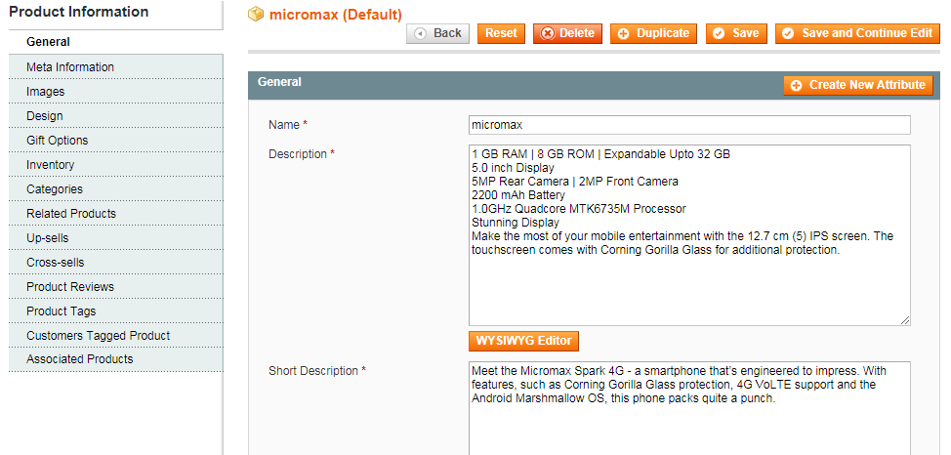
Add product

Slide 58
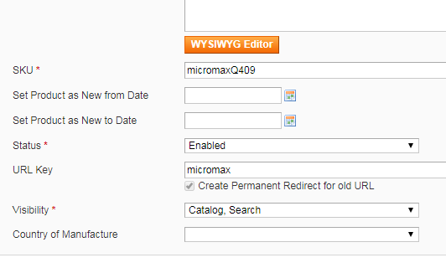
product

Slide 59
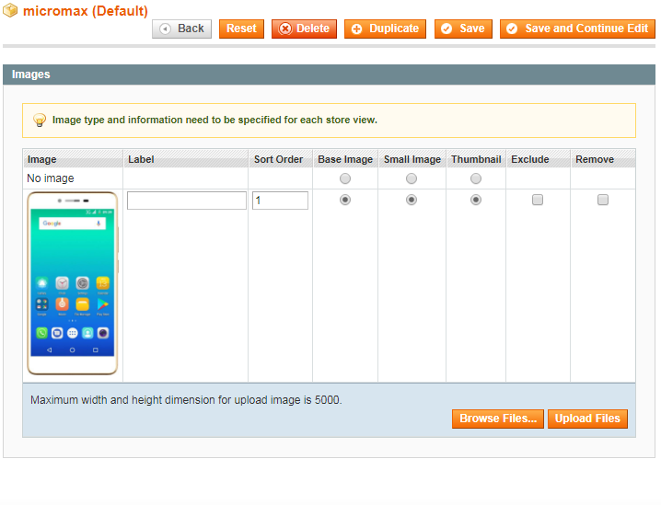
product images

Slide 60
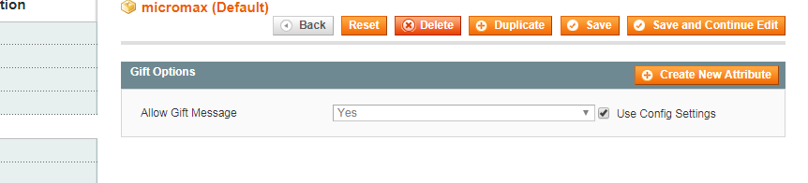
Gift

Slide 61
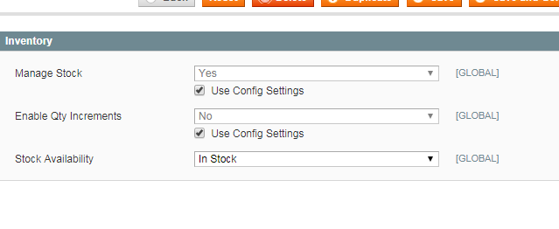
stock

Slide 62
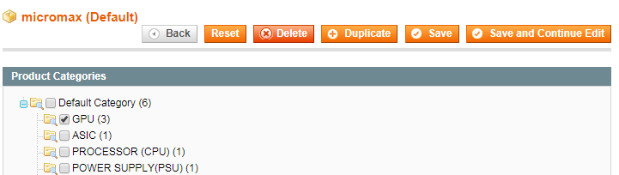
category

Slide 63
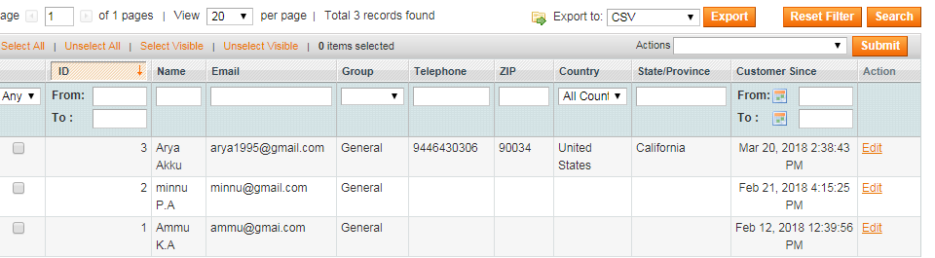
customer information

Slide 64
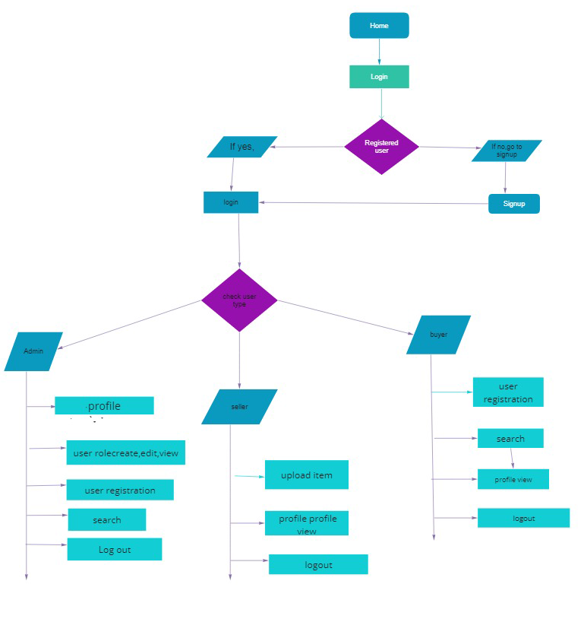
Flow chart

Slide 65
Future enhancement
Customers can use electronic payment
This site act as intermediate between buyer and seller

Slide 66
conclusion
Customers can buying or selling online. Electronic commerce draws on technologies such as electronic fund transfer, supply chain management, Internet marketing, online transaction processing, electronic data inter change(EDI),inventory management system, and automated data collection systems. E-commerce brings convenience for customers as they do not have to leave home and only need to browse website online, especially for buying the products which are not sold in near by shops. It could help customers buy wider range of products and save customer’s time. consumers are able to research products and compare prices among retailers.

Slide 67
Thank you

