Slide 1
jQuery
SYAI&DS-A

Slide 2
Introduction to jQuery
jQuery is a lightweight, "write less, do more", JavaScript library.
jQuery is an open-source JavaScript library that simplifies the interactions between an HTML/CSS document
jQuery is a fast, small, and feature-rich JavaScript library.
The purpose of jQuery is to make it much easier to use JavaScript on your website.
jQuery is cross-platform.

Slide 3
jQuery Features
Event handling: Simplify event handling such as click, hover, submit, etc.
Animations: Create smooth animations and effects.
jQuery is simple and has powerful features
It helps us to manipulate DOM (Document Object Model) elements
Provides event methods to trigger and respond to an events on a html page such as mouse click, keypress etc

Slide 4
Advantages of jQuery
Wide range of plug-ins that allows developers to create plug-ins on top of the JavaScript library.
Large development community.
It is a lot easier to use compared to standard javascript and other javascript libraries.
It lets users develop Ajax templates with ease. Ajax enables a sleeker interface where actions can be performed on pages without requiring the entire page to be reloaded.
Being Light weight and a powerful chaining capabilities makes it more strong.

Slide 5
Adding jQuery to Your Web Pages
There are several ways to start using jQuery on your web site.
Use the Google-hosted/ Microsoft-hosted content delivery network (CDN) to include a version of jQuery.
Download own version of jQuery from jQuery.com and host it on own server or local filesystem.

Slide 6
jQuery Syntax
The jQuery syntax is tailor-made for selecting HTML elements and performing some action on the element(s).
$(selector).action()
$ sign: It grants access to jQuery.
(selector): It is used to find HTML elements.
jQuery action(): It is used to perform actions on the elements.

Slide 7
Examples
$(this).hide() - hides the current element.
$("p").hide() - hides all <p> elements.
$(".test").hide() - hides all elements with class="test".
$("#test").hide() - hides the element with id="test

Slide 8
Document Ready Event:
$(document).ready(function(){
$(selector).action() // jQuery methods go here...
});
All jQuery methods should be inside a document ready event to prevent any jQuery code from running before the document is finished loading
The factory function $() is a synonym of jQuery() function.

Slide 9
Document Ready Event:
if methods are run before the document is fully loaded then following actions that can fail
Trying to hide an element that is not created yet
Trying to get the size of an image that is not loaded yet

Slide 10
jQuery Selectors
jQuery selectors allow you to select and manipulate HTML element(s).
HTML element Name
Element ID
Element Class
Element attribute name
Element attribute value
Many more criteria
jQuery selectors are used to "find" (or select) HTML elements based on their name, id, classes, types, attributes, values of attributes and much more.
It's based on the existing CSS Selectors, and in addition, it has some own custom selectors.
All selectors in jQuery start with the dollar sign and parentheses: $()

Slide 11
jQuery Selectors Syntax
$(document).ready(function(){
$(selector)
});

Slide 12
The element Selector
The jQuery element selector selects elements based on the element name.
You can select all <p> elements on a page like this:
$(document).ready(function(){
$("Html Element Name")
});

Slide 13
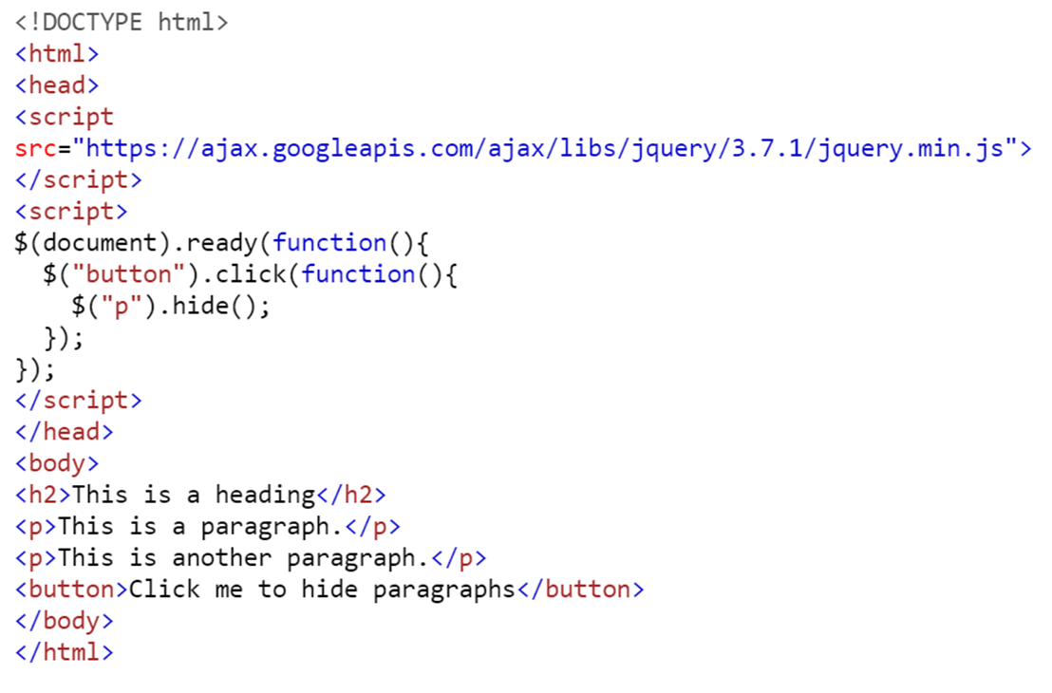

Slide 14
The #id Selector
The jQuery #id selector uses the id attribute of an HTML tag to find the specific element.
An id should be unique within a page, so you should use the #id selector when you want to find a single, unique element.
$(document).ready(function(){
$("#id of the element")
});

Slide 15
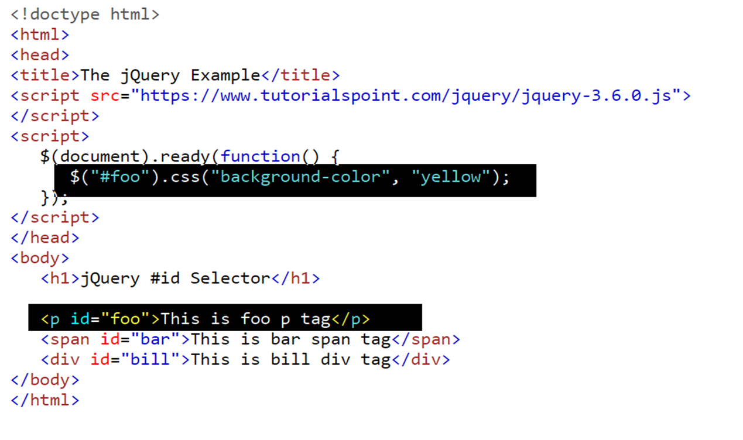

Slide 16
The #class Selector
The jQuery .class selector selects HTML element(s) based on the element class attribute.
$(document).ready(function(){
$(".class of the element")
});

Slide 17
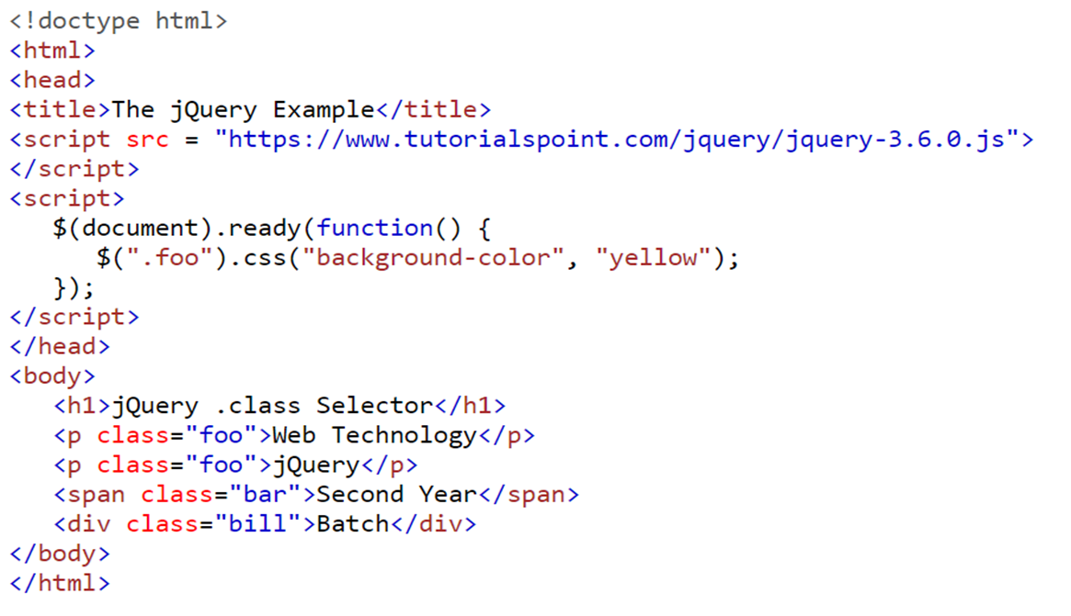

Slide 18
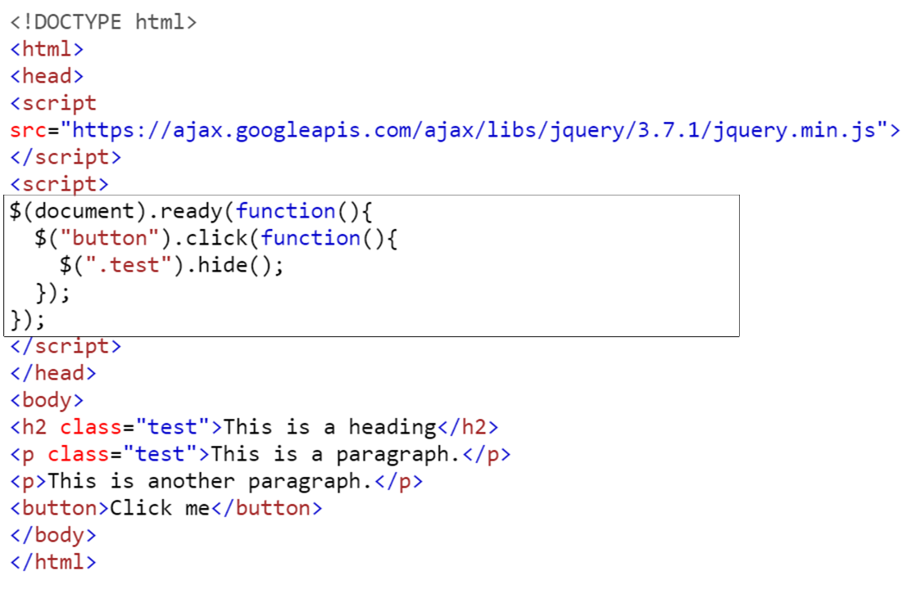

Slide 19
jQuery Event Methods
jQuery events are the actions that can be detected by your web application. They are used to create dynamic web pages. An event shows the exact moment when something happens.
Examples of events.
A mouse click
An HTML form submission
A web page loading
A keystroke on the keyboard
Scrolling of the web page etc.

Slide 20
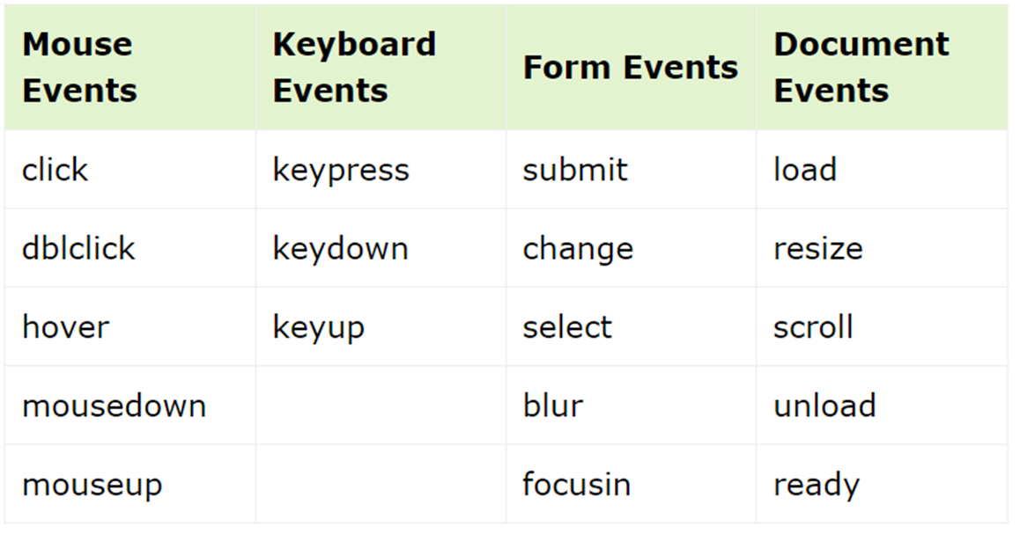

Slide 21
Syntax
$("div").click(function(){
// jQuery code goes here
});
$("div").bind('click', function(){
// jQuery code goes here
});

Slide 22
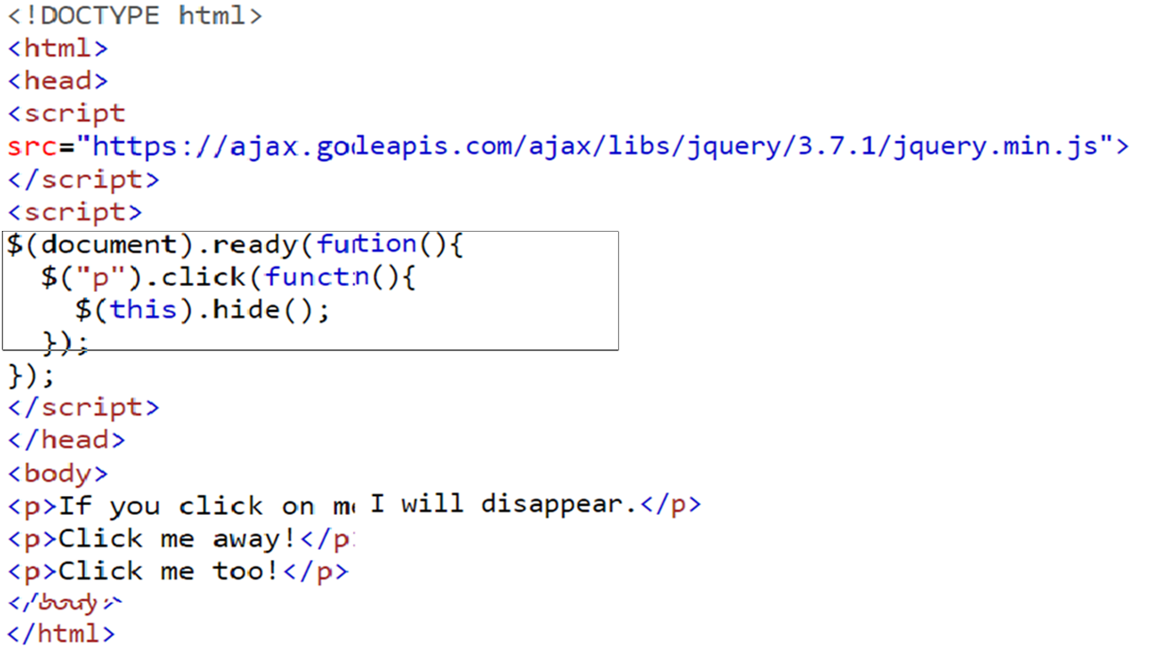

Slide 23
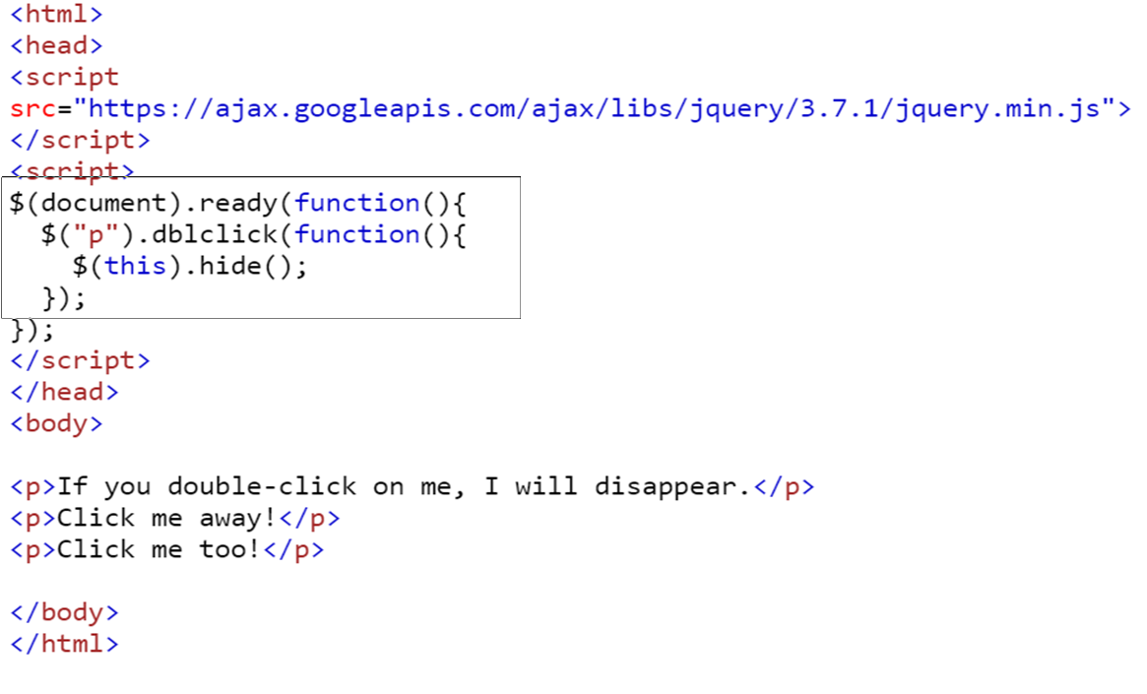

Slide 24
How can we change styles when certain events got triggered with the help of JQuery.
We can apply styles on elements by using either the
JQuery CSS Classes or the
JQuery .css() method.

Slide 25
Approach 1: Using JQuery CSS Classes..
This approaches consists of using methods such as the addClass() method, removeClass() method and the toggleClass() method
We can create some classes with some css rules and add or remove them using JQuery as per the requirement.

Slide 26
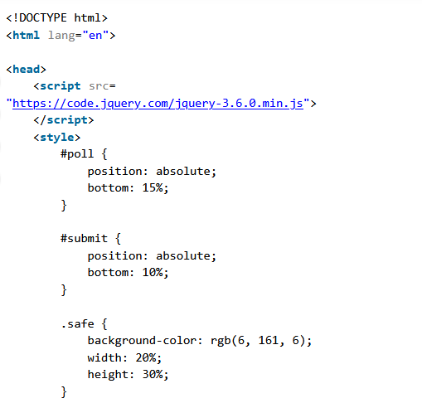
Example

Slide 27
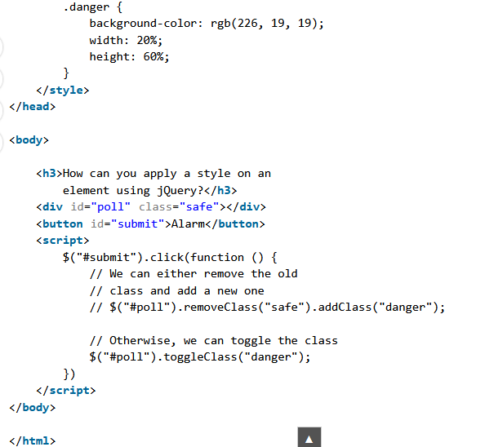

Slide 28
Approach 2: Using the JQuery css() method:
In this method, instead of creating separate classes inside the stylesheet, you can directly set styles from javascript itself.
The css() method can be used to either return a single property based on the given property or set a single or multiple CSS properties.

Slide 29
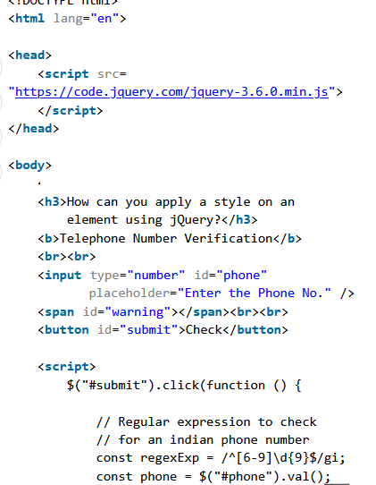

Slide 30
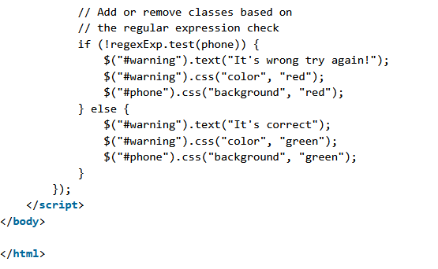

Slide 31
How to create an HTML element using jQuery ?
To create and append the HTML element, we use the jQuery append() method.
The jQuery append() method is used to insert some content at the end of the selected elements.
Syntax:
$(selector).append( content, function(index, html) )
Parameters:
content: It is a required parameter and is used to specify the content which is to be inserted at the end of selected elements. The possible value of contents is HTML elements, jQuery objects, and DOM elements.
function(index, html): It is an optional parameter and is used to specify the function that will return the content to be inserted.
index: It is used to return the index position of the element.
html: It is used to return the current HTML of the selected element.

Slide 32
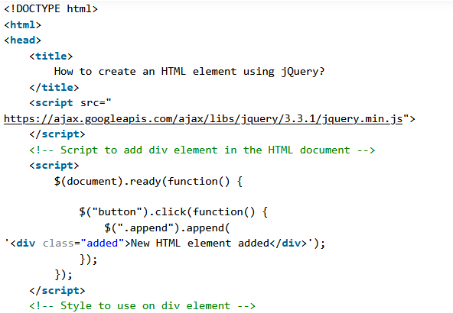

Slide 33
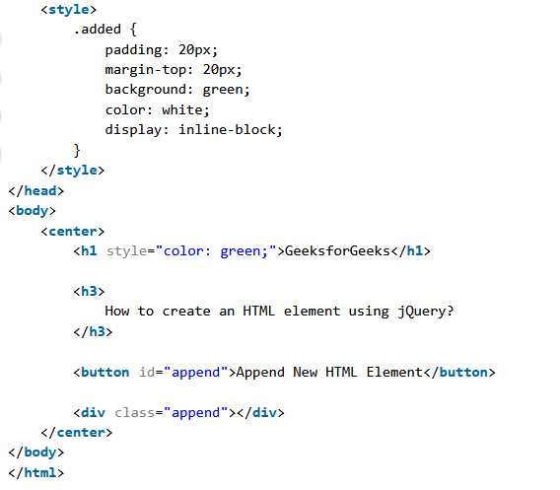

Slide 34
jQuery - Remove Elements
Remove Elements/Content
To remove elements and content, there are mainly two jQuery methods:
remove() - Removes the selected element (and its child elements)
empty() - Removes the child elements from the selected element

Slide 35
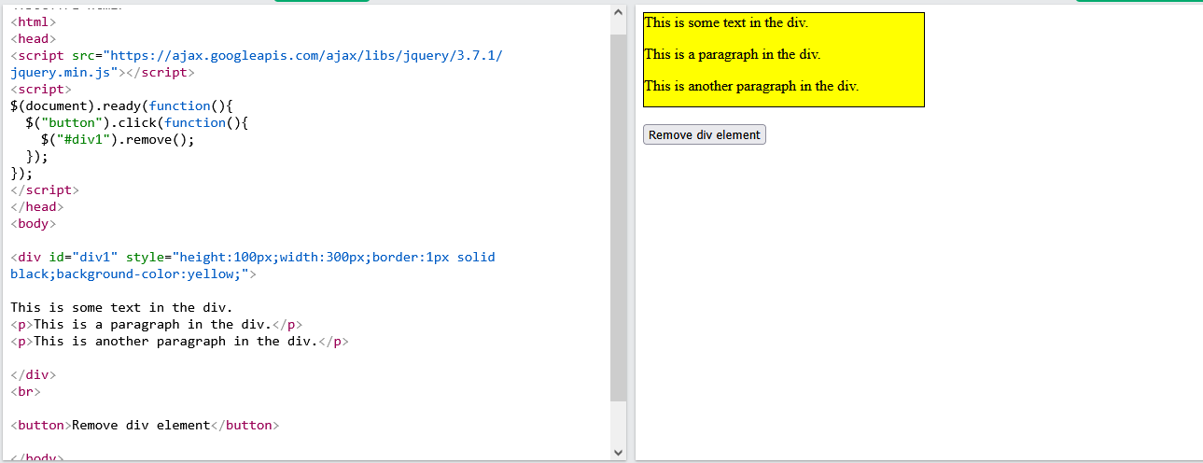

Slide 36
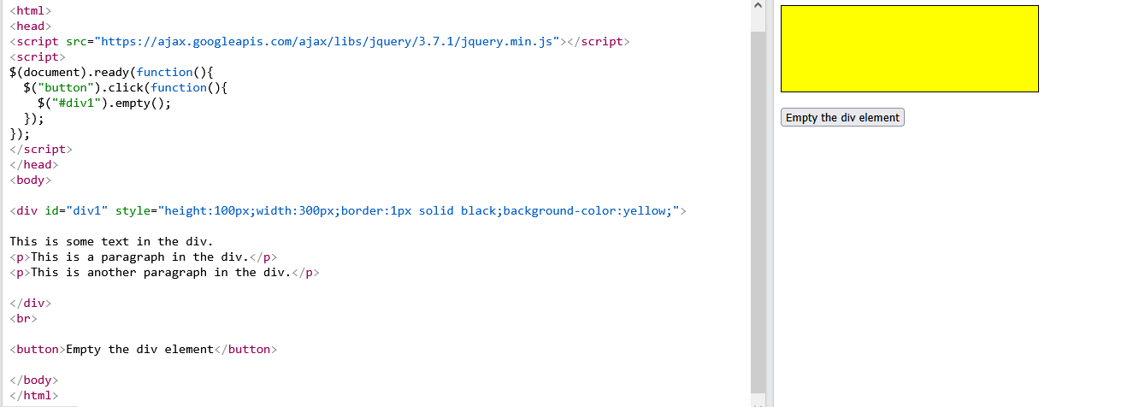
jQuery empty() Method

Slide 37
Filter the Elements to be Removed
The jQuery remove() method also accepts parameter, which allows you to filter the elements to be removed.
The parameter can be any of the jQuery selector syntaxes.

Slide 38
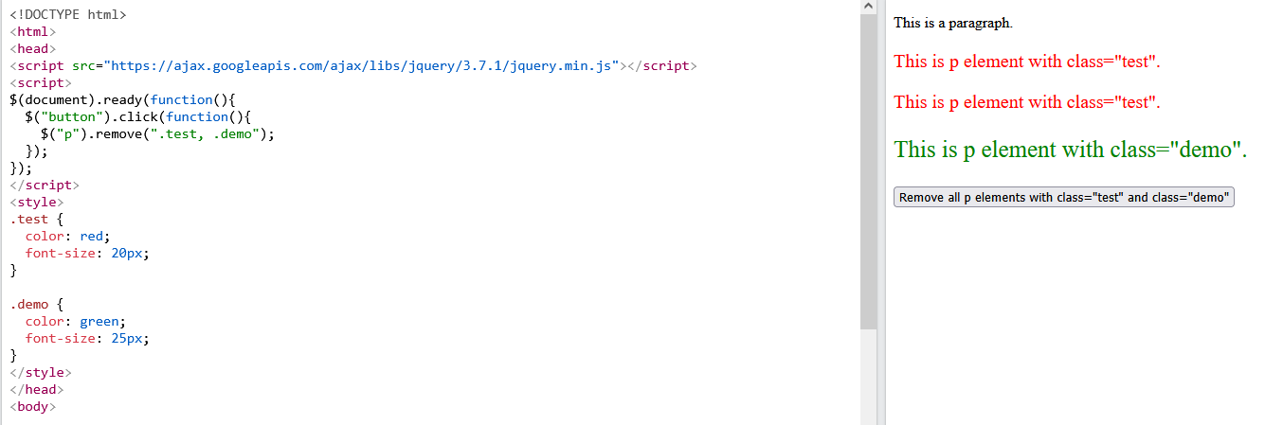

Slide 39
