Slide 1
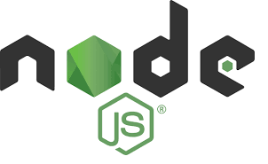
NodeJS

Slide 2
Importance
Node.js is an opensource and crossplatform JavaScript runtime environment.
A Node.js app runs in a single process, without creating a new thread for every request. Node.js provides a set of asynchronous I/O primitives in its standard library that prevent JavaScript code from blocking.
Libraries in Node.js are written using nonblocking paradigms, making blocking behaviour the exception rather than the norm.
When Node.js performs an I/O operation, like reading from the network, accessing a database or the filesystem, instead of blocking the thread and wasting CPU cycles waiting, Node.js will resume the operations when the response comes back.

Slide 3
Synchronous Code

Slide 4
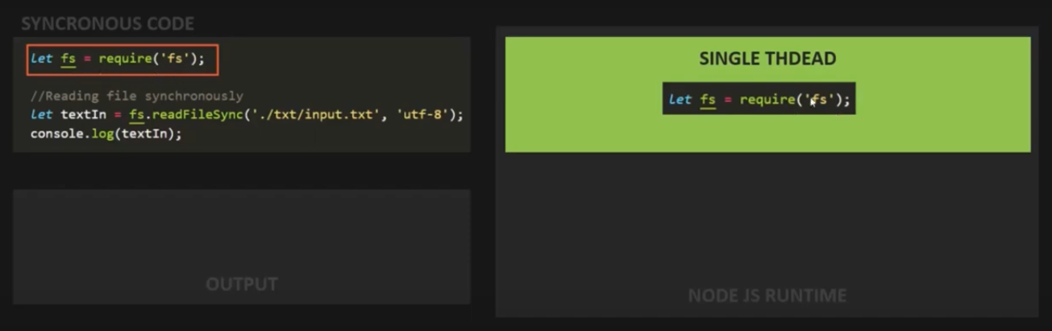

Slide 5
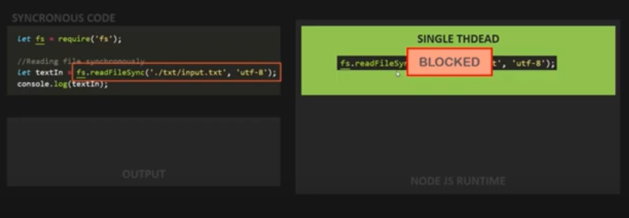

Slide 6
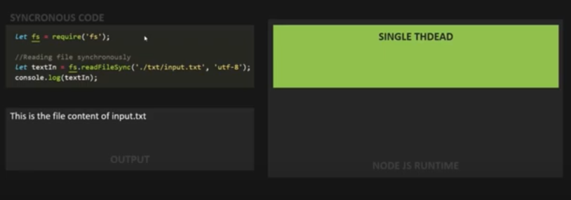

Slide 7
ASynchronous Code

Slide 8
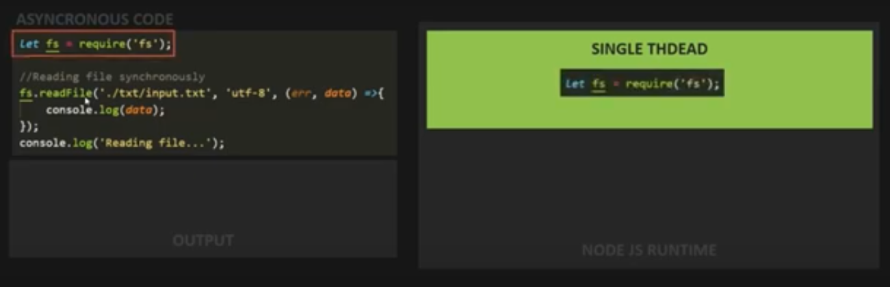

Slide 9
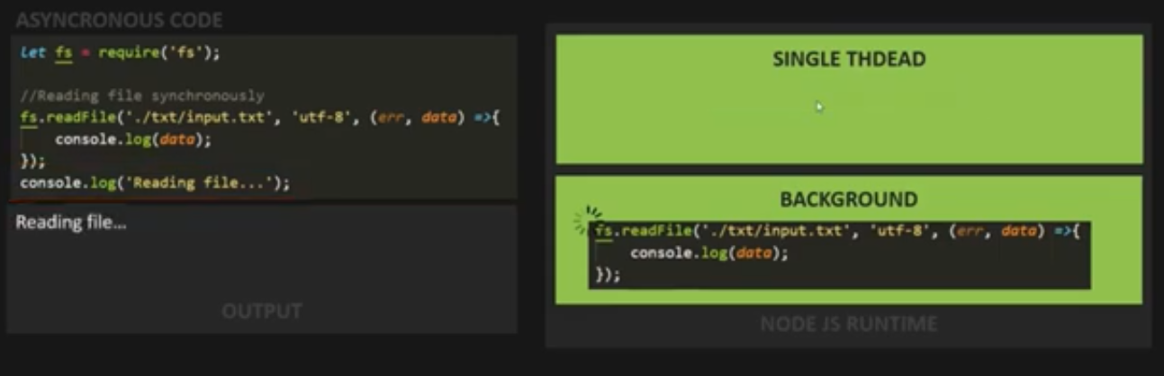

Slide 10
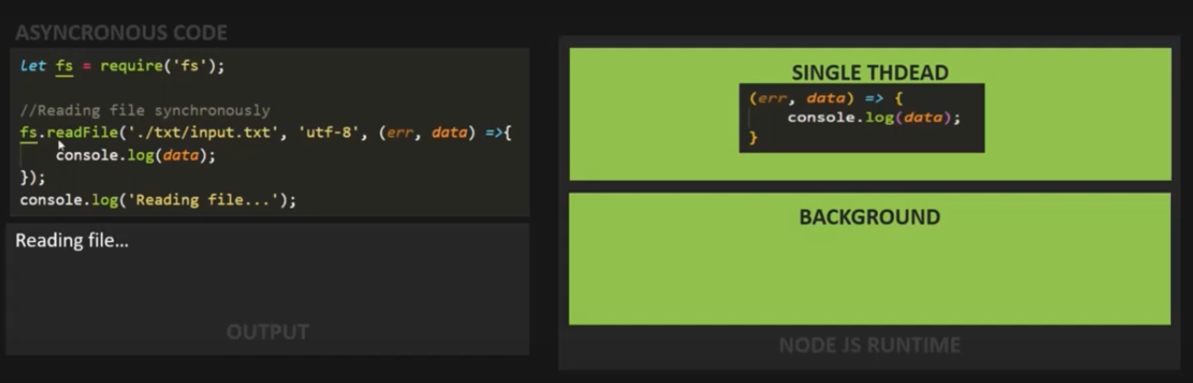

Slide 11
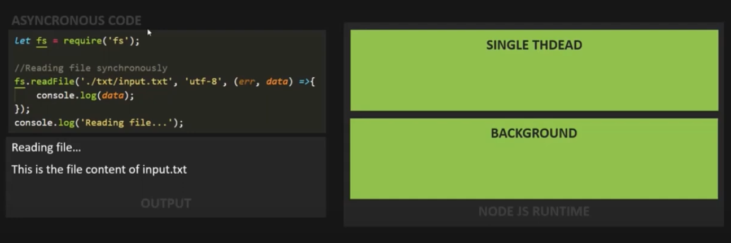

Slide 12
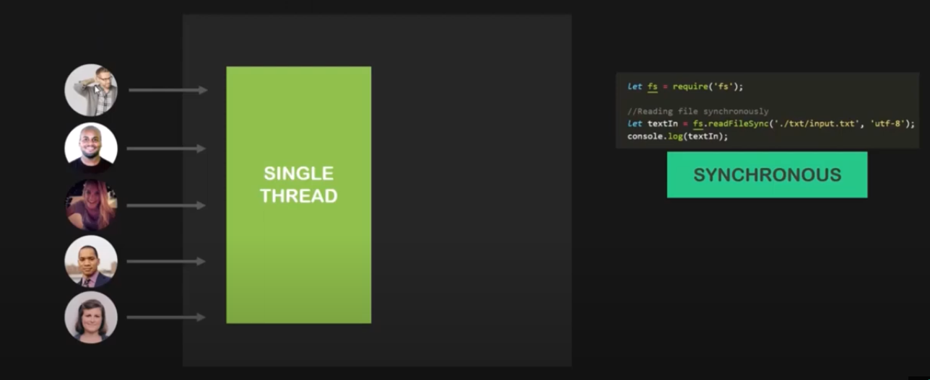
Why Asynchronous?

Slide 13
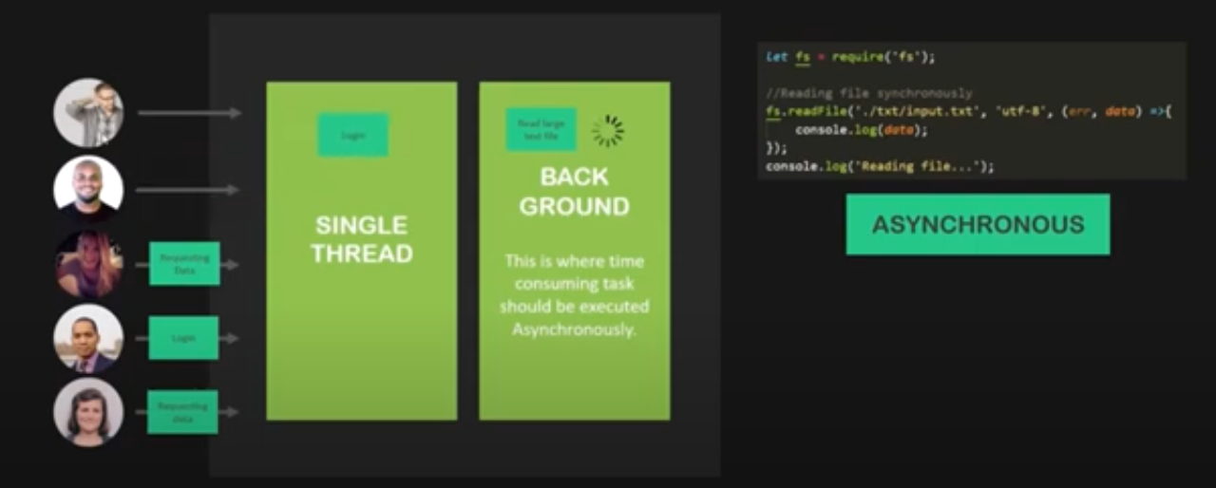
Why Asynchronous?

Slide 14
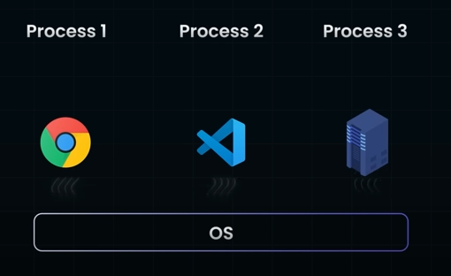
What is a Process?

Slide 15

Single Threaded Problem

Slide 16
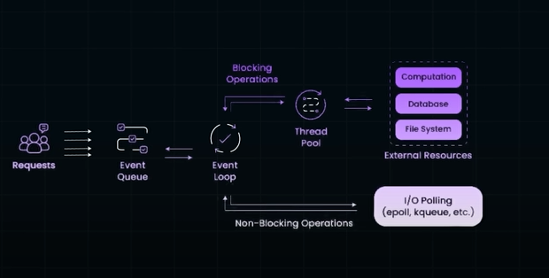
Architecture of Node

Slide 17
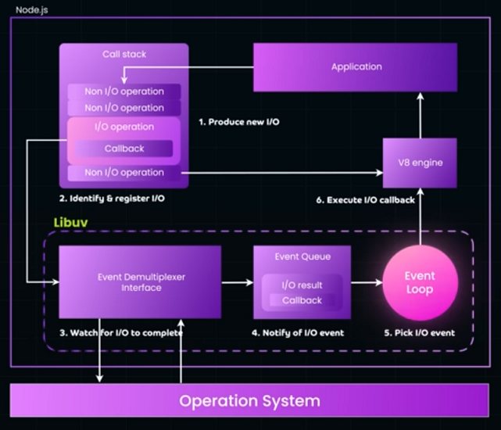

Slide 18
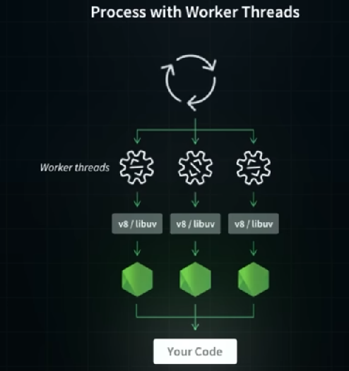
CPU Intensive Task are handled by Worker Thread

Slide 19
Importance
Node.js has a unique advantage because millions of frontend developers that write JavaScript for the browser are now able to write the serverside code in addition to the client side code without the need to learn a completely different language.
In Node.js the new ECMAScript standards can be used without problems, as you don't have to wait for all your users to update their browsers you are in charge of deciding which ECMAScript version to use by changing the Node.js version, and you can also enable specific experimental features by running Node.js with flags.
Node.js is one of the popular choices for developing RESTful APIs, microservices and web applications.

Slide 20
Features of Node.js
Extremely fast: Node.js is built on Google Chrome's V8 JavaScript Engine, so its library is very fast in code execution.
I/O is Asynchronous and Event Driven: All APIs of Node.js library are asynchronous i.e. nonblocking. So a Node.js based server never waits for an API to return data. The server moves to the next API after calling it and a notification mechanism of Events of Node.js helps the server to get a response from the previous API call. It is also a reason that it is very fast.
Single threaded: Node.js follows a single threaded model with event looping.
Highly Scalable: Node.js is highly scalable because event mechanism helps the server to respond in a nonblocking way.
No buffering: Node.js cuts down the overall processing time while uploading audio and video files. Node.js applications never buffer any data. These applications simply output the data in chunks.
Open source: Node.js has an open source community which has produced many excellent modules to add additional capabilities to Node.js applications.
License: Node.js is released under the MIT license.

Slide 21
What Can Node.js Do?
Node.js is a runtime environment that allows you to run JavaScript on the serverside. Here's a breakdown:
Generate dynamic page content: Yes, Node.js can dynamically generate HTML content on the serverside, allowing for dynamic web page generation.
File manipulation: Node.js has builtin modules that allow you to interact with the file system, including creating, opening, reading, writing, deleting, and closing files on the server.
Collect form data: Node.js can handle form submissions from web pages. It can parse form data and process it on the server.
Database operations: Node.js can interact with databases, both SQL and NoSQL. This includes adding, deleting, and modifying data in databases.
These functionalities are often used to create web applications, APIs, and other serverside applications.

Slide 22
Comparing File Handling in PHP/ASP and Node.js
PHP/ASP File Handling:
1. Sends task to file system.
2. Waits for file system to open and read the file.
3. Returns content to client.
4. Ready to handle the next request.
Node.js File Handling:
1. Sends task to file system.
2. Ready to handle the next request.
3. When file system completes operation, returns content to client.
Node.js Advantages:
Eliminates waiting, continues with next request.
Singlethreaded, nonblocking, asynchronous.
Memory efficient.

Slide 23
First Program in Node js to create server

Slide 24
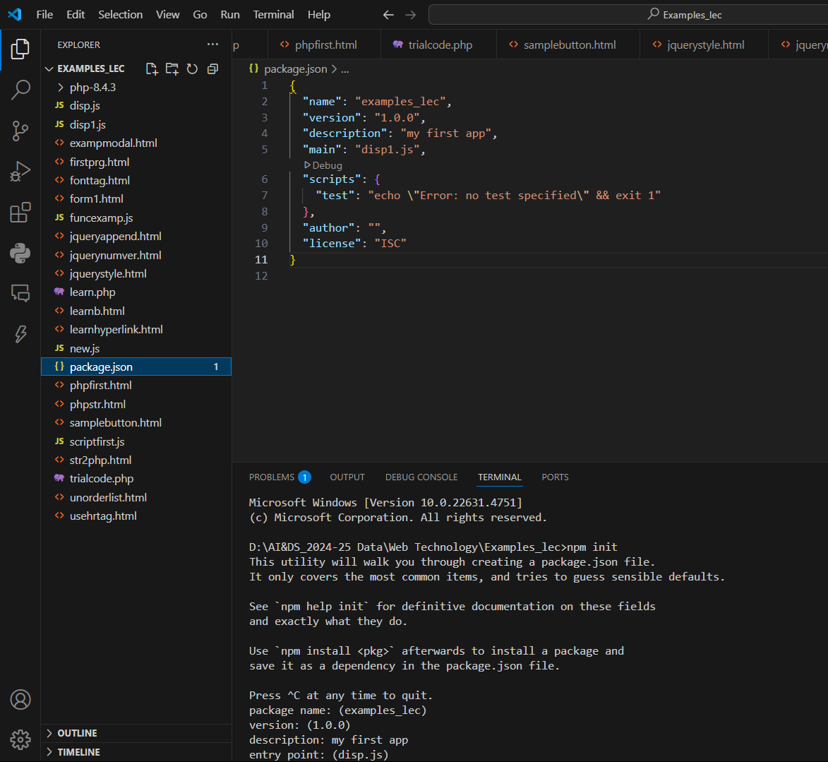

Slide 25
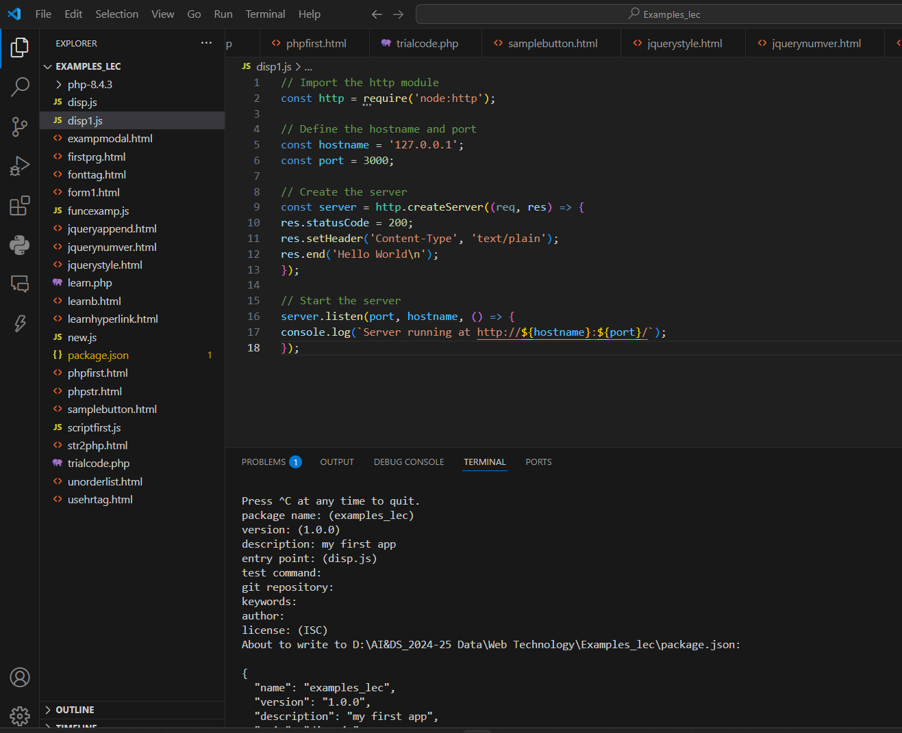

Slide 26
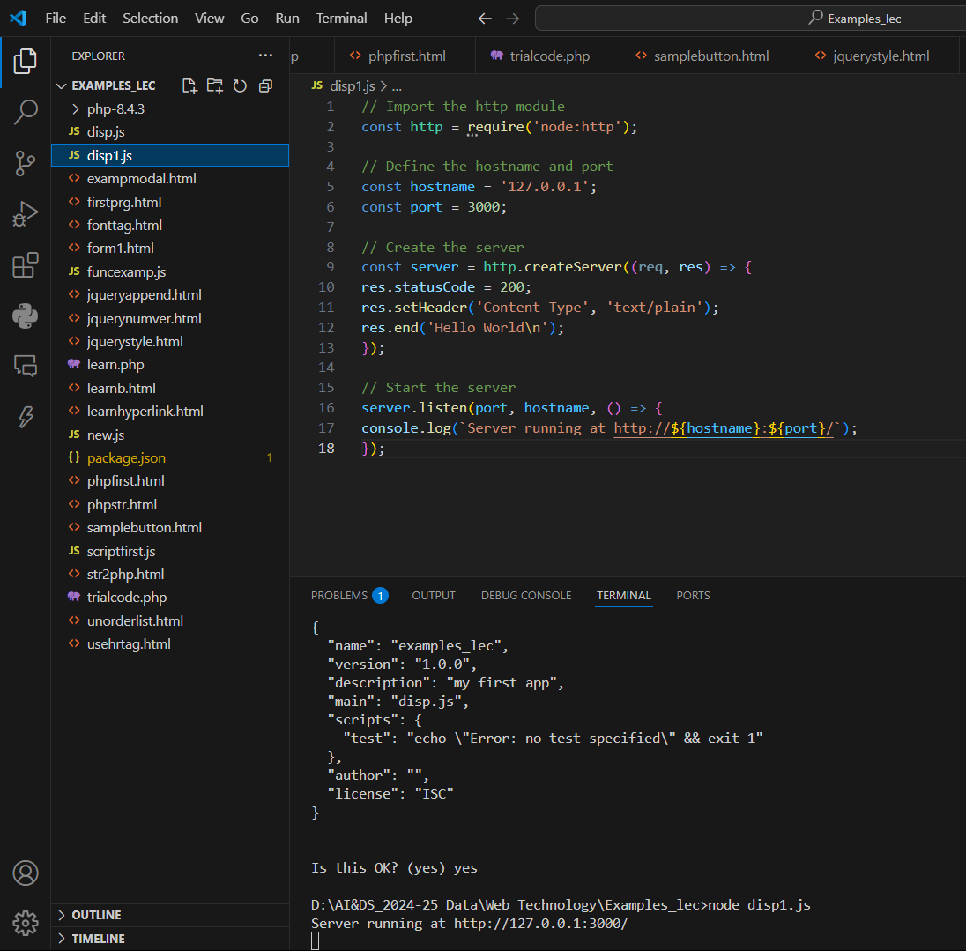

Slide 27


Slide 28
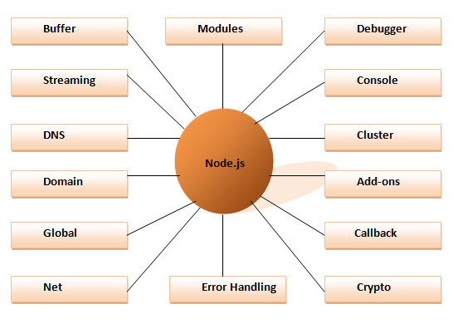
Different parts of Node.js

Slide 29
How to install NodeJS

Slide 30
Creating a Consolebased Node Application
Step 1: Set Up Your Environment
Install Node.js: Download and install Node.js from [nodejs.org](https://nodejs.org/).
Verify Installation: Open your terminal or command prompt and run `node v` to check if Node.js is installed.
Step 2: Initialize Your Node Project
Create a New Directory: Create a new directory for your project using `mkdir mynodeapp`.
Navigate to the Directory: Move into your project directory using `cd mynodeapp`.
Initialize Node Project: Run `npm init y` to initialize a new Node.js project with default settings.
Step 3: Write Your Node.js Script
Create a JavaScript File: Create a new JavaScript file, e.g., `app.js`, in your project directory.
Write Your Code: Write your Node.js script in `app.js`, including any consolebased functionality you want to implement.

Slide 31
Creating a Consolebased Node Application
Step 4: Run Your Node Application
Execute Your Script: In the terminal, run `node app.js` to execute your Node.js application.
Check Output: Check the terminal for any console.log statements or output generated by your script.
Step 5: Iterate and Improve
Test and Debug: Test your application thoroughly and debug any errors or issues.
Refine Your Code: Refactor and improve your code as needed, adding new features or functionality.
Step 6: Share Your Application
Version Control: Consider using Git for version control to track changes to your codebase.
Share Your Project: Share your Node.js project with others on platforms like GitHub for collaboration or feedback.

Slide 32
Creating a Web-based Node Application
Step 1: Set Up Your Environment
Install Node.js: Download and install Node.js from [nodejs.org](https://nodejs.org/).
Verify Installation: Open your terminal or command prompt and run `node v` to check if Node.js is installed.
Step 2: Initialize Your Node Project
Create a New Directory: Create a new directory for your project using `mkdir mynodeapp`.
Navigate to the Directory: Move into your project directory using `cd mynodeapp`.
Initialize Node Project: Run `npm init y` to initialize a new Node.js project with default settings.
Step 3: Install Express.js
Install Express.js: Use npm to install Express.js by running `npm install express`.Express.js: A web application framework for Node.js, simplifying the process of building web apps and APIs.

Slide 33
Creating a Web-based Node Application
Step 4: Write Your Node.js Script
Create a JavaScript File: Create a new JavaScript file, e.g., `app.js`, in your project directory.
Write Your Code: Write your Node.js script in `app.js`, including setting up routes, handling requests, and defining responses.
Step 5: Create Your HTML Views
Create Views Directory: Create a directory named `views` to store your HTML files.
Write HTML Files: Create HTML files for different views/pages of your web application, such as `index.html`, `about.html`, etc.
Step 6: Serve Static Files
Serve Static Files: Use Express.js to serve static files (e.g., CSS, images) by using the `express.static` middleware.
Organize Your Files: Place static files (e.g., CSS, images) in a directory named `public` for better organization.

Slide 34
Creating a Web-based Node Application
Step 7: Run Your Node Application
Execute Your Script: In the terminal, run `node app.js` to start your Node.js application.
Access Your Web App: Open your web browser and navigate to `http://localhost:3000` (or another port if specified) to view your web application.
Step 8: Iterate and Improve
Test and Debug: Test your application thoroughly and debug any errors or issues.
Refine Your Code: Refactor and improve your code as needed, adding new features or functionality.
Step 9: Deployment
Choose a Hosting Provider: Select a hosting provider (e.g., Heroku, AWS, DigitalOcean) to deploy your Node.js application.
Deploy Your App: Follow the hosting provider's instructions to deploy your web-based Node.js application.

Slide 35
Modules in Node.js
1. What is a Module?
A reusable piece of JavaScript code that encapsulates specific functionality.
Helps organize code into logical units, making it easier to manage and maintain large applications.
2. Encapsulation and Modularity
Each module in Node.js encapsulates its own variables, functions, and classes, keeping them private by default.
Node.js follows the CommonJS module system, treating each file as a separate module.
3. Exporting Functionality
Modules can export functionalities using `module.exports` or `exports`.
Exported functionalities are made accessible to other modules through `require()`.

Slide 36
Modules in Node.js
4. Importing Modules
Modules are imported into other modules using the `require()` function.
When a module is required, its code is executed, and its exports are returned for use.
5. Types of Modules
Built-in Modules: Provided by Node.js, e.g., `fs`, `http`, `path`.
User-defined Modules: Created by developers to encapsulate specific functionalities.
6. Benefits of Modules
Facilitate code organization and modularity.
Promote code reuse and maintainability.
Essential for building scalable and maintainable applications in Node.js.

Slide 37
Node.js HTTP Module
1. Introduction to HTTP Module
Node.js includes a built-in HTTP module that allows you to create HTTP servers and make HTTP requests.
Provides a set of functions and classes for handling HTTP-related tasks.
2. Creating an HTTP Server
Use the `http.createServer()` method to create an HTTP server instance.
Define request/response handlers using callbacks or event listeners.
3. Handling HTTP Requests
Access request details such as URL, method, headers, and body.
Process incoming requests and generate appropriate responses.

Slide 38
Node.js HTTP Module
4. Sending HTTP Responses
Use the `response.writeHead()` method to set the status code and headers of the response.
Write the response body using the `response.write()` method.
End the response with `response.end()`.
Example:
const http = require('http');
const server = http.createServer((req, res) => {
res.writeHead(200, { 'Content-Type': 'text/plain' });
res.end(‘Viomesh Sir:NodeJS Class');
});
server.listen(3000, () => {
console.log('Server running on port 3000');
});

Slide 39
Node.js HTTP Module
5. Additional Functionality
Supports HTTPS for secure communication.
Can be extended with middleware frameworks like Express.js for more advanced routing and request handling.
6. Benefits of HTTP Module
Lightweight and efficient for building simple HTTP servers.
Ideal for handling basic web applications, APIs, and microservices.

Slide 40
Node.js File System Module
1.Introduction to File System Module
Node.js includes a built-in File System module (`fs`) for interacting with the file system on your computer.
2.Key Functions
Reading Files: Use `fs.readFile()` or `fs.readFileSync()` to read the contents of a file asynchronously or synchronously, respectively.
Writing Files: Use `fs.writeFile()` or `fs.writeFileSync()` to write data to a file asynchronously or synchronously, respectively.
Working with Directories: Functions like `fs.readdir()` and `fs.mkdir()` allow you to work with directories, listing contents or creating new ones.

Slide 41
Node.js File System Module
3.Asynchronous vs. Synchronous Methods
Asynchronous methods are non-blocking and return immediately, allowing your code to continue executing.
Synchronous methods block the execution of code until the operation is completed, potentially leading to performance issues in I/O-heavy applications.

Slide 42
Read File
The fs.readFile() method is used to read files on your computer.
Assume we have the following HTML file (located in the same folder as Node.js):
<html>
<body>
<h1>My Header</h1>
<p>My paragraph.</p>
</body>
</html>
Node.js file that reads the HTML file, and return the content
var http = require('http'); var fs = require('fs'); http.createServer(function (req, res) { fs.readFile('demofile1.html', function(err, data) { res.writeHead(200, {'Content-Type': 'text/html'}); res.write(data); return res.end(); }); }).listen(8080);
Save the code above in a file called "demo_readfile.js", and initiate the file:
C:\Users\Your Name>node demo_readfile.js

Slide 43
Create File
The File System module has methods for creating new files:
fs.appendFile()
fs.open()
fs.writeFile()

Slide 44
The fs.appendFile() method appends specified content to a file. If the file does not exist, the file will be created:
Example
var fs = require('fs'); fs.appendFile('mynewfile1.txt', 'Hello content!', function (err) { if (err) throw err; console.log('Saved!'); });

Slide 45
The fs.open() method takes a "flag" as the second argument, if the flag is "w" for "writing", the specified file is opened for writing. If the file does not exist, an empty file is created:
Create a new, empty file using the open() method:Example
var fs = require('fs'); fs.open('mynewfile2.txt', 'w', function (err, file) { if (err) throw err; console.log('Saved!'); });

Slide 46
The fs.writeFile() method replaces the specified file and content if it exists. If the file does not exist, a new file, containing the specified content, will be created:
Create a new file using the writeFile() method:
var fs = require('fs'); fs.open('mynewfile2.txt', 'w', function (err, file) { if (err) throw err; console.log('Saved!'); });

Slide 47
Self Study
File System Module
Update Files
Delete Files
Rename Files
Upload Files
NodeJS NPM Package

Slide 48
Node.js with MySQL

Slide 49
Advantages of Using Node.js with MySQL
Using Node.js with MySQL offers several advantages for building web applications:
1.JavaScript Everywhere: With Node.js, you can use JavaScript on both the client and server sides of your application. This allows for consistency in development and easier code sharing between different parts of your application.
2.Asynchronous I/O: Node.js is known for its non-blocking, asynchronous I/O model, which allows it to handle multiple concurrent operations efficiently. This aligns well with MySQL's I/O-bound nature, making Node.js a good choice for interacting with MySQL databases.
3.Performance: Node.js's event-driven architecture and asynchronous nature make it well-suited for I/O-heavy tasks like database operations. It can handle a large number of concurrent database queries without blocking, leading to improved performance and responsiveness in web applications.

Slide 50
Advantages of Using Node.js with MySQL
4.Scalability: Both Node.js and MySQL are known for their scalability. Node.js can handle a large number of concurrent connections efficiently, and MySQL can scale horizontally by adding more servers to distribute the load. Together, they form a scalable stack for building high-performance web applications.
5.Community and Ecosystem: Both Node.js and MySQL have large and active communities, with extensive libraries, frameworks, and tools available to streamline development. This rich ecosystem provides developers with the resources they need to build robust and feature-rich web applications.
6.Ease of Development: Node.js's simple and lightweight runtime, combined with its rich ecosystem of modules, makes it easy to develop and maintain web applications. Integrating Node.js with MySQL allows developers to build data-driven applications quickly and efficiently.
Overall, using Node.js with MySQL provides a powerful and efficient stack for building modern web applications, combining the flexibility and scalability of Node.js with the reliability and performance of MySQL databases.

Slide 51
Advantages of Using Node.js with MySQL
4.Scalability: Both Node.js and MySQL are known for their scalability. Node.js can handle a large number of concurrent connections efficiently, and MySQL can scale horizontally by adding more servers to distribute the load. Together, they form a scalable stack for building high-performance web applications.
5.Community and Ecosystem: Both Node.js and MySQL have large and active communities, with extensive libraries, frameworks, and tools available to streamline development. This rich ecosystem provides developers with the resources they need to build robust and feature-rich web applications.
6.Ease of Development: Node.js's simple and lightweight runtime, combined with its rich ecosystem of modules, makes it easy to develop and maintain web applications. Integrating Node.js with MySQL allows developers to build data-driven applications quickly and efficiently.
Overall, using Node.js with MySQL provides a powerful and efficient stack for building modern web applications, combining the flexibility and scalability of Node.js with the reliability and performance of MySQL databases.

Slide 52
Node.js with MySQL
Introduction to MySQL
MySQL is a popular open-source relational database management system (RDBMS) known for its reliability, scalability, and performance.
It's widely used in web development for storing and managing structured data.
Node.js and MySQL
Node.js can be used to interact with MySQL databases, allowing developers to build powerful and data-driven applications.
The `mysql` package is commonly used in Node.js applications for MySQL database connectivity.

Slide 53
Node.js with MySQL
Connecting to MySQL Database
Install Node.js: Download and install Node.js from the official website https://nodejs.org/en/download. This will also install npm (Node Package Manager).
Install MySQL Driver: Use npm to install a driver that lets Node.js communicate with MySQL. A popular option is
npm install mysql

Slide 54
Connecting to MySQL:
Node.js scripts use the installed driver to connect to your MySQL database.
mysql.createConnection().
Example
const mysql = require('mysql');
const connection = mysql.createConnection({
host: 'localhost',
user: 'your_username',
password: 'your_password',
database: 'your_database'
});
connection.connect(function(err) {
if (err) throw err;
console.log("Connected to the database!");
});

Slide 55
Node.js with MySQL
Working with MySQL:
Once connected, you can perform CRUD (Create, Read, Update, Delete) operations on your database. You can write queries to:
Create tables and insert data
Fetch data from tables
Update existing data
Delete data
The mysql driver provides functions like connection.query() to execute SQL statements and handle results.

Slide 56
Node.js with MySQL
Perform SQL queries: Use the connection object to execute SQL queries using methods like `connection.query()`.
Example: Executing SQL Query
connection.query('SELECT * FROM users', (err, rows) => {
if (err) throw err;
console.log('Data received from MySQL:');
console.log(rows);
});

