Slide 1

Computer Networks Unit I- Introduction
Note: Material for this presentations are taken from Internet and books and only being used for student reference

Slide 2
Outline
Introduction of LAN; MAN;WAN; PAN, Ad-hoc Network
Topologies
Network Architectures OSI Model
TCP/IP Model
Design issues for Layers Transmission Mediums Network Devices
Manchester and Differential Manchester Encodings;
IEEE802.11: Frequency Hopping (FHSS) and Direct Sequence (DSSS)

Slide 3
Introduction of Network
Network: A network is defined as a group of two or more computer systems linked together.
Types of Networks:
LAN
MAN
WAN
PAN
Ad-hoc Network

Slide 4
Local Area Networks (LAN)
floor/building-wide
single communication medium
no routing, broadcast
segments connected by switches or hubs
high bandwidth, low latency
Ethernet - 10Mbps, 100Mbps, 1Gbps
no latency guarantees
Notes:
Bandwidth looks at the amount of data being transferred, while latency looks at the amount of time it takes data to transferred. Latency was measured in the mili seconds(ms).
Ethernet-a type of communication protocol that connects computers within what's called a “local area network (LAN)” and a “wide area network (WAN).

Slide 5
LAN- Local Area Network
It is designed for small physical areas such as an office, group of buildings or a factory.
LANs are used widely as it is easy to design and to troubleshoot.
Personal computers and workstations are connected to each other through LANs.
We can use different types of topologies through LAN, these are Star, Ring, Bus,Tree etc.
LAN can be a simple network like connecting two computers, to share files and network among each other while it can also be as complex as interconnecting an entire building.
LAN networks are also widely used to share resources like
printers, shared hard-drive etc.

Slide 6
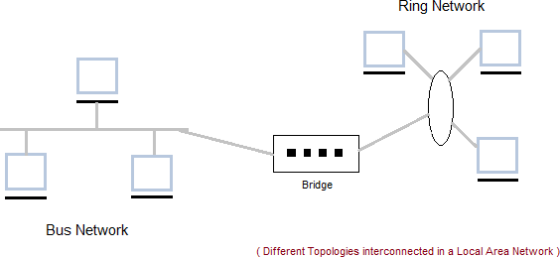
LAN Diagram

Slide 7
LAN Advantages
Cost reductions through sharing of information and databases, resources and network services.
Increased information exchange between different departments in an organization, or between individuals.
The trend to automate communication and manufacturing process.

Slide 8
LAN Disadvantages
Special security measures are needed to stop users from using programs and data that they should not have access to;
Networks are difficult to set up and need to be
maintained by skilled technicians.
If the file server develops a serious fault, all the users are affected, rather than just one user in the case of a stand-alone machine.

Slide 9
Applications
One of the computer in a network can become a server serving all the remaining computers called clients. Software can be stored on the server and it can be used by the remaining clients.
Connecting Locally all the workstations in a building to let them communicate with each other locally without any internet access.
Sharing common resources like printers etc are some common applications of LAN.

Slide 10
MAN- Metropolitan Area Network
It is basically a bigger version of LAN.
It is also called MAN and uses the similar technology as LAN.
It is designed to extend over the entire city.
It can be means to connecting a number of LANs into a larger network or it can be a single cable.
It is mainly hold and operated by single private company or a public company.

Slide 11
MAN- Metropolitan Area Network continued….
Metropolitan Area Networks (MAN)
city-wide, up to 50 km
Digital Subscriber Line (DSL): .25 - 8 Mbps, 5.5km from switch
BellSouth: .8 to 6 Mbps
Cable modem: 1.5 Mbps, longer range than DSL
Bright house w/ Road Runner: .5 to 10Mbps

Slide 12
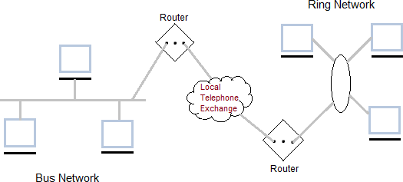
MAN Diagram

Slide 13
MAN-Advantages
It provides a good back bone for a large network and provides greater access to WANs.
The dual bus used in MAN helps the transmission of data in both direction simultaneously.
A Man usually encompasses several blocks of a city or an entire city.

Slide 14
MAN-Disadvantages
More cable required for a MAN connection from one place to another.
It is difficult to make the system secure from hackers and industrial espionage (spying) graphical regions.

Slide 15
MAN Applications
The MAN can be used to provide services including
telecoms,
Internet access,
television and
CCTV to businesses and citizens in these metropolitan areas.

Slide 16
WAN-Wide Area Network
Wide Area Network (WAN)
It is also called WAN.WAN can be private or it can be public leased network.
It is used for the network that covers large distance such as cover states of a country.
It is not easy to design and maintain.
Communication medium used by WAN are PSTN or Satellite links.
WAN operates on low data rates.

Slide 17
WAN-Wide Area Network…continued
Wide Area Networks (WAN)
world-wide
Different organizations
Large distances
routed, latency .1 - .5 seconds

Slide 18
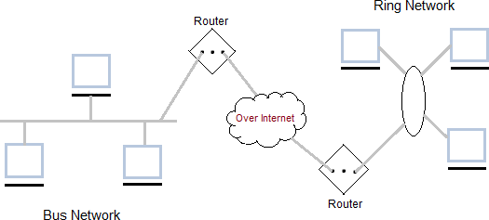
WAN Diagram

Slide 19
WAN Advantages
Covers a large geographical area so long distance businesses can connect on the one network.
Shares software and resources with connecting workstations.
Messages can be sent very quickly to anyone else on the network
Expensive things (such as printers or phone lines to
the internet) can be shared by all the computers on the network without having to buy a different peripheral for each computer.
Everyone on the network can use the same data. This
avoids problems where some users may have older information than others.

Slide 20
WAN Disadvantages
Need a good firewall to restrict outsiders from entering and disrupting the network
Setting up a network can be an expensive, slow and complicated. The bigger the network the more expensive it is.
Once set up, maintaining a network is a full-time job
which requires network supervisors and technicians to be employed.
Security is a real issue when many different people have
the ability to use information from other computers.
Protection against hackers and viruses adds more complexity and expense.

Slide 21
PAN-Personal Area Network
PAN stands for personal area network, a network covering a very small area, usually a small room.
PAN’s can be wired or wireless.
The best known wireless PAN network technology is Bluetooth, and the most popular wired PAN is USB.
Wi-Fi also serves as a PAN technology, since Wi-Fi is also used over a small area.

Slide 22
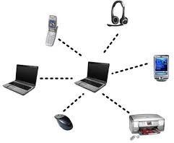
PAN- Diagram

Slide 23
PAN-Advantages
The pan is a personal network of one or two person so there is no risk of any leak of data.

Slide 24
PAN-Disadvantages
The network it can only travel straight up to 10mts and if in different rooms then only 2mts.
In the case of infrared the infra red sensor bust be in a straight line otherwise it won't communicate.
Transmission speed is slow to moderate.

Slide 25
Ad-hoc Networks
A wireless ad hoc network (WANET) or MANET is a decentralized type of wireless network.
The network is ad hoc because it does not rely on a pre- existing infrastructure, such as routers in wired networks or access points in managed (infrastructure) wireless networks.
Ad-hoc means without base station or Access point
(means without infrastructure)

Slide 26
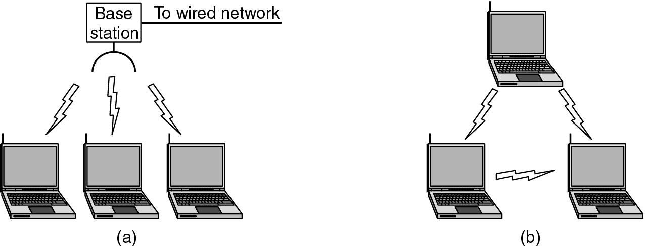
Ad-hoc Network Diagram
Figure (a) Wireless networking with a base station.
(b) Ad hoc networking.

Slide 27
Ad-hoc Network Advantages
Ad-hoc networks can have more flexibility.
It is better in mobility.
It can be turn up and turn down in a very short time.
It can be more economical.
It considered a robust network because of its non- hierarchical distributed control and management mechanisms

Slide 28
Ad-hoc Network Disadvantages
Hostile environment and irregular connectivity.
There are no known boundaries for the maximum range that nodes will be able to receive network frames.
The wireless channel is weak, unreliable, and unprotected from outside interferences.
Limited wireless range.
Hidden terminals.
Packet losses.
Routes changes.
Devices heterogeneity.
Battery power constraints.

Slide 29


Ad-hoc Network Applications
Group of people with laptops and they want to exchange files and data without having an access point.
Incase if we need to exchange information and the network's infrastructure has been destroyed.
It is suitable for military communications at battlefield where there is no network infrastructure.

Slide 30
Other Wireless Networks
Wireless local area networks (WLAN)
IEEE 802.11 (WiFi)
10-100 Mbps, 1.5km
802.11 (1997): upto 2 Mbps, 2.4 GHz
802.11a (1999): upto 54 Mbps, 5 GHz, ~75 feet outdoor
802.11b (1999): upto 11 Mbps, 2.4 GHz, ~150 feet [most popular]
802.11g (2003): upto 54 Mbps, 2.4 GHz, ~150 feet [backward compatible with 802.11b, becoming more popular]
Wireless metropolitan area networks (WMAN)
IEEE 802.16 (WiMax)
1.5-20 Mbps, 5-50km

Slide 31
Other Wireless Networks
Wireless wide area networks (WWAN)
worldwide
GSM (Global System for Mobile communications)
9.6 – 33 kbps
3G (“third generation”): 128-384 kbps to 2Mbps

Slide 32
Other Networks
Internetworks
connecting different kinds of networks
routers, gateways

Slide 33
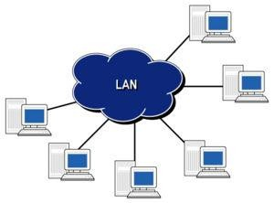
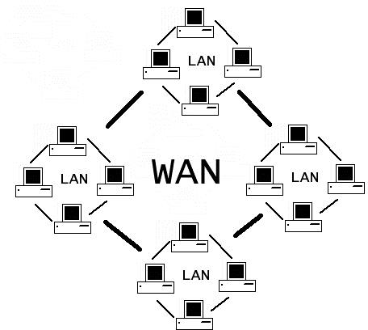
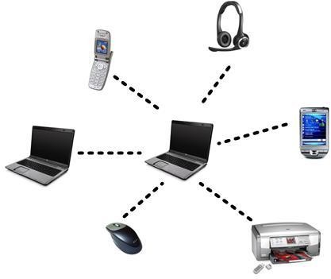
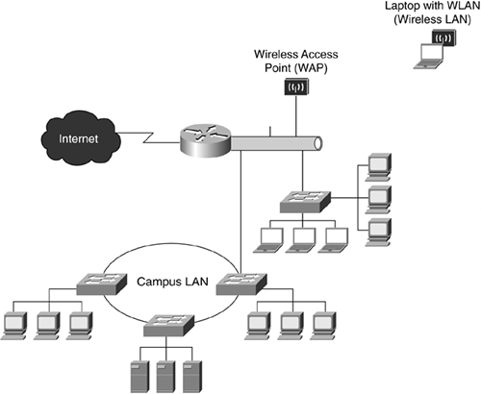
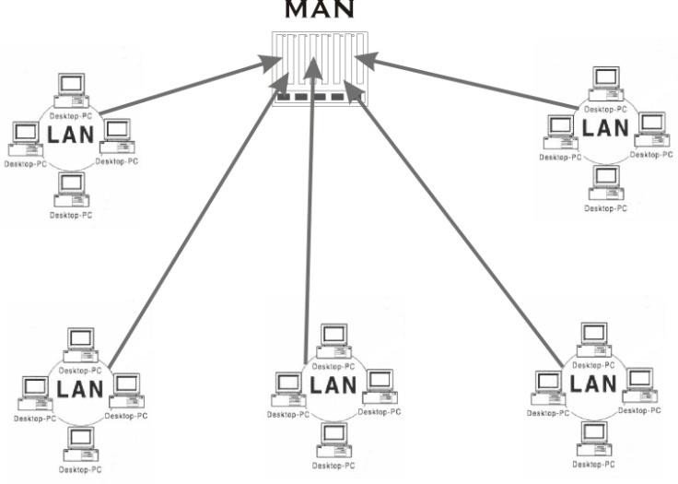
WAN
LAN
PAN
CAN
MAN

Slide 34
DISTINGUISH BETWEEN LAN,WAN,MAN
PARAMETERS | LAN | WAN | MAN
Ownership of network | Private | Private or public | Private or public
Geographical area covered | Small | Very large | Moderate
Design and maintenance | Easy | Not easy | Not easy
Communication medium | Twisted Pair cable (UTP) | PSTN or satellite links | Coaxial cables, PSTN, optical fibre, cables, wireless
Bandwidth | Low | High | moderate
Data rates(speed) | High | Low | moderate

Slide 35
Network performance
 | Example | Range | Bandwidth (Mbps) | Latency (ms)
Wired: LAN | Ethernet | 1-2 km | 10-1000 | 1-10
MAN | ATM | 250 km | 1-150 | 10
WAN | IP routing | worldwide | .01-600 | 100-500
Internetwork | Internet | worldwide | 0.5-600 | 100-500
Wireless: WPAN | Bluetooth (802.15.1) | 10 - 30m | 0.5-2 | 5-20
WLAN | WiFi (IEEE 802.11) | 0.15-1.5 km | 2-54 | 5-20
WMAN | WiMAX (802.16) | 550 km | 1.5-20 | 5-20
WWAN | GSM, 3G phone nets | worldwide | 0.01-2 | 100-500

Slide 36
Outline
Introduction of LAN; MAN;WAN; PAN, Ad-hoc Network
Topologies
Network Architectures OSI Model
TCP/IP Model
Design issues for Layers Transmission Mediums Network Devices
Manchester and Differential Manchester Encodings;
IEEE802.11: Frequency Hopping (FHSS) and Direct Sequence (DSSS)

Slide 37
Topologies-Types of Network Topology
BUS
RING
STAR
MESH
TREE
HYBRID

Slide 38
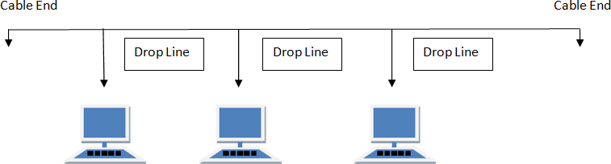
BUS Topology
Bus topology is a network type in which every computer and network device is connected to single cable.When it has exactly two endpoints, then it is called Linear Bus topology.
Features of Bus Topology
It transmits data only in one direction. Every device is connected to a single cable

Slide 39
BUS Topology
Advantages of Bus Topology
It is cost effective.
Cable required is least compared to other network topology.
Used in small networks.
It is easy to understand.
Easy to expand joining two cables together.
Disadvantages of Bus Topology
Cables fails then whole network fails.
If network traffic is heavy or nodes are more the performance of the network decreases.
Cable has a limited length.
It is slower than the ring topology.

Slide 40
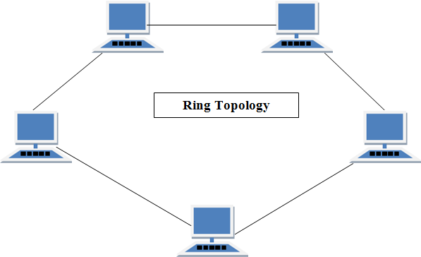
RING Topology
It is called ring topology because it forms a ring as each computer is connected to another
computer, with the last one connected to the first. Exactly two neighbours for each device.

Slide 41
Features of Ring Topology
A number of repeaters are used for Ring topology with large number of nodes, because if someone wants to send some data to the last node in the ring topology with 100 nodes, then the data will have to pass through 99 nodes to reach the 100th node. Hence to prevent data loss repeaters are used in the network.
The transmission is unidirectional, but it can be made bidirectional by having 2 connections between each Network Node, it is called Dual Ring Topology.
In Dual Ring Topology, two ring networks are formed, and data flow is in opposite direction in them. Also, if one ring fails, the second ring can act as a backup, to keep the network up.
Data is transferred in a sequential manner that is bit by bit. Data transmitted, has to pass through each node of the network, till the destination node.

Slide 42
Ring Topology
Advantages of Ring Topology
Transmitting network is not affected by high traffic or by adding more nodes, as only the nodes having tokens can transmit data.
Cheap to install and expand
Disadvantages of Ring Topology
Troubleshooting is difficult in ring topology.
Adding or deleting the computers disturbs the network activity.
Failure of one computer disturbs the whole network.

Slide 43
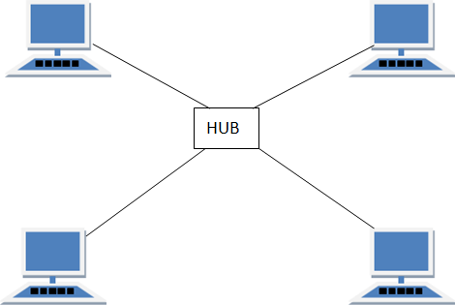
STAR Topology
In this type of topology all the computers are connected to a single hub through a cable. This hub is the central node and all others nodes are connected to the central node.
Features of Star Topology
Every node has its own dedicated connection to the hub. Hub acts as a repeater for data flow.
Can be used with twisted pair, Optical Fibre or coaxial cable.

Slide 44
STAR Topology
Advantages of Star Topology
Fast performance with few nodes and low network traffic.
Hub can be upgraded easily.
Easy to troubleshoot.
Easy to setup and modify.
Only that node is affected which has failed, rest of the nodes can work smoothly.
Disadvantages of Star Topology
Cost of installation is high.
Expensive to use.
If the hub fails then the whole network is stopped because all the nodes
depend on the hub.
Performance is based on the hub that is it depends on its capacity

Slide 45
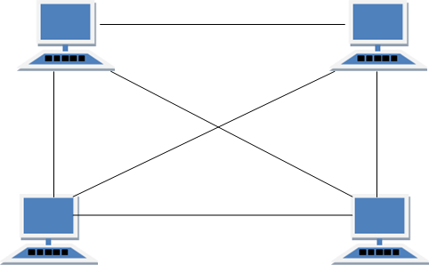
MESH Topology
It is a point-to-point connection to other nodes or devices. All the network nodes are connected to each other. Mesh has n(n-1)/2 physical channels to link n devices.
Features of Mesh Topology
Fully connected. Robust.
Not flexible.

Slide 46
MESH Topology
Advantages of Mesh Topology
Each connection can carry its own data load.
It is robust.
Fault is diagnosed easily.
Provides security and privacy.
Disadvantages of Mesh Topology
Installation and configuration is difficult.
Cabling cost is more.
Bulk wiring is required.

Slide 47
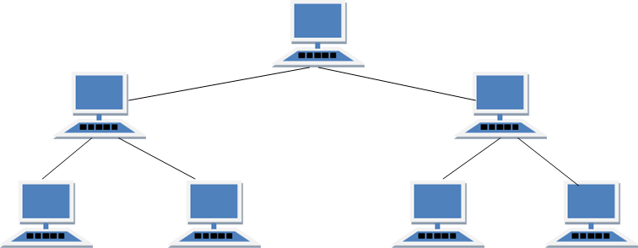
TREE Topology
It has a root node and all other nodes are connected to it forming a hierarchy. It is also called hierarchical topology. It should at least have three levels to the hierarchy.
Features of Tree Topology
Ideal if workstations are located in groups. Used in Wide Area Network.

Slide 48
TREE Topology
Advantages of Tree Topology
Extension of bus and star topologies.
Expansion of nodes is possible and easy.
Easily managed and maintained.
Error detection is easily done.
Disadvantages of Tree Topology
Heavily cabled.
Costly.
If more nodes are added maintenance is difficult.
Central hub fails, network fails.

Slide 49
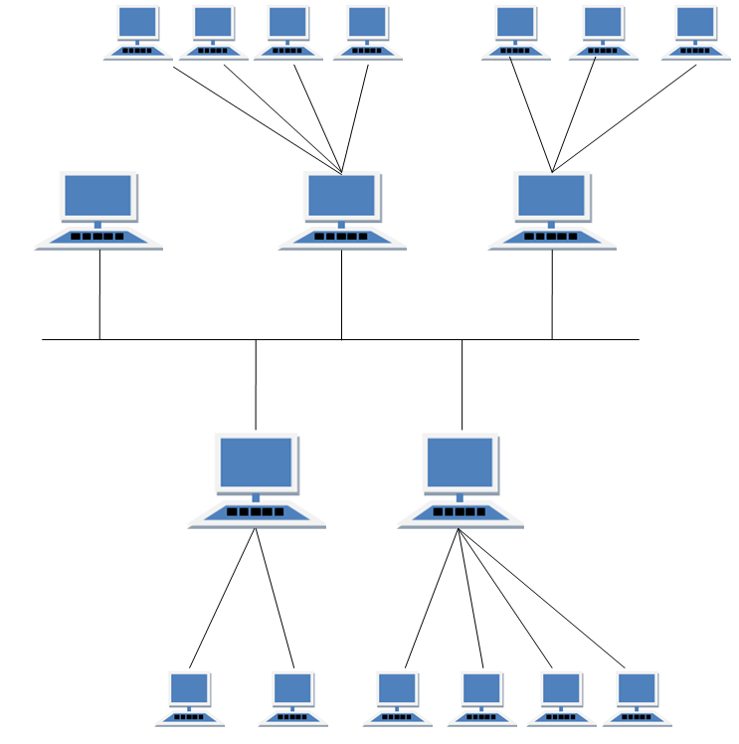
HYBRID Topology
It is two different types of topologies which is a mixture of two or more topologies. For example if in an office in one department ring topology is used and in another star topology is used, connecting these topologies will result in Hybrid Topology (ring topology and star topology).

Slide 50
HYBRID Topology
Features of Hybrid Topology
It is a combination of two or topologies
Inherits the advantages and disadvantages of the topologies
included
Advantages of Hybrid Topology
Reliable as Error detecting and trouble shooting is easy.
Effective.
Scalable as size can be increased easily.
Flexible.
Disadvantages of Hybrid Topology
Complex in design.
Costly.

Slide 51
Outline
Introduction of LAN; MAN;WAN; PAN, Ad-hoc Network
Topologies
Network Architectures
OSI Model TCP/IP Model
Design issues for Layers
Transmission Mediums Network Devices
Manchester and Differential Manchester Encodings;
IEEE802.11: Frequency Hopping (FHSS) and Direct Sequence (DSSS)

Slide 52




NETWORK CLASSIFICATION BY THEIR COMPONENT ROLE
LOCAL AREA NETWORK
PEER TO PEER NETWORK
CLIENT SERVER NETWORK

Slide 53
PEER TO PEER NETWORK
A peer-to-peer network is a distributed network architecture composed of participants that make a portion of their resources, such as processing power, disk storage or network bandwidth directly to network participants without the need for central coordination instances.
Used largely for sharing of content files such as audio, video, data or anything in a digital format.
There are many p2p protocols such as Ares, Bittorrent, or eDonkey.
Can be very large
Can also be used for business solutions for relatively small companies that may not have resources available to implement a server solution.
Peer to peer network is useful for a small network containing less than 10 computers on a single LAN .
In peer to peer network each computer can function as both client and server.
Peer to peer networks do not have a central control system. There are no servers in peer networks.
Peer networks are amplified into home group.

Slide 54
ADVANTAGES & DISADVANTAGES OF PEER TO PEER NETWORK
Advantages:
Use less expensive computer
hardware
Easy to administer
No NOS required
More built in redundancy
Easy setup & low cost
Disadvantages:
Not very secure
No central point of storage or file archiving
Additional load on computer because of resource sharing
Hard to maintain version control

Slide 55
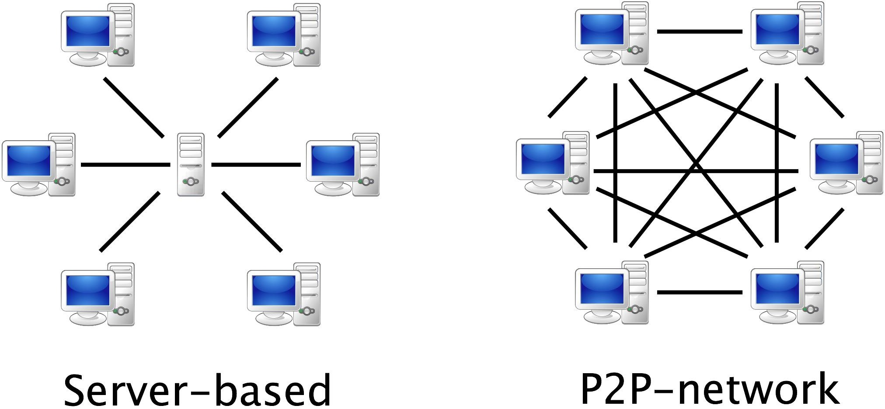

Slide 56
CLIENT/SERVER NETWORK
In client-server network relationships, certain computers act as server and other act as clients. A server is simply a computer, that available the network resources and provides service to other computers when they request it. A client is the computer running a program that requests the service from a server.
Local area network(LAN) is based on client server network relationship.
A client-server network is one n which all available network resources such as files, directories, applications and shared devices, are centrally managed and hosted and then are accessed by client.
Client serve network are defined by the presence of servers on a network that provide security and administration of the network.

Slide 57
ADVANTAGES AND DISADVANTAGES OF CLIENT-SERVER NETWORK
Advantages:
Very secure
Better performance
Centralized backup
very reliable
Disadvantages:
requires professional administration
More hardware-intensive
More software intensive
Expensive dedicated software

Slide 58






TYPES OF SERVERS

Slide 59
TYPES OF SERVERS
File server: These servers provide the services for storing, retrieving and moving the data. A user can read, write, exchange and manage the files with the help of file servers.
Printer server:The printer server is used for controlling and managing printing on the network. It also offers the fax service to the network users.
Application server: The expensive software and additional computing power can be shared by the computers in a network with he help of application servers.
Message server: It is used to co-ordinate the interaction between users, documents and applications.The data can be used in the for of audio, video, binary, text or graphics.
Database server: It is a type of application server. It allows the uses to access the centralised strong database.

Slide 60
Distributed Networks
Arrangement of networked computers in which several processors (the CPUs) are located on scattered machines, but are capable of working both independently and jointly as required.
The key elements of Distributed Network Architecture are, as the name implies, the distribution of decision-making and control out to each site, while simultaneously, networking and synchronizing the various sites together via a central hub.
Distributed networking is a distributed computing network system, said to be distributed when the computer programming and the data to be worked on are spread out across more than one computer. Usually, this is implemented over a computer network.

Slide 61
Benefits of Distributed Network Architecture
Scalability: Enterprise solutions that rely on a single Enterprise server inevitably suffer from performance issues as the Enterprise grows and the server is overwhelmed. Moreover, single server solutions are highly susceptible to network failures.
Cost: Servers and software at each local site can be appropriately sized to meet the specific needs of each site, without requiring installing an expensive server at even the smallest sites.
Reliability: Distributed Network Architecture is much more tolerant of network and hardware failures than a single server approach.

Slide 62
Outline
Introduction of LAN; MAN;WAN; PAN, Ad-hoc Network
Topologies
Network Architectures
OSI Model
TCP/IP Model
Design issues for Layers Transmission Mediums Network Devices
Manchester and Differential Manchester Encodings;
IEEE802.11: Frequency Hopping (FHSS) and Direct Sequence (DSSS)

Slide 63




Reference Models in Communication Networks
The most important reference models are :
OSI reference model.
TCP/IP reference model.

Slide 64
OSI
There are many users who use computer network and are located all over the world. To ensure national and worldwide data communication ISO (ISO stands for International Organization of Standardization.) developed this model.
This is called a model for open system interconnection (OSI) and is normally called as OSI model.
OSI model architecture consists of seven layers.
It defines seven layers or levels in a complete communication system.

Slide 65
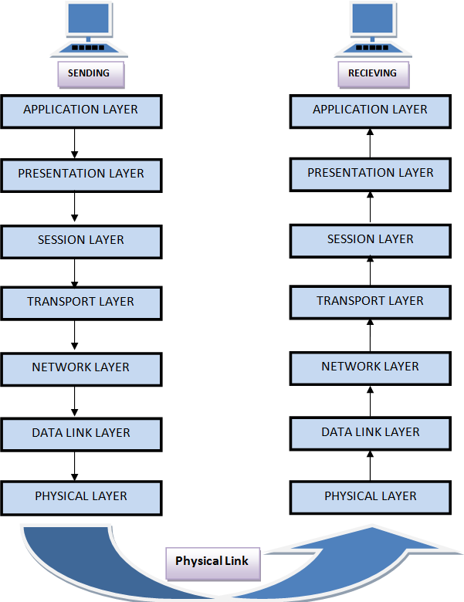
OSI Model

Slide 66
Feature of OSI Model :
Big picture of communication over network is understandable through this OSI model.
We see how hardware and software work together.
We can understand new technologies as they are developed.
Troubleshooting is easier by separate networks.
Can be used to compare basic functional relationships on different networks.

Slide 67
Layer 1: The Physical Layer :
It is the lowest layer of the OSI Model.
It activates, maintains and deactivates the physical connection.
It is responsible for transmission and reception of the unstructured raw data over network.
Voltages and data rates needed for transmission is defined in the physical layer.
It converts the digital/analog bits into electrical signal or optical signals.
Data encoding is also done in this layer.

Slide 68
Layer 2: Data Link Layer :
Data link layer synchronizes the information which is to be transmitted over the physical layer.
The main function of this layer is to make sure data transfer is
error free from one node to another, over the physical layer.
Transmitting and receiving data frames sequentially is managed by this layer.
This layer sends and expects acknowledgements for frames received and sent respectively. Resending of non- acknowledgement received frames is also handled by this layer.
This layer establishes a logical layer between two nodes and also manages the Frame traffic control over the network. It signals the transmitting node to stop, when the frame buffers are full.

Slide 69
Layer 3: The Network Layer :
It routes the signal through different channels from one node to other.
It acts as a network controller. It manages the Subnet traffic.
It decides by which route data should take.
It divides the outgoing messages into packets and assembles the incoming packets into messages for higher levels.

Slide 70
Layer 4: Transport Layer :
It decides if data transmission should be on parallel path or single path.
Functions such as Multiplexing, Segmenting or Splitting on the data are done by this layer
It receives messages from the Session layer above it, convert the message into smaller units and passes it on to the Network layer.
Transport layer can be very complex, depending upon the network requirements.
Transport layer breaks the message (data) into small units so that they are handled more efficiently by the network layer.

Slide 71
Layer 5: The Session Layer :
Session layer manages and synchronize the conversation between two different applications.
Transfer of data from source to destination session layer streams of data are marked and are resynchronized properly, so that the ends of the messages are not cut prematurely and data loss is avoided.

Slide 72
Layer 6: The Presentation Layer :
Presentation layer takes care that the data is sent in such a way that the receiver will understand the information (data) and will be able to use the data.
While receiving the data, presentation layer transforms the data to be ready for the application layer.
Languages(syntax) can be different of the two communicating systems. Under this condition presentation layer plays a role of translator.
It perfroms Data compression, Data encryption, Data conversion etc.

Slide 73
Layer 7: Application Layer :
It is the topmost layer.
Transferring of files disturbing the results to the user is also done in this layer. Mail services, directory services, network resource etc are services provided by application layer.
This layer mainly holds application programs to act upon the received and to be sent data.

Slide 74
Merits of OSI reference model:
OSI model distinguishes well between the services, interfaces and protocols.
Protocols of OSI model are very well hidden.
Protocols can be replaced by new protocols as technology changes.
Supports connection oriented services as well as connectionless service.

Slide 75
Demerits of OSI reference model:
Model was devised before the invention of protocols.
Fitting of protocols is tedious task.
It is just used as a reference model.

Slide 76
Outline
Introduction of LAN; MAN;WAN; PAN, Ad-hoc Network
Topologies
Network Architectures OSI Model
TCP/IP Model
Design issues for Layers Transmission Mediums Network Devices
Manchester and Differential Manchester Encodings;
IEEE802.11: Frequency Hopping (FHSS) and Direct Sequence (DSSS)

Slide 77
TCP/IP model overview
TCP/IP that is Transmission Control Protocol and Internet Protocol was developed by Department of Defence's Project Research Agency (ARPA, later DARPA) as a part of a research project of network interconnection to connect remote machines.
The features of TCP/IP reference model were:
Support for a flexible architecture. Adding more machines to a network was easy.
The network was robust, and connections remained intact untill the source and destination machines were functioning.
The overall idea was to allow one application on one computer to talk to(send data packets) another application running on different computer.

Slide 78
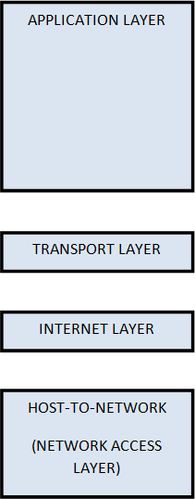
TCP/IP reference model diagram

Slide 79
Layer 1: Host-to-network Layer
Lowest layer of the all.
Protocol is used to connect to the host, so that the packets can be sent over it.
Varies from host to host and network to network.

Slide 80
Layer 2: Internet layer
Selection of a packet switching network which is based on a connectionless internetwork layer is called a internet layer.
It is the layer which holds the whole architecture together.
It helps the packet to travel independently to the destination.
Order in which packets are received is different from the way they are sent.
IP (Internet Protocol) is used in this layer.

Slide 81
Layer 3: Transport Layer
It decides if data transmission should be on parallel path or single path.
Functions such as multiplexing, segmenting or splitting on the data is done by transport layer.
The applications can read and write to the transport layer.
Transport layer adds header information to the data.
Transport layer breaks the message (data) into small units so that they are handled more efficiently by the network layer.
Transport layer also arrange the packets to be sent, in sequence.

Slide 82
Layer 4: Application Layer
The TCP/IP specifications described a lot of applications that were at the top of the protocol stack. Some of them were TELNET, FTP, SMTP, DNS etc.
TELNET is a two-way communication protocol which allows connecting to a remote machine and run applications on it.
FTP(File Transfer Protocol) is a protocol, that allows File transfer amongst computer users connected over a network. It is reliable, simple and efficient.
SMTP(Simple Mail Transport Protocol) is a protocol, which is used to transport electronic mail between a source and destination, directed via a route.
DNS(Domain Name Server) resolves an IP address into a textual
address for Hosts connected over a network.

Slide 83
Merits of TCP/IP model
It operated independently.
It is scalable.
Client/server architecture.
Supports a number of routing protocols.
Can be used to establish a connection between two computers.

Slide 84
Demerits of TCP/IP
In this, the transport layer does not guarantee delivery of packets.
The model cannot be used in any other application.
Replacing protocol is not easy.
It has not clearly separated its services, interfaces and protocols.

Slide 85
Comparison of OSI Reference Model and TCP/IP Reference Model
OSI(Open System Interconnection) | TCP/IP(Transmission Control Protocol / Internet Protocol)
1. OSI is a generic, protocol independent standard, acting as a communication gateway between the network and end user. | 1.TCP/IP model is based on standard protocols around which the Internet has developed. It is a communication protocol, which allows connection of hosts over a network.
2. In OSI model the transport layer guarantees the delivery of packets. | 2. In TCP/IP model the transport layer does not guarantees delivery of packets. Still the TCP/IP model is more reliable.
3. Follows vertical approach. | 3. Follows horizontal approach.
4. OSI model has a separate Presentation layer and Session layer. | 4.TCP/IP does not have a separate Presentation layer or Session layer.
5. OSI is a reference model around which the networks are built. Generally it is used as a guidance tool. | 5.TCP/IP model is, in a way implementation of the OSI model.

Slide 86
Comparison of OSI Reference Model and TCP/IP Reference Model
OSI(Open System Interconnection) | TCP/IP(Transmission Control Protocol / Internet Protocol)
6. Network layer of OSI model provides both connection oriented and connectionless service. | 6.The Network layer in TCP/IP model provides connectionless service.
7. OSI model has a problem of fitting the protocols into the model. | 7.TCP/IP model does not fit any protocol
8. Protocols are hidden in OSI model and are easily replaced as the technology changes. | 8. In TCP/IP replacing protocol is not easy.
9. OSI model defines services, interfaces and protocols very clearly and makes clear distinction between them. It is protocol independent. | 9. In TCP/IP, services, interfaces and protocols are not clearly separated. It is also protocol dependent.
10. It has 7 layers | 10. It has 4 layers

Slide 87
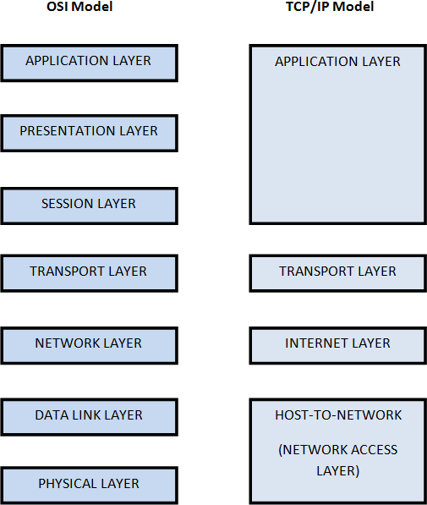
Diagrammatic Comparison between OSI Reference Model and TCP/IP Reference Model

Slide 88
Outline
Introduction of LAN; MAN;WAN; PAN, Ad-hoc Network
Topologies
Network Architectures OSI Model
TCP/IP Model
Design issues for Layers
Transmission Mediums Network Devices
Manchester and Differential Manchester Encodings;
IEEE802.11: Frequency Hopping (FHSS) and Direct Sequence (DSSS)

Slide 89
Design issues for Layers
Addressing
Error Control
Flow Control
Multiplexing
Routing

Slide 90
Addressing
Addressing Level
Unique address for each end system (computer) and each intermediate
system(router)
Network level address-IP or internet address (TCP/IP) Network service access point or NSAP (OSI)
Process within the system-Port number (TCP/IP)
Service access point or SAP
Addressing Scope
Global nonambiguity-Global address identifies unique system,There is only one system with address X
Global applicability-It is possible at any system (any address) to identify
any other system (address) by the global address of the other system
Address X identifies that system from anywhere on the network
e.g. MAC address on IEEE 802 networks

Slide 91
Error Control
Guard against loss or damage of data and control information Error control is implemented as two separate functions:
Error detection
Sender inserts error detecting bits Receiver checks these bits
If OK, acknowledge
If error, discard packet Retransmission
If no acknowledge in given time, re-transmit Performed at various layers of protocol

Slide 92
Flow Control
Done by receiving entity
Function to limit amount or rate of data sent by a transmitting entity
Simplest form: stop-and-wait procedure
More efficient protocols: Credit systems Sliding window Needed at application as well as network layers

Slide 93
Multiplexing
Supporting multiple connections on one machine
-Mapping of multiple connections at one level to a single connection at another
-Carrying a number of connections on one fiber optic cable
-Aggregating or bonding ISDN lines to gain bandwidth

Slide 94
Routing
Determine path or route that packets will follow Use routing protocol based on a routing algorithm “Good” path should be least cost path
Cost : depends on the following factors. Average queuing delay
Propagation delay
Bandwidth, mean queue length, etc.
End systems and routers maintain routing tables Dynamic or static

