Slide 1

WCC Launchpad 30 · Agentic AI track
Notes:
QuoteLens

Slide 2
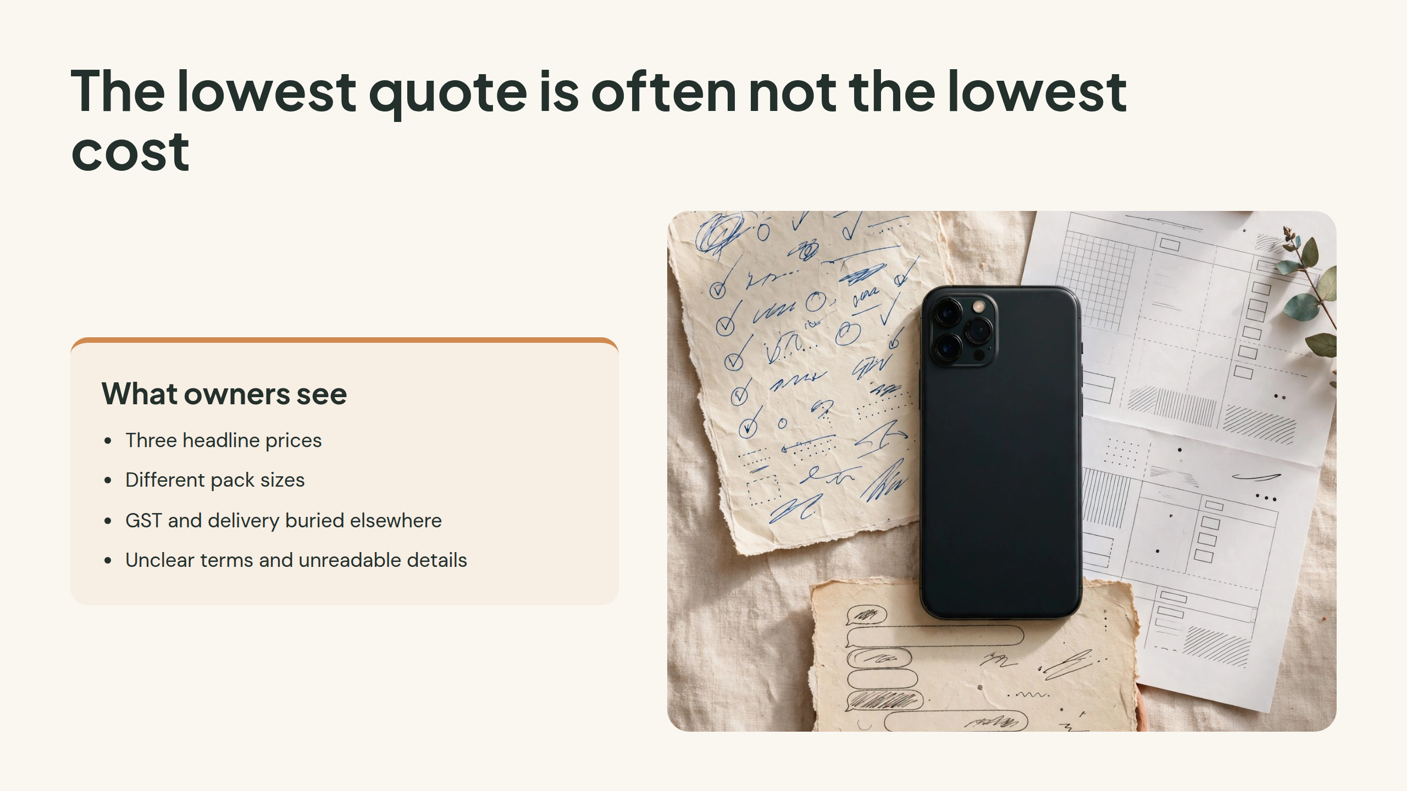
Notes:
The lowest quote is often not the lowest cost

Slide 3
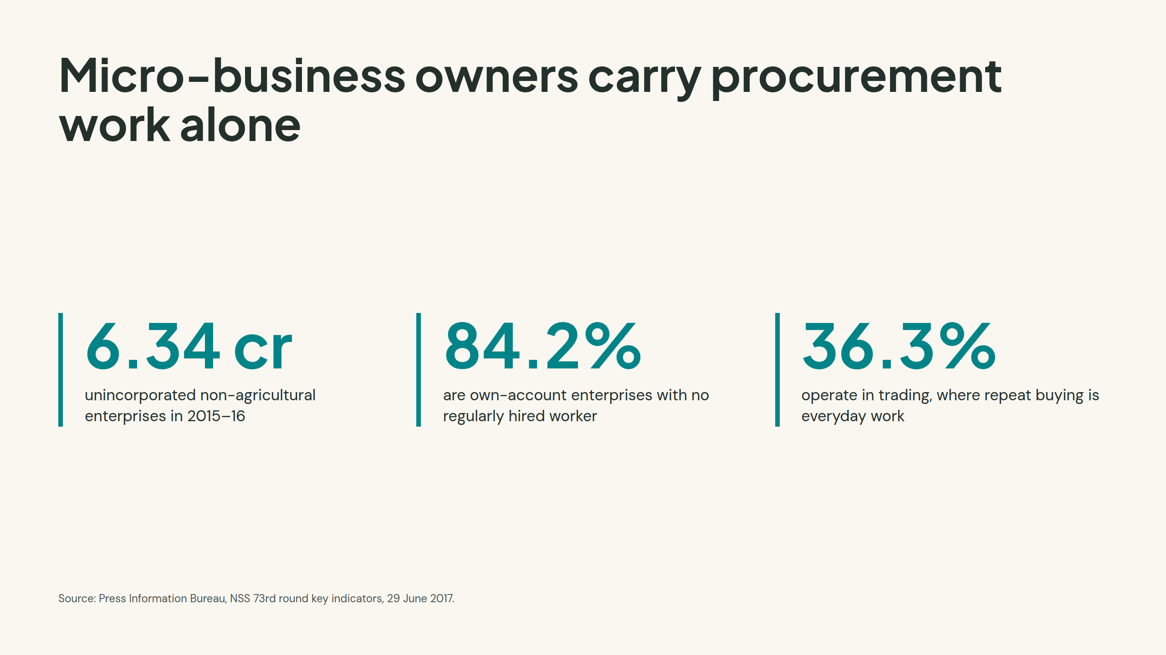
Notes:
Micro-business owners carry procurement work alone

Slide 4
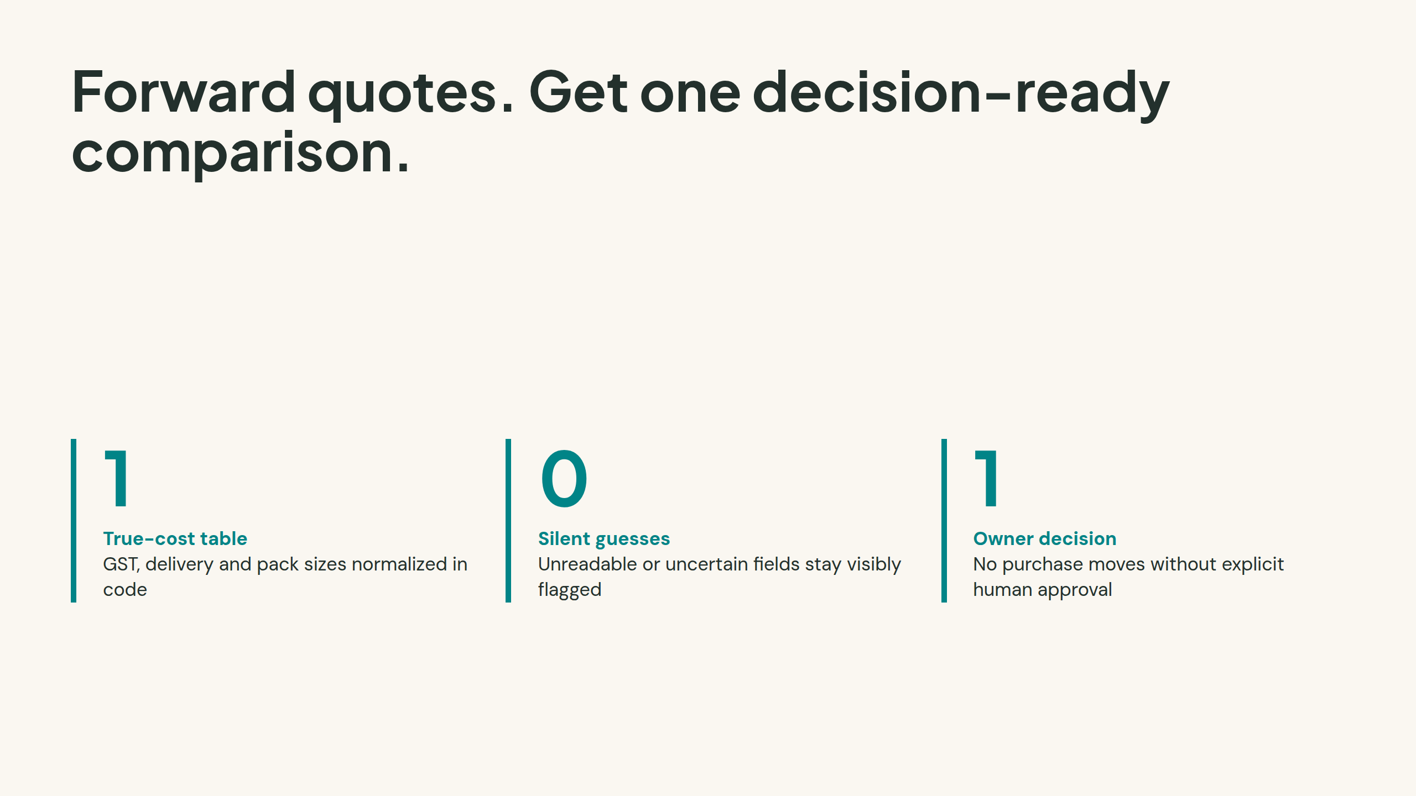
Notes:
Forward quotes. Get one decision-ready comparison.

Slide 5
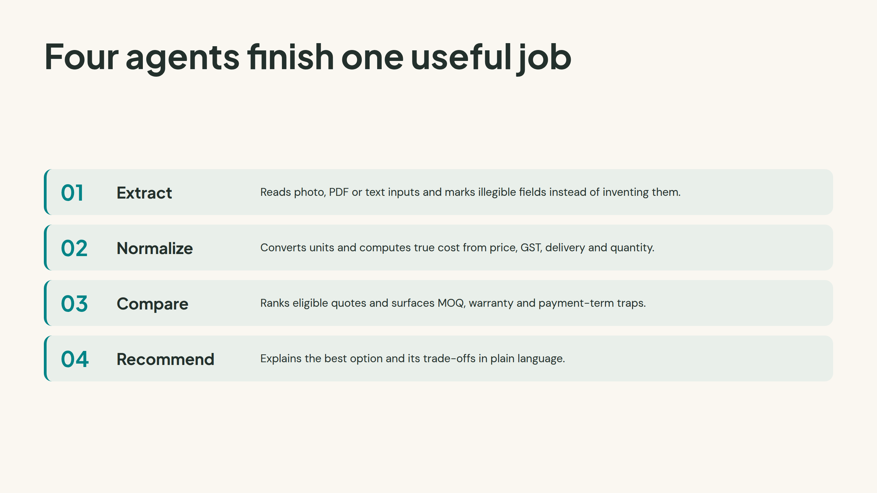
Notes:
Four agents finish one useful job

Slide 6
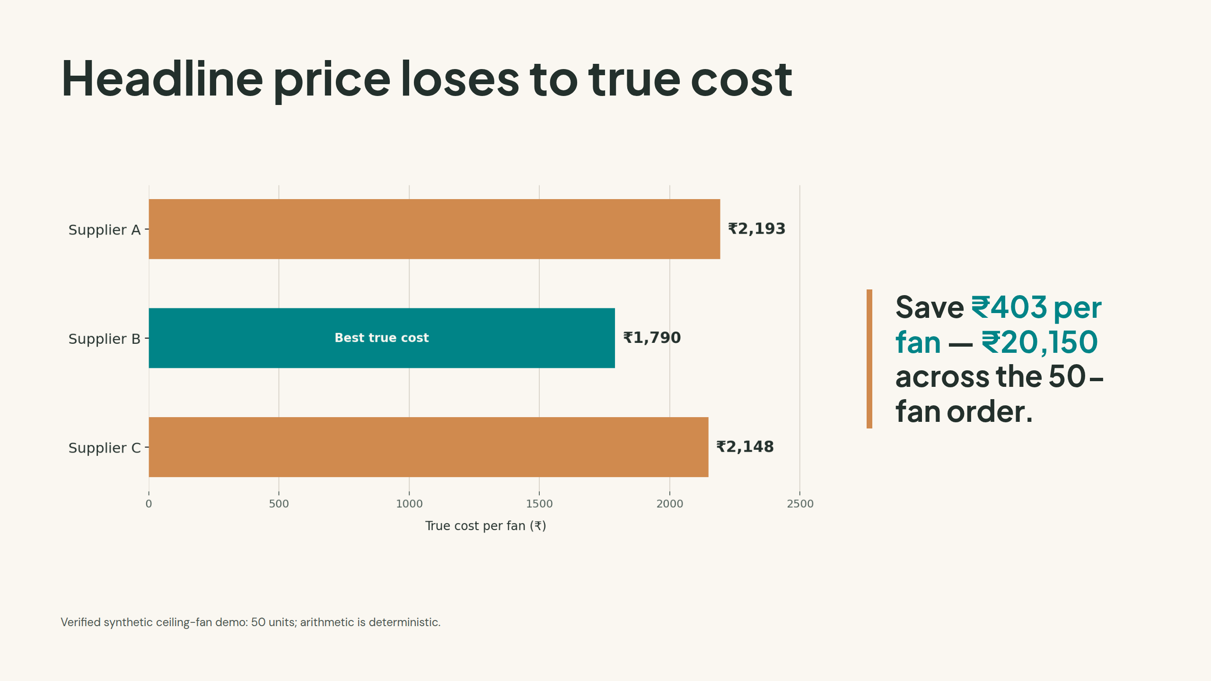
Notes:
Headline price loses to true cost

Slide 7
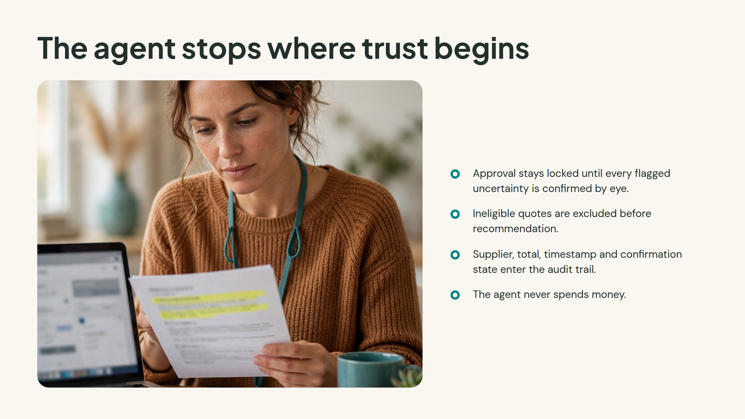
Notes:
The agent stops where trust begins

Slide 8
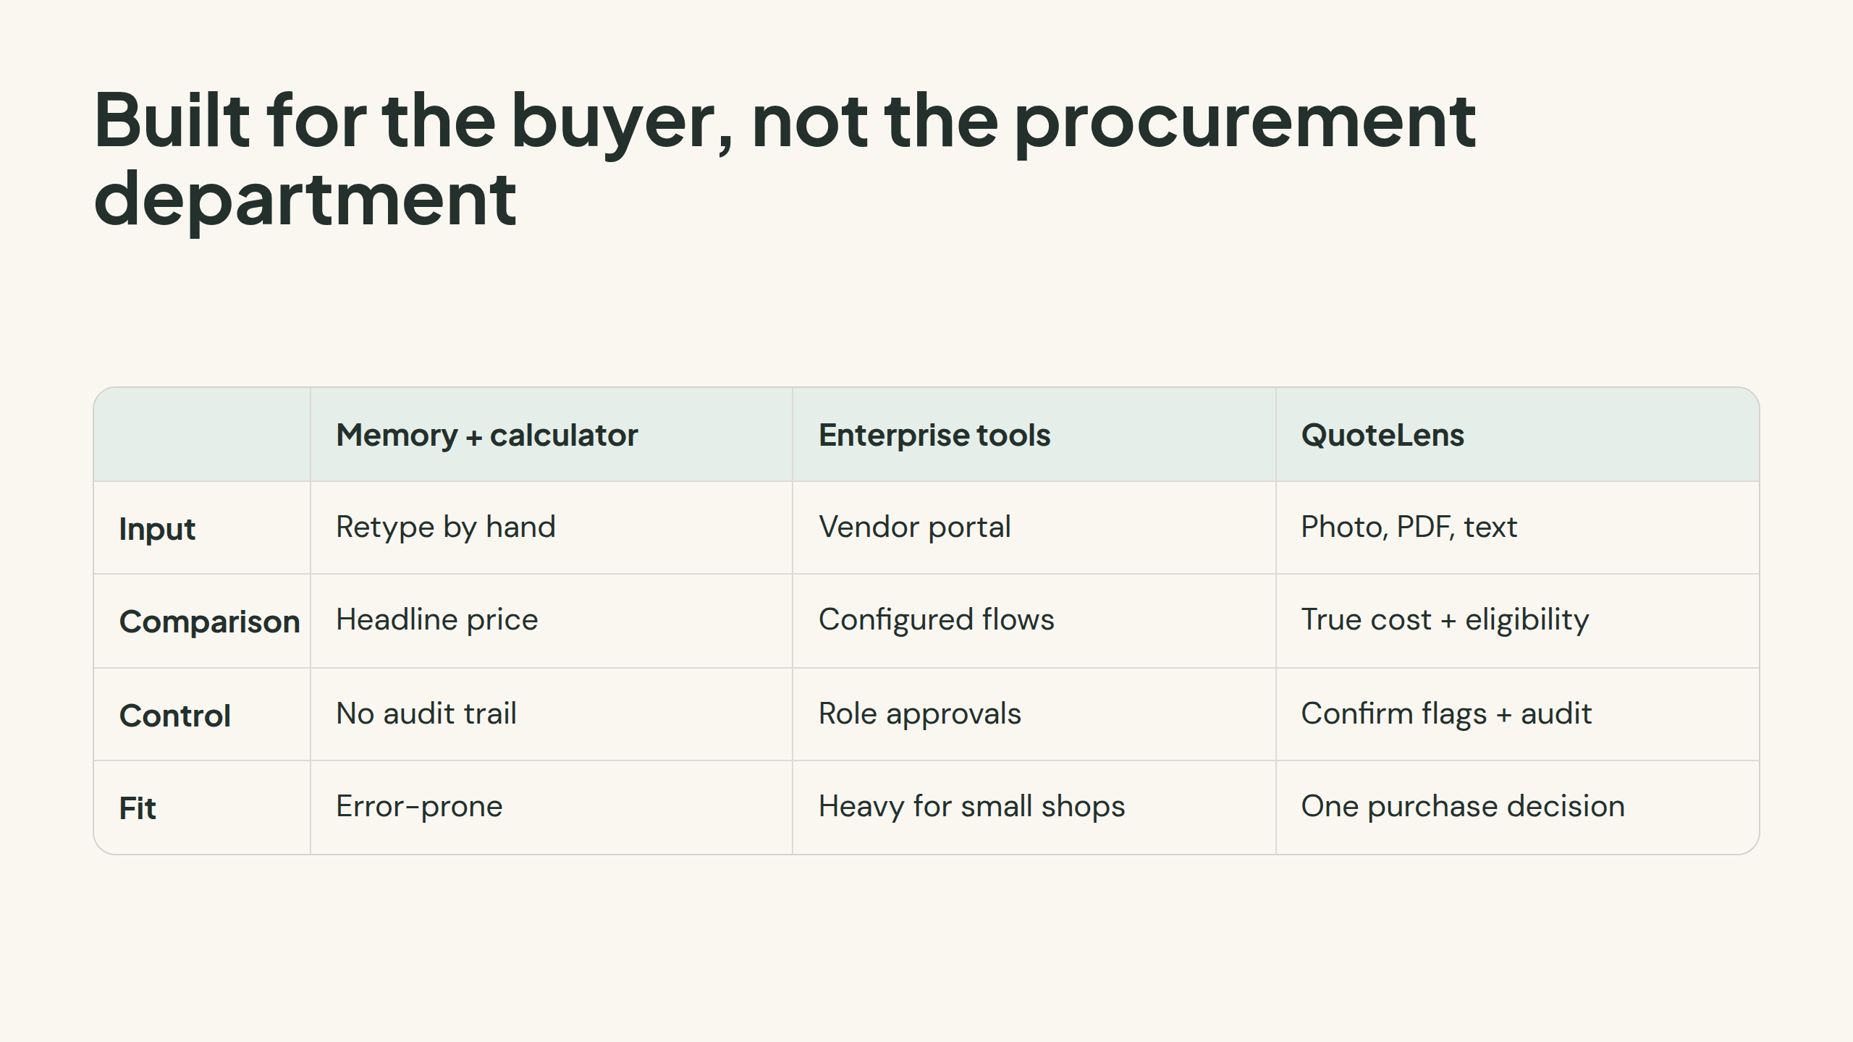
Notes:
Built for the buyer, not the procurement department

Slide 9
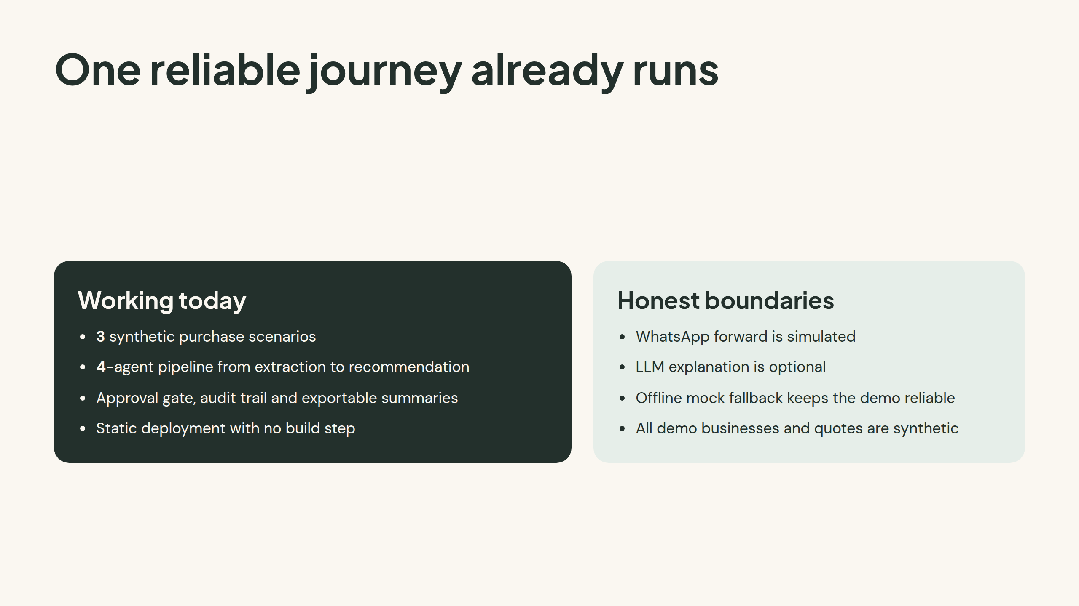
Notes:
One reliable journey already runs

Slide 10
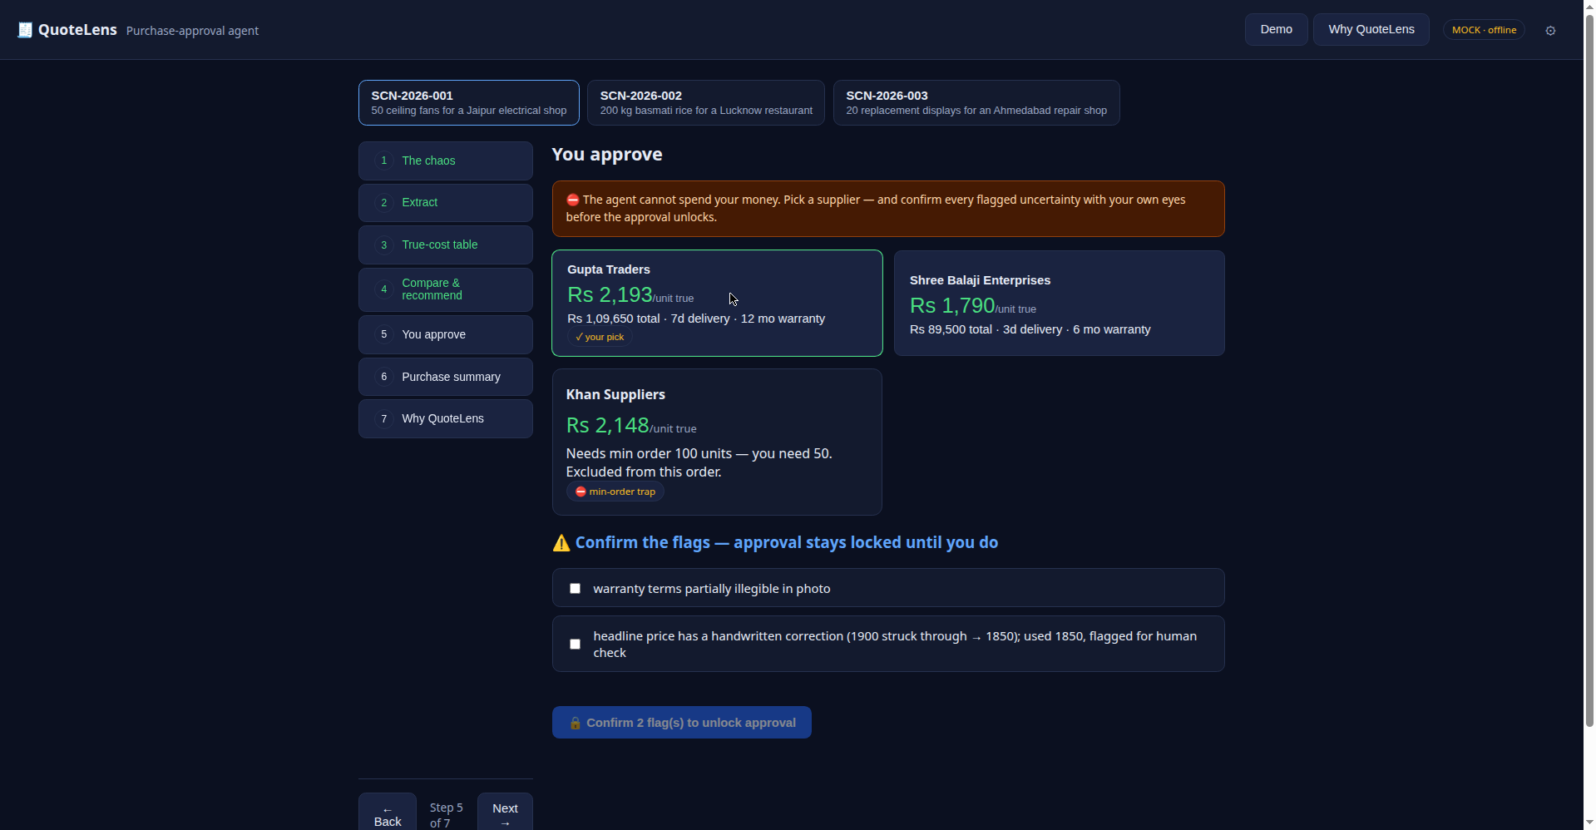
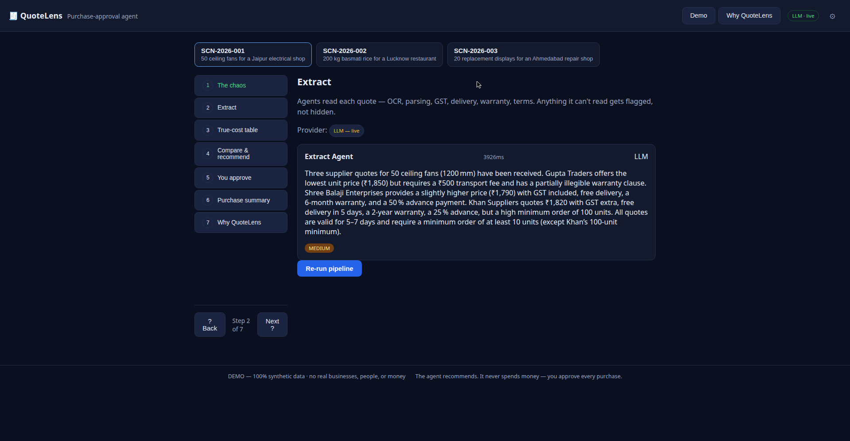
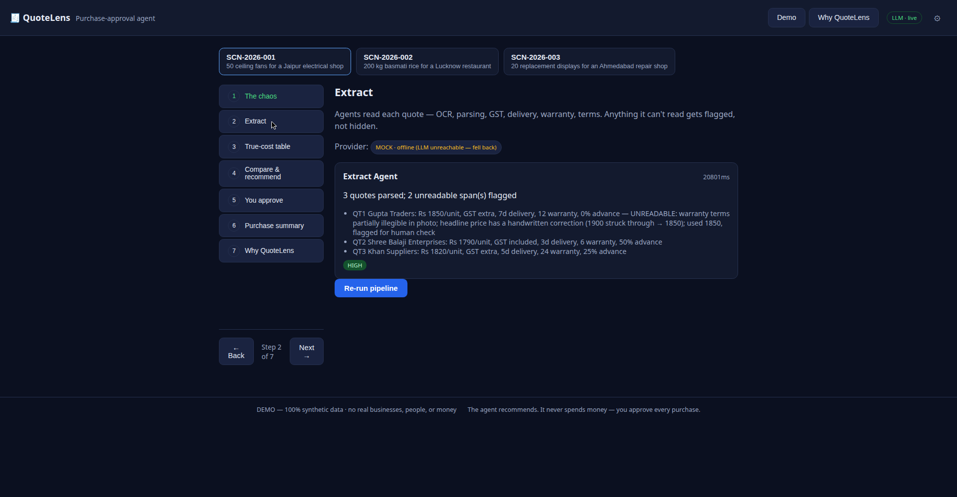
Proof, not promises
Approval stays locked until every flagged uncertainty is confirmed by eye.
A real model run: Extract labeled "LLM" (3.9s). Stages that time out label themselves "mock (fallback)" -- never faked.

Slide 11
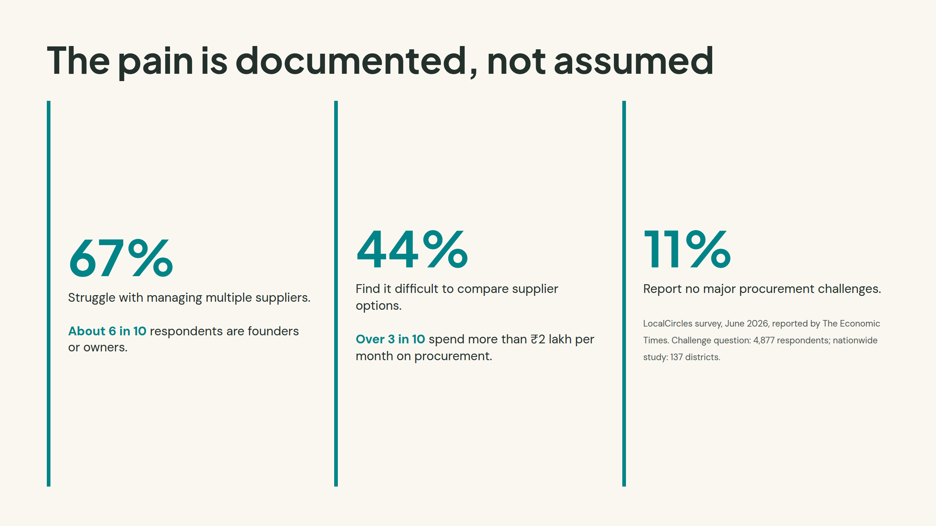
Notes:
The pain is documented, not assumed

Slide 12
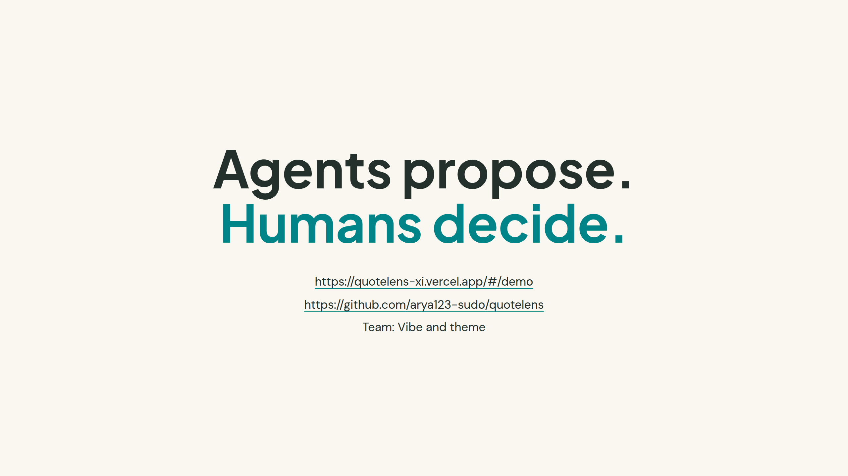
Arya Yaligar · Sanjana T D · G Vajresh Shenoy
Notes:
Agents propose.Humans decide.

