Slide 1
Using Classification model to predict Product Purchase Success
Why Classification models?
Predicts Categorical Outcome
Helps to solve Decision-based Questions
Example :- Logistic Regression, Decision Trees, Random Forest
We will use Logistic Regression for given Problem
Why Logistic Regression and not other models?
Easier to implement
Faster and very efficient to train
Fits the data better than other models

Slide 2
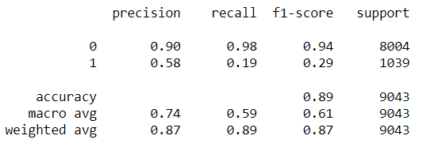
Fitting data on Logistic Regression
Performance Metrics :-
Training Time - 0.37348 s
Training Accuracy – 88.99%
Testing Accuracy – 89.12%
Achieves good accuracy
Model doesn’t Overfit neither Underfit the data ☺
Let’s find out Precision and Recall for both categories
Bad Precision and Recall rate for the Second Category ☹

Slide 3
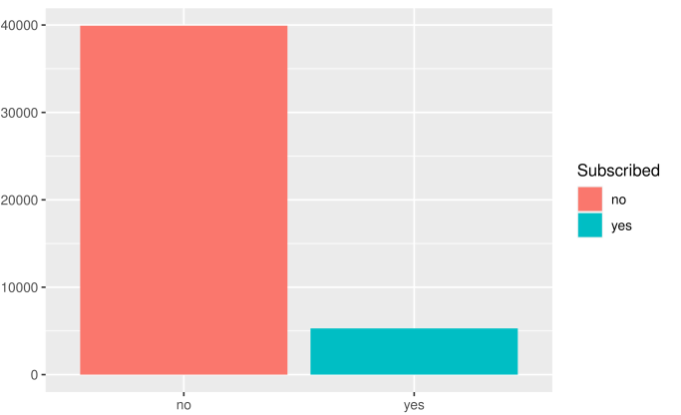
Why do we have Low PR Rate?
Count
Due to High Class Imbalance
Subscription of Product
How do we solve this?
Upsampling data – Not possible, very huge difference between them.
Downsampling data – Could work, let’s find out.

