Slide 1
Sentiment Analysis on Twitter Data
Intro
Data
EDA
Supervised methodology
Results
Unsupervised methodology
Results

Slide 2

Introduction
-Project Goal: Develop a model for sentiment analysis of Twitter data. Want to classify tweets as positive, negative or neutral.
-General Solution Approach: Combination of supervised and unsupervised learning algorithms (i.e. Tf-Idf, Naive Bayes, SVM, etc.)
-Importance: Sentiment analysis has practical applications across several domains, such as business

Slide 3
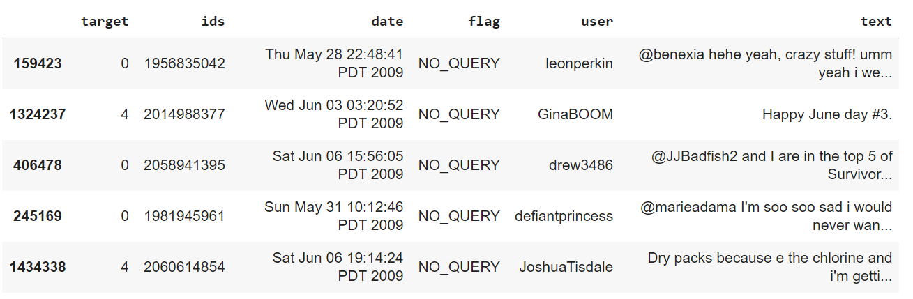
Dataset
-Sentiment140 dataset:
-Contains 1.6 million tweets extracted from Twitter API
-Target variable is polarity of tweet (0 = negative, 2 = neutral, 4 = positive)

Slide 4
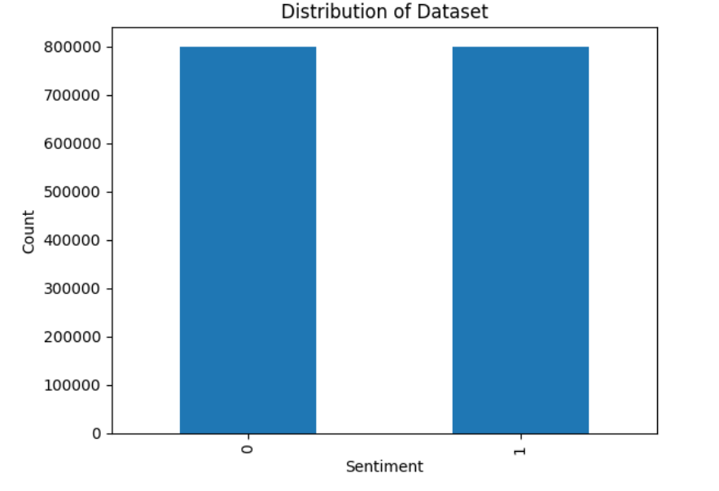
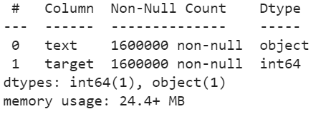
EDA / Preprocessing I
Dropped all columns except the text and target variable
Checked to see if there were any null values in our dataset
Examined the distribution of the target variable in the data

Slide 5
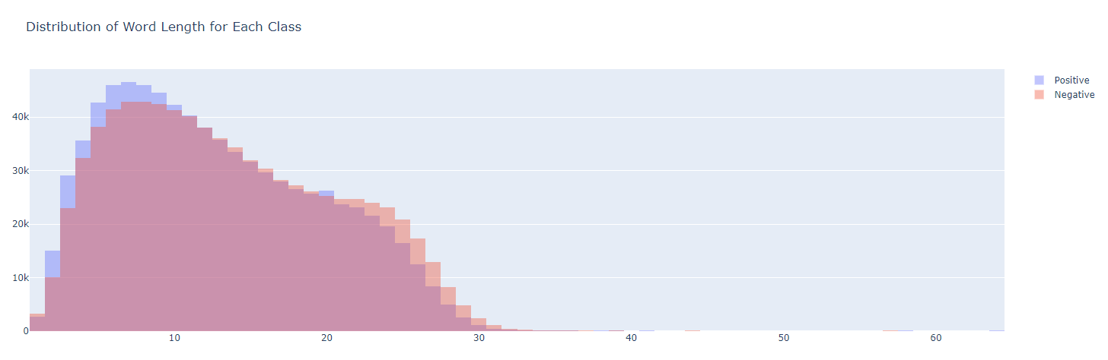
EDA / Preprocessing II
4) Removed stopwords, punctuation, repeating characters, URLs, numbers, as well as performed stemming/lemmatization
5) Created a histogram to show the distribution of tweet length for each class
6) Created word clouds and bar graphs to display the most common words in each class

Slide 6
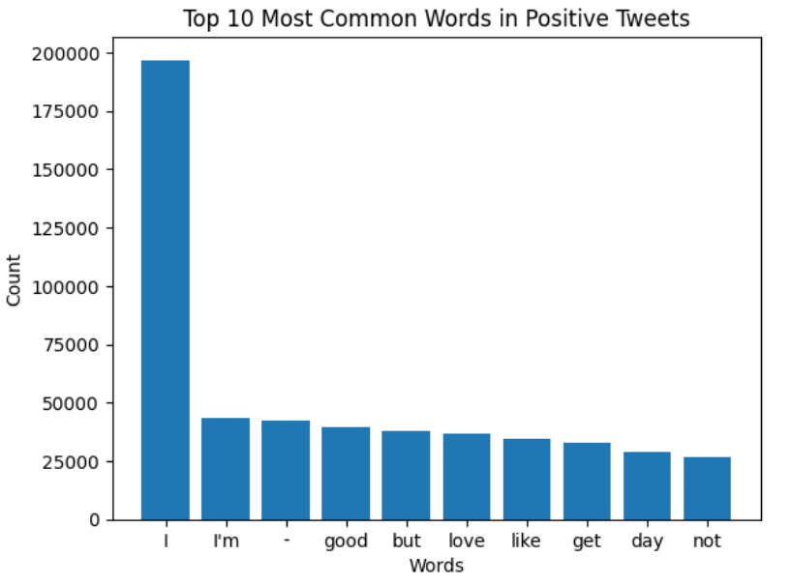
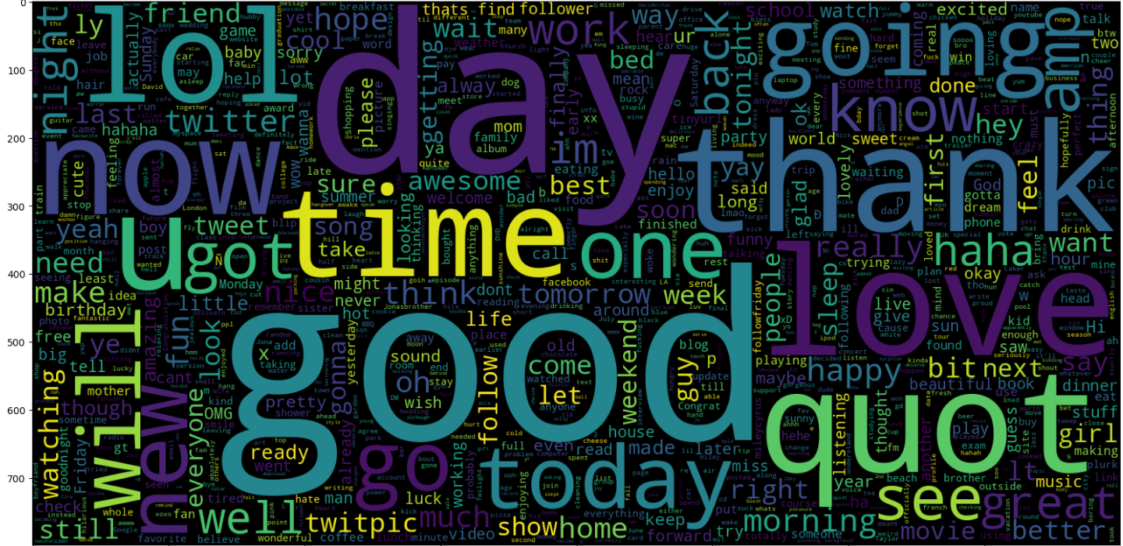
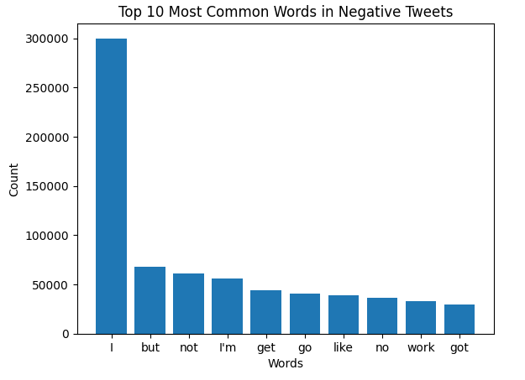
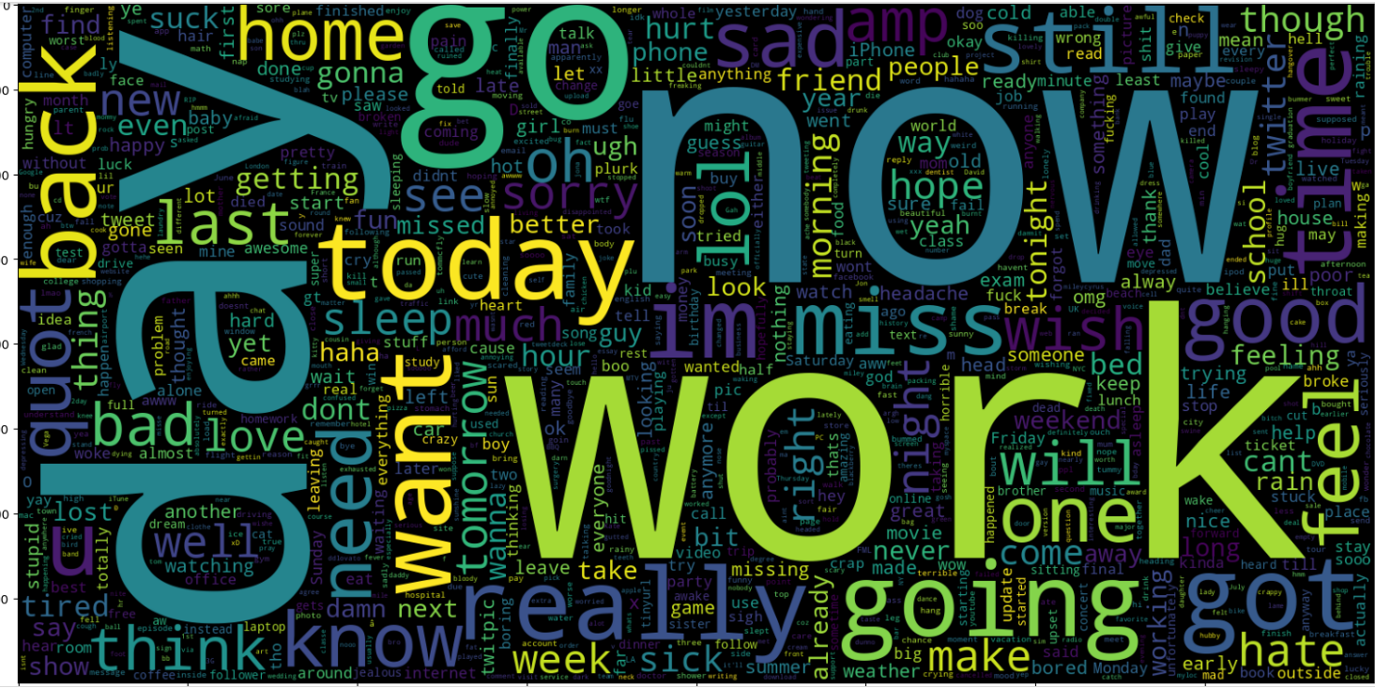
EDA / Preprocessing III

Slide 7
Using Supervised Approach
Supervised learning is a type of machine learning technique where the model is trained on a set of labelled data. In the context of Text analysis, supervised learning involves a set of techniques for identifying parts of speech,entities , sentiments,etc and using these statistical techniques and the Data label to predict the sentiment of the unseen unlabelled data.
For our project, this approach will be split into three main techniques:
Using probabilistic classifiers like Naive Bayes.
Using Support Vector Machines.
Using Logistic regression for handling the Sparse Sentiment data.

Slide 8
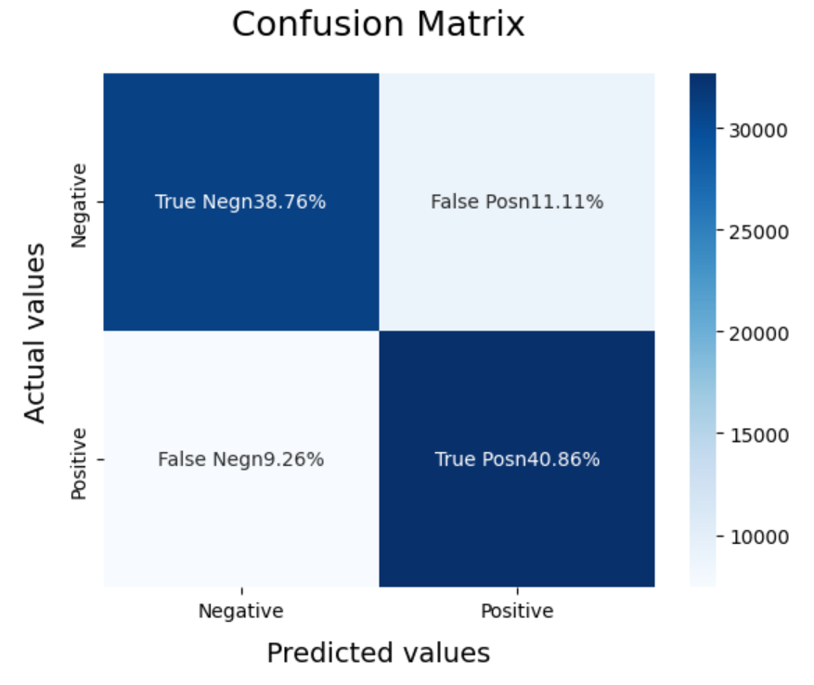
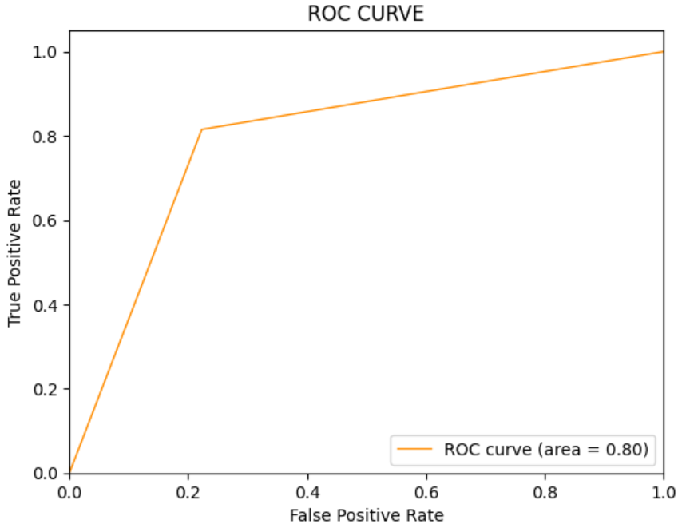
Naive Bayes Approach for Sentiment Analysis
In the Naive Bayes Approach , we make the use of Bayes theorem , which determines the the probability of a hypothesis by using the prior knowledge available. In case of sentiment analysis of tweets we have a labelled data which is used by the naive bayes model to predict the Tweet Sentiments.

Slide 9
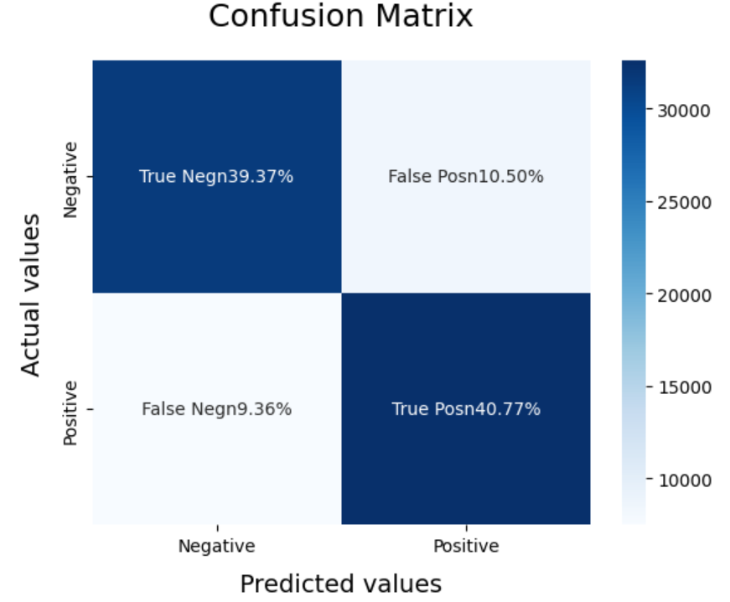
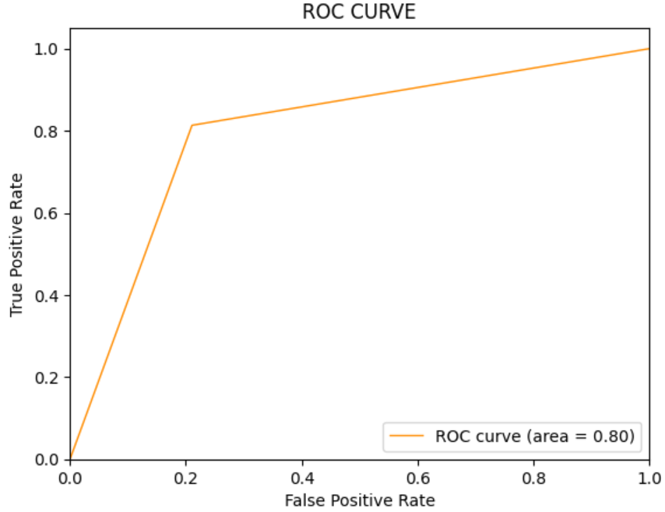
Support Vector Machine Approach for Sentiment Analysis
In the Support Vector Machine Approach , we use the vectorized texts and try to create a hyperplane between the different categories in order to segregate them . In the case of Sentiment Analysis of tweets we used a linear SVC since we only had to Categorize a tweet into Positive or Negative.

Slide 10

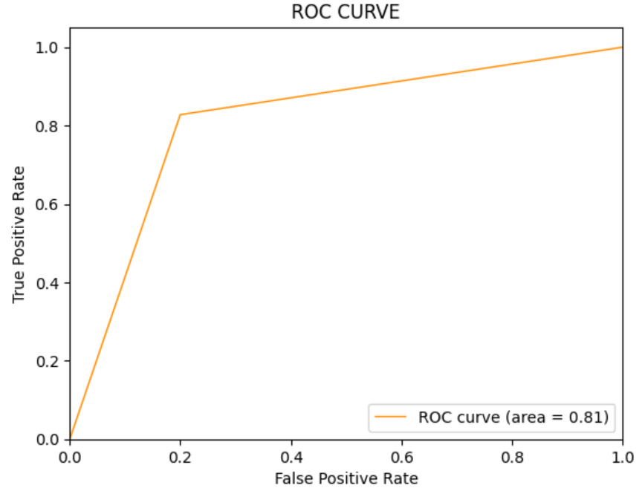
Logistic Regression Approach for Sentiment Analysis
In the Logistic Regression Approach, a sigmoid function is used on the vectorized data which then returns a probability between 0 and 1. In case of Sentiment Analysis of tweets, we can use Logistic regression to give a Binary output , i.e, Positive or Negative Sentiment in a Tweet.

Slide 11
Performance Comparison
Models | Precision | Recall | F1-Score
Naive Bayes | 80% | 81% | 80%
SVC | 81% | 79% | 80%
Logistic Regression | 82% | 80% | 81%

Slide 12
Using Unsupervised Approach
Unsupervised learning is a type of machine learning technique where the model is trained on a set of data without being explicitly told what to look for. In the context of Twitter sentiment analysis, unsupervised learning can be used to identify patterns and groupings in the text data that may be indicative of sentiment.
For our project, this approach will be split into three main techniques:
Using Dimensionality Reduction methods like T-SNE to visualize clusters.
Using Clustering Algorithms like K-means and GMM.
Using Lexicon based approach with Vader and Textblob Lexicons to identify sentiment through the presence of certain words or phrases commonly associated with positive or negative sentiment.

Slide 13
Dimensionality Reduction Methods (T-SNE)
t-SNE (t-Distributed Stochastic Neighbor Embedding) is a machine learning algorithm used for dimensionality reduction and visualization of high-dimensional data. It works by first calculating the similarity between each pair of data points in high-dimensional space and then mapping them to a lower-dimensional space while preserving the similarities as much as possible.
Our corpus will be first created into a TF-IDF Vector Matrix in order to have similar values for similar words. After that, T-SNE Algorithm will be applied to the Matrix.

Slide 14
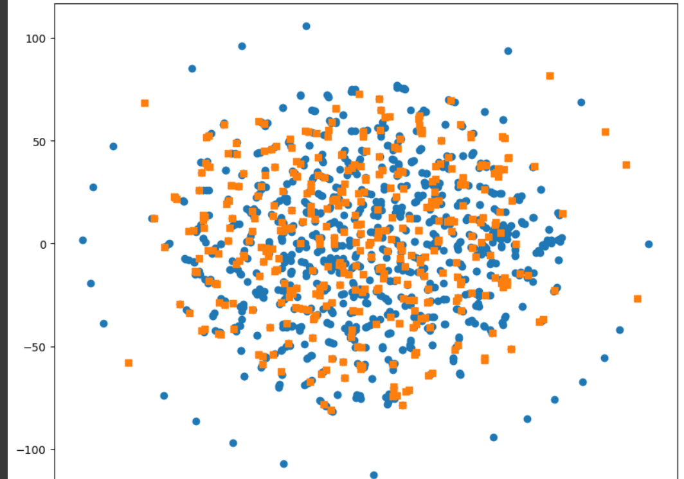
After Applying T-SNE Dim. Reduction Algorithm
We can clearly see that while visualizing the data, clusters are not properly Splitted, but let’s observe what happens when we apply Unsupervised ML methods on the given data.

Slide 15
Clustering Algorithms
Models | Precision | Recall | F1-Score
K-Means | 56% | 53% | 53%
K-Means + PCA | 40% | 49% | 49%
K-Means + T-SNE | 49% | 49% | 49%
Hierarchical Clus. + PCA | 49% | 49% | 49%
Hierarchical Clus. + TSNE | 40.43% | 49.35% | 49.63%
Not a good performance :(

Slide 16
Lexicon Based Approach
A lexicon-based approach in sentiment analysis is a method that uses a sentiment lexicon or dictionary to assign polarity scores to words or phrases based on their sentiment. The polarity scores usually range from -1 to 1, where negative scores indicate negative sentiment, positive scores indicate positive sentiment, and scores close to 0 indicate neutral sentiment.
In our case, we would be utilizing two different libraries and compare their Sentiment Distribution and Performances :-
VADER (Valence Aware Dictionary and Sentiment Reasoner)
TextBlob

Slide 17
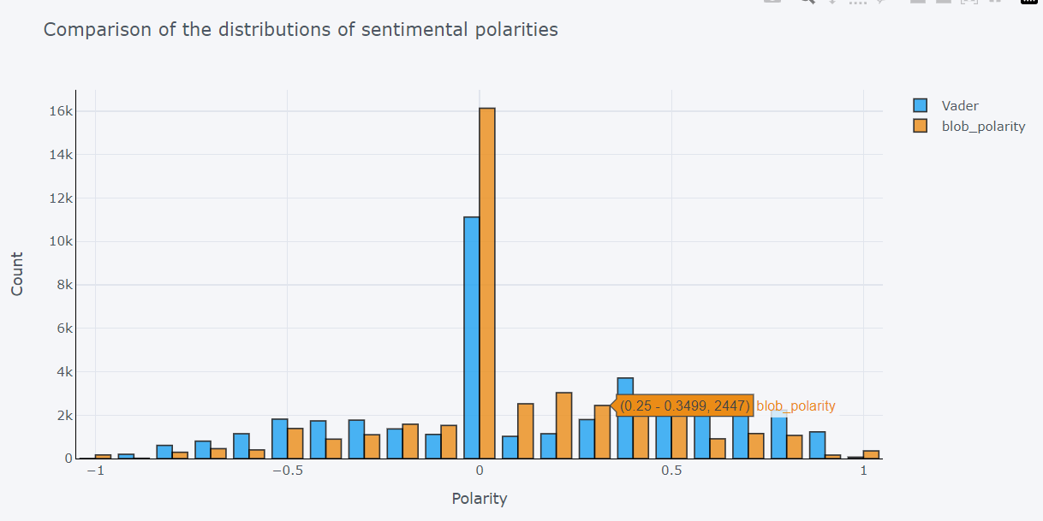
Distribution of Sentiment Polarities of different documents in dataset
As we can see that most of the documents have Neutral Polarity in both Libraries and Vader has better sentiment distribution as compared to TextBlob Library, which helps us in achieving overall better performance.

Slide 18
Performance Comparison
Libraries | Precision | Recall | F1-Score
VADER | 64% | 68% | 65%
TextBlob | 63% | 63% | 62%
As we can see that Using Lexicon Based Approach improved our Performance Metrics and it shows that Unsupervised based Approach in the given data can be used to provide a good enough Performance.

Slide 19
THANK YOU FOR LISTENING :)

