Slide 1
Text to Image USING STABLE DIFFUSION
ROLL NO : 21BCE181 21BCE186
21BCE210

Slide 2
Text to Image - Basic Introduction
Definition:
Text-to-image technology converts textual descriptions into corresponding images using deep learning algorithms and natural language processing.
Methodology:
It primarily relies on Generative Adversarial Networks (GANs), a type of neural network architecture, to generate realistic images based on textual input.
Learning Process:
The models learn to understand the semantics of the text and translate it into visual representations by analyzing large datasets of paired text-image examples.

Slide 3
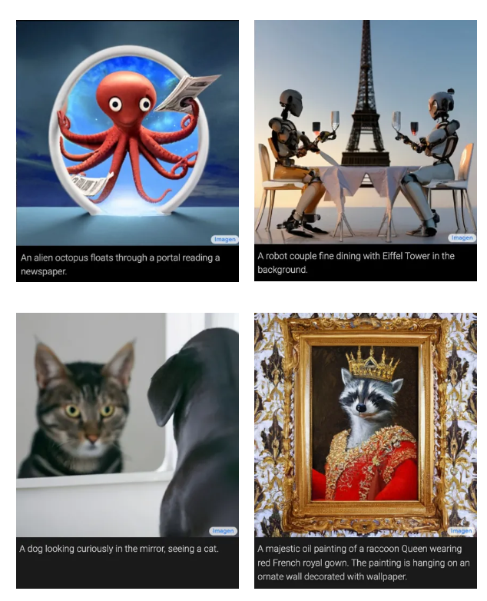
Text to Image

Slide 4
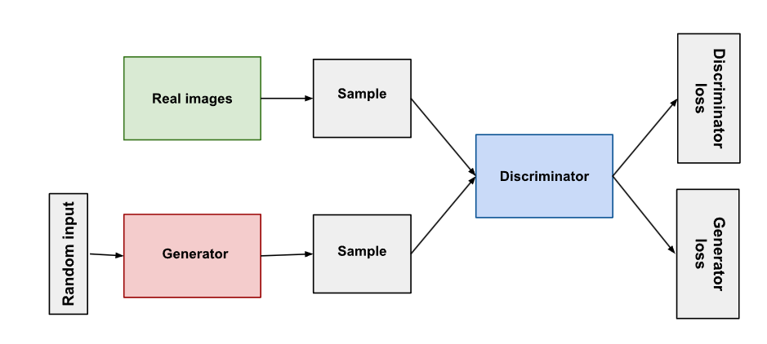
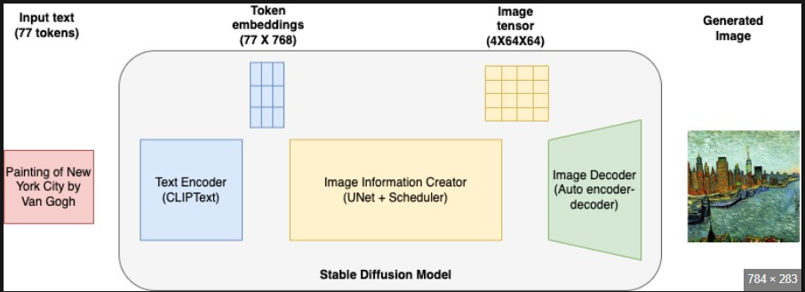
ARCHITECTURES
USING GAN
USING STABLE DIFFUSION

Slide 5
USE OF NLP IN TEXT TO IMAGE
Semantic Understanding:
NLP techniques are employed to understand the semantics of textual descriptions provided as input for generating images. This involves parsing and analyzing the text to extract meaningful information and context.
Text Representation:
NLP helps convert textual descriptions into suitable representations that can be understood by the image generation model. Techniques such as word embeddings or transformer-based models like BERT are commonly used to encode textual information into numerical vectors.
Fine-tuning and Adaptation:
NLP models can be fine-tuned or adapted to specific domains or styles by incorporating textual descriptions related to those domains. This enables the generation of images that are tailored to specific contexts or preferences.

Slide 6
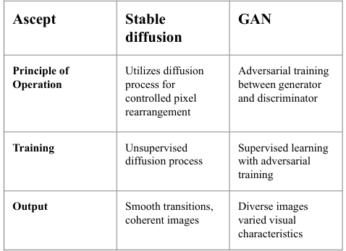
GAN v/s stable diffusion

Slide 7
Benefits of Stable Diffusion:
Stability:
Stable diffusion models tend to produce more stable and consistent results compared to GANs.
They have a more predictable training process with less mode collapse.
Training Simplicity:
Diffusion models are often easier to train compared to GANs, requiring fewer hyperparameters and less fine-tuning.
They have a straightforward likelihood-based training objective.
Better Sampling Efficiency:
Stable diffusion models often achieve higher sample quality per FLOP (floating-point operation) compared to GANs.
They can generate high-quality samples efficiently without requiring extensive computational resources.

Slide 8
Applications of Stable Diffusion
Image Generation and Synthesis:
Stable diffusion models are used to generate high-quality and diverse images across different domains, including natural scenes, faces, artwork, and more.
These models can produce realistic and detailed images with fine-grained control over attributes such as style, texture, and content.
Image Editing and Manipulation:
They enable precise image editing and manipulation by controlling the diffusion process to adjust specific aspects of an image, such as adding or removing details, changing colors, or altering textures.
Users can manipulate the noise level to control the level of detail in generated images, allowing for targeted modifications while preserving overall image coherence.
Data Augmentation:
Stable diffusion models serve as effective tools for data augmentation in training datasets for various machine learning tasks, including image classification, object detection, and segmentation.

