Slide 1

Spectra – VISUAL NAVIGATION ASSISTANT FOR VISUALLY IMPAIRED
By
Arya Kumari - 12020002001071 Anisha Jangid – 12020002001048
(B.Tech 4th Year)
Under the Supervision of
Prof. Dipta Mukherjee
Dept. of Computer Science & Engineering
University of Engineering & Management, Jaipur

Slide 2
Outlines
Introduction
Literature Review
Objectives
Proposed Model
Experimental Setup
Result Analysis
Conclusion & Future Scope
Reference
Acknowledgement

Slide 3
Introduction
In this project "Spectra" we have created a web application that is designed to empower visually impaired individuals through the integration of the advanced technologies. Utilizing React.js, TensorFlow, and facial APIs, the project's core features include facial recognition with age, gender, and emotion detection, enabling users to perceive information about people around them. The addition of object recognition facilitates a deeper understanding of their surroundings. voice navigation system allows users to effortlessly navigate through the web application by speaking, enhancing accessibility. Text recognition feature allow user to read the text properly. The project creates a user-friendly interface tailored to the unique needs of the visually impaired community. With a commitment to inclusivity, "Spectra" strives to provide real-time information and foster independence in daily activities . Spectra is also designed for empowering interaction through Intelligent Recognition. We aimed to create a platform that goes beyond conventional user interfaces, allowing seamless interaction with technology through advanced recognition capabilities.

Slide 4
Literature Review
There are many researchers who have done the work on this project earlier. One such is from 2018 International Symposium on Electronics and Telecommunications (ISETC). The review given by the researchers were as follows:- Facial recognition is a very on-demand task today. What makes a racial detection and recognition system good is its robustness to changes in illumination, rotation and tilt, position and occlusion. In this paper we present a face recognition system trained on a proprietary database. Our method is based on YOLO (You Only Look Once) model, which is a general object detection system, that by modifying and testing different internal parameters we have proven it to be adequate for face recognition. The database was created especially for this project, with images featuring 10 different subjects, different orientations, and illumination conditions, totalling to 120.000 samples. The models were based on 17 variations of the architecture of Darknet-19 neural network, from which we have chosen the one with the best results.

Slide 5
Objectives
Help visually impaired individuals gain independence in daily life activities through user-friendly technology.
Provide detailed information about people nearby, including their age, gender, and emotions, using facial recognition technology.
Assist users in recognizing and understanding their surroundings by implementing object recognition capabilities.
Enable easy navigation within the web application through a voice-controlled system, making it simple for users to move between different sections.
Integrate technologies like React.js to create an accessible platform that accommodates diverse user needs.
Offer real-time information feedback to users, allowing them to interact with their environment more effectively.

Slide 6
Proposed Model
In our proposed model, "Spectra," we aim to create a helpful tool for visually impaired individuals by using technology in a friendly way. The main idea is to give them more independence in their daily lives. With facial recognition, the system can tell them about the people around them—like their age, gender, and emotions. We also want to help them understand their surroundings better by adding object recognition. This way, they can identify and interact with things around them. Moving around the web application will be easy too, as we're including a voice system. Users can just speak to navigate between different parts of the application. We're making sure the system gives feedback in real-time, so users can get information quickly. The interface is designed to be easy and comfortable, focusing on what visually impaired users need. We're not just stopping there; we want to keep making it better based on what users tell us, and we're committed to using the latest technology to make "Spectra" even more helpful over time..

Slide 7
Experimental Set-up
For our entire project we have used:-
Windows 10 Operating system or later
VS code (for writing the code)
NodeJs
ReactJs
Tensorflow
Face Recognition Model
Text to Speech Recognition Model
Object Recognition Model
Git Bash(To run the command to connect our database with the server)

Slide 8
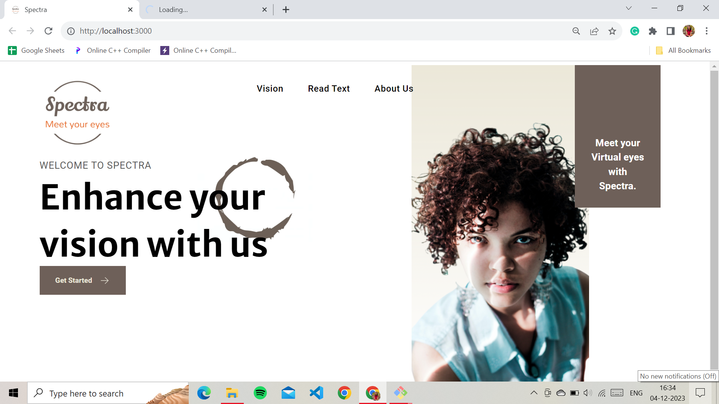
Result: Example
HOME PAGE

Slide 9
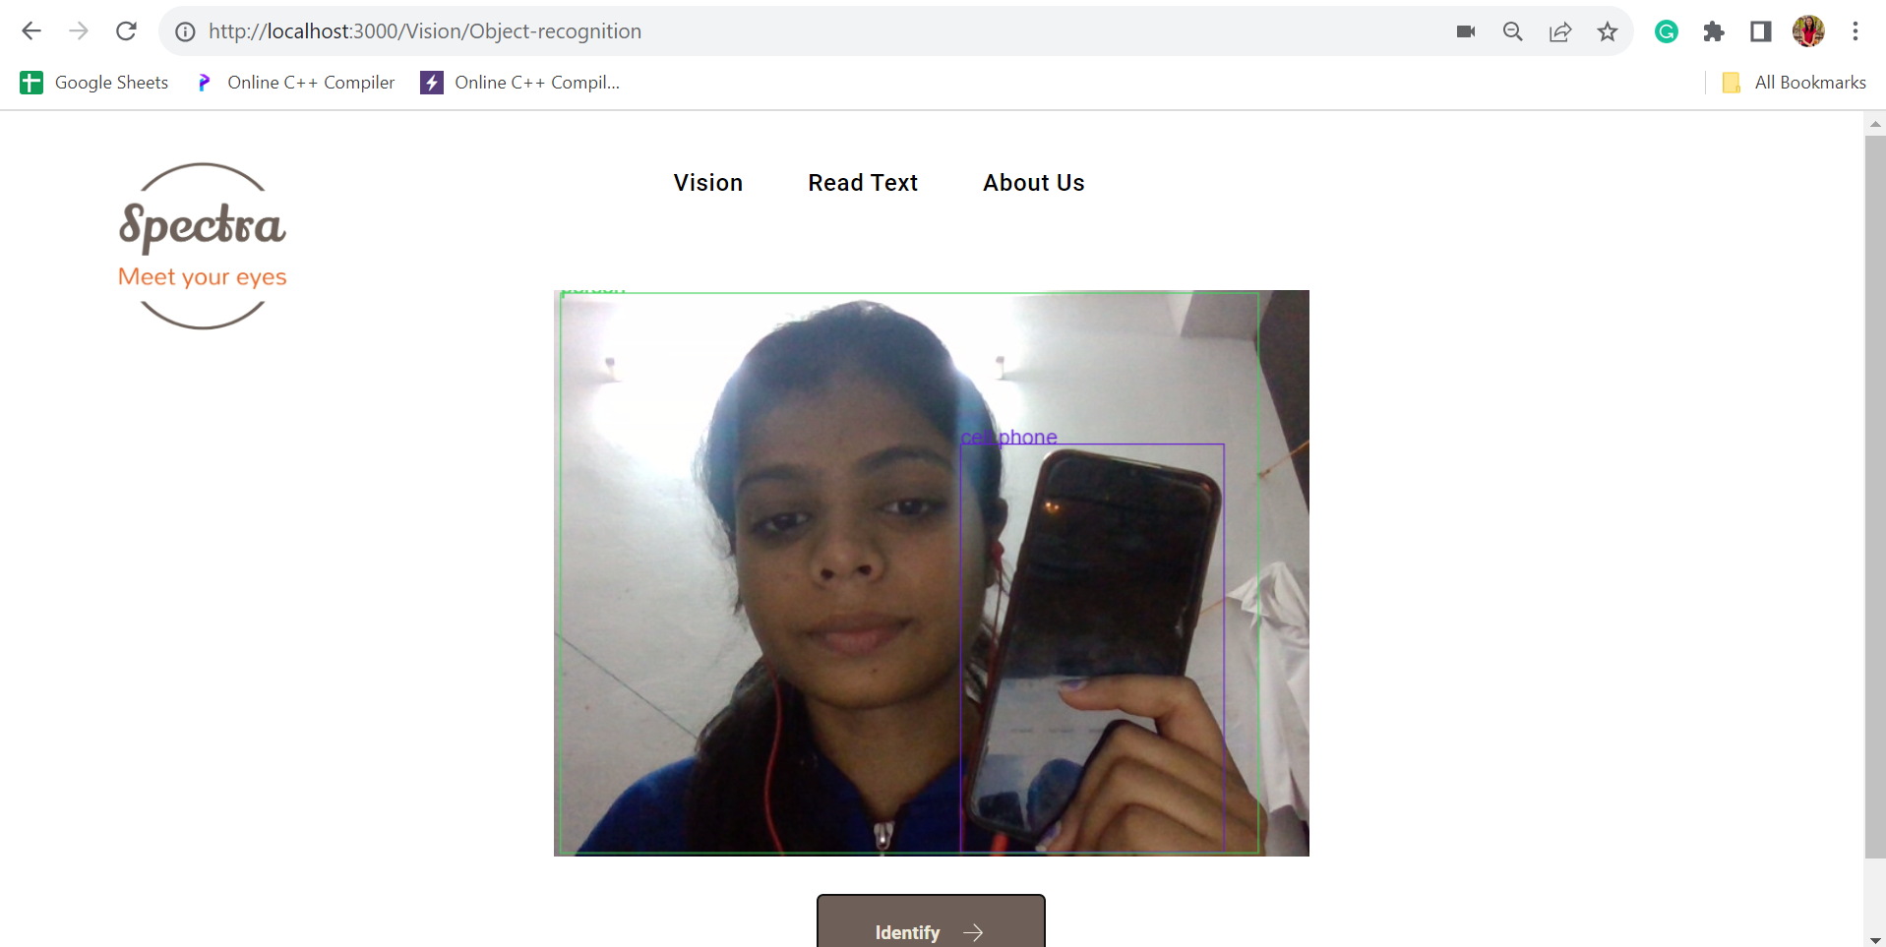
OBJECT DETECTION

Slide 10
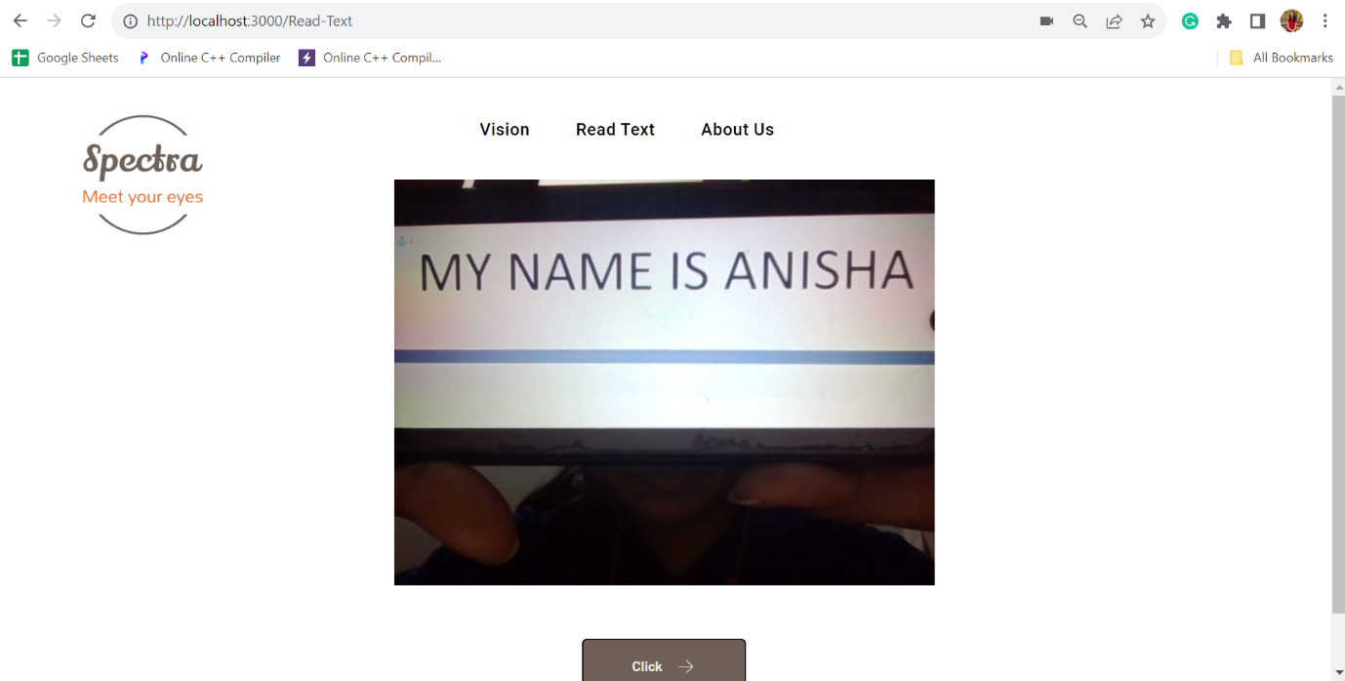
TEXT TO SPEECH

Slide 11
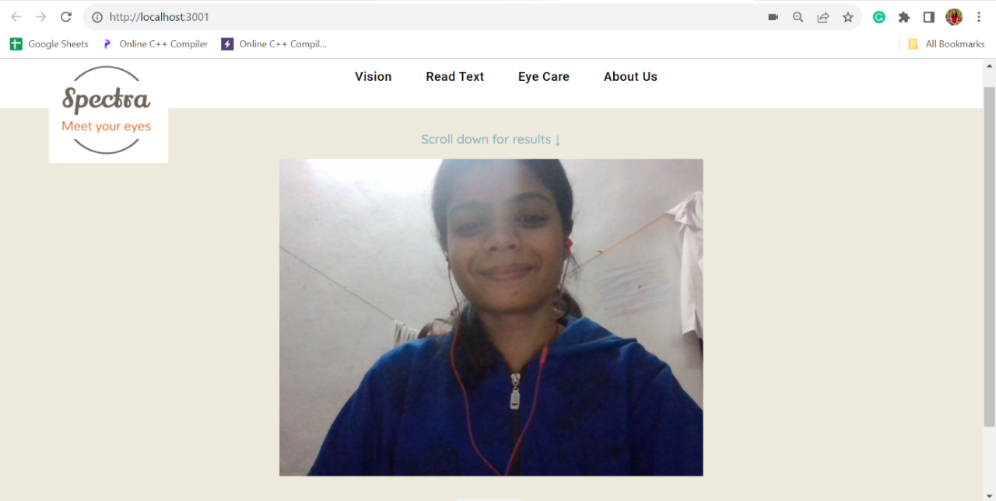
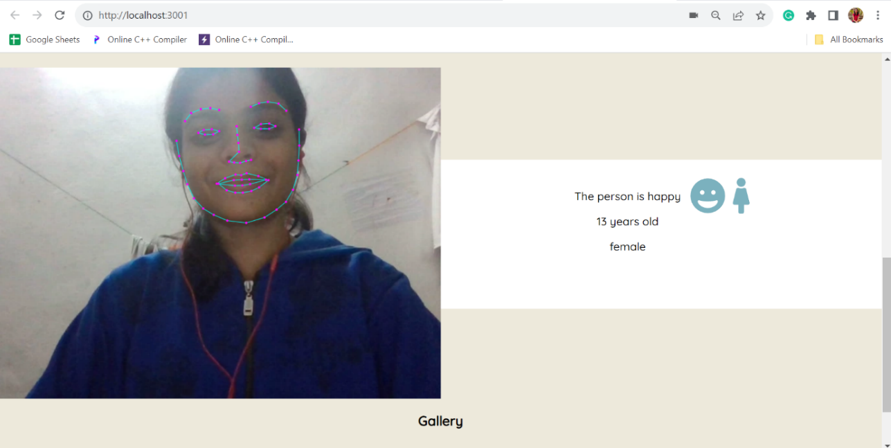
RESULT

Slide 12
Result Analysis
The visually impaired people shows the camera to the faces of the people, our model will recognise the emotion and ages of the people along with the gender of the person.
If the camera is been shown to a written text then our model reads out the written text by using the speech recognition model.
The website activates the voice navigation if the logo is been clicked and the spoken pages is been redirected.
The camera detects the objects by using the Object recognition model and then speaks out the object name.
Results are almost correct according to the model which is integrated to our model.

Slide 13
Conclusion & Future Scope
At last I want to conclude that our web app Spectra would be the best fit for the visually impaired people so that they can easily find out the emotions of the people in their surrounding and also accessibility and functionality for visually impaired individuals would be enhanced. In the rapidly evolving landscape of web development, Spectra stands as a testament to the potential of integrating advanced technologies to create impactful and accessible solutions.
FUTURE SCOPE:-
Login system with personalised data set
Improve accuracy
Distance and speed

Slide 14
References
https://viso.ai/computer-vision/deepface/
https://www.tensorflow.org/lite/examples/object_detection/overview
https://pylessons.com/speech-recognition
https://github.com/mhagglun/Speech-Recognition

Slide 15
Acknowledgement
The endless thanks goes to Lord Almighty for all the blessings he has showered onto me, which has enabled me to write this last note in my project work. During the period of my project work, as in the rest of my life, I have been blessed by Almighty with some extraordinary people who have spun a web of support around me. Words can never be enough in expressing how grateful I am to those incredible people in my life who made this thesis possible. I would like an attempt to thank them for making my time during my project in the Institute a period I will treasure. I am deeply indebted to my research supervisor, Professor Dipta Mukherjee me such an interesting thesis topic. Each meeting with him added in valuable aspects to the implementation and broadened my perspective. He has guided me with his invaluable suggestions, lightened up the way in my darkest times and encouraged me a lot in the academic life.

Slide 16

Dept. of CSE, University of Engineering & Management Jaipur

