Slide 1
IBM University Engagement Project Submission
“Exploring the Power of Agentic AI with IBM Granite and LangFlow”

Slide 2

Eco Lifestyle Agent
Domain of Project – Environment & Sustainability
Student Name | Recent Passport Photo | Email ID | Mobile number [WhatsApp]
Arya L |  | aryaarya6175@gmail.com | 8848536948

Slide 3
Problem Statement -
Problem Statement : Eco Lifestyle Agent
The Challenge
Environmental issues such as plastic pollution, improper waste management, excessive energy consumption, water scarcity, and climate change continue to increase due to a lack of awareness and easy access to reliable sustainability information. Many people struggle to find accurate, trustworthy, and personalized eco-friendly guidance, as environmental information is often scattered across multiple sources. Without AI-powered, real-time assistance, individuals may find it difficult to adopt sustainable habits in their daily lives..
The Objective
Build an AI-powered Eco Lifestyle Agent that provides personalized environmental guidance and sustainable living recommendations using trusted government documents and AI. The solution should:
Waste Management Guidance – Recommend proper waste segregation, recycling methods, and responsible disposal practices.
Plastic Reduction Suggestions – Provide practical ways to reduce single-use plastics and promote sustainable alternatives.
Energy Conservation Advice – Suggest techniques to save electricity and improve energy efficiency.
Water Conservation Guidance – Recommend effective water-saving practices for homes and communities.
Renewable Energy Awareness – Educate users about renewable energy sources and their environmental benefits.
Document-based RAG Retrieval – Retrieve accurate information from government environmental PDF documents using Retrieval-Augmented Generation (RAG).
AI-powered Question Answering – Generate reliable and easy-to-understand responses using the IBM Granite Foundation Model.
Interactive Eco Assistant – Provide users with a simple chatbot interface to ask environmental and sustainability-related questions in natural language.

Slide 4
Proposed Solution -
Proposed Solution: AI-Powered Eco LifestyleAgent
The proposed solution is an AI-powered Eco Lifestyle Agent developed using IBM watsonx.ai, IBM Granite, Retrieval-Augmented Generation (RAG), FAISS, and Streamlit. It provides users with reliable and personalized guidance on sustainable living by answering environmental queries using trusted government documents.
The system uses a RAG pipeline to retrieve relevant information from environmental PDF documents. These documents are converted into vector embeddings using Hugging Face Embeddings and stored in a FAISS vector database. When a user asks a question, the most relevant document sections are retrieved and passed to the IBM Granite model to generate an accurate, natural-language response
.
The system consists of following key components:
Knowledge Retrieval Module – Searches the FAISS vector database to retrieve the most relevant environmental information using semantic search.
AI Response Generation Module – Uses IBM Granite to generate natural language answers based only on the retrieved document context.
Environmental Knowledge Base – Stores trusted government documents covering waste management, plastic waste rules, renewable energy, water conservation, and sustainable practices.
Interactive Chat Interface – Provides a user-friendly Streamlit web application where users can ask environmental questions in natural language and receive AI-generated responses.
Document Processing Pipeline – Automatically extracts text from PDF documents, creates embeddings, and updates the vector database for future retrieval.

Slide 5
Technology Used
IBM Granite Model (ibm/granite-4-h-small) – Used for natural language understanding and generating intelligent, context-aware responses to users' environmental queries.
IBM watsonx.ai – Provides access to the IBM Granite Foundation Model through secure APIs for AI-powered text generation.
IBM Cloud Lite – Provides the cloud infrastructure and platform services required to access IBM watsonx.ai and deploy AI applications.
Retrieval-Augmented Generation (RAG) – Retrieves relevant information from environmental government documents before generating responses, improving accuracy and reducing AI hallucinations.
FAISS Vector Database – Stores vector embeddings of environmental PDF documents and enables fast semantic similarity search for retrieving relevant context.
LangChain – Integrates document loading, text chunking, embeddings, vector database operations, and retrieval into the RAG pipeline
Streamlit – Provides an interactive web-based chatbot interface where users can ask sustainability and environmental questions.
PyPDF – Extracts text from environmental PDF documents used to build the knowledge base.
PyPDF – Extracts text from environmental PDF documents used to build the knowledge base.

Slide 6
Langflow component Used -
1) Chat Input – Interface where users enter environmental questions or sustainability-related queries in natural language.
2) IBM watsonx AI Agent – Processes user queries using IBM Granite models and generates accurate eco-friendly recommendations based on retrieved information.
3) Name of IBM Granite Model – Granite-4.0-8B-Instruct (or Granite-4-h-small if that's the model you actually used in your code) Efficient for real-time environmental question answering and document-based reasoning.
4) Chat Output – Displays AI-generated responses such as waste management guidance, recycling methods, water conservation tips, energy-saving practices, and sustainable lifestyle recommendations.
5) File Component – Stores and retrieves environmental PDF documents (government reports, CPCB guidelines, sustainability documents) used for Retrieval-Augmented Generation (RAG).
6) FAISS Vector Store Component – Converts document embeddings into a searchable vector database, enabling semantic search to retrieve the most relevant document content before sending it to IBM Granite.

Slide 7
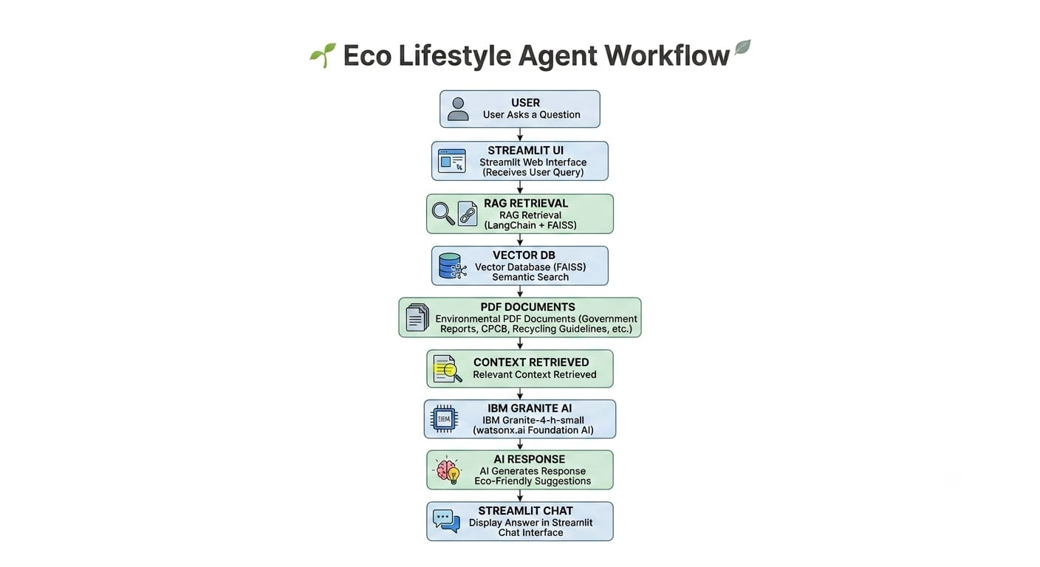

Slide 8
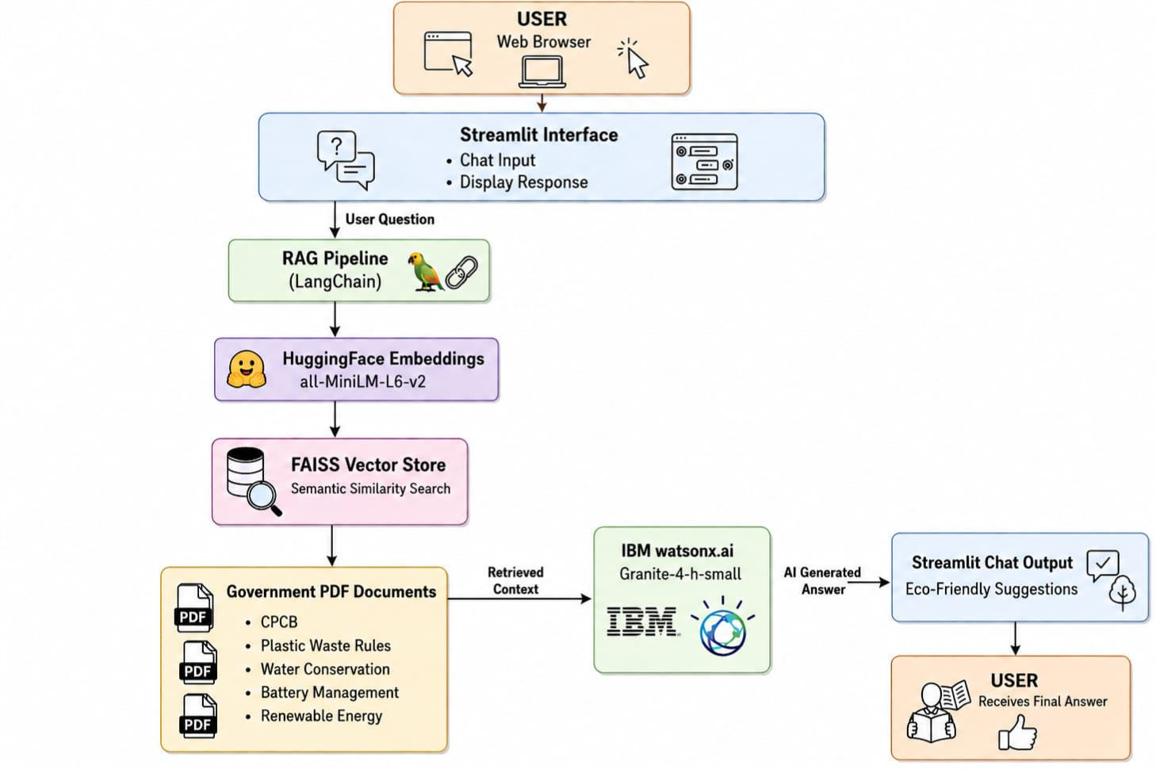
Architecture blueprint

Slide 9

Role of Agentic AI in the solution
Role of Agentic AI in Nutrition Agent
Agentic AI enables the Eco Lifestyle Agent to function as an intelligent assistant rather than a basic chatbot. Using IBM watsonx.ai and the IBM Granite model, it understands user queries, retrieves relevant information from trusted environmental documents through Retrieval-Augmented Generation (RAG), and generates accurate, context-aware responses. It provides personalized recommendations on waste management, recycling, plastic reduction, water conservation, energy saving, and sustainable living. By combining document retrieval with AI reasoning, the system delivers reliable, real-time guidance that helps users make environmentally responsible decisions and encourages the adoption of sustainable practices in their daily lives.

Slide 10
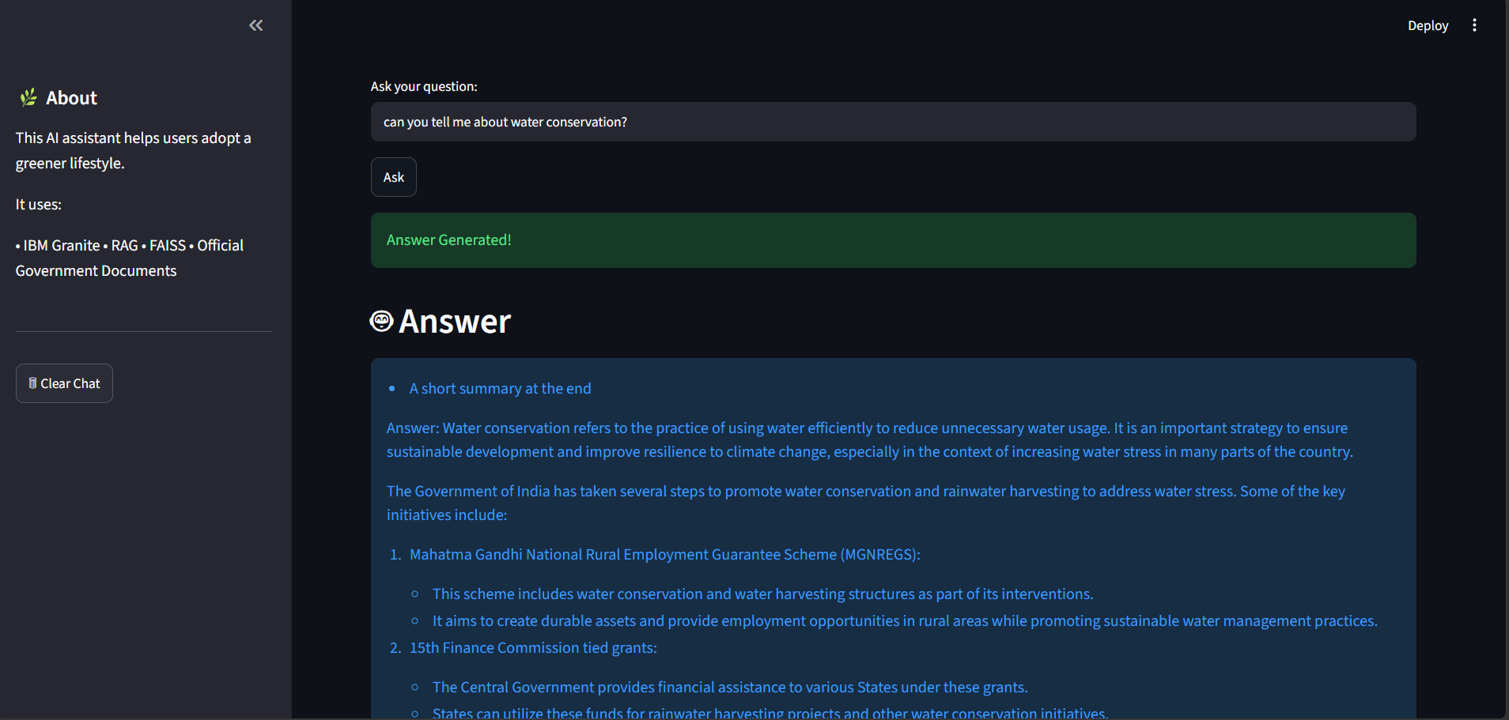
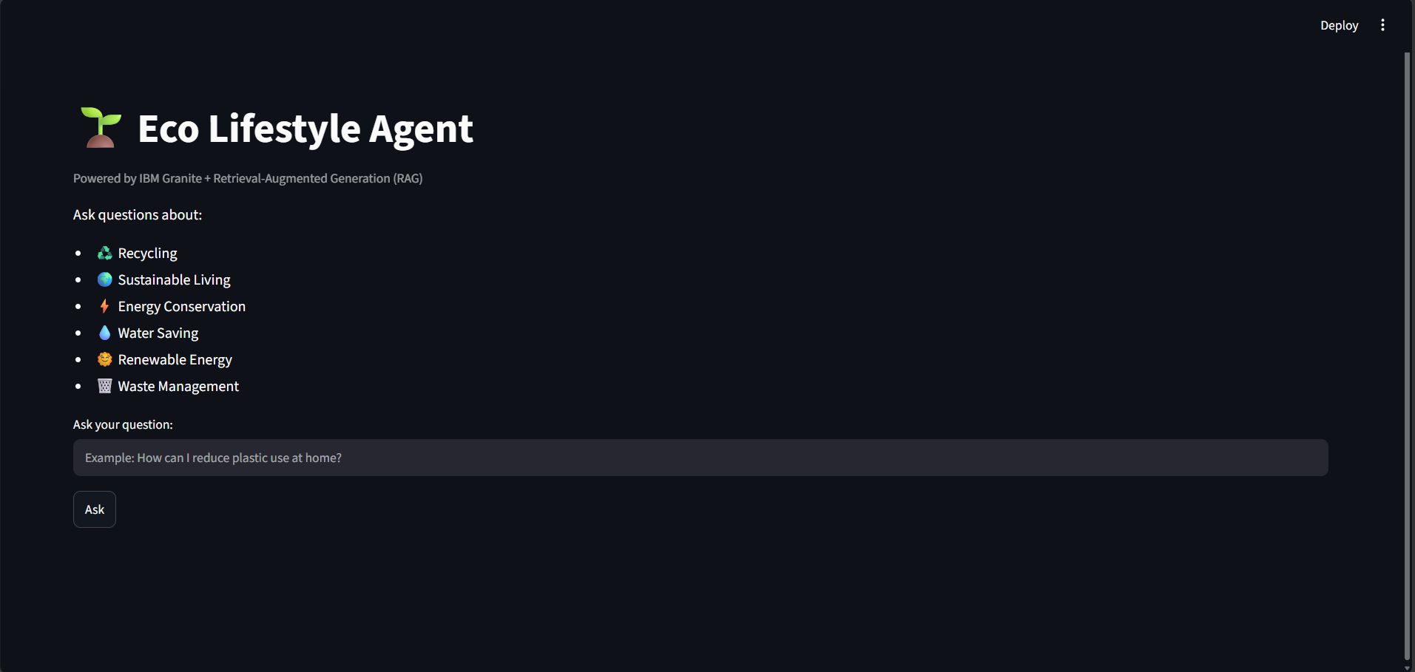
Application User Interface
AI Response Screen
Home Page
·
·
Displays the AI-generated response based on relevant environmental documents retrieved using RAG.
Allows users to enter sustainability-related questions through an interactive Streamlit interface.

Slide 11
Novelty and Uniqueness
The proposed Eco Lifestyle Agent combines Agentic AI, Retrieval-Augmented Generation (RAG), and IBM Granite to deliver accurate and intelligent environmental guidance.
RAG-Based Responses – Retrieves information from trusted government environmental documents for reliable answers.
AI-Powered Assistance – Uses IBM Granite to generate context-aware and easy-to-understand eco-friendly recommendations.
Semantic Search – Employs FAISS vector search to find the most relevant information quickly.
Personalized Guidance – Provides practical suggestions based on the user's environmental queries. Interactive Chat Interface – Offers a simple Streamlit-based chatbot for real-time question answering. Scalable & Reliable – Built using IBM watsonx.ai, IBM Granite, LangChain, and FAISS for efficient and trustworthy performance.
This makes the solution an intelligent Eco Lifestyle Assistant that promotes sustainable living through accurate, AI-powered environmental guidance rather than a simple chatbot..

Slide 12
Git Hub Link
GitHub Repository
Project Name: Eco Lifestyle Agent
Repository Link: https://github.com/arya8848/EcoLifestyleAgent
Repository Includes:
Source Code
README.md
Problem Statement.pdf
Presentation.pptx
Requirements.txt
Vector Database
Environmental PDFs
·
·

Slide 13
Future Scope
1. Smart Eco Monitoring & Personalized Recommendations – The system can be integrated with IoT devices and smart home sensors to monitor electricity usage, water consumption, and waste generation in real time. This will enable the Eco Lifestyle Agent to provide personalized sustainability recommendations and help users reduce their environmental impact through data-driven insights.
2. AI-Powered Voice Assistant & Multi-language Support – Enhancing the system with a voice-enabled assistant and support for multiple languages will improve accessibility and user experience. Users will be able to interact naturally in their preferred language, making the solution more inclusive and encouraging wider adoption of eco-friendly practices across diverse communities.
·
·
·

Slide 14
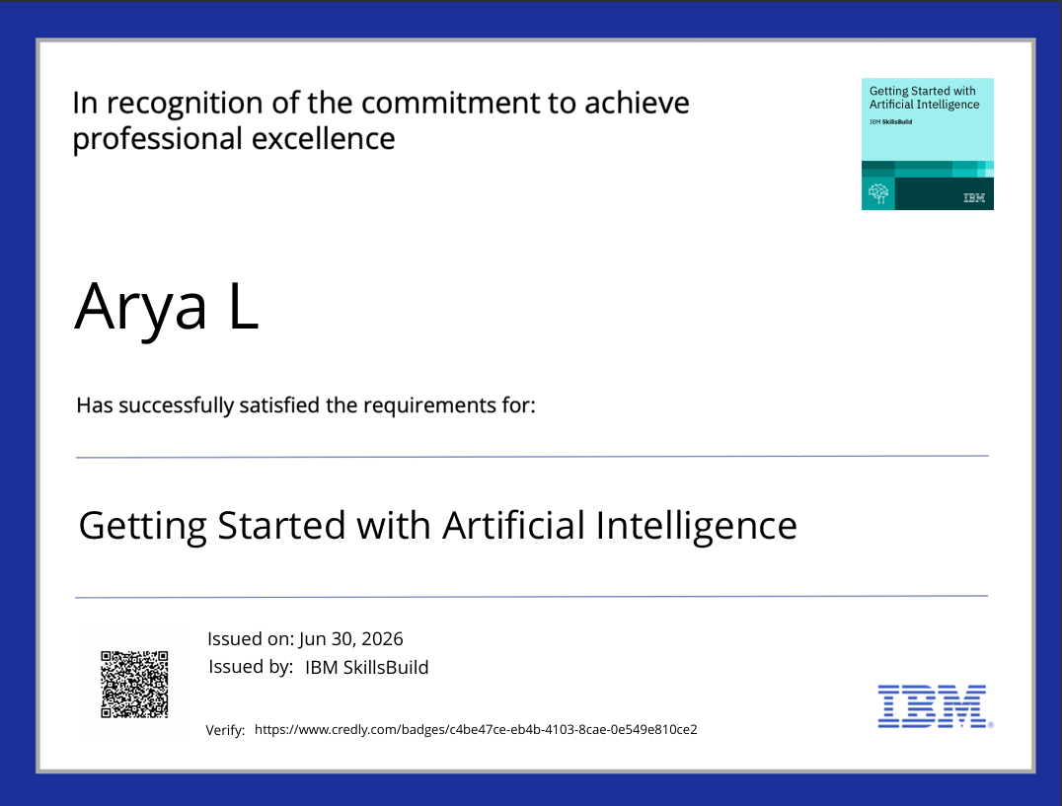
Certificates Earned:

Slide 15

Certificates Earned:

Slide 16

Certificates Earned:​

Slide 17


