Slide 1
PeoplePulse
Workforce attrition & productivity analytics – HR planning recommendations
Data Analytics internship project | IBM HR Analytics dataset (1,470 employees) + labelled synthetic operational layer

Slide 2
EXECUTIVE SUMMARY
Attrition is concentrated, predictable and largely addressable
17.5%
31%
35%
44%
annualised attrition (237 exits / 1,470 records)
exit rate with overtime vs 10% without
exit rate at 0–1 years' tenure
of exits fall in the model's top-10% risk tier
• Overtime is the single strongest driver (odds ratio ×4.4 after controlling for role, pay, tenure and satisfaction).
• Risk peaks early: 0–1 yr tenure (35%), new manager in the last year (32%), grade G1 and age < 25.
• Sales Representatives (40% exit) and Laboratory Technicians (24%) are the hotspot roles; Sales scores Red on talent health (60/100).
• Without action, active headcount drifts from 1,233 to ~1164 by 2027Q3 even with 80% backfill; a freeze would take it to ~1068.
• Recommended: overtime controls, a first-year / manager-transition programme, pay review for entry roles and a targeted retention plan for 124 high-risk employees.
PeoplePulse | IBM HR Analytics (1,470 records)

Slide 3
PHASE 1 – HR DATA FOUNDATION
Data foundation: what is real, what is synthetic, what was fixed
Real – IBM HR Analytics (1,470 records)
Synthetic – generated, flagged is_synthetic
• Employee master: department, role, grade, tenure, pay, overtime, satisfaction, rating, manager & promotion history
• Drives all attrition, risk-model, scorecard, critical-role and forecast results
• No hire/exit dates or locations – left blank, not invented; rates assume exits span 12 months
• 12 months of attendance, 4 quarters of productivity scores, 215 requisitions with source & time-to-fill
• Driven only by real IBM attributes; no exit signal injected
• Used to demonstrate absenteeism, hiring-source and productivity analytics – not as evidence
Source sheet | Issue found | Resolution
KPI_Summary | 'Exited employee records' used COUNTA → 1,470 | COUNTIF(Attrition="Yes") → 237
Attendance / Performance / Hiring samples | IDs E0003/6/9/17 not in master; 5 hires collide with long-tenured IBM IDs | Replaced by synthetic layer keyed to real IDs
Dimensions | Tenure bands and grade list (G1–G4) don't match data (G5 present) | Dimensions rebuilt from data
PeoplePulse | IBM HR Analytics (1,470 records)

Slide 4
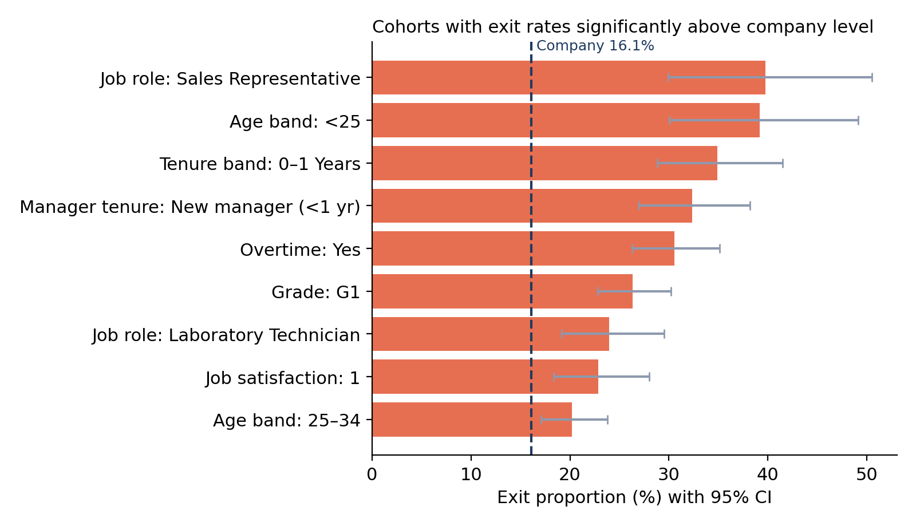
PHASE 2 – ATTRITION & RISK ANALYTICS
Who leaves: early-career, overtime-heavy, entry-grade staff
• Only cohorts whose 95% confidence interval sits above the company rate are shown.
• Sales Representatives: 40% exit proportion (n=83).
• Overtime workers: 31% vs 10%; overtime + low satisfaction reaches 37%.
• New manager in the past year: 32% – a proxy for manager change (no dated manager history).
• Seniority protects: G4–G5, Managers and Directors exit at 2–7%.
PeoplePulse | IBM HR Analytics (1,470 records)

Slide 5
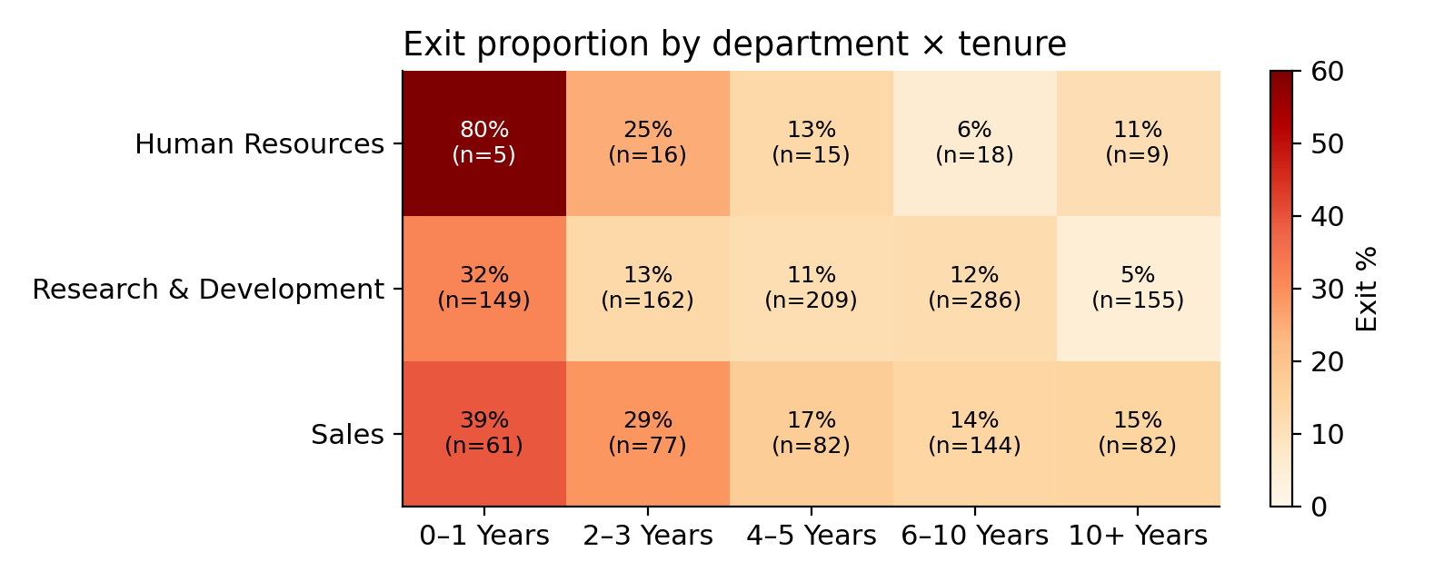
PHASE 2 – COHORT ANALYSIS
Risk is front-loaded: the first two years drive exits in every department
• R&D: 32% exit in 0–1 yr vs 5% at 10+ yrs.
• Sales stays elevated through 2–3 yrs (29%) – the onboarding problem extends into year 3.
• HR 0–1 yr = 80% but n = 5: directional only.
• Implication: retention spend has the highest return in years 0–3.
PeoplePulse | IBM HR Analytics (1,470 records)

Slide 6
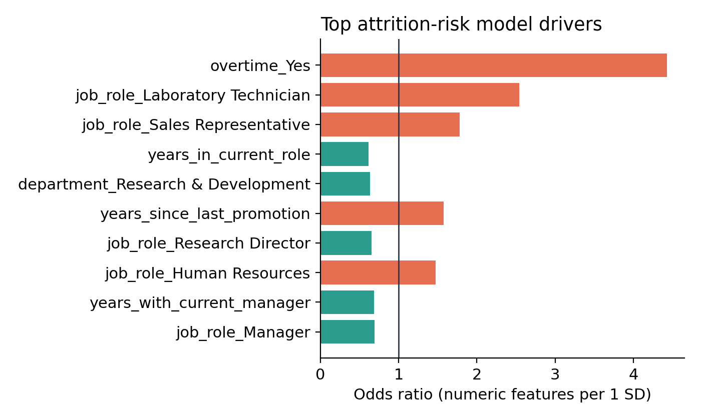
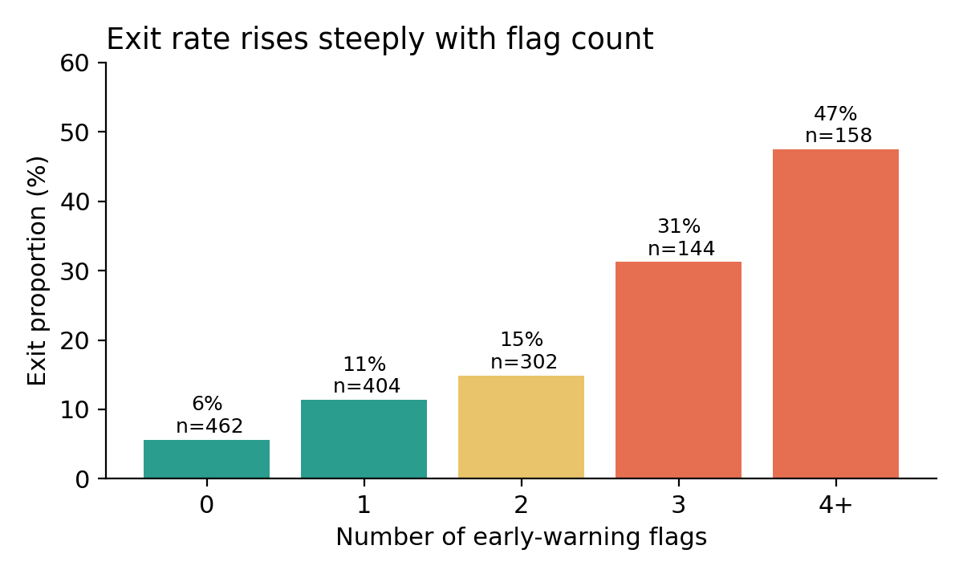
PHASE 2 – EARLY-WARNING INDICATORS
An early-warning score flags 44% of leavers in 10% of the workforce
• Logistic regression, 5-fold CV: ROC AUC 0.773, PR AUC 0.453 vs 16% baseline; gradient boosting no better (0.775).
• Simple rule version: employees with 4+ of 7 flags exit at 47% vs 6% with none – usable without the model.
PeoplePulse | IBM HR Analytics (1,470 records)

Slide 7
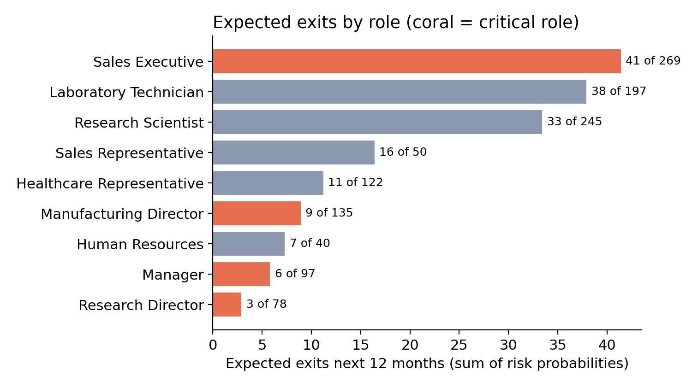
PHASE 4 – CRITICAL ROLE RISK
Critical-role exposure: Sales Executives are the main continuity risk
• Sales Executive: 269 active, 34 high-risk, ~41 expected exits in 12 months.
• Leadership roles (Manager, Research / Manufacturing Director) are stable: ≤ 9 expected exits each.
• Lab Technicians and Research Scientists are not tagged critical but together lose ~70 people a year – a capacity risk for R&D.
• Critical = leadership or revenue-carrying roles (assumption; adjust to company policy).
PeoplePulse | IBM HR Analytics (1,470 records)

Slide 8
PHASE 4 – TALENT HEALTH
Department talent health scorecard
Department | Score | Attrition | High-risk share | Low satisfaction | Overtime | Promotion stalled 5+ yrs | Absenteeism* | Time to fill*
Human Resources | 80 Amber | 21.0% | 9.8% | 47.1% | 23.5% | 15.7% | 3.4% | 33 d
Research & Development | 99 Green | 14.9% | 7.2% | 36.7% | 23.8% | 16.9% | 3.4% | 42 d
Sales | 60 Red | 23.0% | 16.7% | 36.4% | 22.6% | 21.2% | 3.3% | 40 d
• Score 0–100: each metric scored vs the company level (100 at or better, −2 pts per 1% worse); weights: attrition 30%, high-risk 20%, low satisfaction 15%, overtime 10%, absenteeism 10%, time to fill 10%, promotion 5%.
• Sales is Red: highest attrition (23%) and 2.3× R&D's high-risk share. HR is Amber on low satisfaction (47%) and attrition.
• * synthetic inputs (10% + 10% of weight).
PeoplePulse | IBM HR Analytics (1,470 records)

Slide 9
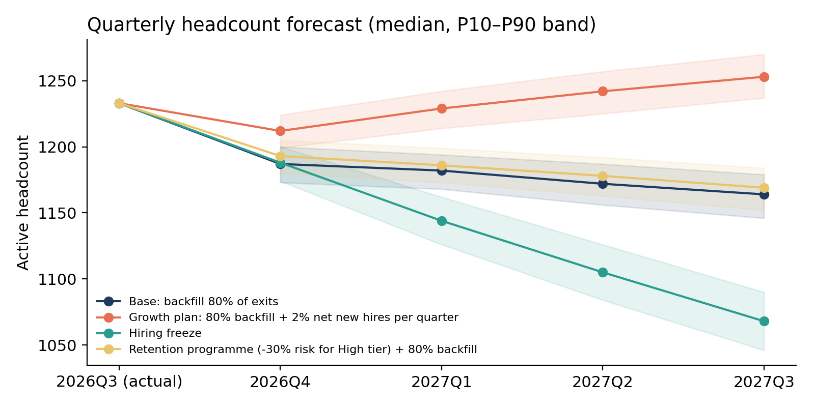
PHASE 4 – WORKFORCE PLANNING
Quarterly headcount forecast: backfilling alone does not hold headcount
Scenario | 2027Q3 median | P10–P90 | Exits (4 qtrs)
Base | 1164 | 1146–1179 | 176
Growth plan | 1253 | 1237–1270 | 191
Hiring freeze | 1068 | 1046–1090 | 165
Retention programme | 1169 | 1152–1184 | 160
• Starting point: 1,233 active employees (2026Q3 snapshot).
• Retention programme on the High tier avoids ~17 exits in a year.
• Holding headcount flat needs ~45 hires per quarter; growing 2% per quarter needs ~70.
• Method: 2,000 Monte Carlo runs over each employee's risk score; backfills arrive a quarter after the exit; new hires carry the observed first-year exit rate.
PeoplePulse | IBM HR Analytics (1,470 records)

Slide 10
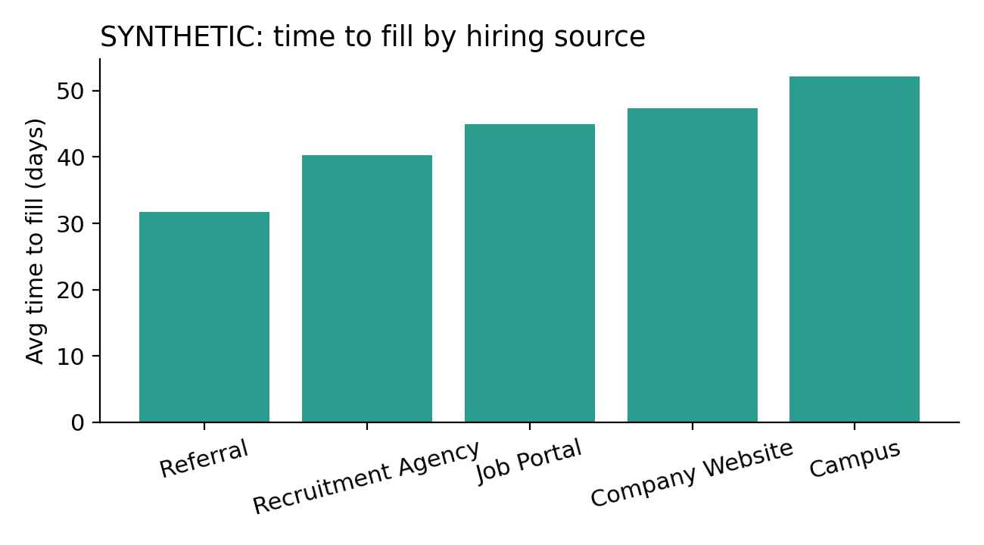
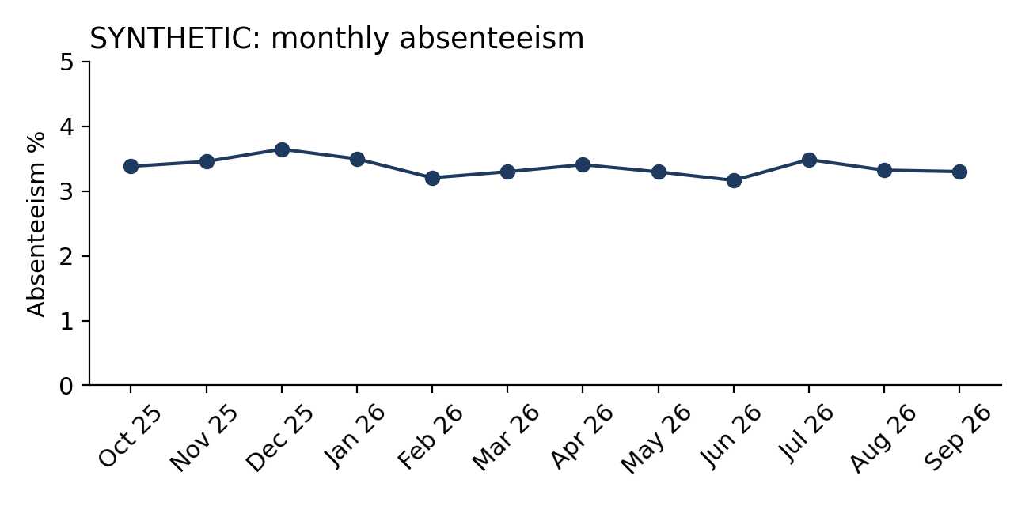
PHASE 3 – PRODUCTIVITY & HIRING INSIGHTS
Hiring, absence and productivity analytics (method demo)
• Synthetic: the IBM dataset has no attendance, requisition or productivity history. Values show what the dashboard and KPIs will report once real HRIS / ATS data is connected.
• Real component: first-year exits (16 of 44 employees with < 1 yr tenure = 36%) – the early-exit outcome attached to each requisition.
• Ready-built: absenteeism by month & department, time-to-fill by source & grade, probation outcomes, productivity by role family and rating.
PeoplePulse | IBM HR Analytics (1,470 records) | SYNTHETIC DATA – illustrative only

Slide 11
HR PLANNING RECOMMENDATIONS
Recommendations for HR and leadership
Action | Evidence | What to do | Owner
1. Cap and rebalance overtime | 31% vs 10% exit; OR ×4.4; 76% of High-tier actives work overtime | Overtime caps / comp-time for Sales Reps, Lab Techs, Research Scientists; monthly overtime review | Ops + HRBP
2. First-two-years programme | 0–1 yr exit 35%; Sales 2–3 yr 29% | Structured onboarding, 30/60/90-day check-ins, buddy system, 12-month career conversation | HR + line managers
3. Protect manager transitions | New manager in last year: 32% exit | Handover plan and skip-level 1:1 within 30 days of any manager change | HRBP
4. Entry-role pay & progression review | G1 exit 26%; leavers in Sales Rep / Lab Tech earn 12–15% less than stayers | Benchmark G1 pay; clearer G1→G2 promotion criteria | Total Rewards
5. Targeted retention for High tier | 124 high-risk active staff; ~17 exits avoidable / yr | Monthly risk-score refresh; stay interviews; manager action plans | HR Analytics + HRBP
6. Sales Executive bench | ~41 expected exits / yr in a critical role | Succession pool from top Sales Reps; pipeline hiring ahead of exits | Sales leadership + TA
PeoplePulse | IBM HR Analytics (1,470 records)

Slide 12
ROADMAP
Next steps and data needed to go from snapshot to live system
• Connect HRIS: hire / exit dates, location, monthly snapshots → true period attrition and trend lines
• Replace synthetic layer with real attendance (time & attendance system) and requisitions (ATS)
• Define productivity per role family (e.g. quota attainment for Sales, output KPIs for R&D)
• Re-train the risk model quarterly; validate on the next period's actual exits
• Week 1–2: pilot retention actions with Sales and the R&D lab teams
• Track KPIs monthly: attrition, first-year exit rate, overtime share, High-tier count
• Governance: risk scores are for workforce planning in aggregate – not for individual performance decisions
• Fairness check: gender is a model input – audit tier rates by gender / age and test removing it before operational use
PeoplePulse | IBM HR Analytics (1,470 records)

Slide 13
APPENDIX
Appendix: methodology and KPI definitions
KPI | Definition | Data basis
Annualised attrition rate | Exits / average headcount = exits / ((records + active) / 2); assumes IBM exits span 12 months | Real
Exit proportion | Exits / employee records in a segment; 95% Wilson confidence interval | Real
Risk probability | Out-of-fold logistic regression probability (10 numeric + 4 categorical features) | Real
Risk tier | High ≥ 0.31 (top 10% of active), Medium ≥ 0.16 (next 20%) | Real
Absenteeism rate | Absent days / scheduled workdays | Synthetic
Time to fill | Fill date − opening date (days) | Synthetic
Early exit within 1 year | Exited with Years_at_Company = 0 | Real
Talent health score | Weighted 0–100 composite vs company level (see scorecard slide) | Mixed
PeoplePulse | IBM HR Analytics (1,470 records)

