Slide 1


Heath Management Information System

Slide 2
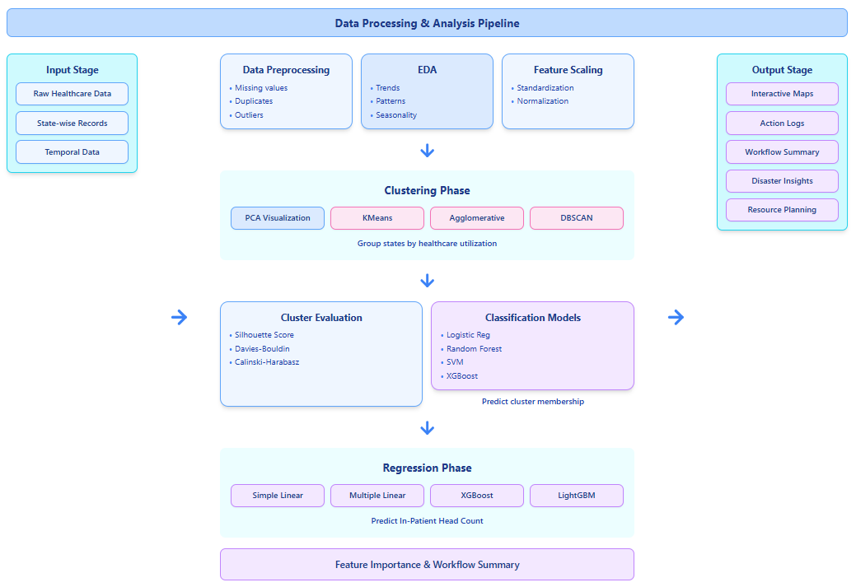
1
2
Solution:
Problem:
We developed a complete Data Science pipeline to understand and model state-wise healthcare service utilization patterns and predict hospital inpatient load.
The Health Management Information System (HMIS) collects monthly healthcare service data from hospitals across India.
However, this data is large, complex, and difficult to interpret directly.
Policymakers struggle to identify which states are performing well, where healthcare services are lacking, and how patient load changes over time.
There is no direct system to:
Compare healthcare performance between states
Group states with similar healthcare patterns
Predict hospital in-patient load for resource planning

Slide 3
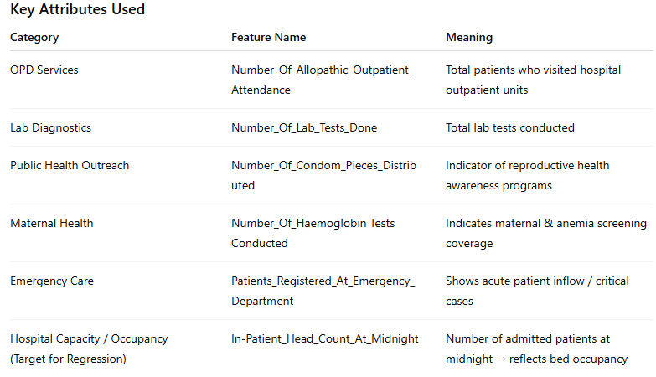
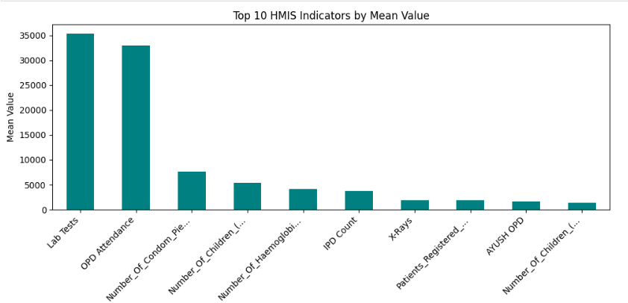
About the Dataset
Preprocessing
The dataset used in this project is the HMIS (Health Management Information System) dataset, which records state-wise monthly healthcare service usage across India.
It contains healthcare indicators related to patient attendance, laboratory tests, maternal health services, emergency care, and inpatient occupancy.
We selected 10 major Indian states for focused comparative analysis: Kerala, Tamil Nadu, Maharashtra, Gujarat, Karnataka, Rajasthan, Uttar Pradesh, Madhya Pradesh, Bihar, West Bengal
The dataset includes multiple monthly entries, allowing trend analysis over time.
Imported and loaded dataset from HMIS portal .csv file.
Selected 10 major Indian states for focused comparative analysis.
Trimmed and standardized column names to ensure consistency.
Removed rows with missing values in key health indicators and target variable.
Checked and removed duplicate entries to avoid repeated records.
Validated data types ensured numeric features were correctly parsed as numbers.
Converted “Month” column into datetime and created YearMonth for time-series analysis.
Grouped data state-wise and month-wise to obtain aggregated healthcare metrics.
Performed exploratory checks for data sanity (no negative counts, unrealistic spikes investigated).
Scaled features using StandardScaler to maintain fair weighting during clustering and ML.
Saved the cleaned dataset as HMIS_Cleaned_Final.csv for reproducibility.
Flow (if applicable)

Slide 4
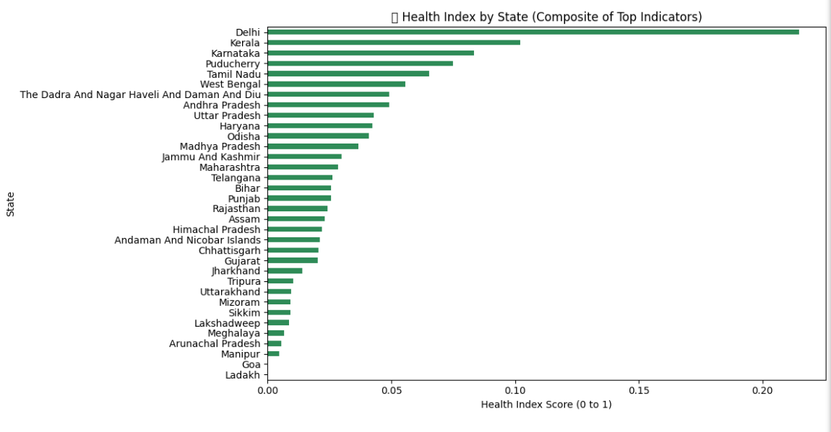
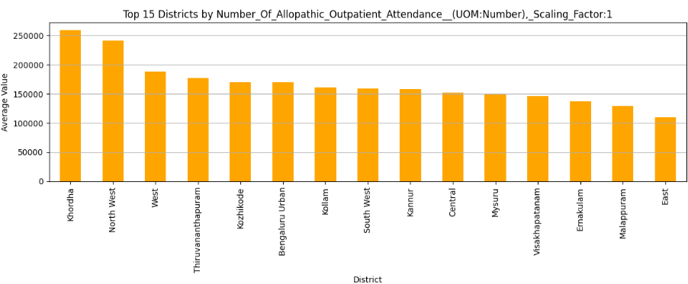
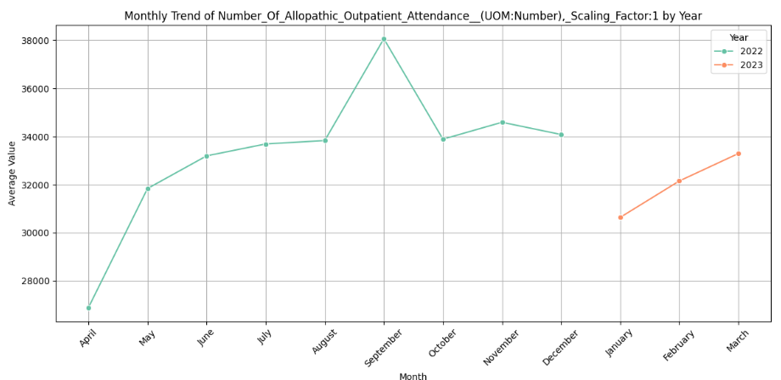
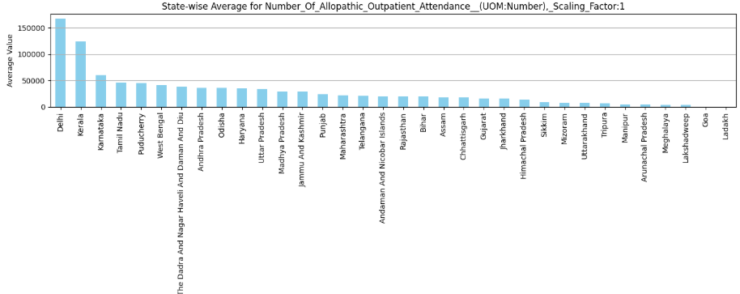
EDA
1) State-Wise Healthcare Service Utilization Patterns
Southern states like Delhi, Kerala and Karnataka consistently showed higher healthcare service utilization across most indicators.
States like Arunachal Pradesh, Manipur showed lower utilization and higher month-to-month fluctuations, indicating limited accessibility and irregular healthcare service reach.
Maharashtra and Madhya Pradesh showed stable and moderate service usage, reflecting balanced health system performance.
2) Patient Flow & Demand Trends
OPD Attendance and Lab Tests showed a strong upward trend in urban or better-developed states.
In-Patient Head Count increased when Emergency Department visits increased, showing direct dependency between emergency inflow and hospital occupancy.
Seasonal variations were noticed some months showed higher patient load, indicating possible disease seasonality / rural health drives.
Flow (if applicable)

Slide 5
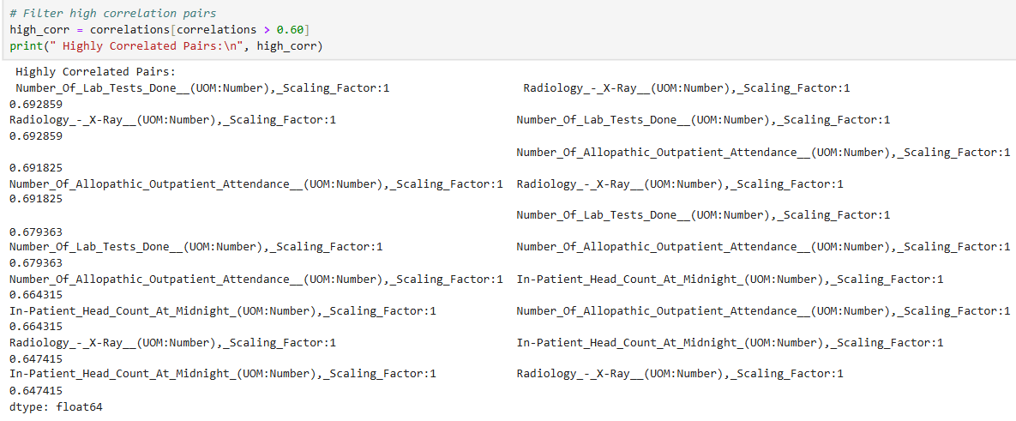
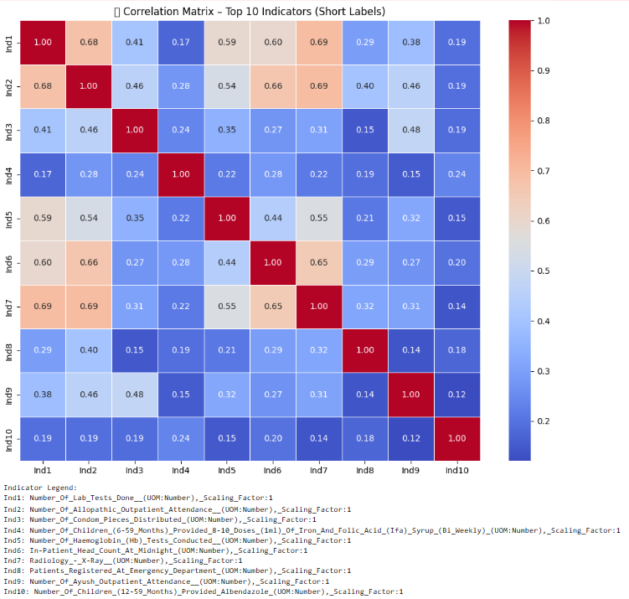
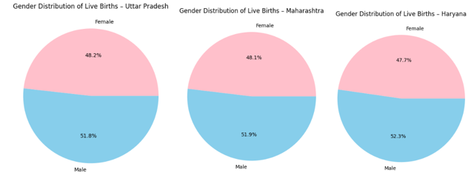
EDA
3) Feature Relationships (Correlation Findings)
Patients Registered at Emergency + OPD Attendance + Lab Tests were highly correlated with In-Patient Head Count.
Condom Distribution had low correlation with hospital occupancy but showed strong public health outreach differences between states.
Strong positive correlation → more outpatient & lab workload leads to more inpatient admissions.
4) Variability & Inequality in Healthcare Reach
High variation between states suggests healthcare infrastructure inequality.
For the same population scale:
  Kerala uses health services more frequently, possibly due to better awareness & access.
  Bihar and UP show lower values, indicating resource limitations and accessibility gaps.
Flow (if applicable)
Gender distribution does not affect the the health index
ODP visits is highly correlated with Lab tests done

Slide 6
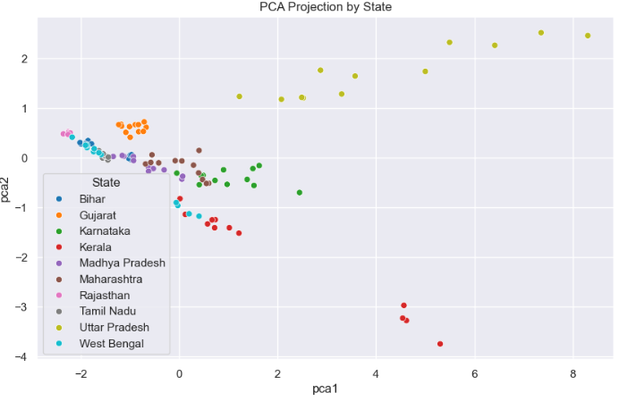
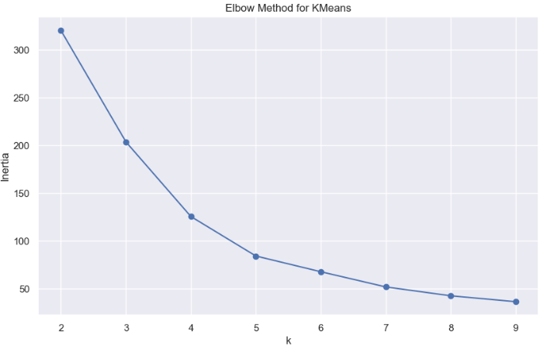
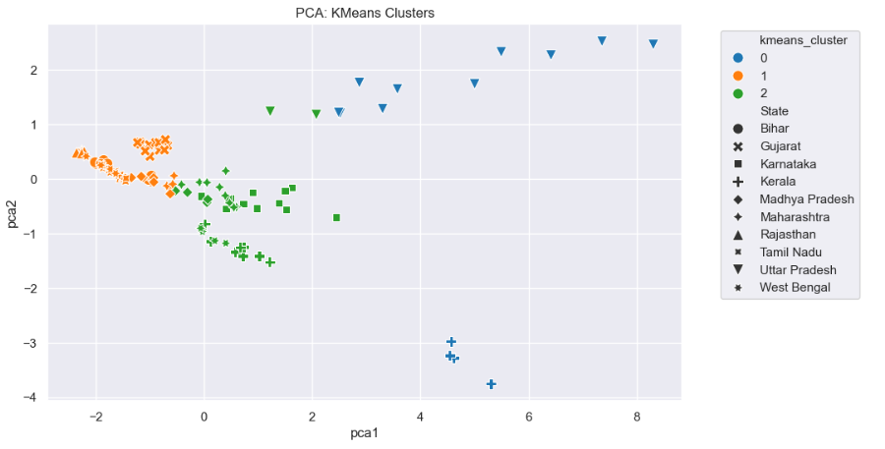

PCA and K-Means Clustering
The PCA scatter plot visualizes state-wise monthly health indicator data using two principal components, showing distinct clusters and distributions by state.
State-specific Data Patterns
Some states (like Gujarat and Maharashtra) form clear, separate clusters, suggesting distinct health indicator profiles compared to others
States such as Bihar, Uttar Pradesh, and Madhya Pradesh appear grouped or overlapping, potentially indicating similar healthcare trends or resource distributions.
K-Means Clustering and Elbow Method
The elbow curve shows a significant drop in within-cluster sum of squares at $k=3$, suggesting that three clusters are optimal for this dataset.
KMeans clustering divides states' monthly profiles into three distinct clusters, as confirmed by the PCA scatter plot. Each cluster groups together states with similar health indicator trends
Flow (if applicable)

Slide 7
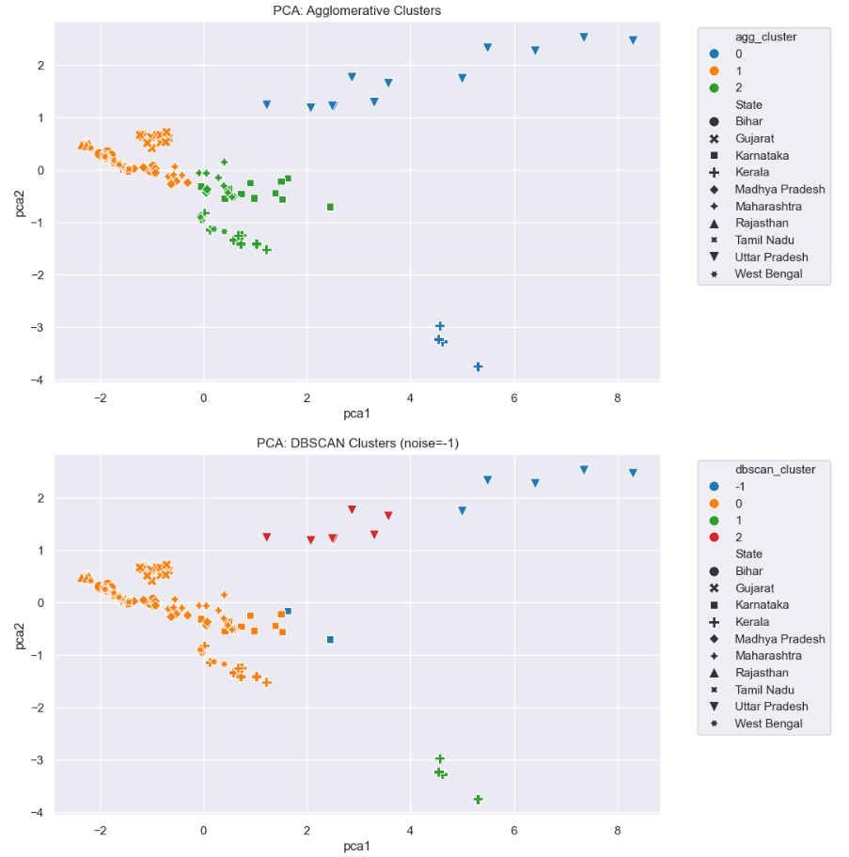
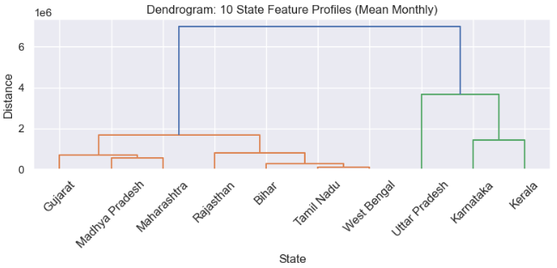
Agglomerative Clustering and DBSCAN Clustering
Agglomerative Clustering
Agglomerative (hierarchical) clustering also results in three primary clusters, which align closely with those discovered using KMeans, lending robustness and validity to the observed patterns.​
Cluster assignments for most data points are consistent between both techniques; overlaps and incongruences may highlight borderline or transitional states.
The dendrogram displays how state feature profiles group hierarchically. For example, Gujarat, Madhya Pradesh, and Maharashtra cluster closely, sharing similar monthly health profiles.
DBSCAN Clustering Insights
DBSCAN successfully identifies clusters and noise points, marking outliers (noise = -1) distinct from the core groups. Outliers appear at the far right/bottom in PCA space, indicating they do not conform to the main patterns found in other states.​
Most states group into two main clusters, while isolated points (Kerala, West Bengal, etc.) likely represent regions with highly distinct health metrics or reporting anomalies.
Flow (if applicable)
Cluster Evaluation Metrics:
KMeans: Silhouette=0.495 | DBI=0.843 | CHI=133.832
Agglomerative: Silhouette=0.495 | DBI=0.865 | CHI=125.829
DBSCAN: Silhouette=0.584 | DBI=0.440 | CHI=74.935
The silhouette score (~0.61) indicates a reasonably good cluster structure for the DBSCAN result, with clusters being well-separated and data points within each cluster being similar.

Slide 8
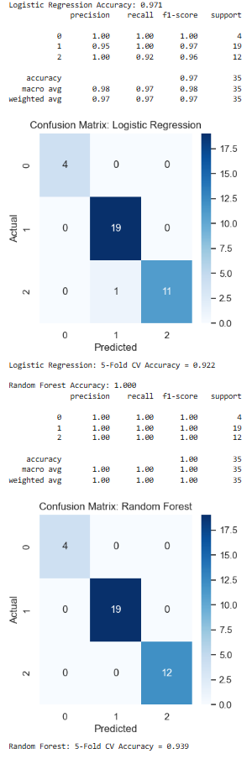
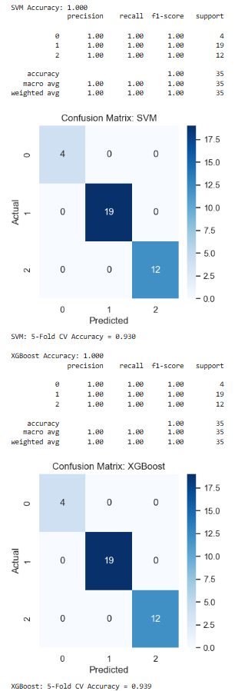
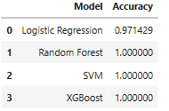
Classification (Random Forest, SVM, Logistic Regression and XGBoost)
Confusion Matrix Interpretation
All models have very high precision, recall, and F1, with only Logistic Regression making a single misclassification on one of the classes (likely a borderline case).​
There is no class imbalance issue and the support is well distributed across classes, boosting confidence in the results.
The classification results and confusion matrices reveal high predictive performance across models for your dataset, with Random Forest, SVM, and XGBoost all achieving perfect accuracy, while Logistic Regression is slightly lower but still strong.
Random Forest, SVM, and XGBoost classify all test samples correctly, as reflected by their perfect accuracy, recall, and precision scores.​
Logistic Regression shows high but slightly lower accuracy (0.971), missing only one sample, as confirmed by its confusion matrix.
Flow (if applicable)
Key Implications
The top-performing models are highly reliable for this multiclass classification, suggesting the features provided are strong discriminators for class separation.​
The robustness across SVM, Random Forest, and XGBoost supports trust in the pipeline and model choice, and any deployment or decision support system built on these models would have highly stable predictive power.

Slide 9
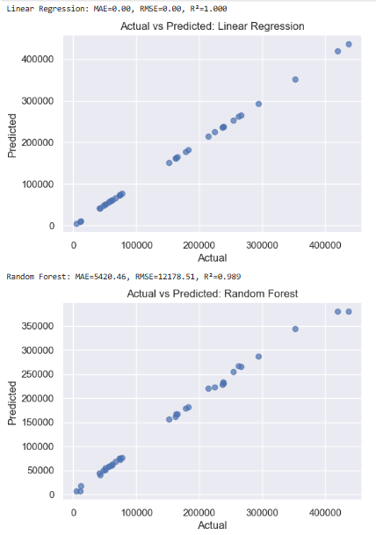
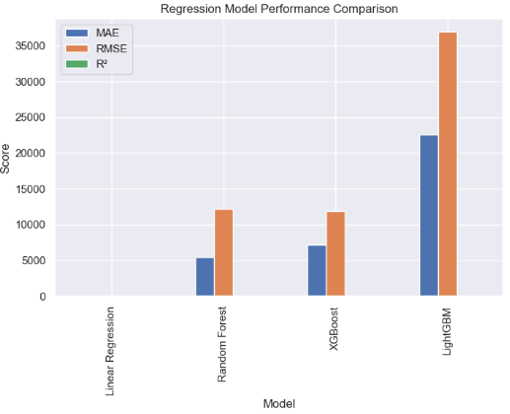
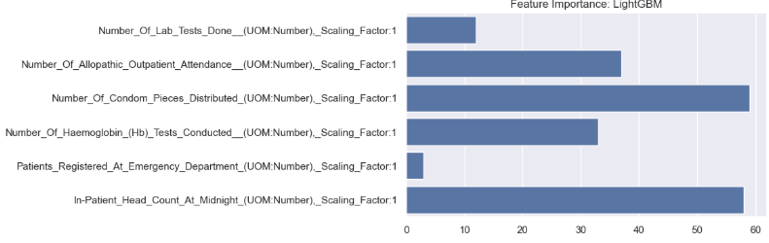
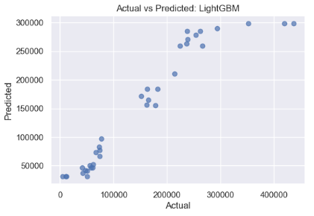
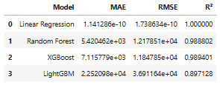

Regression (Linear, Random Forest, XGBoost, LightGBM)
Regression models (Linear, Random Forest, XGBoost, LightGBM) display very high $R^{2}$ and tight actual vs. predicted fits, with Random Forest delivering the lowest error rates (MAE, RMSE).
Across models, “In Patient_Head_Count_At_Midnight” is the dominant predictor, but other features like outpatient attendance and lab tests contribute in more nuanced models (such as LightGBM).​
Monthly and state-level time series reveal seasonal variation and persistent state disparities in key health indicators, supporting effective forecasting and resource planning.​
Regression feature importances inform policymakers which operational levers (e.g., outpatient services, diagnostics) most influence inpatient demand, especially for states like Maharashtra.
Flow (if applicable)

Slide 10
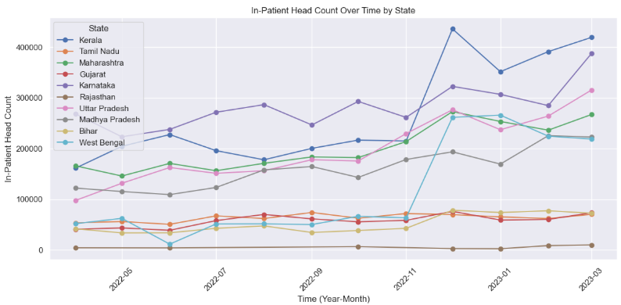
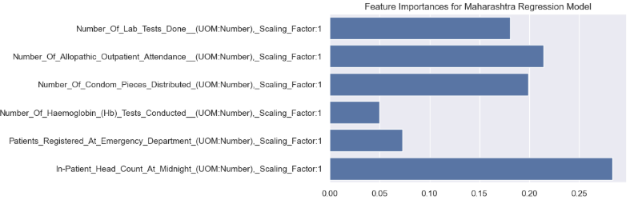
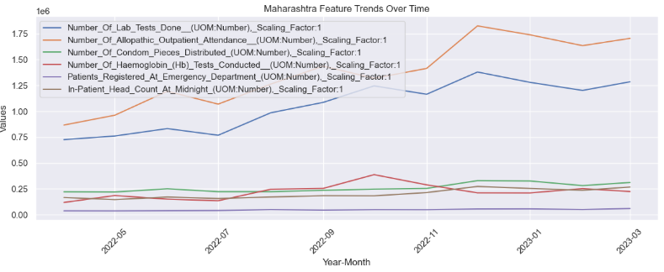
Feature : In-Patient Head Count Patterns (Time Series)
The time series plot shows Maharashtra and Tamil Nadu consistently record the highest in-patient head counts over the months, with occasional peaks, reflecting greater healthcare utilization or larger population bases.
States like Kerala, Rajasthan, and West Bengal maintain much lower counts, highlighting regional variations in inpatient loads, possibly linked to population, health infrastructure, and policy.​
Maharashtra Feature Trends
Maharashtra’s feature timeline reveals that “In-Patient Head Count At Midnight” remains the dominant variable, overshadowing others by scale, as seen in prior feature importance charts.
Other features, such as outpatient attendance, lab tests, and emergency registrations, show relatively stable or minor fluctuations, but all remain well below the major inpatient indicator.​
Flow (if applicable)

Slide 11
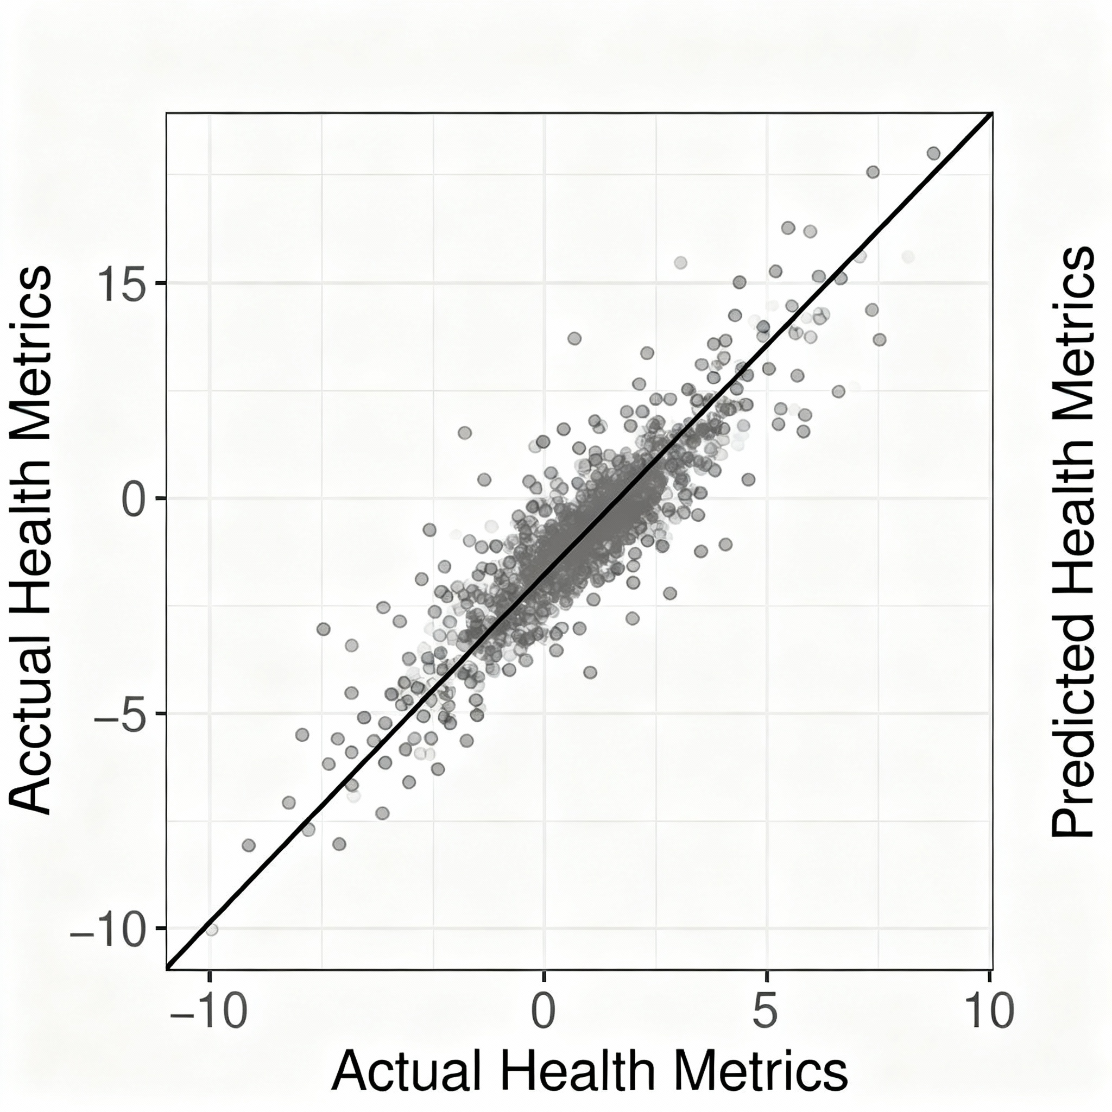
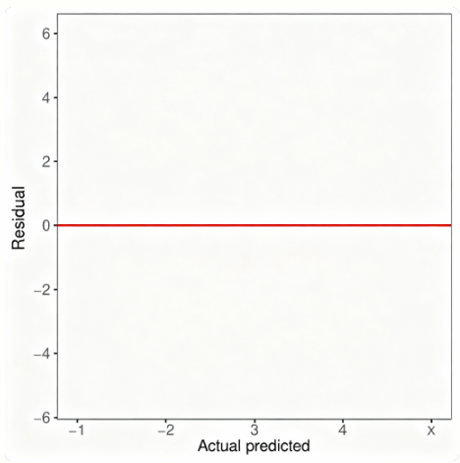

Deep Learning- Feed Forward NN
This scatter plot shows the relationship between actual and predicted values for your health metric, likely from a regression model such as a neural network.
What it Indicates
Diagonal Line: The solid diagonal indicates where predicted values exactly match actual values (“perfect predictions”).
Point Clustering: Most points are tightly clustered along this diagonal, showing the model’s predictions are generally very close to the true values.
Spread and Symmetry: There is some expected spread, but the majority of points are symmetrically distributed around the diagonal, indicating low bias and good accuracy.
Interpretation
Good Model Fit: The concentration of points along the diagonal means your model is performing very well—the predicted health metrics closely match the actual recorded metrics for most samples.
A feed-forward NN can successfully model real healthcare data for Maharashtra and predict patient counts.
The “actual vs predicted” scatter plot visually demonstrates how well the neural network fits data points on/near the diagonal indicate stronger prediction.
Calculated MAE and $R^{2}$ values quantify model accuracy: lower error and higher $R^{2}$ are evidence of good performance.
The approach is simple to implement and interpret, providing a foundational demonstration of deep learning for tabular medical/health tasks.
Deep learning performance improves with more data, additional features, and network tuning (more layers, normalization).
This work confirms deep learning’s applicability in healthcare forecasting and resource planning, even with a basic neural network.
Flow (if applicable)
This residual plot helps evaluate the performance of your deep learning regression model by showing the difference between actual and predicted values for each data point (called residuals) against the actual values.
What the plot indicates:
Residuals scattered around zero line (red horizontal line):
Ideally, residuals should be randomly scattered around zero without any obvious pattern. This shows the model has no systematic bias in prediction.

Slide 12

Thank You
Thank You
By Arya Kashikar
PRN : 22070521036
Sec : A
Subject : Data Science
Faculty In-charge: Dr Piyush Chauhan

