Slide 1
Student Innovation
CSE7101- Capstone Project
Review-3
Batch Number: CSG_1
Roll Number | Student Name
20221CSG0089 20221CSG0069 20221CSG0113 | Arya Abhishek Sri Sai Raghuveer C Archana k
Under the Supervision of,
Dr. Riya Sanjesh
Assistant Professor
School of Computer Science and Engineering
Presidency University
Name of the Program: CSG – Computer Science And Technology
Name of the HoD: Dr. Anandaraj S.P
Name of the Program Project Coordinator: Dr. Sharmasth Vali
Name of the School Project Coordinators: Dr. Sampath A K , Dr. Geetha A

Slide 2
Content
Problem Statement
Abstract
Literature Survey
System Design
Architecture Diagram
Algorithm
Modules
Timeline (Gantt Chart)
References

Slide 3
Problem Statement Number: PCS_154
Organization: AICTE, MIC Student Innovation
Category (Hardware / Software / Both) : Software
Problem Description:
The problem of style change detection, also called style breach detection, is to identify if a document was written by one or multiple authors . It involves identifying the specific positions within a text where the author's writing style changes.

Slide 4
Problem Statement
The problem statement for style change detection is to determine if a document was written by a single author or multiple authors. The task is to identify the exact locations within a multi-author document where the authorship, or writing style, switches. This field of study is also known as style breach detection and is related to intrinsic plagiarism detection. The core challenges of this problem are that no information about the author is provided, there are no external reference documents for comparison, and the analysis must be performed on the document itself to extract stylistic features

Slide 5
Abstract
The problem is to determine if a document was written by a single author or multiple authors. This is also known as style breach detection. The objective is to identify the specific positions within a document where the writing style, and thus the author, changes. The approach to solving this is to use a Multi-Stylometric Feature-based Neural Network that performs an intrinsic analysis of the document, without requiring external reference material.

Slide 6
Literature Survey
Title | Year | Author | Method | Drawback
Ensemble-Based Clustering in Writing Style Change Detection | 2022 | S. Ashkarsaj & M. Mersin | Ensemble-Based Clustering | High computational cost and complexity from running and combining multiple clustering models.
Style Change Detection Based On Bert And Covid-19 | 2022 | C. Liu et al. | BERT-based models | Limited generalizability, as the model's fine-tuning on a specific domain (COVID-19) may not transfer well to other topics.
Style Change Detection Method Based On Pre-Trained Model And Similarity Recognition | 2022 | Z. Zhang, H. Jiang, & M. Zhang | Pre-trained models, similarity recognition | Sensitive to threshold tuning; the choice of the similarity threshold significantly impacts performance.
Three-Shots Similarity: sentence-embedding, auxiliary words, pronunciation | 2022 | C. A. Rodríguez-Lascano & D. Castro-Castro | Sentence-embedding, pronunciation features | Language-dependent; the reliance on English pronunciation features makes the model difficult to adapt to other languages.
Ensemble Pre-trained Transformer Models for Writing Style Change Detection | 2022 | T. Lin et al. | Ensemble Pre-trained Transformer Models | Very high resource demand (CPU/GPU and memory) due to the ensembling of multiple large transformer models.
Style Change Detection using Discourse Markers | 2022 | E. Fakhri Niri & V. Madani | Discourse Markers | Effectiveness is inconsistent as it depends heavily on authors' use of specific discourse markers (e.g., 'however', 'therefore').
Style change detection using Siamese neural networks | 2021 | S. Nath | Siamese Neural Networks | Requires large, well-curated paired data for training, which can be difficult and time-consuming to create.
Stylistic Change Detection using an LSTM-powered Attribution Algorithm | 2021 | R. Prentiss & D. DiPersio | LSTM-powered Attribution Algorithm | Less effective on long-range dependencies in text compared to more modern transformer architectures.
Writing Style Change Detection in Multi-Author Documents | 2021 | N. Sieger, J. Wever-Benque, & R. Greenstadt | Feature-based classification | Struggles with subtle style shifts or when authors have very similar writing styles.
Multi-Step Feature Representation and Bi-Directional Clustering | 2020 | D. Castro Castro et al. | Multi-Step Feature Representation, Bi-Directional Clustering | Risk of error propagation; errors from the initial feature representation step can negatively affect the final clustering accuracy.
A Partial Hierarchical Attention Network for Style Change Detection | 2018 | M. Hosseini & A. Mukerjee | Partial Hierarchical Attention Network | Limited contextual understanding compared to the full self-attention mechanisms in modern transformer models.

Slide 7
System Design
Data Ingestion Module:
This is the entry point. Its sole responsibility is to read raw data from the local file system (.txt files for text, .json files for labels), parse them, and load them into memory as Python lists.
Data Processing & Tokenization Engine:
This component takes the raw data and prepares it for the model. It uses the Hugging Face datasets library to structure the data and the AlbertTokenizer to convert text into numerical tensors. It also handles the crucial step of splitting the data into training, validation, and test sets.
Core Model (ALBERT):
This is the "brain" of the system. It's the AlbertForSequenceClassification model, pre-trained on a vast corpus of text. The pipeline's goal is to fine-tune the existing knowledge of this model for the specific stylometry task.

Slide 8
System Design
Training Orchestrator (Trainer API):
This is the conductor of the entire operation. The Hugging Face Trainer class is a high-level API that abstracts away the complex training loop (gradient updates, optimization, etc.). It's configured by TrainingArguments and coordinates the interaction between the model, the data, and the evaluation module.
Evaluation Module:
A small but critical component (compute_metrics function) that calculates performance metrics like accuracy and F1-score. The orchestrator calls this module to get feedback on the model's performance on the validation and test sets.
Model Artifact Repository:
This is the system's final output destination. It's a directory on the local disk where the fine-tuned model weights, configuration file, and tokenizer are saved. This makes the trained model portable and ready for deployment or inference.

Slide 9
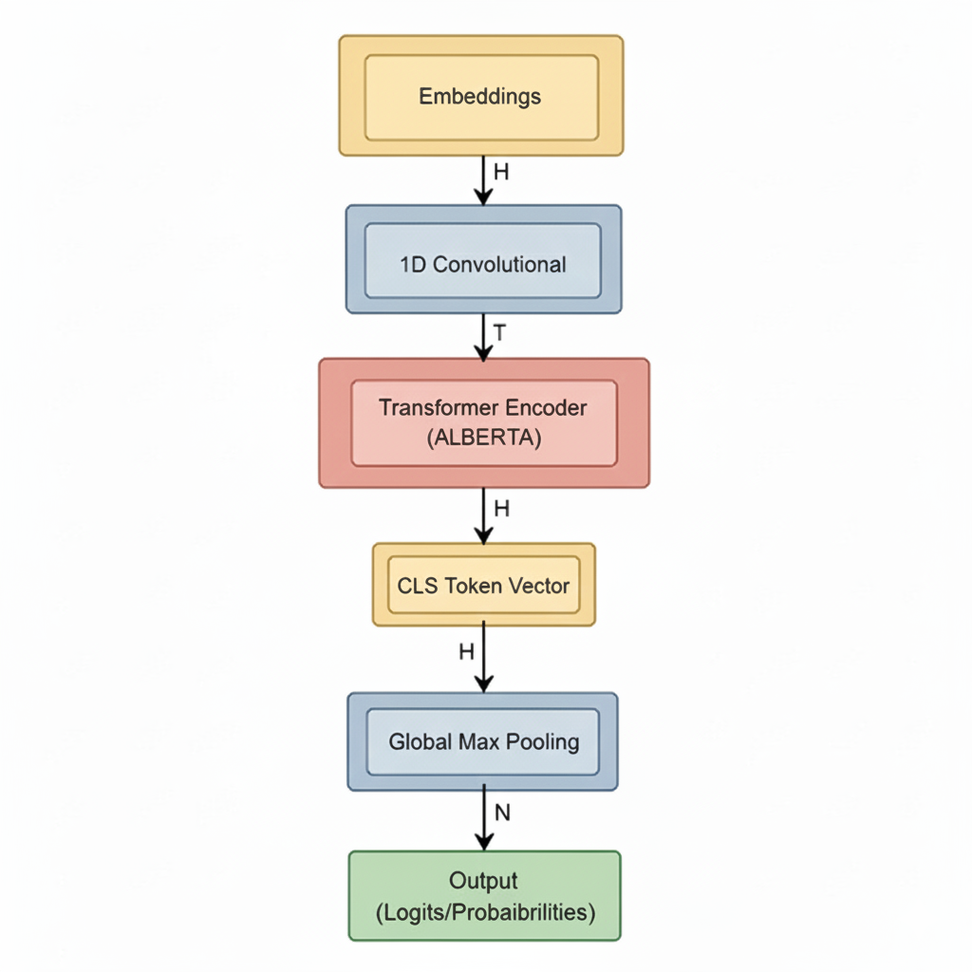
Architecture Diagram(for Alberta Model)

Slide 10
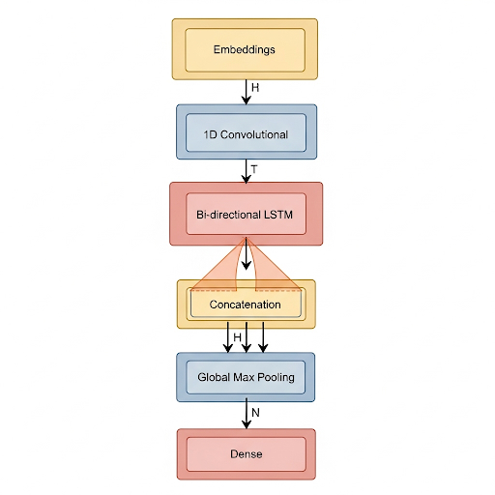
Architecture Diagram(for Image)

Slide 11
Algorithm
Initialization:
Import all necessary libraries like transformers, datasets, torch, and os.
Data Ingestion:
Define paths to the text data and the corresponding JSON "truth" files (which contain the author labels).
Execute the load_style_detection_data function to read paragraphs and their author labels from the files, pairing them together.
Dataset Creation:
Convert the loaded lists of texts and labels into a structured datasets.Dataset object, which is highly optimized for the Hugging Face ecosystem.
Model & Tokenizer Loading: .
Download and initialize the pre-trained 'albert-base-v2' model and its corresponding tokenizer from the Hugging Face Hub. The model is configured for sequence classification with two possible labels (Author 1, Author 2).
Data Preprocessing (Tokenization):
Define a function that uses the ALBERT tokenizer to convert the raw text of each paragraph into numerical IDs.
Apply this function to the entire dataset, ensuring all sequences are padded to the same length for batching.

Slide 12
Algorithm
Data Splitting:
Divide the processed dataset into three distinct subsets to ensure unbiased evaluation:
Training Set (80%): Used to train and update the model's weights.
Validation Set (10%): Used during training to monitor performance and prevent overfitting.
Test Set (10%): A completely unseen set held back until the very end for a final, objective performance evaluation.
Metrics Definition:
Set up a compute_metrics function that will calculate accuracy and F1-score during the evaluation phases.
Training Configuration:
Define all hyperparameters and settings for the training process using the TrainingArguments class. This includes batch size, number of epochs, save strategy, and logging settings.
Trainer Initialization:
Instantiate the Trainer object, which is the core Hugging Face utility that orchestrates the entire training and evaluation process. It brings together the model, training arguments, datasets, and metrics function.
Model Training:
Start the fine-tuning process by calling trainer.train(). The Trainer will handle the training loop, gradient updates, and periodic evaluation on the validation set.
Final Evaluation:
After training is complete, run a final evaluation on the held-out test set to get the definitive performance metrics.

Slide 13
Modules
1. Dependencies and Setup
This section imports all the necessary libraries.
os, json: Standard Python libraries for interacting with the file system (e.g., listing files) and parsing JSON files.
torch, numpy: Core libraries for numerical operations. PyTorch (torch) is the deep learning framework on which the Hugging Face transformers are built.
transformers: The main Hugging Face library. It provides the AlbertTokenizer, AlbertForSequenceClassification model, and the Trainer/TrainingArguments classes.
2. Data Loading and Preprocessing
This module is responsible for getting the raw data from disk into a usable format.
load_style_detection_data(data_dir, truth_dir): This is a custom function designed specifically for your dataset's structure.
It finds all JSON files in the truth_dir.
For each truth file, it extracts the problem_id to locate the corresponding .txt file in the data_dir.
It reads the author labels from the JSON (paragraph-authors) and the text paragraphs from the .txt file

Slide 14
Modules
3. Model and Tokenizer Initialization
Here, we load the pre-trained components.
AlbertTokenizer.from_pretrained('albert-base-v2'): Downloads the tokenizer specifically trained for the ALBERT model. The tokenizer's job is to convert raw text strings into a sequence of numerical tokens that the model can understand.
AlbertForSequenceClassification.from_pretrained('albert-base-v2', num_labels=2)
4. Data Splitting and Tokenization
This module prepares the data for the model.
tokenize_function(examples): A function that takes a batch of data and applies the tokenizer to the "text" field. padding="max_length" ensures that shorter sentences are padded up to a uniform length, and truncation=True cuts down longer sentences.
real_dataset.map(...): This efficiently applies the tokenize_function to the entire dataset.
.train_test_split(...): This is a powerful method from the datasets library. The code uses it in two steps to create a clean 80/10/10 split for training, validation, and testing. This is a critical practice for reliable model evaluation.

Slide 15
Modules
5. Metrics and Evaluation
This section defines how the model's performance will be measured.
evaluate.load("accuracy") / evaluate.load("f1"): These lines load the standard computation logic for accuracy and F1-score.
compute_metrics(eval_pred): This function is called by the Trainer at the end of each evaluation run.
It receives the model's outputs (logits) and the true labels.np.argmax(logits, axis=-1) converts the raw logit scores into the final predicted class (0 or 1).
6. Training Configuration and Execution
This is the control center for the training process.
TrainingArguments(): This class collects dozens of settings. The key ones used here are:
output_dir: Specifies where to save checkpoints and the final model.
per_device_train_batch_size: Sets the number of samples processed in each training step.
num_train_epochs: Defines how many times the model will see the entire training dataset.
save_strategy="epoch": Tells the Trainer to save a model checkpoint at the end of every epoch.

Slide 16
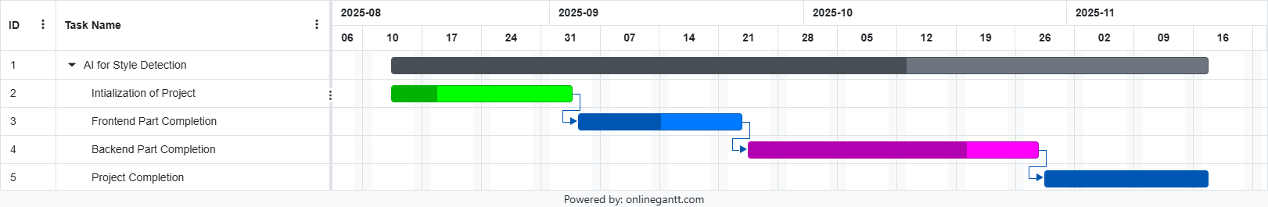
Timeline of the Project (Gantt Chart)

Slide 17
References (IEEE Paper format)
[1] Shams Alshamasi, Mohamed Menai, Ensemble-Based Clustering for Writing Style Change Detection in Multi-Authored Textual Documents. In Guglielmo Faggioli, Nicola Ferro, Allan Hanbury, and Martin Potthast, editors, CLEF 2022 Labs and Workshops, Notebook Papers, September 2022. CEUR-WS.org
[2] Qidi Lao, Li Ma, Wenyin Yang, Zexian Yang, Dong Yuan, Zhenlin Tan, and Langzhang Liang, Style Change Detection Based On Bert And Conv1d. In Guglielmo Faggioli, Nicola Ferro, Allan Hanbury, and Martin Potthast, editors, CLEF 2022 Labs and Workshops, Notebook Papers, September 2022. CEUR-WS.org
[3] Zhijie Zhang Xinyin Jiang and Mingjie Huang, Style Change Detection: Method Based On Pre-trained Model And Similarity Recognition, In Guglielmo Faggioli, Nicola Ferro, Allan Hanbury, and Martin Potthast, editors, CLEF 2022 Labs and Workshops, Notebook Papers, September 2022. CEUR-WS.org.

Slide 18
References (IEEE Paper format)
[4] Carlos A. Rodríguez-Losada and Daniel Castro-Castro, Three Style Similarity: sentence-embedding, auxiliary words, punctuation. In Guglielmo Faggioli, Nicola Ferro, Allan Hanbury, and Martin Potthast, editors, CLEF 2022 Labs and Workshops, Notebook Papers, September 2022. CEUR-WS.org.
[5] Tzu-Mi Lin, Chao-Yi Chen, Yu-Wen Tzeng, and Lung-Hao Lee. Ensemble Pre-trained Transformer Models for Writing Style Change Detection. In Guglielmo Faggioli, Nicola Ferro, Allan Hanbury, and Martin Potthast, editors, CLEF 2022 Labs and Workshops, Notebook Papers, September 2022. CEUR-WS.org.
[6] Hasan Algafri Faisal Alvi and Naif Alqahtani, Style Change Detection using Discourse Markers. In Guglielmo Faggioli, Nicola Ferro, Allan Hanbury, and Martin Potthast, editors, CLEF 2022 Labs and Workshops, Notebook Papers, September 2022. CEUR-WS.org.
[7] Sukanya Nath, Style change detection using Siamese neural networks—Notebook for PAN at CLEF 2021. In Guglielmo Faggioli et al., editors, CLEF 2021 Labs and Workshops, Notebook Papers, September 2021. CEUR-WS.org.

Slide 19
References (IEEE Paper format)
[8] Robert Deibel and Denise Löfflad, Style Change Detection on Real-World Data using an LSTM-powered Attribution Algorithm—Notebook for PAN at CLEF 2021. In Guglielmo Faggioli et al., editors, CLEF 2021 Labs and Workshops, Notebook Papers, September 2021. CEUR-WS.org.
[9] Rhia Singh, Janith Weerasinghe, and Rachel Greenstadt. Writing Style Change Detection on Multi-Author Documents—Notebook for PAN at CLEF 2021. In Guglielmo Faggioli et al., editors, CLEF 2021 Labs and Workshops, Notebook Papers, September 2021. CEUR-WS.org.
[10] Daniel Castro-Castro, Carlos Alberto Rodríguez-Losada, and Rafael Muñoz, Mixed Style Feature Representation and B0-maximal Clustering for Style Change Detection—Notebook for PAN at CLEF 2020. In Linda Cappellato, Carsten Eickhoff, Nicola Ferro, and Aurélie Névéol, editors, CLEF 2020 Labs and Workshops, Notebook Papers, September 2020. CEUR-WS.org.
[11] Marjan Hosseinia and Arjun Mukherjee, A Parallel Hierarchical Attention Network for Style Change Detection—Notebook for PAN at CLEF 2018. In Linda Cappellato, Nicola Ferro, Jian-Yun Nie, and Laure Soulier, editors, CLEF 2018 Evaluation Labs and Workshop – Working Notes Papers, 10-14 September, Avignon, France, September 2018. CEUR-WS.org.

Slide 20


