Slide 1
Handwritten Text Recognition and Conversion Using Convolutional Neural Network (CNN) Based Deep Learning Model
Group members:
1.Pratik Yabaji(210070094)
2.Arya Agarwal(210070012)
3.Sumit Londhe(210070089)

Slide 2
INTRODUCTION
Even in this age of digital information, people prefer writing information on paper due to the unavailability of digital note-taking devices or because they feel more comfortable writing than typing
One of those methods is using Deep learning, more specifically Neural Networks. Neural Networks are designed based on the functionality of neurons in the human brain.
Identifying each character will not be enough as words are a sequence of characters, and each word contains similar characters in different sequences . To understand these sequences, a very specific type of Recurrent Neural Network (RNN) , the Long Short Term Memory (LSTM) is used. LSTM divides the image into time steps and attempts to understand where each character occurs and what it means. The placement of these characters in the input image needs to be precise for LSTM to work but human handwriting does not satisfy this requirement. Human writes each character with different dimensions and in different positions each time. Connectionist Temporal Classification (CTC) loss is used to solve this specific problem. CTC attempts all possible placements of characters and takes the sum of all the probabilities.

Slide 3
Traditional methods
Traditional handwriting recognition systems are built on character recognition. Character recognition consists of the following sequence of steps. Segmentation of words, character segmentation followed by prediction. Therefore the prediction is to be done for each letter separately .
However, each character needs to be segmented and then that individual character needs to be predicted before they are put together. It is also not feasible always to segment each character because human handwriting is not spaced well and some characters are joined

Slide 4
Process Overview

Slide 5
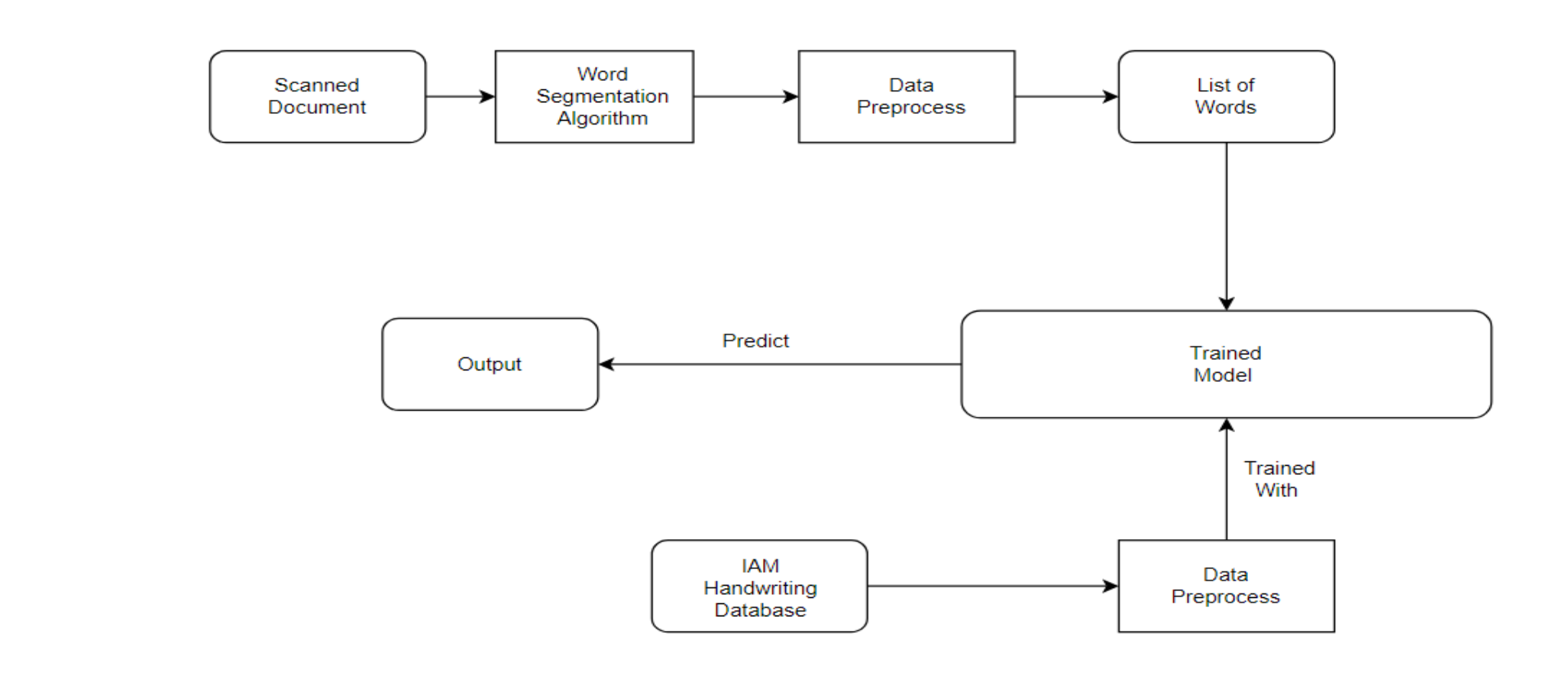

Slide 6
Data Pre-Processing
Extracting all images from their path with their corresponding labels.
Converting all images to same size (32,128) with padding to keep the aspect ratio image same.
Converting all labels into a vector of same length .

Slide 7
Train Model
First Convolution block : convolve our input image with 32 different kernels to extract 32 features.
Max pooling : do max pooling with size 2 and stride 2 , reducing size by 4x.
Second Convolution block : convolve our input image with 64 different kernels to extract 64 features.
Max pooling : do max pooling with size 2 and stride 2 , reducing size by 4x.
Dense layer : The reshaped output feature maps are then passed through a Dense layer with 64 units and a ReLU activation function.A Dropout layer with a rate of 0.2 is applied to the output of the Dense layer to reduce overfitting.
RNN layer: The output of the Dropout layer is passed through two layers of Bidirectional LSTM cells with 128 and 64 units respectively. These layers are used to capture temporal dependencies.

Slide 8
CTC loss : To train the model, a Connectionist Temporal Classification (CTC) layer is added on top of the output Dense layer. This layer computes the CTC loss between the predicted output sequence and the ground truth label sequence.
Finally, the model is compiled using the Adam optimizer and the CTC loss function

Slide 9
Demo Results

Slide 10
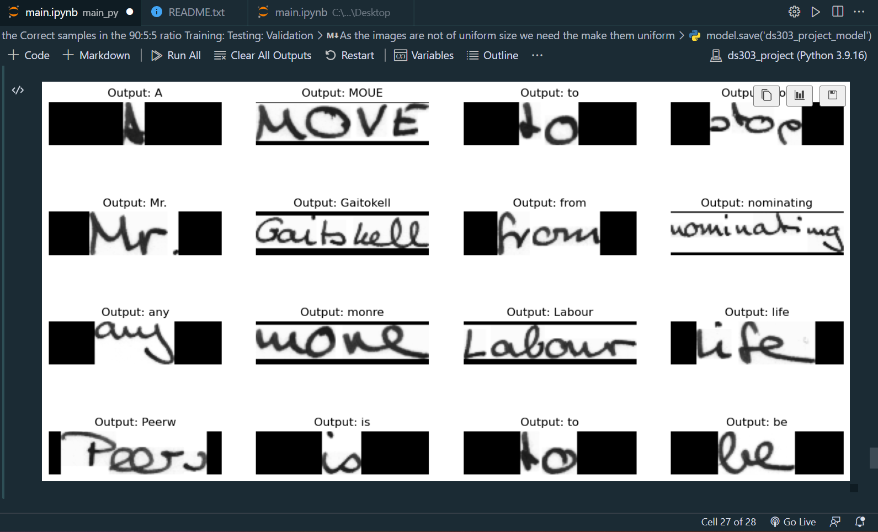

Slide 11
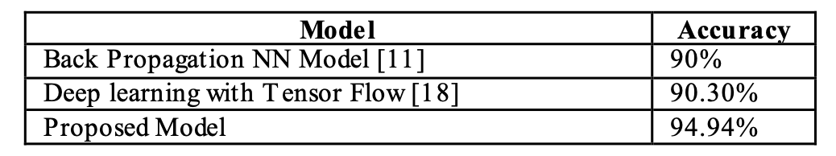
Conclusion
.
It is observed that this model with convolution and RNN with LSTM is more accurate than back propagation or deep learning with tensorflow.

Slide 12
Contribution
It was not something which could be broken in different files, so we all worked together and wrote the code.
A hand waving distribution was:
1.Arya : understand the traditional methods and our method, and compared already existing data.
2.Sumit : Understand convolution ,RNN and why we used CTC loss.
3. Pratik : created all functions and compiled the whole code.

Slide 13
References:
1.Link to the research paper : https://ieeexplore.ieee.org/document/9544513
2.Image dataset : https://fki.tic.heia-fr.ch/databases/iam-handwriting-database
3.some youtube videos.
4.https://keras.io/examples/vision/handwriting_recognition/#data-collection

