Slide 1
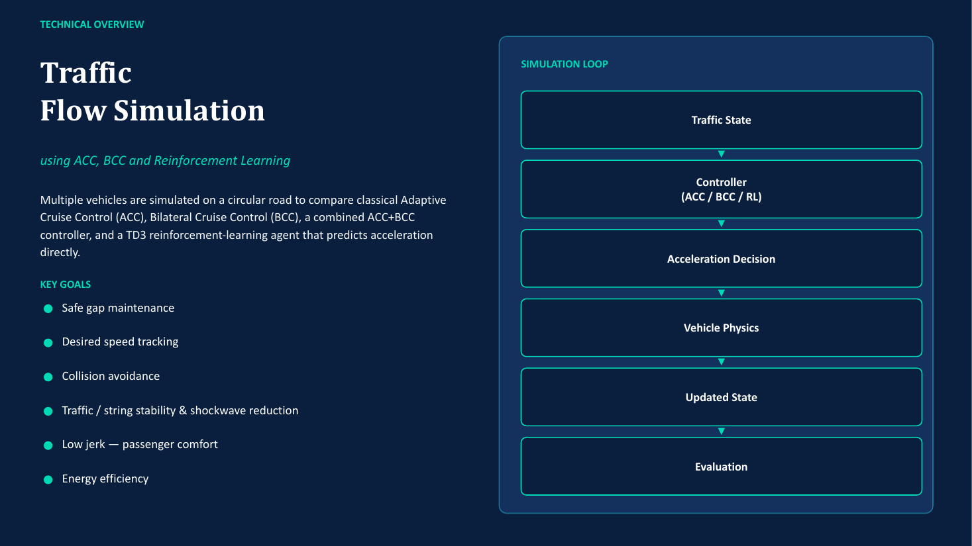

Slide 2
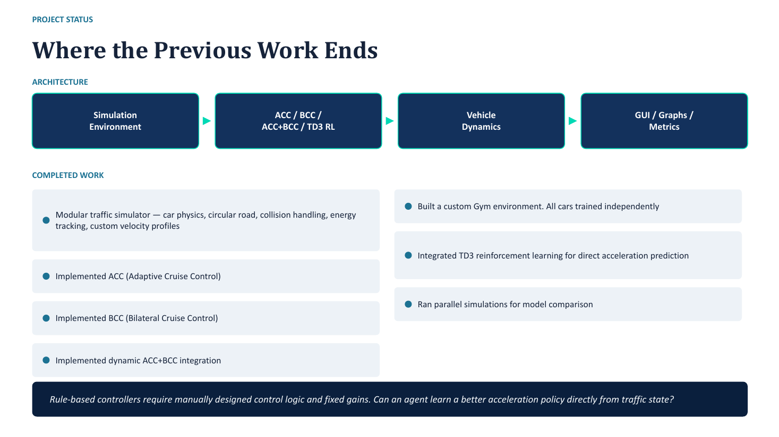

Slide 3
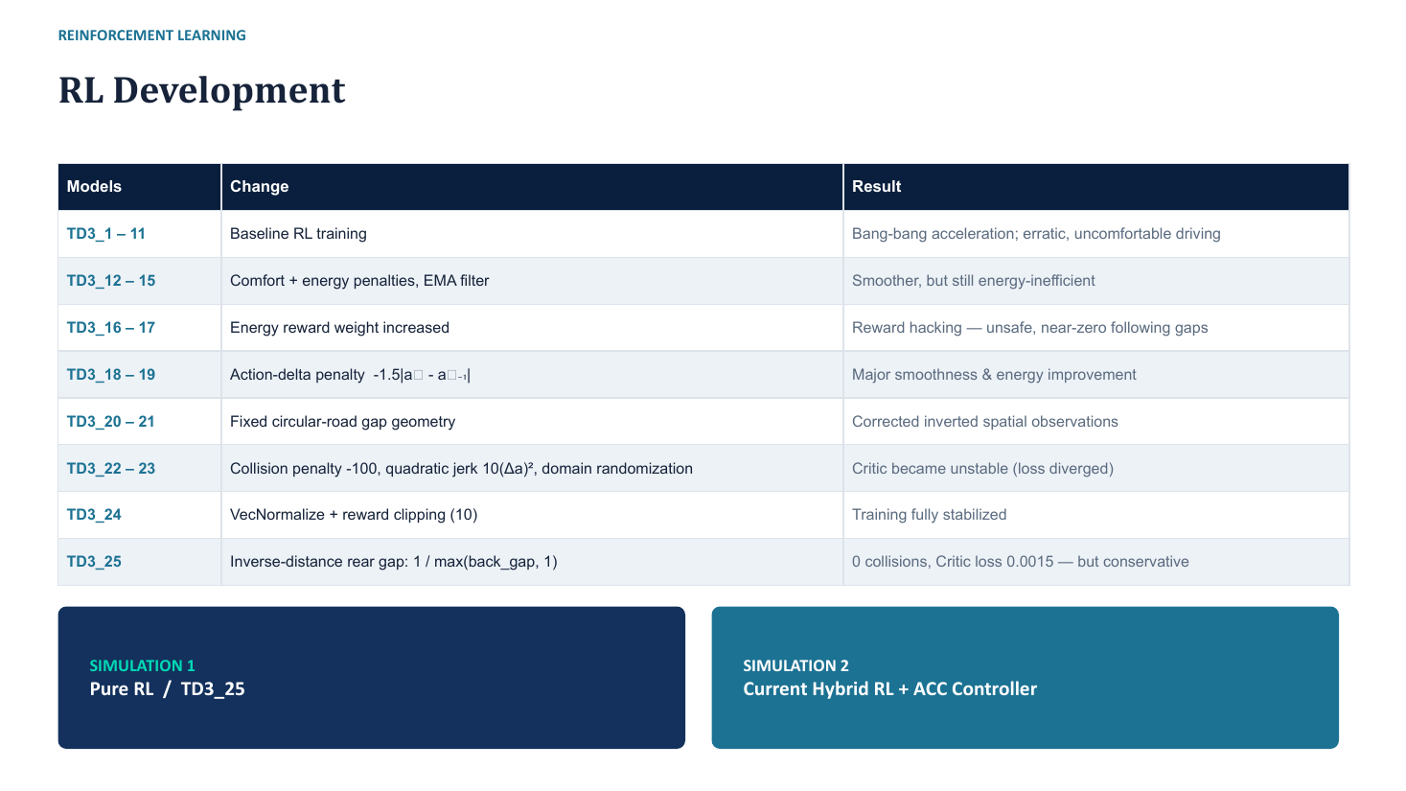

Slide 4
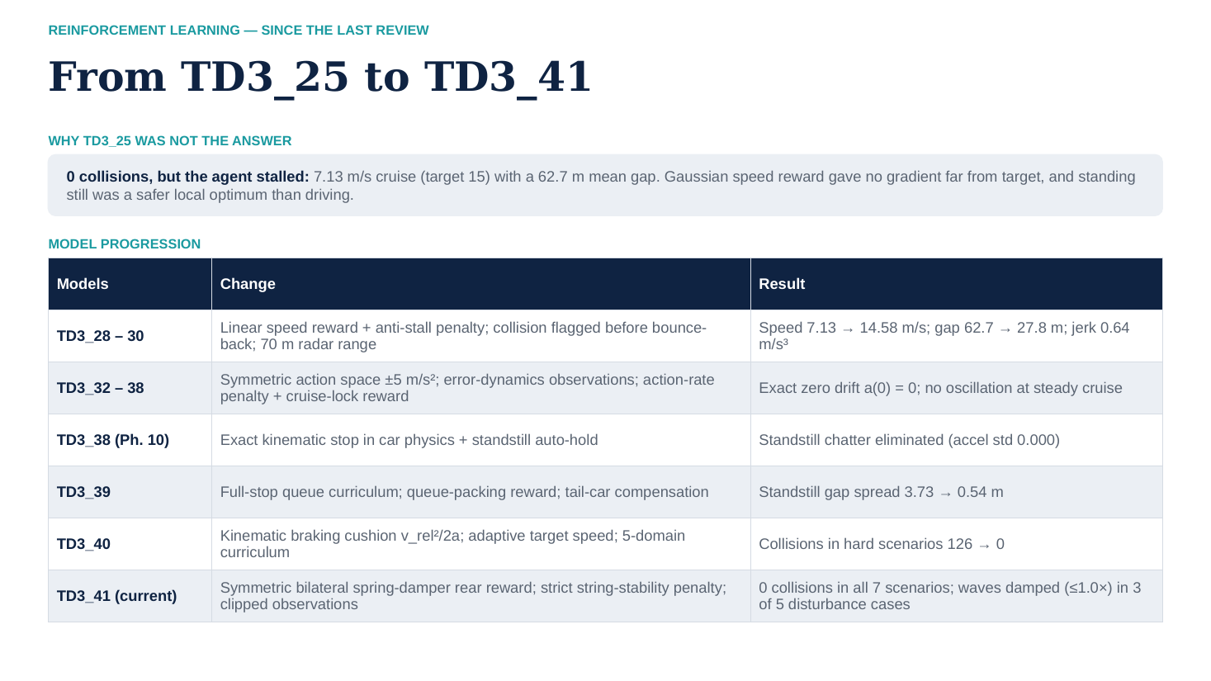

Slide 5
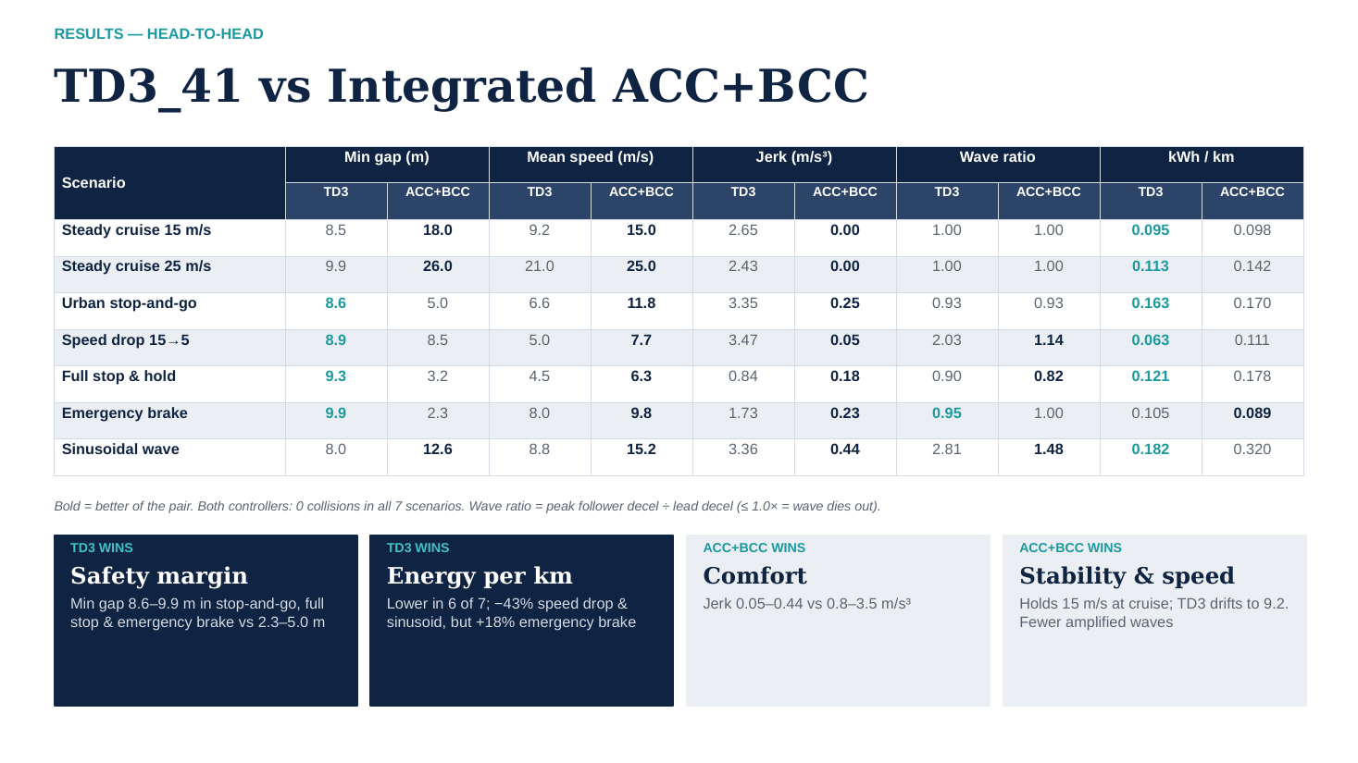

Slide 6
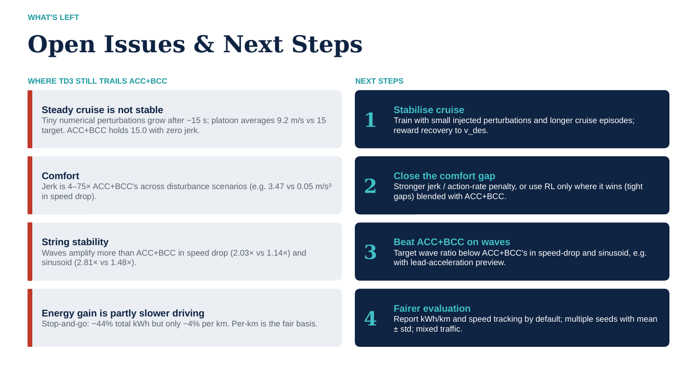

Slide 7
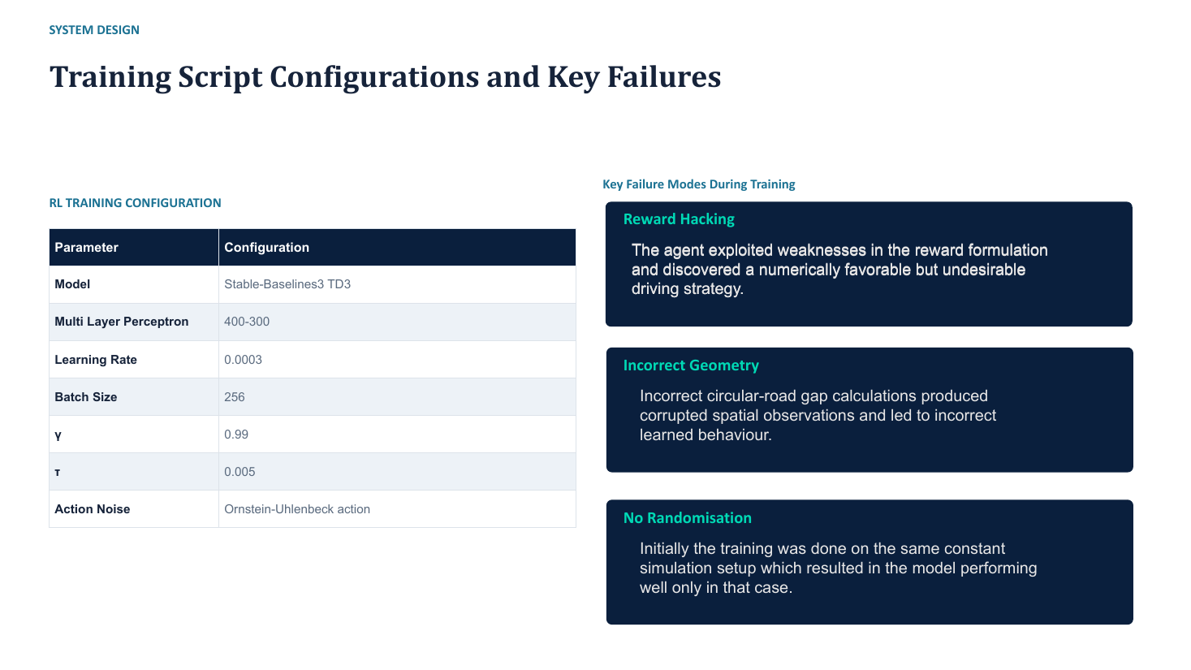

Slide 8
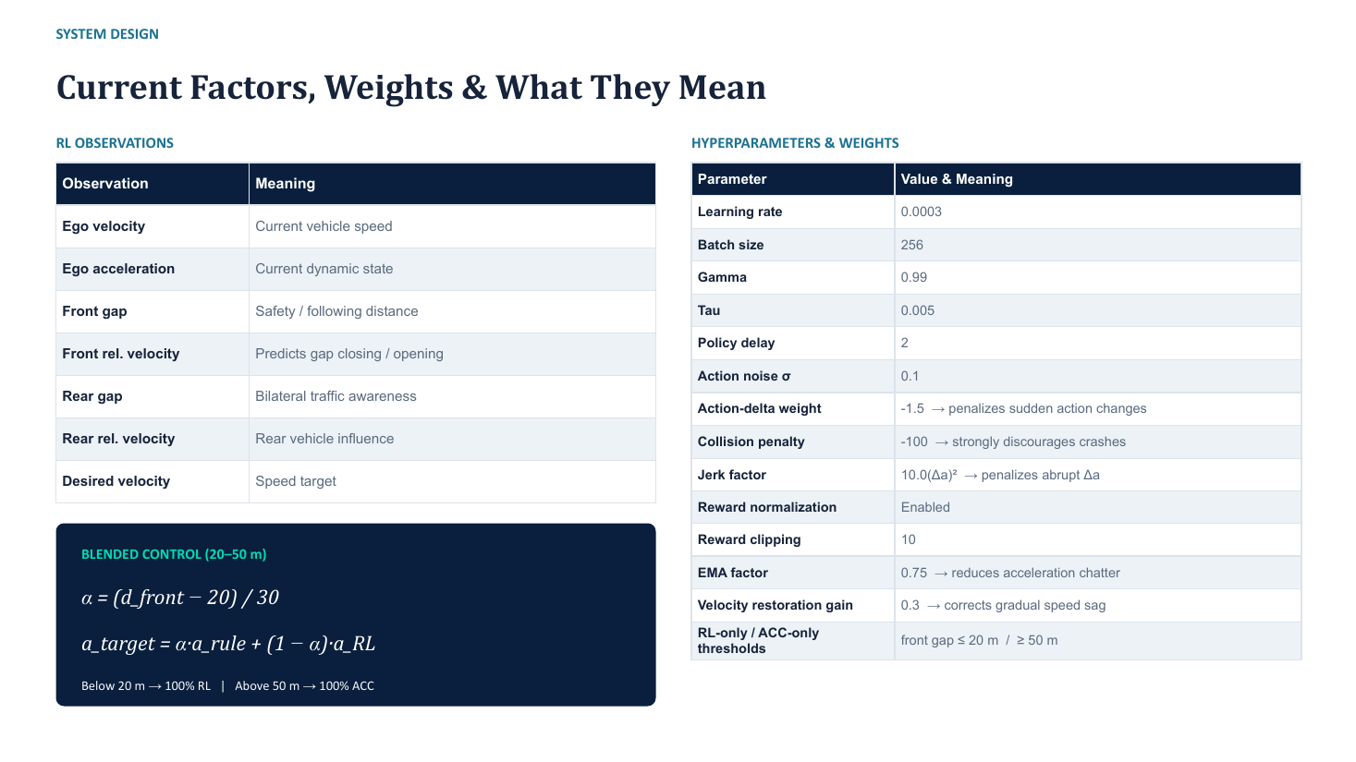

Slide 9
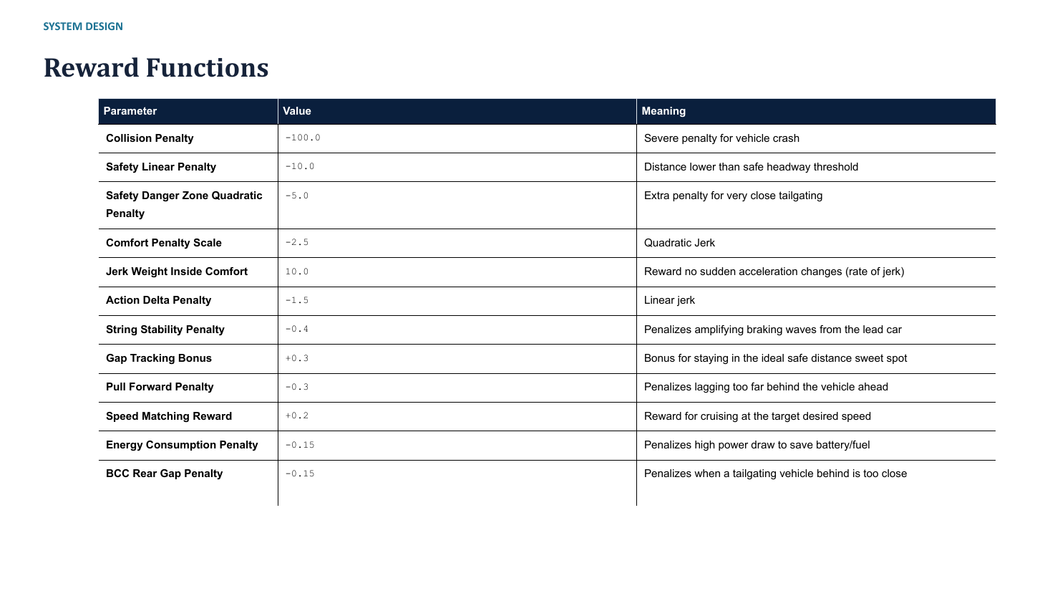

Slide 10
NEW SINCE THE 13 OCT REVIEW
Phase 14: removing acceleration chatter (TD3_42)
What was wrong
What was changed
The acceleration plot showed a 10 Hz saw-tooth (about -0.23 to +0.27 m/s2). The network had no actuator lag, so every 0.1 s step it overshot and corrected. At standstill, cars with a gap above the minimum pulsed the throttle against a stopped leader, and acceleration jumped from -1.2 to 0 at the moment of stopping.
1) First-order actuator filter in simulation/rl_city.py: a = 0.35 x new command + 0.65 x previous (time constant about 0.2 s).
2) Smooth tapering of braking as speed approaches zero.
3) New reward for matching the average speed of the cars in front and behind (the BCC idea).
4) Penalty for harsh braking when the gap is already safe; stronger string-stability penalty.
TD3_42 was fine-tuned from TD3_41 (60k steps, learning rate 0.00003). The filter is confirmed in the current code; the standstill taper was later superseded by Phase 16.

Slide 11
NEW SINCE THE 13 OCT REVIEW
Phase 15: platoon would not restart after a full stop
Symptom: after all 15 cars stopped and the lead car restarted, every follower stayed frozen at 0 m/s.
Cause 1, cascade lock: a car stayed held if the car ahead had not moved yet, so the hold propagated down all 14 followers.
Cause 2, dead-band: at the 11-13 m stopped gaps the policy asked for braking, so static friction kept the car at rest.
Cause 3, input cliff: once the gap passed 35 m, the clipped inputs pushed the network to output about -4.9 m/s2 (emergency braking) on open road.
Interim fix
A hand-written drive-off supervisor in rl_city.py that held the brake or launched the car, plus tighter input limits (gap errors +/-15 m, speed error +/-10 m/s).
It worked, but the rules were coded by hand, not learned. That led to Phase 16.

Slide 12
NEW SINCE THE 13 OCT REVIEW
Phase 16: removing the hand-coded supervisor
The hand-written supervisor was removed. In the current rl_city.py the only logic left is the actuator filter and physical limits; the acceleration comes straight from the network. Tests on the earlier models (TD3_42-47) found three causes of the freezing:
1. Observation cliff
2. Inverted gap response
3. Reward imbalance
Target speed jumped from the leader's speed to 15 m/s at a 12 m gap, so the speed error changed from about -0.5 to -10 m/s in one step.
Training never rewarded closing a growing gap, so the network braked when the road ahead was open.
With rewards clipped to 10, hard braking cost about -42 but a crash only -10, so braking was penalised more than crashing.
Numbers from docs/l_training_log.md (Phase 16 root-cause analysis).

Slide 13
NEW SINCE THE 13 OCT REVIEW
Phase 16: environment and training changes
Change | Purpose
Smooth blend of target speed with the gap ahead | Removes the 12 m cliff in the observation
Emergency-brake reward (r_safety_brake) | Rewards decelerating by the amount physics requires
Launch reward (r_launch) | Rewards decisive drive-off when the car ahead leaves; penalises braking or hesitating
Standstill spacing reward (r_standstill_gap) | Penalises queues that compress or spread too much
Anti-panic braking penalty (r_panic_brake) | Discourages harsh braking when the gap is safe
Comfort penalties reduced during emergencies | Comfort must not outweigh avoiding a crash
Reward clip raised (10 to 35 in current train script) | Keeps the crash and emergency signals from being flattened
Trained fresh: 150k steps, learning rate 0.0003 | Instead of fine-tuning older policies
Verified in env/accel_traffic_env.py and training/train_td3_accel.py (15 Oct commit). The log describes TD3_49 with a clip of 25 and slightly different weights, so the code has been tuned since that entry was written.

Slide 14
NEW SINCE THE 13 OCT REVIEW
Behaviour check: old policy vs TD3_49
Situation tested (acceleration output) | TD3_42 | TD3_49
Everything on target | 0.00 | 0.00
Emergency danger (closing at 8 m/s, gap 10 m short) | -4.04 | -3.47
Car ahead braking | -4.87 | -3.02
Stopped, leader starts moving | -4.56 (frozen) | +3.37 (launch)
Stopped, leader far away | -4.98 (frozen) | +2.03
Standstill behind stopped car (6 m) | -2.83 | 0.00 (holds)
Lagging 15 m behind on open road | -3.75 (phantom brake) | +0.95 (catches up)
Slightly over target speed | -3.49 | -0.54
Values in m/s2 from the diagnostic probe in docs/l_training_log.md. Negative means braking.

Slide 15
NEW SINCE THE 13 OCT REVIEW
TD3_49 benchmark against ACC+BCC (7 scenarios)
Scenario | Min gap (m) RL / ACC+BCC | Jerk (m/s3) RL / ACC+BCC | Wave ratio RL / ACC+BCC | Energy (kWh) RL / ACC+BCC
Steady cruise 15 and 25 m/s | identical to ACC+BCC | 0.00 / 0.00 | 0.00 / 0.00 | equal
Urban stop-and-go | 6.46 / 8.95 | 0.66 / 0.25 | 0.93 / 0.93 | 1.951 / 1.795
Speed drop 15 to 5 | 8.27 / 9.30 | 0.20 / 0.05 | 2.04 / 1.14 | 0.806 / 0.763
Full stop and hold | 5.78 / 9.40 | 0.38 / 0.18 | 0.89 / 0.82 | 1.057 / 1.009
Emergency braking | 4.15 / 9.60 | 0.27 / 0.23 | 0.98 / 1.00 | 0.522 / 0.509
Sinusoidal wave | 15.53 / 9.25 | 0.09 / 0.44 | 0.95 / 1.48 | 1.735 / 4.357
0 collisions in every scenario. Steady cruise now holds the target with zero jerk.
Jerk is far lower than in TD3_41 (earlier slide), and the sinusoid wave is damped (0.95 vs 1.48).
Trade-off: smaller gaps in stop and emergency cases (4.15 m vs 9.60 m), and a speed-drop wave of 2.04 vs 1.14.
Source: docs/l_training_log.md. Energy is total kWh per run, not kWh/km, so it is not directly comparable with the earlier per-km table.

Slide 16
NEW SINCE THE 13 OCT REVIEW
Codebase refactor, tooling and verification
Reorganised into packages: simulation, env, gui, training, evaluation, tests, tools, docs, logs, plots, data.
main.py is one entry point: --gui, --train, --eval, --headless, --energy, --analytics, --test, --rewards.
simulation/config.py holds shared paths and default parameters (15 cars, dt 0.1 s, kd 0.9, kv 0.5, kc 0.4).
requirements.txt pins the dependencies.
Reward has 24 terms in 8 groups: safety, headway, speed, string stability, standstill, bilateral consensus, comfort, efficiency.
tools/log_reward_breakdown.py writes a readable log and a 3,000+ row CSV of every term, to audit each reward.
Tests: 15-car stop-and-resume, leader-stop and emergency-brake plot, quick scenario diagnostics.
docs/ holds the 16-phase training log and the reward specification.

Slide 17
DRIVER INTUITIVENESS INDEX (DII)
What the DII is, how it is computed, and its weights
Intuitive = the car does what an occupant expects a competent human driver to do, and never feels unsafe. The DII turns that into one 0–100 score from six measurable parts of the ride.
1 Simulate
2 Measure
3 Normalise
4 Weight
5 Average
15-car ring road, dt 0.1 s. 7 benchmark scenarios + 20 unseen lead profiles.
Per follower: TTC, gap, jerk, accel, headway, reversals, error vs a human model.
Each metric → 0–100 on a line between a “good” and a “bad” anchor.
Weighted sum of six sub-scores. A collision zeroes S and halves the DII.
Mean over the 5 dynamic benchmark scenarios (or 20 unseen profiles).
DII = γ × (0.30·S + 0.30·Hm + 0.133·J
+ 0.10·A + 0.10·H + 0.067·O), γ = 0.5 if any collision
lin(x; good, bad) = 100 × clip((x − bad) / (good − bad), 0, 1)
Why these weights: safety and human-likeness lead, because intuitive means acting as an occupant expects a human to, without feeling unsafe. Jerk leads the comfort group; oscillation is smallest because it overlaps jerk and acceleration.
Energy, speed and throughput are left out on purpose: they measure efficiency, not how intuitive the ride feels.
Notes:
Intuitive = the car does what an occupant expects a competent human driver to do, and never feels unsafe. Every controller drives the same scenarios; six raw metrics are mapped to 0-100 and weighted. All numbers were recomputed by replaying each controller in the repo simulator; each TD3 checkpoint runs in its own commit’s code. Weights are expert judgement, set before seeing results: safety and human-likeness lead at 0.30 each. The comfort group keeps 4:3:3:2 proportions; jerk leads it as the best single predictor of rated smoothness; oscillation is smallest because it overlaps with jerk and acceleration. Energy, speed and throughput are left out on purpose: they measure efficiency, not how intuitive the ride feels.

Slide 18
DRIVER INTUITIVENESS INDEX (DII)
The six component formulas
S Safety margin weight 0.30
TTC = gap / closing speed; TET = s/car/min with TTC < 3 s
S = ½ lin(TET; 0, 6) + ½ lin(g_min; 6 m, 1 m)
TTC < 3 s = conflict; 6 m = project min_dis. Collision → S = 0.
Hm Human-likeness weight 0.30
aʰ = Improved-IDM accel in the same v, gap, Δv
Hm = lin(√mean(a − aʰ)²; 0.2, 1.5) [m/s²]
0.2 m/s² ≈ human noise; 1.5 = clearly different.
J Jerk weight 0.133
j = Δa / Δt; J_rms = √mean(j²); J₉₅ = p95 |j|
J = ½ lin(J_rms; 0.3, 2.0) + ½ lin(J₉₅; 0.9, 4.0)
0.3 barely felt, 0.9 comfortable, ≥2 m/s³ uncomfortable.
A Acceleration comfort weight 0.10
A_rms = √mean(a²); f_out = share outside [−3, +2] m/s²
A = ½ lin(A_rms; 0.3, 1.5) + ½ lin(f_out; 0, 0.05)
Band from ACC practice (ISO 15622) and hard-braking studies.
H Time-gap consistency weight 0.10
THW = gap / v (v > 3 m/s); CV = std / mean per car
H = ½ lin(CV; 0.1, 0.6) + ½ lin(share in 0.8–3 s; 1, 0.5)
Humans hold a steady 1–2 s gap; < 0.8 s is tailgating.
O Oscillation and effort weight 0.067
R = reversals/min; SW = max decel / leader decel; E = |a| / |a_lead|
O = ⅓[lin(R; 2, 20) + lin(SW; 1, 2) + lin(E; 1, 2.5)]
SW = 1 means string stable; R catches pedal hunting.
Special cases: if the leader never brakes, the SW term is 100; if it barely moves, E scores the followers’ absolute mean |a| (0.05 → 0.5 m/s²).
Notes:
Each card: the raw metric, the 0-100 score, and where the anchors come from. Followers i = 1..14, samples every 0.1 s, pooled over one scenario.

Slide 19
DRIVER INTUITIVENESS INDEX (DII)
Benchmark: TD3_56 is level with ACC+BCC
Controller | S | Hm | J | A | H | O
Human model | 87 | 100* | 94 | 65 | 85 | 96
ACC+BCC | 74 | 84 | 90 | 42 | 94 | 93
TD3_56 | 76 | 88 | 74 | 46 | 93 | 91
ACC | 76 | 77 | 76 | 23 | 93 | 88
BCC only | 66 | 58 | 97 | 62 | 96 | 97
Why compare with the Intelligent Driver Model (IDM)?
IDM is the standard model of a human following the car ahead (Treiber 2000; improved form 2013). The repo has no recorded human driving, so IDM stands in: Hm measures how close each controller’s acceleration is to what a human would do in the same state.
Settings: a = 1.4, b = 2.0 m/s² (human comfort); s0 = 6 m, T = 0.8 s (project spacing). It scores 90, not 100: a harsh leader forces even a human into hard braking, so 90 is the realistic ceiling.
*Hm is 100 for the human model by construction; read that row as a ceiling. 0 collisions for every controller on the benchmark.
Notes:
Mean DII over the 5 dynamic benchmark scenarios (steady cruise is ~100 for all). 0 collisions for every controller. Per scenario: TD3_56 best in stop-hold (70.7) and sine wave (97.9); ACC+BCC best in stop-and-go (83.5); ACC best in emergency braking (66.0); BCC only worst in emergency braking (38.2, 0.9 m gap). TD3_56: most human-like (Hm 88), joint-best on safety, loses on jerk spikes in stop-and-go (p95 2.6 vs 1.0 m/s3). BCC only: smoothest but least safe and least human-like. ACC: harshest ride (A 23), amplifies braking waves 1.85x. IDM: s* = s0 + max(0, vT + v dv / 2 sqrt(ab)); a_h = a(1 - (s*/gap)^2).

Slide 20
DRIVER INTUITIVENESS INDEX (DII)
Which controller is better today, and why
ACC · 73.6
Looks only at the car ahead, with fixed gains.
Corrects hard and passes braking waves down the platoon: safe and fairly human-like, but uncomfortable.
BCC only · 72.4
Balances the gap ahead against the gap behind.
The averaging damps waves (smoothest), but it brakes late for the car ahead, and no human drives for the car behind.
ACC+BCC · 79.4
Integration factor blends ACC and BCC by situation.
Keeps most of BCC’s smoothness and ACC’s forward safety: the most balanced and the most robust.
TD3_56 (RL) · 79.1
Learned from comfort, safety and string-stability rewards.
Most human-like and best at absorbing waves. Jerk spikes and tight emergency gaps remain from the TD3_49/50 blend.
85.1 vs 80.7
1 collision
Verdict: ACC+BCC, narrowly
TD3_56 ties it on the benchmark and is the most human-like, but generalises less well. Restoring TD3_49’s safety margin while keeping TD3_56’s smoothness should put RL ahead.
ACC+BCC vs TD3_56 on 20 unseen profiles (gap holds statistically)
TD3_56 on a 25 → 0 m/s stop; ACC and ACC+BCC had none
Benchmark DII shown after each controller name. Unseen profiles: seeded random leader schedules with holds, brakes, full stops and accelerations.
Notes:
Unseen profiles: 20 seeded random 60 s leader schedules (holds, brakes, full stops, accelerations up to 25 m/s). TD3_56 minus ACC+BCC there: -4.3 points, 95% bootstrap CI [-8.6, -0.6]. TD3_56 collided once (25 to 0 m/s stop in 3.9 s, ~1 m/s creep). Note: the classical min gaps on the earlier TD3_49 benchmark slide come from the training log and do not reproduce when re-run (e.g. ACC+BCC emergency braking 2.3 m, not 9.60 m).

