Slide 1
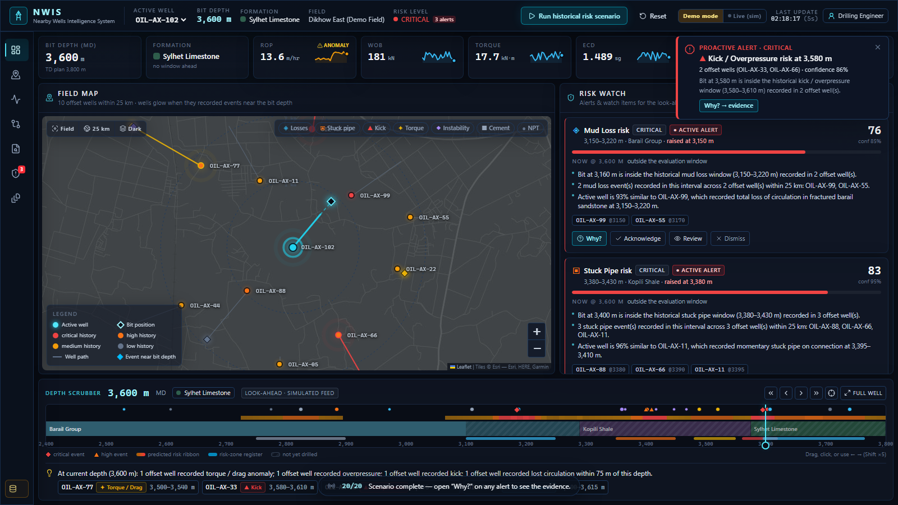

NWIS
Nearby Wells Intelligence System
Institutional memory beside the active well — what nearby wells experienced at this depth, why, and what to check next.
SIH 2026 · Problem statement SIH26121 · Oil India Limited
Working prototype · synthetic demo data (not OIL operational records)
Notes:
Open with the operational problem, not technology. NWIS gives every drilling engineer institutional memory — connecting the active well's current depth to what nearby and historical wells experienced, why it happened, and what to check next.

Slide 2



THE PROBLEM
Drilling knowledge is scattered — so risks repeat
Buried in reports
Held by people
Needed right now
Daily drilling reports, completion reports and mud logs sit as PDFs — searched by hand, if at all.
The engineer who cured the losses on the last well may be on another rig — or retired.
Decisions happen at the bit, in minutes. Manual offset review happens before spud, once.
110 h
of NPT in 8 offset events inside the three windows our active well is about to drill — Barail losses, Kopili stuck pipe, Sylhet kick.
Demo field (synthetic) — the pattern NWIS is built to break.
NWIS · SIH26121 · synthetic demo data
2
Notes:
Critical knowledge is distributed across completion reports, daily reports, databases and individual experience. In our synthetic demo field, the next 500 m of the active well cross three windows where offsets lost 110 hours of NPT.

Slide 3



THE INSIGHT
Engineers don't lack data — they lack the link
This depth, right now
What happened here before
eRTMAC: 3,150 m · Barail Group · ECD 1.48 sg and climbing · torque steady
OIL-AX-99 lost 45 m³ at 3,150 m when ECD hit 1.52 sg; cured with LCM + MW 1.38 sg (DDR Day 42, p.3).
NWIS is that link — depth-aware, evidence-backed, explainable.
NWIS · SIH26121 · synthetic demo data
3
Notes:
This is the idea everything is built on: join the live depth to the history at that depth.

Slide 4




THE SOLUTION
One workflow from the bit to the decision
01
02
03
04
05
Active well
Current depth
Nearby wells
Historical events
Depth / formation correlation
06
07
08
09
Evidence
Risk signal
Proactive alert
Recommended checks
GIS map
Correlation
Evidence search
Explainable alerts
Offsets in a user radius, well paths, bit position
Formation tops & parameters on one depth axis
Cited answers from reports & events
Why? — factors, wells, pages, checks
A standalone intelligence layer beside eRTMAC — it informs the engineer; it does not control the rig.
NWIS · SIH26121 · synthetic demo data
4
Notes:
Active well → current depth → nearby wells → historical events → correlation → evidence → risk signal → proactive alert → recommended checks → engineer decision.

Slide 5
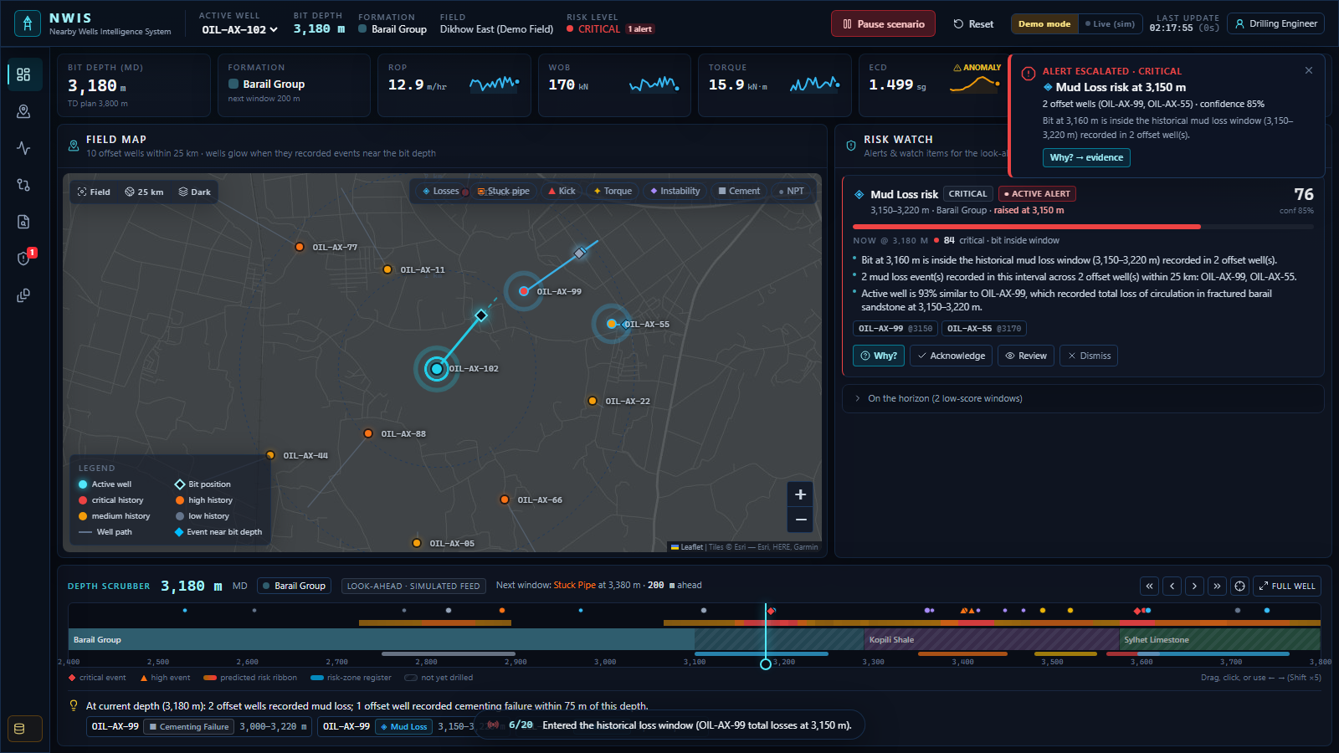
LIVE DEMO
Drill 3,100 → 3,600 m and watch history speak up
3,150 m
Mud loss — HIGH → critical
OIL-AX-99 & 55 lost returns here; ECD rising above programme
3,380 m
Stuck pipe — HIGH → critical
OIL-AX-88, 66, 11 stuck in the Kopili; torque 1.3× baseline
3,580 m
Kick / overpressure — CRITICAL
OIL-AX-33 kicked at the Sylhet top; MW 1.44 < 1.52 sg
Torque window at 3,500 m stays a watch card: medium history and no live confirmation → no alarm fatigue.
NWIS · SIH26121 · synthetic demo data
5
Notes:
Click Run historical risk scenario. At 3,150 m the mud-loss alert fires and OIL-AX-99 and OIL-AX-55 glow on the map; at 3,380 m stuck pipe; at 3,580 m a critical kick warning. Then click Why?.

Slide 6
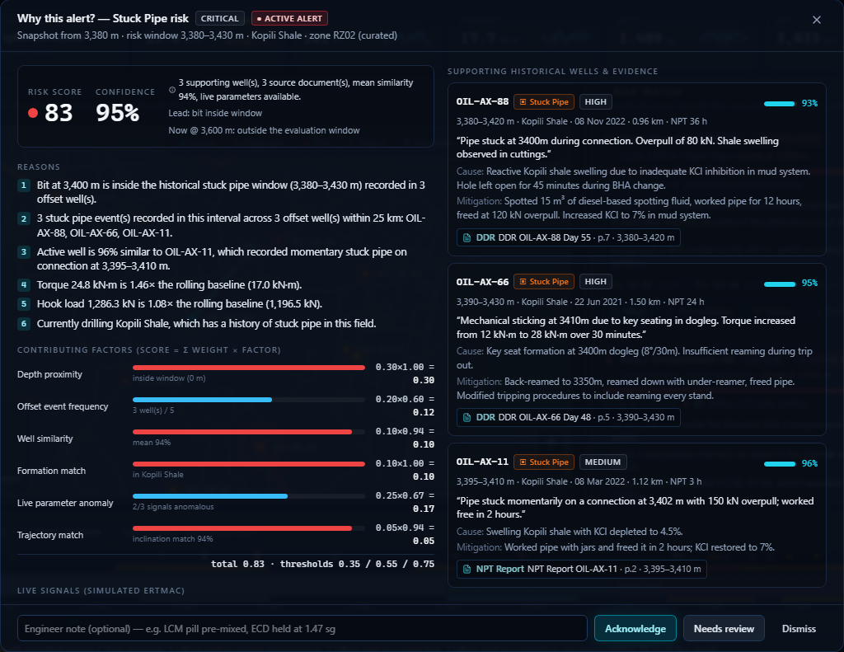
EXPLAINABLE RISK
Every alert shows its working
Risk score = Σ weight × factor
Thresholds 0.35 · 0.55 · 0.75 (medium · high · critical)
Medium-history zones need live confirmation to alert
Confidence from supporting wells, sources and similarity
WHAT · WHERE · WHEN · WHY · WHICH wells · WHAT evidence · WHAT to check · HOW confident
NWIS · SIH26121 · synthetic demo data
6
Notes:
Never a mysterious 'AI says high risk'. The Why? view lists numbered reasons, the weighted factor breakdown, live signals versus baseline, the supporting offset wells with quotes and page citations, recommended checks, and the audit trail. Scores rank risk; they are not calibrated probabilities.

Slide 7
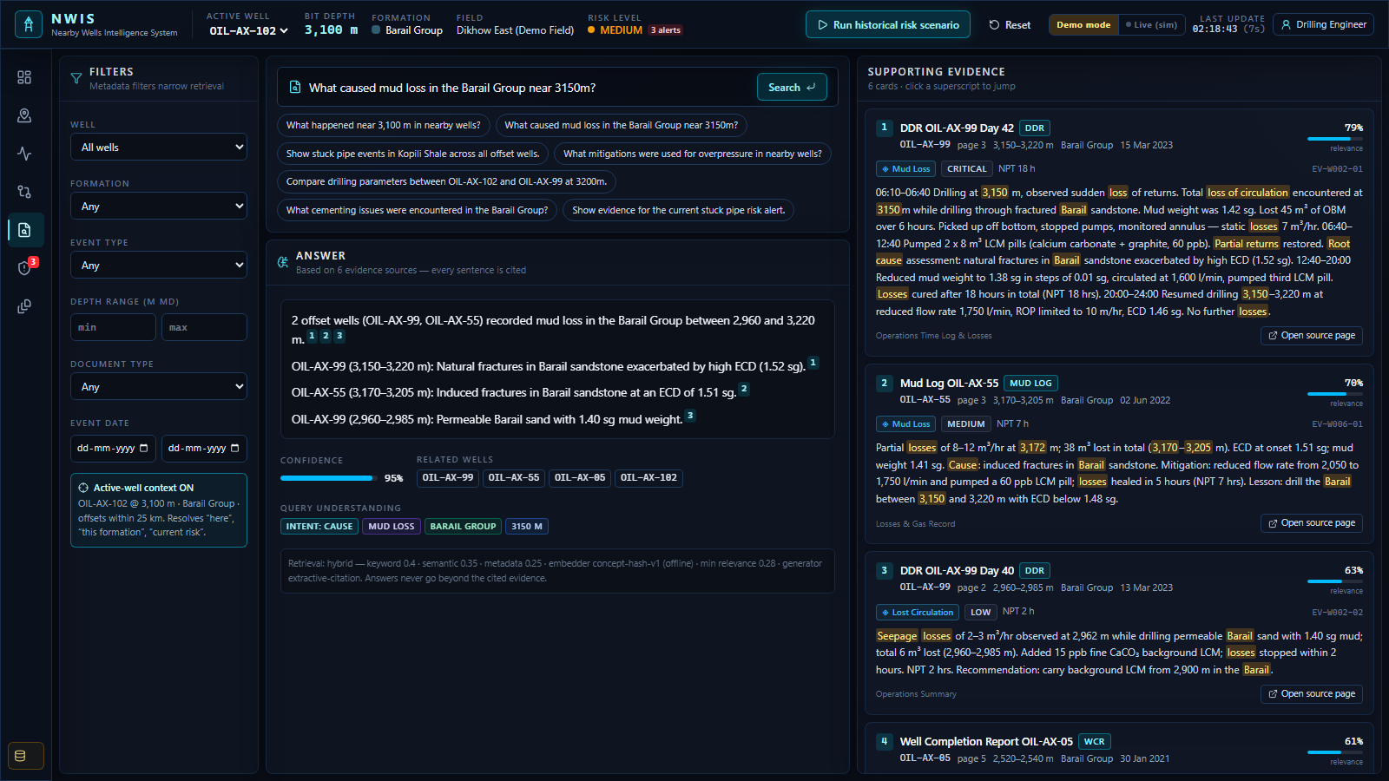


EVIDENCE-FIRST AI
No answer without a source page
Hybrid retrieval
Keyword 0.40 + semantic 0.35 + metadata 0.25 (depth, formation, risk family, well)
Understands drilling queries
“near 3400 m”, “this formation”, “lost returns” ≈ mud loss, “current risk”
Cited, or it says so
Every sentence carries [n] citations; below threshold → “Insufficient evidence”
Offline and deterministic for the demo; an optional Claude adapter writes the answer over the same cited evidence and is discarded if it cites nothing.
NWIS · SIH26121 · synthetic demo data
7
Notes:
Ask: What mitigations were used for stuck pipe in Kopili Shale? The answer names OIL-AX-88, 66 and 11 with what worked, each sentence cited to a report page. Click a citation to open the page.

Slide 8
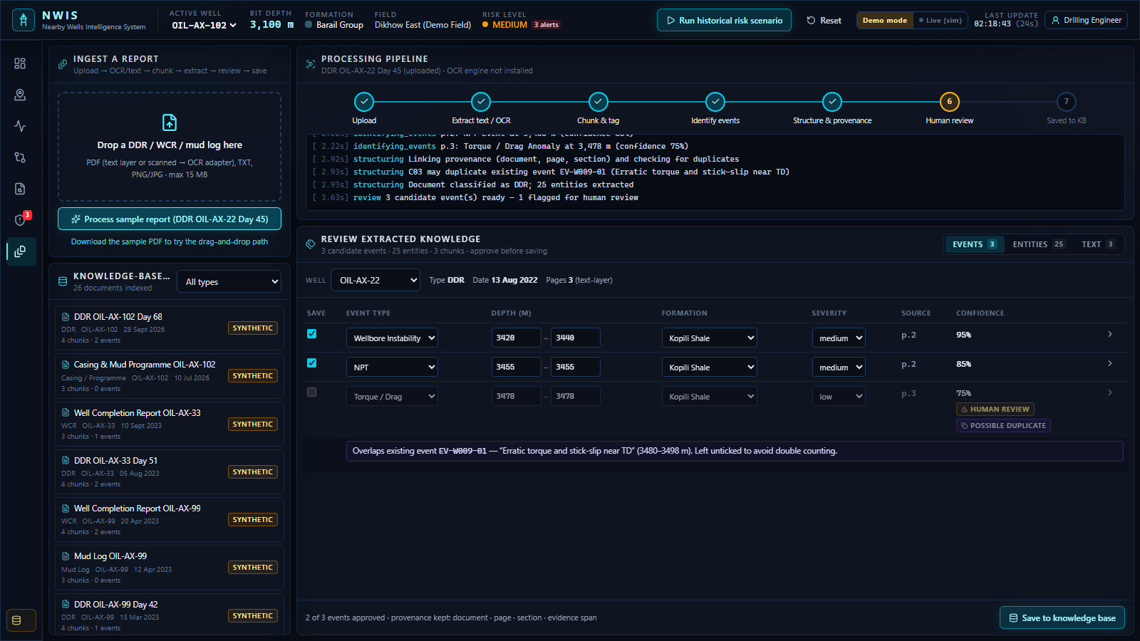
DOCUMENT INTELLIGENCE
Reports become structured, reviewed knowledge
1
2
3
4
5
6
7
Upload
Text / OCR
Chunk & tag
Extract events
Dedupe & provenance
Human review
Knowledge base
PDF text layer, TXT, or images via the OCR adapter (Tesseract)
Rule-based NLP finds losses, sticking, kicks, torque, cementing, NPT with depth, formation, cause, mitigation
Confidence scoring; < 75% flagged for human review
Duplicate check against the knowledge base — the sample report's torque rise matches an existing record
Nothing is saved until an engineer approves it — then it is searchable and used by the risk engine
NWIS · SIH26121 · synthetic demo data
8
Notes:
Process the sample daily drilling report for OIL-AX-22: three candidate events, one flagged as a possible duplicate, entities extracted, provenance kept. Save, then search for it.

Slide 9
ARCHITECTURE & INTEGRATION
Built to plug into OIL's systems
Sources
NWIS services (FastAPI)
Cockpit (Next.js)
Production swap-ins
DDR · WCR · mud logs
eRTMAC parameter stream
Surveys · formation tops
Casing & mud programmes
Document pipeline
Knowledge base (SQL)
Hybrid evidence search
Explainable risk engine
Well similarity
Command Center
Well Intelligence & Compare
Evidence Search
Risk Explorer
Document Intelligence
eRTMAC / WITSML → same parameter schema
OIL report archive → batch ingest
PostgreSQL + pgvector
Sentence-embedding model
Grounded LLM answers
SSO + role views
→
→
Runs offline on a laptop · deterministic demo mode · REST API with OpenAPI docs · 10 end-to-end tests
NWIS · SIH26121 · synthetic demo data
9
Notes:
A standalone layer beside eRTMAC. Every demo component has a named production replacement; the data model already carries provenance so authorised OIL data can replace the synthetic set.

Slide 10


IMPACT & NEXT STEPS
Less time between a signal and the evidence
Earlier warnings
Lessons reused
Faster ramp-up
Alerts before the bit reaches historically difficult windows — with lead distance and confidence.
What worked on offsets is shown with every alert and answer — not rediscovered.
New engineers get the field's history at the depth they are drilling, with sources.
NEXT
1
Connect eRTMAC and the OIL report archive
2
Calibrate weights on labelled NPT history
3
Close the loop: outcomes become lessons
NWIS doesn’t replace the drilling engineer — it shortens the path from a signal to the evidence.
NWIS · SIH26121 · synthetic demo data
10
Notes:
Close: decision support — the engineer decides. Be explicit that all data shown is synthetic and that the risk weights are transparent, not trained.

