Slide 1


SMART INDIA HACKATHON 2026
TITLE PAGE
Problem Statement ID – SIH26121
Problem Statement Title – Nearby Wells Intelligence System (NWIS)
Theme – ‹as listed on the SIH portal›
PS Category – Software
Team ID – ‹Team ID›
Team Name – ‹Team name›
NWIS · Nearby Wells Intelligence System
Drilling decision support beside eRTMAC · Oil India Limited
Notes:
SIH26121 from Oil India Limited: a Nearby Wells Intelligence System. One sentence: NWIS gives every drilling engineer the field's memory at the depth it matters.

Slide 2
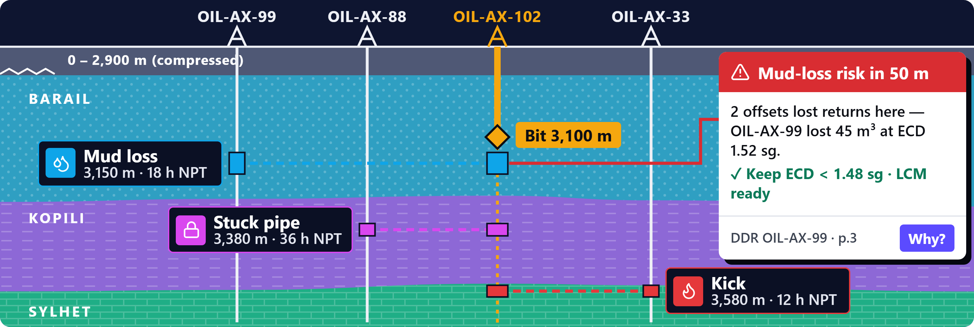
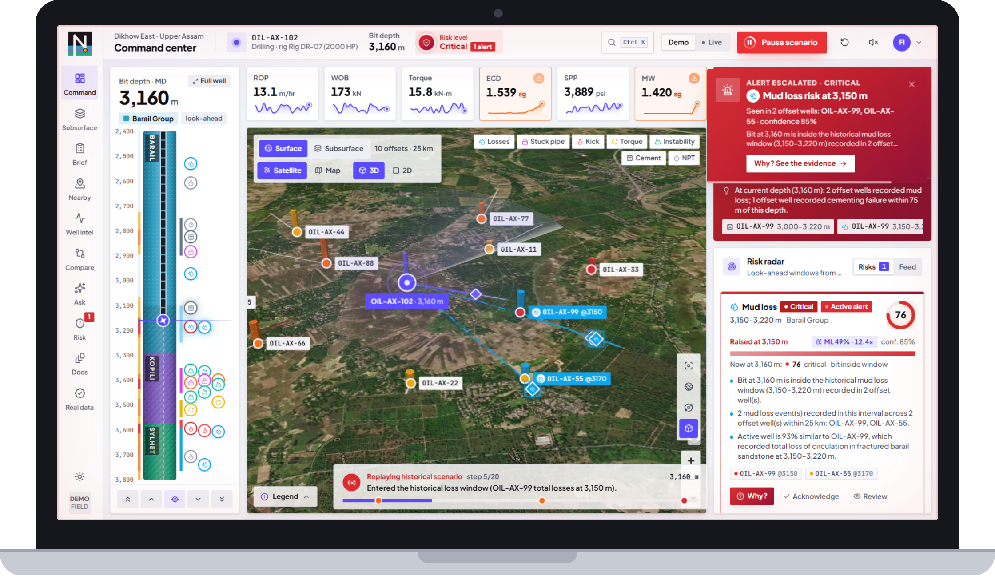












NWIS — Nearby Wells Intelligence System
Team Name
Proposed Solution (Describe your Idea/Solution/Prototype)
1
Detailed explanation of the proposed solution
Links the active well's bit depth to what offset wells hit at that depth — and warns before the bit gets there.
LIVE PROTOTYPE
2
How it addresses the problem
✓ All 20 official requirements PASS
See it working
Nearby wells on a 3D map, any radius
Offset history in seconds — every line cited
Correlates depth, formation, casing & mud
Warns before the bit reaches a risky depth
Prototype
Video
GitHub
‹add link›
‹add link›
sih26121 ↗
3
Innovation and uniqueness of the solution
Depth-linked
Evidence-first
Explainable + ML
Look-ahead brief
Real-data proof
bit depth drives map, 3D, risk, search
every answer cites report, page, depth
6-factor score + ML check (AUC 0.86)
next 300 m for the shift handover, ₹ NPT
1,970 real well histories, 94 % precision
Notes:
The picture is the idea. The active well is at 3,100 m. Offset wells hit mud loss at 3,150, stuck pipe at 3,380 and a kick at 3,580. NWIS reads their reports, links each event to the same depth on the active well and raises an alert 50 m before the bit gets there — with the fix that worked and the source page. The laptop is the working prototype; all 20 official requirements pass an automated check.

Slide 3















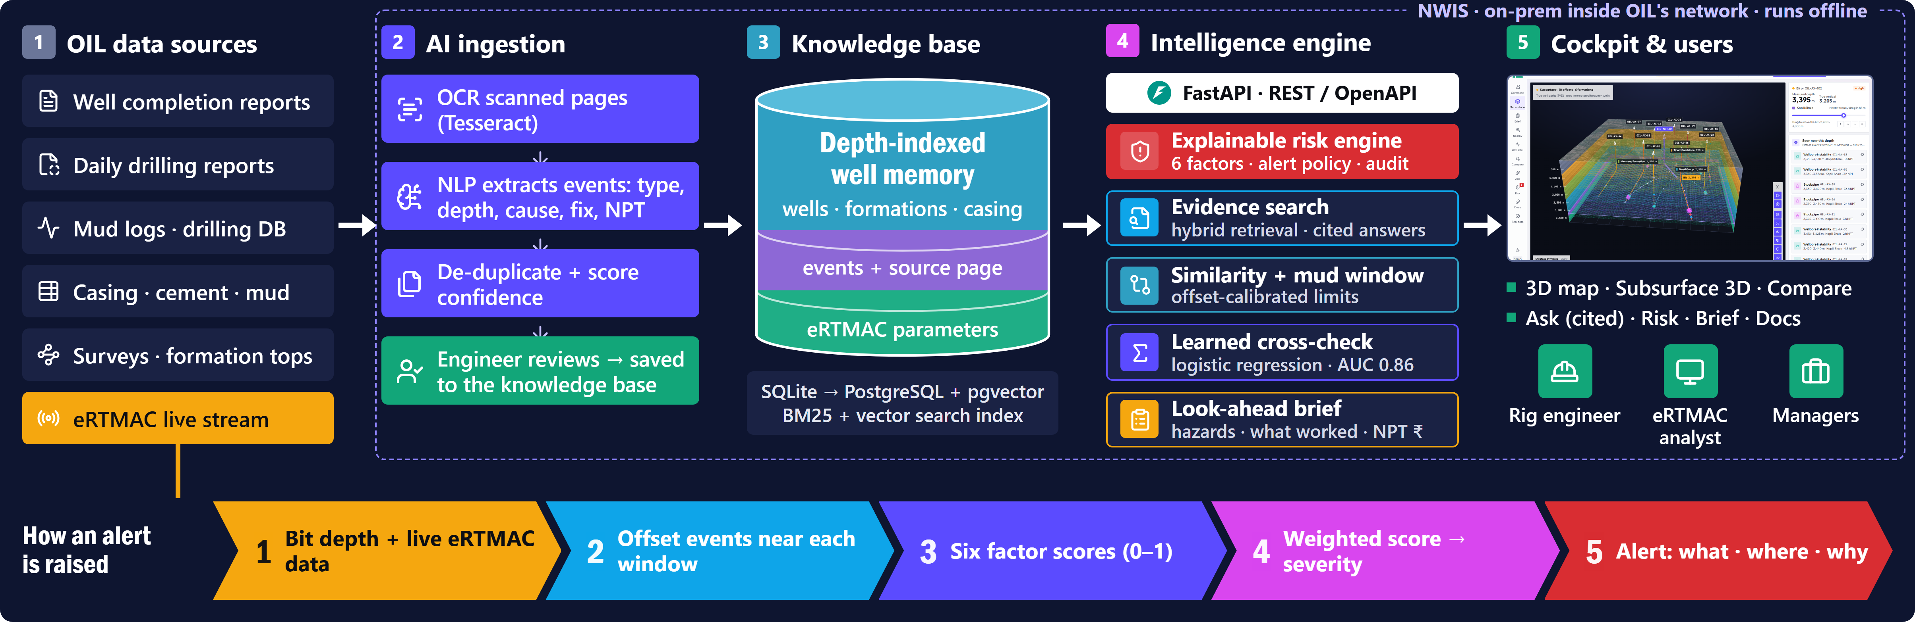
TECHNICAL APPROACH
Team Name
1
Technologies to be used
Frontend
Backend
AI · NLP · OCR
Data & integration
Next.js 16
React 19
MapLibre
three.js
Python 3
FastAPI
Pydantic
Tesseract
Drilling NLP
BM25 + vec
Log. regr.
Claude opt.
PostgreSQL
SQLite
WITSML
2
Methodology and process for implementation
Notes:
Top: the stack, all open source. Below: OIL's reports go through OCR and NLP, an engineer approves what becomes knowledge, and a depth-indexed knowledge base feeds the intelligence engine behind one API. The amber line is the live loop — every eRTMAC depth step re-scores the windows ahead, and the chevrons show how an alert is made.

Slide 4





FEASIBILITY AND VIABILITY
Team Name
1
Analysis of the feasibility of the idea
2
Potential challenges and risks
3
Strategies for overcoming these challenges
20/20
94 %
Confidential well data
On-prem in OIL's network, runs offline; the LLM is optional and off by default; SSO roles.
High
official SIH26121 requirements pass an API check
precision on real, held-out well histories
Scanned, messy old reports
OCR with per-page confidence; an engineer approves every extracted event.
High
0.86
< 30 ms
Alert fatigue on the rig
Weak windows need live confirmation; one alert per window — it escalates, never repeats.
Medium
AUC of the learned risk cross-check
for a cited answer or a full risk evaluation
Trust in AI advice
Every alert shows Why? — factors, cited evidence, confidence. The engineer decides.
Medium
Technical — open source, one server, no GPU
Operational — beside eRTMAC, no workflow change
Demo-tuned weights
Refit on OIL's NPT history, then a shadow pilot before alerts go live.
Low
Economic — no licence cost; saves NPT days
Viability — from prototype to OIL rigs in 12 months
NOW
MONTH 0–3
MONTH 3–6
MONTH 6–12
Prototype ready
Ingest one field
Shadow pilot at eRTMAC
Roll out
20/20 requirements · real-data proof · demo film
OIL DDR / WCR archive, SME review, refit weights
2 rigs · alerts logged, not shown · measure lead
live WITSML feed · SSO · all Assam rigs
Notes:
Feasibility is shown, not claimed: it is built and measured. Each risk has a concrete answer, most already built. The path to the rig is one field ingested, then a shadow pilot at eRTMAC before any alert goes live.

Slide 5







IMPACT AND BENEFITS
Team Name
1
Potential impact on the target audience
Why it matters
2
Benefits of the solution
Rig engineer & driller
≈ 20 %
Economic
Sees what offsets hit at this depth — 50 m before the bit gets there.
Fewer repeated losses, stuck pipe and kicks → less NPT, faster planning.
of well-construction time is lost as non-productive time (NPT) [2]
eRTMAC monitoring team
Live data linked to offset history; cited evidence in seconds.
Safety
up to 40 %
Earlier kick and overpressure awareness supports well control.
Planners & DWOP
Look-ahead brief: hazards, mud window and NPT in ₹ per section.
of NPT comes from kicks, losses and wellbore instability — exactly what NWIS warns about [3]
Environmental
New engineers & managers
≈ ₹21 cr / yr
Fewer loss events → less mud, LCM and cement lost; less rig diesel.
The field's memory stays searchable; every alert is audited.
if NWIS saves one NPT day on each of the ~70 wells OIL spuds a year [4]*
Social
Engineers don't lack data. They lack the link between this depth, right now and what happened here before.
Expert knowledge stays in India's energy PSU; faster onboarding.
* 1 day × 70 wells × ₹30 lakh/day assumed spread rate — an illustration, not a forecast.
Notes:
Industry numbers first: about a fifth of well time is NPT and up to 40 % of it comes from kicks, losses and instability. At OIL's scale one avoided NPT day per well is about 21 crore rupees a year — an illustration at an assumed spread rate, not a forecast.

Slide 6


RESEARCH AND REFERENCES
Team Name
1
Research — where today's approaches fall short
2
Validated on real public well records
Manual
offset review
Monitoring
alone
Generic
chatbot
NWIS
Same extractor, rules frozen — Norwegian shelf [7]
yes
partly
no
Tied to the live bit depth
1,970
611
94 %
Reads DDR / WCR text, even scans
well histories read
problems found
held-out precision
Cites report page + depth
stuck pipe 161 · mud loss 144 · kick 112 · NPT 100 · instability 82
Warns before the risky depth
Prior work mines report text [5] or predicts stuck pipe from parameters [6]. NWIS joins both at the live bit depth.
3
Details / links of the reference and research work
[1] SIH26121 Nearby Wells Intelligence System — Oil India Limited · SIH 2026 portal
[2] NPT ≈ 20 % of well-construction time — Drilling Contractor, 2018
[3] Kicks, losses and instability: up to 40 % of NPT — Offshore Magazine, 2011
[4] OIL: 70 wells spudded in FY25, 21 rigs — Chairman's speech, 66th AGM, 2025
[5] Hoffimann et al., Pattern mining in drilling reports with deep NLP — arXiv, 2017
[6] Montes, Ashok, van Oort, Review of stuck-pipe prediction — SPE Journal, 2025
[7] Norwegian Offshore Directorate well data, NLOD 2.0 — Sodir FactPages
[8] WITSML real-time drilling data standard (eRTMAC adapter) — Energistics
Notes:
NWIS is the only approach tied to the live bit depth with cited evidence. We proved the extractor on 1,970 real public well histories with 94 % precision. Give us three anonymised OIL DDR pages and we ingest them live.

