Slide 1
EduFund – Full-Stack Digital Banking Project
Role-Based Access | OTP-Secured Transactions | React + Spring Boot + JWT

Slide 2
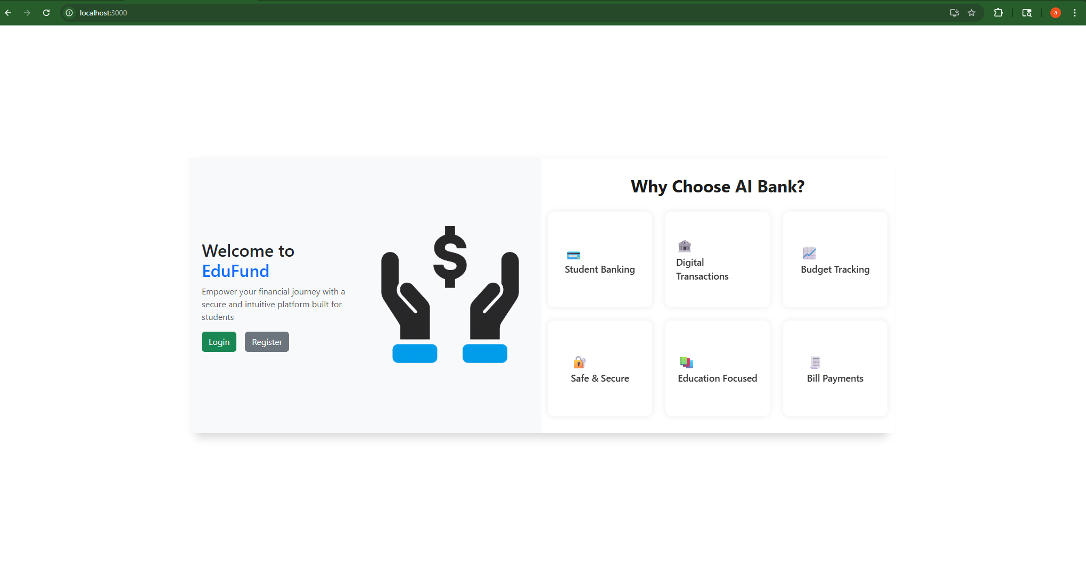
🎯 Home Page
Login and Register for Customers

Slide 3
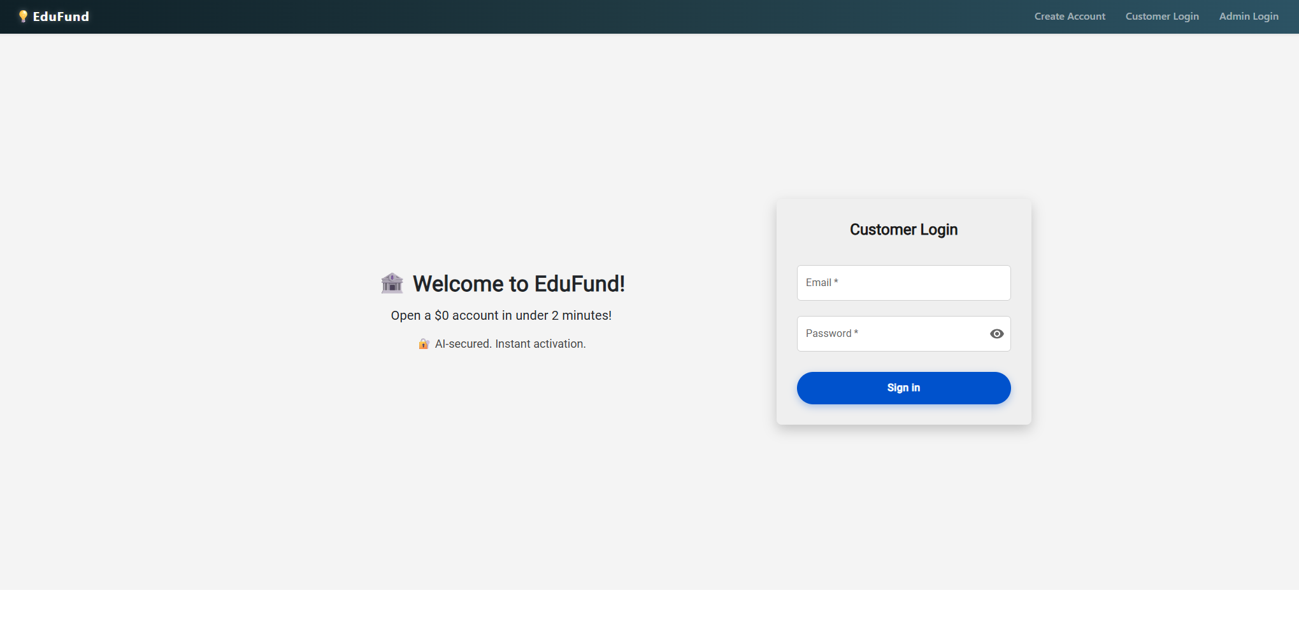
🔐 Customer Login – JWT-based Authentication
Secure login with Spring Security and token generation

Slide 4
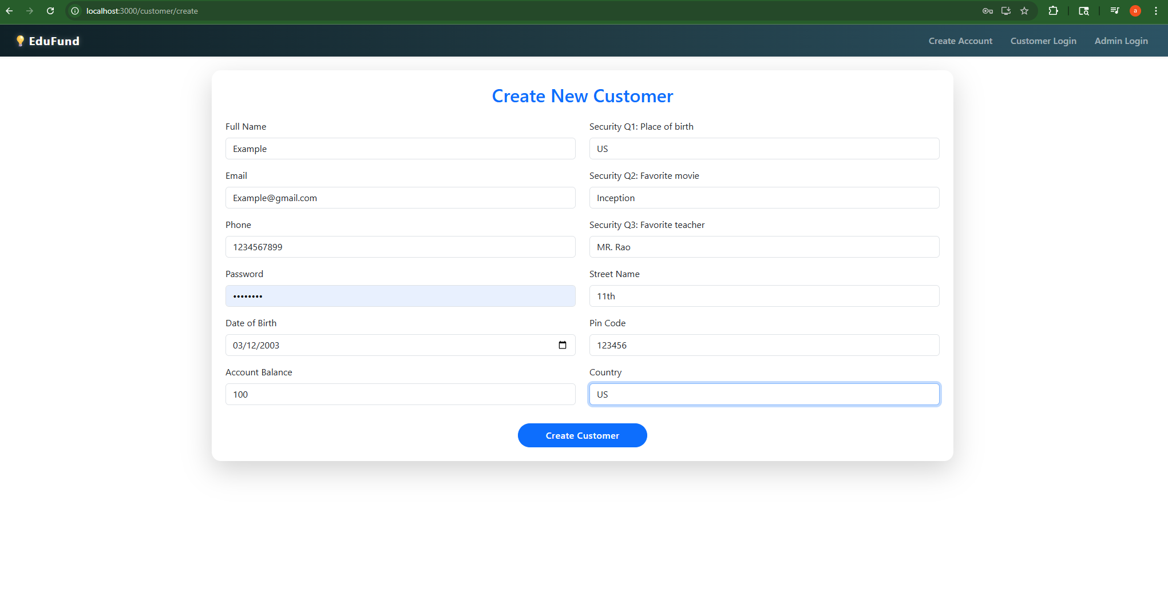
🧾 Create New Customer – Validated Form
New customer form with account auto-number, password encryption, and address details

Slide 5
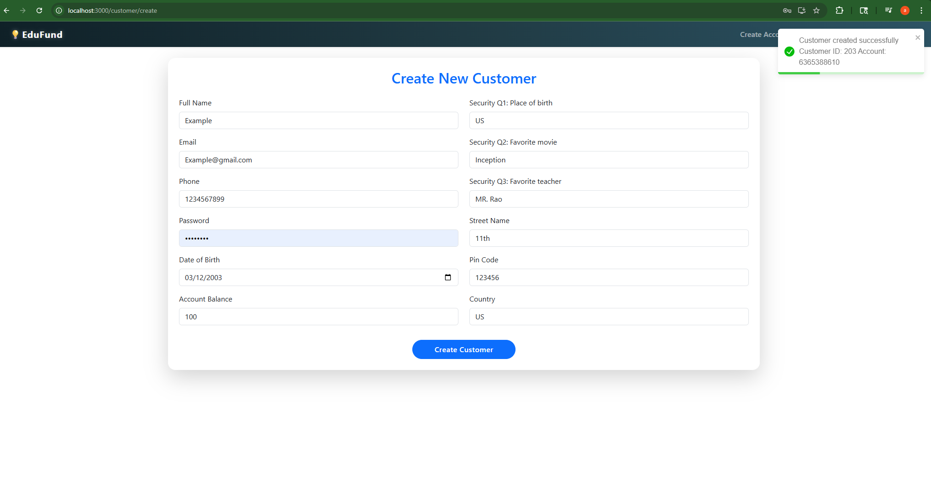
✅ Customer Created Successfully
API response with account number and customer ID

Slide 6
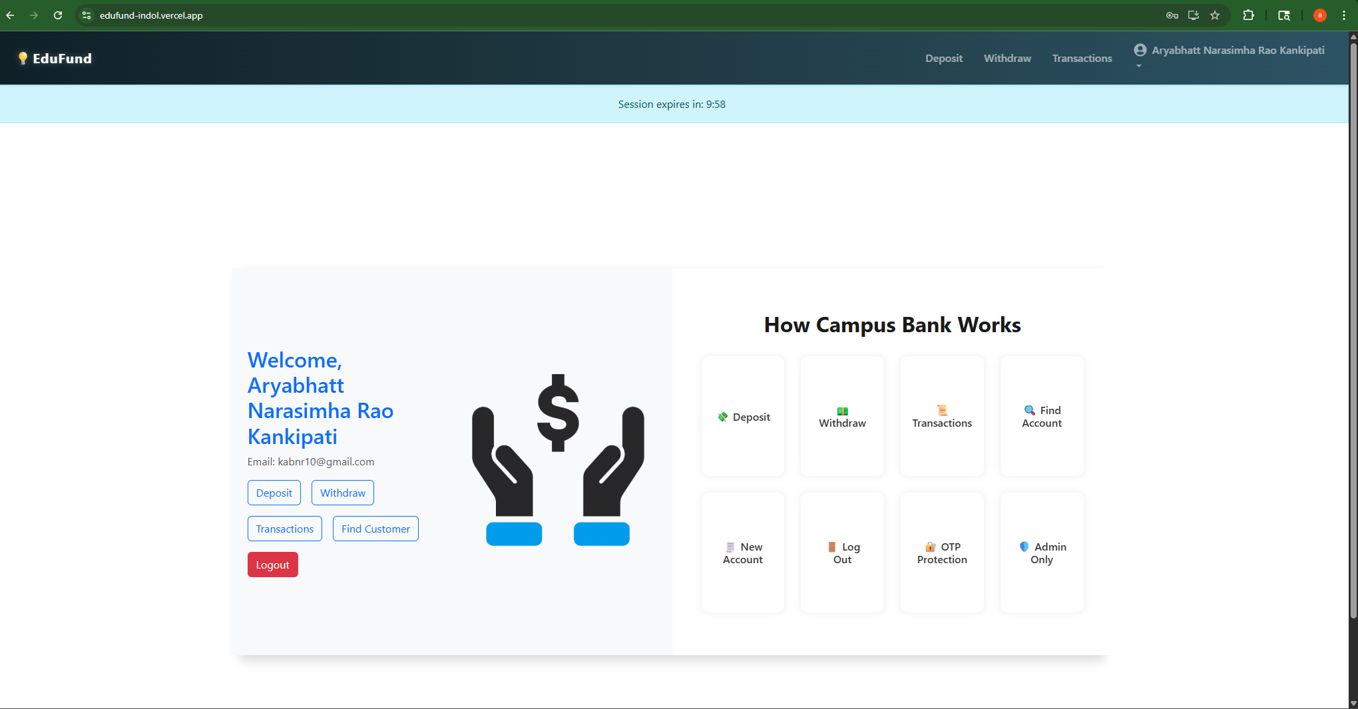
✅ Customer Login
Successful customer login with custom UI

Slide 7
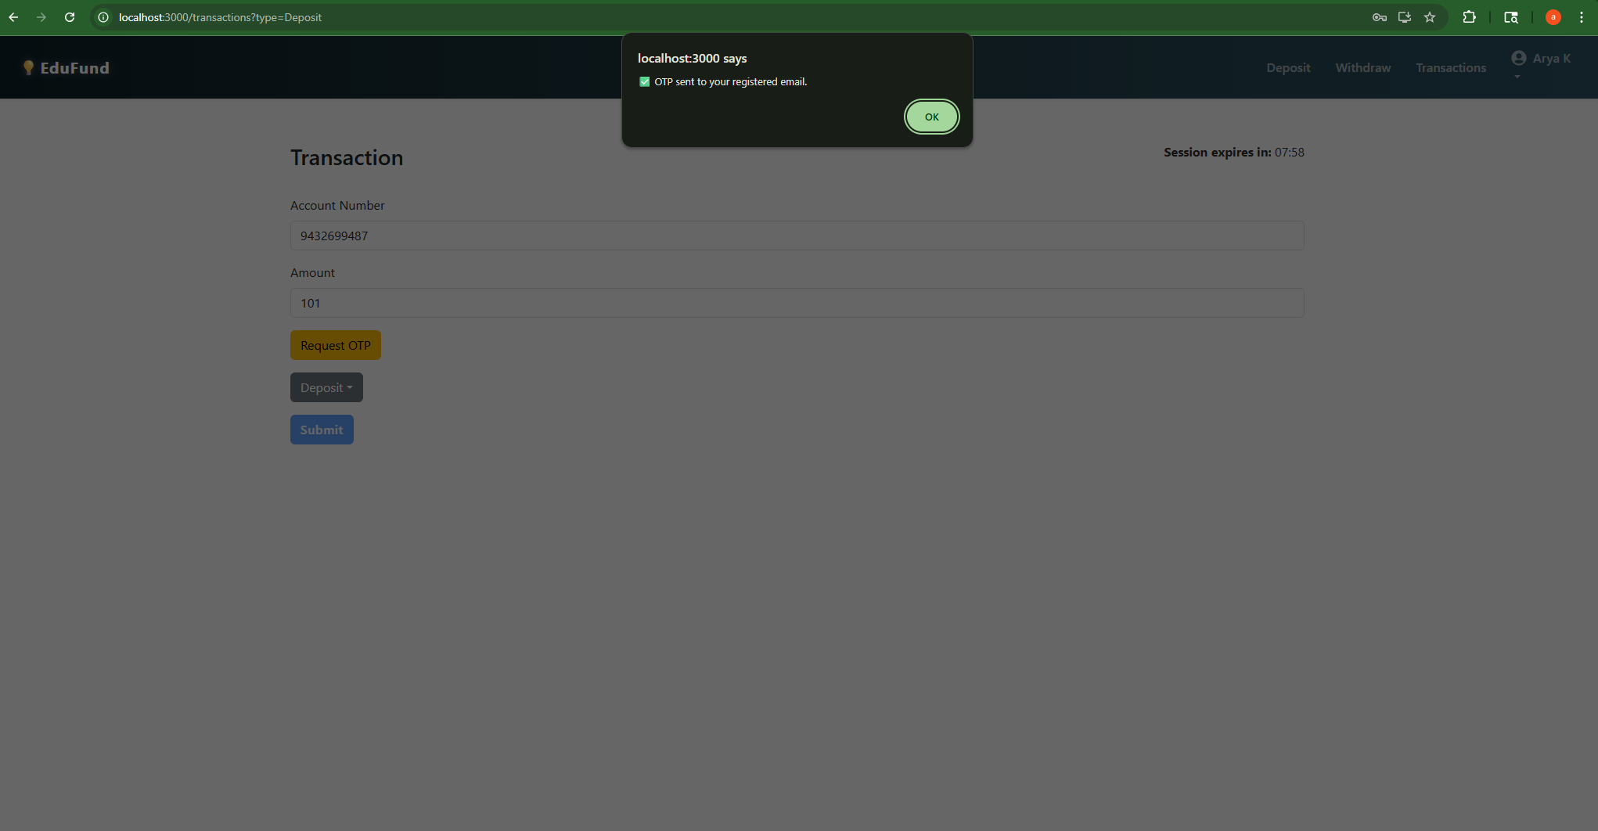
📩 OTP Request – Secure Transactions
OTP sent before deposit action with account + amount payload

Slide 8
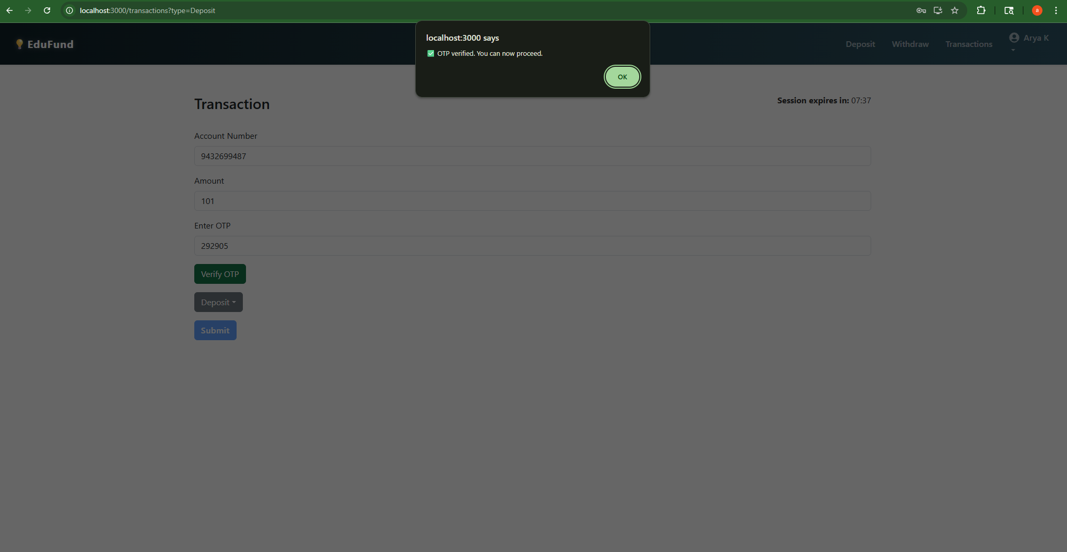
🔑 OTP Verification
Verifies OTP before allowing critical actions like deposit

Slide 9
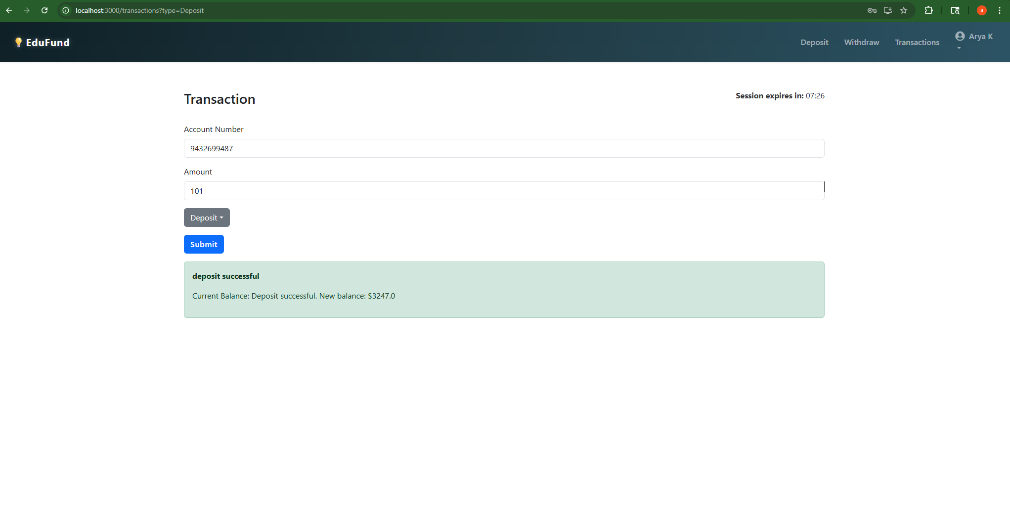
💸 Deposit Successful – Token Verified
Protected deposit flow with session timer

Slide 10
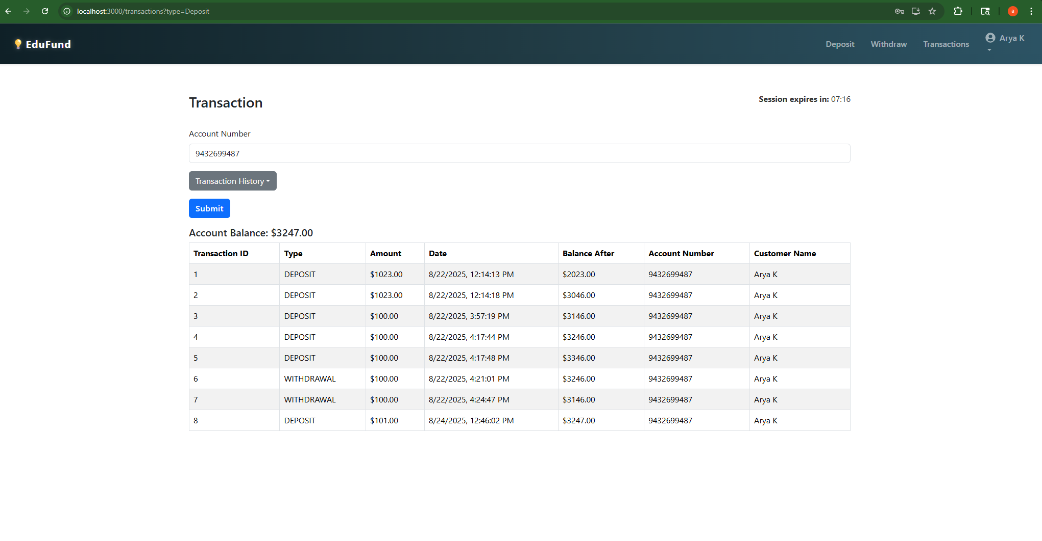
📊 Transaction History – Real-time UI
View previous deposits/withdrawals dynamically

Slide 11
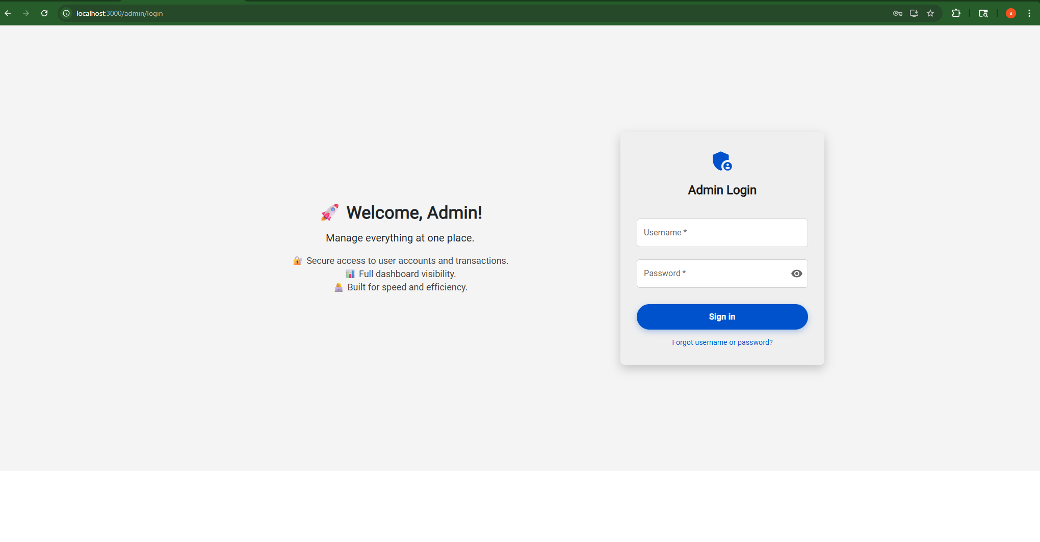
🧑‍💼 Admin Login
Admin visibility into all account activities

Slide 12
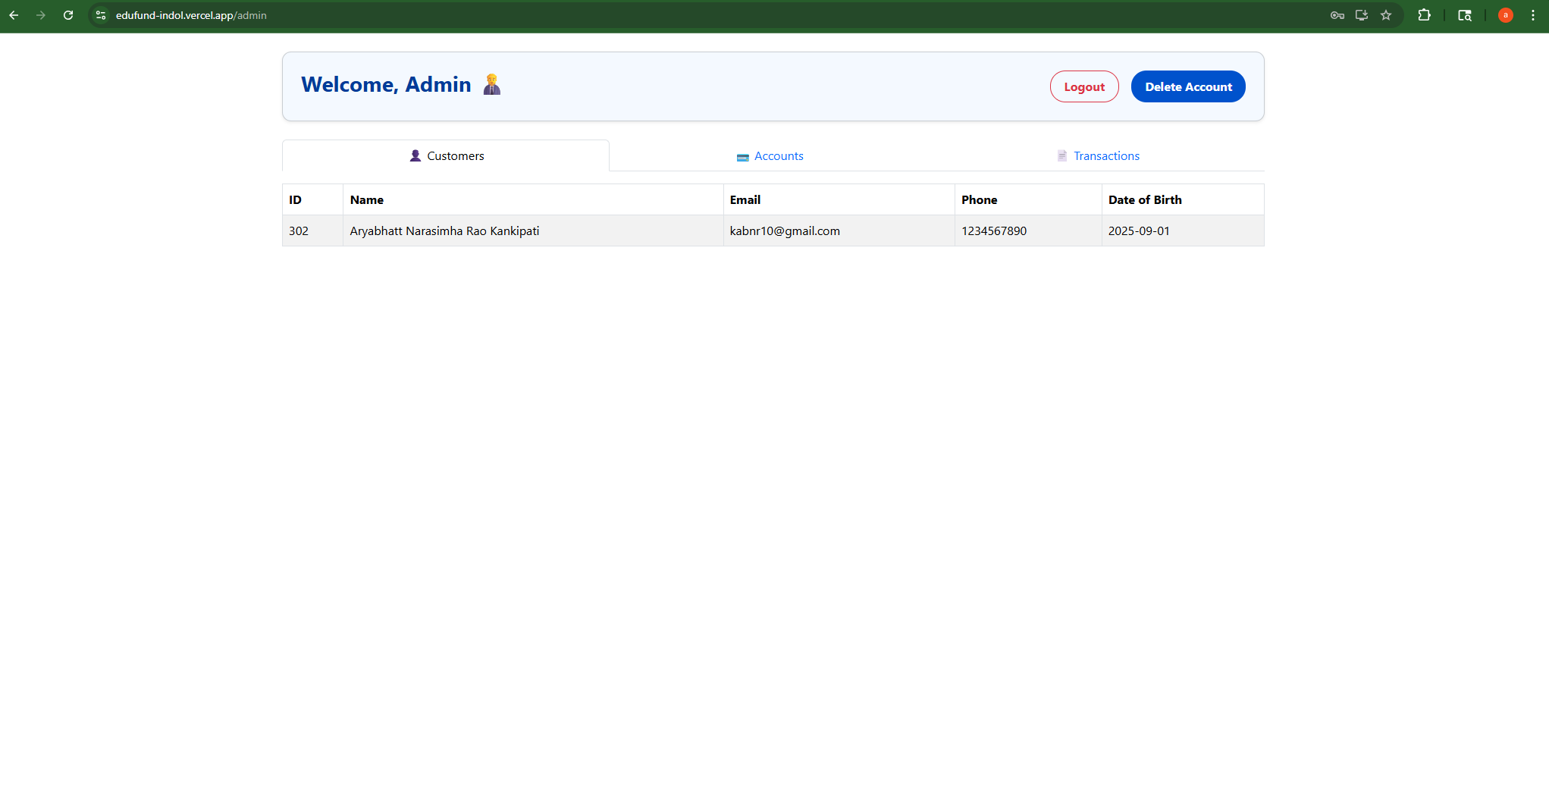
🧑‍💼 Admin Dashboard - View All Customers
Full list of Customers with ID, Name, email, phone, and DOB

Slide 13
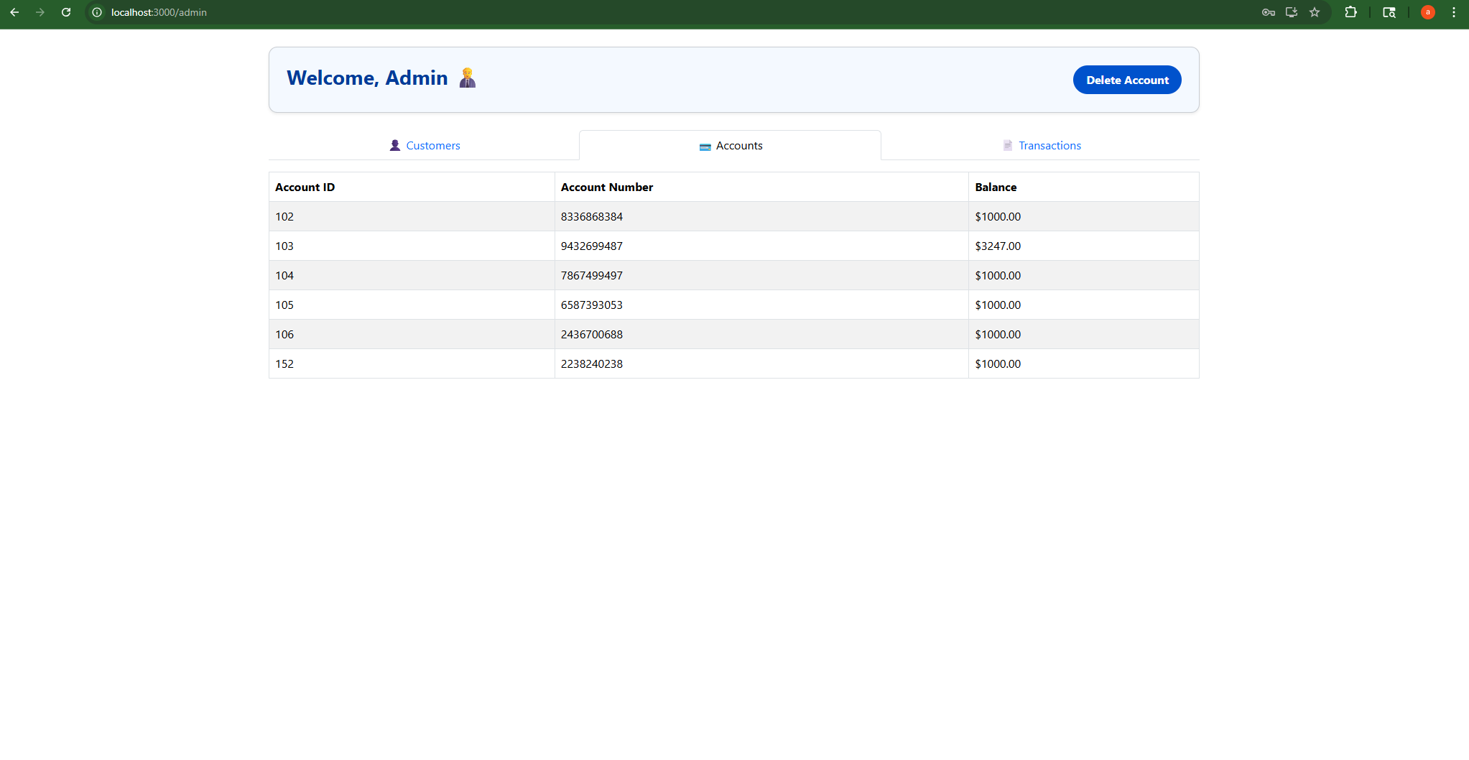
👤 Admin – View All Accounts
Full list of Accounts with IDs, Account Numbers, and Balances

Slide 14
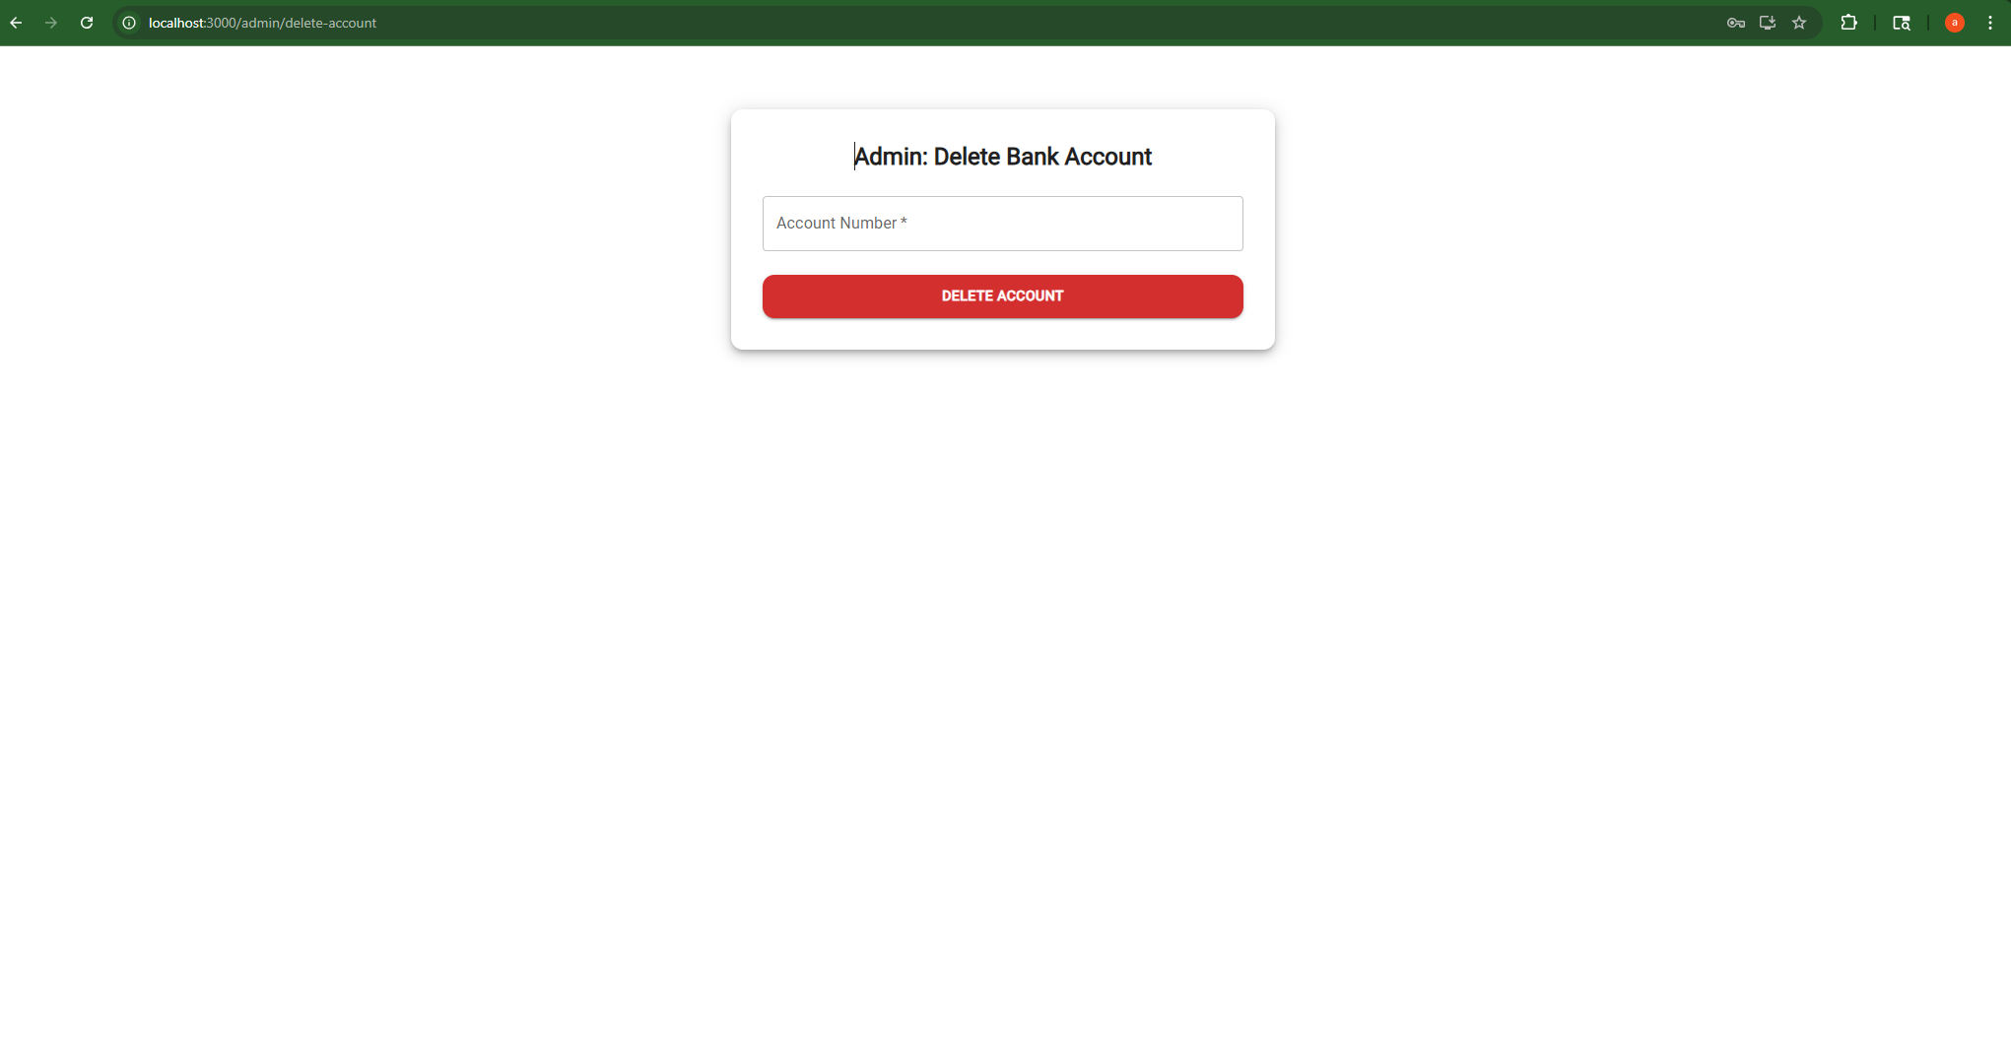
🗑️ Admin – Delete Account UI
Admin deletes account via account number (secure endpoint)

Slide 15
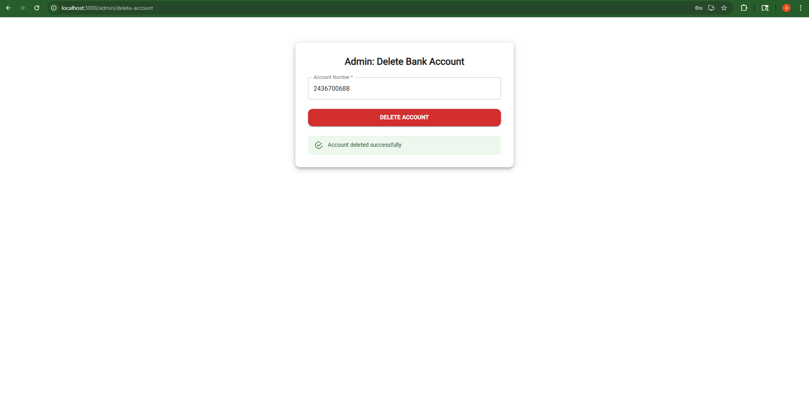
✅ Delete Success – Admin Action
Account deletion confirmation message

Slide 16
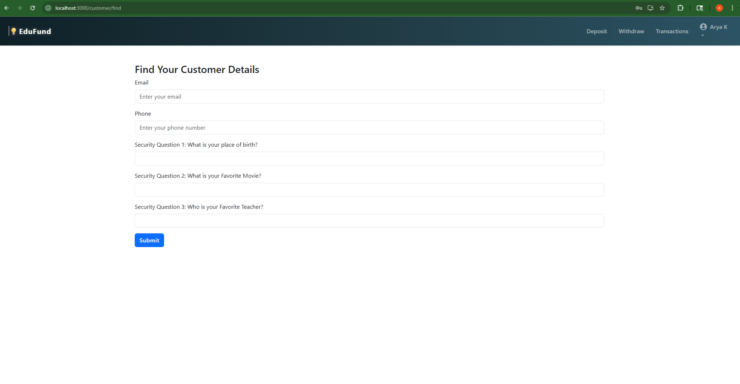
Search by email, phone, and 3 security questions
🔍 Account Recovery – Find Customer

Slide 17
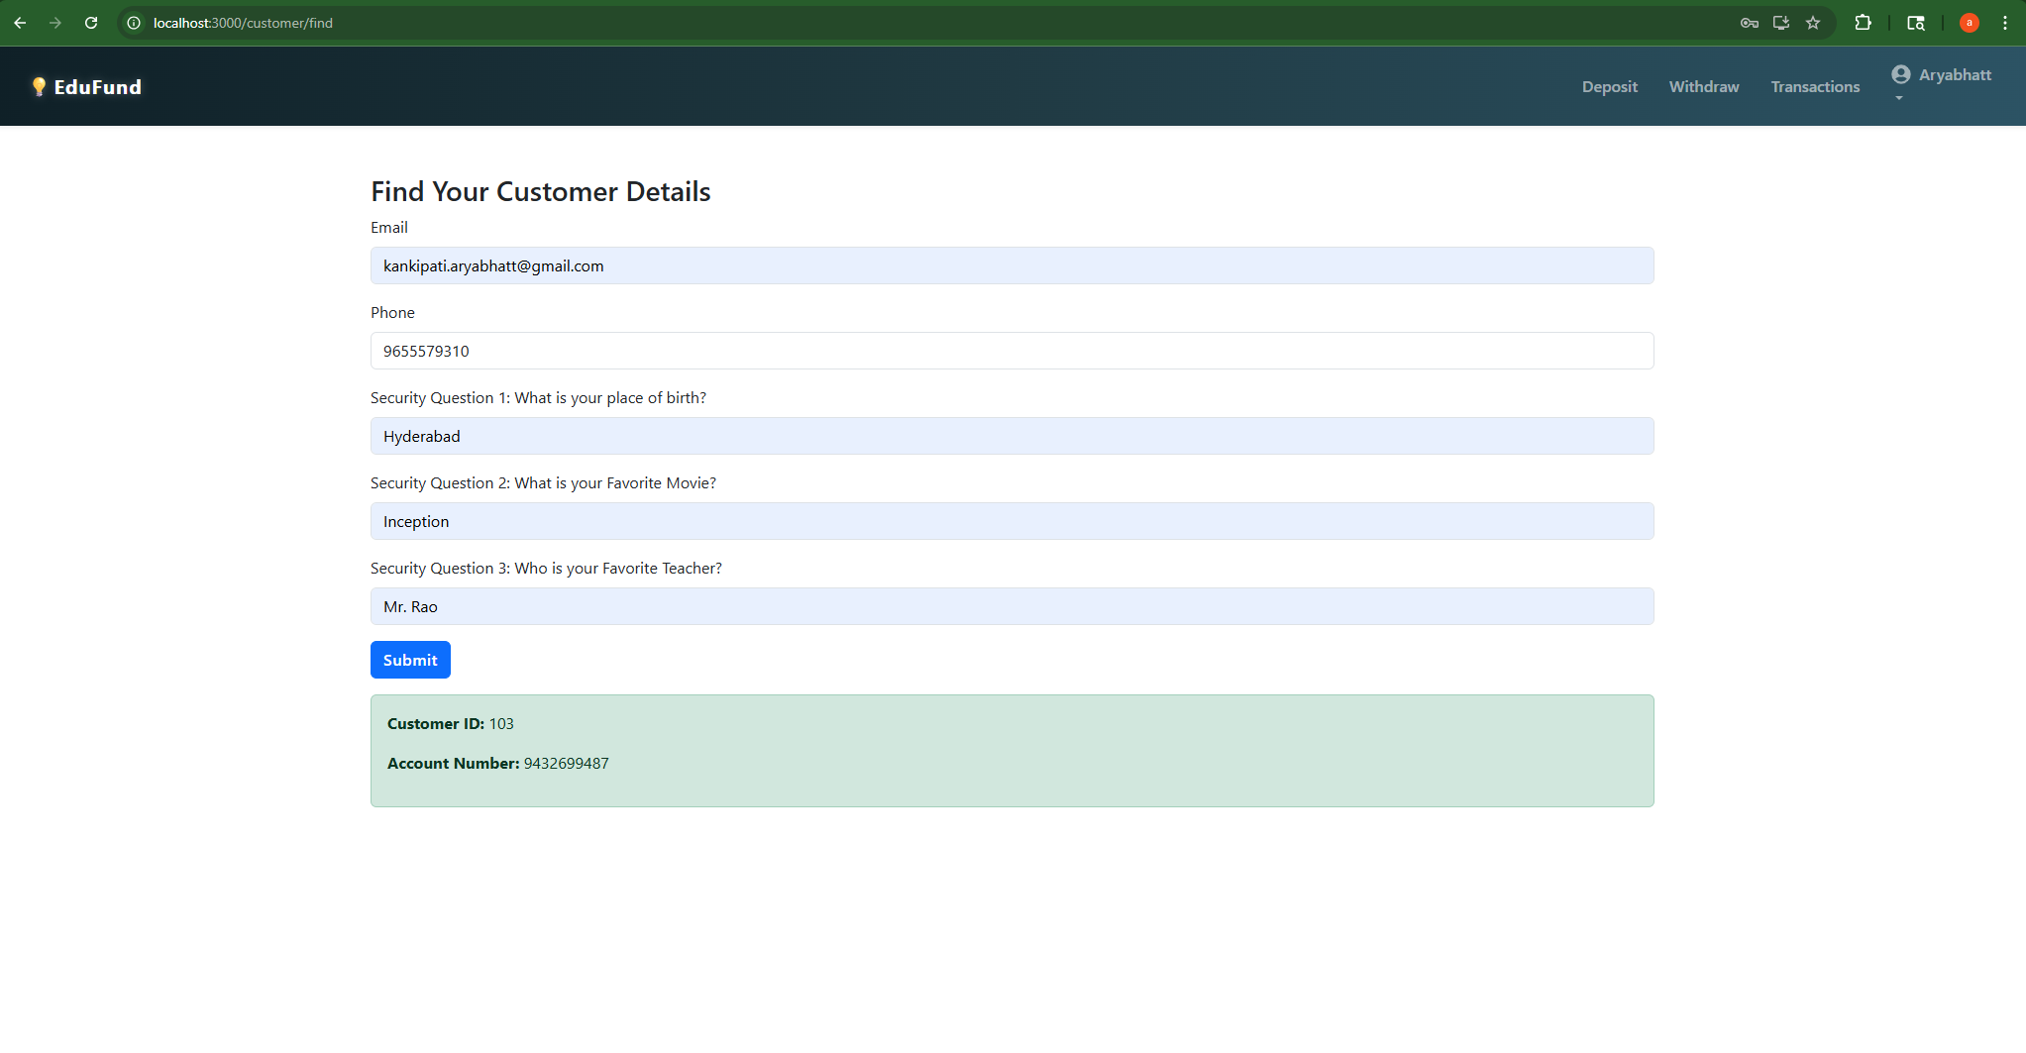
🧠 Account Recovered – Result Screen
Customer ID and account number shown upon correct answers

