Slide 1

REAL-LIFE HACKERS
Artificial Intelligence
Code Gladiators 2019

Slide 2
Executive Summary
We our creating an user-friendly app which will show the parking details (updated after every 10 seconds).
Through this app user can do the advance booking of parking slot at just Rs.20 extra in which it can select the date and timngs.
Also extra feature of this app will show user the directions to its alloted parking slot when car enters the parking area .
Parking cameras will automatically detect the parking slots empy or occupied which will be given to the app through which user can easily select the parking slot.
If the car is there in parking slot more than alloted time the extra charges will be made at Rs. 10 per half an hour.
One more Advance Feature we have created in App that it automatically generates Total Parking bill of user = PARKING CHARGES + Advance parking Booking charges.
We are also maintaining the Database using Firebase containing each and every information of user like E-mail ,Name , Phone number , parking slot number booked ,Billing details etc.
2

Slide 3
Problem at hand
Smart Parking for Smart Cities of the future!!
Where shuould I park my car ??
As we know car parking is major problem issue now-a- days and frustrating for people to find the parking spaces in malls and other parking areas .
3

Slide 4
Solution
So to solve this probelm , there will be an App which will help the user to detect the parking spot in the parking lot if available which will make easy for the user to find the parking space from the app in which the parking area avaibility will be updated after every 10 seconds (will show where there is parking space available by using automated cameras in parking places).
Extra feature of this App will be that user can also book there favourable parking slot in advance thorugh this app by selecting the date and timings for how many hours they want to park there car and on which date in advance , in just Rs.20 extra as advance booking charges and Rs.10 per extra half an hour if vehicle parked after ending of alloted time.
Also , this app will show the directions to the user when user enters the parking lot to the parking spot alloted to the user thus helping the user to easily reach to its parking slot.
Due to automated cameras in parking lot at every 10 seconds the parking lot condition get updated by telling which parking spots are empty or occupied.(Green box for empty parking spot)
One more Advance Feature we have created in App that it automatically generates Total Parking bill of user = PARKING CHARGES + Advance parking Booking charges.
We are also maintaining the Database using Firebase containing each and every information of user like E-mail ,Name , Phone number , parking slot number booked ,Billing details etc.
4

Slide 5
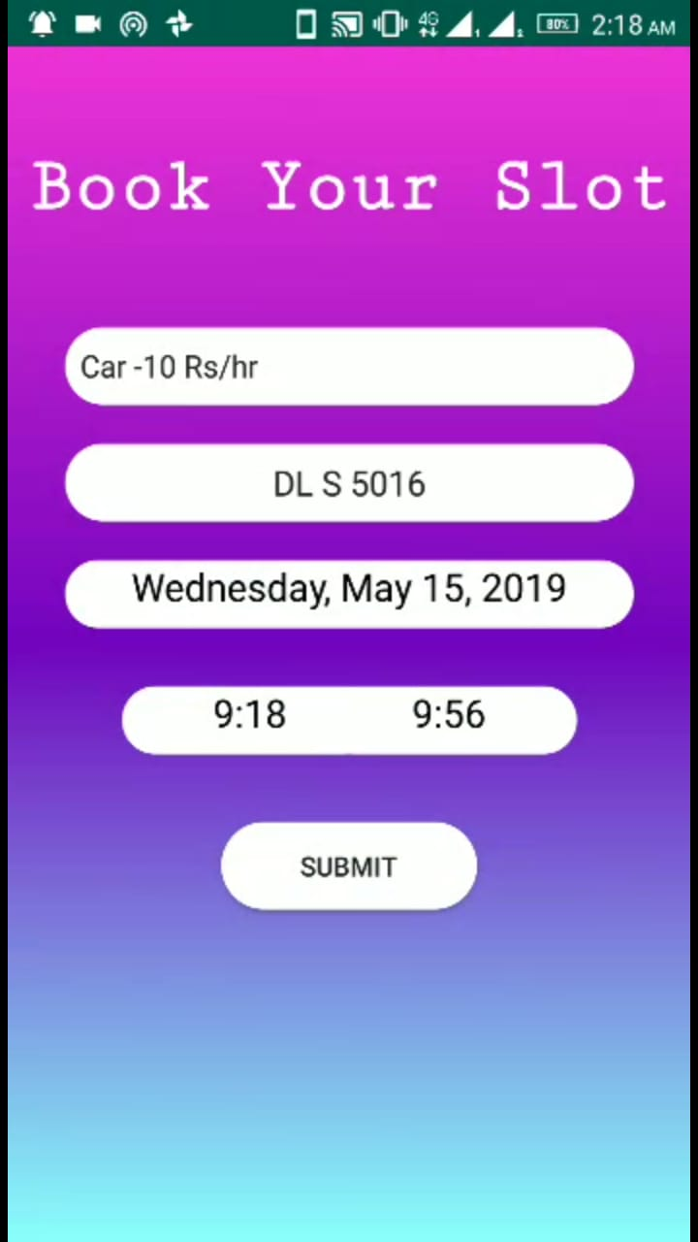
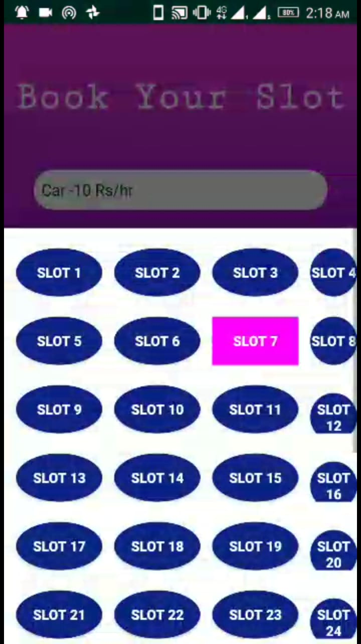
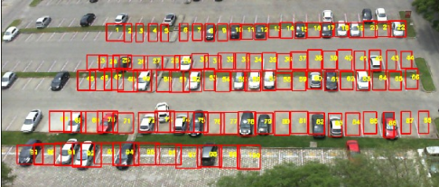
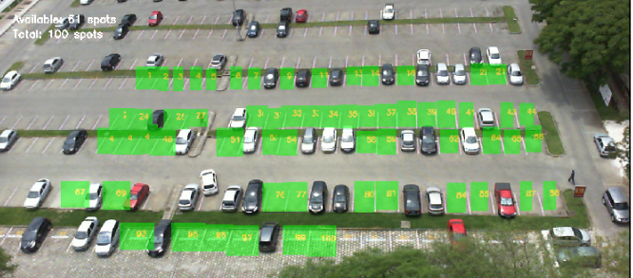
Demo/ Prototype
Link to the demo/ prototype-
https://github.com/aryachiranjeev/Parking-Lot/blob/master/Parking%20App%20Video.mp4
Snapshots-
Cars in Parking Slots in Parking Lot
Empty parking spaces are detected with Test Accuracy of 99.28%
Some Android App Glimpses
5

Slide 6
Approach
We created the segmented dataset for parking spot images of parking area in different weather conditions.
We train the convolutional neural network model for the segmemented dataset which contain various empty and occupied parking slots in different weather conditions and got training Accuracy 98% and Validation Accuracy 99% .
Then we annotated the full parking lot using OpenCv by detecting the parking slots in the parking area and finding there co-ordinates and saved them as pickel file.
After combining these two in the whole parking area we detected which parking slot is empty and which is occupied.(Green Box for Empty).
We saved the model and put it into the andoid app through which user can easily access the parking slot in the parking area and can do advance booking at just Rs.20 extra advance booking charges .
We used firebase to create datsbase to store the information of every user like name , email , the parking slot user booked ,payment done by user and many other details.
6

Slide 7
Technology Stack
Technologies used-
Computer Vision
Deep learning (Convolutional Neural Network)
Android app development
Libraries used-
OpenCV
Tensorflow(keras)
Tensorflow Lite
Firebase
Technical architecture -
https://github.com/aryachiranjeev/Parking-Lot/blob/master/Read%20Me(Technial%20Architecture).docx
https://github.com/aryachiranjeev/Parking-Lot/blob/master/project%20architecture.docx
7

Slide 8
Why our team is the best!
Our team is best !! Because we have created the user friendly App which will help the user to book there parking spot in the parking area in advance.
Also the great feature in our App will be that it will show user the dierction to reach the alloted parking slot when vehicle enetrs the parking area of any mall or complex.
And in App after every 10 seconds the parking area information about parking slots get updated which will help the user to easily select the empty parking space in big parking lots.
We are using cameras setup in parkng lots due to which our idea is feasible and can easily be bring into the deployement as there are no installation charges .
We are using Artificial Intelligence by making cameras automatically detect the parking spots in big parking lots.
Also ,Our team is best we have been working smartly and hardly to bring this idea in deployemnet for public use as this App will definetly come in demand if it gets deployed in real life applictions for parking .
8

Slide 9
Associated attachments/ files
Dataset link- https://github.com/aryachiranjeev/Parking-Lot/blob/master/puc_data_segmented.tar
Parking Lot image-https://github.com/aryachiranjeev/Parking-Lot/blob/master/test.jpg
CNN Model link - https://github.com/aryachiranjeev/Parking-Lot/blob/master/CNN_MODEL_PARKING.ipynb
Parking slot Detector Model link- https://github.com/aryachiranjeev/Parking-Lot/blob/master/DETECTING_PARKING_SLOTS.ipynb
Android App link – https://github.com/aryachiranjeev/Parking-Lot/blob/master/app-debug.apk
- https://github.com/aryachiranjeev/Parking-Lot/blob/master/ParkingApp-master.zip
Problem Solution Architecture link –https://github.com/aryachiranjeev/Parking-Lot/blob/master/project%20architecture.docx
Technical Architecture link -https://github.com/aryachiranjeev/Parking-Lot/blob/master/Read%20Me(Technial%20Architecture).docx
Github Repository link-https://github.com/aryachiranjeev/Parking-Lot
9

Slide 10
Thank you
10

Slide 11
Appendix
11

Slide 12
Challenges
Annotation of parking slots in parking area is time consuming.
Tunning of Cnn model for getting better accuracy.
Connecting OpenCV and tensorflow model to Android App.
Training of large image datasets is too time consuming.
12

Slide 13
Possible Improvements
Our Dataset is for four tyre vehicles and our future scope is to make detect parking spots in parking lot even for two tyre vehicles .
The camera will automatically detect the number plates of cars and the type of car for mainting record of car details.
Automatic fee charging thorugh time couting of car through parking lot cameras(like for how many hours the vehicle was in parking and which type of vehicle it was and generate charges according to it).
Make automatic fee charging even for the people who are not using the App but parking vehicle in the parking area.
Using QR Scan code to check the entry and exit of user so that user cant exit the parking without doing the payment of parking charges ,It will bring the whole model to totally Artificially controlled Parking which will not require human to check parking bills of person exiting the parking.
13

