Slide 1
210252-Advanced Data Structures
UNIT-II
Graphs
Basic Concepts, Storage representation, Adjacency matrix, adjacency list, adjacency multi list, inverse adjacency list. Traversals-depth first and breadth first, Introduction to Greedy Strategy, Minimum spanning Tree, Greedy algorithms for computing minimum spanning tree- Prims and Kruskal Algorithms, Dikjtra's Single source shortest path, Topological ordering.
Case study- Data structure used in Webgraph and Google map.

Slide 2
Outlines…
Introduction to Graph Data Structures
Basic Terminologies of Graphs
Representation of Graphs
Adjacency Matrix
Adjacency List
Adjacency Multi List
Inverse Adjacency List
Operations on Graph
Creation of Graph
Insertion Operation
Deletion Operation
Graph Traversals
Depth First Search (DFS)
Breadth First Search (BFS)

Slide 3
Outlines…
Introduction to Greedy Strategy
Minimum Spanning Trees
Prim’s Algorithm
Kruskal’s Algorithm
Single Source Shortest Path
Dijkstra’s Algorithm
Topological Sorting
Web Graph and Google Maps

Slide 4
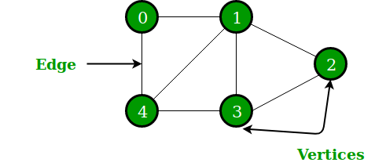
Introduction to Graphs
A Graph is a non-linear data structure consisting of nodes and edges. The nodes are sometimes also referred to as vertices and the edges are lines or arcs that connect any two nodes in the graph.
More formally a Graph can be defined as, A Graph consists of a finite set of vertices(or nodes) and set of Edges which connect a pair of nodes.
A data structure that consists of a set of nodes (vertices) and a set of edges that relate the nodes to each other.
● The set of edges describes relationships among the vertices .
● A graph G is defined as follows:
G=(V,E)
V(G): a finite, nonempty set of vertices
E(G): a set of edges (pairs of vertices)
In the given Graph, the set of vertices V = {0,1,2,3,4} and the set of edges E = {01, 12, 23, 34, 04, 14, 13}.

Slide 5
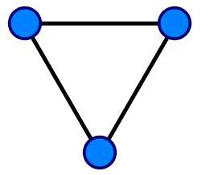
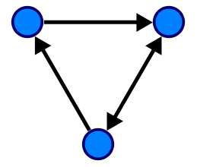
Types of Graph
Graphs are classified as directed and undirected graphs:
Undirected Graphs-
In an undirected graph, an edge is a set of two vertices where order does not make any relevance, whereas in a directed graph, an edge is an ordered pair.
Directed Graphs-
In an undirected graph, an edge is a set of two vertices where order does not make any relevance, whereas in a directed graph, an edge is an ordered pair.

Slide 6
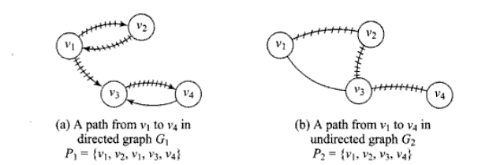
Graph Terminologies
Paths
• A path in a graph is a sequence of vertices such that from each of its vertices there is an edge to the next vertex in the
sequence.
The length of a path is the number of edges on it.
The length can be zero for the case of a single vertex.

Slide 7
Graph Terminologies
A path may be infinite.
• A finite path always has a first vertex, called its start vertex, and a last vertex, called its end vertex.
• Both of them are called terminal vertices of the path.
• The other vertices in the path are internal vertices.

Slide 8
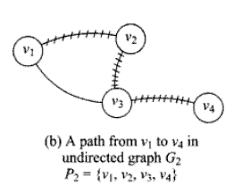
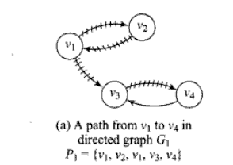
Graph Terminologies
Simple path
• A graph with no loops or multiple edges is called a simple graph.
• A path with no repeated vertices is called a simple path.
• The path from v1 to v4 is said to be simple path as
vertices is touched more than once.
• The path from v1 to v4 is not simple as
v1 is touched twice or looped.
cycle:
• Simple path, except that the last vertex is the same as
the first vertex. Its also known as a circuit or circular path.

Slide 9
Graph Terminologies
Connected graph
• Two vertices vi, vj in a graph G is said to be connected only if there is a path in G between vi and vj.
• A undirected graph is said to be connected graph if every pair of distinct vertices vi, vj are connected.
Connected undirected graph

Slide 10
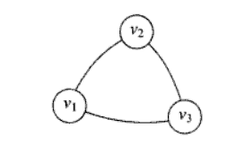
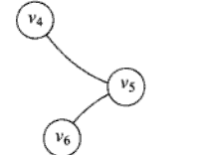
Graph Terminologies
In the case of an undirected graph, which is not connected, the maximal connected subgraph is called as a connected component or simply a component.
The graph below has 3 connected components.

Slide 11
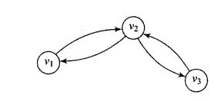
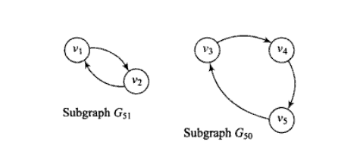
Graph Terminologies
Connected directed graph
• A directed graph is said to be strongly connected only if every
pair of distinct vertices vi, vj are connected.
• If there is a directed path from vi to vj then there must be a
directed path from vj to vi.
Strongly connected components of directed graph
• The below graph is not strongly connected but is said to possess two strongly connected components.

Slide 12
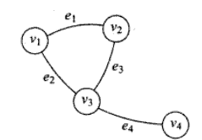
Graph Terminologies
Degree
• The degree of vertex in an undirected graph is the number of edges incident to that vertex.
• A vertex with degree one is called pendent vertex or end vertex.
• A vertex with degree zero and hence has no incident edges is called an isolated vertex.
In the undirected graph vertex v3 has the degree 3 And vertex v2 has the degree 2

Slide 13
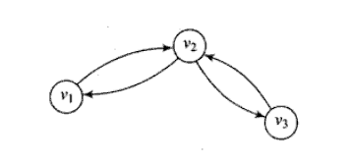
Graph Terminologies
Degree in directed graph
• Degree of directed graph has two types
i. In-degree- No of edges with their head towards the vertex.
ii. Out-degree- No of edges with their tail towards the vertex.
In-degree of vertex v2 is 2 and
Out-degree of vertex v1 is 1.

Slide 14
Graph Terminologies
Isomorphic graphs
• Isomorphism
– Two graphs are isomorphic, if they are structurally identical, Which means that they correspond in all structural details.
– Formal vertex-to-vertex and edge –to-edge
correspondence is called isomorphism.
• Two graph are said to be isomorphic if
▪ They have the same no of vertices.
▪ They have the same number of edges.
▪ They have an equal number of vertices with a given
degree.

Slide 15
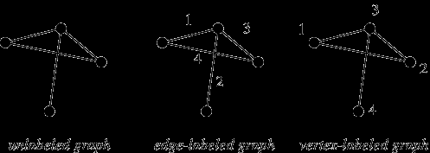
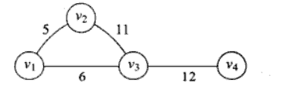
Graph Terminologies
Labeled graph
• A graph G is called a labeled graph if its edges and/or vertices are assigned some data.
• A graph labeling is the assignment of labels, traditionally represented by integers, to the edges or vertices, or both, of a graph.
• If the edge e is assigned a non-negative number then it is called the weight or length of the edge e.
Vertex-labeled graph
• If all the vertices in a graph are given a label then it is vertex-labeled graph
Edge-labeled graph
• If all the Edges in a graph are given a label then it is Edge-labeled graph

Slide 16
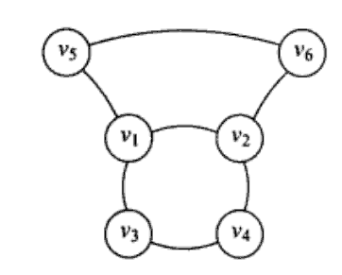
Graph Terminologies
Hamiltonian circuit
• Hamiltonian paths and circuits are named after the mathematician ,William Rowan Hamilton.
• A Hamiltonian circuit in a connected graph is defined as a closed walk that traverses every vertex of G exactly once.
also called Hamiltonian cycles.
• It is called as circuit if it includes every vertex of G. If any edge is removed then it is Hamiltonian path.
The above is a Hamiltonian circuit
as each and every vertex is traversed once
And completes the circuit by ending in starting point.
Hamiltonian circuit:
{v1,v3,v4,v2,v6,v5,v1}

Slide 17
Graph Terminologies
A Hamiltonian path or traceable path is a path that visits each vertex exactly once. Its also called as a traceable graph.
Hamiltonian path
A graph is Hamiltonian-connected if for every pair of vertices there is a Hamiltonian path between the two vertices.

Slide 18
Implementation of Graphs
We need to store two sets V and E to represent a graph. Here V is a set of vertices and E is a set of incident edges. These two sets basically represent the vertices and adjacency relationship among them.
There are two standard representations of a graph given as follows:
Adjacency matrix (sequential representation) and
Adjacency list (linked representation)

Slide 19
Adjacency Matrix
Adjacency matrix is a square, two-dimensional array with one row and one column for each vertex in the graph. An entry in row i and column j is 1 if there is an edge incident between vertex i and vertex j, and is 0 otherwise. If a graph is a weighted graph, then the entry 1 is replaced with the weight. It is one of the most common and simple representations of the edges of a graph; programs can access this information very efficiently.
For a graph G = (V, E), suppose V = {1, 2, …, n}. The adjacency matrix for G is a two-
dimensional n ∗ n Boolean matrix A and can be represented as
A[i][ j] = {1, if there exists an edge <i, j>
0, if edge <i, j> does not exist}

Slide 20
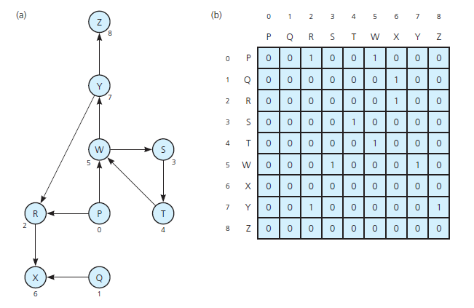
Example: Adjacency Matrix
The graphs represented using a sequential representation using matrices is called an adjacency matrix
Fig.: A directed graph and its adjacency matrix

Slide 21
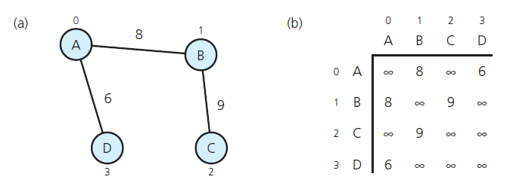
Adjacency Matrix
For a weighted graph, the matrix A is represented as
A[i][ j] = {weight, if the edge <i, j> exists
0, if there exists no edge <i, j>}
A weighted undirected graph and its adjacency matrix

Slide 22
Adjacency List
In this representation, the n rows of the adjacency list are represented as n-linked lists, one list per vertex of the graph. The adjacency list for a vertex i is a list of all vertices adjacent to it. One way of achieving this is to go for an array of pointers, one per vertex. For example, we can represent the graph G by an array Head, where Head[i] is a pointer to the adjacency list of vertex i. For list, each node of the list has at least two fields: vertex and link. The vertex field contains the vertex id, and the link field stores a pointer to the next node that stores another vertex adjacent to i.

Slide 23
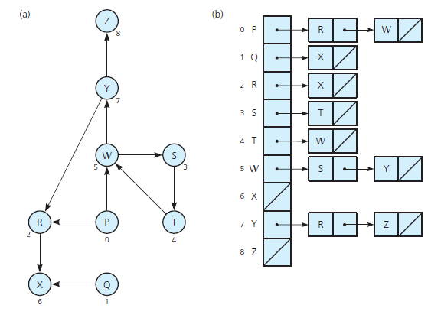
Adjacency List
A directed graph and its adjacency list

Slide 24
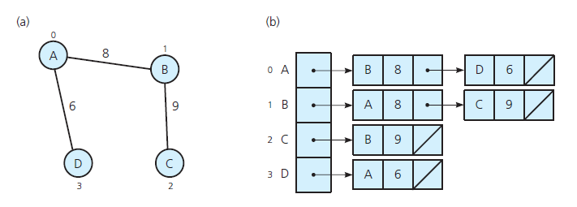
Adjacency List
A weighted undirected graph and its adjacency list

Slide 25
Adjacency Multi List
In the adjacency list representation of an undirected graph, each edge (vi, vj) is represented by two entries, one on the list of vi and the other on the list of vj. For the graph G1 in Fig. 8.9, the edge connecting the vertices 1 and 2 is represented twice, in the lists of vertices 1 and 2. In applications such as minimum spanning tree computation, if we process any edge once, then it has to be marked as a processed one. To avoid processing of that edge again, we need to find the other entries for that particular edge and mark it as processed. This adds to time complexity, which should be avoided. This can be achieved if the adjacency list is maintained as multilists such that the nodes are shared among several lists.
For each edge, there will be exactly one node, but this node will be in two lists, that is, the adjacency lists for each of the two nodes it is incident on. The node structure of such a list can be represented as follows:

Slide 26


Adjacency Multi List
N1
 | 1 | 2 | N2 | N4
 | 1 | 3 | N3 | N4
 | 1 | 4 | 0 | N5
 | 2 | 3 | N5 | 0
 | 2 | 4 | 0 | 0
Edge (1, 2)
Edge (1, 3)
Edge (1, 4)
Edge (2, 3)
Edge (2, 4)
1
2
N2
Vertex
N3
1
2
3
4
N4
N5
4
3
(a)
(b)
Adjacency multilist (a) Graph G1 (b) Adjacency multilist for G1

Slide 27



Inverse Adjacency List
An inverse adjacency list is a set of lists that contains one list for each vertex. Each list contains a node per vertex adjacent to the vertex it represents.
Head
1
2
2
1
2
3
3
1
2
(a)
(b)
Inverse adjacency list (a) Graph G2 (b) Inverse adjacency list of G2

Slide 28
Traversals of Graph
To solve many problems modeled with graphs, we need to visit all the vertices and edges in a systematic fashion called graph traversal. We shall study two types—depth-first traversal and breadth-first traversal. Traversal of a graph is commonly used to search a vertex or an edge through the graph; hence, it is also called a search technique. Consequently, depth-first and breadth-first traversals are popularly known as depth-first search (DFS) and breadth-first search (BFS), respectively.
There are two standard algorithms for graph traversals:
Depth First Search(DFS)
Breadth First Search(BFS)

Slide 29
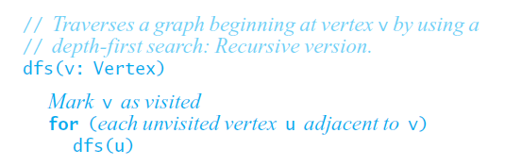
Depth First Search(DFS)
In DFS, as the name indicates, from the currently visited vertex in the graph, we keep searching deeper whenever possible. All the vertices are visited by processing a vertex and its descendents before processing its adjacent vertices. This procedure can be written either recursively or non-recursively.
For recursive code, the internal stack would be used, and for non-recursive code, we would use a stack.
Recursive Algorithm

Slide 30
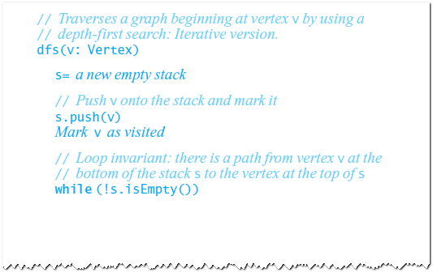
DFS Contd…
Non Recursive DFS Traversal
Iterative algorithm, using a stack

Slide 31
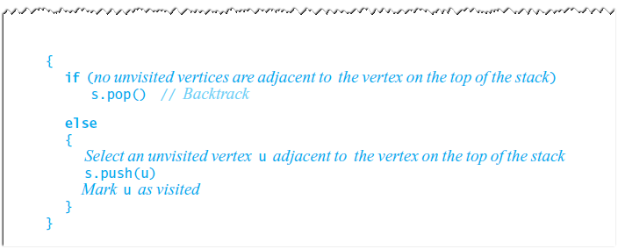
DFS Contd…

Slide 32
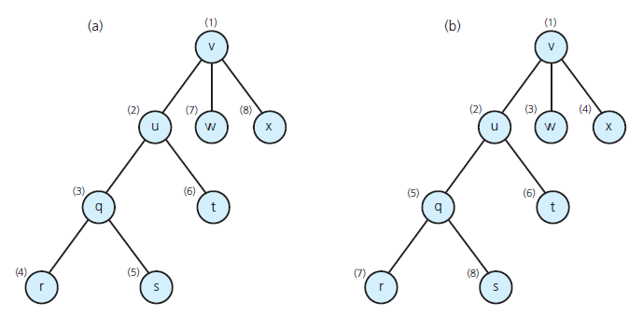
Example: DFS & BFS
(a) DFS: vuqrstwx (b) BFS: vuwxqtrs
Visitation order for (a) a depth-first search; (b) a breadth-first search

Slide 33
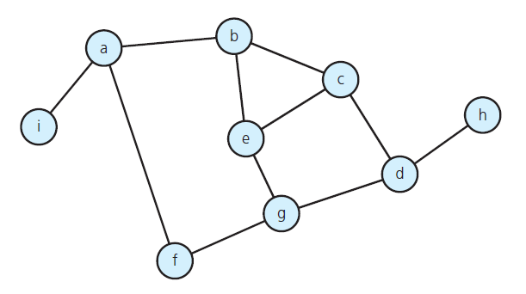
DFS: Example
Let us consider a connected Graph G=<V, E>
A connected graph with cycles

Slide 34
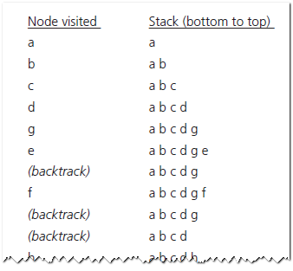
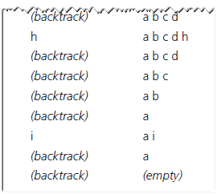
DFS: Example
The results of a depth-first traversal, beginning at vertex a , of the graph

Slide 35
Time and Space Complexity
Space complexity The space complexity of a depth-first search is lower than that of a breadth- first search.
Time complexity The time complexity of a depth-first search is proportional to the number of vertices plus the number of edges in the graphs that are traversed. The time complexity can be given as (O(|V| + |E|)).
Completeness Depth-first search is said to be a complete algorithm. If there is a solution, depth- first search will find it regardless of the kind of graph. But in case of an infinite graph, where there is no possible solution, it will diverge.

Slide 36
Time Complexity
Time Complexity of DFS (Using Adjacency List)
Assume adjacency list
n = number of vertices m = number of edges
O(n + m)
Time Complexity of DFS (Using Adjacency Matrix)
Assume adjacency matrix
n = number of vertices m = number of edges
O(n²)

Slide 37
Breadth First Search
Another systematic way of visiting the vertices is the breadth-first search (BFS). The BFS differs from DFS in a way that all the unvisited vertices adjacent to i are visited after visiting the start vertex i and marking it visited. Next, the unvisited vertices adjacent to these vertices are visited and so on until the entire graph has been traversed. The approach is called ‘breadth-first’ because from the vertex i that we visit, we search as broadly as possible by next visiting all the vertices adjacent to i.

Slide 38
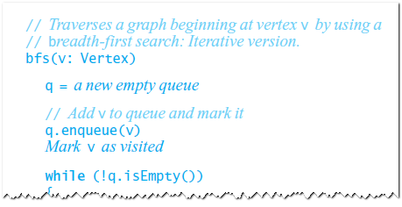
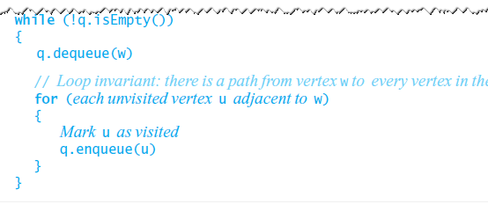
Breadth First Search(BFS)
Visits all vertices adjacent to vertex before going forward
Breadth-first search uses a queue
Algorithm of BFS

Slide 39
BFS: Example
Let us consider a connected Graph G=<V, E>
A connected graph with cycles

Slide 40
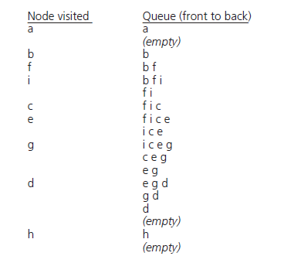
BFS: Example
The results of a breadth-first traversal, beginning at vertex a, of the graph.

Slide 41
Time and Space Complexity
Space complexity In the breadth-first search algorithm, all the nodes at a particular level must be saved until their child nodes in the next level have been generated. The space complexity is therefore proportional to the number of nodes at the deepest level of the graph.
the space complexity can also be expressed as O ( | E | + | V | ), where | E | is the total number of edges in G and| V | is the number of nodes or vertices.
Time complexity In the worst case, breadth-first search has to traverse through all paths to all possible nodes, However, the time complexity can also be expressed as O( | E | + | V | ), since every vertex and every edge will be explored in the worst case.
Completeness Breadth-first search is said to be a complete algorithm because if there is a solution, breadth-first search will find it regardless of the kind of graph. But in case of an infinite graph where there is no possible solution, it will diverge.
Optimality Breadth-first search is optimal for a graph that has edges of equal length, since it always returns the result with the fewest edges between the start node and the goal node.

Slide 42
Spanning Trees
Tree: an undirected connected graph without cycles
Observations about undirected graphs
Connected undirected graph with n vertices must have at least n – 1 edges.
Connected undirected graph with n vertices, exactly n – 1 edges cannot contain a cycle
A connected undirected graph with n vertices, more than n – 1 edges must contain at least one cycle

Slide 43
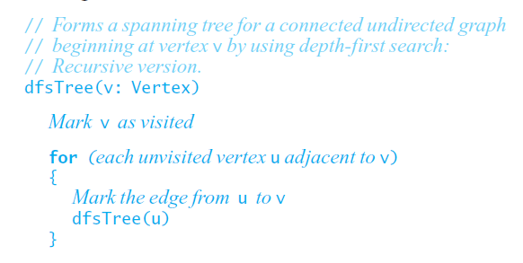
DFS Spanning Tree
DFS Spanning Tree Algorithm
Recursive Algorithm:

Slide 44
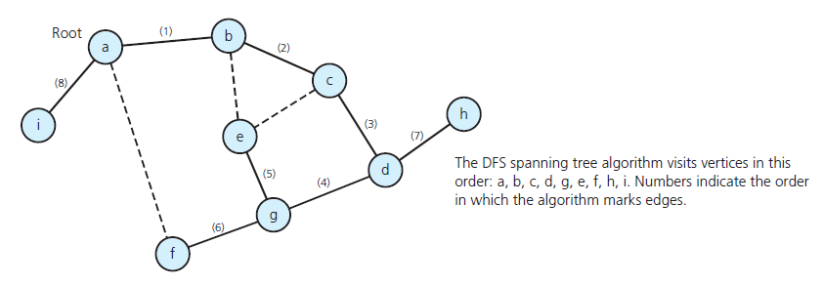
DFS Spanning Tree: Example
The DFS spanning tree rooted at vertex a for the graph

Slide 45
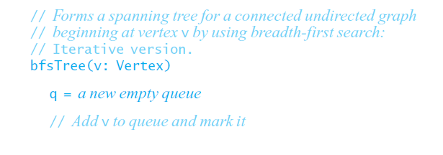
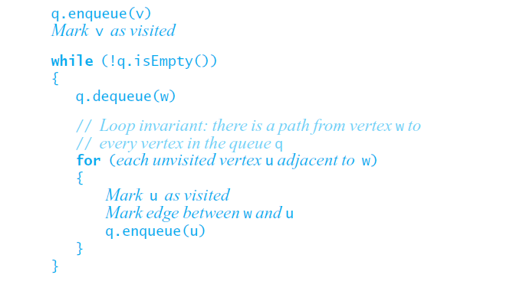
BFS Spanning Tree
Non Recursive BFS Spanning Tree Algorithm

Slide 46
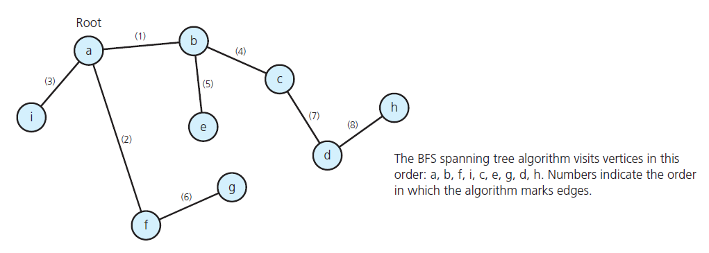
BFS Spanning Tree: Example
The BFS spanning tree rooted at vertex a for the graph

Slide 47
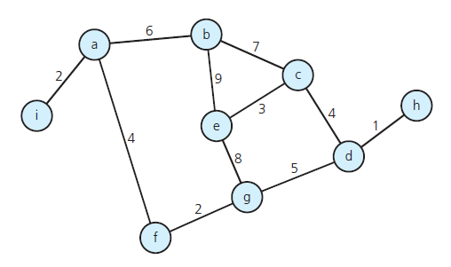
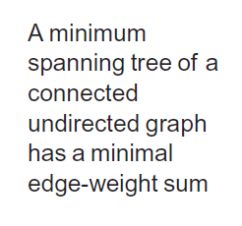
Minimum Spanning Tree
A weighted, connected, undirected graph

Slide 48
Prim’s Algorithm
Initially discovered in 1930 by Vojtěch Jarník, then rediscovered in 1957 by Robert C. Prim
1. Starts off by picking any node within the graph and growing from there
2. Label the starting node, A, with a 0 and all others with infinite
3. Starting from A, update all the connected nodes’ labels to A with their weighted edges if it less than the labeled value
5. Find the next smallest label and update the corresponding connecting nodes.
6. Repeat until all the nodes have been visited.

Slide 49
Prim’s algorithm
Prim’s algorithm is a greedy algorithm that is used to form a minimum spanning tree for a connected weighted undirected graph. In other words, the algorithm builds a tree that includes every vertex and a subset of the edges in such a way that the total weight of all the edges in the tree is minimized.
For this, the algorithm maintains three sets of vertices which can be given as below:

Slide 50
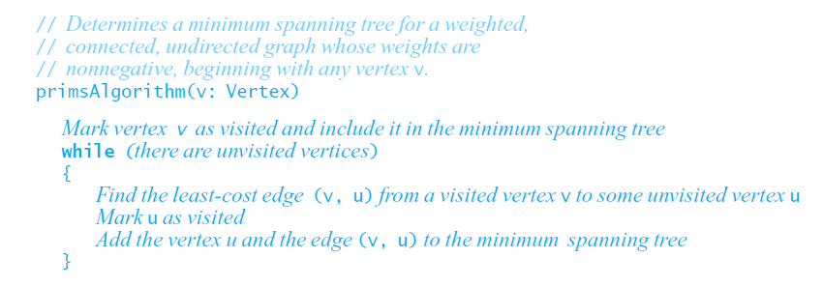
MST: Algorithms
Prim’s Algorithm

Slide 51
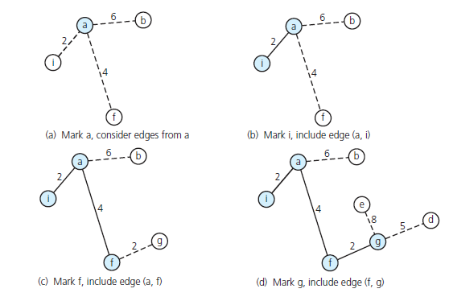
Prim’s Algorithm
A trace of prim’s Algorithm for the graph, beginning at vertex a

Slide 52
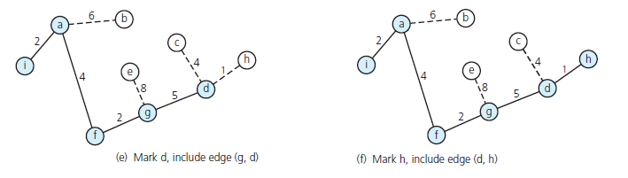
Prim’s Algorithm
A trace of prim’s Algorithm for the graph, beginning at vertex a

Slide 53
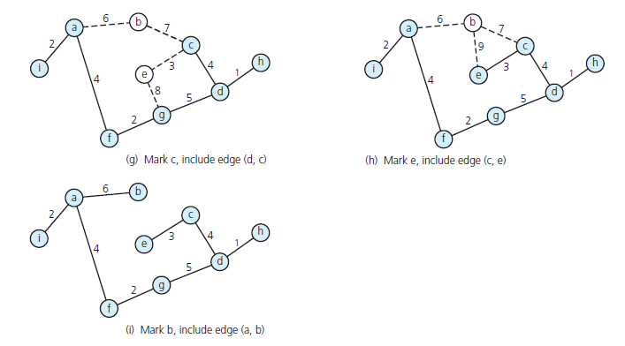
Prim’s Algorithm
A trace of prim’s Algorithm for the graph, beginning at vertex a

Slide 54
Example: Prim’s Algorithm
8
7
the root vertex
b
c
d
4
9
2
a
11
i
14
e
4
7
6
8
10
h
g
f
1
2
8
7
b
c
d
9
4
2
a
11
i
14
e
4
7
6
8
10
h
g
f
1
2

Slide 55
Example: Prim’s Algorithm
8
7
b
c
d
9
4
2
a
11
i
14
e
4
7
6
8
10
h
g
f
1
2
8
7
b
c
d
9
4
2
a
11
i
14
e
4
7
6
8
10
h
g
f
1
2

Slide 56
Example: Prim’s Algorithm
8
7
b
c
d
9
4
2
a
11
i
14
e
4
7
6
8
10
h
g
f
1
2
8
7
b
c
d
9
4
2
a
11
i
14
e
4
7
6
8
10
h
g
f
1
2

Slide 57
Example: Prim’s Algorithm
8
7
b
c
d
9
4
2
a
11
i
14
e
4
7
6
8
10
h
g
f
1
2
8
7
b
c
d
9
4
2
a
11
i
14
e
4
7
6
8
10
h
g
f
1
2

Slide 58
Example: Prim’s Algorithm
8
7
b
c
d
9
4
2
a
11
i
14
e
4
7
6
8
10
h
g
f
1
2
The time complexity is O(VlogV + ElogV) = O(ElogV)
where V is the no of vertices and E is the no. of edges.

Slide 59
MST: Kruskal’s Algorithm
Kruskal’s algorithm is used to find the minimum spanning tree for a connected weighted graph. The algorithm aims to find a subset of the edges that forms a tree that includes every vertex. The total weight of all the edges in the tree is minimized. However, if the graph is not connected, then it finds a minimum spanning forest. Note that a forest is a collection of trees. Similarly, a minimum spanning forest is a collection of minimum spanning trees.
Kruskal’s algorithm is an example of a greedy algorithm, as it makes the locally optimal choice at each stage with the hope of finding the global optimum.

Slide 60
Kruskal’s Algorithm
Step 1:Create a forest in such a way that each graph is a separate tree.
Step 2:Create a priority queue Q that contains all the edges of the graph.
Step 3: Repeat Steps 4 and 5 while Q is NOT EMPTY
Step 4:Remove an edge from Q
Step 5: IF the edge obtained in Step 4 connects two different trees, then Add it to the forest (for combining two trees into one tree).
ELSE Discard the edge
Step 6: END

Slide 61
Execution of Kruskal’s Algorithm
The edges are considered by the algorithm in sorted order by weight.
The edge under consideration at each step is shown with a red weight number.
8
7
b
c
d
9
4
2
a
11
i
14
e
4
7
6
8
10
h
g
f
1
2

Slide 62
Kruskal’s Algorithm: Example
8
7
b
c
d
9
4
2
a
11
i
14
e
4
7
6
8
10
h
g
f
8
7
1
2
b
c
d
9
4
2
a
11
i
14
e
4
7
6
8
10
h
g
f
1
2

Slide 63
Kruskal’s Algorithm: Example
8
7
b
c
d
9
4
2
a
11
i
14
e
4
7
6
8
10
h
g
f
1
2
8
7
b
c
d
9
4
2
a
11
i
14
e
4
7
6
8
10
h
g
f
1
2

Slide 64
Kruskal’s Algorithm: Example
8
7
b
c
d
9
4
2
a
11
i
14
e
4
7
6
8
10
h
g
f
1
2
8
7
b
c
d
9
4
2
a
11
i
14
e
4
7
6
8
10
h
g
f
1
2

Slide 65
Kruskal’s Algorithm: Example
8
7
b
c
d
9
4
2
a
11
i
14
e
4
7
6
8
10
h
g
f
8
7
1
2
b
c
d
9
4
2
a
11
i
14
e
4
7
6
8
10
h
g
f
1
2

Slide 66
Kruskal’s Algorithm: Example
8
7
b
c
d
9
4
2
a
11
i
14
e
4
7
6
8
10
8
7
h
g
f
c
d
1
2
b
9
4
2
a
11
i
14
e
4
7
6
8
10
Time Complexity of Kruskal's algorithm can be shown to run in O(E log E) time, or equivalently, O(E log V) time, where E is the number of edges in the graph and V is the number of vertices.
h
g
f
1
2

Slide 67
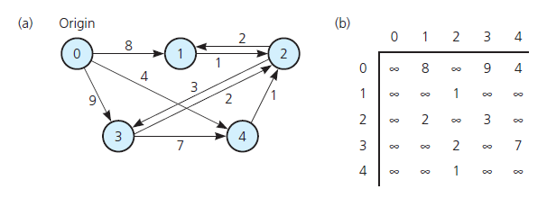
Shortest Path
Shortest path between two vertices in a weighted graph has smallest edge-weight sum
(a) A weighted directed graph and (b) its adjacency matrix

Slide 68

Dijkstra’s Algorithm
Edsger Wybe Dijkstra (1930-2002)
Invented concepts of structured programming, synchronization, weakest precondition, and "semaphores" for controlling computer processes. The Oxford English Dictionary cites his use of the words "vector" and "stack" in a computing context.
Believed programming should be taught without computers
1972 Turing Award
“In their capacity as a tool, computers will be but a ripple on the surface of our culture. In their capacity as intellectual challenge, they are without precedent in the cultural history of mankind.”

Slide 69
Dijkstra’s Algorithm for Single Source Shortest Path
Classic algorithm for solving shortest path in weighted graphs (with only positive edge weights)
Similar to breadth-first search, but uses a priority queue instead of a FIFO queue:
Always select (expand) the vertex that has a lowest-cost path to the start vertex
a kind of “greedy” algorithm
Correctly handles the case where the lowest-cost (shortest) path to a vertex is not the one with fewest edges

Slide 70
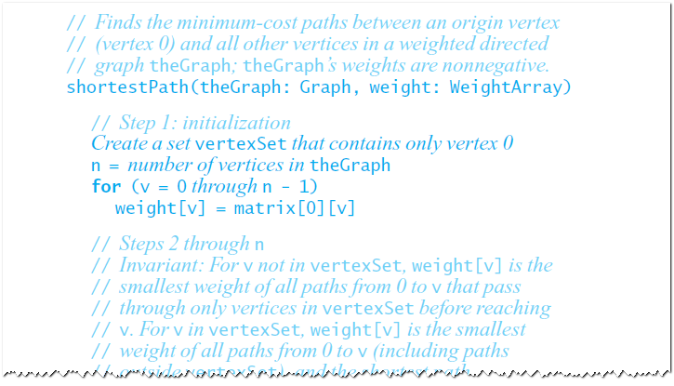
Shortest Path Algorithms
Dijkstra’s Shortest-Path Algorithm

Slide 71
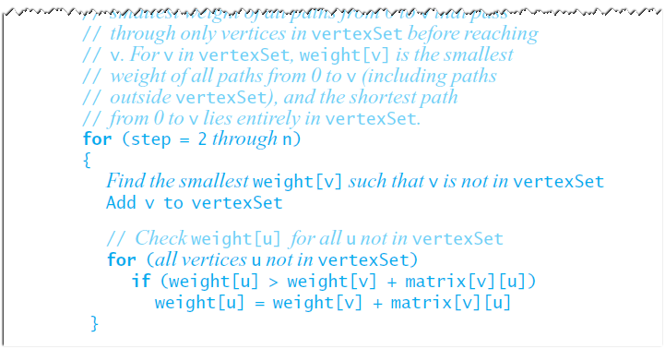
Shortest Path Algorithms

Slide 72
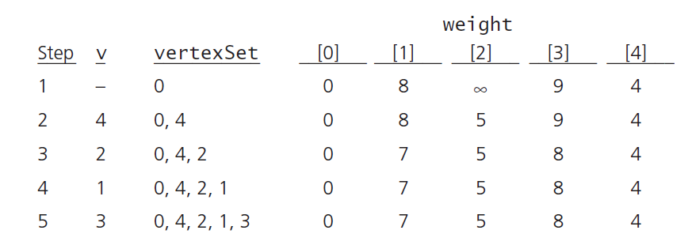
Example
A trace of the shortest-path algorithm applied to the above graph

Slide 73
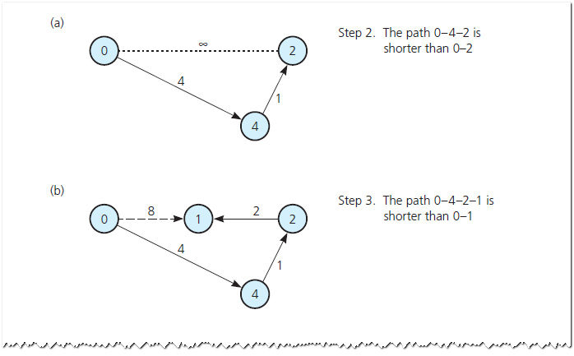
Dijkstra’s Algorithm: Example
Checking weight [u] by examining the graph: (a) weight [2] in step 2; (b) weight [1] in step 3;

Slide 74
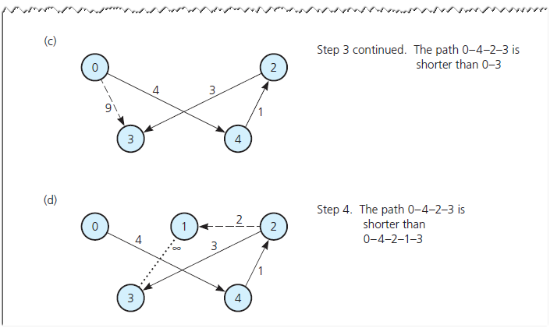
Dijkstra’s Algorithm: Example
Checking weight [u] by examining the graph(c) weight [3] in step 3; (d) weight [3] in step 4

Slide 75
Time Complexity of Dijkstra’s Algo.
Every time the main loop executes, one vertex is extracted from the queue. Assuming that there are V vertices in the graph, the queue may contain O(V) vertices. Each pop operation takes O(log V) time assuming the heap implementation of priority queues. So the total time required to execute the main loop itself is O(V log V).
In addition, we must consider the time spent in the function expand, which applies the function handle edge to each outgoing edge. Because expand is only called once per vertex, handle edge is only called once per edge. It might call push(v'), but there can be at most V such calls during the entire execution, so the total cost of that case arm is at most O(V log V). The other case arm may be called O(E) times, however, and each call to increase priority takes O(log V) time with the heap implementation.
Therefore the total run time is O(V log V + E log V), which is O(E log V) because V is O(E) assuming a connected graph.

Slide 76
Topological Sorting
Topological sort of a directed acyclic graph (DAG) G is defined as a linear ordering of its nodes in which each node comes before all nodes to which it has outbound edges. Every DAG has one or more number of topological sorts.
A topological sort of a DAG G is an ordering of the vertices of G such that if G contains an edge (u, v), then u appears before v in the ordering. Note that topological sort is possible only on directed acyclic graphs that do not have any cycles.
Topological sorting is widely used in scheduling applications, jobs, or tasks. The jobs that have to be completed are represented by nodes, and there is an edge from node u to v if job u must be completed before job v can be started.

Slide 77
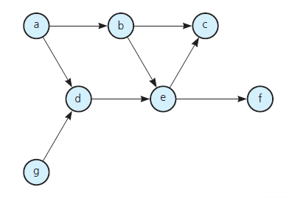
Topological Sorting
A topological sort of such a graph gives an order in which the given jobs must be performed.
For example- Let us consider a Graph
A directed graph without cycles

Slide 78
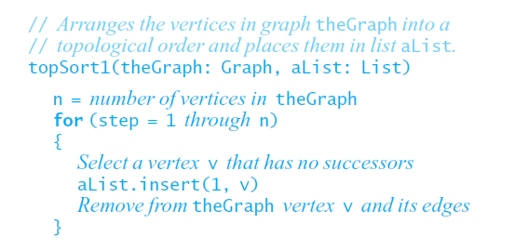
Topological sorting
Topological sorting Algorithm

Slide 79
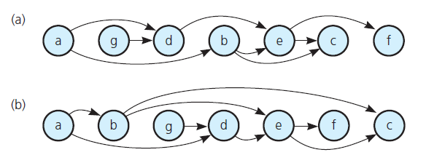
In our Example
The graph in above graphs arranged according to the topological orders (a) a, g, d, b, e, c, f and
(b) a, b, g, d, e, f, c

Slide 80
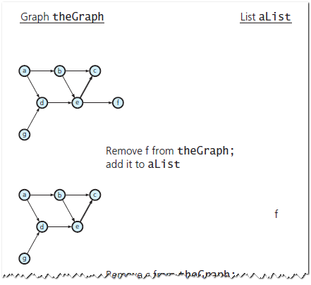

Topological Sorting: Example
A trace of topSort1 for the graph

Slide 81


Topological Sorting: Example
A trace of topSort1 for the graph

Slide 82

Topological Sorting: Example
A trace of topSort1 for the graph

Slide 83
Runtime Table
n vertices, m edges no parallel edges no self-loops | Edge List | Adjacency List | Adjacency Matrix
Space | n + m | n + m | n²
Finding all adjacent vertices to v | m | deg(v) | n
Determining if v is adjacent to w | m | deg(v) | 1
adding a vertex | 1 | 1 | n²
adding an edge to v | 1 | 1 | 1
removing vertex v | m | n? | n²
removing an edge from v | m | deg(v) | 1

Slide 84
Some Difficult Problems
Hamiltonian Circuit
Path that begins at a vertex v, passes through every vertex in the graph exactly once, and terminates at v .
The Traveling Salesman Problem
Variation of Hamilton circuit
Involves a weighted graph that represents a road map
Circuit traveled must be the least expensive

Slide 85

Some Difficult Problems
The three utilities problem

Slide 86
Some Difficult Problems
Planar Graph
Can draw it in a plane in at least one way so that no two edges cross
The four-color problem
Given a planar graph, can you color the vertices so that no adjacent vertices have the same color, if you use at most four colors?

Slide 87
Case Study: Web Graph and Google Map

Slide 88
Conclusion

