Slide 1
DATA VISUALIZATION PROJECT
AMAZON SALES DASHBOARD
ARYADEVI R
Internship Project

Slide 2
objective
Amazon is an American multinational technology company, engaged in e-commerce, cloud computing, online advertising, digital streaming and artificial intelligence
Sales management has gained importance to meet increasing competition and the need for improved methods of distribution to reduce cost and to increase profits
Sales team wants the analyst to ETL(Extract-Transform-Load) and find month-wise, year-wise, yearly month-wise sales-trend
Hence, it is decided to develop a KPI dashboard to determine key metrics and show meaningful relationships between attributes
This will help the sales team to take strategic sales decisions based on insights generated from dashboard

Slide 3
PROBLEM STATEMENT
Amazon sales data identified for sales analysis
Clean and transform data as per requirement
Create a sales dashboard that measures key metrices
Add relevant filters to slice and dice the data
Dashboard should have sales trend and attribute relation

Slide 4
SOLUTION APPROACH
There is 1 table with sales details(country, Item type, cost, revenue, profit)
MySQL was used to execute EDA (Exploratory data analysis)
Power BI was the tool used for creating the visualization/dashboard
Data was imported, analyzed and transformed using Power Query

Slide 5
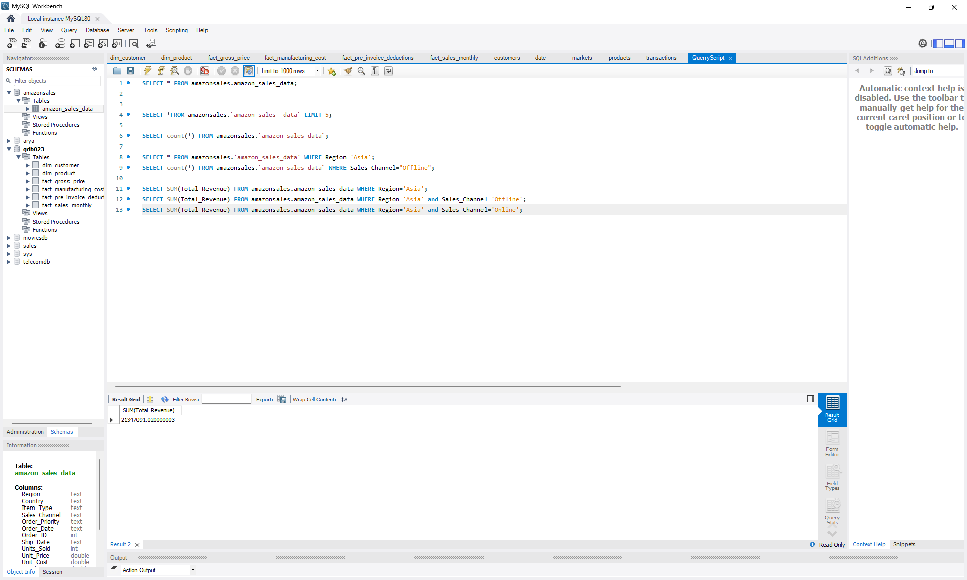
EXPLORATORY DATA ANALYSIS

Slide 6
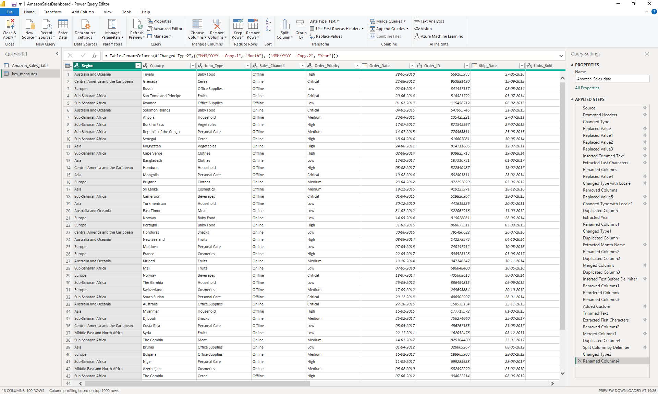
DATA TRANSFORMATION IN POWER QUERY

Slide 7
SOLUTION APPROACH
Measures are created to calculate following KPIs:
Revenue = Sum of all revenue from all sold products
Sold quantity = Sum of all sold quantity
Profit = Total profit generated from each products
Cost = Total cost of all products

Slide 8
SOLUTION APPROACH
A few measures were created to measure the KPIs:
Revenue Contribution % = Divide revenue by all product type, region and country
Profit Margin % = Profit / Revenue
Profit Margin Contribution % = Divide profit margin % by all product type, region and country
Profit Contribution % = Divide profit by all product type, region and country

Slide 9
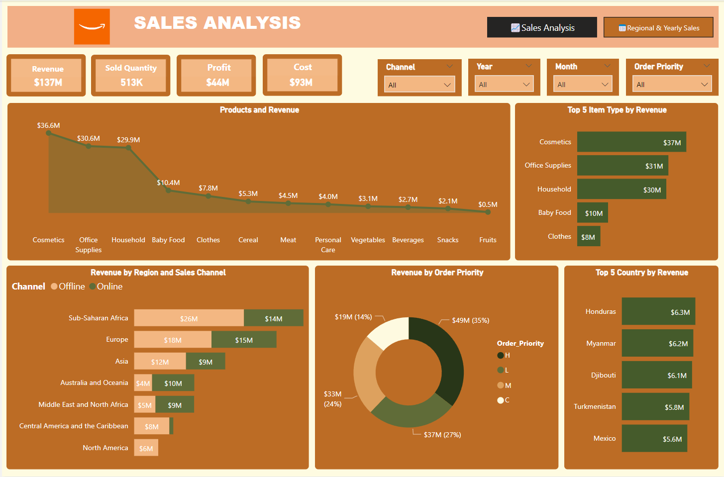
SALES DASHBOARD

Slide 10
DASHBOARD FEATURES
Sales dashboard has following 5 visuals:
Products and Revenue = Line chart shows the revenue generated across various product type
Revenue by Region and Sales Channel = Stacked bar chart shows revenue generated in regions by channel
Revenue by Order Priority = Donut chart shows revenue generated by order priority
Top 5 Item Type by Revenue = Bar chart shows top 5 product type which generates highest revenue
Top 5 Country by Revenue = Bar chart shows top 5 countries generating highest revenue

Slide 11
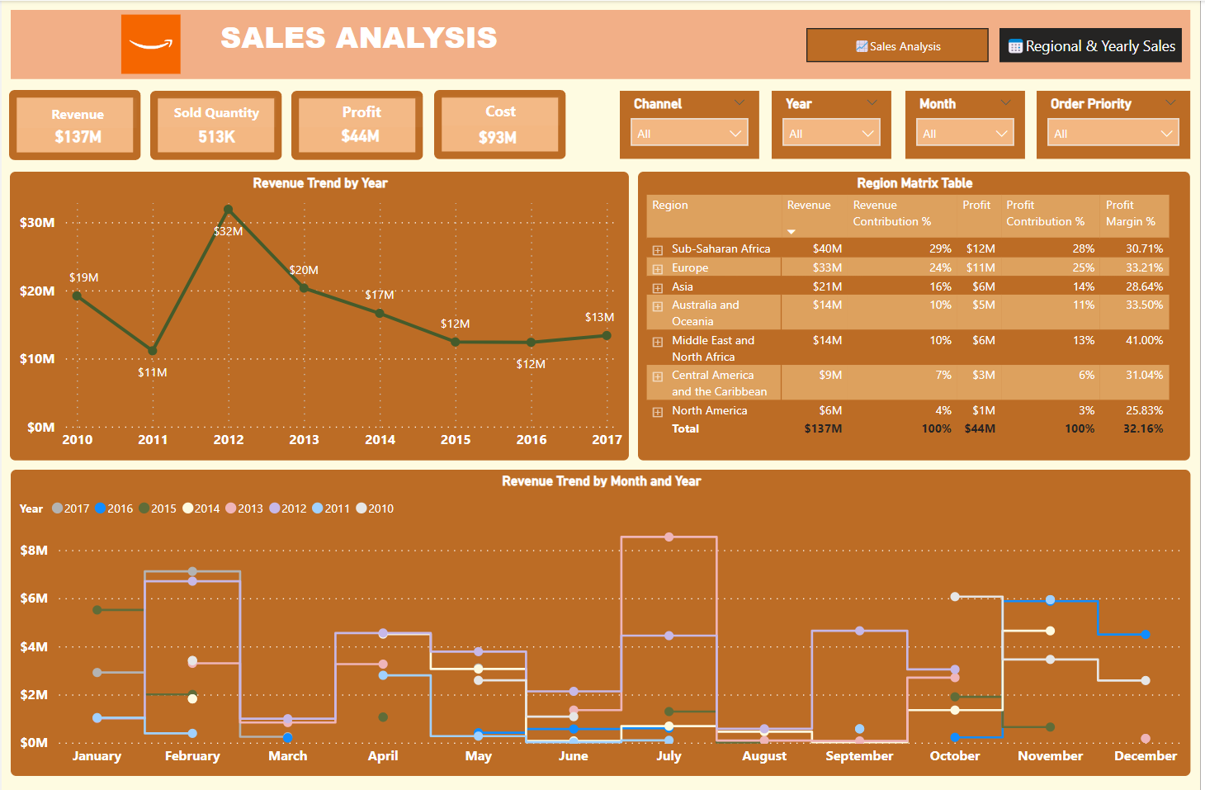
Regional YEARLY SALES DASHBOARD

Slide 12
DASHBOARD FEATURES
Regional and Yearly sales dashboard has following visuals:
Revenue Trend by Month and Year = Line chart shows the year-month revenue trend
Revenue Trend by Year = Line chart shows revenue generated in each year
Region Matrix table = Matrix table shows region with revenue, revenue contribution %, profit, profit contribution %, profit margin%

Slide 13
DASHBOARD FEATURES
A bunch of card visuals were placed on the top left to show the values of important KPIs
The following filters were created to slice and cube the data:
Month
Year
Channel
Order Priority
A warm theme was selected
Visuals were interactive

Slide 14
BUSINESS OUTCOMES
Following are some of the sales insights derived from sales analysis dashboard:
Cosmetic Products: Highest revenue at $36.6M, while Fruits have the lowest at $0.5M.
Sales Channels: Offline channels generate higher revenue compared to online channels.
Top 5 Countries by Revenue:
Honduras: $6.3M (highest)
Mexico: $5.6M (5th position)
Kuwait: Lowest revenue-generating country.

Slide 15
BUSINESS OUTCOMES
Following are some of the sales insights derived from sales analysis dashboard:
Highest revenue and profit is for cosmetic products
Highest total cost is for Office supplies
Regional Revenues:
Sub-Saharan Africa: Highest at $26M
North America: Lowest at $6M
Priority Levels:
H Priority: 35% of total revenue
C Priority: 14% (lowest)

Slide 16
BUSINESS OUTCOMES
Following are some of the sales insights derived from sales analysis dashboard:
Peak Revenue Year: 2012 (within the range of 2010-2017)
Lowest Revenue Year: 2011
Post-2012 Trend: Significant decrease in revenue
Highest Revenue Month: July 2013
Lowest Revenue Month: August 2015

Slide 17
CONCLUSION
A sales dashboard was built for Amazon sales management team depicting its various KPIs visually
Relevant filters and interactions was provided in the dashboard
This dashboard can be used for both high-level and in-depth analysis of KPIs across various dimensions

Slide 18
THANK YOU !

