Slide 1
DATA VISUALIZATION PROJECT
ATTRITION ANALYTICS DASHBOARD FOR A HR CLIENT
ARYADEVI R
Internship Project

Slide 2
OBJECTIVE
XYZ company was established few year back
Company faces 15% attrition rate from last couple of years and is majorly effecting the company in many aspects
Hence, it is decided to create a HR dashboard to derive some relevant KPIs that helps to determine the reason why employees leave the company.
This will help to reduce the attrition rate of the company based on the insights developed by the dashboard

Slide 3
PROJECT SCOPE
Identify data source towards the employee analysing data
Clean and transform data as per analysis requirement
Create a HR dashboard that measures important KPIs
Relevant filters need to added to slice and dice the data
Dashboard should showcase both high level and miniscule insights.

Slide 4
SOLUTION APPROACH
There is table with employee details(ratings, salary, job roles, department)
EDA was executed using Excel
Power BI was used for creating visualization/dashboard
Data was imported, analysed and transformed using Power Query

Slide 5
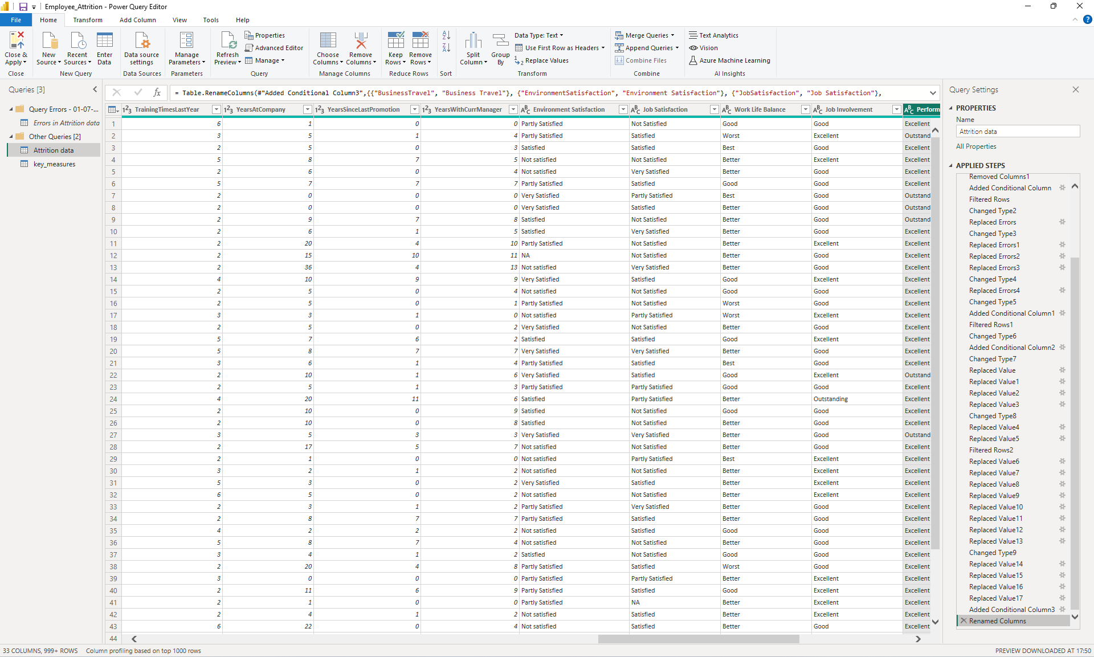
DATA TRANSFORMATION IN POWER QUERY

Slide 6
SOLUTION APPROACH
Measures created to calculated KPIs are:
Total Employees = Total employees in the company
Attrition Count = Total attrition count in the company
Attrition Rate = Percent of attrition in the company
Currently Working = Total employees working in the company currently
Average Monthly Salary = Average of monthly salary
Average Age = Average age of all employees working in the company
Average Years at Company = Average years of employees working in the company

Slide 7
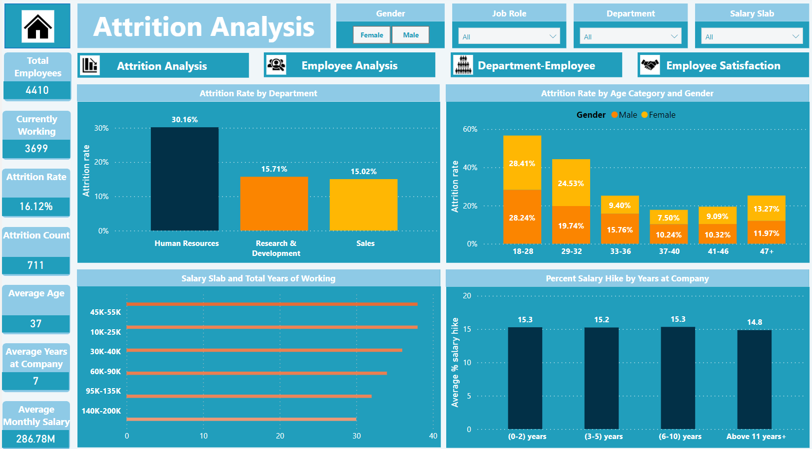
ATTRITION DASHBOARD

Slide 8
DASHBOARD FEATURES
The following visuals were provided in Attrition dashboard:
Attrition Rate by Department = Bar chart shows the attrition rate across departments
Attrition Rate by Age Category and Gender = Stacked column chart shows the attrition rate in age category by gender
Salary Slab and Total Years of Working= Clustered bar chart shows the salary slab against the total work experience of the employees in years
Percent Salary Hike by Years at Company = Bar chart depicts the average percent salary hike by working years at company

Slide 9
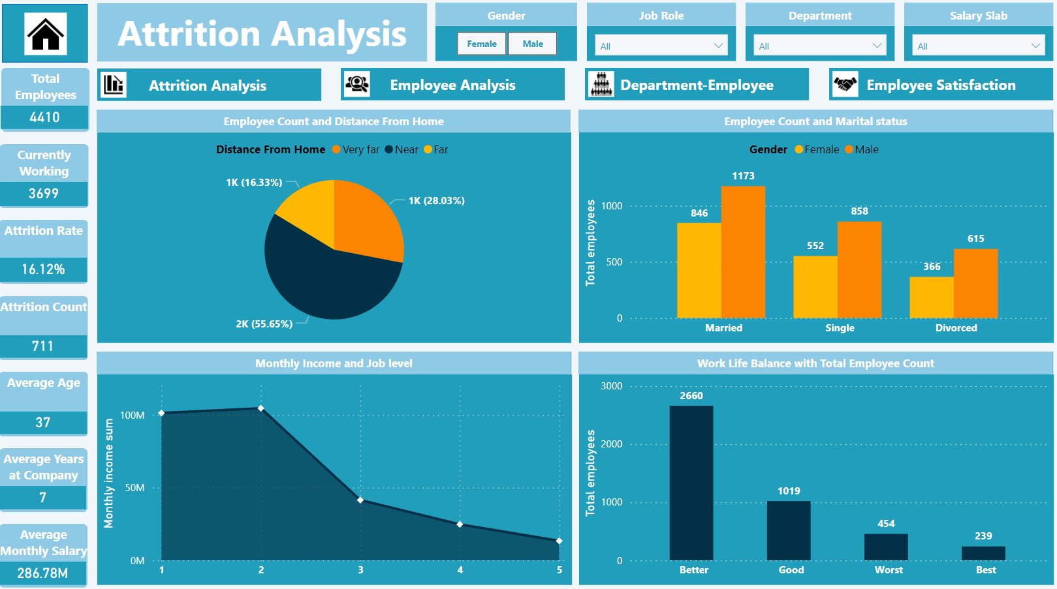
EMPLOYEE DASHBOARD

Slide 10
DASHBOARD FEATURES
The following visuals were provided in Employee dashboard:
Employee count and distance from home = Pie chart draws the employee count according to the distance from home
Employee count and marital status = Clustered column chart shows total employees with the marital status according to gender
Monthly income and job level = Shaded line graph scales the trend in of monthly salary sum by job level
Work life balance with total employee count = Bar chart depicts the Total employee count by the work life balance rating

Slide 11
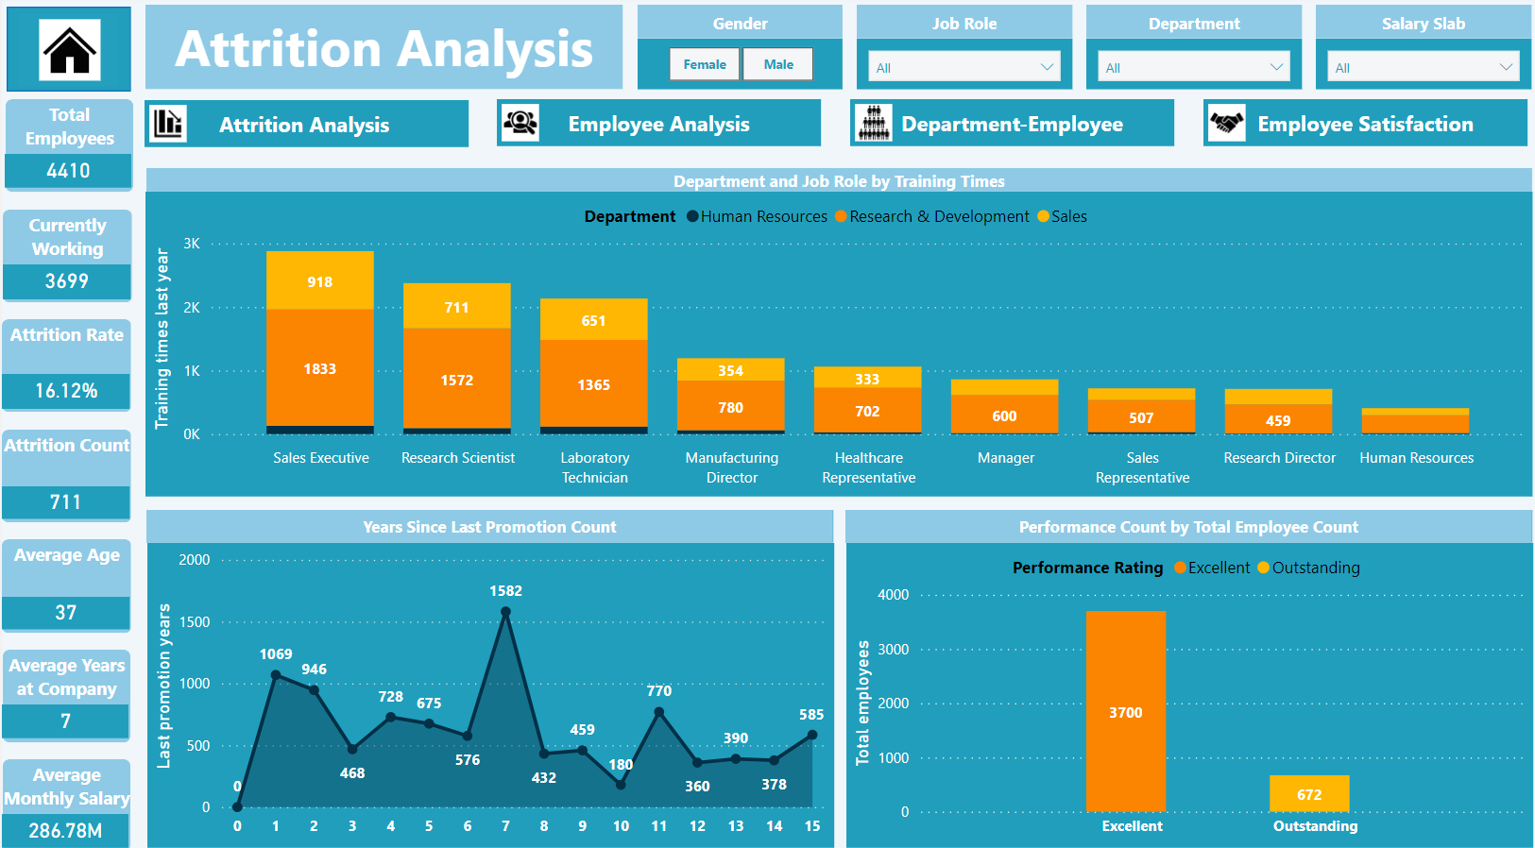
EMPLOYEE DEPARTMENT DASHBOARD

Slide 12
DASHBOARD FEATURES
The following visuals were provided in Employee 2 dashboard:
Department and job role by training times = Bar graph shows the last year training times by job role according to department
Years since last promotion count = Shaded line graph draws the trend of years since last promotion of employees
Performance count by total employee count = Bar graph shows total employees by performance rating

Slide 13
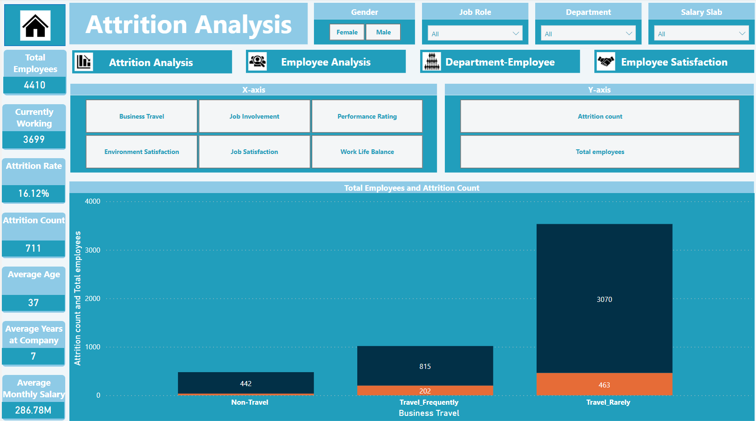
SATISFACTION DASHBOARD

Slide 14
DASHBOARD FEATURES
The following visuals were provided in Employee satisfaction dashboard:
Total employee and Attrition = Bar graph with dynamic x and y axis shows total count by different satisfactions
Y axis : Attrition count, Total employees
X axis : Business travel, Job involvement,
Performance rating, Environmental satisfaction,
Job satisfaction, Work life balance

Slide 15
DASHBOARD FEATURES
Cluster of card visuals were created in the left to show the values of critical KPIs
Following filters were created to slice and cube the data:
Gender
Job Role
Department
Salary Slab
A warm theme was selected
Visuals were interactive
Tooltips will pop-up when hovering over a visual for more information about the data point

Slide 16
OUTCOMES
The following are some insights developed from the HR dashboard:
Departmental Attrition: The HR department has the highest attrition rate, while the Sales department has the lowest
Age-Based Attrition: Employees aged 18-28 have the highest attrition rate, whereas those aged 37-40 have the lowest
Gender-Based Attrition: The attrition rate for males is 16.67% higher than for females.
Training-Based Attrition: The HR department received very few training sessions last year.

Slide 17
OUTCOMES
The following are some insights developed from the HR dashboard:
Salary-Based Attrition: The 60k-90k salary range experiences the highest attrition rate at 19.03%, while the 95k-135k range has the lowest at 11.31%
Tenure-Based Attrition: Employees with 0-2 years of tenure have an attrition rate of 29.82%, compared to 8.13% for those with over 11 years of experience
Promotion-Based Attrition: Employees with extended intervals between promotions experience higher attrition rates.

Slide 18
OUTCOMES
The following are some insights developed based on satisfaction ratings from employees and attrition rate:
Job Involvement:
High : Poor (21.22%)
Low : Excellent (15.39%)
Performance Rating:
High : Outstanding (18.35%)
Low : Excellent (15.81%)
Environment Satisfaction:
High : Not Satisfied (25.45%)
Low : Very Satisfied (13.42%)

Slide 19
OUTCOMES
The following are some insights developed based on satisfaction ratings from employees and attrition rate:
4. Job Satisfaction:
High : Not Satisfied (22.91%)
Low : Very Satisfied (11.40%)
5. Work Life Balance:
High : Worst (31.22%)
Low : Good (14.41%)
6. Business Travel:
1. High : Travel Frequently (24.79%)
2. Low : Non Travel (8.14%)

Slide 20
CONCLUSION
HR dashboard was built for XYZ company depicting with various KPIs visually
Relevant filters along with tooltips and interactions was provided in the dashboard
This dashboard can be used for both high-level and in depth-analysis on KPI across various dimensions

Slide 21
Thank you

