Slide 1


AtliQo Telecom Analysis

Slide 2
Company
Atliqo Telecom
15 Cities
5G Launch - May

Slide 3
CHALLENGE
5G
Active Users & Revenue
Pre & Post 5G
KPI Metrics Analysis
Internet Plan

Slide 4
Take aways
Metrics Understanding
Total Revenue
ARPU
Active Users
Unsubscribed Users

Slide 5
Revenue
Category | Value
Total Revenue | 32bn
Before 5G | 16.0bn
After 5G | 15.9bn
Change% | -0.50%

Slide 6
Mumbai Raipur
February June
High
Low

Slide 7
ARPU
Category | Value
ARPU | 200.74
Before 5G | 190.2
After 5G | 211.3
Change% | 11.05%

Slide 8
Mumbai Pune
June February
High
Low

Slide 9
Total Active Users (TAU)
Category | Value
TAU | 161.72M
Before 5G | 84.4M
After 5G | 77.4M
Change% | -8.28%

Slide 10
Mumbai Raipur
February June
High
Low

Slide 11
Total Unsubscribed Users (TUU)
Category | Value
TUU | 12.59M
Before 5G | 5.6M
After 5G | 7.0M
Change% | 23.50%

Slide 12
Mumbai Raipur
August January
High
Low

Slide 13
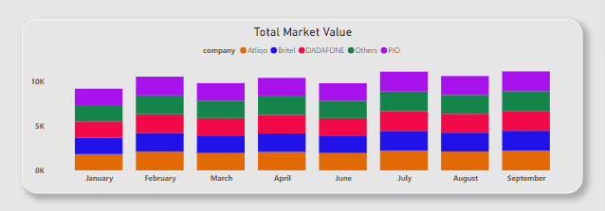
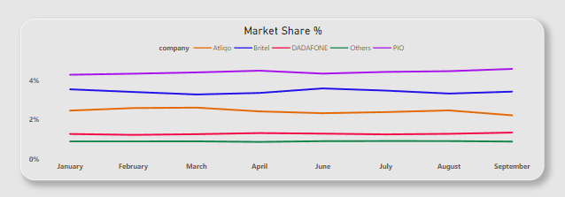
Total Market Value (TMV) & Market Share%

Slide 14
Plans
Category | Value
Total Plan Revenue | 19.5bn
Before 5G | 8.8bn
After 5G | 10.7bn

Slide 15
Recommendations
Service Quality
Network coverage
Online surveys
Assess customers

Slide 16
Recommendations
Personal plan recommendations
Service Quality check
Competitor 5G plan check
Reduce cost of plans

