Slide 1

UE20CS390A – Capstone Project Phase – 1
SEMESTER - VI
END SEMESTER ASSESSMENT
Project Title : Image Tampering Detection
Project ID : PW23_SRU1
Project Guide : Dr. Sujatha R Upadhyaya
Project Team : Anil Kumar MG PES1UG21CS804
Divya M PES1UG21CS810
Nagaratna Manjunath Naik PES1UG21CS821
Nandana CL PES1UG21CS822

Slide 2
Outline
Image Tampering Detection
Problem Statement
Abstract and Scope
Literature Survey
Suggestions from Review – 3
Design Approach
Proposed Methodology / Approach
Design Constraints, Assumptions & Dependencies
Architecture
Design Description
Technologies Used
Project Progress
References

Slide 3
Problem Statement
Image Tampering Detection
With the increased availability of digital image editing tools, it has become increasingly easier to manipulate images which are too difficult for the human eye to detect. This has led to an increase in the number of tampered images that are spread online. These tampered images are being used for various malicious purposes, including spreading fake news or even defaming someone. Traditional methods of detecting tampered images rely on visual inspection, which is time-consuming and prone to errors. So there is a need for an automated system that can accurately and efficiently detect image tampering.

Slide 4
Abstract
Image Tampering Detection
The project aims to develop an image tampering detection system using convolutional neural networks (CNNs) for feature extraction and classification. The trained model can classify if an image is tampered or not. If the image is tampered, then we localize the tampered region. The tampered area is then highlighted, and the percentage of tampering is provided.
The system will be implemented as a website that accepts input images, and the trained model is used to classify if the image is tampered or not, with the tampered area localization and tampering percentage being provided if the image is tampered.

Slide 5
Scope
Image Tampering Detection
Input image : RGB
Tampering types : Copy-move, image splicing

Slide 6
Literature Survey
Image Tampering Detection

Slide 7
Image Tampering Detection
Research Paper 1
Learning Rich Features for Image Manipulation Detection
Datasets:
NIST: Contains spliced, copy-move, removal images
CASIA: Contains spliced, copy-move of various objects.
Columbia: Contains only spliced images
COVER: Contains only copy-move images

Slide 8
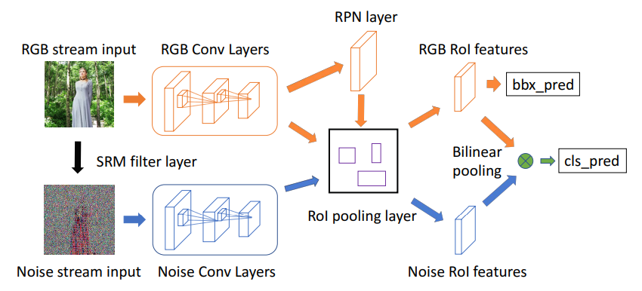
Image Tampering Detection

Slide 9

Image Tampering Detection
Methodology:
Using RGB stream extract features from RGB images.
Pass the RGB image through SRM(Steganalysis Rich Model) filter and obtain a noise feature map.
RPN network uses RGB features as input
Then features from both streams are selected by an RoI(Region of Interest) pooling layer.
Then using a bilinear pooling layer the spatial co-occurrence features are combined.
Then pass it to the softmax layer which determines whether the predicted area is tampered with or not
Accuracy

Slide 10
Image Tampering Detection
Research Paper 2
Detection of Image Tampering Using Deep Learning, Error Levels & Noise Residuals
Datasets used:
CASIA v2.0: Contains both spliced and copy-move image

Slide 11
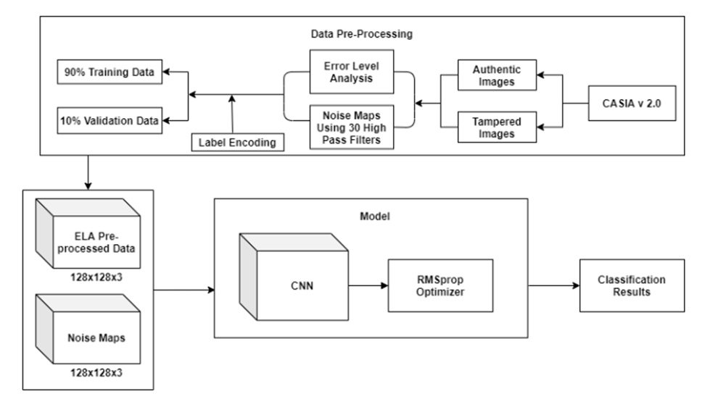
Image Tampering Detection

Slide 12
Methodology:
Image Tampering Detection
1. As we have already mentioned two pre-processing steps for further understanding of the learning of our CNN.
2. First the ELA and noise residual image for all images in the dataset.
3. To obtain noise residual images for their analysis, the researchers used 30 high-pass filters that were specifically created for the Spatial Rich Model (SRM).).
4. Then, we resize the pictures and include the labels in a corresponding manner. Later we divide the information into two sets,

Slide 13
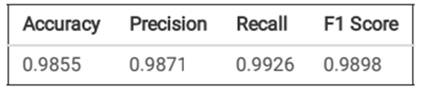
Image Tampering Detection
5. The researchers utilized two separate data sets, where one was utilized to train the model and the other was used to assess and confirm its performance.
6. ELA resaves an image at a pre-determined compressed rate e.g. 95% and then checks the difference between the original and the resaved image.
7. Another technique that we added is to extract features from the noise residuals of an image using SRM.
Accuracy

Slide 14
Image Tampering Detection
Research Paper 3
Deep Learning-based Technique for Image Tamper Detection
Datasets used:
There are several image tampering datasets available for research purposes, including MICC, CASIA, and UCID, among others are used in existing tampering detection methodologies for validating tampering detection accuracies.

Slide 15
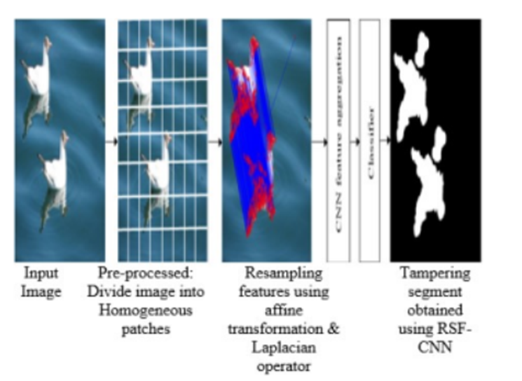
Image Tampering Detection

Slide 16
Methodology:
Image Tampering Detection
First, the image is segmented into different patches.
To identify duplicated regions even in small and smooth areas, a scale-invariant descriptor was utilized to extract features.
Various types of noise, such as compression and resampling, are often present in tampered images and can be effectively identified by analyzing resampling features.
However, using resampling features exhibit periodic correlations between the pixels; this is because of interpolation.
The CNN is robust to translation for capturing noisy information using resampling features and generating spatial maps among different segments of an image.
Thus both are utilized for localizing tampered segments. Thus, the resampling feature will be estimated for detecting inconsistencies in the estimated resampling factors using improved CNN architecture

Slide 17

Image Tampering Detection
Accuracy:

Slide 18
Image Tampering Detection
Research Paper 4
A novel deep learning framework for copy-move forgery detection in images
Dataset:
CASIA V1.0
CASIA V2.0
MICC-F220
key-points:
CNN,copy-move

Slide 19
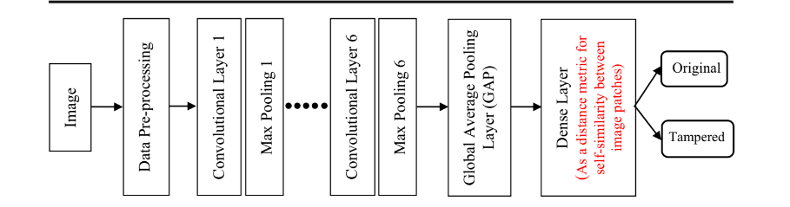
Image Tampering Detection
Fig:Proposed method

Slide 20
Image Tampering Detection
Methodology:
1. In data pre-processing phase,input image are resized to specified size without cropping any parts.
2. feature extraction is performed through a series of six CNV layers,each followed by maximum pooling layers.
3.The CNV layers acts as a feature extractors.
4.CNN produces feature maps through its specific filters.

Slide 21
Image Tampering Detection
5.feature maps produced from first CNN layer,max pooling layer produces resized pooled feature maps.
6.we take this as input to the next CNN layer.
7.GAP is used to data reduction.
8. dense layer is a classification phase.it classifies whether the image is tampered or not.

Slide 22
Suggestions from Review - 3
Image Tampering Detection
The Panel suggested us to implement and show demo.

Slide 23
Design Details
Image Tampering Detection
Novelty: We are creating an interactive web interface that allows users to upload images and visualize the results of the tampering detection and localization algorithm. This will make it easier for users to use the system and interpret the results, even if they have limited technical knowledge.
Innovativeness: Converting RGB to YCbCr and using those images for feature extraction and training using CNN along with NMS.
Performance: The use of deep learning models and advanced image processing techniques ensures high performance in terms of tampering detection and localization accuracy.
Security: The system can help in ensuring the security of digital images by detecting tampering attempts and identifying tampered areas.

Slide 24
Image Tampering Detection
Reliability: The system's reliability depends on the accuracy of the trained model and the robustness of the image processing techniques used.
Maintainability: The system can be maintained through periodic updates and model retraining to improve the accuracy of tampering detection and localization.
Reusability: The trained model can be reused for tampering detection and localization in different applications and systems.
Resource utilization: The system requires sufficient computational resources, especially during the training and testing of the deep learning model. However, the use of optimized algorithms can help in reducing resource requirements.

Slide 25
Proposed Methodology
Image Tampering Detection
Preprocessing: The input RGB image is converted to the YCbCr color space to separate the luminance (Y) and chrominance (Cb and Cr) components.
Feature Extraction using CNN: A convolutional neural network (CNN) is used to learn the features of authentic and tampered regions in the image. The CNN consists of multiple layers of filters that perform convolutions on the input image to extract different features at different scales.
Training with the CNN and SGD: The CNN is trained on a dataset of labeled images, including both authentic and tampered images. The training process involves feeding the labeled images into the CNN, which learns to extract features from the images and classify them as authentic or tampered. The training process is typically done using stochastic gradient descent (SGD) to adjust the weights and biases of the network to minimize the loss function and improve its accuracy in detecting tampered images.

Slide 26
Image Tampering Detection
Tampered Region Localization with Sliding Window Detection: Once the CNN has been trained to recognize tampered images, it can be used to localize the tampered regions within an image. This is done using a technique called sliding window detection, where a small window is moved across the image at different positions and scales, and the CNN is used to classify each window as authentic or tampered. The regions with the highest probability of being tampered are then considered as the tampered regions.
Post-processing with NMS: To improve the accuracy of the tampered region localization, post-processing techniques can be applied, such as non-maximum suppression (NMS), which removes overlapping regions and keeps only the regions with the highest probability of being tampered.
Tampered Image Output: Finally, the system outputs whether the image is tampered or not and the tampered image with the localized tampered regions highlighted.

Slide 27
Image Tampering Detection
Benefits of the Proposed Approach
Accurate tampered region detection: The use of CNN and sliding window detection helps to accurately detect tampered regions in an image, even in cases where the tampering is subtle or difficult to detect.
Flexibility: The use of multiple layers of filters in the CNN allows the network to learn and extract features at different scales, making it adaptable to different types of tampering.
Generalization: The use of a large and diverse dataset for training the CNN helps to ensure that the network can generalize well to new, unseen images.
Speed: The use of sliding window detection and post-processing techniques such as NMS helps to improve the speed of tampered region detection, making it feasible for real-time applications.

Slide 28
Image Tampering Detection
Drawbacks of the Proposed Approach
Complexity: The use of CNNs and sliding window detection requires a high degree of computational complexity, making it difficult to implement on low-end devices.
Training data requirements: The accuracy of the tampered region detection depends on the quality and size of the training dataset, which can be time-consuming.
Sensitivity to noise: The CNN may be sensitive to noise or other artifacts in the input image, which can lead to false positives or false negatives in tampered region detection.

Slide 29
Image Tampering Detection
Design Constraints
The CNN must be trained on a large dataset of labeled images, which requires significant computational resources and time.
The accuracy of the tampered region localization may be affected by the size and complexity of the image, as well as the quality and type of tampering.
The use of additional input channels (Cb and Cr) may increase the computational requirements and memory usage of the system.

Slide 30
Image Tampering Detection
Assumptions
The YCbCr color space provides a more effective representation of the image for tampering detection than the RGB color space.
The use of CNN is an effective approach for learning the features of authentic and tampered regions in an image.
The sliding window detection technique is an effective approach for localizing tampered regions within an image.
The post-processing techniques, such as non-maximum suppression, are effective in improving the accuracy of the tampered region localization.

Slide 31
Image Tampering Detection
Dependencies
Data availability: The design approach is highly dependent on the availability of a large and diverse dataset of tampered and untampered images. If the dataset is limited or biased, it can impact the accuracy and effectiveness of the tampered image detection system.
Quality of input images: The performance of the tampered image detection system is highly dependent on the quality of the input images. Poor image quality can affect the accuracy and effectiveness of the system.
Accuracy of YCbCr color space conversion: The design approach involves converting the input RGB image to YCbCr color space, and using the Y component as input to the CNN. The accuracy and reliability of this conversion process may impact the overall accuracy of the tampered region detection.

Slide 32
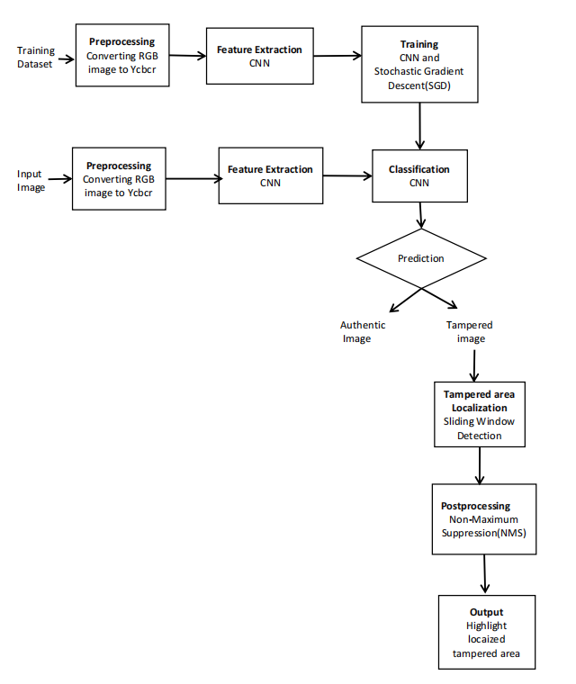
Architecture
Image Tampering Detection

Slide 33
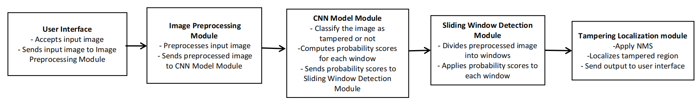
Image Tampering Detection
Collaboration and interaction between the major components

Slide 34
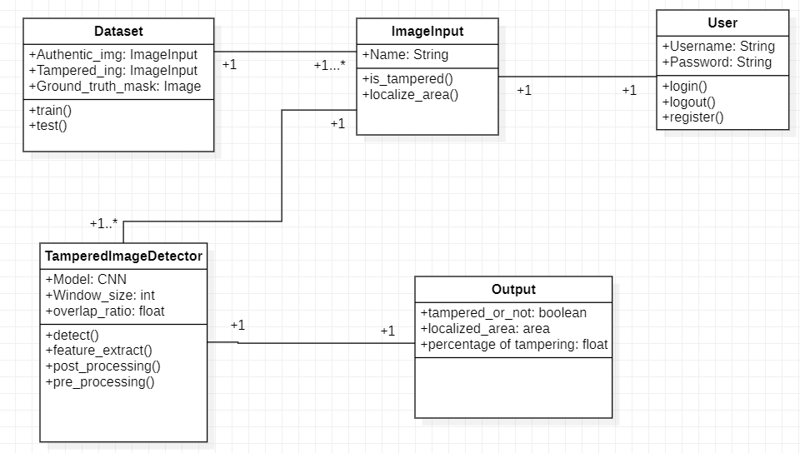
Image Tampering Detection
Master class diagram

Slide 35
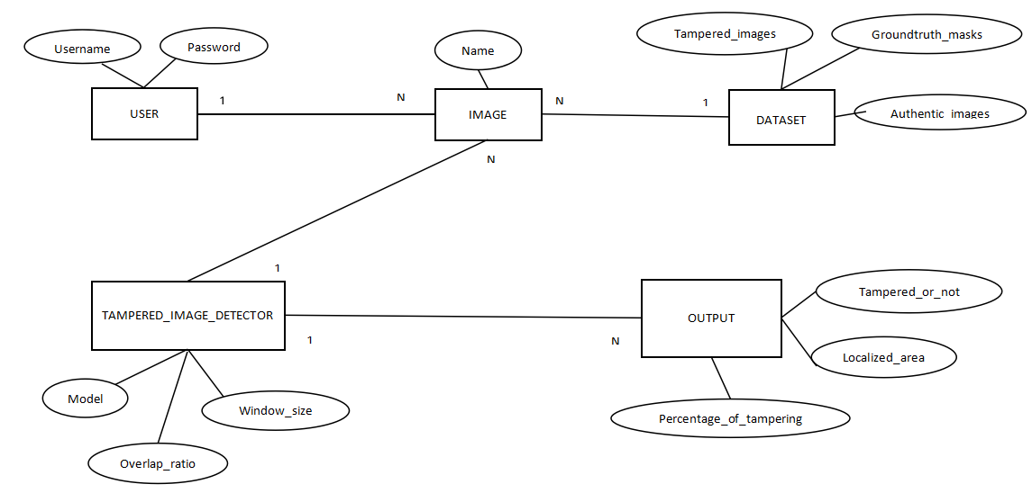
Image Tampering Detection
ER Diagram

Slide 36
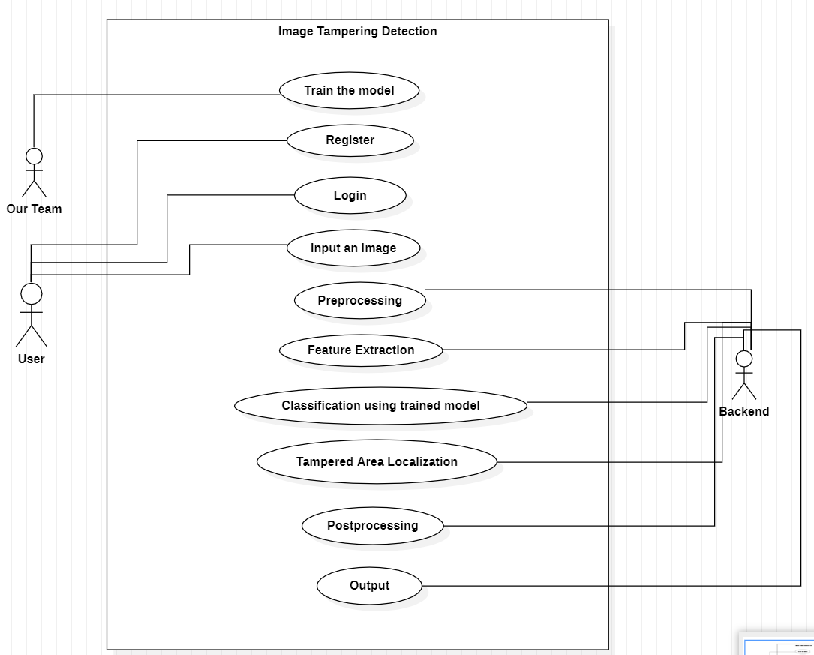
Image Tampering Detection
Use Case Diagram

Slide 37
Technologies Used
Image Tampering Detection
OpenCV library: OpenCV is a widely used open-source computer vision library that provides a range of functions for image and video processing, feature detection, and object recognition. It can be used for tasks such as image preprocessing, color space conversion, and tampered region localization.
Convolutional Neural Network (CNN) frameworks: Deep learning frameworks such as TensorFlow, PyTorch, and Keras provide pre-built neural network architectures and tools for building and training CNNs for image classification and detection tasks.
Stochastic Gradient Descent (SGD): SGD is a popular optimization algorithm for training neural networks. It updates the weights and biases of the network based on the gradients of the loss function with respect to the parameters. It is computationally efficient and can handle large datasets, making it suitable for training the CNN on the labeled dataset.
Non-maximum Suppression (NMS): NMS is a post-processing technique that can be used to reduce the number of overlapping bounding boxes or regions. It keeps only the regions with the highest probability of being tampered, which improves the accuracy of the tampered region localization.

Slide 38
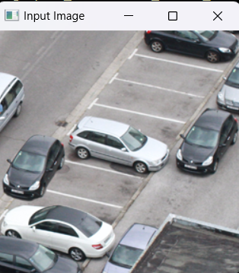
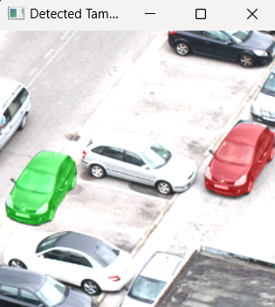
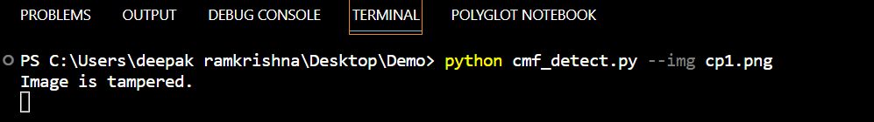
Walkthrough
Image Tampering Detection

Slide 39



Slide 40
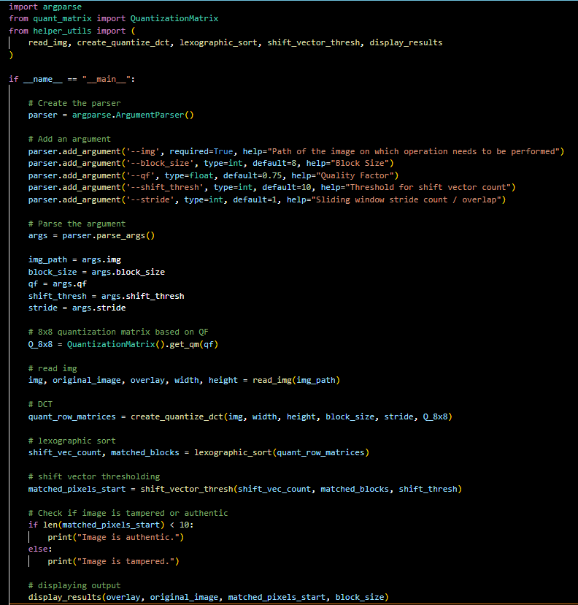

Slide 41
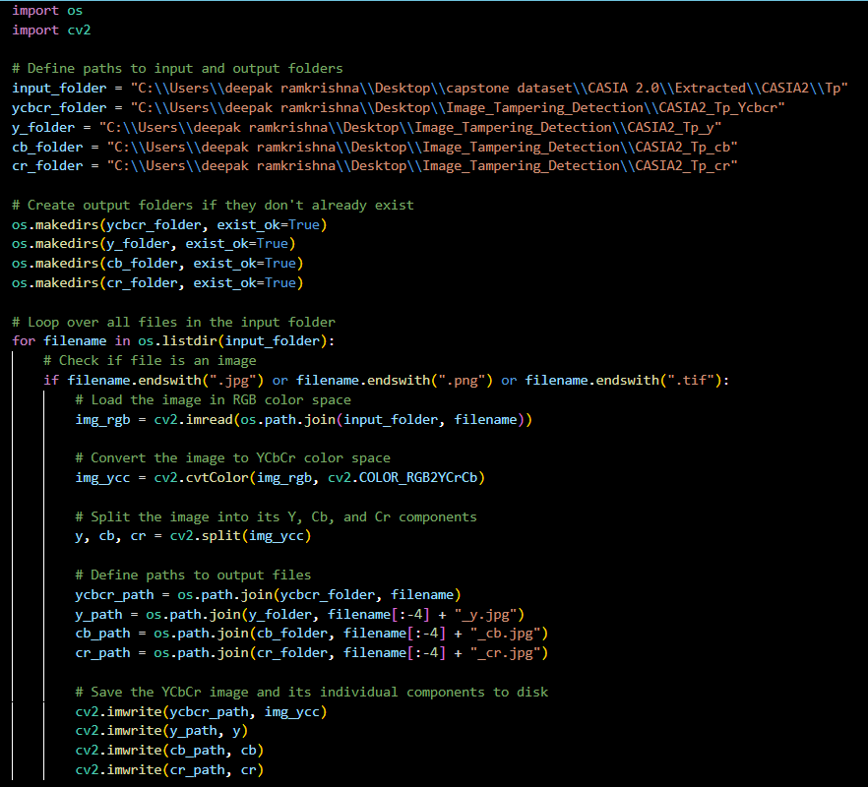
Image Tampering Detection
Preprocessing

Slide 42
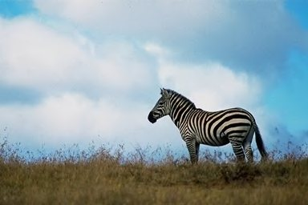

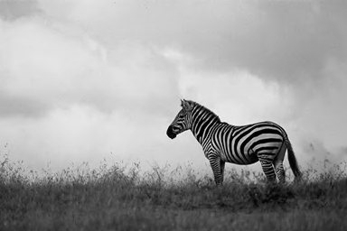
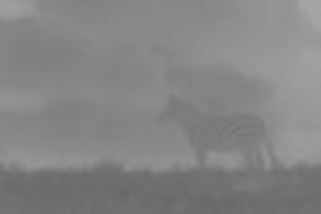
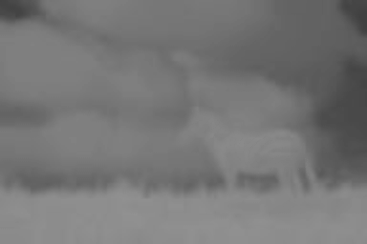
Image Tampering Detection
Original Image
RGB Image
Ycbcr Image
Y component
Cb component
Cr component
Anil_Divya_Nagaratna_Nandana

Slide 43
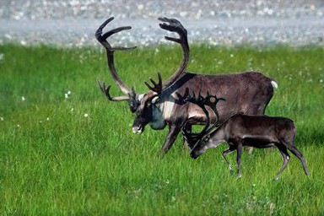
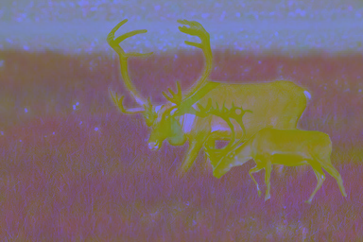
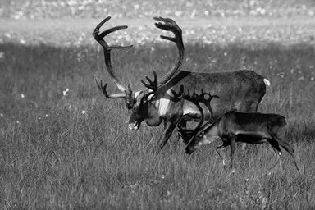
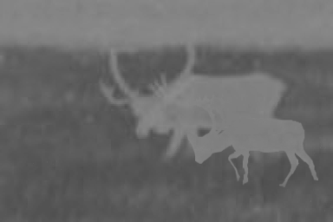
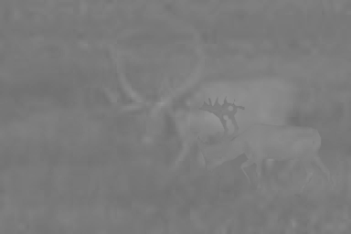
Image Tampering Detection
Tampered image
RGB Image
Ycbcr Image
Y component
Cb component
Cr component
Anil_Divya_Nagaratna_Nandana

Slide 44
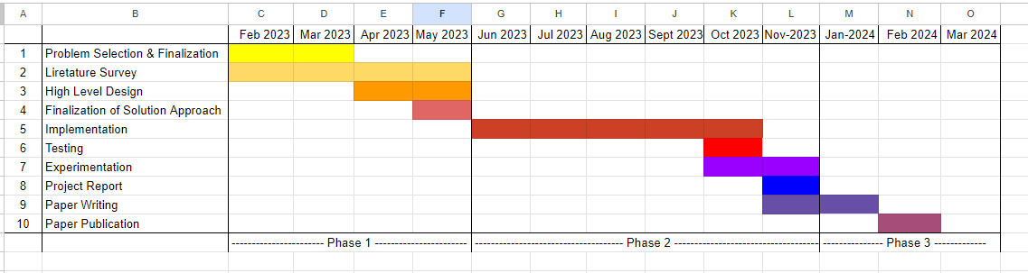
Project Progress
Image Tampering Detection
Percentage of completion 25%

Slide 45
Summary of work done in Capstone Phase-1
Image Tampering Detection
In our Capstone Phase-1 we completed our problem statement selection and finalization. We identified the abstract, scope and feasibility study of our project. We also did a Literature survey and understood the already existing approaches and methodologies. This gave us some idea of what we should implement and do.
Then we finalized our design approach. We have also put together our Requirement Specification document and High-Level Design document. We have also done the Pre-processing part of our project. We have also completed the Project report for Capstone phase-1

Slide 46
Project Plan for Capstone Phase-2
Image Tampering Detection
We will complete the implementation of our proposed methodology. Perform testing, experimentation and project report for Capstone Phase-2.
We will also start preparing our research paper.

Slide 47
References
Image Tampering Detection
International Journal of Recent Technology and Engineering (IJRTE) ISSN: 2277-3878, Volume-8, Issue-1S4, June 2019
Peng Zhou, Xintong Han, Vlad I. Morariu and Larry S. Davis “ Learning Rich Features for Image Manipulation Detection” in 2018 IEEE/CVF Conference on Computer Vision and Pattern Recognition, 18-23 June 2018, doi: 10.1109/CVPR.2018.00116
Sunen Chakraborty, Kingshuk Chatterjee, and Paramita Dey are affiliated with the Government College of Engineering & Ceramic Technology, October 20th, 2022
Manjunatha. S Department of Information Science & Engineering.Global Academy of Technology Bengaluru, 560 098, India, Malini M Patil Department of Information Science & Engineering.J S S Academy of Technical Education Bengaluru, 560 060, India “Deep learning-based Technique for Tamper Detection @2021

Slide 48
Image Tampering Detection
Thank You

