Slide 1
FORM ORDER SYSTEM
Order Form + Order Management + Multi-Platform Ad Tracking
github.com/aryagpradana97-byte/form-order-system

Slide 2
What It Is
A single system that runs order forms across all ad platforms and captures every lead into one place — with tracking that fires only for the submitted form.
• Order forms for Meta, Google, TikTok, Microsoft & organic traffic
• One reusable tracking snippet handles ALL forms on a page
• Every UTM + click ID stored together (not scattered)
• New Google Sheet backup — never touches your existing sheets

Slide 3
Order Form Types
SHORT
FULL
DIRECT
ORDER
Name, Phone, Workshop — quick reservation
Name, Phone, Plate, Car, Workshop, Complaint
One-tap WhatsApp 'Consult now' button
Select products/services + quantities, auto total
Each form is embeddable separately via 'Copy Embed' — generates a complete HTML block (form + tracking + pixel IDs) ready for Elementor / WordPress / any page.

Slide 4
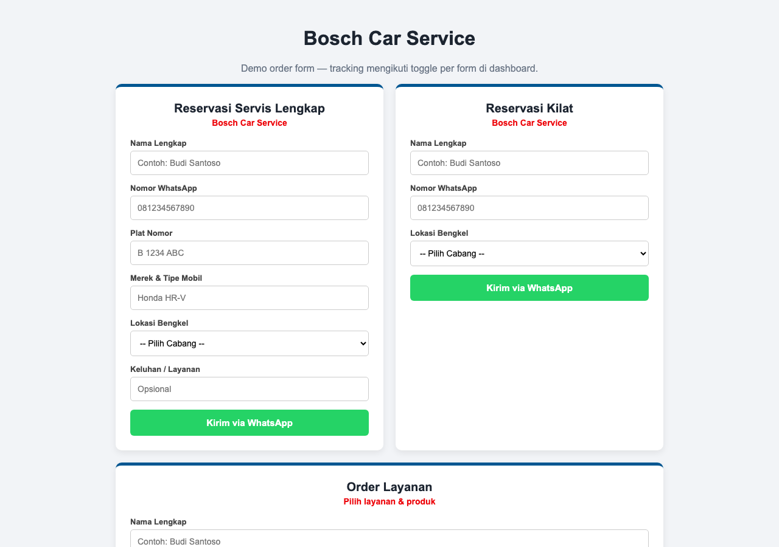
Order Form — Live Demo
Live view of the dashboard / form

Slide 5
Per-Form Tracking — the Core Fix
• Each form has its OWN toggle: Meta Pixel · GTM · TikTok · Google Ads
• Pixels fire ONLY when the form is valid AND submitted
• Draft / incomplete / invalid submits are still recorded as 'Draft' (not sent)
• Pixel ID fields per form: Meta ID, TikTok ID, GTM container, Google Ads conversion
• No more 'one form triggering every pixel on the page'

Slide 6
Consolidated Tracking (One Place)
UTM
utm_source, utm_medium, utm_campaign, utm_term, utm_content, utm_id
Generic
campaignId, adgroupId, adId, clickId, entityId
Google
gclid, gbraid, wbraid, gc_campaign_id, gc_adgroup_id, gc_ad_id
Meta
fbclid, entity_id, fb_campaign_id, fb_adset_id, fb_ad_id
TikTok
ttclid, tt_campaign_id, tt_adgroup_id, tt_ad_id
Other
msclkid · keyword · promo · site_source_name · products · total · notes

Slide 7
Promos & Scale (Platform × Promo × Form)
• Promos tab: create a promo per platform, then 'Generate Short + Full' forms.
• Tracking defaults follow the platform: Meta → Meta Pixel · Google → Google Ads · TikTok → TikTok.
• Supports hundreds of combos — e.g. 10 promos × 5 platforms × 2 forms = 100
• All forms remain independently editable (separate tracking toggles & pixel IDs)

Slide 8
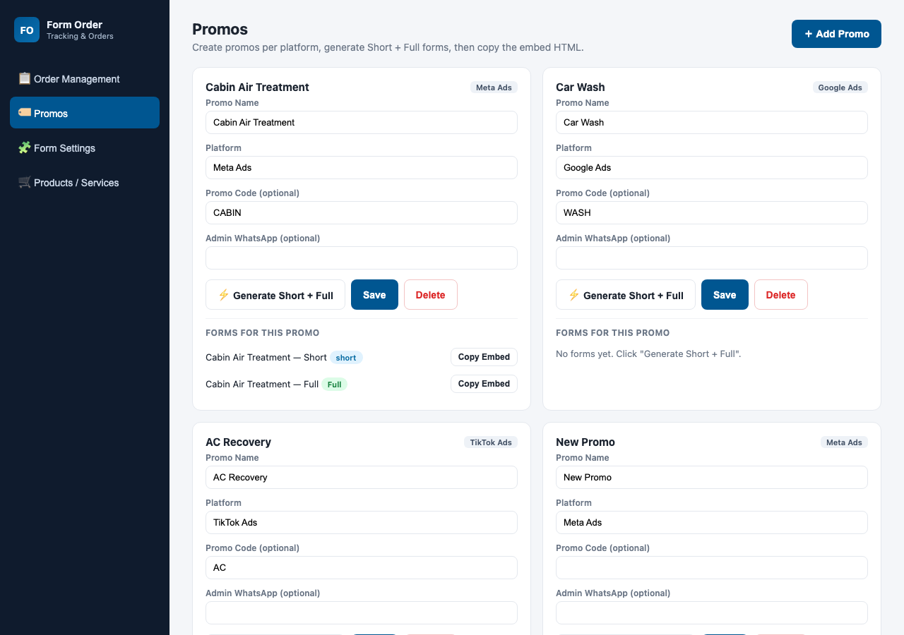
Promos — Generate Short + Full
Live view of the dashboard / form

Slide 9
Order Management Dashboard
• List all orders with search + filters (platform, form, status, date)
• Statuses (editable + notes/reason): Draft → Submitted → Valid → Connected → Not Connected → Deal
• Detail modal: full lead + tracking + products/total + events, edit status & notes
• 'Columns' button → popup to choose which detail columns to show (Save / Cancel)
• Add manual order (with product selection) · Delete · Export CSV
• UI is in English

Slide 10
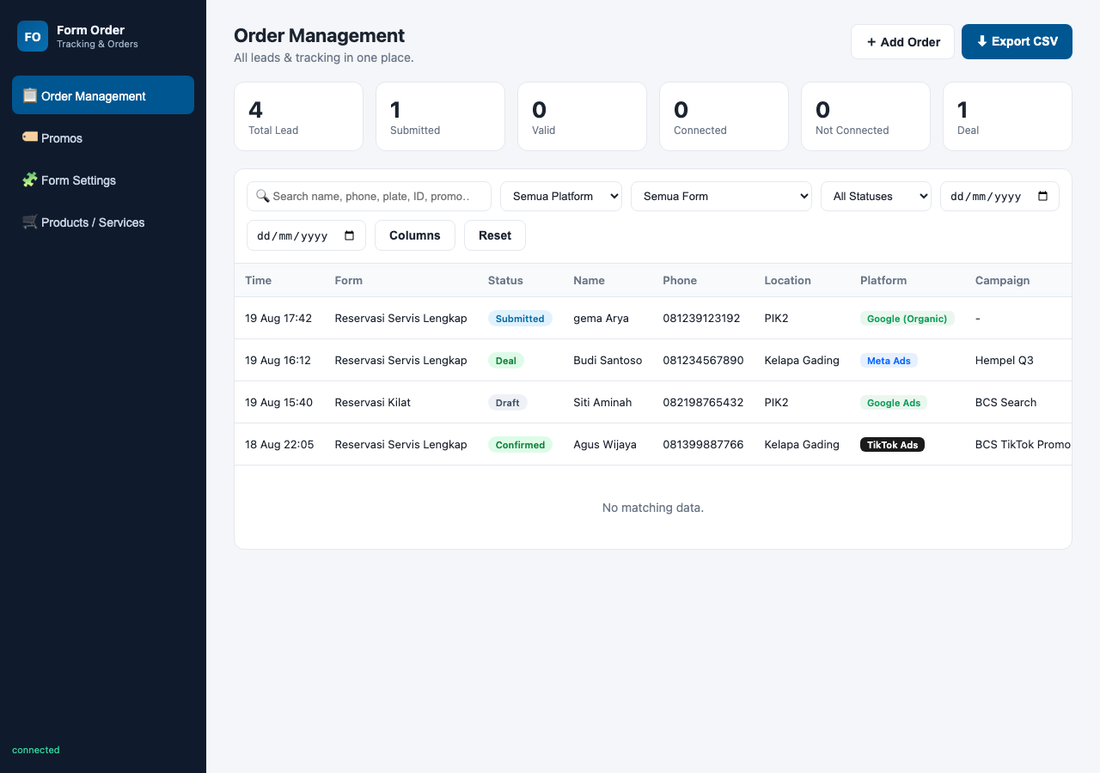
Order Management Dashboard
Live view of the dashboard / form

Slide 11
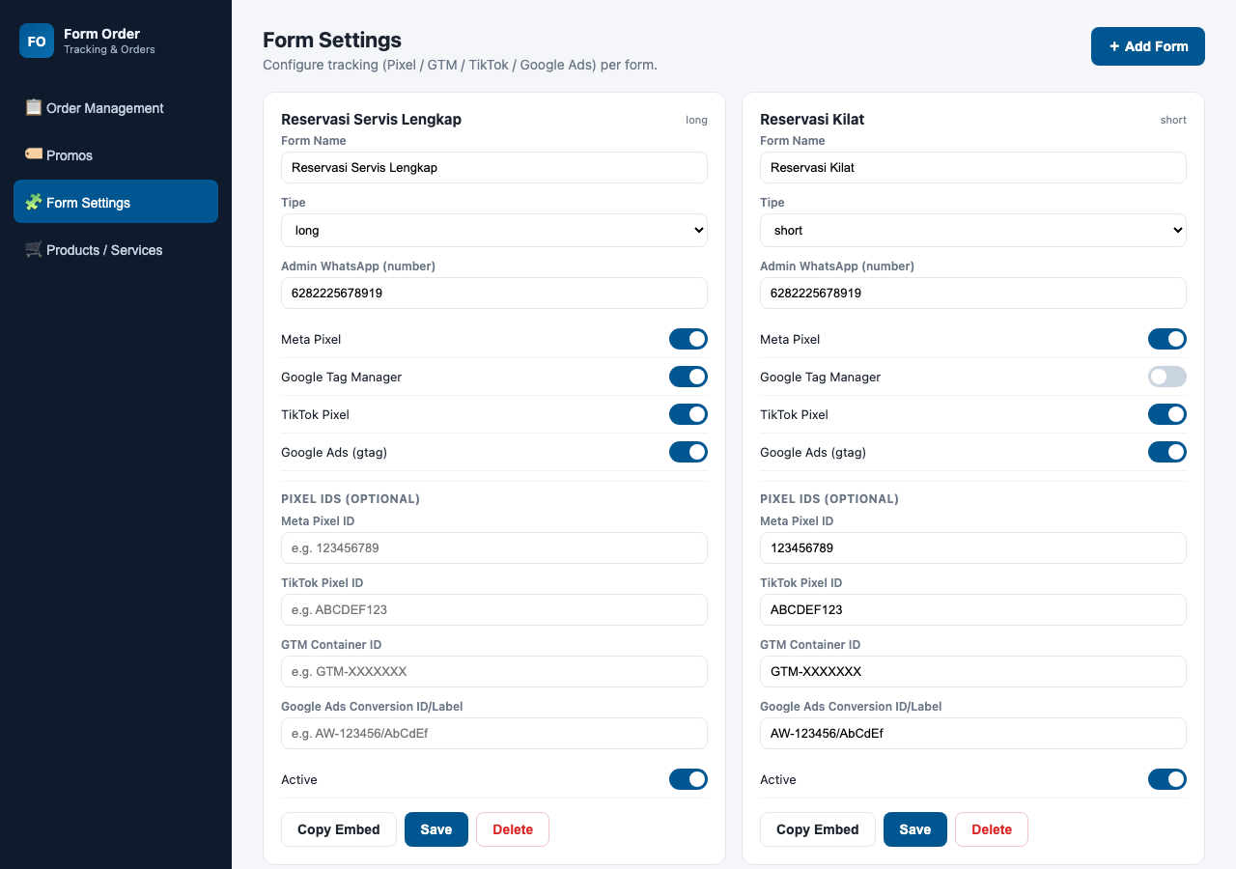
Form Settings — Tracking Toggles & Pixel IDs
Live view of the dashboard / form

Slide 12
Google Sheet Mirror
• Ships its own Apps Script (apps-script/Code.gs)
• Creates a brand-new spreadsheet 'Form Order System - Leads' automatically
• NEVER touches your existing spreadsheet
• Set config.json → googleSheetWebAppUrl = your /exec URL
• Every submission then writes to BOTH the dashboard (JSON) and the new sheet

Slide 13
Tech & Files
• Node.js (zero dependencies) + JSON storage + static dashboard
• server.js — REST API; data/ — runtime JSON (orders, forms, products, promos)
• public/tracker/bcs-tracker.js — embeddable tracking snippet
• public/index.html + app.js + styles.css — dashboard (Orders, Promos, Form Settings, Products)
• apps-script/Code.gs — new Apps Script → new spreadsheet
• Run: node server.js → Dashboard at http://localhost:3000

Slide 14
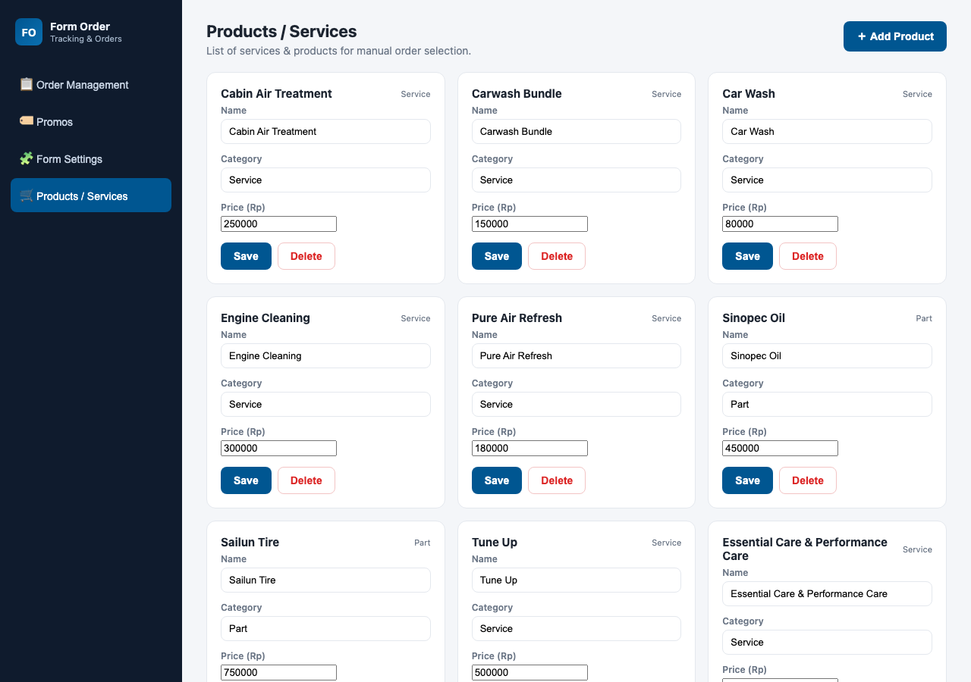
Products / Services
Live view of the dashboard / form

Slide 15
Status
• Verified: server boots, all API endpoints respond
• Form submits → recorded in dashboard (confirmed with real submissions)
• Google Sheet created + mirror active (existing sheet untouched)
• Pixel ID fields save & are used when firing
• Pushed to GitHub: github.com/aryagpradana97-byte/form-order-system

