Slide 1


April 2023
GPU Multi-threading to interpret our simple ML language
Group: Aryan Dua, Arya Grayeli, Ebaad Imran, Jimmy Bao
CSIDs: dua, agrayeli, ebaad, jb79823
Final Project for CS429H, Dr. Gheith
Notes:
Dua

Slide 2
Our Motivation and Goals
Get more insight into the workings of a GPU
Learn a new programming language: CUDA
Apply GPU programming to an applicable field like Machine Learning
Do something cool!
Notes:
Jimmy

Slide 3
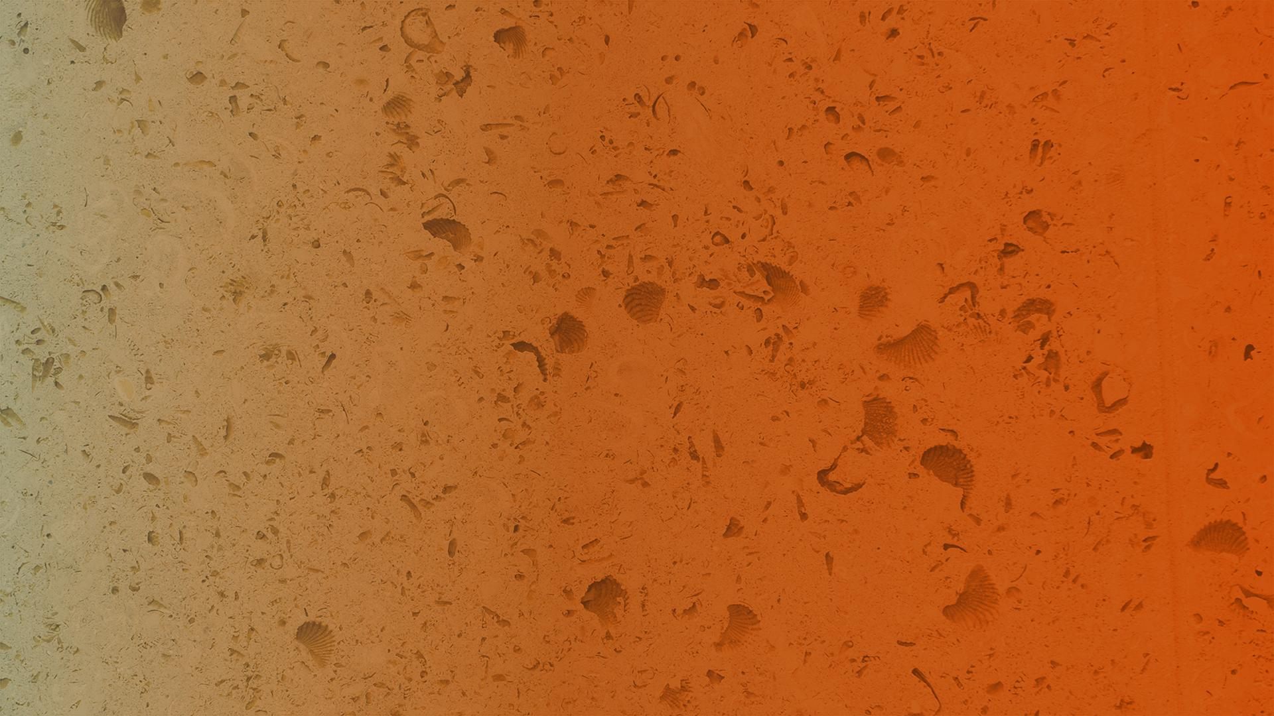
April 2023
Background information: GPUs and FFNN
Notes:
Jimmy

Slide 4
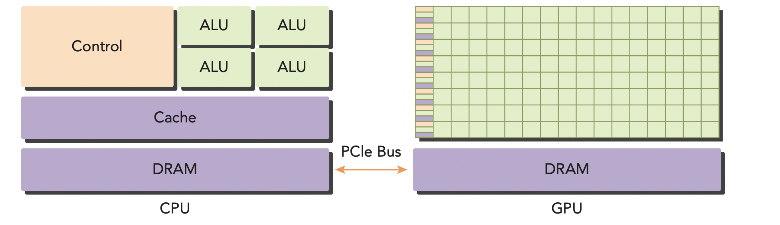
Heterogeneous Architecture
The GPU isn’t a standalone platform, but a co-processor to the CPU
GPUs get data dumps from the CPU via the PCIe bus
CPU is the “host”, GPU is the “device”, we will use these terms often
Notes:
Jimmy

Slide 5
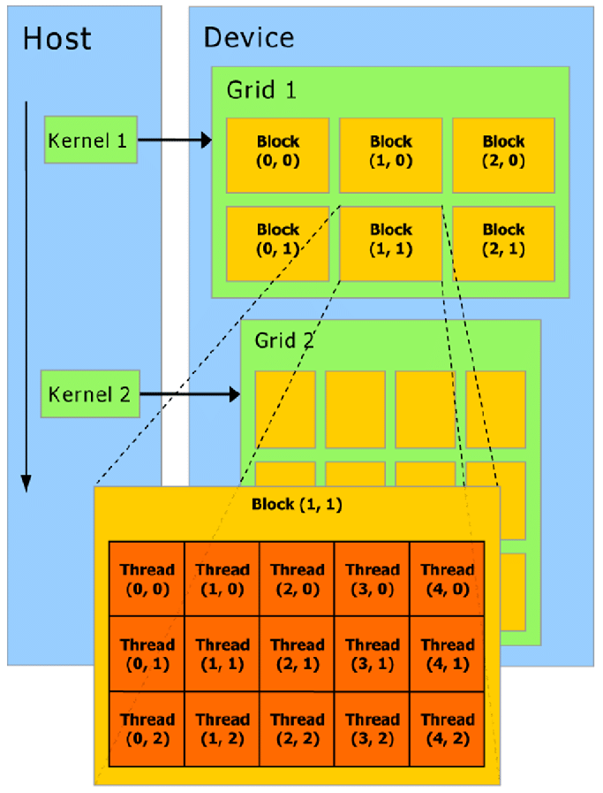
GPUs parallelize, but how?
Kernels
GPUs create threads of execution - independent & simultaneous execution of instructions
Grids divided into blocks and threads (view image on right)
Notes:
Jimmy

Slide 6
CUDA
Nvidia’s Language, extends C , supports GPU
General CUDA programming paradigm is 3 steps
Copy over the data to GPU, load and execute the GPU program, copy the result back to the host
Can define “kernels”: functions that run in parallel, each executing the same code on different data
It has thread/block variables, synchronizations, and other paradigms to help with parallelism
Notes:
Dua

Slide 7
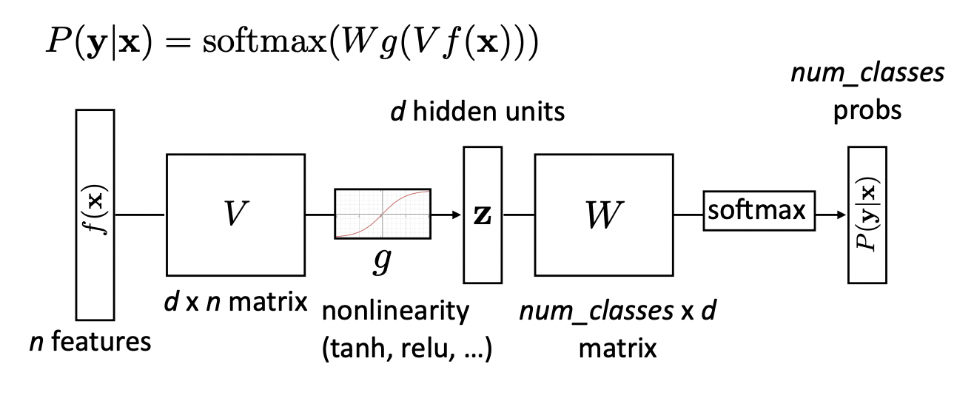
Feed Forward Neural Networks
Put simply, FFNNs are just matrix multiplications and scalar matrix operations … highly parallelizable!
Notes:
Arya

Slide 8
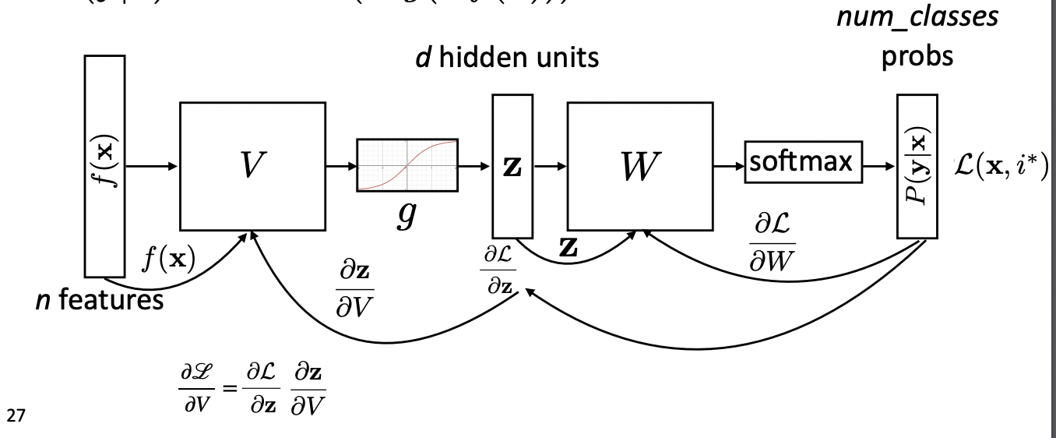
Back Propagation
The model produces an output → we compute how wrong we are and using calculus → update the weights → do it again … highly parallelizable!
Notes:
Arya

Slide 9
April 2023
Our Project
Notes:
Arya

Slide 10
Components in Action
NN description (.arch)
Interpreter, host to device logic
(.c, .cuda)
Parallelized logic for FFNN + backprop (.cuda)
Trained weights
(.pth)
GPU Core
GPU Core
Train data set
(data folder)
GPU Core
GPU Core
Testing Results
GPU Core
Test data set
(data folder)
GPU Core
Notes:
Arya

Slide 11
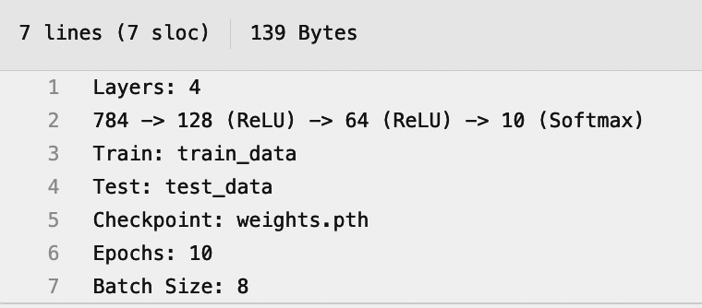
“Language” to specify any FFNN (.arch)
Simply specify the number of layers as needed for your model
Specify linear transformation sizes for each layer
Choose which non-linearity functions you want to apply
ReLU
TanH
Sigmoid
Softmax
Give a folder of train and test data
Specify where to dump the trained
weights run on GPU
C interpreter reads these params
Notes:
Arya

Slide 12
CUDA for parallelization
We wrote the algorithm for a feed forward neural network both in C and CUDA
Parallelized all operations possible assuming infinite cores were available (we had more than enough)
Mostly matrix operations → have a natural parallelizable nature
Notes:
Ebaad

Slide 13
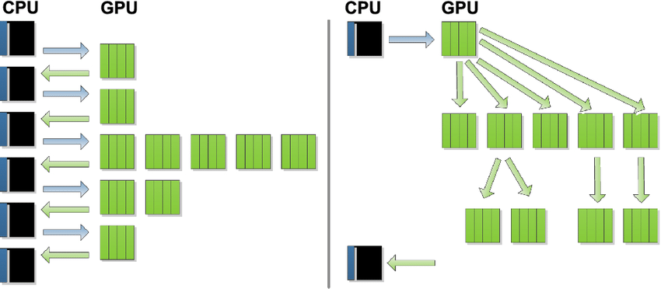
Dynamic Parallelism
one kernel may launch another kernel, and that kernel may launch another…
kernels can launch to the same device without host interaction → faster for large computations
Notes:
Ebaad

Slide 14
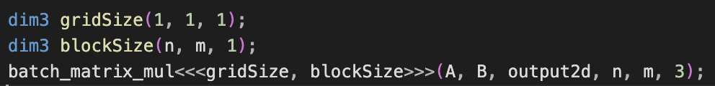
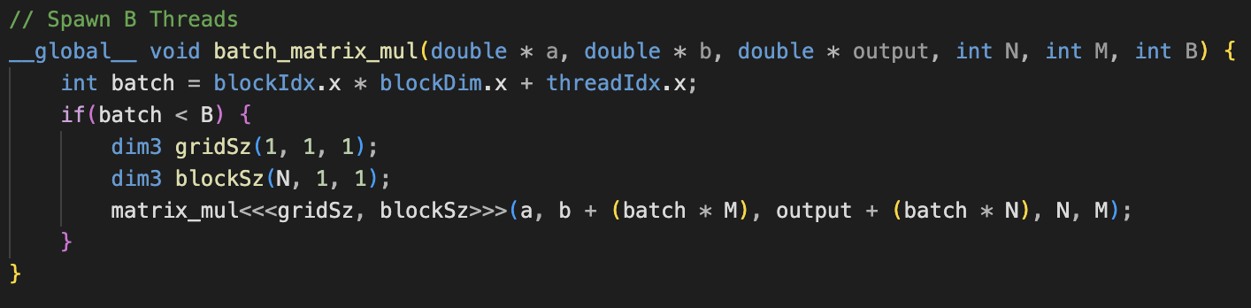
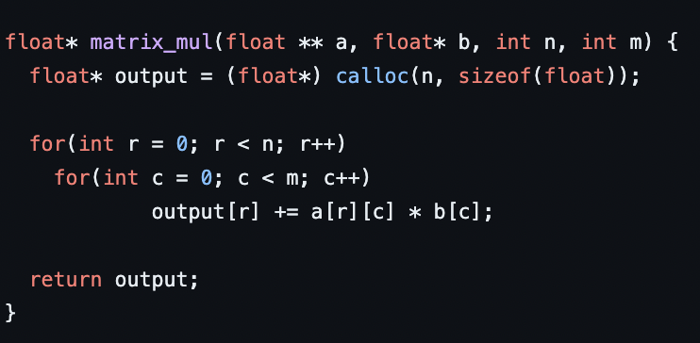
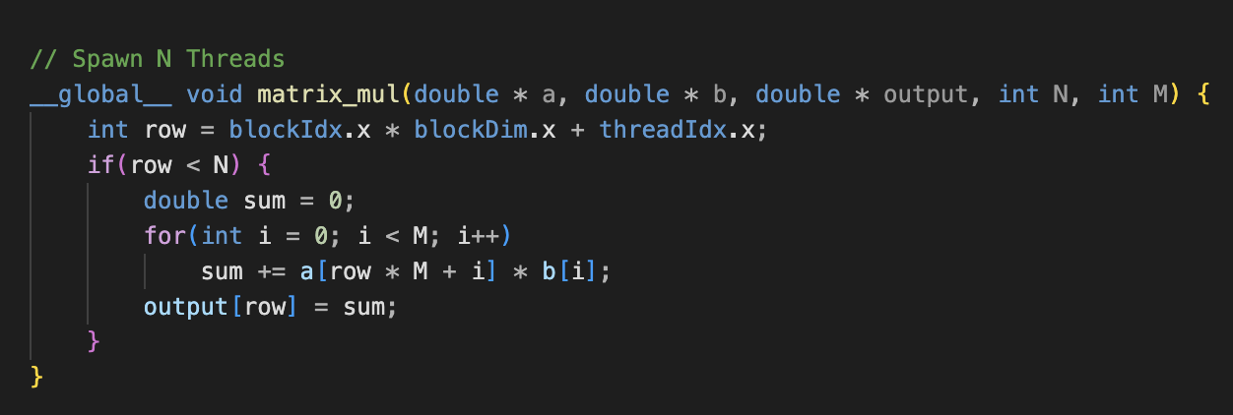
Example: Matrix Multiplication in C vs CUDA
Notes:
Ebaad

Slide 15

April 2023
Results
Notes:
Dua

Slide 16
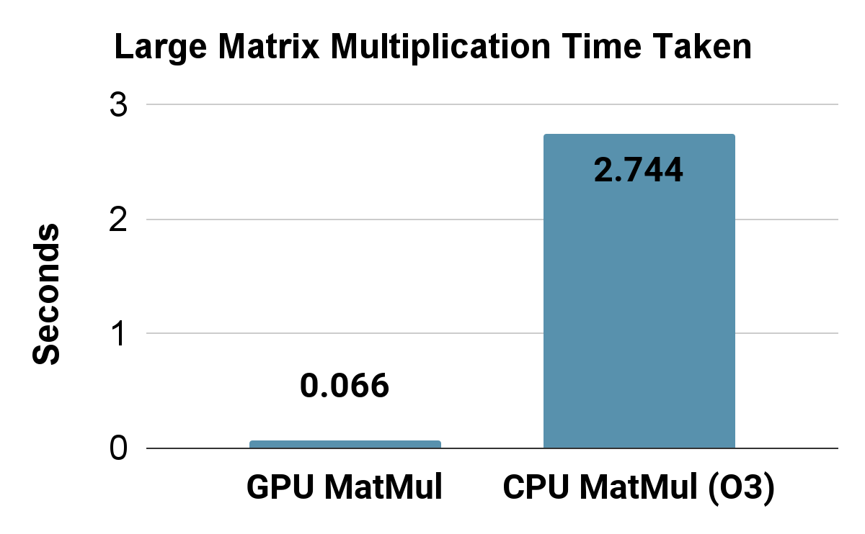
Performance Gains with GPUs
Notes:
Dua

Slide 17
Speedup,
Visualized
Time Taken by CPU
for 32k by 32k into 32k multiplication
Time Taken by GPU
Notes:
Dua

Slide 18
Testing Accuracy
98% accuracy on MNIST Task
Very easy to try different layer sizes due to design of our language
Fits perfectly in ~2 minutes
60,000 training images and 15 epochs
Approx. 50M matrix operations in 2 minutes
Notes:
Arya

Slide 19
April 2023
Demo!
Notes:
Arya

Slide 20
April 2023
Questions?

