Slide 1
Mutual Fund Portfolio Analytics
End-to-End Performance Scorecard, Advanced Risk Metrics & Delivery
Prepared by: Data Analyst Team | Bluestock Capstone Project

Slide 2
1. Project Scope & Key Objectives
Relational Database Layer: Develop a robust, relational data storage layer in SQLite using a star schema design.
Automated ETL Pipeline: Construct a programmatic ETL pipeline to clean, ingest, and integrate transaction logs, NAV history, and fund master files.
Performance Engineering: Calculate industry-standard performance metrics including CAGR (1y/3y/5y), Sharpe/Sortino ratios, and OLS Alpha/Beta.
Advanced Risk Analytics: Perform advanced analytics on Value at Risk (VaR), sector concentration (HHI), and investor behavioral cohorts.
Production Delivery: Deliver interactive reporting interfaces (Power BI) and automated delivery files.

Slide 3
2. Relational Database & Star Schema Design
Design Philosophy: Organized around a central Dimension-Fact structure to support efficient analytical queries.
Dimension Tables: dim_fund (AMFI code PK, fund house, category, fees, risk profile).
Fact Tables: fact_nav (historical NAVs, computed daily returns), fact_transactions (investor logs), and fact_performance.
Indexing Strategy: Applied indexes on nav_date, amfi_code, and transaction_date to speed up time-series lookups.
SQLite Data Model Schema
- dim_fund (Fund Master)
- fact_nav (NAV history & returns)
- fact_transactions (Investor ledger)
- fact_performance (Scorecard metrics)
- fact_portfolio_holdings (Stock allocations)
- fact_benchmark (Index closing history)
- fact_aum & fact_sip_inflows (Industry metrics)

Slide 4
3. Data Cleaning, Imputation & Auditing
Missing Value Imputation: Imputed missing daily NAV data using forward-fill (FFill) grouped by AMFI code to preserve market time series without look-ahead bias.
Ledger Validation: Audited and removed invalid negative transaction amounts in the investor ledger to secure mathematical integrity.
Categorical Standardisation: Standardized schema names, transaction types (SIP, Lumpsum, Redemption), and KYC status columns.
Quality Checks: Cross-referenced daily fund returns against benchmark index returns to detect anomalous movements.

Slide 5
4. Exploratory Data Analysis (EDA) Insights
AUM Concentration: AUM distribution shows high concentration in top 10 AMC houses (such as HDFC, SBI, ICICI), leaving a long tail of smaller funds.
Plan Cost Spread: Regular plans charge significantly higher expense ratios than direct plans (averaging 0.8% - 1.2% higher per year).
Asset Class Performance: Equity funds outperform debt funds on absolute returns but experience substantially higher annualized standard deviation.
SIP Growth Trend: Monthly SIP inflows grew steadily across the 2022-2025 period, indicating resilient retail investor participation.

Slide 6
5. The Weighted Fund Scorecard Model
Objective: Ensures a balanced, multi-dimensional view of performance rather than looking solely at raw historical returns.
Return & Risk-Adjusted: CAGR 3-Year (30% weight) and Sharpe Ratio (25% weight).
Manager Alpha & Tail Risk: OLS Benchmark Alpha (20% weight) and Maximum Drawdown (10% weight, inverse).
Cost Efficiency: Expense Ratio (15% weight, inverse) to penalize high management fees.
Normalisation Method: Scores are computed using percentile ranks (0 to 100 scale) within categories to ensure fair comparisons.

Slide 7
6. Top & Bottom Performers by Category
Equity Top: HDFC Mid-Cap Opportunities Fund (Score: 81.1)
Equity Second: ABSL Frontline Equity Fund (Score: 69.4)
Equity Third: UTI Flexi Cap Fund (Score: 50.1)
Equity Bottom: Axis Bluechip Fund - Regular (Score: 38.2)
Debt Top: Kotak Liquid Fund - Regular (Score: 39.5)
Debt Second: SBI Magnum Gilt Fund - Regular (Score: 36.9)
Debt Third: Nippon India Gilt Securities Fund (Score: 35.9)
Debt Bottom: ABSL Short Term Debt Fund (Score: 28.5)

Slide 8
7. Tail Risk: Value at Risk (VaR) & CVaR
Value at Risk (95%): Historical VaR (95%) represents the daily loss threshold that will only be breached 5% of the time.
Conditional VaR (95%): Conditional VaR (CVaR) represents the average loss expected on those worst 5% of days.
Equity Risk Profile: Mid cap and Small cap funds show a daily VaR 95% of -1.8% to -2.3%, indicating high short-term drawdown risk.
Debt Risk Profile: Liquid and Short Term Debt funds present a VaR of -0.01% to -0.15%, making them ideal for capital preservation.

Slide 9
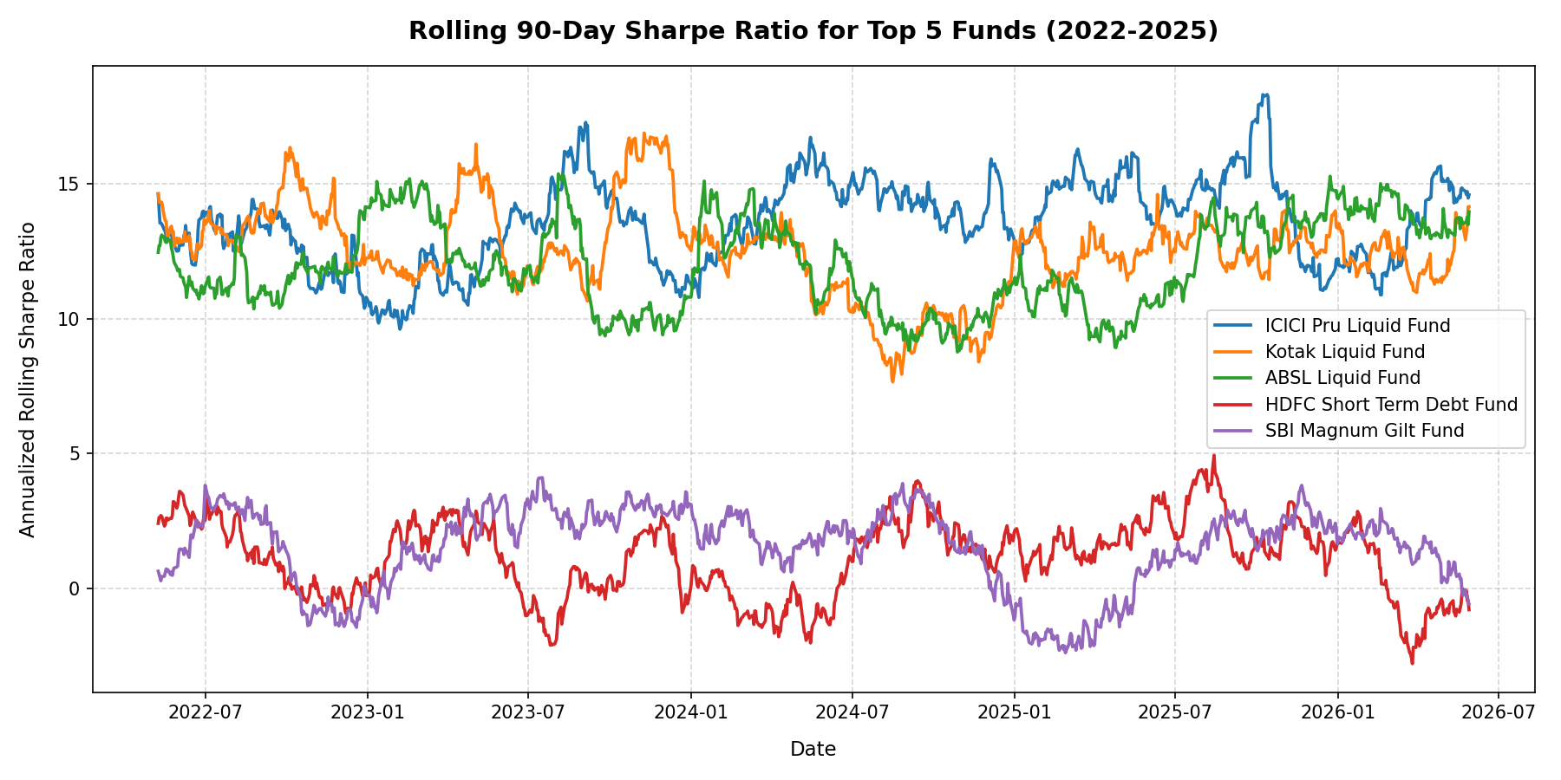
8. Rolling 90-Day Sharpe Ratio Trends
Rolling Sharpe (90 Days): Evaluates how risk-adjusted returns evolve over market cycles, highlighting return consistency.
Liquid Fund Stability: Liquid and Short Term Debt funds show very high and stable rolling Sharpe ratios due to extremely low volatility.
Equity Volatility: Equity fund Sharpe ratios fluctuate wildly, ranging from negative during market corrections to over 2.5 during rallies.

Slide 10
9. Investor Cohort & Behavioral Analytics
Acquisition Cohorts: 2024 cohort (1362 investors) vs. 2025 cohort (12 investors) shows transaction volume concentration in 2024.
SIPSizing: Average SIP size remains highly stable across cohorts (around Rs. 4,500 - 5,000 per month).
SIP Continuity: Out of 1362 active SIP clients, 1332 (97.8%) were flagged as 'at-risk' due to transaction gaps exceeding 35 days.
Retention Insight: High attrition highlight the need for automated reminders and mandate tracking to prevent SIP defaults.

Slide 11
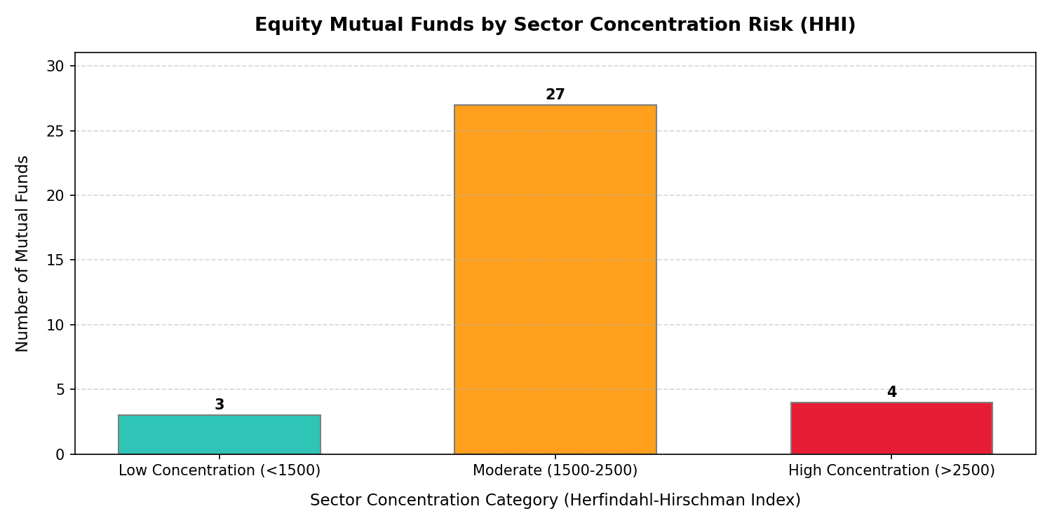
10. Sector HHI & Recommender Logic
Sector HHI: Assesses sector concentration. HHI > 2500 represents highly concentrated thematic portfolios.
CLI Recommender: The fund recommendation engine is built as an interactive command-line interface.
Recommender Rules: Maps risk profile (Low, Moderate, High) and Asset Class (Equity, Debt) to select top 3 funds sorted by Sharpe ratio.

Slide 12
11. Summary & Actionable Recommendations
For Operations: Implement automated payment mandate checks to address the 97.8% default risk flagged in the SIP continuity analysis.
For Advisory: Promote Direct Plans to yield-sensitive clients; regular plans impose an unnecessary drag on long-term compound growth.
For Performance: Use the weighted fund scorecard instead of raw returns to benchmark fund managers and detect performance decay early.
For Tech: Deploy the recommender engine as a microservice to assist advisory teams in offering objective, risk-aligned recommendations.

