Slide 1
Segment 3

Slide 2
Features and the Target Variables
Target variable: log price
141 Features:
Given Features | 130 Amenities
Accommodates | Kitchen
Bathrooms | Wireless Internet
City | Air conditioning
Bedrooms | Cable TV
Beds | Family/kids friendly
Latitude | Pool
Longitude | Free Parking on premises
Review_scores_rating | TV
Room_type | Heating
Cancellation_policy | Pets allowed
Zipcode | Washer, and etc.

Slide 3
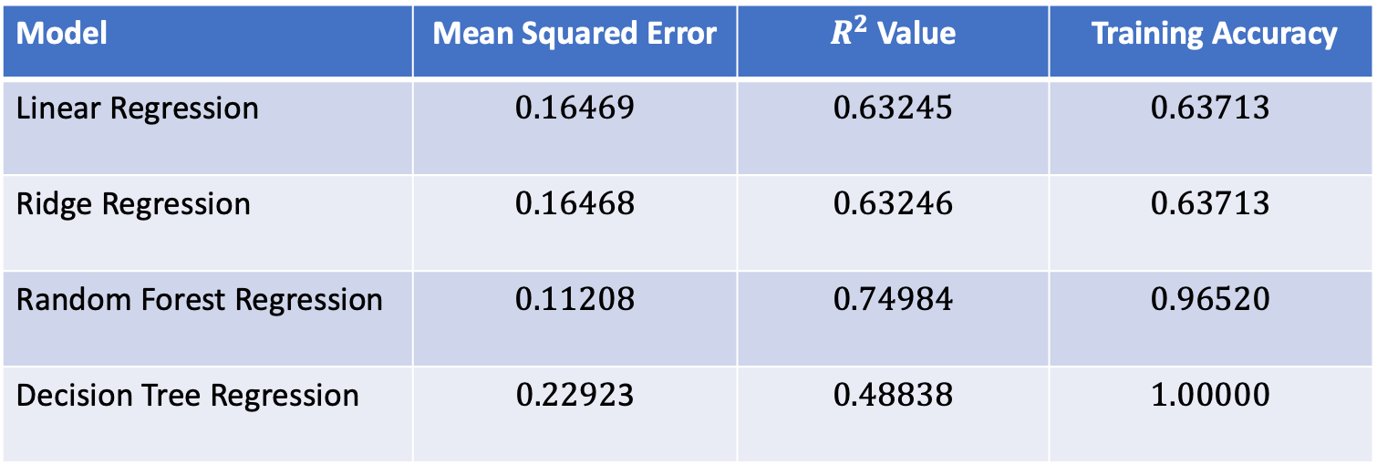
Regression Models
Following four methods were considered
Linear Regression
Random forest Regression
Ridge Regression
Decision Tree Regression
Model | Mean Squared Error | $R^{2}$ Value | Training Accuracy
Linear Regression | $$0.16469$$ | $$0.63245$$ | $$0.63713$$
Ridge Regression | $$0.16468$$ | $$0.63246$$ | $$0.63713$$
Random Forest Regression | $$0.11208$$ | $$0.74984$$ | $$0.96520$$
Decision Tree Regression | $0.2292$3 | $$0.48838$$ | $$1.00000$$

Slide 4
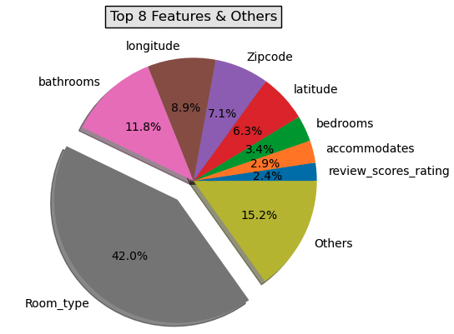
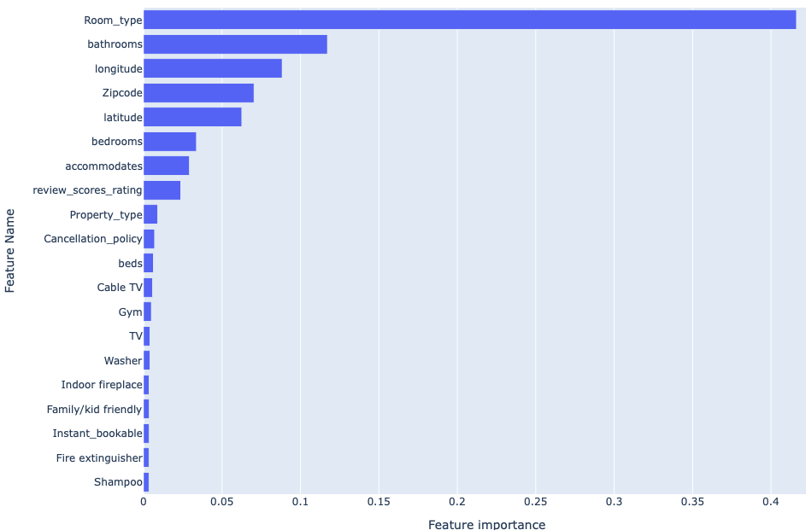
Feature Importance

Slide 5
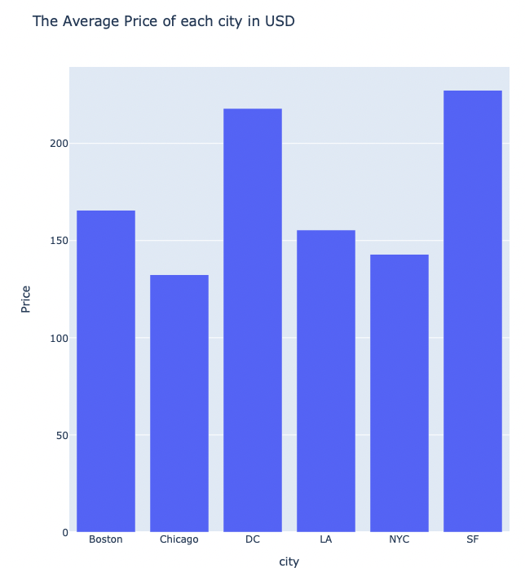
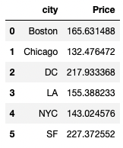
Average Price of Each City in USD

