Slide 1
Database Management Systems Prof. Dr Helen Uzamere Subject Code – IS 613
TESLA ONLINE CAR BOOKING DATABASE
Group Members – Arya Joshi, Rohin Mehta, Prashant Chaudhary, Sichen Yang

Slide 2
Project Scope
The objective of this project is to create a database with the flexibility to process meaningful data which is essential for the company to streamline their online purchase funnel and improve customer experience. The proposed database will offer quick access to the resources such as customer data and their purchase history. Customer and order tracking will have a major part to play in analyzing and investigating data in order to churn out insights to improve business processes and make informed decisions.

Slide 3
Problem Definition
The company’s shift to e-commerce has made a necessity to have a robust structure for its online customers. So we intend to design a database for the company to keep track of its customers, orders and customer preferences for business efficiency.

Slide 4
Database Entities
Entity | Description
Customer | Individuals who place an order for purchasing car
Order Details | Description of car orders
Customizations | Car customization for model, color, Interior, version and wheel
Model | Different car models available for purchase
Color | Colors available for selection
Interior | Interior types for selection
Version | Version types available for selection
wheel | Wheel types available for selection
Payment Details | Invoice details when order is placed
Payment Types | Different payment types available for customer

Slide 5

Table Attributes
Customer – Customer_ID, First_Name, Last_Name, Phone_Number,Email_Address, Street, City, State, Zipcode
Order Details – Order_Id, Customizations_Id, Order_Date
Customizations – Customizations_Id, First_Name, Version_Type, Model_Type, Color_Type, Wheel_Type, Interior_Type
Model – Model_Id, Model_Type, Model_Price, Model_Year
Color – Color_Id, Color_Type, Color_Price
Interior - Interior_Id, Interior_Type, Interior_Price
Version – Version_Id, Version_Type, Version_Price
Wheel – Wheel_Id, Wheel_Type, Wheel_Price
Payment – Paymet_Id, Order_Id, Payment_Type
Payment Type – Payment_Type_Id, Payment_Type

Slide 6
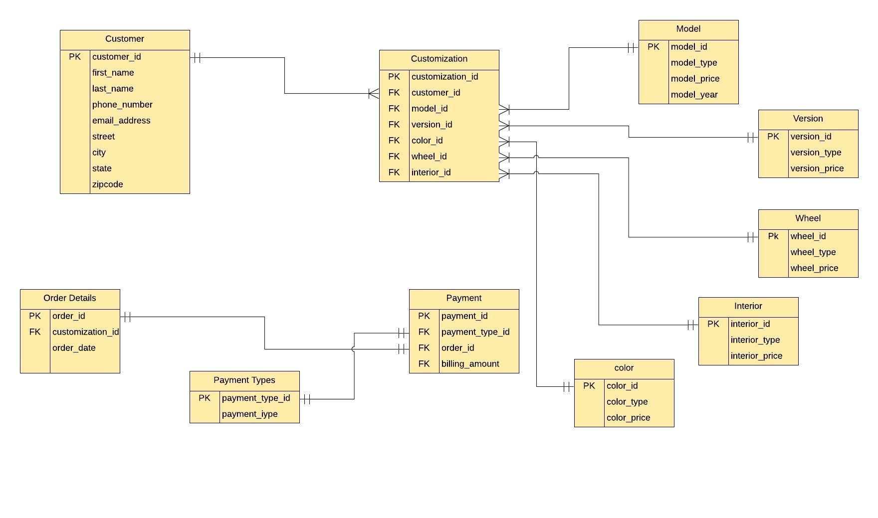
Entity Relationship Diagram

Slide 7
Relationships and Cardinalities
Entity Relationships |  | Cardinalities
Parent | Child | Max | Min
Customer | Customizations | 1:M | 1:1
Order Details | Payment | 1:1 | 1:1
Payment | Payment Types | 1:1 | 1:1
Model | Customizations | 1:M | 1:1
Version | Customizations | 1:M | 1:1
Wheel | Customizations | 1:M | 1:1
Interior | Customizations | 1:M | 1:1
Color | Customizations | 1:M | 1:1

Slide 8
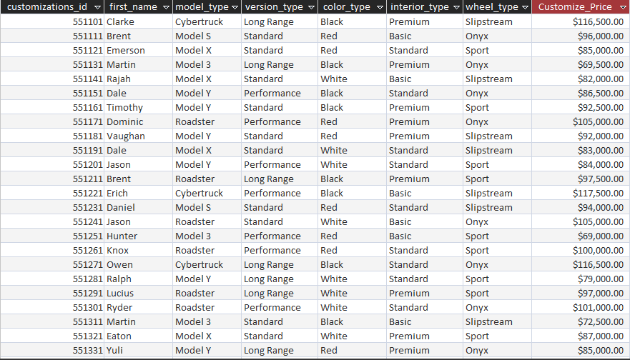
SQL Query 1
Display Customization Pricing

Slide 9
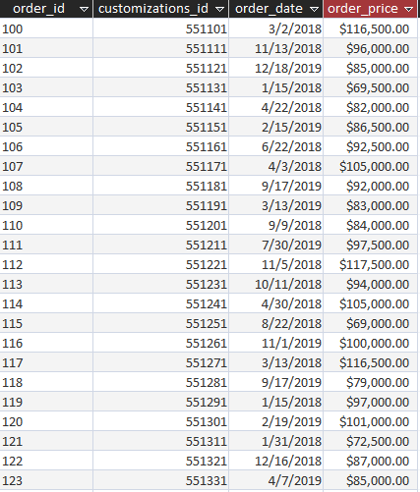
SQL Query 2
Display Order Pricing

Slide 10
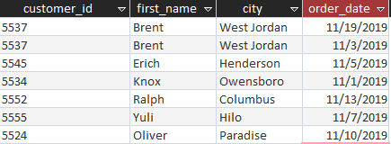
SQL Query 3
Display Customer Orders placed in November 2019

Slide 11
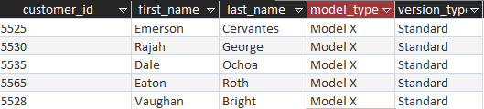
SQL Query 4
Display customers with model X and standard version

Slide 12
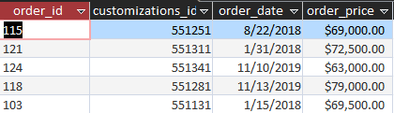
SQL Query 5
Display orders with less than $80000

Slide 13

SQL Query 6
Display sum of order price in the state of “Utah”

Slide 14
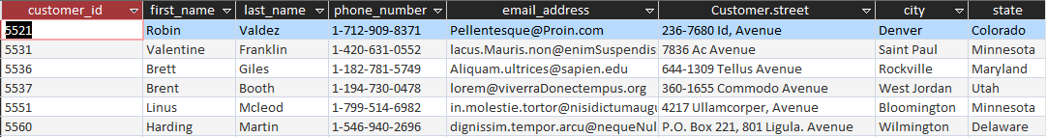
SQL Query 7
Display All customers with street “Avenue”.
Query:
SELECT Customer.*, Customer.street
FROM Customer
WHERE Customer.street Like "*Avenue*";

Slide 15
SQL Query 8
Display customer and customization where state is Ohio or Colorado
Query:
SELECT Customer.*, customizations.*
FROM Customer INNER JOIN customizations ON Customer.customer_id = customizations.first_name
WHERE state="Colorado" OR state="ohio";

Slide 16
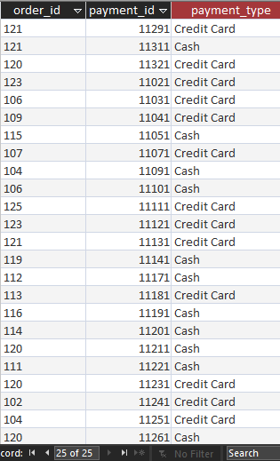
SQL Query 9
Display orders with payment type cash and credit card
Query:
SELECT order_details.order_id, payment_details.payment_id, payment_details.payment_typeFROM order_details INNER JOIN payment_details ON order_details.order_id = payment_details.order_id
WHERE payment_type="1"OR payment_type="3";

Slide 17
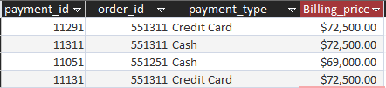
SQL Query 10
Display order payment between 60000 and 80000
Query:
SELECT [Payment option].*
FROM Payment option
WHERE Billing_price Between 60000 And 80000;

Slide 18
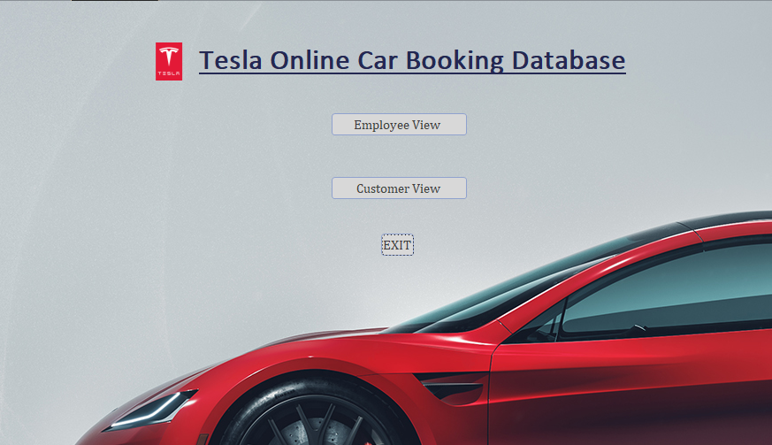
Main Form

Slide 19
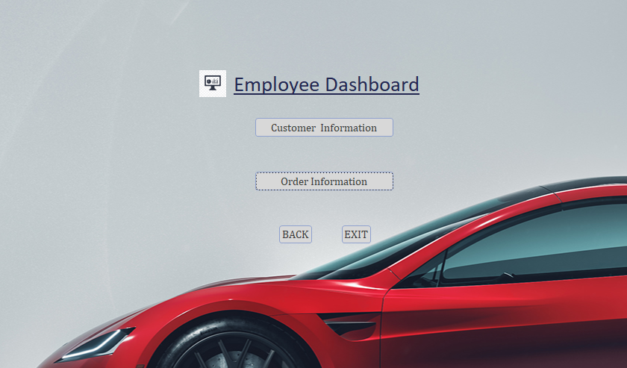
Employee View Form

Slide 20
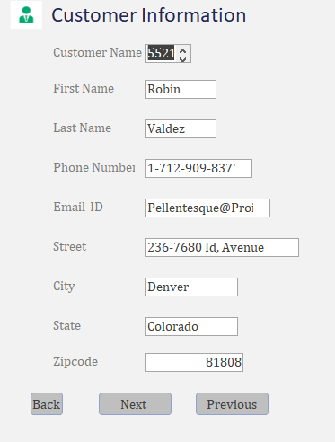
Customer Information Form

Slide 21
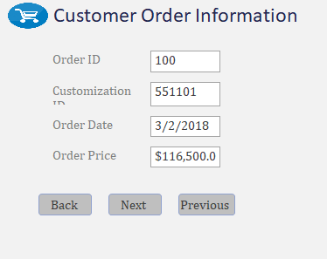
Customer Order Information Form

Slide 22
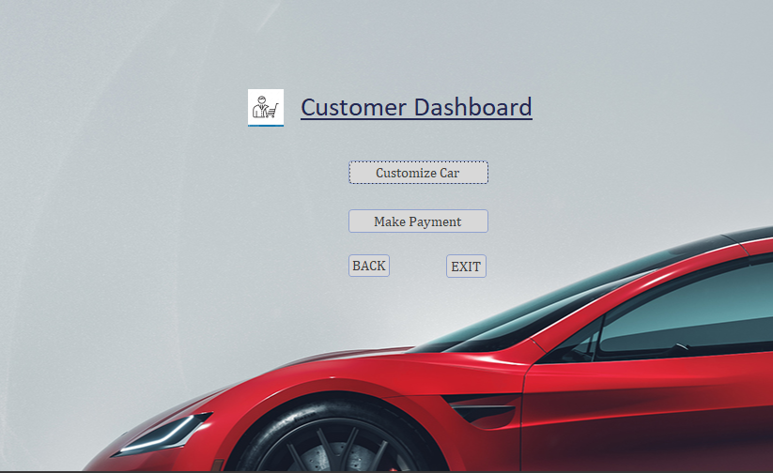
Customer View Form

Slide 23
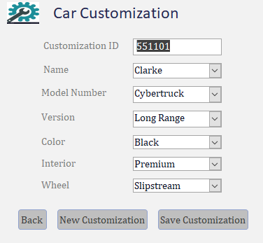
Car Customization Form

Slide 24
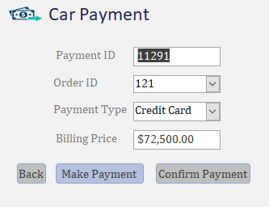
Car Payment Form

Slide 25
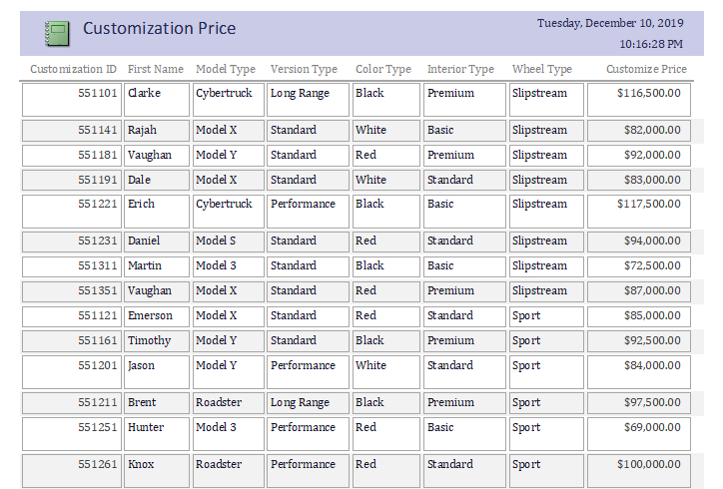
Customization Price Report

Slide 26
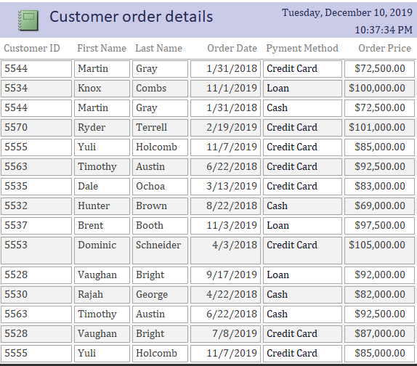
Customer Order Details Report

Slide 27
Thank You!

