Slide 1

ANDROID APP DEVELOPMENT MINI PROJECT
GROUP NO: 10 PROJECT TITLE: STUDENT GRADE MANAGER APP

Slide 2
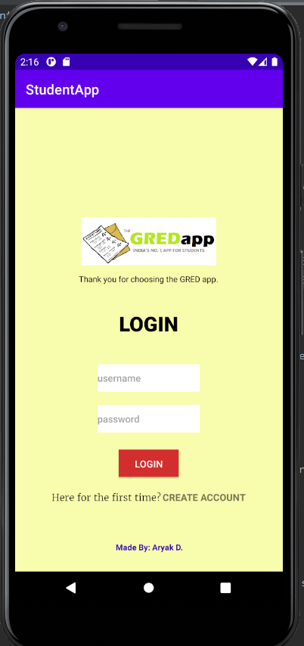
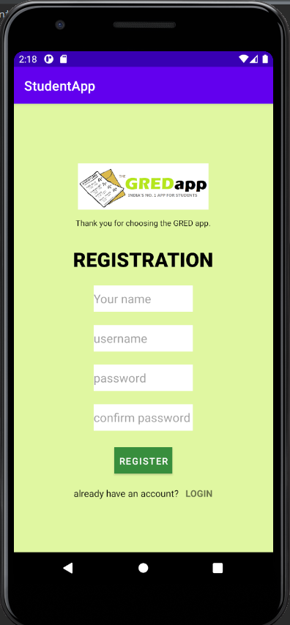
CONTENTS
OVERVIEW AND FEATURES, SCOPE
ENTITIES, DATABASE SCHEMA AND DESIGN
MODEL CLASSES AND ENCAPSULATION
CRUD / DATABASE OPERATIONS
SERVICE CLASS AND OBJECT ORIENTATION
ACTIVITIES AND INTENTS
SCREENSHOTS OF PROJECT

Slide 3
OVERVIEW AND FEATURES
Students can create an account and then login to use services
Add/delete/update subjects and corresponding marks
Rigorous validations on above operations in place
Subject grade calculated with percentage and CGPA
Reset account password
Deactivate account
Object oriented, scalable design

Slide 4
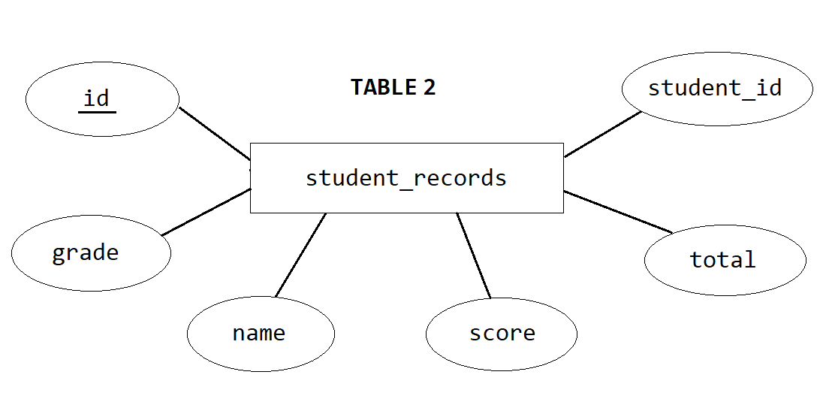
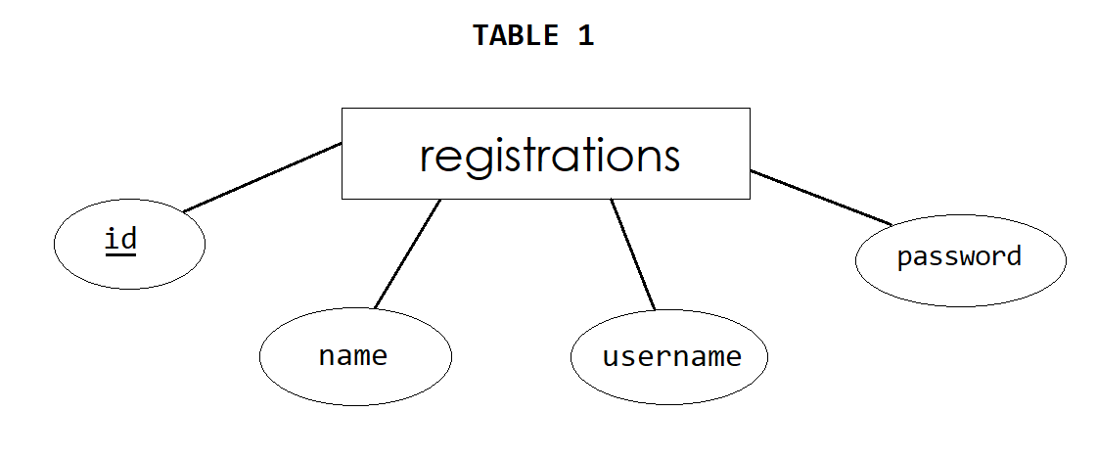
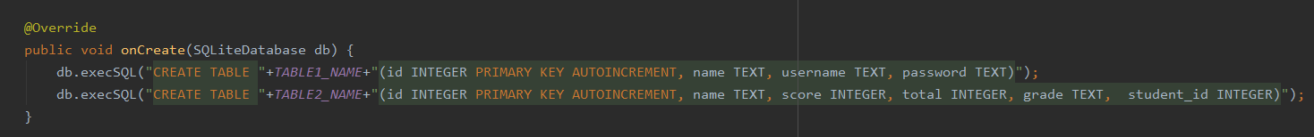
DATABASE DESIGN AND SCHEMA
1 TO MANY RELATIONSHIP
DatabaseHelper Class snippet:

Slide 5
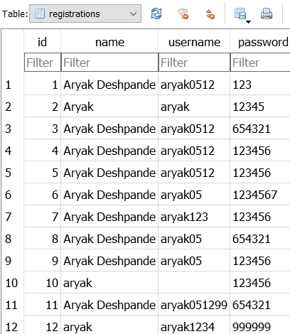
MODELS
Created Models that map to the attributes of the entities in the database.
Mapped objects to relations [ORM]
Implemented Encapsulation in the java classes
Generated getters and setters for the mapped variables
toString() method of java.lang.Object class was overrided in every model to print object attributes while debugging
The objects were transferred from one activity to another
Student object => registrations table

Slide 6
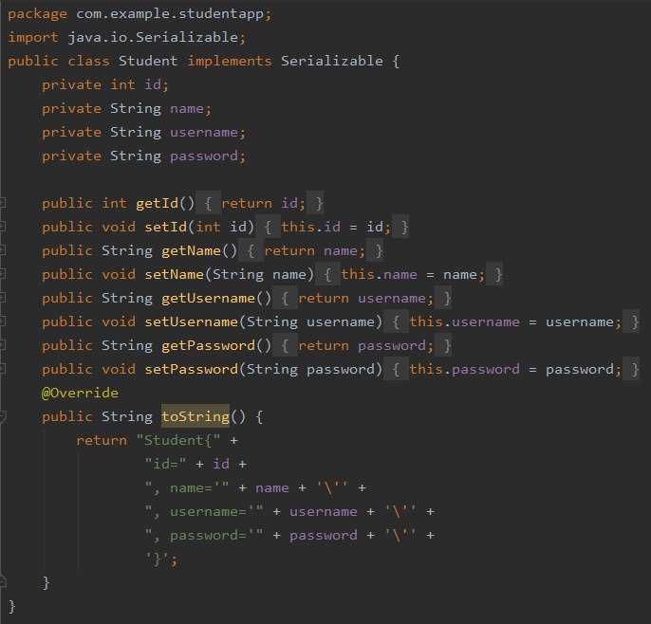
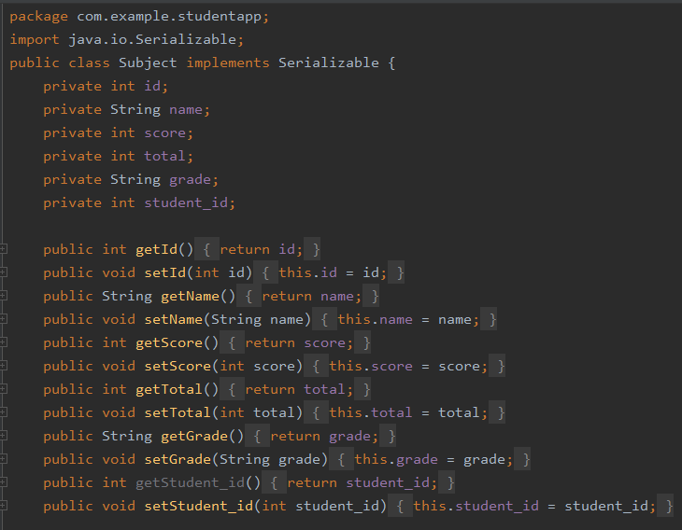
MODELS (PART 2)

Slide 7
SERVICE CLASS AND OBJECT ORIENTATION
Created a separate service class that provides service to all activities and carries out specific operations with methods like calculateCGPA( ), getPercentage( ), getGrade( )
Object oriented, scalable design
Objects transferred from one activity to another through intents in form of extras
All Models have implemented Serializable Interface.
To retrieve object on a new activity, use intent.getSerializableExtra(<label>) method
Example:
Intent toSubjectPage = new Intent (HomeActivity.this, SubjectActivity.class);
toSubjectPage.putExtra("student", student);
startActivity(toSubjectPage);

Slide 8
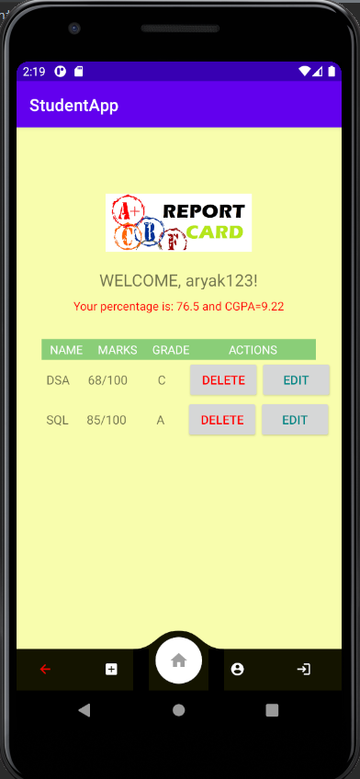
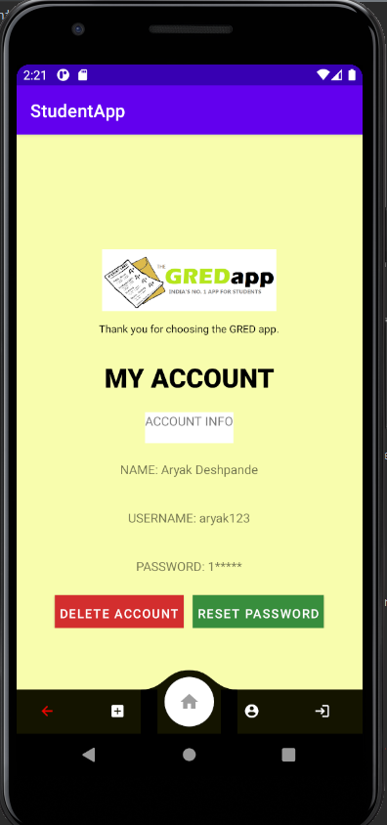
LAYOUTS (PART 1)

Slide 9
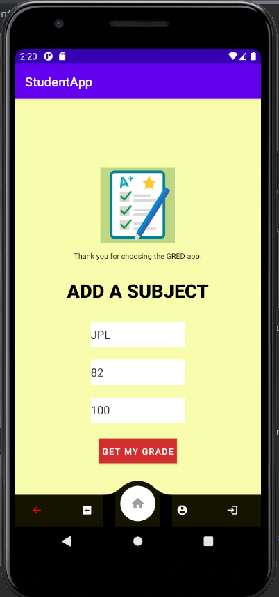
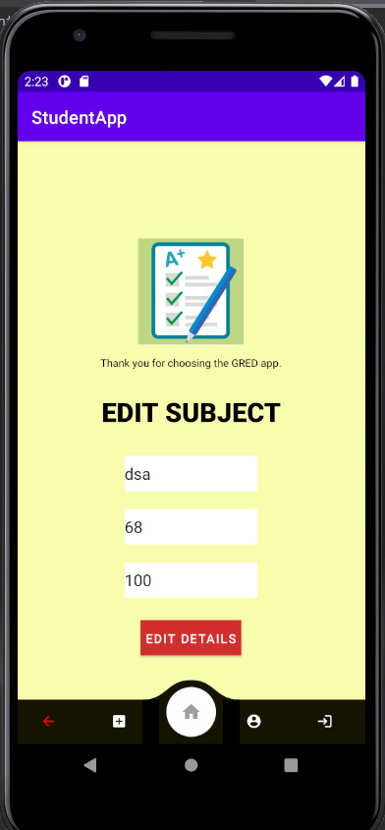
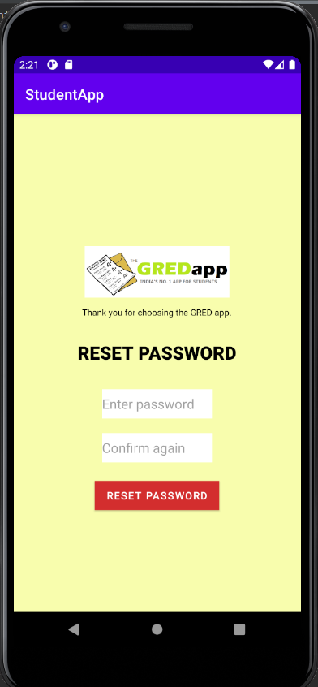
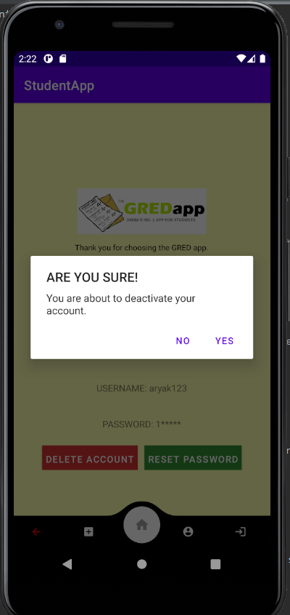
LAYOUTS (PART 2)

Slide 10
THANK YOU

