Slide 1


automatic irrigation system
By Aashish Aryal
Batch 19b
College id: 160313

Slide 2

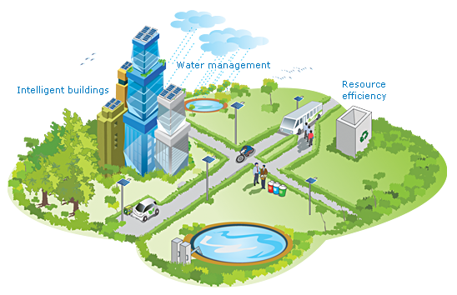
Pervasive Computing
Pervasive computing (also called ubiquitous computing) is the growing trend toward embedding microprocessor.
Integration of information and communications Technology into people’s lives and environments, made possible by the growing availability of microprocessors with inbuilt communication facilities.
It spreads intelligent and connectivity to every device almost every thing.
Cars, Aircraft, Irrigation, Refrigerator etc.

Slide 3
Introduction
This automatic irrigation system can controls and provide adequate amount of water which intern saves the greenery of the lawn and Farm.
In the system Sensor (soil moisture) sense the moisture value in soil and microcontroller controls the water motor according to the soil moisture value and notifies the water motor sates by glowing blub insight and with SMS notification remotely.

Slide 4
Aim and Objectives
Aim
To develop an Arduino based smart Irrigation system thereby saving time & power for the farmer.
Objectives
Detect moisture of soil using soil moisture sensor.
Operate water motor according to the soil moisture detected by the sensor.
Notify the status of soil moisture and water motor to the individual through GSM Module remotely and locally indicate through on-sight light bulb.

Slide 5
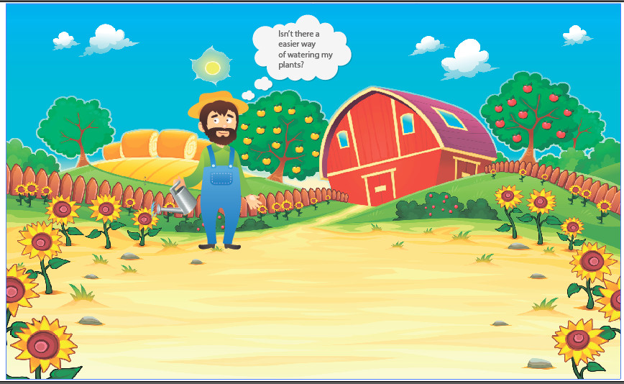
Problem domain
Manual irrigation brings many problems from water wastage to inadequate supply of water in farm.
Farmers have to waste their time in this monotonous task.

Slide 6
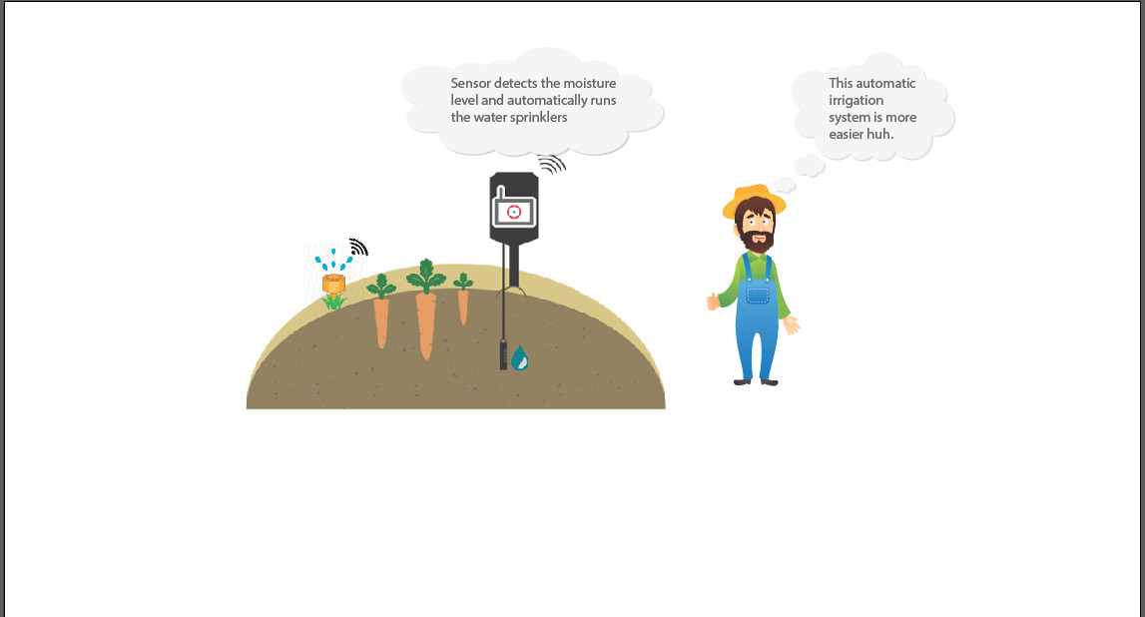
Solution
Look at the image above how happy this farmer seems to be right now.
All the stuffs now are controlled automatically by smart Irrigation system.

Slide 7
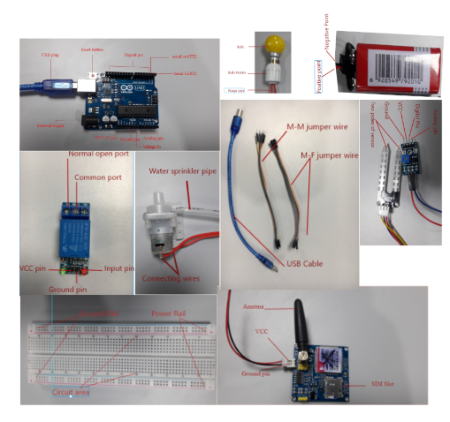
Hardware Required
Arduino Uno
Breadboard
Soil moisture sensor
GSM module
Water motor
Relay (multiple)
Blub, holder and wires
Power battery 9v
Jumper wires

Slide 8
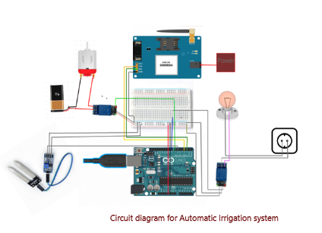
The build
Working of this Automatic Irrigation system is quite simple.
Moisture sensor collects the analog signal which is processed by microcontroller and action is taken according to the obtained moisture vale.

Slide 9
Troubleshooting
In case of any errors during the build, the following steps can assist in troubleshooting.
There may be a condition when the soil moisture sensor may not cause the water motor to operate. During then, we can check if it is working or not by looking at the serial the serial motor.
If there are values showing up, then we can check the connectivity of water motor.
Similarly, if there is no notification on the user’s phone, we can double check the connectivity of the GSM module and the sim card inserted

Slide 10
Other Application
This is magnificent that the project developed can also be used at multiple locations like,
Household Water tank
We can put the sensor at the lid of tank and when the water level touches sensor, the moisture value obtained will be high and controller can cut off the circuit of water motor and vice versa.
Internal Planting/Lawn
This system is also suitable for small internal Lawn. This will help to increase greenery in your Lawn without any human interaction.

Slide 11
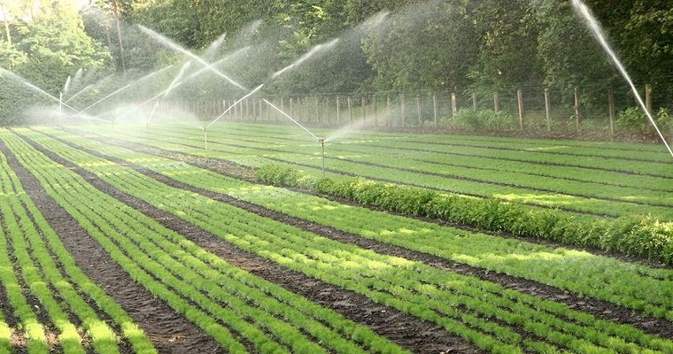
Future Scope
We can add improvements in this project in near future. This future work will assist farmers and helps to grow more greener crops.
We can add pesticides and fertilizers automatically in water as required.
Other parameters such as humidity, temperature, light intensity can be measured which will additionally improve cultivating.
The whole system can be powered using solar panels which will make system trouble-free to use in remote farm.
An additional LCD screen can be added to the system which will provide all the sensor values and other data.
Currently the system does not store any log information. We can add database that will store all data log which can be further processed to obtain different information.

Slide 12

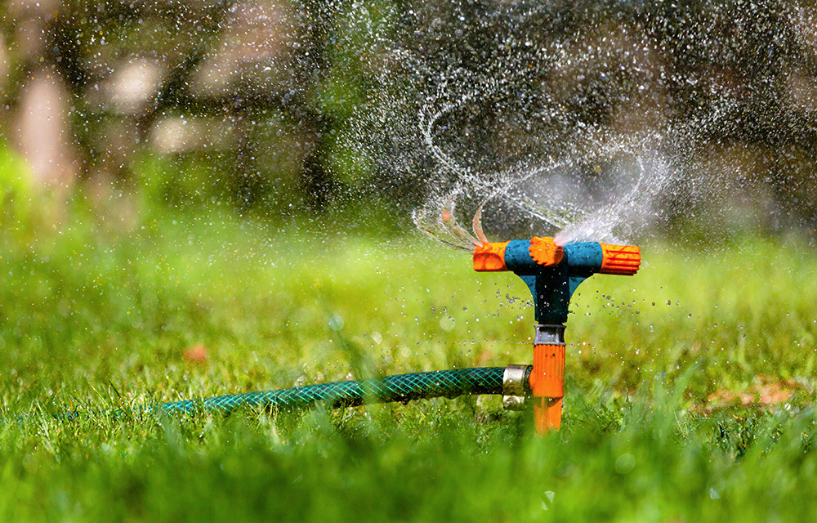
Thank You!
Aashish Aryal

