Slide 1
Copyright ©2016 Cengage Learning. All Rights Reserved. May not be scanned, copied or duplicated, or posted to a publicly accessible website, in whole or in part.

Slide 2
Discuss information privacy and methods for improving the privacy of information
Explain the privacy of e-mail, data collection issues, and censorship
Discuss the ethical issues related to information technology
Discuss the principles of intellectual property and issues related to the infringement of intellectual property

Slide 3
Discuss information system issues that affect organizations, including the digital divide, electronic publishing, and the connection between the workplace and employees’ health
Describe green computing and the ways it can improve the quality of the environment

Slide 4
Privacy Issues
Employers search social networking sites for background information on applicants
Monitoring systems are adopted by employers to check employee performance
Information technology has aided in the easy availability of personal information
  Information in databases can be used for direct marketing and for credit checks on potential borrowers or renters

Slide 5
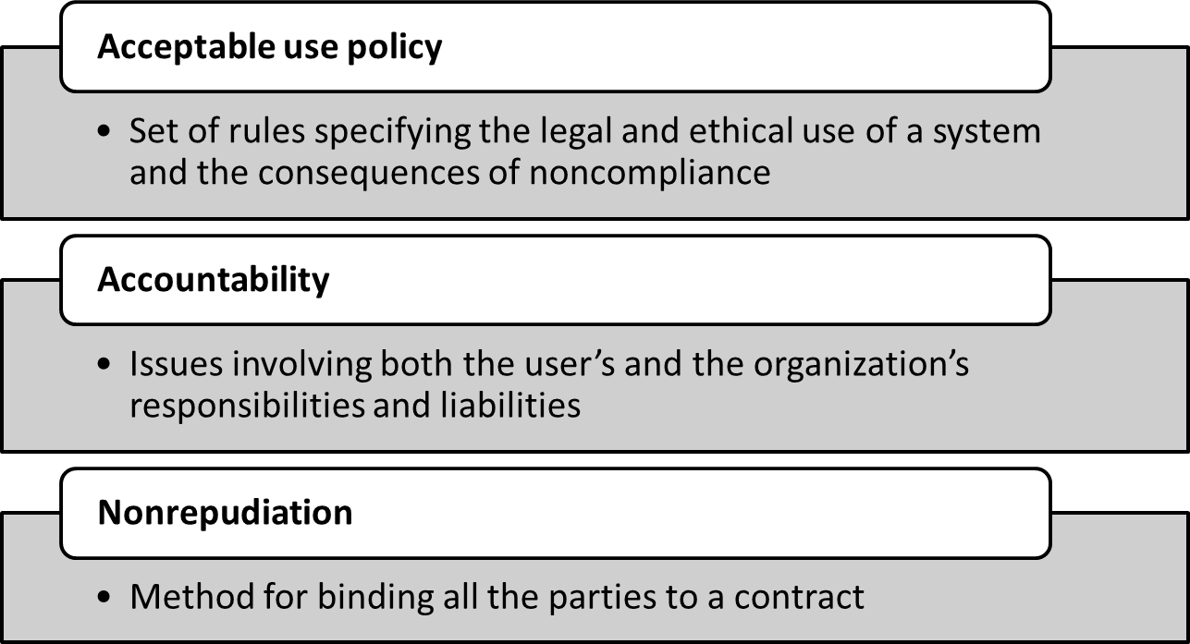
Concepts of the Web and Network Privacy

Slide 6
Guidelines to Minimize the Invasion of Privacy
Conduct business only with websites having privacy policies
Limit access to personal information to those with authorization
Ensure data’s reliability and take precautions to prevent misuse of the data
Data collection must have a stated purpose
Identify ways to prevent personal information gathered being disclosed without consent

Slide 7
Guidelines to Minimize the Invasion of Privacy
Organizations should use verification procedures to ensure data accuracy
Organizations must correct or delete incorrect data
  Prevent unauthorized access to data and misuse of data
Users should review their records and correct any inaccuracies
Transparency in record-keeping systems storing personal data

Slide 8
Privacy Issues Presented by E-mail
Spam: Unsolicited e-mail sent for advertising purposes
  Sent in bulk using automated mailing software
Ease of access
  Individuals should assume that others have access to their messages
  Any e-mails sent on company-owned computers are the property of the organization

Slide 9
Data Collection on the Web
Due to the increase in online shopping, personal details of individuals are prone to misuse
  Issue of personal information being sold to telemarketing firms resulting in spam
Information provided on the Web can be combined with other information and technologies to produce new information

Slide 10
Technologies Used for Data Collection
Cookies: Small text files with unique ID tags that are embedded in a Web browser and saved on the user’s hard drive
  Help websites customize pages for users
  Considered an invasion of privacy when users’ information is used without prior consent
  Installing a cookie manager helps users disable cookies
Log files: Generated by Web server software, record a user’s actions on a website

Slide 11
Ethical Issues of Information Technologies
Information technology offers opportunities for unethical behavior due to ease of collecting and disseminating information
  Increase of cybercrime, cyberfraud, identity theft, and intellectual property theft
Organizations can reduce unethical behavior of employees by developing and enforcing codes of ethics

Slide 12
Censorship of Types of Information on the Web
Public information
  Posted by an organization or public agency
  Censored for public policy reasons
  Censored if the content is deemed offensive to a political, religious, or cultural group
Private information
  Posted by a person
  Uncensored because of constitutional freedom of expression

Slide 13
Censorship
Restricting access to the Web
  Countries like Burma, China, and Singapore, restrict or forbid their citizens’ access to the Web
    Internet neutrality: Internet service providers (ISPs) and government agencies should treat all data on the Internet equally
  Parents use programs like CyberPatrol, CyberSitter, Net Nanny, and SafeSurf to prevent children’s access to certain websites

Slide 14
Intellectual Property
Legal umbrella covering protections that involve copyrights, trademarks, trade secrets, and patents developed by people or businesses

Slide 15
Categories in Intellectual Property
Industrial property
  Inventions, trademarks, logos, and industrial designs
Copyrighted material
  Literary and artistic works
  Covers online materials like Web pages, HTML code, and computer graphics
  Fair Use Doctrine: Exception to the Copyright law which allows the use of copyrighted material for certain purposes

Slide 16
Intellectual Property Protections
Trademark: Protects product names and identifying marks
Patent: Protects new processes
  Advantages to organizations
    Generates revenue by licensing the patent
    Attracts funding for research and development
    Keeps competitors from entering certain market segments

Slide 17
Laws Covering Software Piracy
1980 revisions to the Copyright Act of 1976 include computer programs
Laws covering legal issues related to information technologies in the United States
  Telecommunications Act of 1996
  Communications Decency Act (CDA)
  Laws against spamming

Slide 18
Cybersquatting
Registering, selling, or using a domain name to profit from someone else’s trademark
Typosquatting: Relies on typographical errors made by Web users when typing a website address into a Web browser
  Variation of cybersquatting
  Called URL hijacking

Slide 19
Digital Divide
Information technology and the Internet that is not accessible for all
  Increasing funding for computers at schools, public places, helps offset the divide

Slide 20
Impact of Information Technology in the Workplace
Creation of technical jobs, requiring extensive training
Increased consumers’ purchasing power
  Results in a stronger economy by reducing production costs
Direct effect on the nature of jobs
  Telecommuting enables work from home option
  Organizations can use the best and most cost-effective human resources in a large geographical region

Slide 21
Impact of Information Technology in the Workplace
Job deskilling: Occurs when skilled labor is eliminated due to high technology
Virtual organizations: Companies, suppliers, customers, and manufacturers connected via information technologies
  To share skills and cost
  To have access to each other’s markets

Slide 22
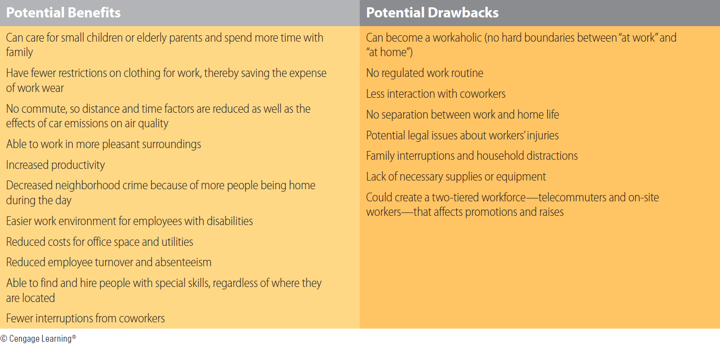
4.1 Potential Benefits and Drawbacks of Telecommuting

Slide 23
Information Technology and Health Issues
Increasing popularity of touchscreens result in stress related injuries of the users’ hands, arms, back, and eyes
Related health problems associated with computer equipment
  Vision issues
  Musculoskeletal issues
  Skin issues
  Reproductive system issues
  Stress issues

Slide 24
Green Computing
Promotes a sustainable environment and consumes the least amount of energy
  Involves the design, manufacture, use, and disposal of computers, servers, and computing devices with minimal impact on the environment
Requires cooperation of both private and public sectors

Slide 25
Ways to Achieve Green Computing
Design products that last longer and are modular in design
  Parts can be upgraded without replacing the entire system
Design search engines and computing routines that are faster and consume less energy
Replace underutilized smaller servers with one large server using a virtualization technique

Slide 26
Ways to Achieve Green Computing
Use computing devices that consume less energy and are biodegradable
Allow certain employees to work from their homes to reduce carbon foot prints
Conduct meetings over computer networks to reduce business travel
  Encourage carpool and nonmotorized transportation for employees
Turn off idle PCs and recycle computer-related materials

Slide 27
Acceptable use policy
Accountability
Cookies
Cybersquatting
Digital divide
Green computing

Slide 28
Intellectual property
Log files
Nonrepudiation
Spam
Virtual organizations

Slide 29
Employers search social networking sites, such as Facebook or MySpace, to find background information on applicants
e-mail is distributed through the Web or a company network; people should assume that others have access to their messages
Public information, posted by an organization or public agency, can be censored for public policy reasons

Slide 30
Children, in particular, are victims of the digital divide
Information technology has created many new jobs
Green computing is one of the methods for combating global warming

