Slide 1


FOOD2GO
Prepared By:
Sajit Khadka (n01323814)
Prekshya Aryal (n01323774)

Slide 2
INTRODUCTION
Food2Go is an mobile application designed for a particular restaurant
Enables customer to order food online from the restaurant.
Food2Go provides two options for the customer
Take out
Dine In
Customer can view the nearby restaurant location and choose the nearby restaurant to order food.
Customer have two options:
they can either register first and then login in and browse through menu and order food
They can directly go to the menu and select the food and drinks item and add it to cart and then sign up or login in order to pay.

Slide 3
WHY THIS PROJECT?
We built RESTRO-MANAGER in the Android I.
RESTRO-MANAGER ??
App which helps restaurant to manage their food ordering system and keep the track of transactions, sales and profit.
App provides table status(empty or occupied), helps waiter to take order and when the order is confirmed, it goes to cook’s end where cook change the food status from on the line to cooking and when food is ready cooking staff changes the status to “Ready”.
Waiter can see the food status and hence serves the food and changes the status to served in the app.
Have three logins : Waiter, Cook, Managers/Admin

Slide 4
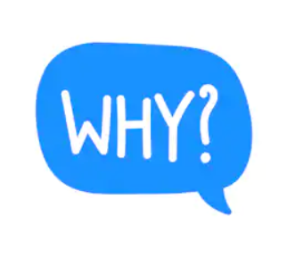
We buit Restro-manager for the successful operation of the restaurant.
But due to COVID-19 almost everything was shut down by government
Hence we decided to created an app for the restaurant by which customer can order their food .
Have option for dine in as well (Which is temporarily unavailable due to COVID19)
But In the normal scenario Clicking on Dine-In will let you book a table inside the restaurant.

Slide 5

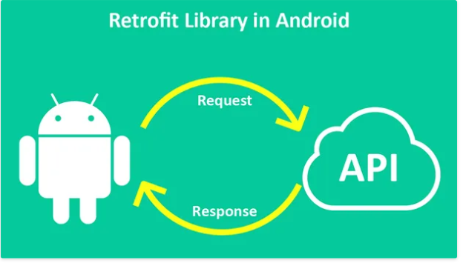




TECHNOLOGY USED

Slide 6
ARCHITECTURE

Slide 7
IMPLEMENTATION

Slide 10
REFERENCES
https://miro.medium.com/max/600/1*0RO7DPGncNN1az6EXWQwCg.jpeg
https://i.dlpng.com/static/png/6998339_preview.png
https://www.shutterstock.com/search/why+icon
https://webstockreview.net/explore/catering-clipart-hotel-server/
https://blog.logrocket.com/design-patterns-in-node-js-2/
http://www.hrbaptist.ca/sermonarchive/now-that-im-a-christian-how-should-i-vote/

Slide 11
THANK YOU

