Slide 1
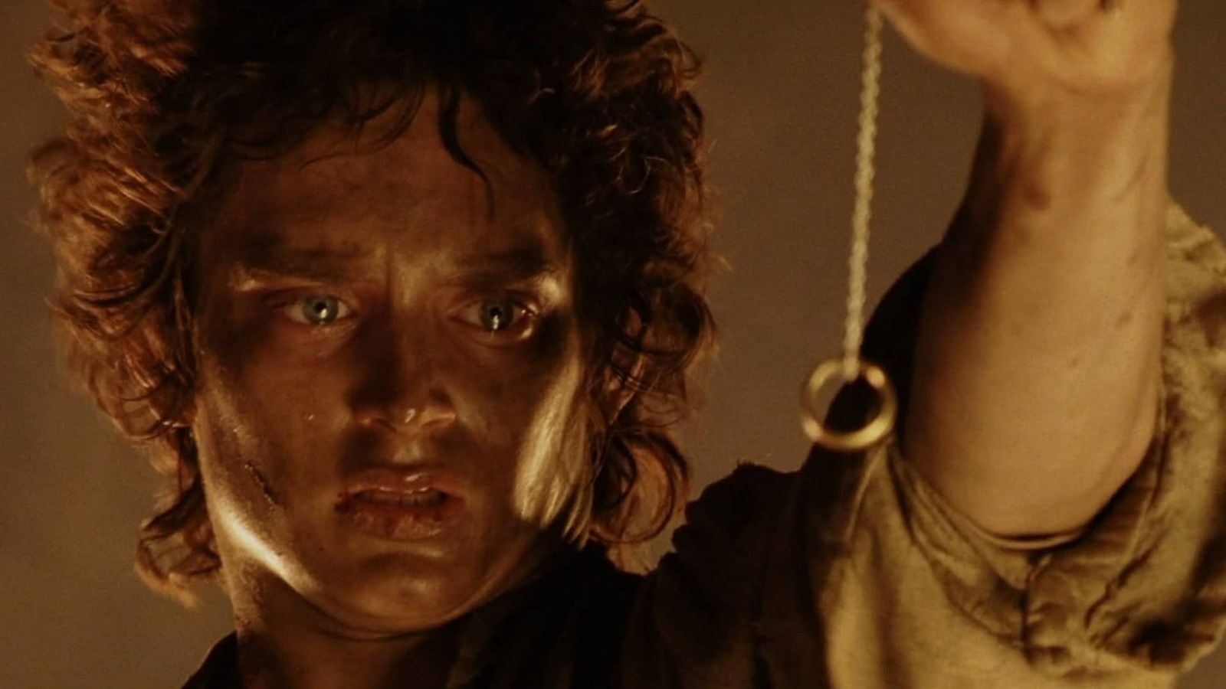
Q1—How does prudential goodness differ from moral goodness?
Q2—How does intrinsic goodness differ from extrinsic goodness?
Q3—How does prudential goodness relate to God’s will?

Slide 2
Central Value-Theoretic Distinctions

Slide 3
Goods
Is it part of what makes up a good life?
No
Non-prudential good
(E.g. moral good, aesthetic good)
Yes
Prudential good

Slide 4
Prudential Goods
Is the good itself the source of value?
No
Extrinsic good
(E.g. money)
Does the good causally contribute to the source of value?
No Yes
Non-instrumental Instrumental Good
Yes
Intrinsic good
(E.g. ________)

Slide 5
Intrinsic Goods
Is its goodness a function of what makes it up?
No
Basic good
(E.g. pleasure)
Yes
Non-Basic good
(E.g. driving a luxury car)

Slide 6
Prudential Goods
Is the good itself the source of value?
No
Extrinsic good
Does the good causally contribute to the source of value?
No Yes
Non-instrumental Instrumental Good
Yes
Intrinsic good
Is its goodness a function of what makes it up?
No Yes
Basic Good Non-basic Good

Slide 7
Some Further Distinctions

Slide 8
Intrinsic Goods
Does it have goodness in all instances?
No
Conditional
(E.g. ________)
Yes
Unconditional
(E.g. ________)

Slide 9
Intrinsic Goods
Are they extrinsically linked to bads?
No
Pure Goods
(E.g. ________)
Yes
Impure Goods
(E.g. ________)

Slide 10
Prudential Goods
Do we choose the end for its own sake?
No
Motivationally Instrumental
(E.g. ________)
Yes
Motivationally Final
(E.g. Fun)

Slide 11
Quantitative Distinctions

Slide 12
Prudential Goods
Duration
Shorter- vs Longer-lasting Goods
Weight
Lesser vs Greater Source of Goodness
Fertility
Disposing to Less vs More Goodness

Slide 13
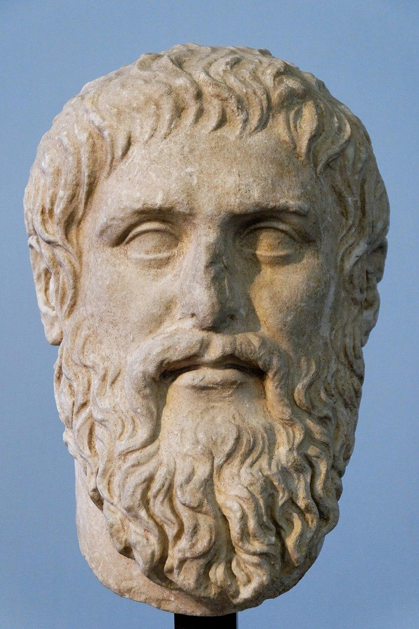
Plato’s Republic
Plato
Ancient Athenian Philosopher (5th-4th century)
Marie-Lan Nguyen (copy of 4th century BCE bust)

Slide 14
Glaucon’s Question
What kind of good is justice?
A constituent, a contributor or requirement, or merely a characteristic?
Notes:
I assigned this reading for three reasons:
Glaucon’s question is an important one. Part of philosophical ethics is not just treating the question, what does morality require of us?, but also, why should we do what morality requires of us?
Glaucon also introduces helpful distinctions between different kinds of value, distinctions that are important for other topics we’ll cover in this class: On the one hand, he will distinguish between intrinsic and instrumental value. On the other hand, he will distinguish between what’s good for each of us as individuals (what philosophers sometimes call welfare value) and what is morally good or morally right.
Finally, Glaucon uses a short story as part of his argument. And so we can think about one way in which stories impact philosophical argumentation.

Slide 15
2. Glaucon’s Question
Three kinds of goods:
“some which are welcome for their own sake” (Plato 1)
Those “which are desirable not only in themselves, but also for their results” (1)
Those which “do us good but [which] we regard… as disagreeable; and no one would choose them for their own sakes” (2)
G’s Q: Under which of these three categories belongs the end of doing what’s morally right or what’s just?
Notes:
Can we think of examples of these?
E.g. fun, harmless pleasures (like enjoying the smell of coffee), pointless achievements.
Glaucon gives knowledge (like knowing who your parents are), health
E.g. exercise, crummy jobs, unpleasant medicine (like getting a shot)

Slide 16
Glaucon’s Argument
Whenever they have a choice, people will usually choose what’s best for them unless they are ignorant of what that is or of how to bring it about.
When they have a choice between gaining something valuable by breaking moral or legal rules or losing that thing by conforming to these rules, people always choose breaking the rules.
Therefore, either following moral and legal rules does not itself constitute part of the good life or people are generally ignorant about what’s good for them.
Objection:
Don’t lots of people make moral sacrifices all the time?
Notes:
Example:

Slide 17
Glaucon’s Argument Revised
Whenever they have a choice, people will usually choose what’s best for them unless they are ignorant of what that is or of how to bring it about.
When they have a choice between gaining something valuable by breaking moral or legal rules or losing that thing by conforming to these rules, and they aren’t afraid of getting caught and punished for breaking the rules, people always choose breaking the rules.
Therefore, either following moral and legal rules does not itself constitute part of the good life or people are generally ignorant about what’s good for them.
Notes:
Example:

Slide 18
Glaucon’s Argument Revised
Whenever they have a choice, people will usually choose what’s best for them unless they are ignorant of what that is or of how to bring it about.
When they have a choice between gaining something valuable by breaking moral or legal rules or losing that thing by conforming to these rules, and they aren’t afraid of getting caught and punished for breaking the rules, people always choose breaking the rules.
Therefore, either following moral and legal rules does not itself constitute part of the good life or people are generally ignorant about what’s good for them.
Is premise 2 true?
Is it true of you?
Notes:
Example:

Slide 19
Notes:
Would you continue to follow all the rules of justice and morality? Or would you break them now that you can get away with it.
Glaucon thinks all humans would break them.
The deeper question is why shouldn’t they?

Slide 20
Glaucon’s Argument Revised
Whenever they have a choice, people will usually choose what’s best for them unless they are ignorant of what that is or of how to bring it about.
When they have a choice between gaining something valuable by breaking moral or legal rules or losing that thing by conforming to these rules, and they aren’t afraid of getting caught and punished for breaking the rules, people always choose breaking the rules.
Therefore, either following moral and legal rules does not itself constitute part of the good life or people are generally ignorant about what’s good for them.
Is premise 2 true?
Is it true of you?
Notes:
Example:

Slide 21
Glaucon’s Argument Revised
Whenever they have a choice, people will usually choose what’s best for them unless they are ignorant of what that is or of how to bring it about.
When they have a choice between gaining something valuable by breaking moral or legal rules or losing that thing by conforming to these rules, and they aren’t afraid of getting caught and punished for breaking the rules, people always choose breaking the rules.
Therefore, either following moral and legal rules does not itself constitute part of the good life or people are generally ignorant about what’s good for them.
Even if premise 2 is true, there’s a further question.
Maybe we’re missing something important about morality when we make these choices. But what…?
Notes:
Rachels will try to give an answer.

