Slide 1



XLPLAT - Enterprise Resource Planning
System Using Django and TCL
Jaypee University of Information Technology, Waknaghat - 173234 (India)
Major Project - II (18B19CI891) | AY 2024-25
Mid-Term Evaluation | March 17-22, 2025.
Group No.: 27 C
Student Details
Aryam (211392)
Designation: Software Product Developer Intern
Organization: TT Consultants
Location: Mohali, Punjab
Supervisor
Name: Mr. Amit Kanwar
Designation: Manager
Organization: TT Consultants
Location:Mohali, Punjab

Slide 2
Outline
Introduction
Problem Statement
Objectives
Work Done
Project Design
Implementation
Experimental Results and Evaluation
Key Learnings
Work Plan (till End-Term Evaluation)
Work Contribution and Other Details
References

Slide 3
Introduction
Enterprise Resource Planning (ERP) systems are crucial for organizations to streamline operations by integrating various business functions into a centralized system. In today's fast-paced work environment, managing multiple processes separately can lead to delays, miscommunication, and inefficiencies.
This ERP system is specifically developed to automate and simplify essential workplace operations, including project allocation, attendance tracking, resignation management, mail transfer, and calendar scheduling. It provides a user-friendly interface with role-based access, allowing employees, managers, HR, and admins to seamlessly interact with the system based on their responsibilities. By centralizing data and automating workflows, it minimizes errors, enhances productivity, and ensures that all users have real-time access to the information they need.
With a secure and scalable Django-based backend, the system guarantees data integrity and adaptability to meet the evolving needs of an organization. Ultimately, this ERP transforms day-to-day operations, making them more efficient, structured, and hassle-free.

Slide 4
Problem Statement
In many organizations and companies, managing projects, attendance, resignations, communication, and scheduling can be a real headache. Employees often struggle with tracking their attendance, submitting resignations, and getting timely approvals, while managers and HR teams deal with manual paperwork, delays, and inefficiencies. Sending important emails requires switching to external software, which adds unnecessary steps and increases the chances of miscommunication.
Additionally, project allocations and tracking the work done by fellow employees on the same project become chaotic due to the lack of a centralized system, leading to confusion, duplication of effort, and missed deadlines.
This not only slows down productivity but also creates frustration among employees and decision-makers. Without an integrated system, organizations struggle to maintain transparency, accountability, and efficiency in their daily operations.
To solve these challenges, we need an intuitive, automated ERP system that brings everything under one roof—streamlining workflows, automating approvals, and ensuring seamless communication for a more efficient and organized workplace.

Slide 5
Objectives
Streamlining Business Operations: The ERP system integrates core workplace functions such as project allocation, attendance tracking, resignation management, mail transfer, and calendar scheduling, reducing manual effort and improving workflow efficiency.
Enhancing Automation and Transparency: By automating approvals, notifications, and record-keeping, the system ensures real-time updates, accurate data management, and seamless tracking, eliminating inefficiencies and delays in decision-making.
Improving Communication and Collaboration: With a centralized platform, employees, managers, and HR can interact smoothly, reducing miscommunication and dependency on external tools for emails, project updates, and scheduling.
Ensuring Scalability and Data Security: Built on a robust Django-based backend, the system guarantees data integrity, secure access control, and adaptability, making it capable of handling an organization's growing needs efficiently.

Slide 6
Work Done (after Major Project - I)
Since I have opted for a new project after getting placed and starting my internship, my work has been focused on developing and optimizing the ERP system.

Slide 7
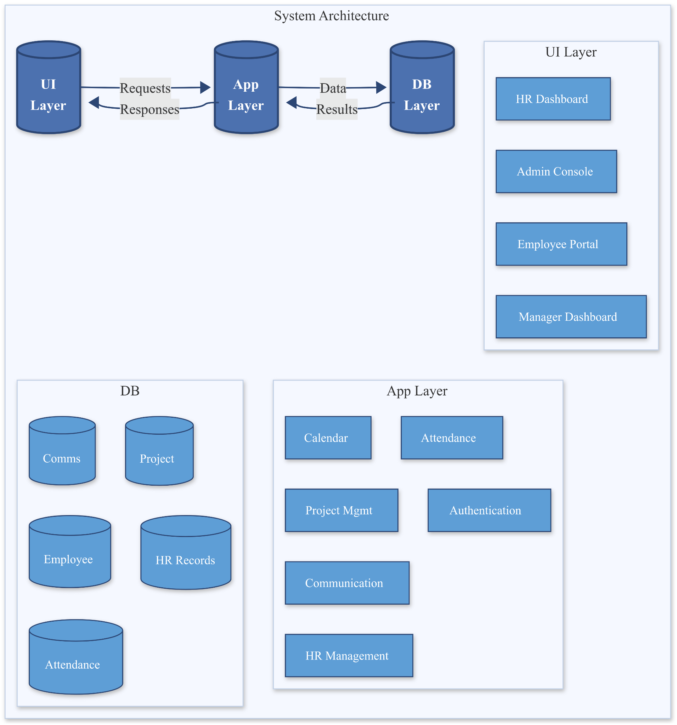
Project Design
Figure 1. System Architecture

Slide 8
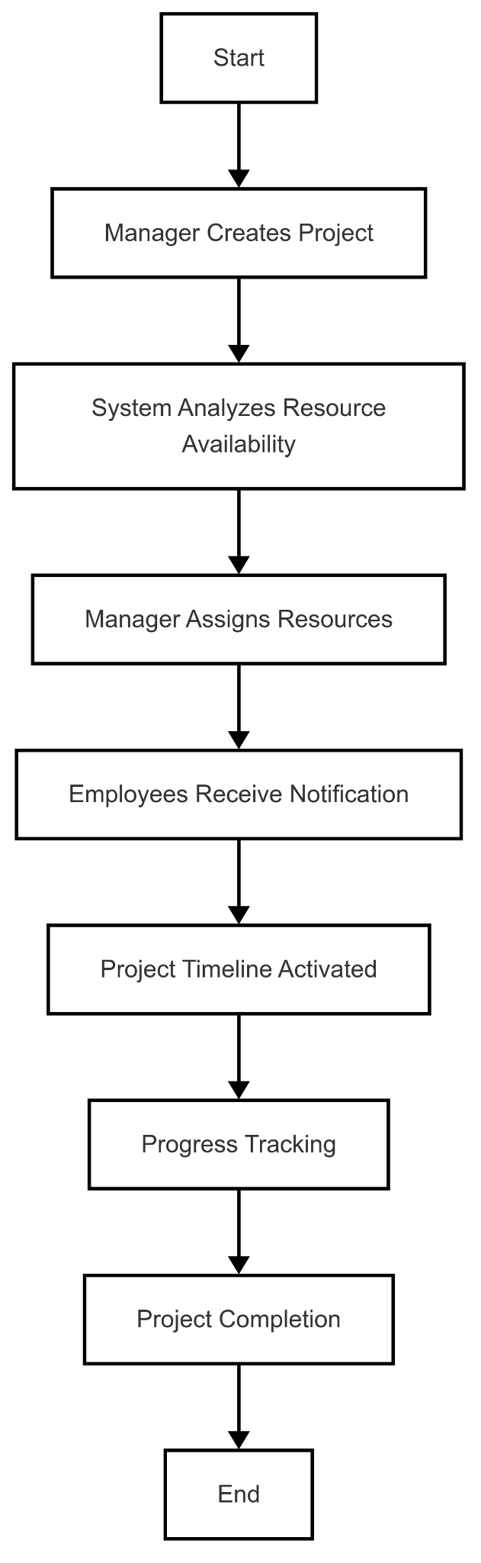
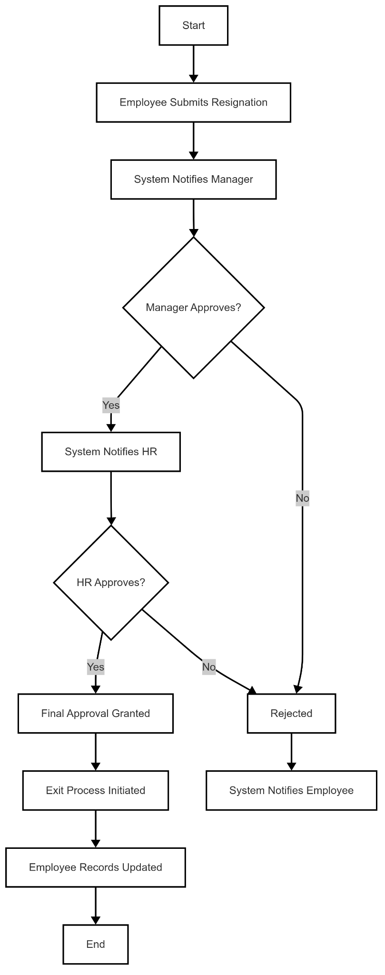
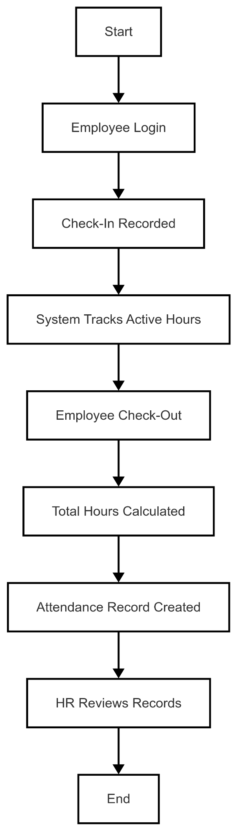
Project Design (cont…)
Figure 2. Project Workflow
Figure 3. Resignation Workflow
Figure 4. Attendance Workflow

Slide 9
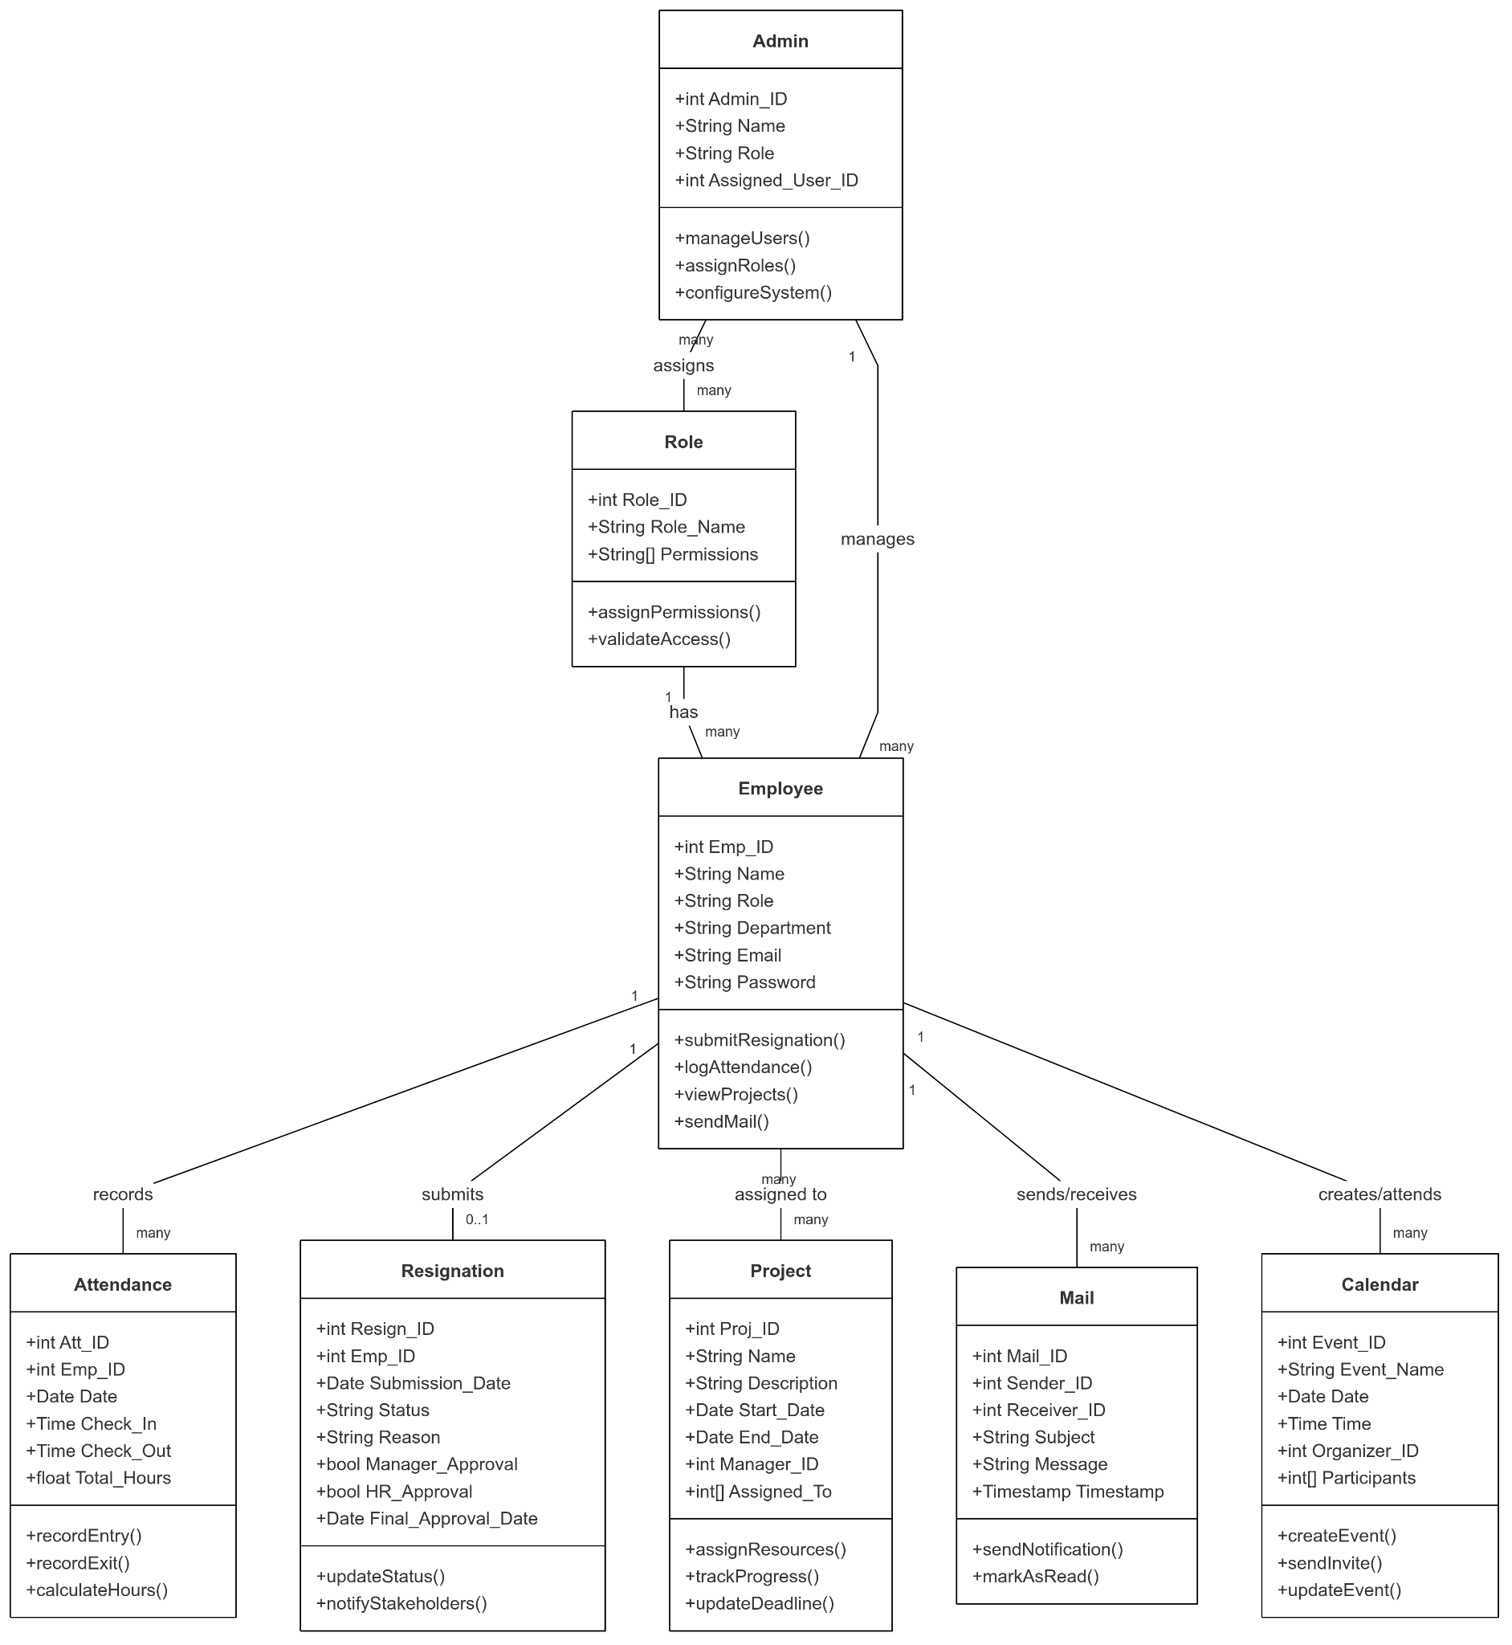
Project Design
Figure 5. ER-Diagram

Slide 10
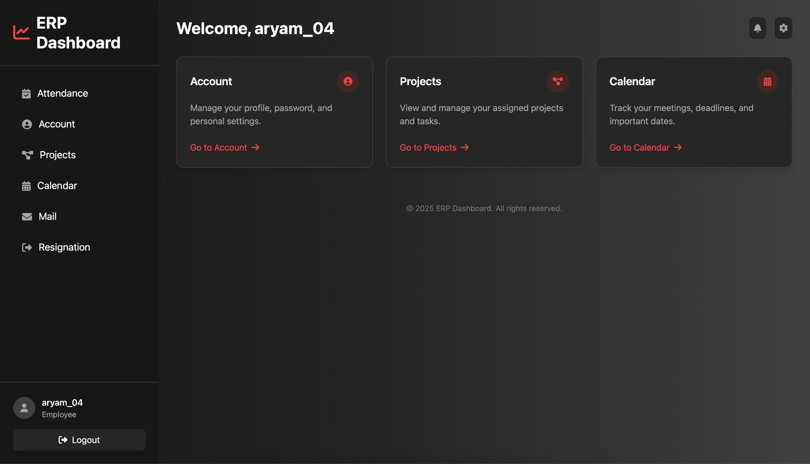
Implementation
Figure 6. ERP Dashboard (Employee View)

Slide 11
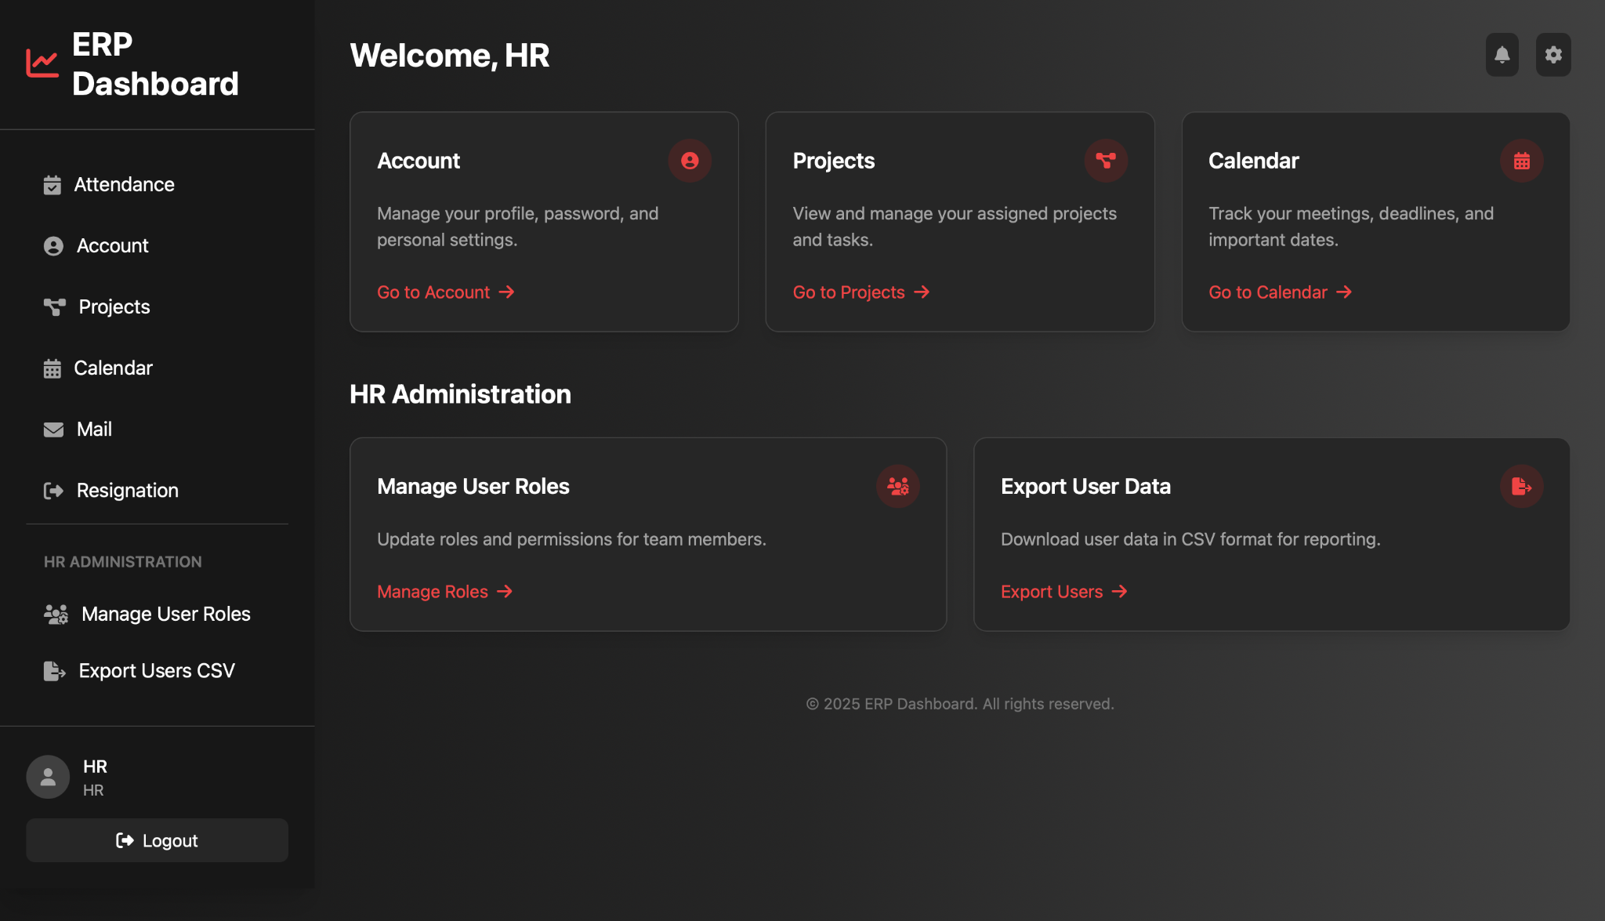
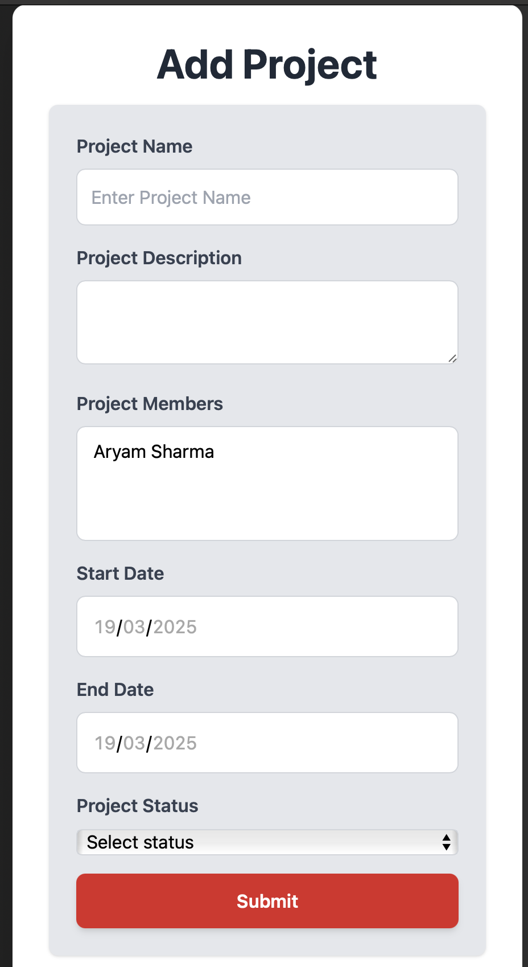
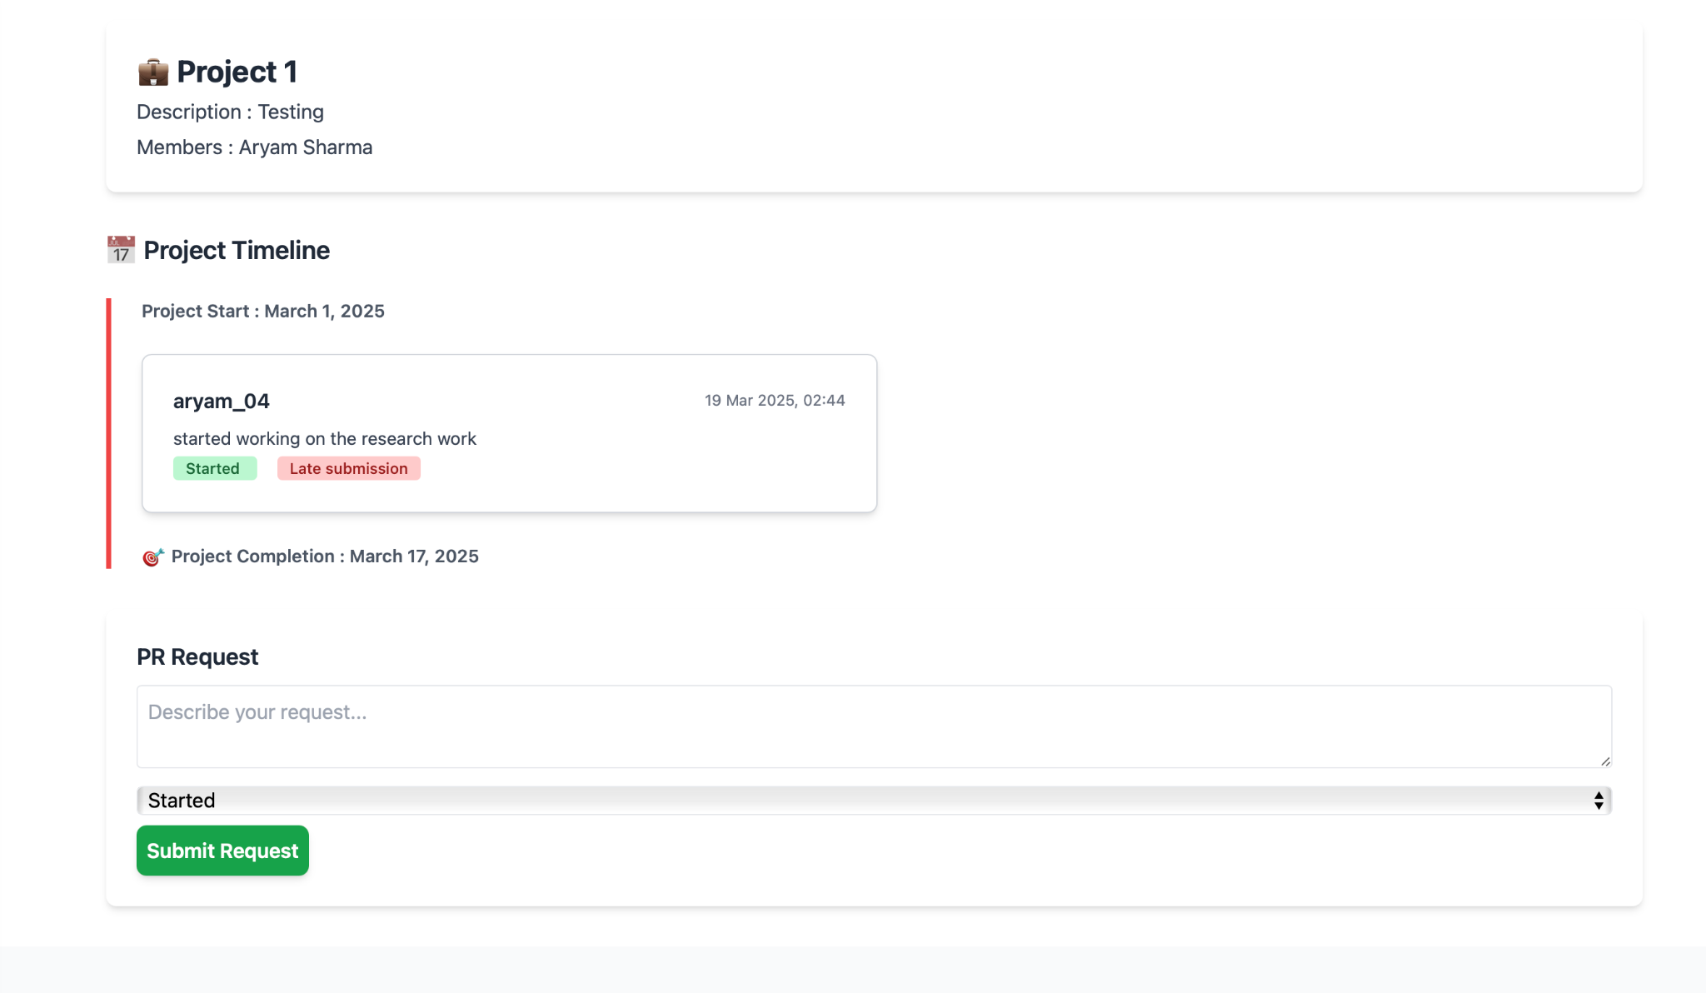
Implementation (cont…)
7(a)
7(c)
7(b)
Fig. 7(a) - ERP Dashboard (HR View), Fig. 7(b) - Add Project Form, Fig. 7(c) - Add PR Request

Slide 12
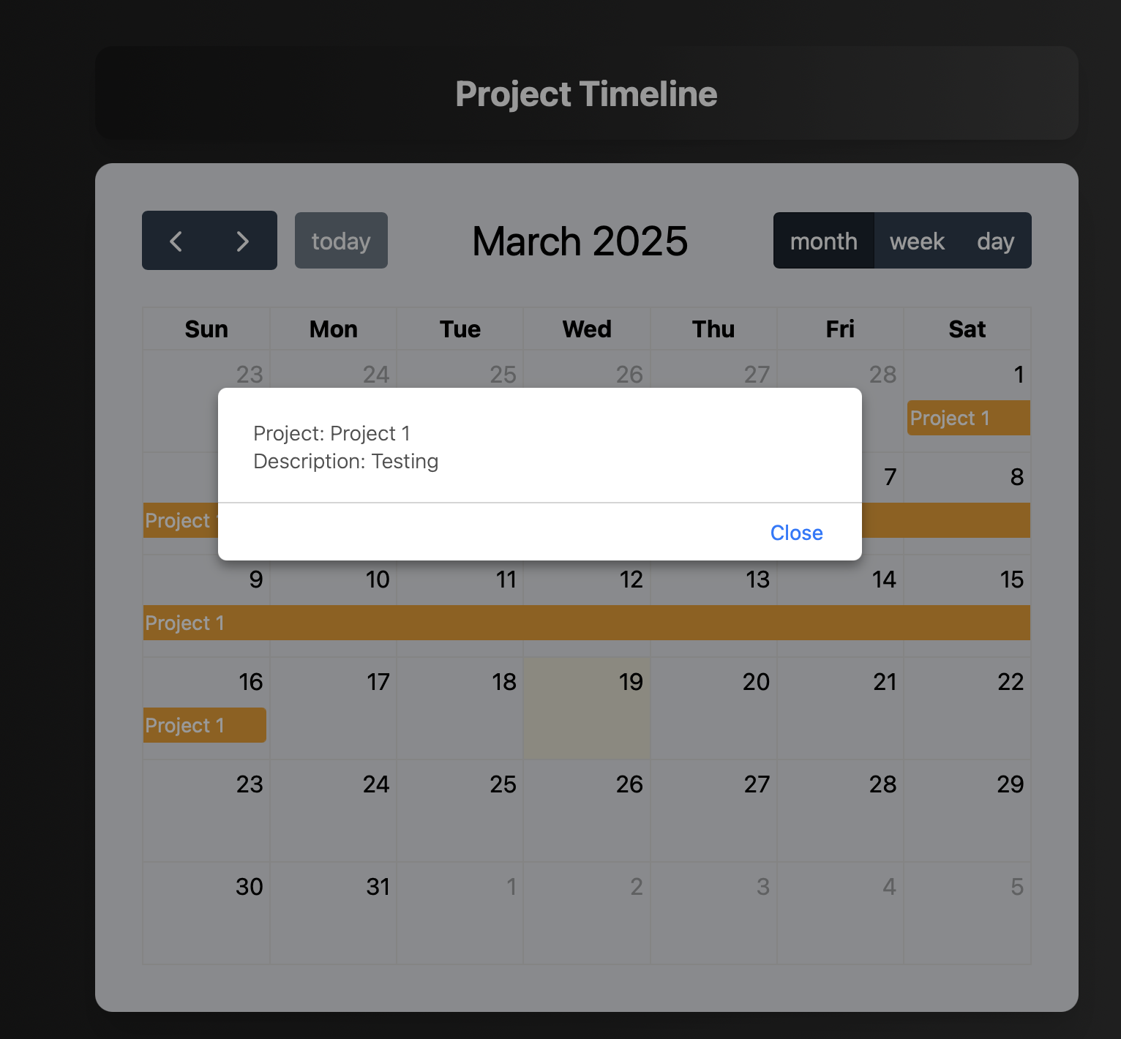
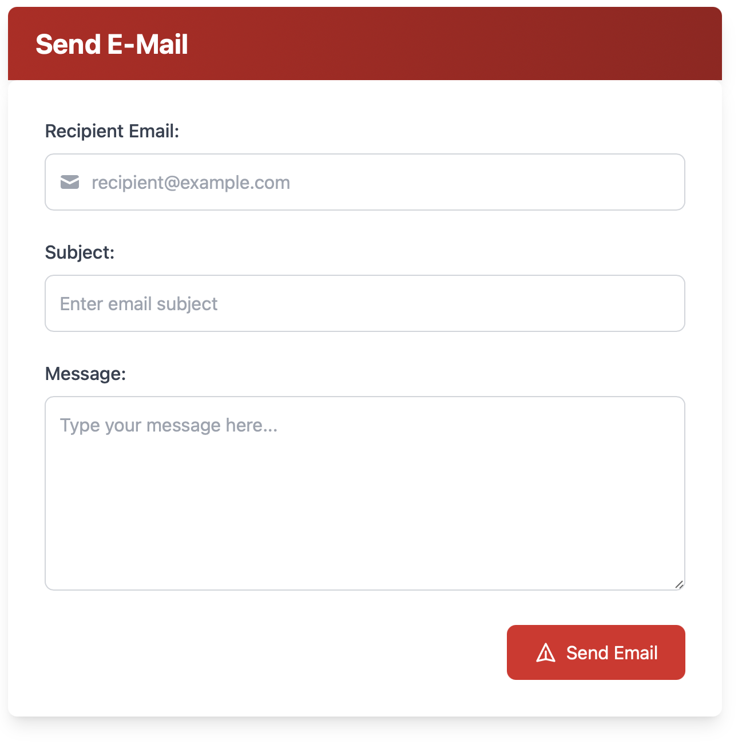
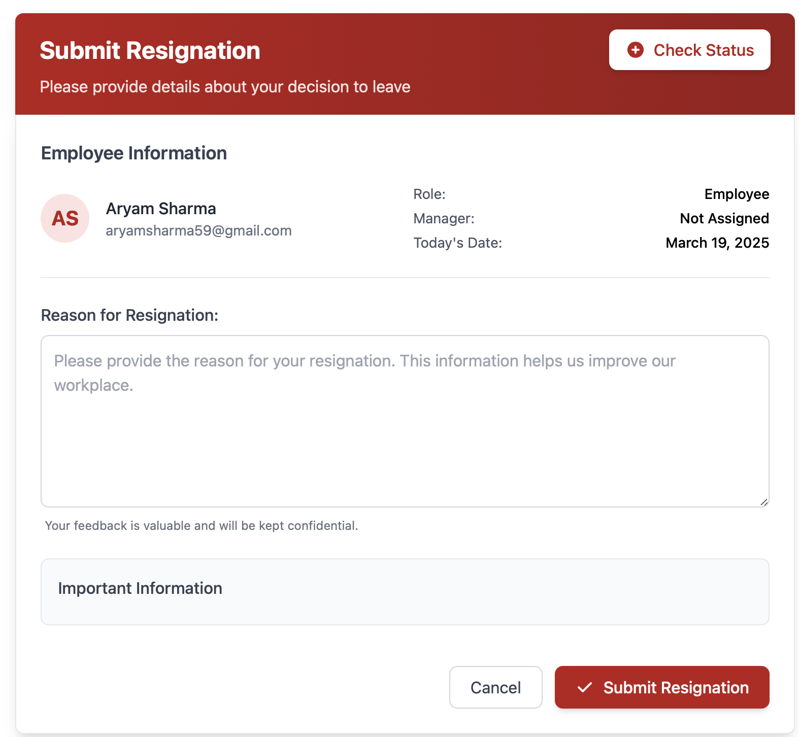
Implementation (cont…)
8(a)
8(b)
Fig. 8(a) - Project Timeline View,
Fig. 8(b) - Send Email,
Fig. 8(c) - Resignation
8(c)

Slide 13
Experimental Results and Evaluation
The experimental results demonstrate significant improvements in ERP system efficiency, with optimized modules enhancing performance, user experience, and data integration.

Slide 14
Key Learnings
Workflow Automation & Role-Based Access – Implemented a multi-step approval process for resignation requests, automated attendance tracking, and role-based access control for Employees, Managers, HR, and Admins. Ensured authorization and authentication mechanisms were in place, restricting sensitive operations to designated users.
Scalability & Future Enhancements – Designed the system with scalability in mind, allowing for API integrations, additional automation features, and potential AI-driven enhancements in the future. Ensured that the architecture supports future expansion, making it adaptable to organizational growth and evolving business requirements.
System Architecture & Security – Developed a layered architecture comprising the User Interface Layer, Application Layer, and Database Layer, ensuring modularity and scalability. Integrated secure authentication mechanisms, access control policies, and emails, enhancing system security and usability.
Database Design & ER Modeling – Designed a well-structured Entity-Relationship (ER) model, ensuring proper one-to-many and many-to-many relationships between entities such as Employees, Attendance, Projects, Resignations, and Mail.

Slide 15
Work Plan (till End-Term Evaluation)
Optimization of Existing XLPlat Modules: The current XLPlat ERP system, built using TCL, needs to be optimized by migrating its existing modules to Django. This transition will improve performance, security, and maintainability while ensuring smoother data management.
Integration of Additional Modules (Finance & BDM): The Finance and Business Development Management (BDM) modules will be studied and integrated into the ERP system. These modules will enhance financial tracking, automate business operations, and provide better insights for decision-making. Using Django, the implementation will focus on seamless data flow, efficient reporting, and enhanced user accessibility.
Development of a New Resume Parser: A new resume parser will be developed to automate the extraction of relevant candidate details for recruitment. This will be done using claude ai’s api.The goal is to integrate it into the ERP system, making the hiring process faster and more accurate.
Completion of the Reimbursement Module: The reimbursement module, which is in progress, aims to digitize and streamline expense claim submissions. Employees will be able to submit claims, attach documents, and track approvals within the ERP system.

Slide 16
Work Contribution and Other Details
Roll No. |  | Start Date (dd/mm/2025) |  | Organization & Location | Work Mode (Online/Offline) | Work Nature (Tech./Non-Tech.) | Work Domain
211392 |  | 20/01/2025 |  | TT Consultants, Mohali | Offline | Tech | Software Product Development
GitHub Repository URL: https://github.com/aryam643/ERP_Training.git
Work Contribution
Week 1 | 20/01/2025 to 24/01/2025 |  | Getting Started with Tailwind CSS – Began exploring Tailwind CSS, understanding its utility-first approach and how it simplifies styling compared to traditional CSS frameworks. Hands-on Practice with Tailwind – Built a small project using React and Tailwind CSS, practicing component-based styling without external CSS files.
Week 2 | 27/01/2025 to 31/01/2025 |  | Diving into Django Basics – Studied the Django framework, learning about its file structure (models.py, views.py, urls.py, settings.py) and core functionalities. CRUD Operations in Django – Created a project to implement Create, Read, Update, and Delete (CRUD) operations, working with migrations and database handling.
Week 3 | 03/02/2025 to 07/02/2025 |  | Exploring TCL – Started learning TCL (Tool Command Language) from scratch, using its documentation to understand syntax and integration with HTML. TCL Mini-Projects – Built small projects to get hands-on experience with TCL and understand its role in ERP system development.
Week 4 | 10/02/2025 to 14/02/2025 |  | Jinja Templating in Django – Explored Jinja templates to enhance the frontend experience in Django applications. Tailwind & Django Integration – Successfully integrated Tailwind CSS into Django templates, improving styling and responsiveness. Authentication & Forms – Worked on user authentication, implementing login, registration, and form validation.

Slide 17
Work Contribution and Other Details (cont…)
Work Contribution
Week 5 | 17/02/2025 to 21/02/2025 | Understanding ERP Systems – Started working on the in-house ERP system (XLPlat), learning about user roles, access levels, and data abstraction. PostgreSQL Integration – Connected PostgreSQL with Django and TCL-based applications, learning complex queries and database relationships.
Week 6 | 24/02/2025 to 28/02/2025 | PostgreSQL & TCL Integration – Implemented PostgreSQL queries within TCL-based ERP applications, optimizing data retrieval and performance. Enhancing ERP Functionalities – Added new features to ERP, improving user interaction, data tracking, and workflow automation.
Week 7 | 03/03/2025 to 07/03/2025 | Email Integration in ERP – Developed a feature that allows users to send emails directly from the ERP system, streamlining communication. Resignation Module Development – Created the resignation workflow, ensuring that approvals from managers and HR are required before final submission.
Week 8 | 10/03/2025 to 13/03/2025 | UI Enhancements in ERP – Improved the user interface of ERP using Tailwind CSS, making it more user-friendly and visually appealing. Optimizing ERP Performance – Analyzed the performance bottlenecks and optimized database queries for faster processing.
Week 9 | 17/03/2025 to 21/03/2025 | Finalizing the TCL Project – Focused on refining a TCL-based ERP module, ensuring seamless PostgreSQL and HTML integration.

Slide 18
References
The ERP system development is based on industry best practices, official documentation, and real-world implementation of Django, PostgreSQL, and Tailwind CSS.

Slide 19
Thanks.

