Slide 1
Module 2: RNA-sequencing from raw data
Dana Nachmanson
01/14/2020

Slide 2
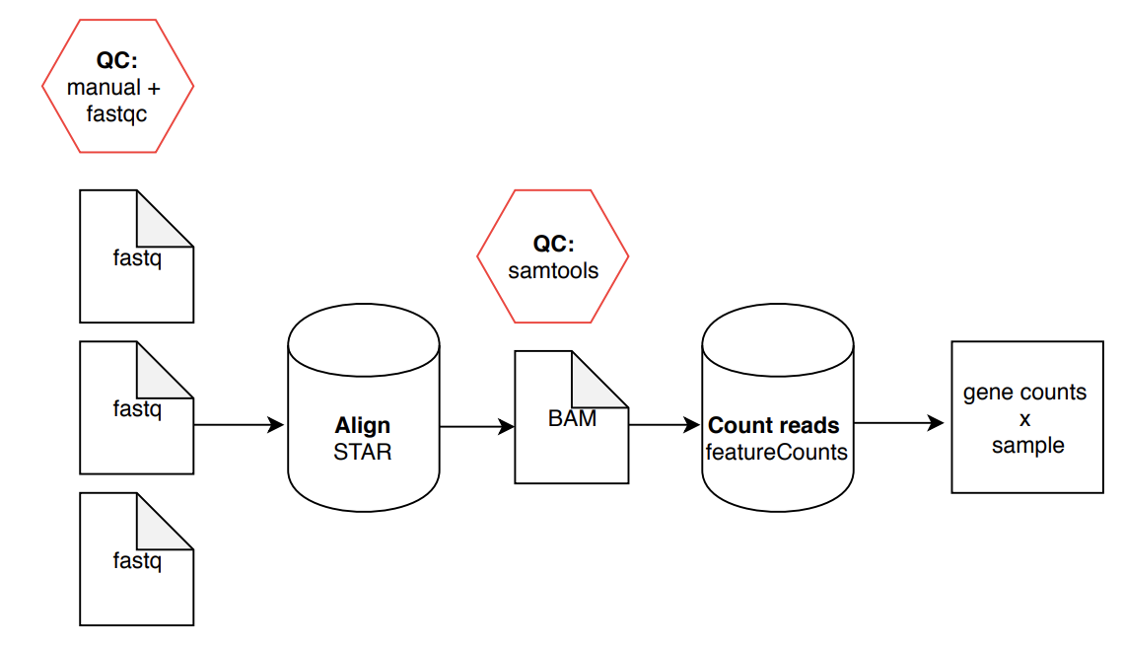
RNA-Seq Analysis Overview (Part 1):

Slide 3

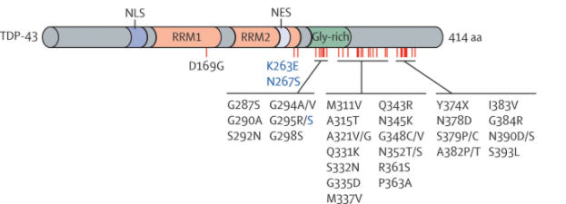
Experiment: TARDBP shRNA from ENCODE
TARDBP/TDP-43:
DNA and RNA-binding protein regulating transcription and alternative splicing
Aberrantly processed forms of TARDBP miseggregate to cytoplasm and are associated with neurodegenerative diseases (FTLD, ALS)
Dataset: What are the transcriptional consequences of TARDBP depletion?
https://www.encodeproject.org/rna-seq/long-rnas/
Each replicate should have 30 million aligned reads, although older projects aimed for 20 million reads.
Notes:
The Encyclopedia of DNA Elements (ENCODE) is a public research project launched by the US National Human Genome Research Institute (NHGRI) in September 2003. Intended as a follow-up to the Human Genome Project (Genomic Research), the ENCODE project aims to identify all functional elements in the human genome.

Slide 4
Fastq File
First line is the information about the location of the read and specific sequencing machine used:
Second line is the nucleotide sequence called
Third line is “+” and can optionally be followed by a repeat of the filename in line 1
Fourth line contains the quality score as determined by the sequencer
Sometimes old fastq files will have different encoding, can cause errors
Example:
@NS500672:54:HL775BGXX:1:11101:22716:1042 1:N:0:CCCCGG
CCGCCNATGCCCATGCCACAGTTGTTGAGCTTGAGTTCCTGCAGGGTGAAGCAGGCTGAGCTCTTGAGCAGGGCCTCGAA
+
AAAAA#EEEEEEEEEEEEEEEEEEEEEEEEEEEEEEEEEEEEEEEEEEEEEEEEEAEEEEEEEEEEEEEEEEEEEEEEEE
Notes:
Four lines represent 1 read off the machine

Slide 5
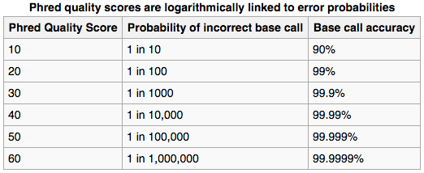
Fastq File – Phred Quality Score
Quality scores report the probability that the base call is incorrect
Field standard is to accept bases with quality >20
Notes:
Four lines represent 1 read off the machine
Quality scores have been converted into the ascii code for reporting… not important here

Slide 6
RNA-Seq Analysis Overview (Part 1):

Slide 7
Lower quality scores at the end of reads
30
Quality score
20
0
100
200
300
Cycle #

Slide 8
RNA-Seq Analysis Overview (Part 1):

Slide 9
What does it mean?!
HWI-D00271:193:C9EMKANXX:5:2103:9073:19661 403 chr10 92991 1 100M = 92971 -120 \ AGAGTTCTAGGCCACCTCCTCCTCGGCATACTCCTCATCCTCCTCCTCCTCGGCCGTGGCATCCTGATATTGCTGATATTCAGACACCAGGTCGTTCATG \ DGGGGGGGC@GFCFDF.GDDC;/E>EGF@CC0BF0GG>BGBD>CBGG<CCAGGE<GGGGGGGGCGGGGGGGGGCGEGGGEGGGFFCB@GGEBGGF:03BB \
NH:i:3 HI:i:3 AS:i:198 nM:i:0

Slide 10
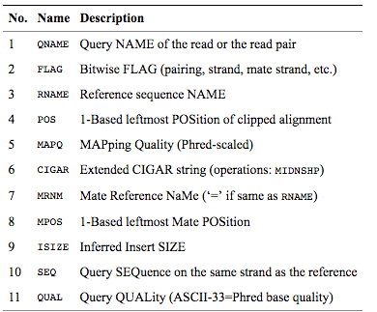
SAM/BAM file – (after alignment)
BAM files are binary, you must use samtools to view them
Bioinformatics. 2009 Aug 15;25(16):2078-9. Epub 2009 Jun 8. The Sequence Alignment/Map format and SAMtools.

Slide 11
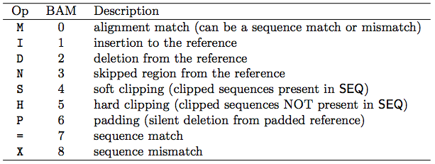
Concise Idiosyncratic Gapped Alignment Report (CIGAR) String
Contains specific information about the mapping information at specific positions across the read
Bioinformatics. 2009 Aug 15;25(16):2078-9. Epub 2009 Jun 8. The Sequence Alignment/Map format and SAMtools.

Slide 12
BAM example read
HWI-D00271:193:C9EMKANXX:5:2103:9073:19661 403 chr10 92991 1 100M = 92971 -120 \ AGAGTTCTAGGCCACCTCCTCCTCGGCATACTCCTCATCCTCCTCCTCCTCGGCCGTGGCATCCTGATATTGCTGATATTCAGACACCAGGTCGTTCATG \ DGGGGGGGC@GFCFDF.GDDC;/E>EGF@CC0BF0GG>BGBD>CBGG<CCAGGE<GGGGGGGGCGGGGGGGGGCGEGGGEGGGFFCB@GGEBGGF:03BB \
NH:i:3 HI:i:3 AS:i:198 nM:i:0

