Slide 1



VISHWANIKETAN'S INSTITUTE OF MANAGEMENT ENTREPRENEURSHIP AND ENGINEERING TECHNOLOGY (VIMEET)
(Affiliated to University of Mumbai/Approved by DTE/AICTE/NAAC at A+ Grade in 1st Cycle)
HACK TO CRACK 2.O
CODE . . CONQUER
CREATE

Slide 2

HACK TO CRACK 2.O
1.0
Team Details
Team Name : Ctrl Alt Innovate
Team Leader Name : Jiten Vijay Purswani
Team Members : Arya Manoj Madhavi, Ajinkya Sunil Patil
Problem Statement : Build an AI-powered recommendation system for farmers to select optimal crops based on soil type, weather conditions, and market demand.
PS No: AI/ML002

Slide 3
HACK TO CRACK 2.O
1.0
Problem Statement Description
Knowledge Gap: Smallholder farmers lack access to scientific farming insights, leading to suboptimal crop selection and reduced yields
Financial Vulnerability: Limited awareness of insurance schemes and risk management tools leaves farmers exposed to climate uncertainties
Market Disconnection: Inability to access real-time price information creates dependency on middlemen and results in lower profit margins
Digital Divide: Existing agricultural technologies fail to address literacy barriers and connectivity challenges in rural farming communities

Slide 4
HACK TO CRACK 2.O
1.0
Idea Details
Data-Driven Agriculture: Personalized crop recommendations through integrated soil analysis and hyperlocal weather prediction models
Predictive Risk Assessment: Advanced algorithms that forecast pest outbreaks and disease risks based on environmental conditions
Market Intelligence System: Price forecasting and optimal harvest timing based on real-time market analytics and supply-demand trends
Inclusive Digital Solution: Voice-based multilingual platform with offline capabilities for reaching farmers in connectivity-challenged regions

Slide 5
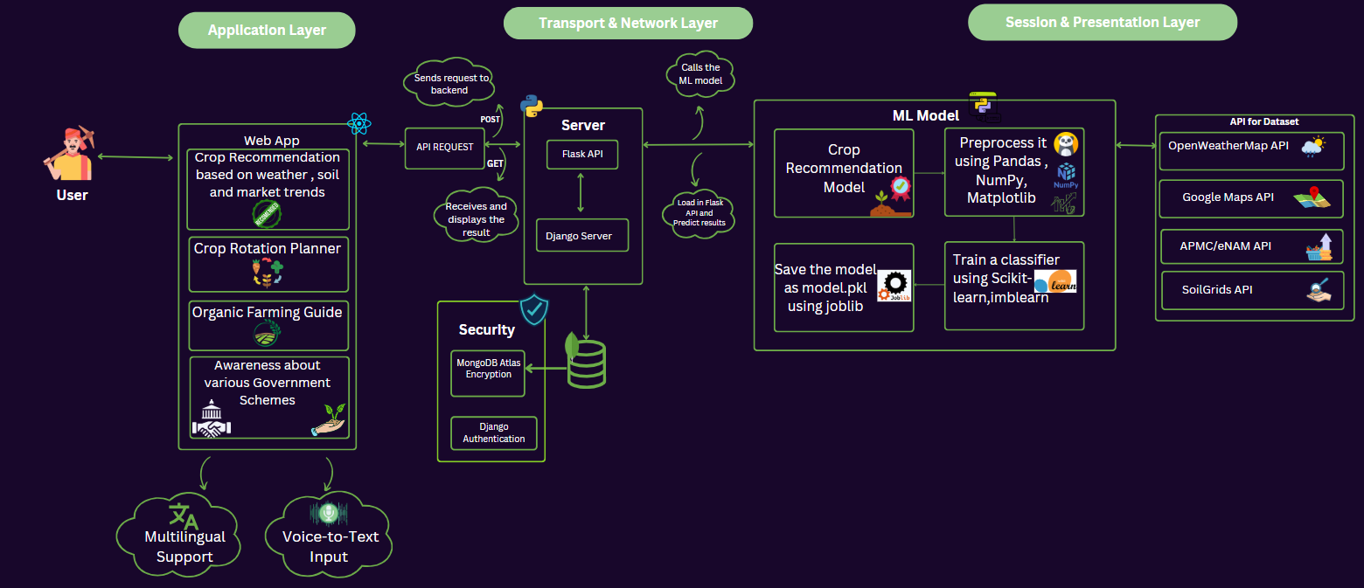
HACK TO CRACK 2.O
1.0
Flowchart / Architecture

Slide 6
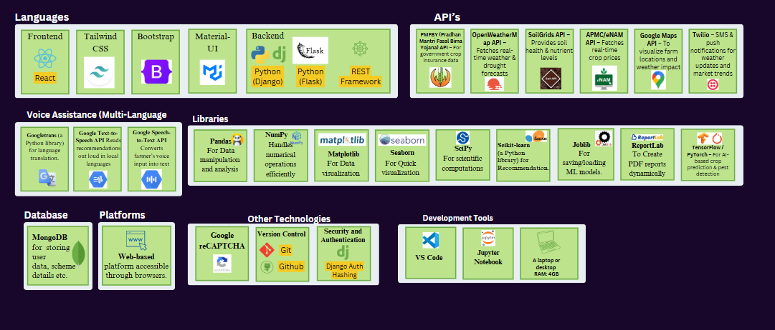
HACK TO CRACK 2.O
1.0
Tech Stack Used

