Slide 1
ML PROJECT
Stock Trend Prediction Using Candlestick Charting and Ensemble Machine Learning Techniques
Aryaman Sakthivel
Aniket Mishra
Ayusha Priyadarshani
Satvik Rohira

Slide 2
Index
Introduction 3
Stock Market Forecasting
Benefits
Methods
Candlestick Charting
Datasets and Charting 10
Nifty50
Axis Bank
Patterns
Algorithms 13
Conclusion 18
Algorithms Used:
Logistic Regression
Decision Tree
Support Vector Machine
K- Nearest Neighbour
Random Forest

Slide 3
Introduction

Slide 4
Stock Market Forecasting
Stock market forecasting involves using various techniques and tools to predict the future movement of stock prices and market trends.
Investors, traders, and analysts use stock market forecasting as a valuable tool to make informed decisions about buying, selling, or holding stocks.
With the help of historical data, statistical models, technical analysis, and other methods, stock market forecasting aims to provide insights into the potential direction of stock prices, allowing market participants to make informed investment decisions.

Slide 5
Stock market forecasting can offer several benefits to investors and traders:
Firstly, it helps them make informed decisions by providing insights into potential price movements of stocks, which can guide their buying and selling decisions.
Additionally, stock market forecasting allows for risk management as it helps investors anticipate market trends and volatility, allowing them to adjust their investment strategies accordingly.
There are various methods used to make stock market predictions, including technical analysis, fundamental analysis, and quantitative analysis.

Slide 6
Methods
Technical analysis involves studying historical price and volume data to identify patterns and trends that may indicate future price movements.
Fundamental analysis involves analysing a company's financial statements, management team, and industry trends to determine its intrinsic value.
Quantitative analysis involves using mathematical models and algorithms to predict stock prices based on historical data and market indicators.

Slide 7
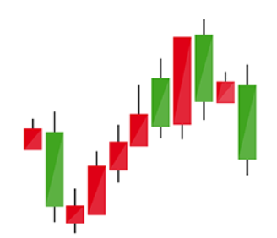
Candlestick Charting
One popular tool in technical analysis is the candlestick chart, which visually displays price movements over a specified time period.
A candlestick chart provides information on the opening, closing, high, and low prices of a stock, represented by "candles" with different colours and shapes.
Candlestick charting helps traders identify patterns and trends, such as bullish or bearish signals, which can provide insights into potential price movements and help with decision-making.

Slide 8
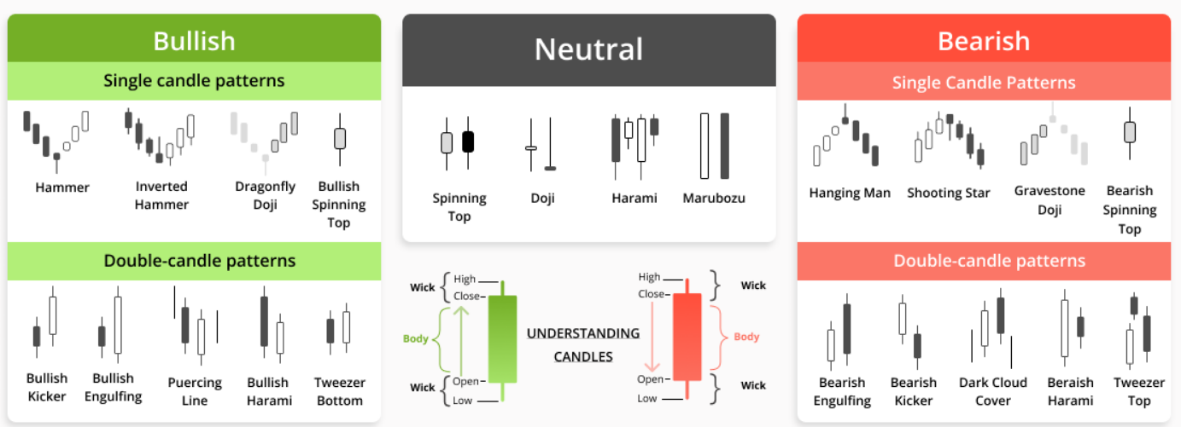
Candlestick Patterns

Slide 9
Datasets &
Candlestick Charts

Slide 10
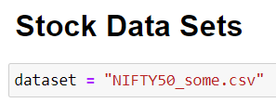
For this project, two significant datasets that were utilized are the Nifty50 and Axis Bank datasets. The Nifty50 dataset contains historical stock market data of the National Stock Exchange of India Limited (NSE) Nifty50 index, which represents the performance of the top 50 companies listed on the NSE. The dataset includes information such as opening and closing prices, volume, and other market indicators for each trading day.
On the other hand, the Axis Bank dataset comprises historical data specifically related to Axis Bank, one of the leading private sector banks in India. It contains financial and market data, including stock prices, financial ratios, and other relevant metrics for Axis Bank. These datasets provide valuable information for models to make predictions and analyse trends.
For our sample codes below, the Nifty50 dataset is used as the main csv file. At the end of the algorithms, the a sample view of the datasets and their respective candlestick charts are also provided

Slide 11
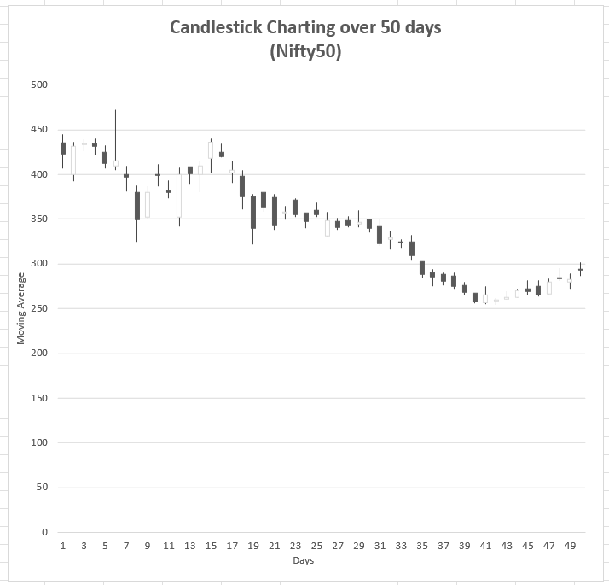
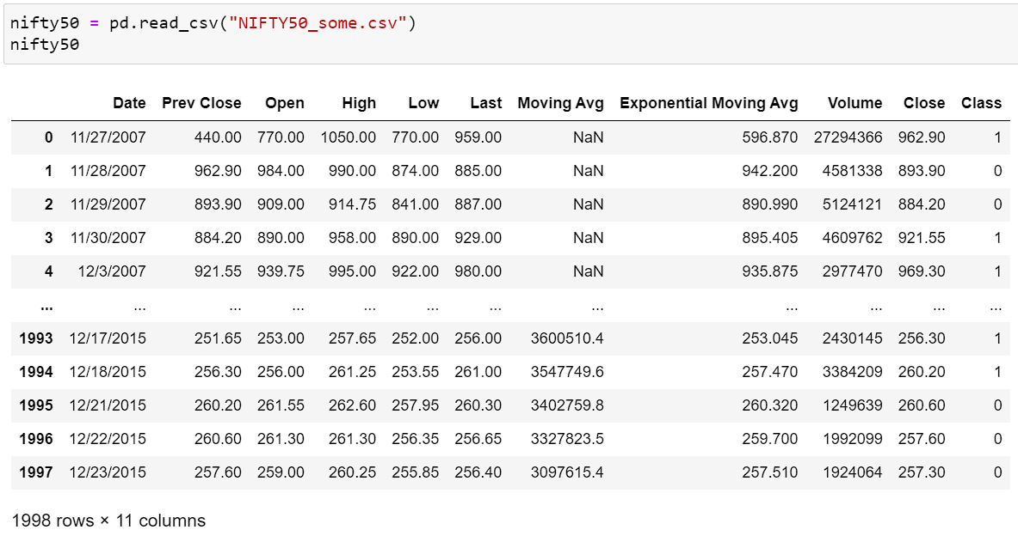
Nifty50

Slide 12
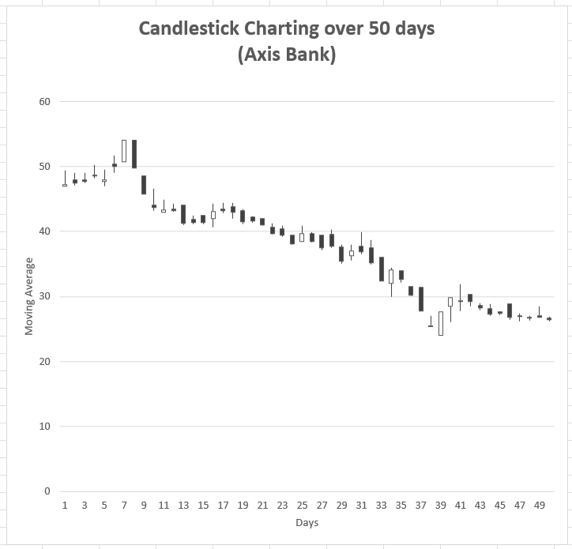
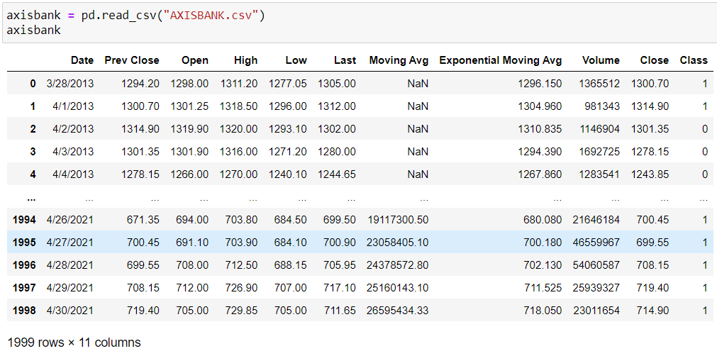
Axis Bank

Slide 13
Algorithms

Slide 14
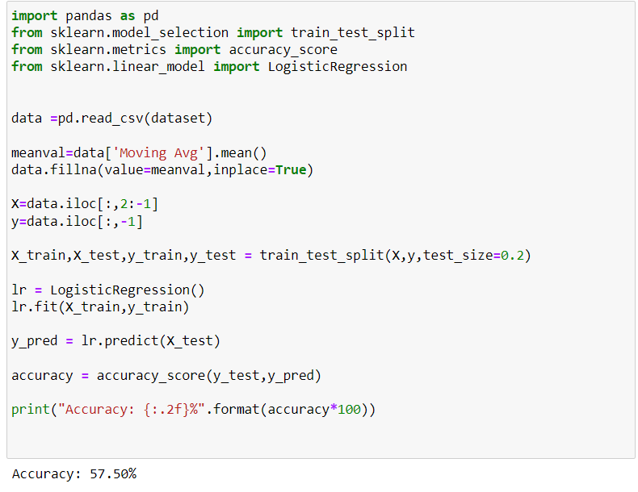
Logistic Regression
This type of statistical model (also known as logit model) is often used for classification and predictive analytics. Logistic regression
estimates the probability of an event occurring, such as voted or didn't vote, based on a given dataset of independent variables.

Slide 15
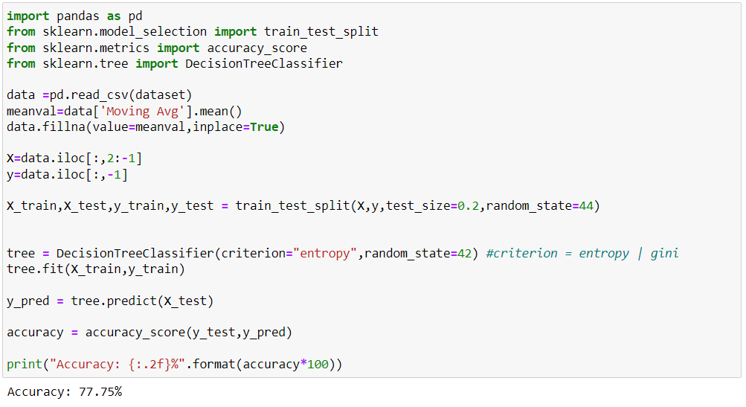
Decision Tree
Decision Tree is
a Supervised learning technique that can be used for both classification and Regression problems, but mostly it is preferred for solving Classification problems. It is a tree-structured classifier, where internal nodes represent the features of a dataset, branches represent the decision rules and each leaf node represents the outcome

Slide 16
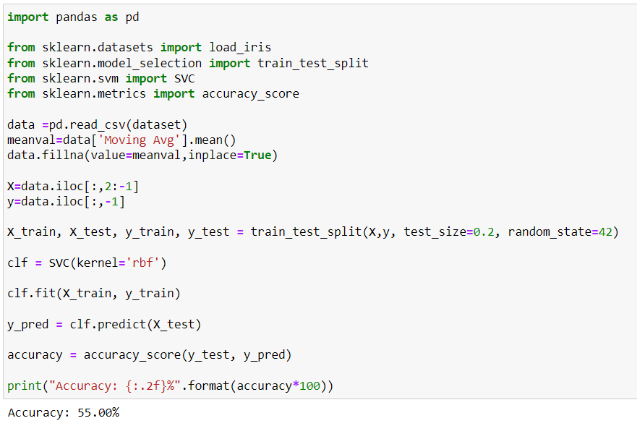
Support Vector Machine
The goal of the SVM algorithm is to create the best line or decision boundary that can segregate n-dimensional space into classes so that we can easily put the new data point in the correct category in the future. This best decision boundary is called a hyperplane. We choose the extreme points/vectors that help in creating the hyperplane which are called as support vectors

Slide 17
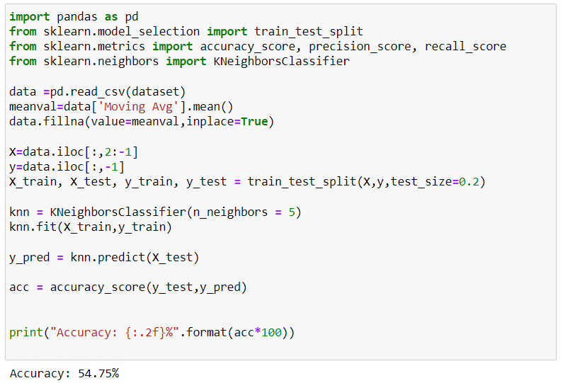
K-Nearest Neighbours
KNN is a non-parametric, supervised learning classifier, which uses proximity to make classifications or predictions about the grouping of an individual data point. While it can be used for either regression or classification problems, it is typically used as a classification algorithm, working off the assumption that similar points can be found near one another.

Slide 18
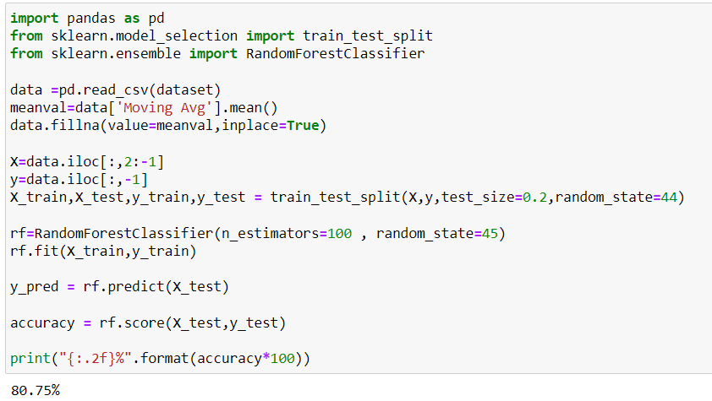
Random Forest
Random forest is a commonly-used machine learning algorithm which combines the output of multiple decision trees to reach a single result. Its ease of use and flexibility have fuelled its adoption, as it handles both classification and regression problems.

Slide 19
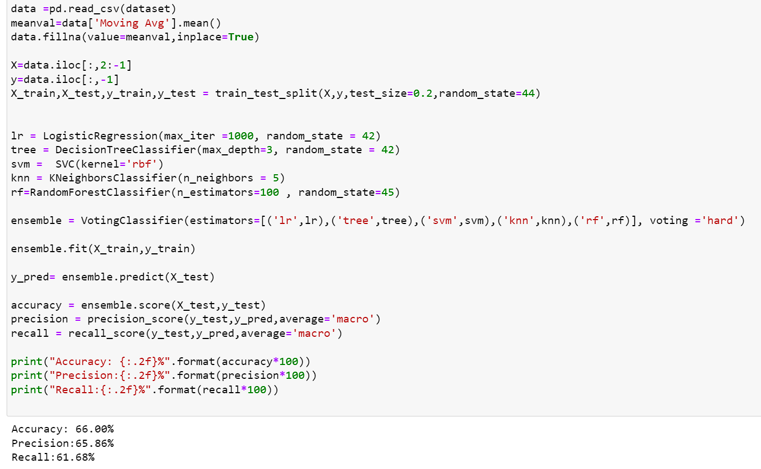
Ensemble
Ensemble learning refers to a machine learning approach in which the predictions from multiple models are merged to enhance the accuracy and resilience of the ultimate forecast. The underlying concept behind ensemble learning is to mitigate the errors or biases that may exist in individual models by leveraging the collective intelligence of multiple models, which ultimately leads to a more precise prediction.

Slide 20
Model Accuracy

Slide 21
Conclusion

Slide 22
In conclusion, this research paper explored the use of candlestick charting and ensemble machine learning techniques with a novelty feature engineering scheme for stock trend prediction. By leveraging historical stock market data and incorporating candlestick chart patterns as features, along with a novel approach to feature engineering, the study aimed to develop an effective model for predicting stock trends. The findings highlight the potential of combining traditional technical analysis techniques with machine learning algorithms to improve the accuracy and reliability of stock trend prediction.

Slide 23
Thank You

