Slide 1
Tutorial 3 – Turing Machines
COMP2048

Slide 2
Why didn’t we like FSMs too much?
What is a Turing Machine?
Finite number of states → cannot solve many problems
Finite memory (only for current state) → cannot work with unbounded inputs
Finite memory → no keeping track of past inputs
Not very powerful
Abstract model of computation
Proposed by Alan Turing in 1936
An extension of FSMs with unlimited, unrestricted memory
Can do anything a real computer can do

Slide 3
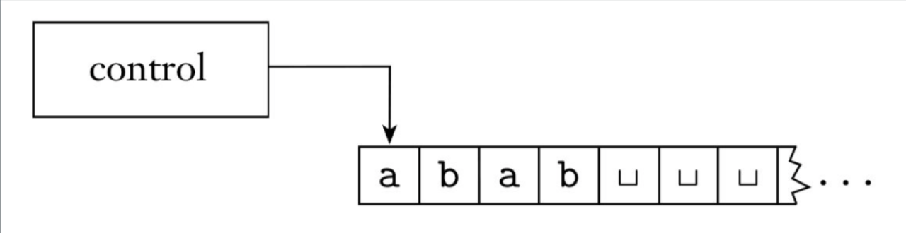
Turing Machine Schematic
Tape head
Infinite tape
Tape head can read and write symbols (only one at a time)
Tape head can move left or right
Tape initially contains input string and everything else is blank
Halts as soon as it reaches an accept or reject state

Slide 4
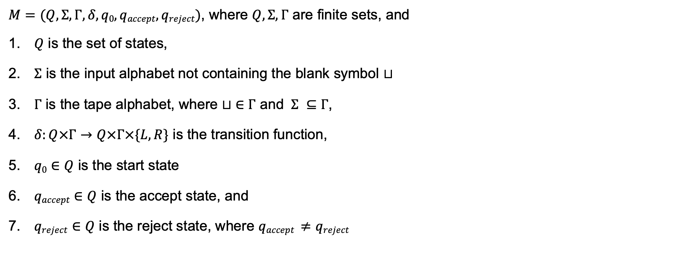
Turing Machine Formal Definition
$M=(Q,Σ, Γ,δ,q0,qaccept,qreject)$, where $Q,Σ, Γ$ are finite sets, and
$Q$ is the set of states,
$Σ$ is the input alphabet not containing the blank symbol $⊔$
$Γ$ is the tape alphabet, where $⊔ ∈Γ$ and $Σ ⊆Γ$,
$δ:Q×Γ→Q×Γ×\{L,R\}$ is the transition function,
$q0∈Q$ is the start state
$qaccept∈Q$ is the accept state, and
$qreject∈Q$ is the reject state, where $qaccept ≠qreject$
Can we define computation with this?
Define machine configuration

Slide 5
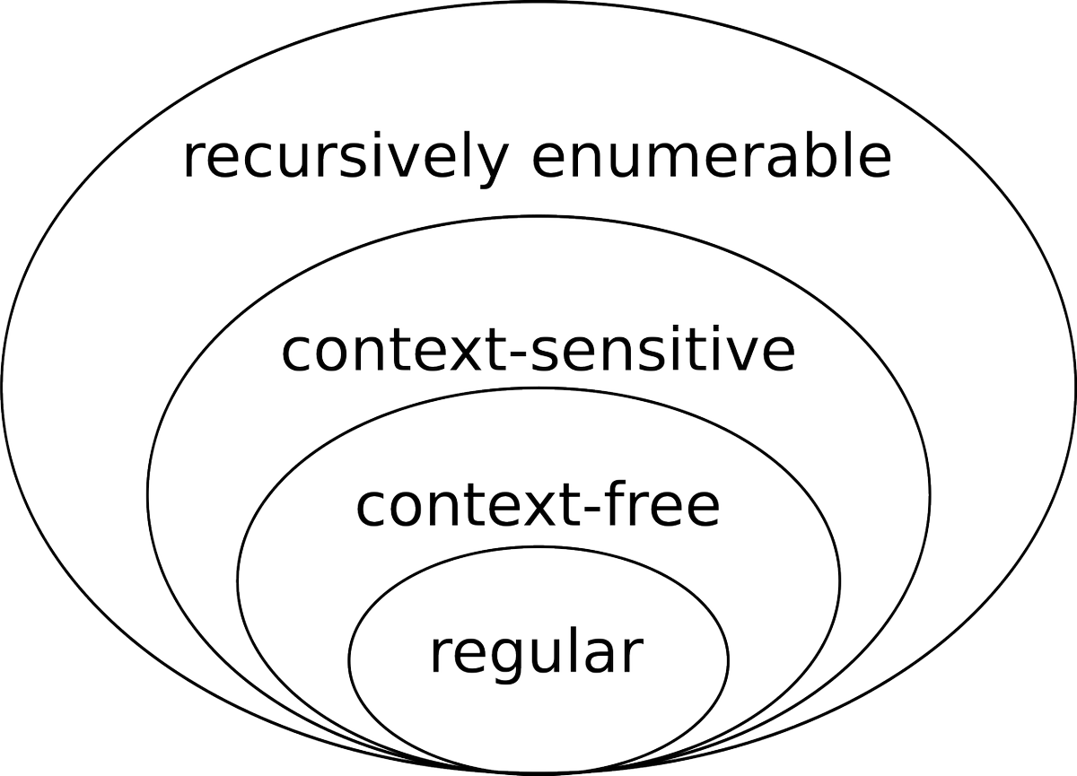
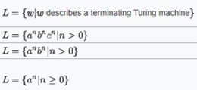
Problem 1
List all the differences between finite state machines and computers we have today with the concept of Turing machines.
FSM | TM | PC
States and transitions only (No memory)
transition rules δ : { S }× { A } → { S }​ (Read → Head: R)
Describes the class of regular languages |  | Any n, as long as it does not run out of memory?​
Hypothetical
Hypothetical
Physical
States and transitions only (No memory)
Infinite memory (tape)
Finite memory
transition rules δ : { S }× { A } → { S }​
(Read → Head: R)
δ : { S } × { A }_{TAPE} → { S } × { A } _{TAPE} × {L, R}​
(Read → Write → Head: L/R)
Read/write
Limited run time
Unlimited run time
Limited run time?
Describes the class of regular languages
Any n, as long as it does not run out of memory?​
Accepts a much larger class of languages

Slide 6
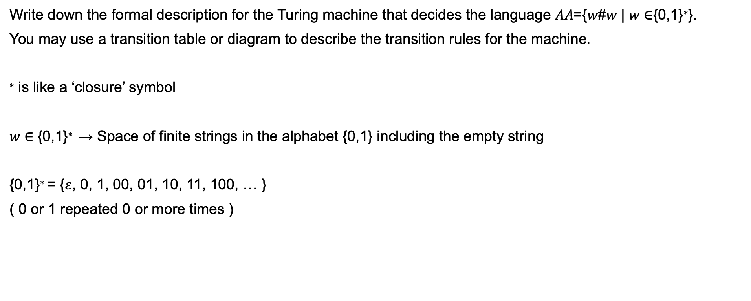
Problem 2
Write down the formal description for the Turing machine that decides the language 𝐴𝐴={𝑤#𝑤 | 𝑤 ∈{0,1}∗}.
You may use a transition table or diagram to describe the transition rules for the machine.
∗ is like a ‘closure’ symbol
𝑤 ∈ {0,1}∗ → Space of finite strings in the alphabet {0,1} including the empty string
{0,1}∗ = {$ε$, 0, 1, 00, 01, 10, 11, 100, … }
( 0 or 1 repeated 0 or more times )

Slide 7
𝐴𝐴={𝑤#𝑤 | 𝑤 ∈{0,1}∗}
Idea
Consider the example 011#011
At the start, the tape-head is at the left-most cell
Read the first symbol and cross it off (replace with a new symbol x, ‘remember’ if it was a 0 or 1 using states)
Move right until #
Keep moving right until first non-x symbol
Verify a = b, cross it off
If a != b → Reject
6. Go back to the left-most non-x symbol to repeat
if:
more than one #
different symbols
more symbols on one side than the other
else:
accept
0 | 1 | 1 | # | 0 | 1 | 1
x | 1 | 1 | # | 0 | 1 | 1
→ Reject
a
x | 1 | 1 | # | 0 | 1 | 1
a
x | 1 | 1 | # | 0 | 1 | 1
a
b
x | x | x | # | x | x | x
x | 1 | 1 | # | x | 1 | 1
a
b
x | 1 | 1 | # | x | 1 | 1

Slide 8
State diagram
x | 1 | 1 | # | x | 1 | 1
0 | 1 | 1 | # | 0 | 1 | 1
x | 1 | 1 | # | 0 | 1 | 1
x | 0 | 0 | # | x | 0 | 0
x | 0 | 0 | # | 1 | 0 | 0
1 | 0 | 0 | # | 1 | 0 | 0
q₁
q₂
q₆
q₁
q₇
q₄
q₁
q₃
q₆
x→R
q₁
q₇
q₅
0,1→R
q₂
#→R
q₄
0,1→L
0→x,R
0→x,L
#→L
q₁
q₆
q₇
#→R
1→x,L
0,1,x→L
1→x,R
q₃
q₅
0,1→R
x→R
x→R

Slide 9

State diagram
x | x | x | # | x | x | x
x | x | x | # | x | x | x
q₁
q₈
q₁
q₈
0,1→R
x→R
q₂
#→R
q₄
0,1→L
0→x,R
0→x,L
x→R
#→R
#→L
q₁
q₈
q_{accept}
q₆
q₇
$⊔$→R
#→R
1→x,L
0,1,x→L
1→x,R
q₃
q₅
0,1→R
x→R
x→R

Slide 10
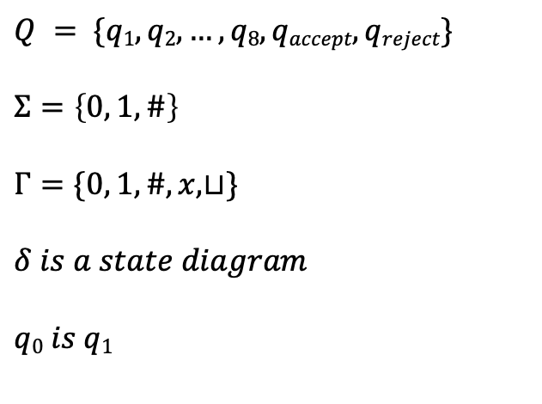
Formal definition
𝐴𝐴={𝑤#𝑤 | 𝑤 ∈{0,1}∗}
0,1→R
x→R
$$Q = \{q1, q2, …, q8, qaccept, qreject\}$$
$$Σ=\left\{0, 1, \#\right\}$$
$$Γ=\{0, 1, \#, x,⊔\}$$
$$δ is a state diagram$$
$$q0 is q1$$
q₂
#→R
q₄
0,1→L
0→x,R
0→x,L
x→R
#→R
#→L
q₁
q₈
q_{accept}
q₆
q₇
$⊔$→R
#→R
1→x,L
0,1,x→L
1→x,R
q₃
q₅
0,1→R
x→R
x→R

Slide 11

Transition table
Symbol
0
1
x
$$⊔$$
#
State
q1
(q2,x,R)
(q3,x,R)
-
(q8, ,R)
-
q2
(q2, ,R)
(q2, ,R)
-
(q4, ,R)
-
q3
…
q8
-
-
(q8, ,R)
-
(qaccept, , )

Slide 12


Problem 3
Design and formally describe a Turing machine that decides $B=\left\{0^{2^{n}} \right| n≥0\}$ , the language consisting of all strings of 0s whose length is a power of 2. Include
a) a high-level description of its algorithm,
b) a formal description of the Turing machine,
c) a transition/state diagram of the Turing machine,
d) a sample run of the machine on the string 0000 noting its configuration at each step.
Example strings:
$0^{2^{0}}$= 0
$0^{2^{1}}$= 00
$0^{2^{2}}$= 0000
$0^{2^{3}}$= 00000000

Slide 13
a) a high-level description of its algorithm
0
On input string w:
Sweep left to right across the tape, crossing off every other 0 (Divide by 2)
If the tape contained a single 0 → accept
Return the head to the left–hand end of the tape, repeat from 2
If all inputs are crossed off (all x) or last=0 (only remaining zero is the last) → accept
If the tape contained more than a single 0 and the number of 0s was odd → reject
0 | 0 | 0 | 0 | 0 | 0 | 0 | 0
x
→
x | 0 | x | 0 | x | 0 | x | 0
accept
→
x | 0 | x | 0 | x | 0 | x | 0
x | x | x | x | x | x | x | x
→ accept
0 | 0 | 0 | 0 | 0 | 0 | 0
→
x | x | x | 0 | x | x | x
→ reject

Slide 14
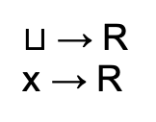



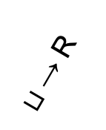
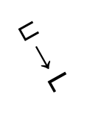


c) a transition/state diagram of the Turing machine
0 → L
x → L
$$⊔$$
x | x | x | x
$$⊔$$
x | 0 | 0 | 0
x | 0 | x | 0
x | x | x | 0
0 | 0 | 0 | 0
q₅
$⊔$→ R
x→ R
$⊔$→ L
x→ R
q₁
0→ $⊔$,R
q₂
0→ x,R
q₃
$⊔$→ R
x → R
$⊔$→ R
0→ R
0→ x,R
q_{accept}
q_{reject}
q₄
$⊔$→ R

Slide 15
















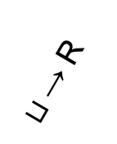





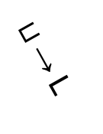














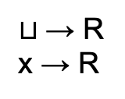

d) a sample run of the machine on the string 0000 noting its configuration at each step
$$⊔$$
x | x | x | x
$$⊔$$
x | 0 | 0 | 0
x | 0 | x | 0
x | x | x | 0
0 → L
x → L
0 | 0 | 0 | 0
q₅
$$q_{1}$$ | 0 | 0 | 0 | 0
$$⊔$$ | x | x | $$q_{3}$$ | 0 | $$⊔$$
$$⊔$$ | x | x | x | $$q_{3}$$ | $$⊔$$
$⊔$→ R
$$⊔$$ | $$q_{2}$$ | 0 | 0 | 0
$$⊔$$ | x | x | x | $$q_{3}$$ | $$⊔$$
$$⊔$$ | x | x | x | $$q_{5}$$ | $$⊔$$
x→ R
$⊔$→ L
$$⊔$$ | x | $$q_{3}$$ | 0 | 0
$$⊔$$ | x | x | $$q_{5}$$ | x | $$⊔$$
$$⊔$$ | x | x | x | $$q_{5}$$ | $$⊔$$
x→ R
$$⊔$$ | x | 0 | $$q_{4}$$ | 0
$$⊔$$ | x | x | $$q_{5}$$ | 0 | $$⊔$$
$$⊔$$ | x | $$q_{5}$$ | x | x | $$⊔$$
q₁
0→ $⊔$,R
q₂
0→ x,R
q₃
$$⊔$$ | x | 0 | x | $$q_{3}$$
$$⊔$$ | x | $$q_{5}$$ | x | 0 | $$⊔$$
$$⊔$$ | $$q_{5}$$ | x | x | x | $$⊔$$
$$⊔$$ | x | 0 | x | $$q_{5}$$ | $$⊔$$
$$⊔$$ | $$q_{5}$$ | x | x | 0 | $$⊔$$
$$⊔$$ | $$q_{2}$$ | x | x | x | $$⊔$$
$⊔$→ R
$$⊔$$ | x | 0 | $$q_{5}$$ | 0 | $$⊔$$
$$⊔$$ | $$q_{2}$$ | x | x | 0 | $$⊔$$
$$⊔$$ | x | $$q_{2}$$ | x | x | $$⊔$$
$⊔$→ R
x → R
0→ R
0→ x,R
$$⊔$$ | x | $$q_{5}$$ | x | 0 | $$⊔$$
$$⊔$$ | x | $$q_{2}$$ | x | 0 | $$⊔$$
$$⊔$$ | x | x | $$q_{2}$$ | x | $$⊔$$
q_{accept}
$$⊔$$ | x | x | $$q_{2}$$ | 0 | $$⊔$$
$$⊔$$ | x | x | x | $$q_{2}$$ | $$⊔$$
$$⊔$$ | $$q_{5}$$ | 0 | x | 0 | $$⊔$$
q_{reject}
q₄
$$⊔$$ | $$q_{2}$$ | 0 | x | 0 | $$⊔$$
$$⊔$$ | x | x | x | $$q_{2}$$ | $$⊔$$
$$⊔$$ | x | x | x | x | $$q_{a}$$
$$⊔$$ | x | $$q_{2}$$ | x | 0 | $$⊔$$
$⊔$→ R

Slide 16

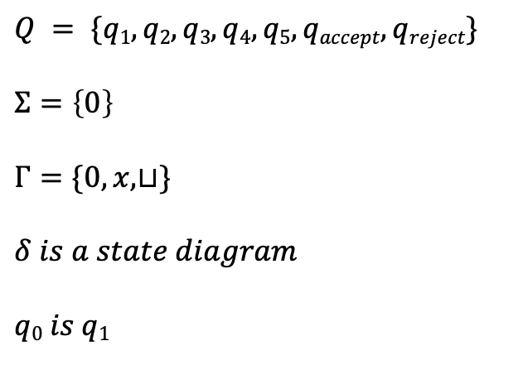
b) a formal description of the Turing machine
0 → L
x → L
$$B=\left\{0^{2^{n}} \right| n≥0\}$$
q₅
$⊔$→ R
$$Q = \{q1, q2,q3,q4,q5, qaccept, qreject\}$$
$$Σ=\left\{0\right\}$$
$$Γ=\{0, x,⊔\}$$
$$δ is a state diagram$$
$$q0 is q1$$
x→ R
$⊔$→ L
x→ R
q₁
0→ $⊔$,R
q₂
0→ x,R
q₃
$⊔$→ R
$⊔$→ R
x → R
0→ R
0→ x,R
q_{accept}
q_{reject}
q₄
$⊔$→ R

Slide 17
Problem 4
Show that the language 𝐶={𝑎^{𝑖}𝑏^{𝑗}𝑐^{𝑘} | 𝑖×𝑗=𝑘 and 𝑖,𝑗,𝑘≥1} cannot be recognisable by a finite state machine by designing a Turing machine that decides it.
eg: For 𝑖 =2, 𝑗 =3 → 𝑘 =6
Input → 𝑎𝑎𝑏𝑏𝑏𝑐𝑐𝑐𝑐𝑐𝑐
Need to keep track of i, j, k
Have unbounded inputs → FSM has finite number of states​
For some large sufficiently large input → not enough states to process​

Slide 18
Pseudocode
x | x | y | y | z | z | z | c
x | x | y | y | z | z | z | z
a | a | b | b | c | c | c | c
x | a | b | b | c | c | c | c
x | a | y | b | c | c | c | c
x | a | y | b | z | c | c | c
x | a | y | y | z | c | c | c
x | a | y | y | z | z | c | c
x | a | y | b | z | z | c | c
x | a | b | b | z | z | c | c
x | x | b | b | z | z | c | c
x | x | y | b | z | z | c | c
x | x | y | b | z | z | z | c
If the input doesn’t match a*b*c* after a full initial sweep → reject
Move the head back to the leftmost symbol.
Cross off an a with an x, scan to the right until b
Cross off a b with a y, scan to the right until c
Cross off c with a z, move to the left-most uncrossed b
Repeat steps 4 & 5, until all b’s are crossed off.
If all c’s get crossed off while doing this (uncrossed
a’s remaining) → reject
Move left until left-most uncrossed a, while uncrossing b’s
If there’s another a left, then repeat from stage 3.
If all a’s are crossed out
Check if all c’s are crossed off
If yes → accept, else → reject
Basically, need to multiply a, b and see if it matches c . ​
( multiplication = repeated addition)​

Slide 19

Transition/state diagram
x | x | y | y | z | z | z | c
x | x | y | y | z | z | z | z
a | a | b | b | c | c | c | c
x | a | b | b | c | c | c | c
x | a | y | b | c | c | c | c
x | a | y | b | z | c | c | c
x | a | y | y | z | c | c | c
x | a | y | y | z | z | c | c
x | a | y | b | z | z | c | c
x | a | b | b | z | z | c | c
x | x | b | b | z | z | c | c
x | x | y | b | z | z | c | c
x | x | y | b | z | z | z | c
y→ R
z→ R
$⊔$→ L
q₅
q₆
y→ R
b → R
z→ R
b→ R
a→ R
z→ L
b→ b,L
a→ x,R
b→ y,R
c→ z,L
q₀
q₁
q₂
q₃
x→ R
z→ L
y→ R
q₄
a→ L
y→ b,L

Slide 20
Problem 5
Given the differences between finite state machines and Turing machines, and the definition of a Turing machine. In no more than one page (12pt, normal 2.54 cm margins), argue either for or against why a Turing machine can or cannot obtain artificial intelligence (AI).
Discuss what needs to be added or removed to ensure that AI can result or can’t result.
If an AI can result, what restrictions or safeguards do you need in place to protect human-kind from becoming obsolete?
If an AI can’t result, how will computers and advancements in computing help human-kind in the future?

