Slide 1
INNER CALM
VOICE ASSISTANT MODEL (FOR GOOD MENTAL HEALTH)

Slide 2
TABLE OF CONTENTS
01.
02.
03.
project overview
IDEA implementation
TECHNOLOGIES USED
04.
05.
06.
BUSINESS MODEL
CONCLUSION
Problem to be solved

Slide 3
01.
project OVERVIEW

Slide 4

The goal of this project is to develop a voice assistant powered by a large language model (LLM) designed to provide empathetic, supportive, and educational interactions for individuals dealing with mental health challenges. The assistant aims to complement professional mental health services by offering-
1.Immediate emotional support
2.Psychoeducation and coping strategies
3.Guided exercises (e.g., mindfulness, journaling)
4.Resource recommendations, such as helplines and mental health professionals

Slide 5
02.
CODE IMPLEMENTATION

Slide 6
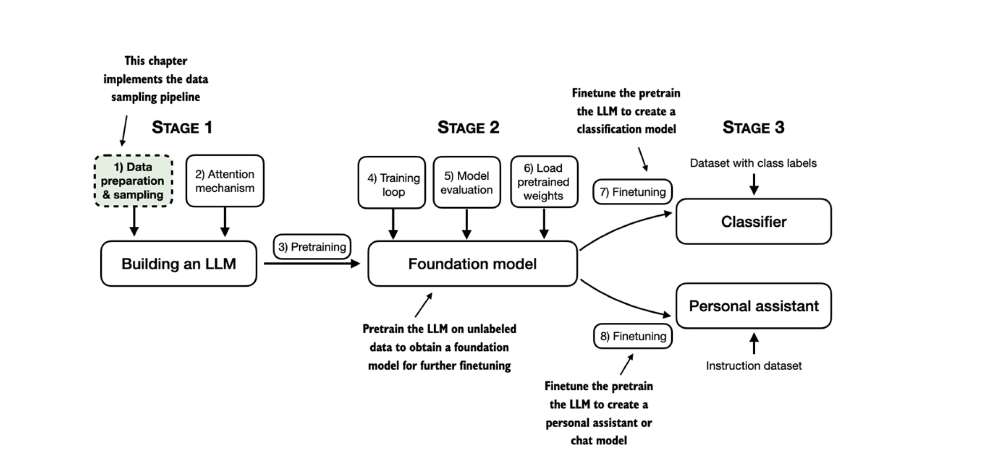
WORKING

Slide 7
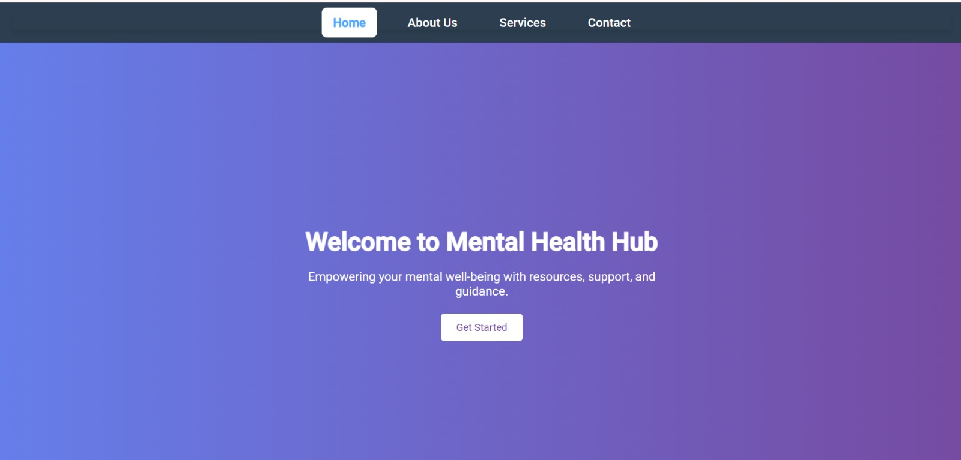

Slide 8
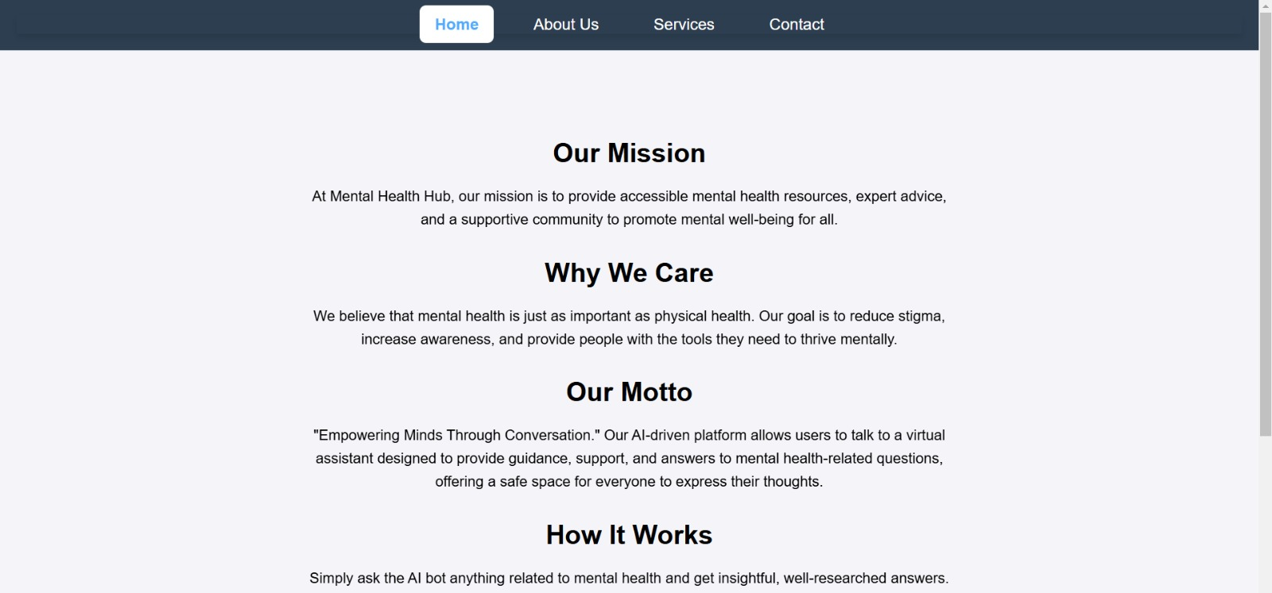

Slide 9
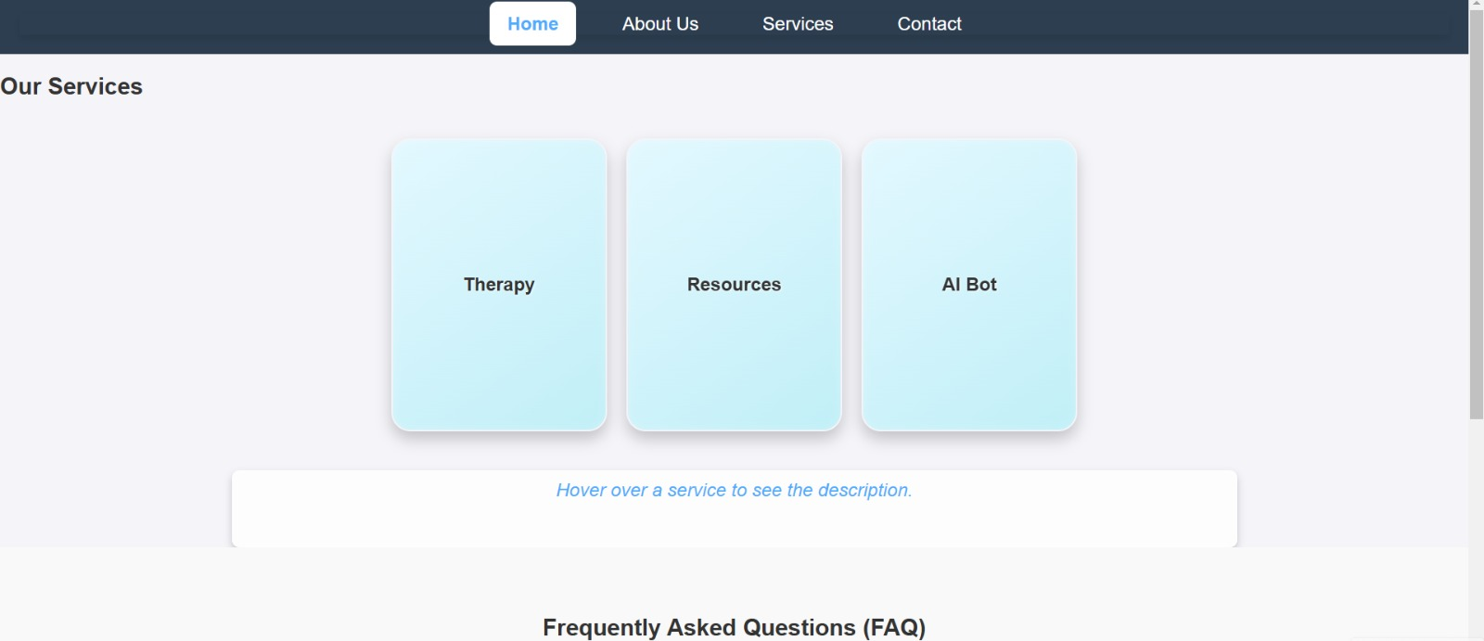

Slide 10
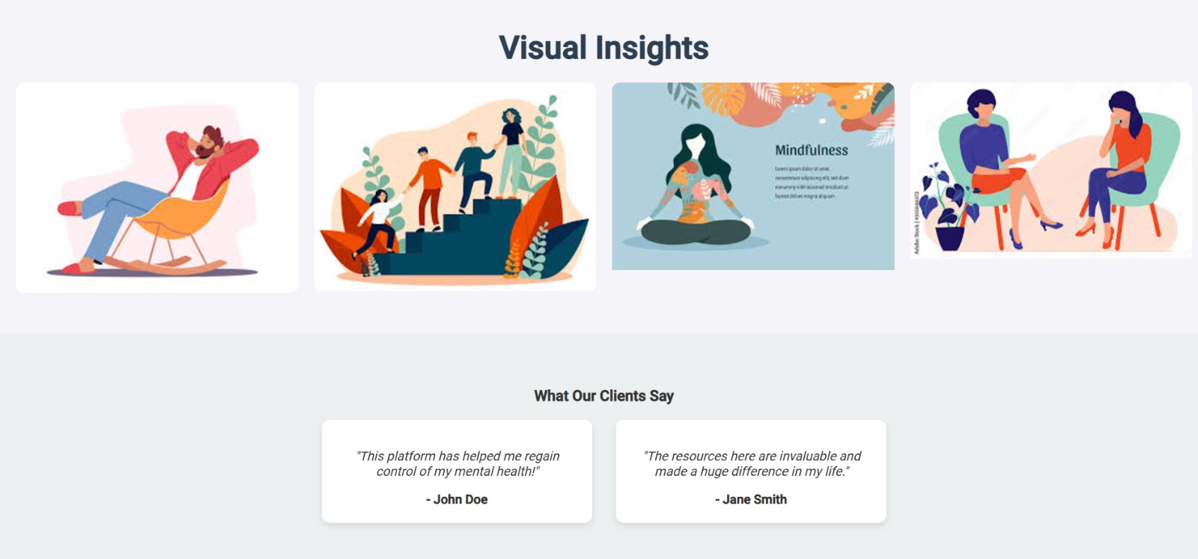

Slide 11
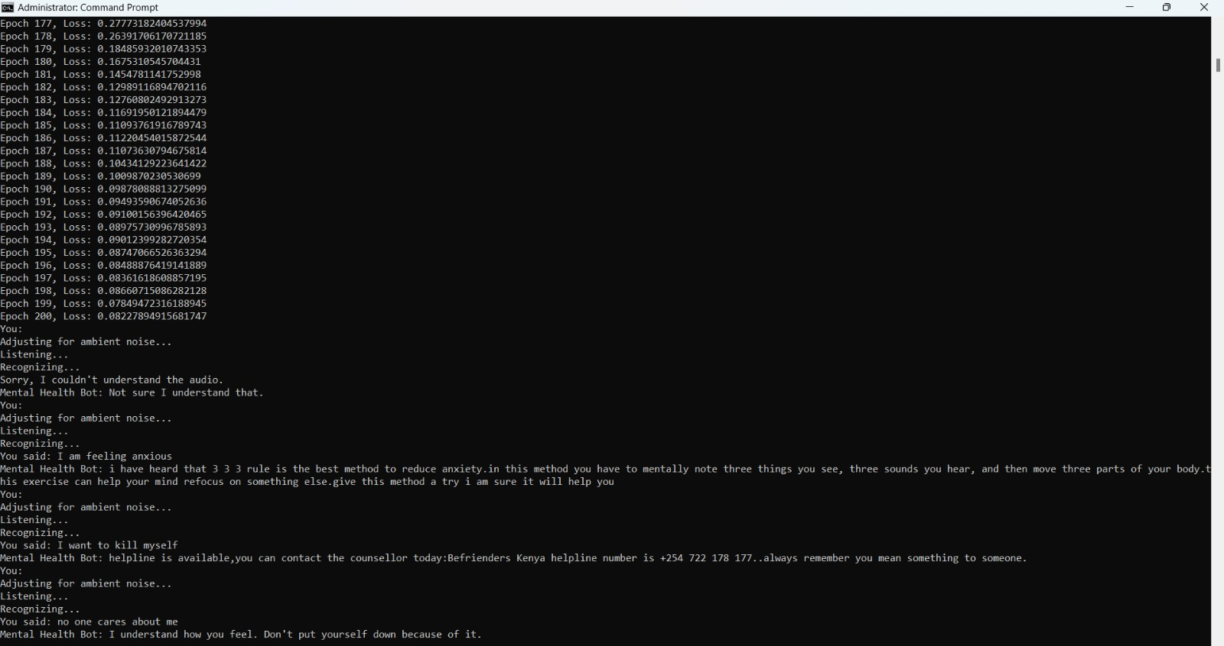

Slide 12
Problem
Mental health issues are on the rise globally, yet millions of individuals lack access to affordable, personalized mental health support. Many people face barriers such as financial constraints, stigma, and geographical limitations, preventing them from seeking help. This leaves those in need feeling isolated and without adequate resources to address their emotional well-being.
There is a critical need for a solution that provides free, confidential, and easily accessible one-on-one therapy sessions, offering professional support to individuals struggling with mental health challenges while breaking down the barriers of stigma and affordability.

Slide 13
TECHNOLOGY USED
Frontend Development:
React.js: For building a responsive and dynamic user interface.
HTML/CSS: Standard web technologies for structure and design.
Backend Development:
Node.js with Express: Server-side logic and API management.
Python: For AI model integration and backend processing.
AI and Machine Learning:
LLM Model: Large language model for voice-based interactions.
Natural Language Processing (NLP): Enhances understanding
and response generation.
Speech-to-Text & Text-to-Speech: For voice input/output capabilities.

Slide 14
03.
BUSINESS MODEL

Slide 15
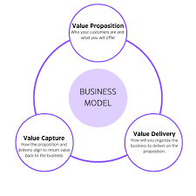
Free Access:
5-10 minutes of daily conversation at no cost for basic mental health support.
Premium Subscription:
Unlimited access and advanced features (e.g., personalized plans, guided sessions) for a monthly or yearly fee.
Pay-Per-Use:
Option for users to pay for extended sessions beyond the free daily allowance.
Corporate Partnerships:
Collaborate with organizations to integrate the assistant into employee wellness programs.

Slide 16
ABSTRRACT
The integration of Large Language Models (LLMs) into Audio assistant bot that has opened new frontiers in mental health support, offering accessible and personalized interactions. This paper explores the design and implementation of an LLM-powered virtual assistant chatbot aimed at providing empathetic, non-clinical mental health support. Leveraging the advanced natural language understanding and contextual reasoning capabilities of LLMs, the chatbot engages users in meaningful conversations, offering stress management techniques, mindfulness exercises, and empathetic responses tailored to individual needs. This considerations, including user privacy, cultural sensitivity, and avoidance of harmful advice, are prioritized through robust content moderation and anonymized data handling. The system also integrates escalation protocols to direct users to licensed professionals or emergency services when critical situations are detected. Initial evaluations demonstrate the chatbot’s potential in reducing barriers to mental health resources and fostering a sense of connection, particularly for individuals in underserved communities. This work highlights the promise of AI-driven tools in augmenting mental health ecosystems and outlines future directions for enhancing their reliability, safety, and accessibility.

Slide 17

CONCLUSION
In conclusion, this free one-on-one therapy website aims to make mental health support accessible to all, breaking down barriers related to cost, stigma, and availability. By leveraging diverse revenue streams such as grants, sponsorships, and partnerships, the platform can sustain its mission of providing
professional, confidential therapy.

